Slide 1
eScope: A Resource Model Agnostic Power Prediction Tool for Mobile Applications
Atul Sandur, Dipayan Mukherjee, Pratik Lahiri, Kirill Mechitov, Gul Agha

Slide 2
Outline
Motivation
Background on Power prediction
Design of eScope
Evaluation

Slide 3
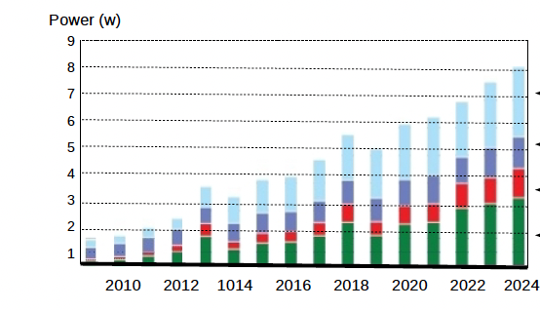
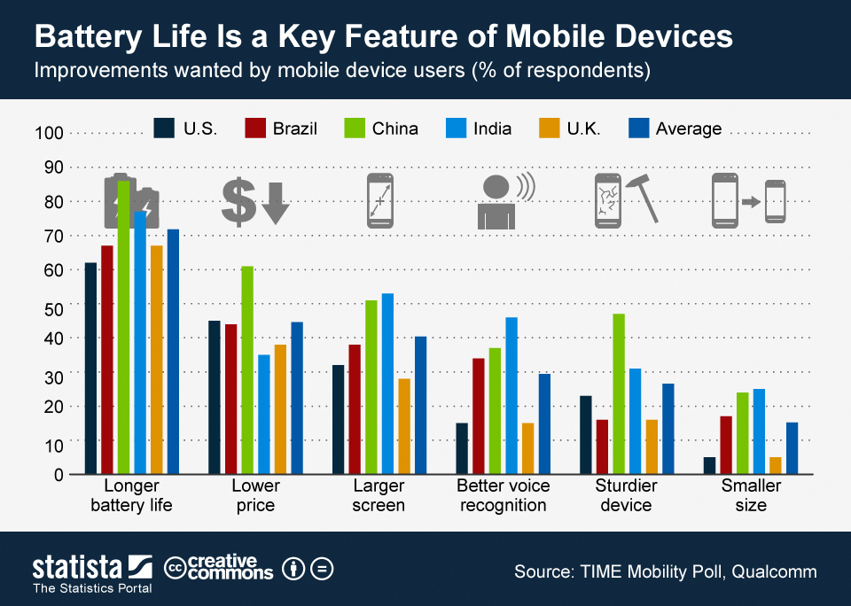
Why is mobile power important?
Mobile power consumption trend and prediction
Importance of battery life for users

Slide 4

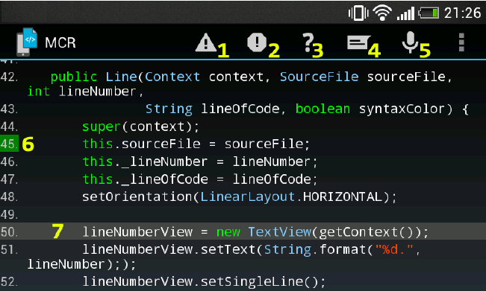

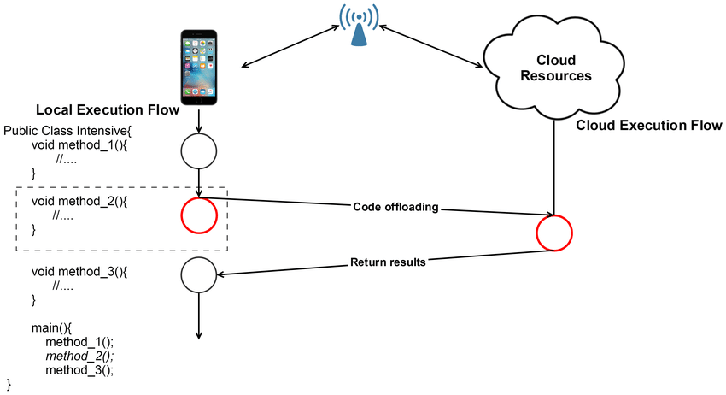





How prediction can improve power usage
Application debugging
Code Offloading
Mobile Applications
Prediction
Sharing resources

Slide 5
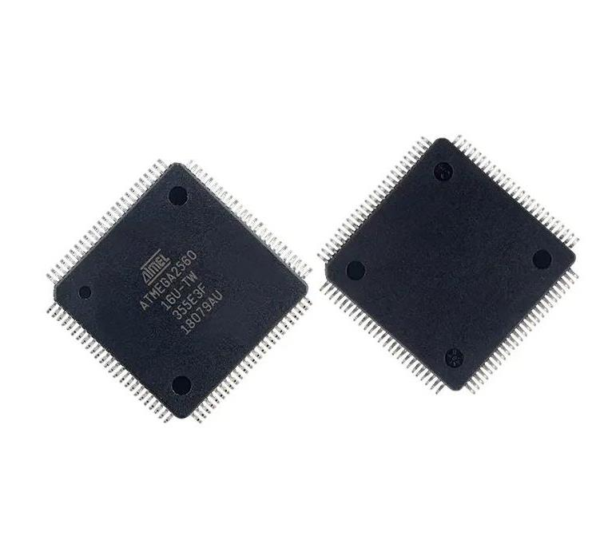
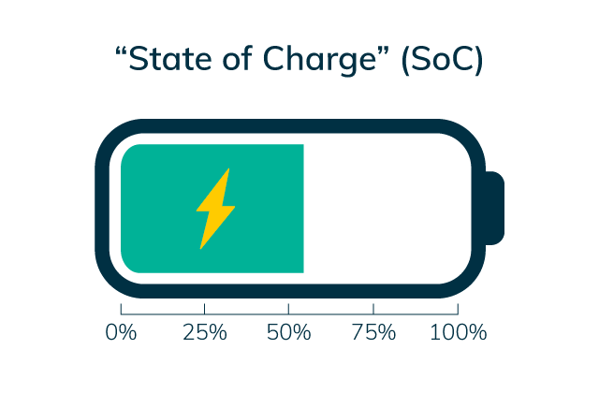
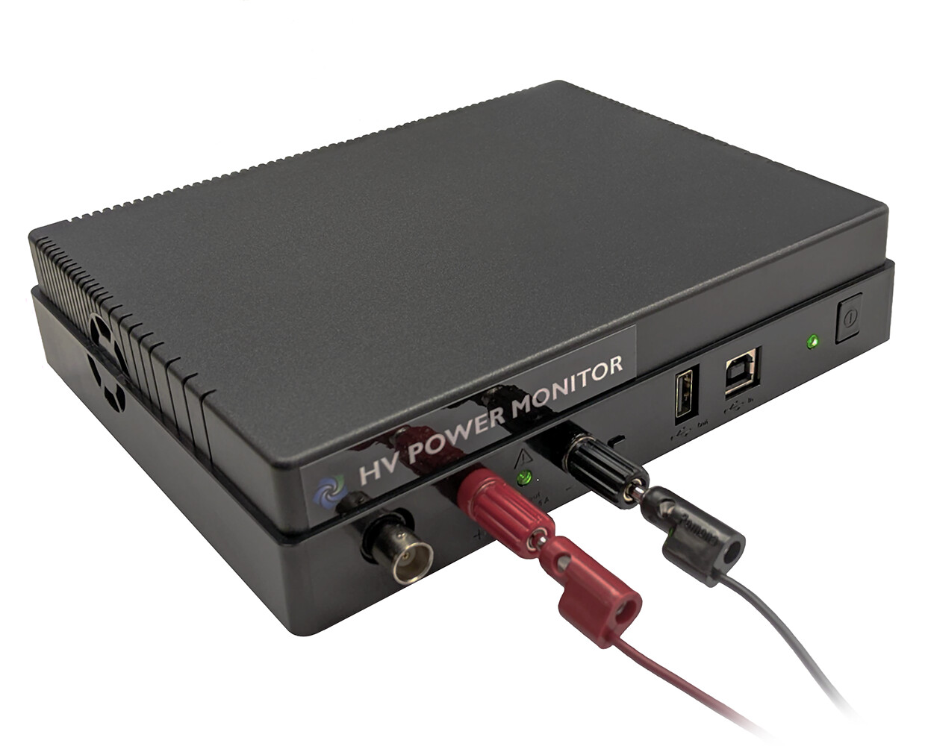
Background: Measurement Methods
Power Monitors
Specialized Chip
Battery SoC

Slide 6
Background: Modeling Methods
Power monitoring
Hardware modeling
Hybrid (hardware + software) modeling
Software modeling
Code Offloading
Energy Debugging
Approximate Computing
Web Pages
Neural Networks
Neural Networks
MAUI (2010), CloneCloud, Deep Compressive Offloading, ...
PowerTutor, AppScope, ...
PowerDial (ASPLOS '11), ...
RECON (METRICS '17), CAMEL (INFOCOM '20)
NeuralPower, Eyeriss, ...
Noiseout, Optimal Brain Damage, Han et al NIPS '15, Network Trimming, ...

Slide 7
Limitations
Hardware models don't scale
require manual work for each new HW architecture
Software-only models may be inaccurate (under investigation)
different devices have different behavior
eScope:
Mostly software modeling
Implicit learned hardware model (collect data on-device)

Slide 8
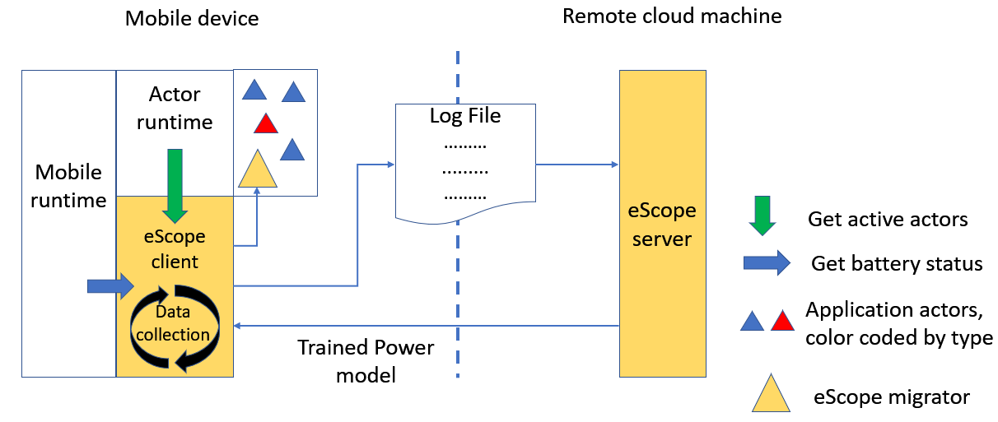
eScope: Overview
Key Idea: Map application execution segment to power drop

Slide 9
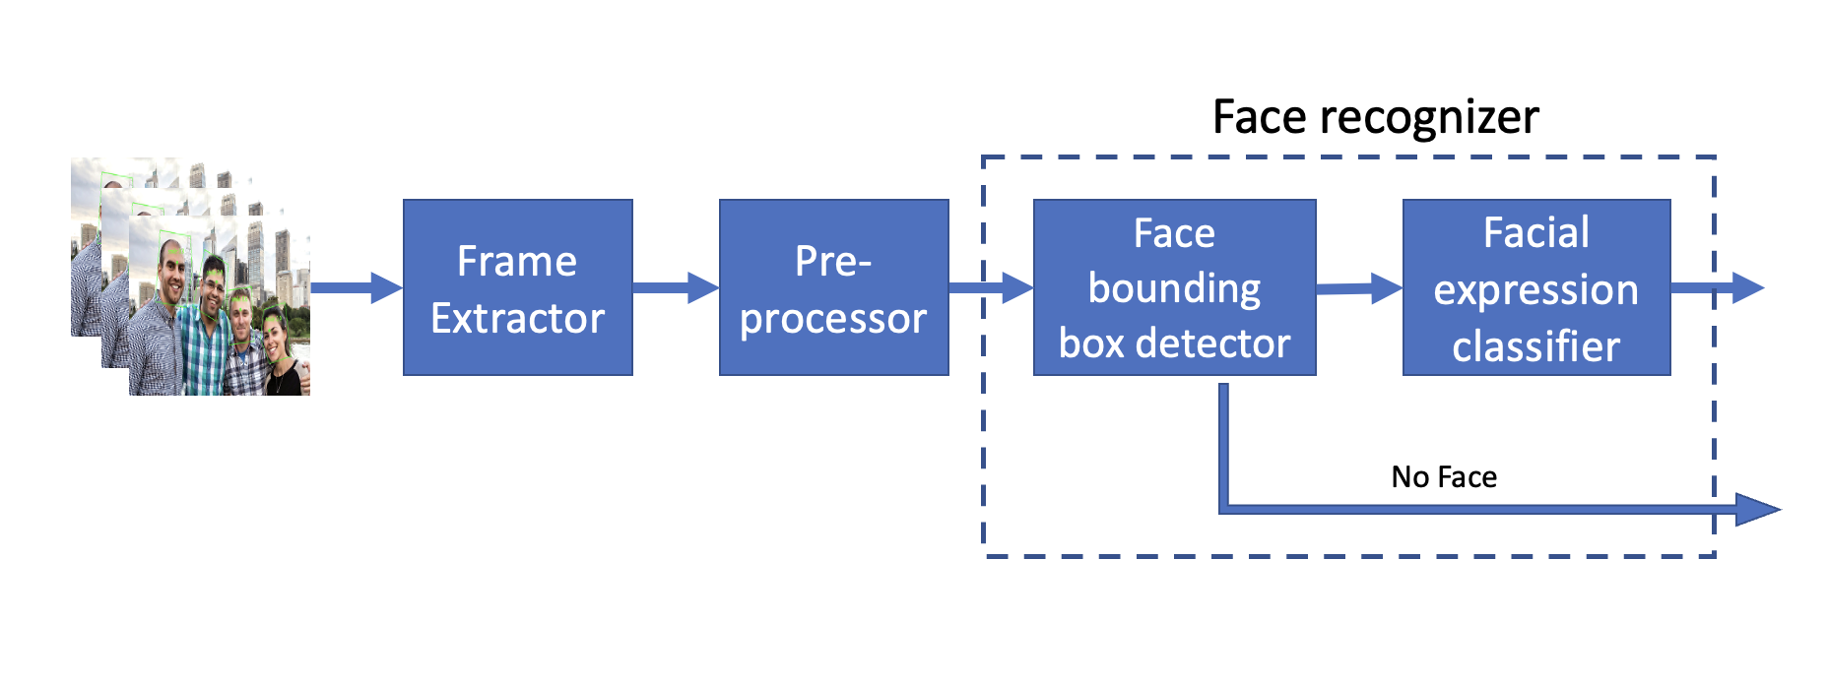
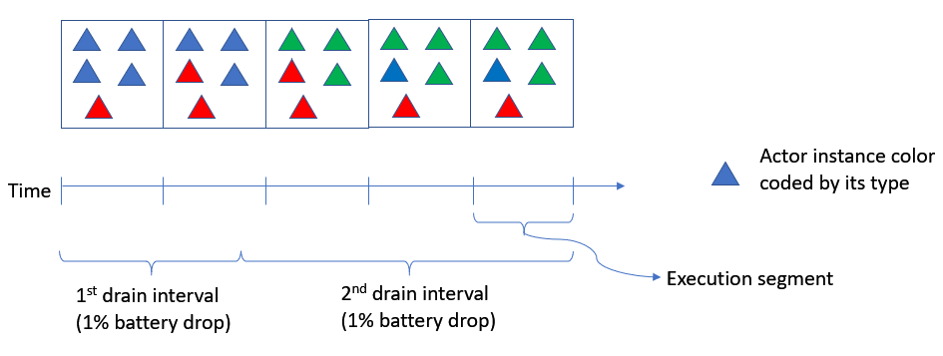
Proposed Model
Application model
DAG of stream of operations
Each edge denotes data dependency
Power consumption model
Operators perform tasks based on app logic
Map operator power by attributing power drop in SoC to the active operators in the execution segment

Slide 10
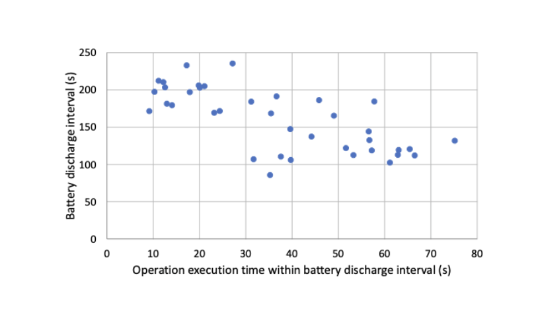
Prediction Models
Linear Models: Map execution segment
SVR: useful for large dimensional feature space
NN: Useful technique to learn from large amount of data
Sample training data for eScope

Slide 11
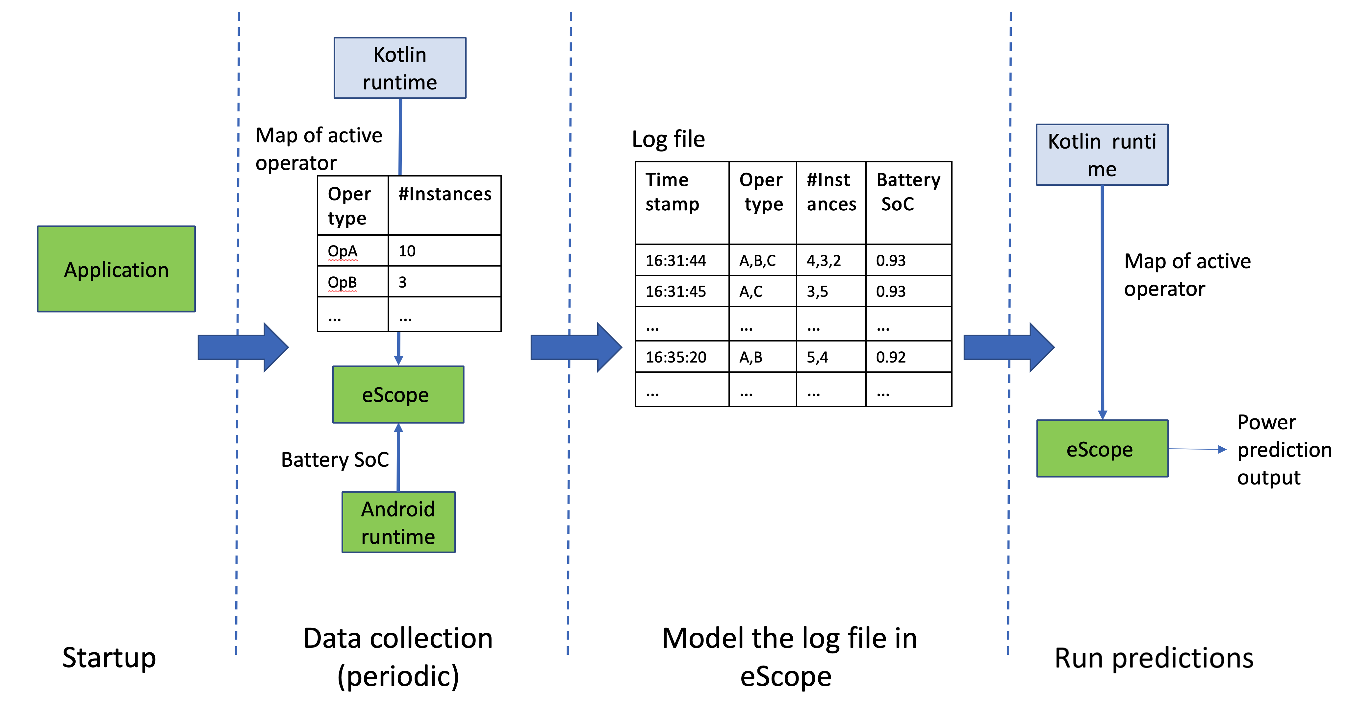
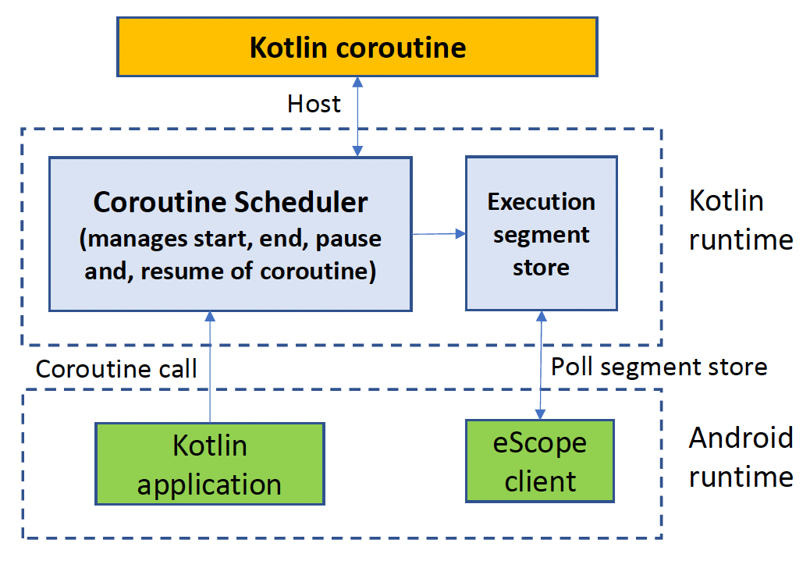
Implementation
Phases of execution
Modifying the runtime

Slide 12
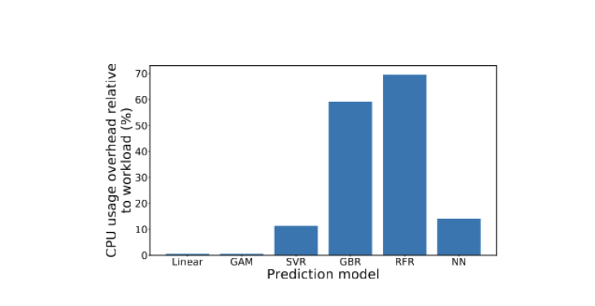
Evaluation: Feasibility of our approach
We observe different learning models have various overheads.
Linear has least overhead but can have lower accuracy
SVR has acceptable overhead but high accuracy
Other approaches are not feasible
Overhead of various approach

Slide 13
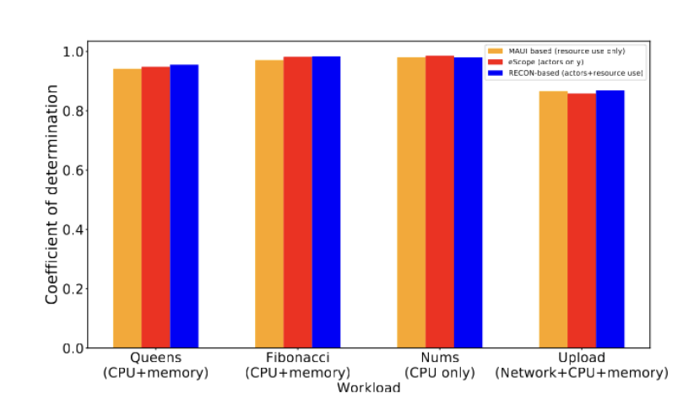
Comparison with related work

Slide 14
Evaluation of real-world application
Face recognizer:
Linear Approach: 3% error in power prediction
SVR Approach : 1.5% error in power prediction
Video conferencing application:
Linear Approach: 3.4% error in power prediction
SVR Approach : 3.6% error in power prediction
eScope uses heuristic to choose SVR if it performs > 15% than linear, to compensate for overhead

Slide 15
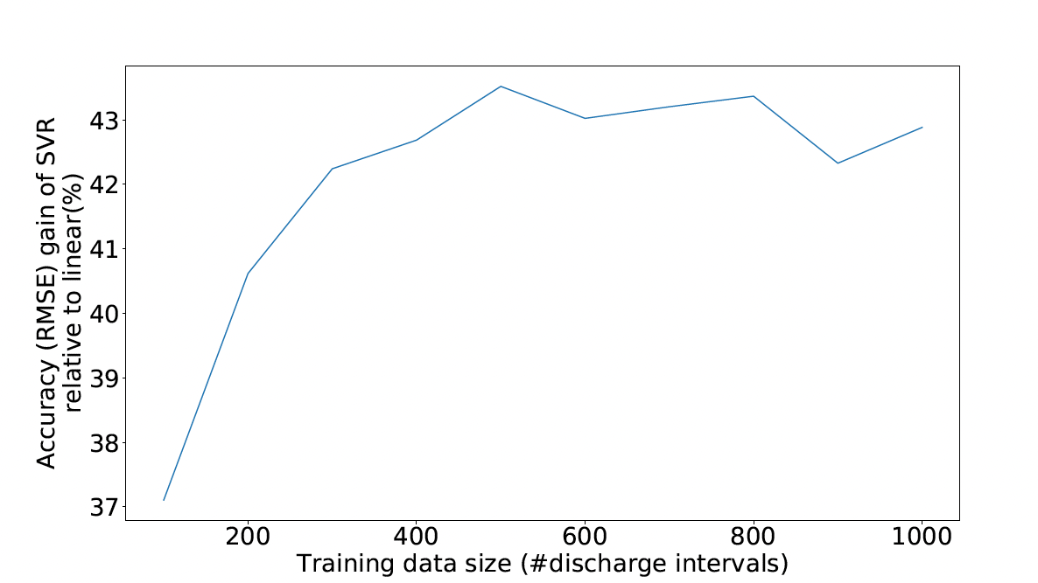
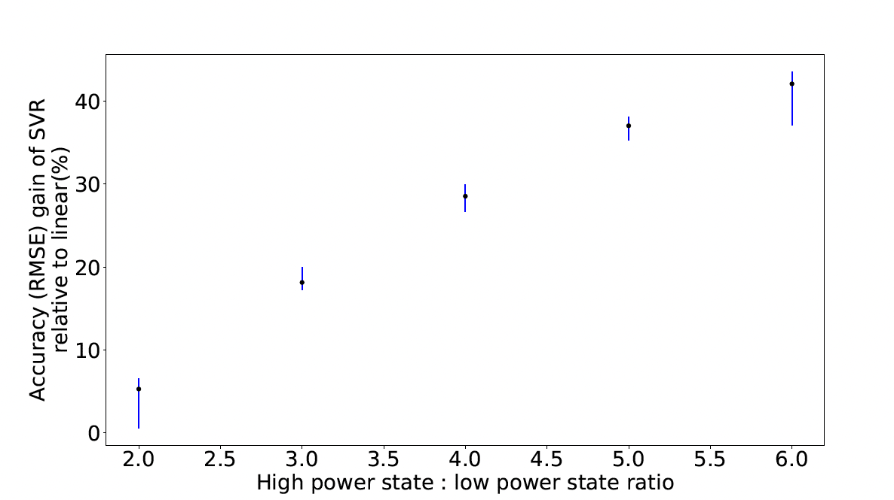
Comparing different modeling approach
Accuracy gain of SVR relative to linear with increasing training size
Accuracy gain of SVR relative to linear with increased variation between power state of an operator

Slide 16
Conclusion
Our approach provides a resource agnostic power modeling
It does a fine-grained power attribution based on tracing in the runtime
It models the different power consumption based on execution time and power draw to estimate fine-grained prediction
We provide a 97% accuracy with low power overhead

