Slide 1
Automating containerized tracking app creation
29th July
Dipayan Pal
IISER, Pune
Mohammed Hashim M
Chennai Mathematical Institute
internship@coriolis

Slide 2
Tools used
Kubernetes
Docker
Ansible
Spark
CCTV cameras images
Various deep learning models

Slide 3
Problem Statement
Automating the process of creating multi-container tracking software end-to-end and making the system scalable and fault tolerant

Slide 4
How we automated the kubernetes cluster creation?
Containers deployed using Kubernetes.
Kubernetes cluster creation automated using ansible.
Automation of Deployment of various containers also achieved through ansible.

Slide 5
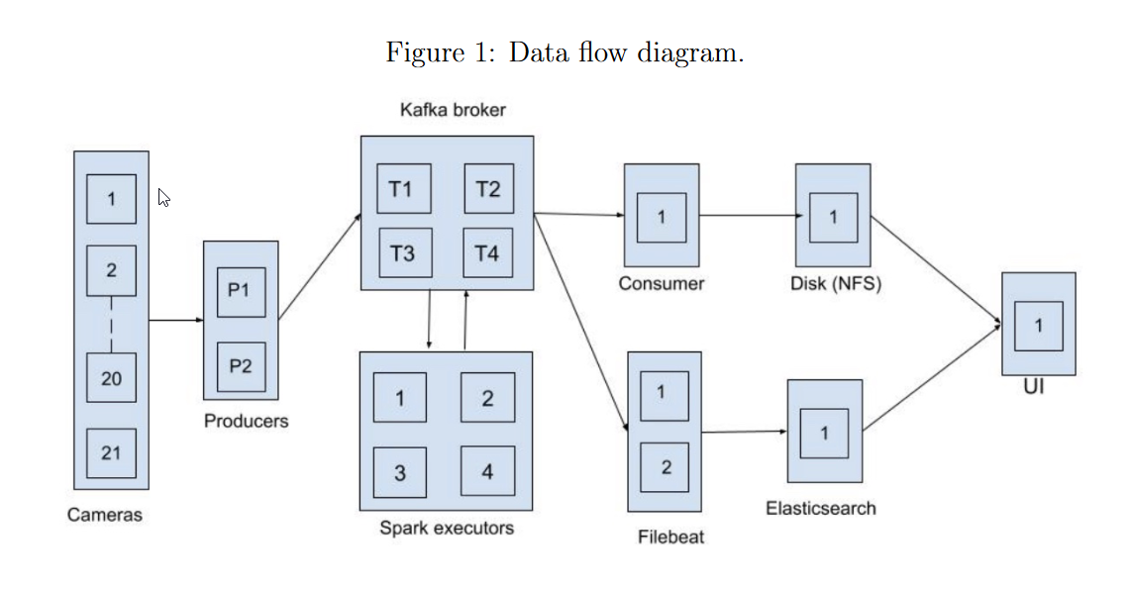
Flowchart of the tracking app

Slide 6
Containers deployed with their use
• Producers: Producers take data coming from the cameras, perform some basic operations on the image and sends the data to Kafka broker.
• Kafka and Zookeeper: Kafka(along with zookeeper) is a distributed data store that is used for storing and retrieving streaming data.
• Spark drivers and executors: Spark runs various object detection and face detection deep learning algorithms. The various spark executors take data from kafka, perform the algorithms on those data(images) and send their output to the kafka broker.
cont.

Slide 7
• Consumer: The consumer takes the output from object detection model and saves it to NFS disk.
• Filebeat: This tool sends the output the spark executors (Deep Learning Models) generate, which is is present in kafka broker to elasticsearch.
• Elasticsearch: Elasticsearch is a distributed search and analytics engine built on Apache Lucene. All the data that comes out of the ML models is saved in the elasticsearch database.
• UI: This is a user interface which displays images and result of Deep Learning models.

Slide 8
ConfigMaps
API object used to store data key-value pairs
Containers consume configmaps as environment variable.
Created configmaps for spark driver and producer.
Passed environment variables to the deployed containers using configmaps.

Slide 9
Future Work
Autoscaling
Better face detection algorithms
Making a face recognition application
Making elasticsearch stateful

