Slide 1


Bogoliubov Laboratory
of Theoretical Physics
Simple atomistic modeling of adsorptions on various surfaces
By:
Edwine Matlou, Son Nguyen and Andrej Dedić
Supervised By:
Dr. Miroslav Iliaš
Dr. Dipayan Sen
Bogoliubov Laboratory of Theoretical Physics, JINR

Slide 2
Outlines
1.Introduction
2.Methodology
Results
Conclusion
1

Slide 3
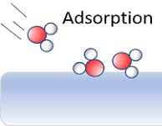
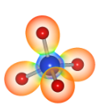

1. Introduction
Aim:
Utilize open-source computational physics tools for fast and automated modeling of adsorptions
Modifying the template code to incorporate other types and sizes of surfaces, for different adsorbates and for different interatomic models
Adsorption of water
molecule on surface
Objectives:
Simple atomic modeling of atom adsorption on surfaces that can be used as detectors in the synthesis of superheavy elements
Methods such as DFT provide precise and reliable results, but they are computationally very demanding. Therefore, we use simpler methods (Lennard-Jones potential implemented within the Atomic Simulation Environment (ASE)) that are faster and still offer sufficiently accurate results.

Slide 4
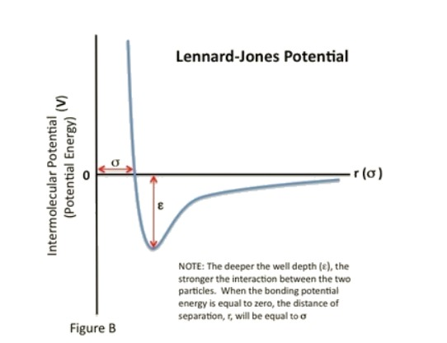

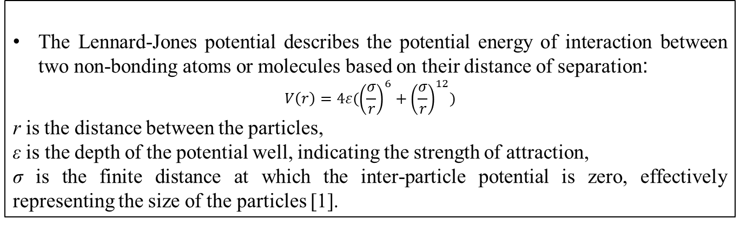
Lennard Jones:
The Lennard-Jones potential describes the potential energy of interaction between two non-bonding atoms or molecules based on their distance of separation:
$$V\left(r\right)=4ε({\left(\frac{σ}{r}\right)}^{6}+{\left(\frac{σ}{r}\right)}^{12})$$
r is the distance between the particles,
ε is the depth of the potential well, indicating the strength of attraction,
σ is the finite distance at which the inter-particle potential is zero, effectively representing the size of the particles [1].
L-J potential graph
ASE:
open-source Python library
makes it easier and faster to perform tasks like improving atomic structures (geometry optimization), simulating how atoms move over time (molecular dynamics), and calculating material properties [2].

Slide 5
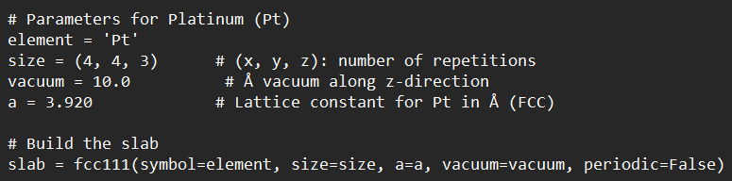
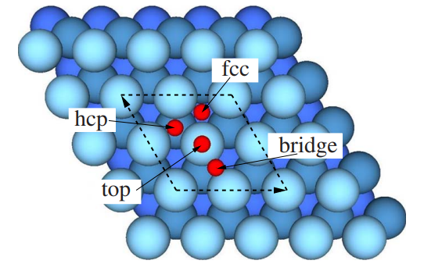
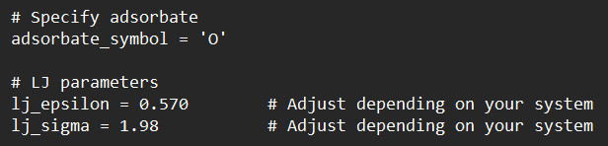
2. Methodology
Slab construction
Adsorption setup
Metal surfaces (Ag, Au, Pt, Cu) (111) modeled as periodic slabs using the Atomic Simulation Environment (ASE)
Adsorbates placed at different adsorption sites (top, bridge, hollow) on the metal surface.
Adsorbate selection
Single atoms (C, H, O, N, S) chosen as representative adsorbates with their specific LJ parameters.

Slide 6
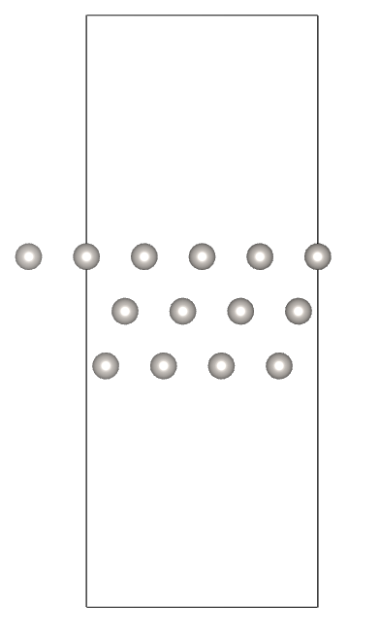
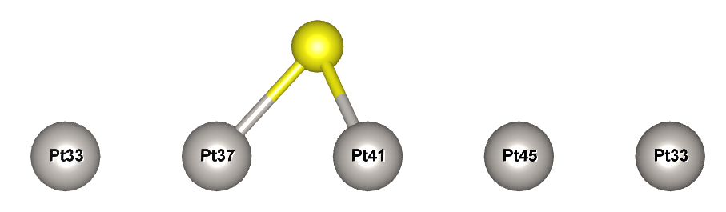
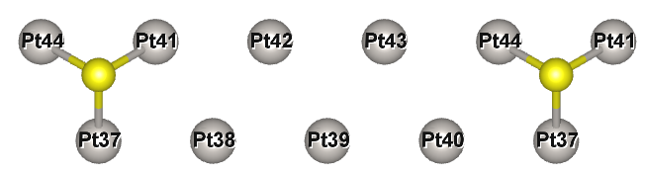
Analysis
Calculated nearest atom–atom distances to evaluate interaction strength and site preference.
25 Å
Adsorption of sulfur platinum metal surface from x axis
Adsorption of sulfur platinum metal surface from z axis

Slide 7

3. Results

Slide 8
Table 1. The Lennard-jones (Lj) parameters for atom adsorption on metal (111) slabs.
Atoms | Au | Cu | Ag | Pt
ε [eV] & σ [ Å]
O | 0.04 & 1.95 | 0.03 & 1.75 | 0.03 & 1.92 | 0.57 & 1.98
N | 0.04 & 1.60 | 0.04 & 1.70 | 0.04 & 1.57 | 0.15 & 1.78
H | 0.03 & 1.75 | 0.02 & 2.00 | 0.05 & 1.50 | 0.10 & 1.60
C | 0.03 & 1.90 | 0.08 & 1.65 | 0.05 & 2.67 | 0.20 & 1.70
S | 0.03 & 2.10 | 0.02 & 2.00 | 0.06 & 1.96 | 0.25 & 2.14
Table 2. The number of generated sites for atom adsorption on metal (111) slabs.
Atoms | Au, Cu, Ag, Pt
 | Top | Bridge | Hollow
 |  |  | hcp | fcc
O | 16 | 48 | 16 | 16
N | 16 | 48 | 16 | 16
H | 16 | 48 | 16 | 16
C | 16 | 48 | 16 | 16
S | 16 | 48 | 16 | 16

Slide 9
Table 3. The calculated and literature atom–adsorbate distances (O, N, H, C, S) on metal (Au, Cu, Ag, Pt) (111) surfaces [Å].
Atoms | Au (Cal) | Au (Lit) | Cu (Cal) | Cu (Lit) | Ag (Cal) | Ag (Lit) | Pt (Cal) | Pt (Lit)
O | 2.17 | 2.16 ^{[3]} | 1.97 | 1.94 ^{[8]} | 2.18 | 2.3 ^{[11]} | 2.20 | 2.07 ^{[16]}
N | 1.77 | 1.39 ^{[4]} | 1.90 | 1.85 ^{[9]} | 1.77 | 1.43 ^{[12]} | 1.98 | 1.18 ^{[17]}
H | 1.94 | 1.88 ^{[5]} | 2.17 | 1.78 ^{[10]} | 1.77 | 1.8 ^{[13]} | 1.79 | 1.87 ^{[18]}
C | 2.17 | 2.12 ^{[6]} | 1.85 | 1.85 ^{[10]} | 2.92 | 3.00 ^{[14]} | 1.90 | 1.85 ^{[19]}
S | 2.31 | 2.40 ^{[7]} | 2.23 | 2.23 ^{[10]} | 2.18 | 2.20 ^{[15]} | 2.37 | 2.38 ^{[4]}
Table 4. The most stable site for atom adsorption on metal (111) slabs.
Atoms | Au | Cu | Ag | Pt
O | hcp hollow | hcp hollow | hcp hollow | hcp hollow
N | hcp hollow | hcp hollow | hcp hollow | hcp hollow
H | hcp hollow | hcp hollow | hcp hollow | hcp hollow
C | hcp hollow | hcp hollow | hcp hollow | hcp hollow
S | hcp hollow | hcp hollow | hcp hollow | hcp hollow

Slide 10
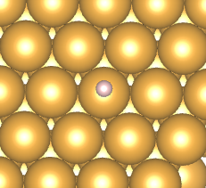
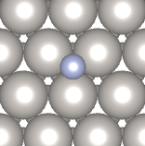
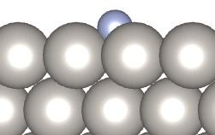
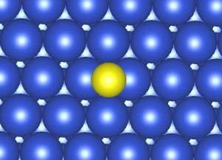
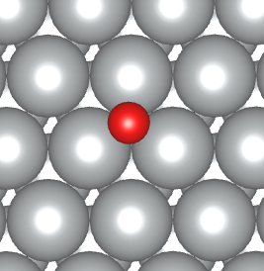
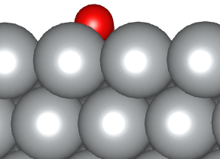
(i).
(ii).
Au-H top site
Pt-N HCP hollow site
(iii).
(iv).
Cu-S bridge site
Ag-O FCC hollow site
Figures: (i) Au–H (top site), (ii) Pt–N (hcp hollow), (iii) Cu–S (bridge), (iv) fcc hollow site.

Slide 11
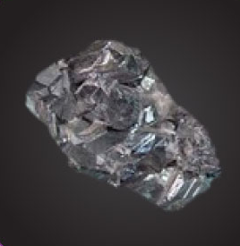
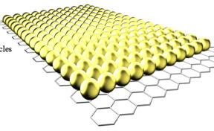
4. Conclusion
The Lennard–Jones model provides reasonable estimates of adsorption distances when well-calibrated and is computationally efficient. However, it incorrectly predicts the hcp hollow site as the most stable configuration, whereas DFT identifies the fcc hollow as more favorable.
This discrepancy stems from the LJ potential’s purely distance-based, pairwise nature. Its apparent hcp preference results from numerical rounding or minor geometric differences rather than true physical stabilization.
Future work could:
  explore applications in molecule adsorption studies
  optimization of structures during adsorption processes
The developed code can be applied in designing gold-based detectors for the synthesis of superheavy elements such as copernicium

Slide 12
References
Atkins, Peter and de Paula, Julio. Physical Chemistry for the Life Sciences. New York, N.Y. W. H. Freeman Company, 2006.
Larsen, A.H., Mortensen, J.J. et al., J. Phys.: Condens. Matter, 29, (2017).
Baker, T.A., Friend, C.M. et al., J. Phys. Chem. C, 113, (2009).
Wang, G.C., Jiang, L. et al., J. Phys. Chem. B, 109, (2005).
Dokhlikova, N.V., Gatin, A.K. et al., Materials, 18, (2025).
Kumar, P., Meyerstein, D. et al., ChemPhysChem, 26, (2025).
Ting, E.C., Popa, T. et al., Beilstein J. Nanotechnol., 7, (2016).
Yu, K., McDaniel, J.G. et al., J. Phys. Chem. B, 115, (2011).
Soon, A., Wong, L. et al., Surf. Sci., 601, (2007).
Pang, X.Y., Xue, L.Q. et al., Langmuir, 23, (2007).
Jia, L., Wang, Y. et al., J. Phys. Chem. B, 107, (2003).
Raju Karimadom, B., Varshney, S. et al., ChemPhysChem, 23, (2022).
Bürker, C., Ferri, N. et al., Phys. Rev. B, 87, (2013).
Shen, M., Liu, D.J. et al., J. Phys. Chem. C, 112, (2008).
Jennings, P.C., Aleksandrov, H.A. et al., Nanoscale, 6, (2014).
Zeng, Z.H., Da Silva, J.L. et al., Phys. Rev. B, 79, (2009).
Hanh, T.T.T., Takimoto, Y. et al., Surf. Sci., 625, (2014).
Wang, J.X., Robinson, I.K. et al., J. Phys. Chem. B, 109, (2005).
Yang, Z., Wu, R. et al., Phys. Rev. B, 65, (2002).

Slide 13



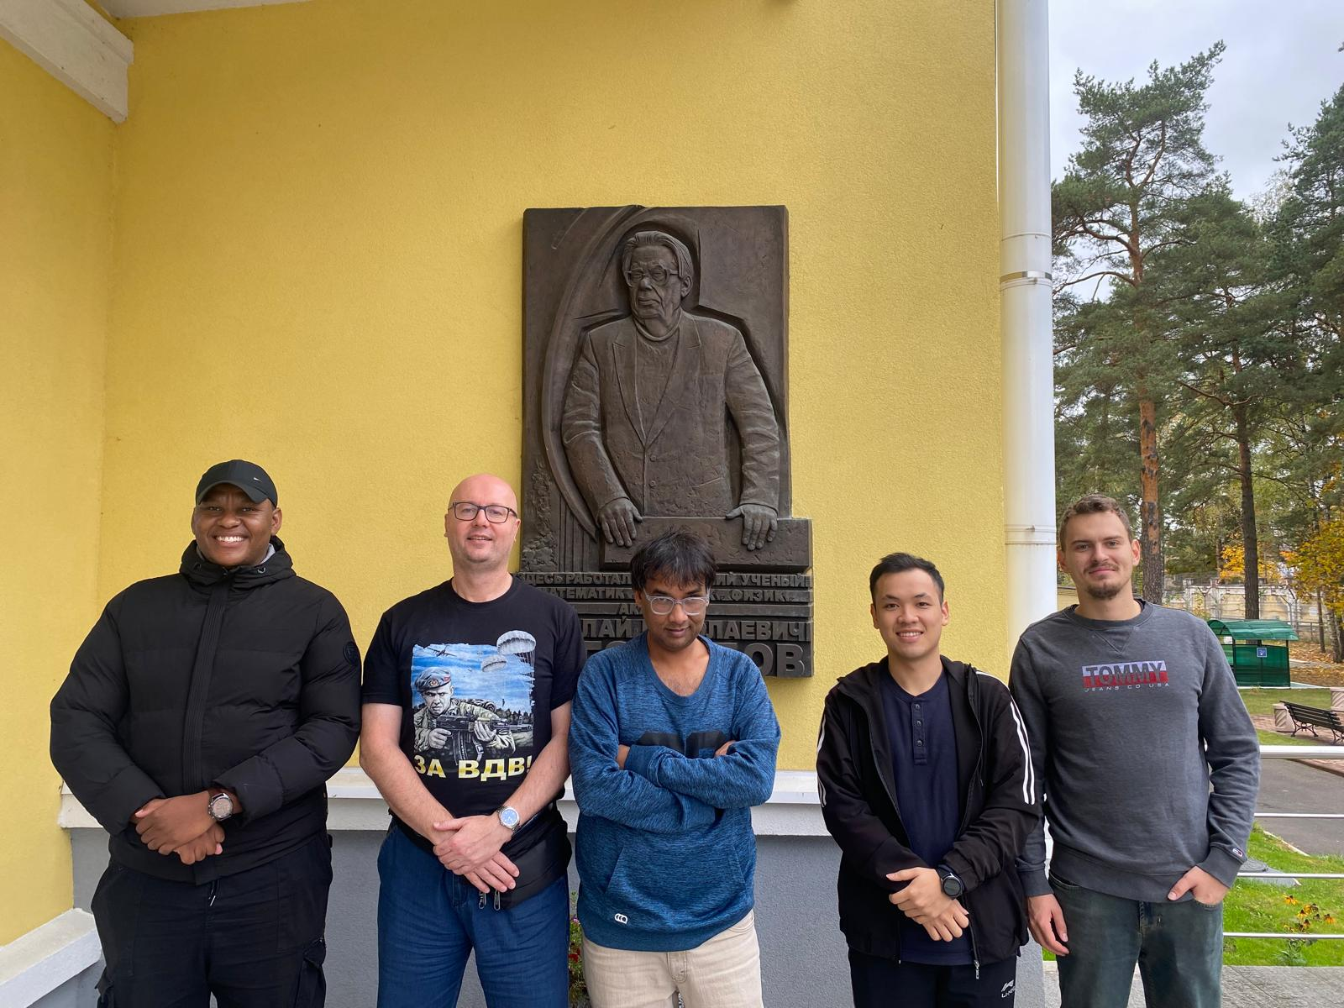





Acknowledgements
спасибо
Kea leboga
dakujem
धन्यवाद
Cảm ơn
хвала вам

