Slide 1
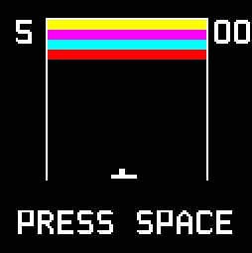
CMPEN 351 Final Project Presentation
- Dipen R (dar6078@psu.edu)

Slide 2
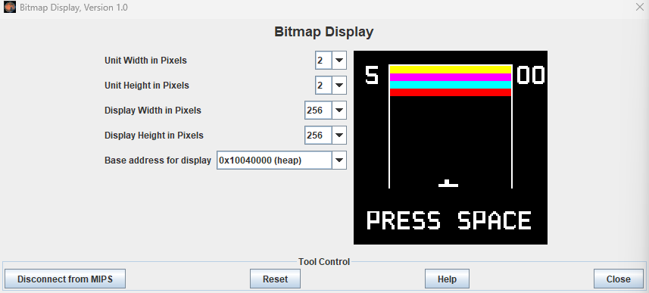
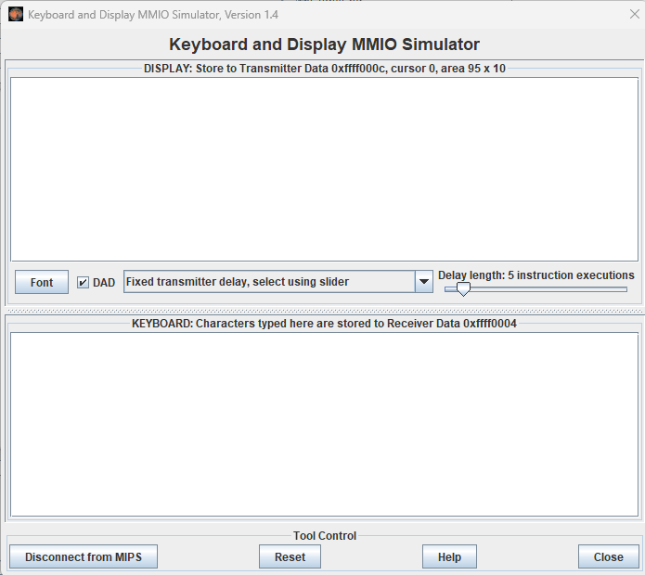
Peripherals
Bitmap Display:
Display Resolution: 256x256
Unit Width = Unit Height = 2
Effective Resolution (from memory perspective) = 128x128
Keyboard Simulator:
User input handled via Keyboard interrupts
Audio: Optional

Slide 3
Rules
Player has 5 lives to win the game
They must destroy all 32 bricks before losing all lives, which is kept track of using the score field
Player loses a life if the ball falls below the paddle
Instructions
Press the Space bar to start the game or resume after losing a life
Press A to move paddle left
Press D to move paddle right

Slide 4
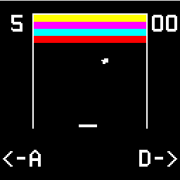



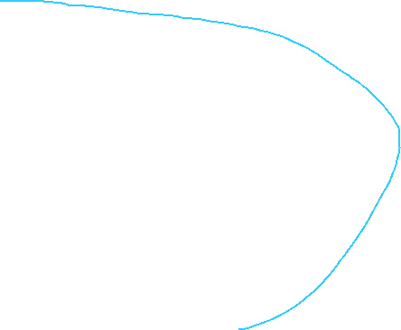



Game Elements
Top Border
Score card
Lives Counter
Left Border
Brick Grid
Right Border
Ball
Paddle
Instruction messages

Slide 5
Game Flags
Game Active Flag:
  Set after the preparations (drawing game elements) are done
  That is, the flag is set before entering the game loop
  Reset after the player either wins or loses
  The game loop is exited when this flag is reset
Paddle Free Flag:
  Can be set only after the game's active flag is set
  This flag is set when the user presses the space bar
  The game loop can only progress if the paddle free flag is set
  Paddle movement keys are only processed if the paddle free flag is set
  This flag is reset upon losing a life

Slide 6
Color
Color is kept track of using a color table.
The table has hex entries for different color combinations
A color is retrieved via indexing into the table
Digits
Characters on the screen (A, D, -, >, 0, etc.) are 8x12 black and white values
These characters are stored in a table
Most were provided in lecture, and the remaining, such as ‘>’ were created in PixilArt
Erasing Elements
Erasing elements on the screen is equivalent to drawing the element, but with all 0s for its hex values
For example, a brick is destroyed by drawing a black rectangle over it
Text is cleared by writing empty text over it

Slide 7
Bricks
Dimensions: 10x5
Arranged in an 8x4 grid for a total of 32 bricks
Laid right next to each other
Destroyed bricks are tracked in a bricks left array, which is indexed into using a row and column index
This layout logic makes accessing any brick simple:
X coordinate of a brick:
word at (BricksLayoutTable + 0) + (Column index * Width of brick)
Y coordinate of a brick = word at (BricksLayoutTable + 4 bytes) + (Row index * Height of brick)
BricksLayoutTable is the table in which information about the top-left brick is saved. All other bricks can be computed using the above logic. BricksLayoutTable:
.word 24, 10, 6
  First column = Starting X coordinate
  Second column = Startng Y coordinate
  Third column = Color index
Color for each next row = color index of previous row -1

Slide 8
Borders
There are 3 borders:
  Two vertical borders (left and right)
  One horizontal border (top)
They are simple lines
Border information is stored in a table:
  First two row entries for the vertical borders
  Last row entry for the horizontal border
  Three columns for data:
    (Starting) X coordinate
    (Starting) Y coordinate
    Border length
Ball
The ball is a square. This design choice aids in easier drawing and calculations
Ball data is stored in a single row entry table:
.word 60, 85, 60, 85, 3, 2, 1, 1, -1
  First entry = Current Top-Left X coordinate
  Second entry = Current Top-Left Y coordinate
  Third entry = Old Top-Left X coordinate
  Fourth entry = Old Top-Left Y coordinate
  Fifth entry = Ball size
  Sixth entry = X-axis speed
  Seventh entry = X-axis direction
  Eight entry = Y-axis speed
  Nineth entry = Y-axis direction
Tracking the previous position helps in erasing the ball before redrawing it post-collision
The ball’s original position is stored separately in memory to restore it after losing a life
The ball’s Y-axis speed remains constant, but its X-axis velocity and Y-axis direction may change
It’s default velocity values are stored in memory for restoration after losing a life

Slide 9
Paddle
The paddle is also a rectangle like a brick
Paddle data is stored in a single row entry table:
.word 56, 88, 40, 40, 13, 2, 10, 1
  First entry = Current Top-Left X coordinate
  Second entry = Current Top-Left Y coordinate
  Third entry = Old Top-Left X coordinate
  Fourth entry = Old Top-Left Y coordinate
  Fifth entry = Paddle Width
  Sixth entry = Paddle Height
  Seventh entry = X-axis speed
  Eight entry = X-axis direction
Tracking the previous position helps in only redrawing the paddle if it has moved (current and old coordinates do not match)
The paddle’s original position is stored separately in memory to restore it after losing a life
Redrawing Elements
Due to the large number of game elements, it is essential to redraw elements only when necessary (even-driven):
  Don’t redraw bricks. Only need to “redraw” a brick with black when it has been destroyed
  Don’t redraw borders.
  Draw the ball in every game loop iteration, as it will always move in active gameplay
  Redraw the paddle only when the old and current positions don’t match

Slide 10
Ball and Border Collision Detection and Action
Left border collision:
  Ball (Top) Left <= the left border X coordinate.
  Action: Reverse ball’s X-axis direction and change its X coordinate to border’s X coordinate + 1
Right border collision:
  Detection: Ball (Top) Right >= the right border X coordinate
  Action: Reverse ball’s X-axis direction and change its X coordinate to border’s X coordinate – ball size – 1
Top border collision:
  Detection: (Ball Top) Left<= the top border Y coordinate.
  Action: Reverse the ball’s Y-axis direction and update the ball’s current Y coordinate to the border’s Y coordinate + 1

Slide 11
Ball and Paddle Collision Detection and Action
Paddle collision changes the ball’s X-axis speed and possibly its X-axis direction
Cases where a ball and paddle collision is not possible:
  If Ball bottom < Paddle top, no collision
  If Ball top > Paddle bottom, no collision
  If Ball right < Paddle left, no collision
  If Ball left > Paddle right, no collision
Otherwise, there is a collision
If the ball collides with the left side of the paddle:
  Change the ball’s X-axis direction to make it move left (if it’s not moving so already)
If the ball collides with the right side of the paddle:
  Change the ball’s X-axis direction to make it move right (if it’s not moving so already)
The ball’s X-axis speed is calculated using linear interpolation.
  Linear interpolation formula: y = y1 + ((x - x1) * (y2 - y1)) / (x2 - x1))
  y = New X speed
  y1 = Ball min X speed
  y2 = Ball max X speed
  x = offset (between ball and paddle center) = Ball center X – Paddle center X
  x1 = start of input range = start of paddle from either side = 0
  x2 = end of input range = paddle width / 2
  Absolute values of offset will be used because direction is handled elsewhere
New X speed = Ball min X speed + (|Offset| * (max X speed - min X speed)) / (Paddle width / 2

Slide 12
Ball and Brick Collision Detection and Action
Spatial hashing is used to identify which brick in the grid (area enclosed by the borders) the ball may be colliding with
  Column index = (Ball X - Grid X) / Brick Width
  Row index = (Ball Y - Grid Y) / Brick Height
Only the brick at that row index, column index is selected for checking
Before actual collision detection logic, it is checked whether the brick has already been destroyed or not by looking into the bricks left array.
  If it has been destroyed, we leave the function
Collision conditions:
  Ball left edge >= Brick right edge, no collision
  Ball right edge <= Brick left edge, no collision
  Ball top edge >= Brick bottom edge, no collision
  Ball bottom edge <= Brick top edge, no collision
Otherwise, there is a collision
On collision:
  The brick is marked as destroyed with a 1 in the bricks left array
  A black brick is drawn over it
X and Y overlap is used to determine the side of the brick the ball hit
  X overlap = min(Ball right, Brick right) - max(Ball left, Brick left)
  Y overlap = min(Ball bottom, Brick bottom) - max(Ball top, Brick top)

Slide 13
Ball and Brick Collision Detection and Action (continued)
If Ball center X < Brick center X, the ball hits the left side
  Else, the ball hit the right side
If Ball center Y < Brick center Y, the ball hit the top side
  Else, the ball hit the bottom side
Collision with the top of the brick:
  Reverse the Y-axis direction if the ball is not moving up
Collision with the bottom of the brick:
  Reverse the Y-axis direction if the ball is not moving down
Collision with the right side of the brick:
  Reverse the X-axis direction if the ball is not moving right
Collision with the left side of the brick:
  Reverse the X-axis direction if the ball is not moving left
Updating Score and Lives Left
On destroying the brick, the score is updated in memory.
When the ball falls below the paddle (checked during paddle collision), the lives left value is updated in memory
The old and new values for both are kept track of in memory.
If the old and new values don’t match, the relevant screen portions are cleared with an empty string, and new values are displayed
Old values are updated to match the new (current) values
Upon losing or winning, the appropriate message is displayed.

Slide 14
Audio
Notes are played for short durations using syscall 31, which does not block code execution, when the ball collides with any game element
  The note played is different for each type of game element
Syscall 33 is used to play winning and losing tunes at the end of game play

