Slide 1
Housing Prices Dataset
What Seems To Drive Housing Prices?
545
homes in a clean dataset
4.34M
An initial pricing story built from 545 housing records with size, room counts, and amenity features.
median home price
68.2%
Story lens
price variation explained by a simple all-features linear read
Price behaves like a ladder: space sets the
base, convenience creates the premium.
5.74M
Caveat
price where the upper quartile begins
Use this as a structural first read, not a
final market model.
Source: Housing.xlsx | Prices shown in millions
Notes:
This is the first story from the Housing Prices dataset. We have 545 homes and no missing values, so it is a clean snapshot for an initial read. The question is simple: what seems to push a house into the premium price tier? Because the dataset has no date or explicit location field, this story is about structural price drivers rather than trend analysis over time.
[Sources]
- Housing.xlsx dataset with 545 records; summary metrics and charts generated from housing_story_project/analyze_housing.py.

Slide 2
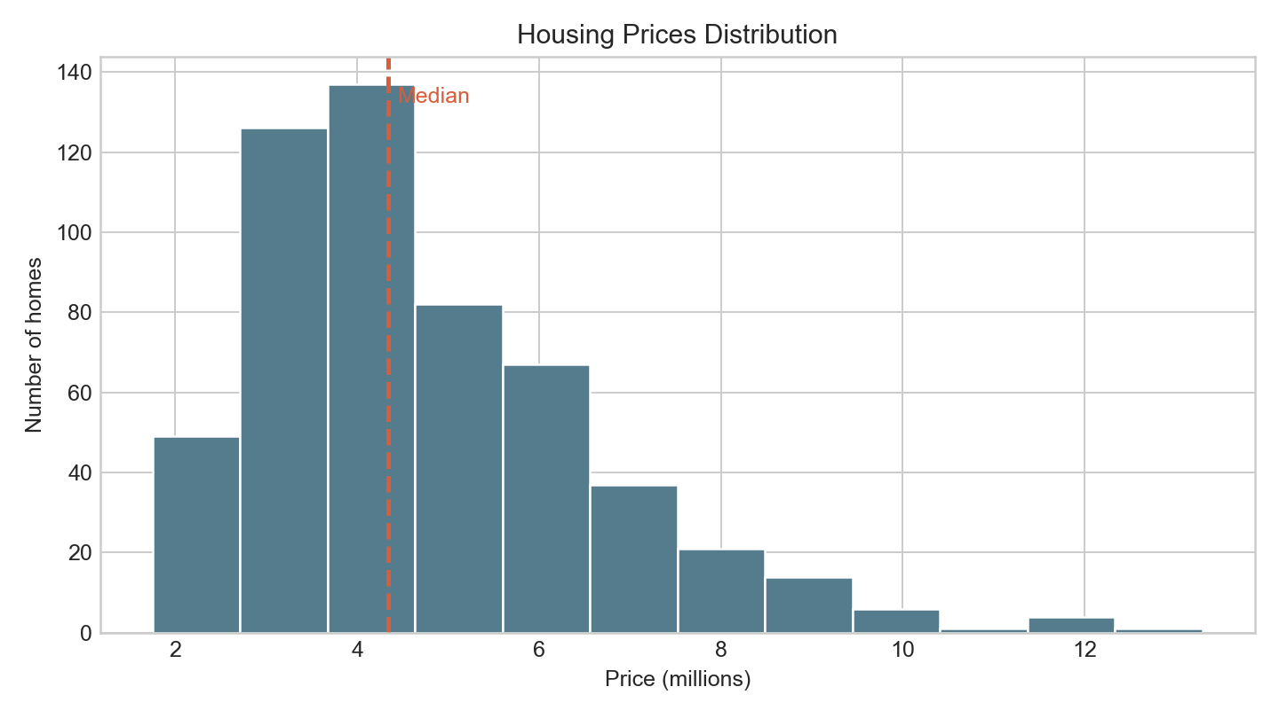
MARKET SNAPSHOT
02 / 05
The Dataset Shows A Wide Price Ladder
Most homes sit in the middle of the market, but the upper tier is clearly separated from the rest.
4.34M
Median home price
5.74M
Upper quartile threshold
7.35M
Top 10% threshold
Price distribution exported from the Python project.
Takeaway
Distinct premium tier.
Source: Housing.xlsx | Prices shown in millions
Notes:
Start with the shape of the market. The median home price is 4.34 million, the upper quartile begins at 5.74 million, and the top ten percent starts at 7.35 million. So this market is not flat; it has a visible premium tier. That gives us a simple question for the next slides: what separates mid-market homes from top-end homes?
[Sources]
- Housing.xlsx dataset with 545 records; summary metrics and charts generated from housing_story_project/analyze_housing.py.

Slide 3
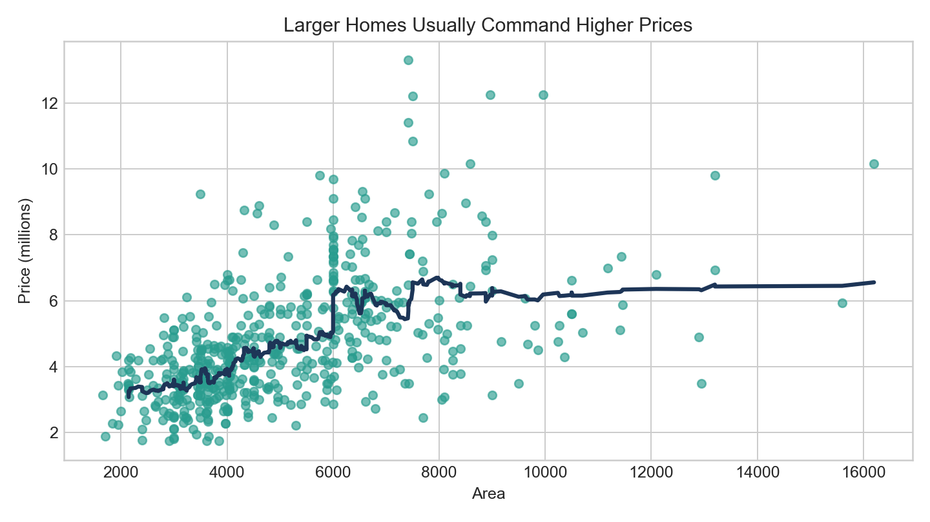
BASE VALUE
03 / 05
Space And Layout Set The Base Price
Area is the strongest numeric signal, with bathrooms close behind.
0.536
Correlation between area and price
0.518
Correlation between bathrooms and price
3.54M to 6.22M
Mean price from the smallest to largest area quartile
Area versus price from the Python project.
Interpretation
Base price driver.
Source: Housing.xlsx | Prices shown in millions
Notes:
Area is the strongest numeric driver in the dataset, and bathrooms are almost as influential. Mean price rises from about 3.54 million in the smallest area quartile to 6.22 million in the largest quartile. That tells us space and layout set the base value. In other words, homes start earning price through usable scale before premium features even come into the picture.
[Sources]
- Housing.xlsx dataset with 545 records; summary metrics and charts generated from housing_story_project/analyze_housing.py.

Slide 4
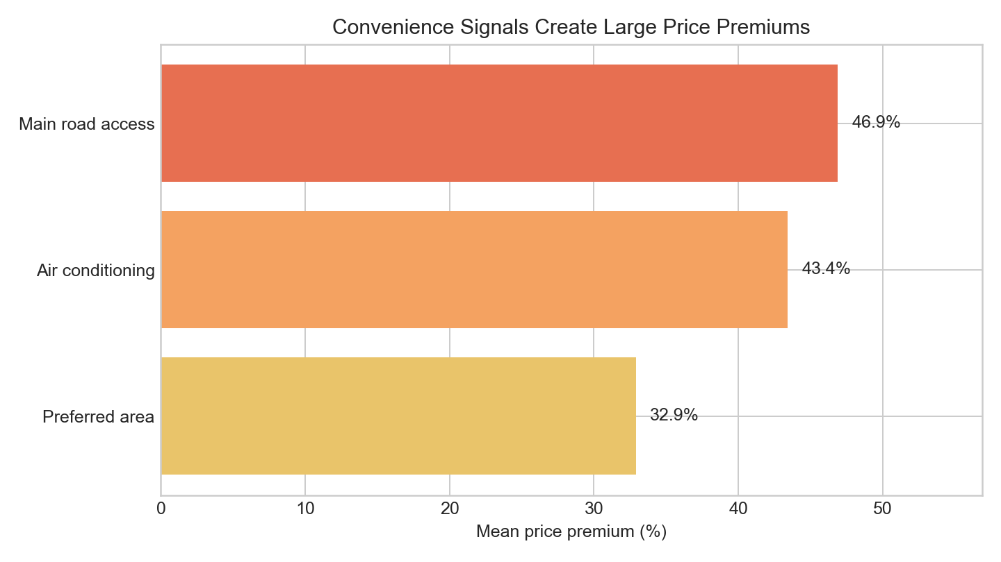
PREMIUM SIGNALS
04 / 05
Amenities And Accessibility Create The Premium Gap
Comfort and convenience features are strongly associated with higher prices.
+46.9%
Main-road access premium
+43.4%
Air-conditioning premium
+32.9%
Amenity premium chart exported from the Python project.
Preferred-area premium
Furnishing status reinforces the same story
Median price is 5.08M for furnished homes, 4.58M for semi-furnished homes, and 3.43M for
unfurnished homes.
Source: Housing.xlsx | Prices shown in millions
Notes:
Once the base value is set, convenience features widen the premium gap. Homes with air conditioning average about 43 percent higher prices, preferred-area homes about 33 percent higher, and main-road access about 47 percent higher. Furnishing status supports the same pattern, with furnished homes showing a much higher median than unfurnished homes. That suggests premium prices come from a bundle of comfort, accessibility, and presentation.
[Sources]
- Housing.xlsx dataset with 545 records; summary metrics and charts generated from housing_story_project/analyze_housing.py.

Slide 5
CONCLUSION
05 / 05
Initial Story: Housing Price Behaves Like A Ladder
Use this as a first pricing narrative, then improve it with richer market context.
Base Value
Premium Lift
Next Step
Area and bathrooms establish
the first pricing layer.
Bigger, more functional
homes start higher on the
ladder.
Main-road access, air
conditioning, preferred
area, and furnishing status
push homes toward the
premium segment.
Add time and location detail
to turn this from an initial
pricing story into a
stronger valuation model.
68.2%
of price variation is explained by a simple all-features linear read, which is strong for a first pass but not enough for final valuation.
Source: Housing.xlsx | Prices shown in millions
Notes:
The first pricing story is that housing prices behave like a ladder. Size and bathrooms establish the lower rungs, then comfort and access signals lift homes into premium tiers. A simple all-features linear read explains about 68 percent of price variation, which is strong for a first pass but not enough for final valuation. The next step is to add date and location detail so the analysis can move from storytelling to more precise prediction.
[Sources]
- Housing.xlsx dataset with 545 records; summary metrics and charts generated from housing_story_project/analyze_housing.py.

