Slide 1
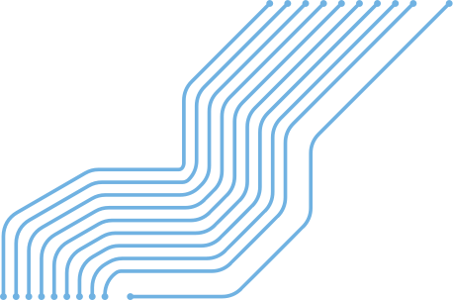

DIGITAL
COMPUTING
From AND Gates
to Algorithms
A workshop for curious minds - understanding
the machine beneath your fingertips.

Slide 2

WHAT IS DIGITAL COMPUTING?

Slide 3
WHAT IS DIGITAL COMPUTING?
•Computers work with only 2 values: 0 and 1
•0 = OFF (no electricity), 1 = ON (electricity flows)
•Everything — photos, videos, games — is stored as 0s and 1s
•This simple idea powers all modern technology
•Even your robot uses digital signals to move!

Slide 4

🔌 Analogue vs Digital
Analogue: values can be anything (like a dial)
Digital: only 0 or 1 — much easier for machines!
💡 Why Binary?
Switches are simple — just ON or OFF. Billions of tiny switches make a computer.
📦 Fun Fact
The word 'bit' comes from Binary digIT — the smallest piece of digital data.

Slide 5
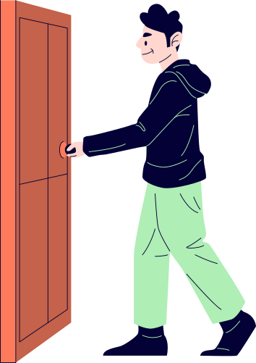
LOGIC GATES..
LOGIC
AND Gate
OR Gate
NOT Gate
•Output = 1 only when BOTH inputs are 1
•0 AND 0 = 0
•0 AND 1 = 0
•1 AND 1 = 1 ✅
•Think: 'both switches must be ON'
•Output = 1 when AT LEAST ONE input is 1
•0 OR 0 = 0
•0 OR 1 = 1 ✅
•1 OR 1 = 1 ✅
•Think: 'either switch is enough'
•Flips the input — called an Inverter
•NOT 0 = 1
•NOT 1 = 0
•Just one input, one output
•Think: 'opposite day'

Slide 6
LOGIC GATES..
LOGIC
NAND Gate
NOR Gate
XOR Gate
•= NOT + AND
•Opposite of AND
•0 NAND 0 = 1
•1 NAND 1 = 0
Used in most memory chips!
•= NOT + OR
•Output is 1 ONLY when both are 0
•0 NOR 0 = 1 ✅
•0 NOR 1 = 0
•Building block for storage
•eXclusive OR
•Output = 1 when inputs are DIFFERENT
•0 XOR 1 = 1 ✅
•1 XOR 1 = 0
•Used in addition circuits!

Slide 7
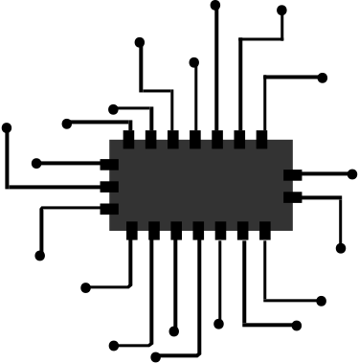

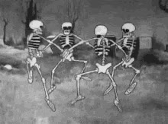
•Connect multiple gates to do useful work
•A Half Adder adds two bits (uses XOR + AND)
•A Full Adder adds bits with a carry — like column addition
•Chain many adders → a full calculator!
•Every arithmetic operation is built from gates
•This is what lives inside your CPU right now
LOGIC
CIRCUIT
**LOGIC GATES INSIDE A CIRCUIT
03

Slide 8

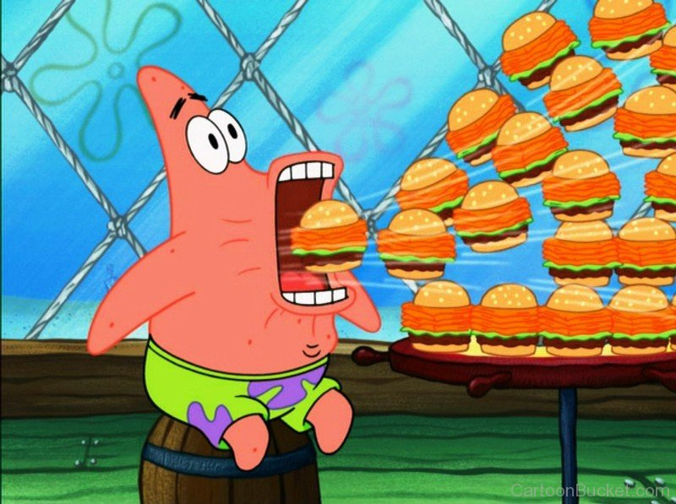
*Computer
HOW COMPUTER STORES DATA?
0
1
1
1
1
0
0
0

Slide 9



RAM AUR ROM
•RAM (Random Access Memory) — temporary, fast
•ROM — permanent, stores boot instructions
•Hard Drive / SSD — long-term file storage
•Registers — tiny, super-fast memory inside the CPU
•Cache — small memory that keeps recent data handy
•The CPU only works with data in RAM or registers
RAM: LOST WHEN POWER OFF (LIKE A WHITEBOARD)
ROM: stays forever (like a printed book)

Slide 10


what is algorithm?

Slide 11
what is algorithm?
Let’s make CHAI
•A step-by-step set of instructions to solve a problem
•Like a recipe — follow the steps, get the result
•Must be: clear, finite (must end), and correct
•Used in search engines, GPS, social media feeds
•Robots follow algorithms to move, sense, and decide
•Good algorithms = fast & efficient programs
that’s an algo...

Slide 12
THANK YOU!

