Slide 1
Computer Networks
Transport layer
Thanks to
A. B. Forouzan
Igor Radovanović, i.radovanovic@tue.nl
TU/e Computer Science, System Architecture and Networking

Slide 2
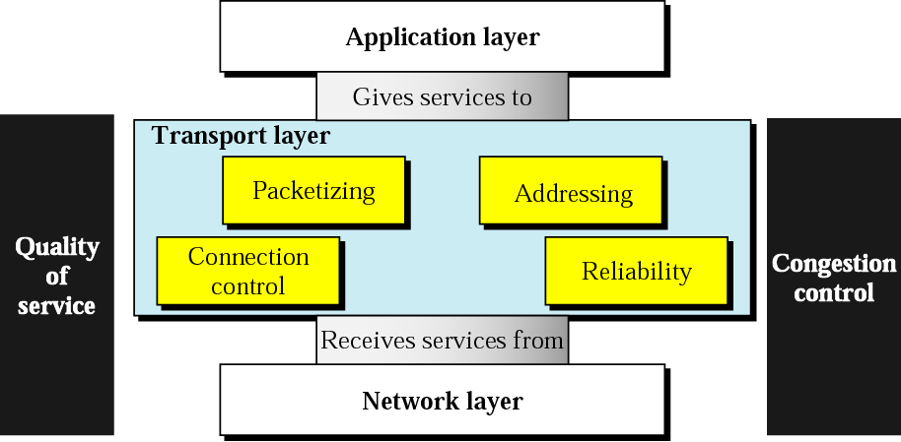
Position of Transport layer
Igor Radovanović, i.radovanovic@tue.nl
TU/e Computer Science, System Architecture and Networking

Slide 3
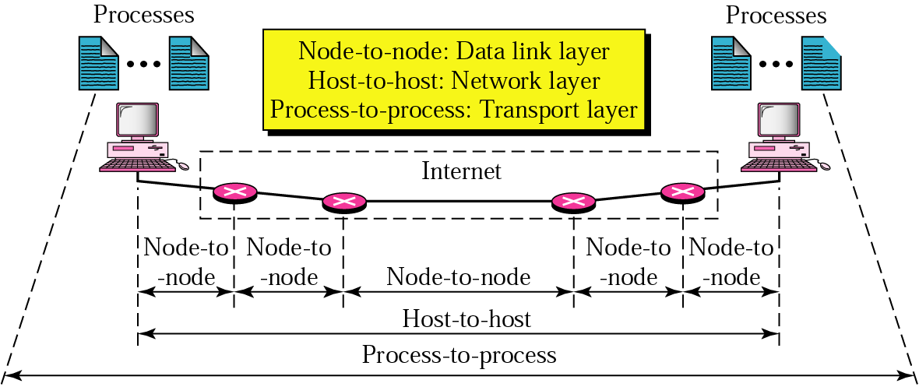
Process-to-process delivery
Several processes (application programs) can run on both the source and the destination host
Two communicating processes are in client-server relationship
  Client – a process on the local host
  Server – a process at the remote host
Igor Radovanović, i.radovanovic@tue.nl
TU/e Computer Science, System Architecture and Networking

Slide 4
Analogy
Two houses, each with a dozen of kids, are located in Eindhoven and Amsterdam.
All kids in different houses are relatives (cousins)
Each kid weekly writes a letter to every other kid in another house
  144 letters/week in total (huge cost)
    Dutch kids would probably use e-mail (low cost)
In each household there is one kid (Jantje & Pietje, respectively) responsible for mail collection and mail distribution
  each week they give all the letters to a postal-service mail carrier who makes daily visits to the house.
Application message = letters in the envelope
Processes = cousins
Hosts (end systems) = houses
Transport-layer protocol = Jantje & Pietje
Network-layer protocol = postal service (including mail carriers)
Igor Radovanović, i.radovanovic@tue.nl
TU/e Computer Science, System Architecture and Networking

Slide 5
Position of Transport layer
Igor Radovanović, i.radovanovic@tue.nl
TU/e Computer Science, System Architecture and Networking

Slide 6
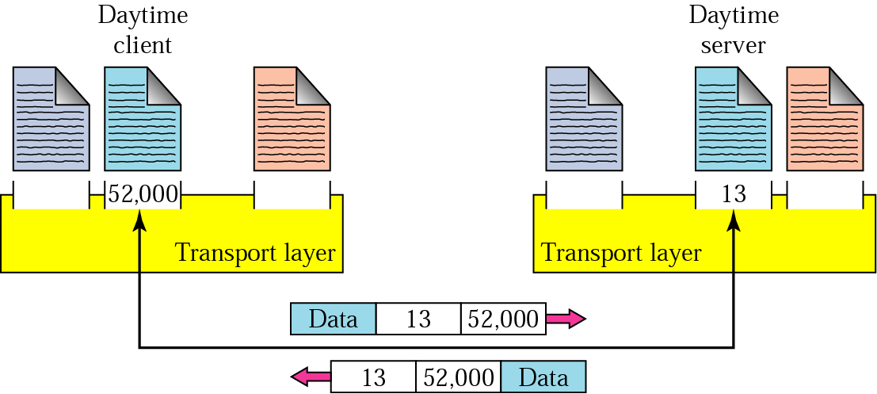
Addressing
Data link - MAC address
Network – IP address
Transport – port number
  needed to chose among multiple processes running on the destination host
  The Internet model: 16 bit integer 0 – 65 535
    Client mostly chooses ephemeral port number
    Server mostly uses well-known (permanent) port numbers
ephemeral port number
well-known port number
Igor Radovanović, i.radovanovic@tue.nl
TU/e Computer Science, System Architecture and Networking

Slide 7
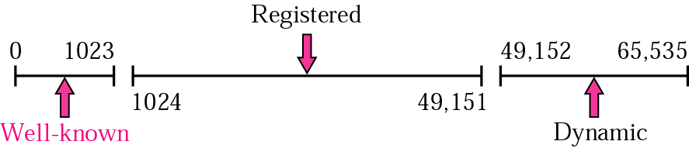
Addressing (cnt’d)
Internet Assigned Number Authority
Igor Radovanović, i.radovanovic@tue.nl
TU/e Computer Science, System Architecture and Networking

Slide 8
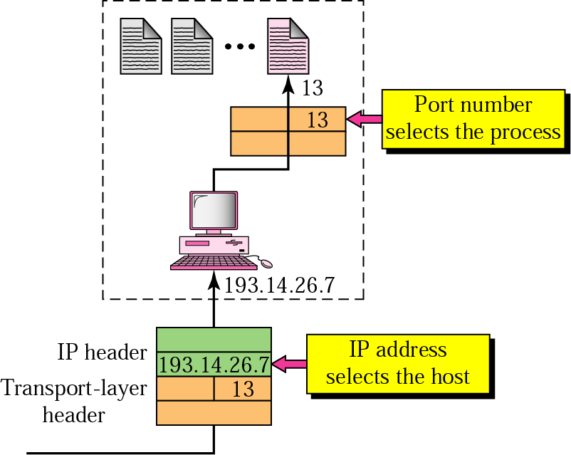
IP addressing versus port addressing
destination IP defines the host
after the host has been selected:
the port number defines one of the processes on this host
Igor Radovanović, i.radovanovic@tue.nl
TU/e Computer Science, System Architecture and Networking

Slide 9
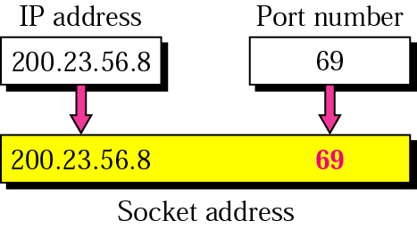
Socket address
Process-to-process delivery needs 2 identifiers:
  IP number
  port number
Igor Radovanović, i.radovanovic@tue.nl
TU/e Computer Science, System Architecture and Networking

Slide 10
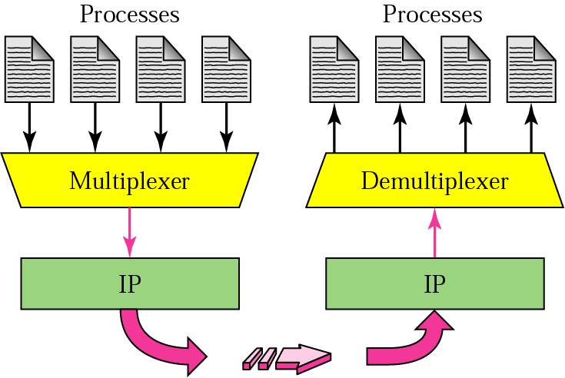
Transport layer MUX & DeMUX
Extending host-to-host delivery to process-to-process delivery
Transport layer de/multiplexes several processes on the transport layer protocol (TCP, UDP)
Igor Radovanović, i.radovanovic@tue.nl
TU/e Computer Science, System Architecture and Networking

Slide 11
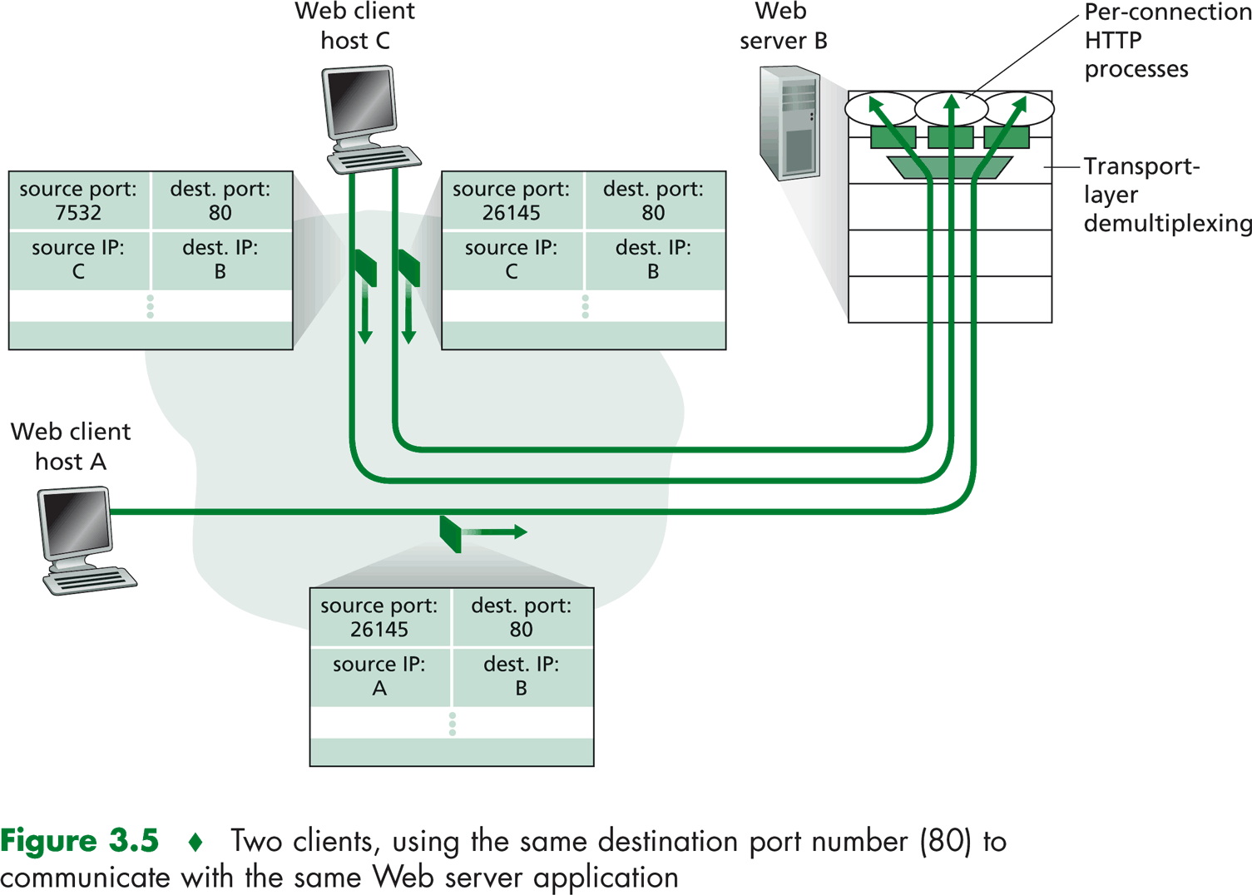
Transport layer MUX & DeMUX (cnt’d)
Copyright © 2005 Pearson Addison-Wesley. All rights reserved.
Igor Radovanović, i.radovanovic@tue.nl
TU/e Computer Science, System Architecture and Networking

Slide 12
Question
What is the analogy of multiplexing and de-multiplexing in the example of the two houses with kids?
Igor Radovanović, i.radovanovic@tue.nl
TU/e Computer Science, System Architecture and Networking

Slide 13
Position of Transport layer
Igor Radovanović, i.radovanovic@tue.nl
TU/e Computer Science, System Architecture and Networking

Slide 14
Connection control
Connectionless services
  no connection establishment
  packets are not numbered, may be delayed, lost or arrive out of order
  UDP
Connection-oriented services
  connection established prior to data transmission
  TCP
What is the difference with respect to the Network layer services?
  transport code runs only on the user’s machine and not in the routers (usually operated by the carriers)
  Network layer can offer inadequate service (frequent packet loss, routers crash from time to time); user does not have control over the Network layer
Igor Radovanović, i.radovanovic@tue.nl
TU/e Computer Science, System Architecture and Networking

Slide 15
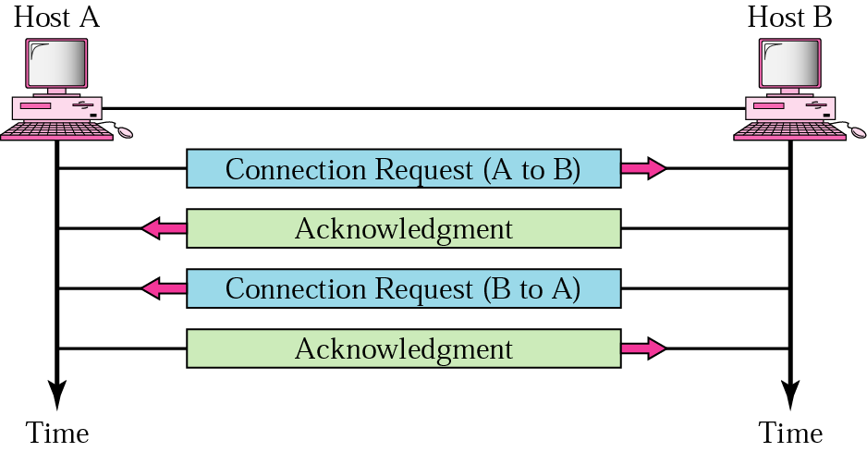
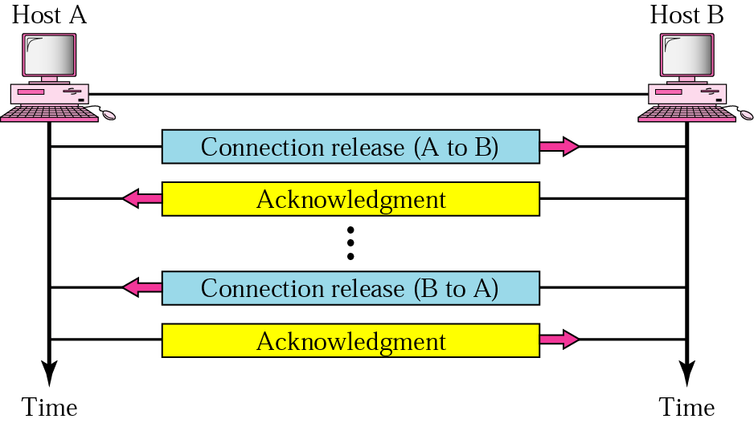
Connection establishment/termination
Connection-oriented service
Establishment: three way handshake
Connection termination
  asymmetric
Igor Radovanović, i.radovanovic@tue.nl
TU/e Computer Science, System Architecture and Networking

Slide 16
Connection-oriented over connectionless service
Analogy parcel delivery
  Post office gives no guarantee that 100 sent parcels will arrive in order
    Solution: agents placed at the destination post office
      Once all 100 parcels arrive, reorder them and deliver them to the recipient
Igor Radovanović, i.radovanovic@tue.nl
TU/e Computer Science, System Architecture and Networking

Slide 17
Position of Transport layer
Igor Radovanović, i.radovanovic@tue.nl
TU/e Computer Science, System Architecture and Networking

Slide 18
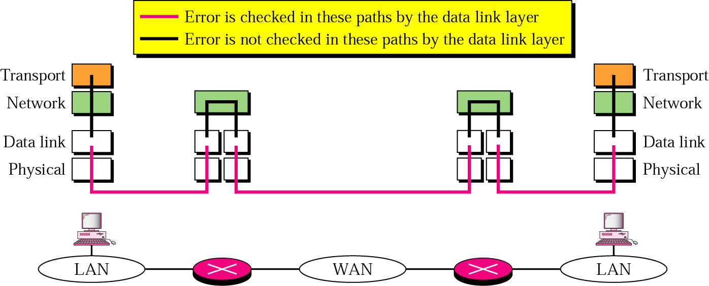
Reliable versus unreliable
Reliable service
  error control
  flow control
  congestion control
  TCP
Unreliable service
  UDP
Question: Do we need reliable transport service if the Data link transport is reliable?
Igor Radovanović, i.radovanovic@tue.nl
TU/e Computer Science, System Architecture and Networking

Slide 19
User Datagram Protocol
UDP – unreliable connectionless transport protocol
Why would anybody need this?
  small overhead
  suitable for short message transport
  does not require much sender-receiver interaction
  required for (de)multiplexing
Application:
  simple request-response communication with little concern about flow & error control
  in processes with internal flow & error control
    Trivial File Transport Protocol
  multicasting
  updating routing information (in RIP)
  in conjunction with Real Time Transport Protocol (RTP) for real-time data
Igor Radovanović, i.radovanovic@tue.nl
TU/e Computer Science, System Architecture and Networking

Slide 20
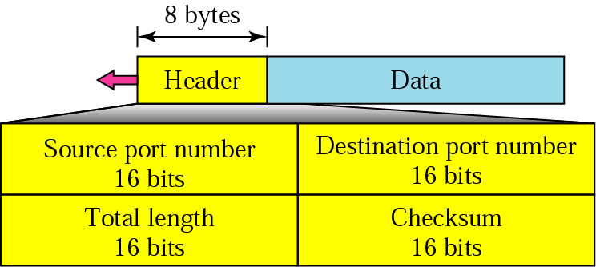
User datagram format
source port number – from 0 – 65535
destination port number – 0 – 65535
length – the total length of the user datagram (header + data)
checksum – detect errors over the entire datagram
    Checksum is the 16-bit one's complement of the one's complement sum of a pseudo header of information from the IP header, the UDP header, and the data, padded with zero octets at the end (if necessary) to make a multiple of two octets.
        optional (if not calculated filled with 0’s)
Igor Radovanović, i.radovanovic@tue.nl
TU/e Computer Science, System Architecture and Networking

Slide 21
UDP checksum calculation
IP pseudo header
  Source address
  Destination address
  Zeros
  Protocol
  UDP length
Igor Radovanović, i.radovanovic@tue.nl
TU/e Computer Science, System Architecture and Networking

Slide 22
UDP
A process (application program) sends a chunk of bytes to UDP for delivery
UDP adds its own header to this chunk of data (user datagram) and delivers it to IP
UDP treats each chunk independently
QUESTION: Are both UDP & IP unreliable to the same degree? Why?
Igor Radovanović, i.radovanovic@tue.nl
TU/e Computer Science, System Architecture and Networking

Slide 23
Transmission Control Protocol
Port numbers
Port | Protocol | Description
7 | Echo | Echoes a received datagram back to the sender
9 | Discard | Discards any datagram that is received
11 | Users | Active users
13 | Daytime | Returns the date and the time
17 | Quote | Returns a quote of the day
19 | Charger | Returns a string of characters
20 | FTP, Data | File Transfer Protocol (data connection)
21 | FTP, Control | File Transfer Protocol (control connection)
23 | TELNET | Terminal Network
25 | SMTP | Simple Mail Transfer Protocol
53 | DNS | Domain Name Server
67 | BOOTP | Bootstrap Protocol
79 | Finger | Finger
80 | HTTP | Hypertext Transfer Protocol
111 | RPC | Remote Procedure Call
Igor Radovanović, i.radovanovic@tue.nl
TU/e Computer Science, System Architecture and Networking

Slide 24
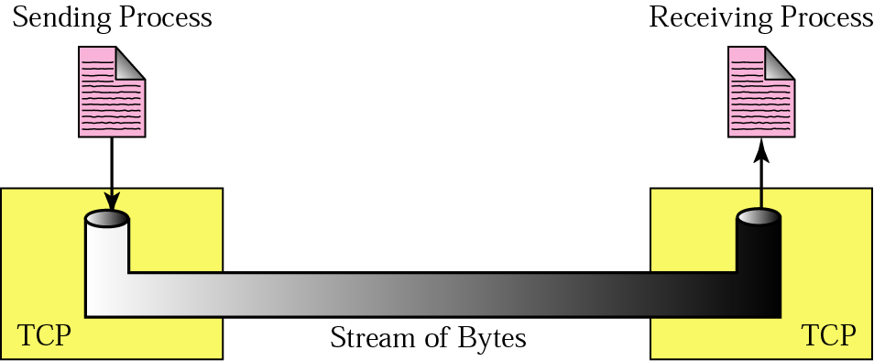
Transmission Control Protocol
Byte-stream connection-oriented & reliable transport protocol
Igor Radovanović, i.radovanovic@tue.nl
TU/e Computer Science, System Architecture and Networking

Slide 25
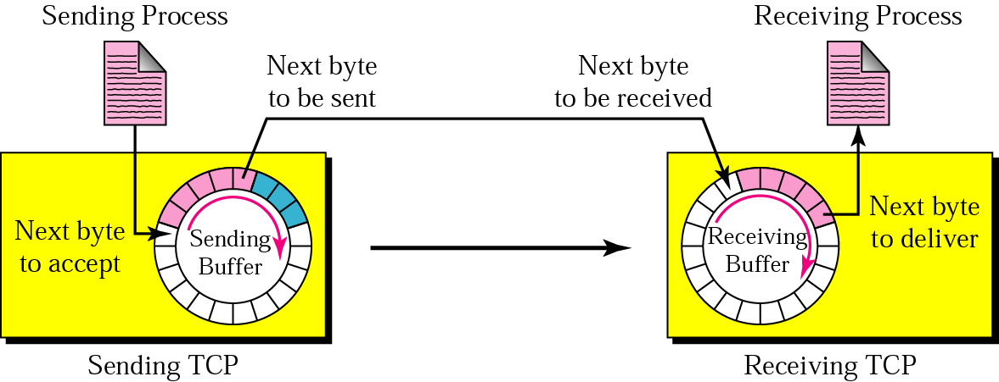
TCP - buffers
Sending & receiving buffers
  Processes do not consume data at the same speed
Sending site:
  White section: empty locations to be filled by sending process
  Blue section: bytes sent but not yet acknowledged
  Red section: bytes to be sent by sending TCP
Receiving site:
  White section: empty locations to be filled by bytes from the networks
  Red section: received bytes to be consumed by the receiving process
Igor Radovanović, i.radovanovic@tue.nl
TU/e Computer Science, System Architecture and Networking

Slide 26
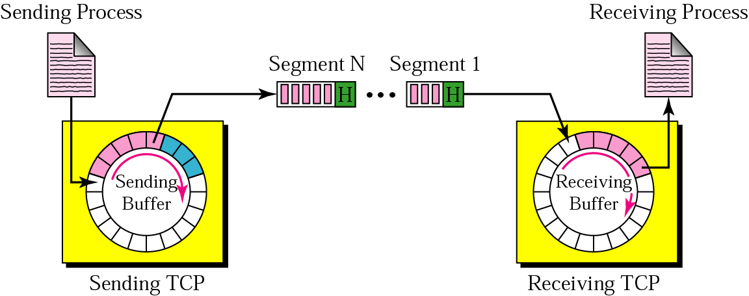
TCP – bytes & segments
TCP at the sending site gathers bytes into a packet called a segment
TCP adds a header to each segment and delivers it to IP for transmission
Segments can arrive out of order
Size of the segment varies
Igor Radovanović, i.radovanovic@tue.nl
TU/e Computer Science, System Architecture and Networking

Slide 27
TCP – numbering bytes
Numbering is used for flow & error control
Segments are not numbered, only bytes
Full-duplex connection – numbering is independent in each direction
Numbers generated randomly from 0 to 2³²-1
Sequence number
  The number of the first byte carried in the segment
Acknowledgement number
  To confirm received bytes
  Defines the number of the next byte the party expects to receive
  Cumulative
Igor Radovanović, i.radovanovic@tue.nl
TU/e Computer Science, System Architecture and Networking

Slide 28
TCP numbering – an example
Imagine a TCP connection is transferring a file of 6000 bytes.
The first byte is numbered 10010.
What are the sequence numbers for each segment if data are sent in five segments with the first four segments carrying 1000 bytes and the last segment carrying 2000 bytes?
The following shows the sequence number for each segment:
Segment 1 ==> sequence number: 10 010 (range: 10,010 to 11,009)
Segment 2 ==> sequence number: 11 010 (range: 11,010 to 12,009)
Segment 3 ==> sequence number: 12 010 (range: 12,010 to 13,009)
Segment 4 ==> sequence number: 13 010 (range: 13,010 to 14,009)
Segment 5 ==> sequence number: 14 010 (range: 14,010 to 16,009)
Igor Radovanović, i.radovanovic@tue.nl
TU/e Computer Science, System Architecture and Networking

Slide 29
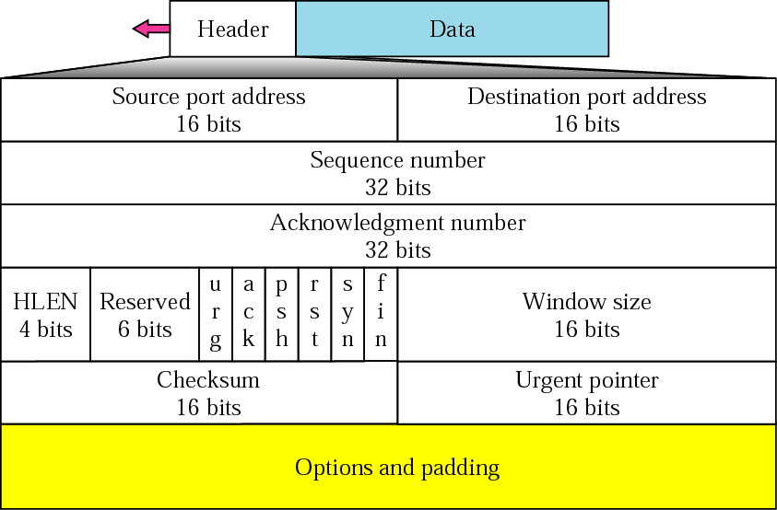
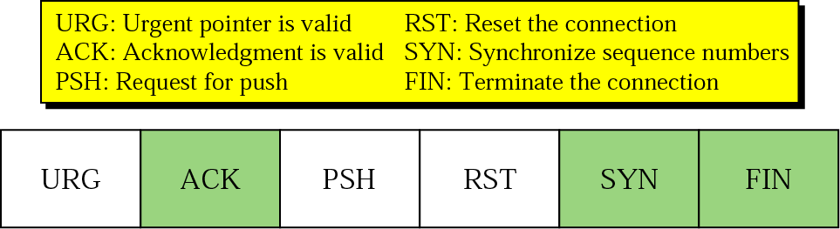
TCP segment format
Igor Radovanović, i.radovanovic@tue.nl
TU/e Computer Science, System Architecture and Networking

Slide 30
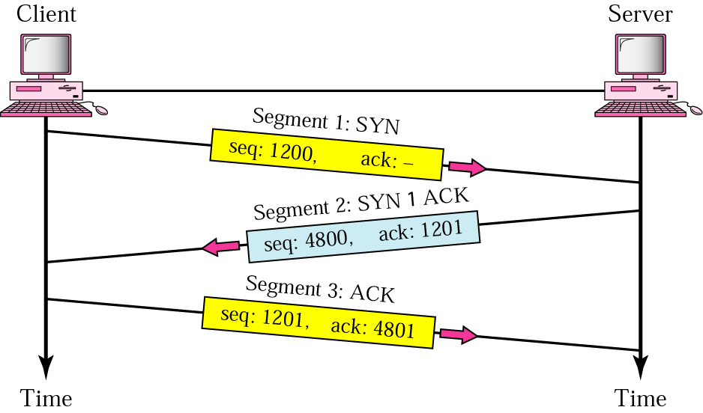
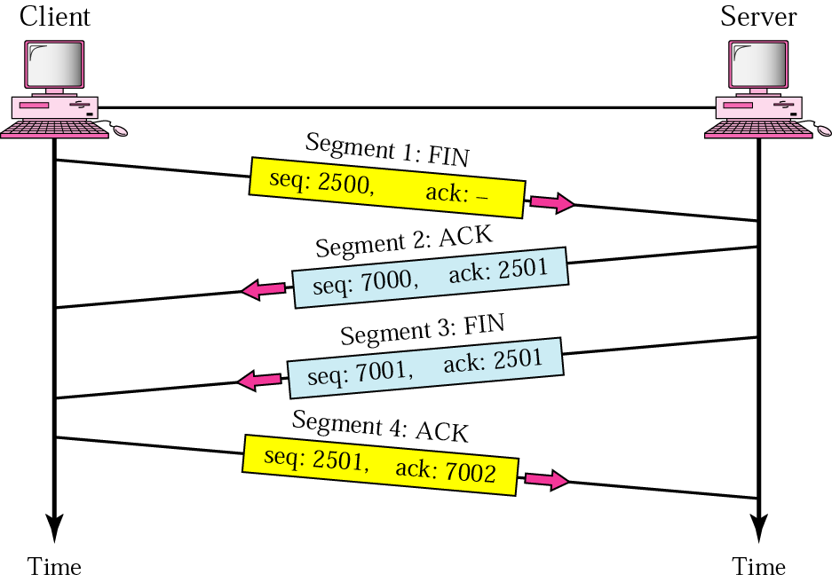
TCP - connections
Connection establishment
  Three-way handshake
Why is two-way handshake not enough?
Connection termination
  Four steps
Igor Radovanović, i.radovanovic@tue.nl
TU/e Computer Science, System Architecture and Networking

Slide 31
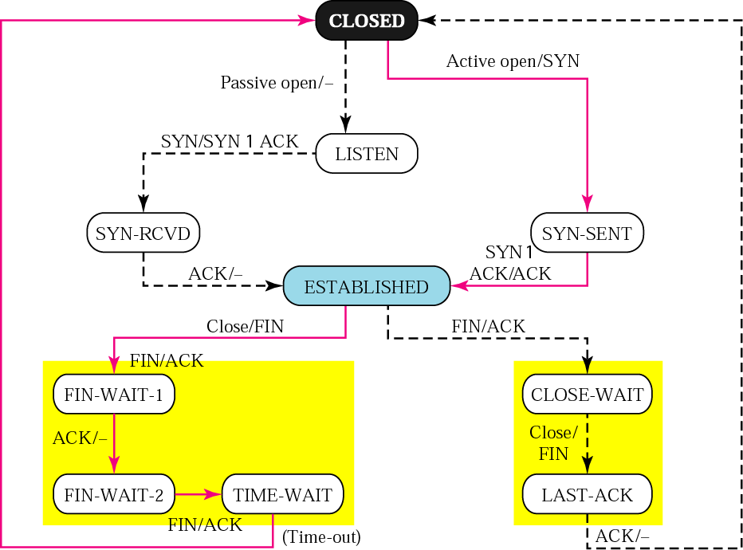
TCP – a state transition diagram
A finite state machine
A state transition diagram
input/output
Client Server
Igor Radovanović, i.radovanovic@tue.nl
TU/e Computer Science, System Architecture and Networking

Slide 32
Flow control
Remember?
The amount of data a source can send before receiving an ACK from the destination
Whether to send 1 byte of data and wait for ACK or send all bytes and wait for the ACK for the complete message?
TCP gives a solution in between
Sliding window protocol
  byte oriented
Igor Radovanović, i.radovanovic@tue.nl
TU/e Computer Science, System Architecture and Networking

Slide 33
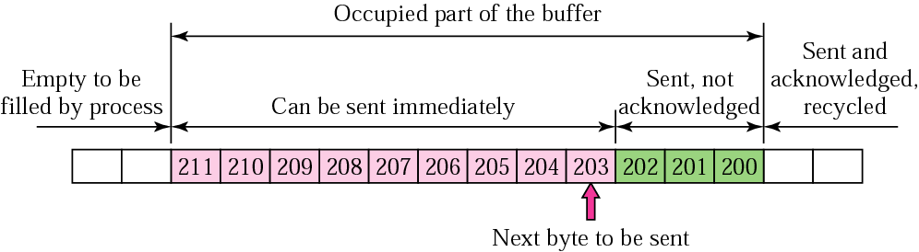
Flow control (cnt’d)
sender buffer
Direction of transmission
If no window, a sender can send all bytes without regarding the condition of the receiver
  if data are consumed too slowly then receiver buffer becomes full -> drop the packet (retransmit)
  the sender must adjust itself to the number of the free locations in the receiver buffer
Igor Radovanović, i.radovanovic@tue.nl
TU/e Computer Science, System Architecture and Networking

Slide 34
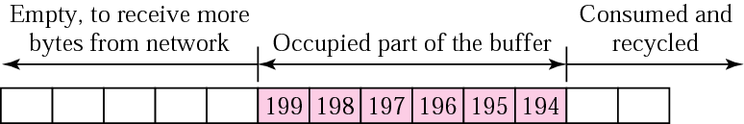
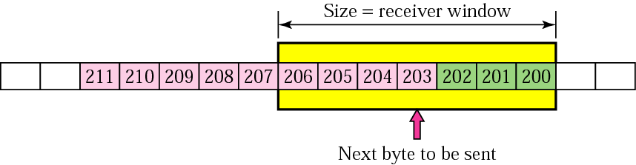
Flow control (cnt’d)
Receiver window
M
N
N-M = receiver window
Sender window
Igor Radovanović, i.radovanovic@tue.nl
TU/e Computer Science, System Architecture and Networking

Slide 35
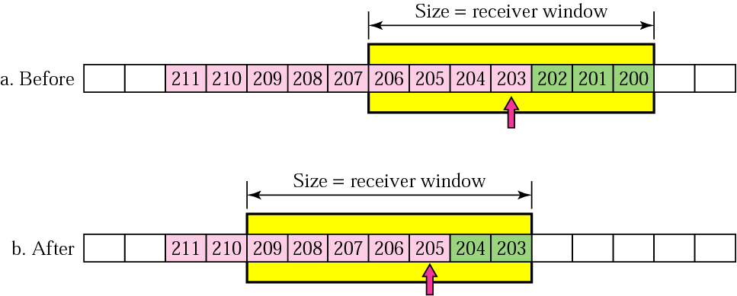
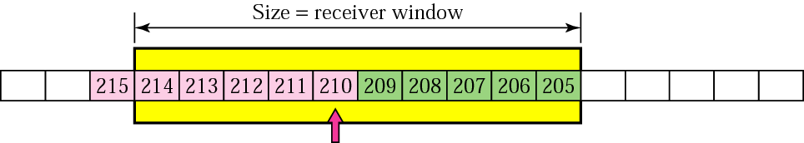
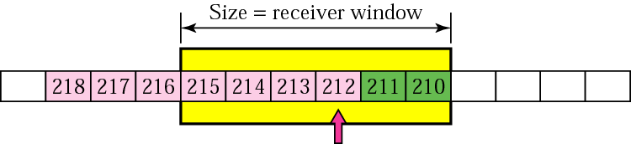
Flow control (cnt’d)
Direction of window shift
sliding widow
ACK is received for bytes 200-202
the sender can send bytes 205-209
Direction of transmission
expanding the sender widow
shrinking the sender widow
Igor Radovanović, i.radovanovic@tue.nl
TU/e Computer Science, System Architecture and Networking

Slide 36
Silly window syndrome
When either a sending application sends data slowly or a receiving application consumes data slowly
  Example: when 1 byte sent, 40 bytes overhead – not efficient
Syndrome created by the sender
  Nagle’s algorithm
    to prevent TCP from sending data byte by byte
      send the 1st byte
      wait for either the received ACK or the maximum-size segment full
      repeat step 2
Syndrome created by the receiver
  Clark’s solution
    send ACK as a data arrive, but advertise 0 size window
  Delayed ACK
Igor Radovanović, i.radovanovic@tue.nl
TU/e Computer Science, System Architecture and Networking

Slide 37
Strength of Nagle’s algorithm
simplicity
It considers the speed of the application program & speed of the network both.
If Application program is faster than the network
segments are larger
otherwise segments are smaller
Delayed acknowledgement
Reduces traffic
May force the sender to retransmit the unacknowledged segment
Igor Radovanović, i.radovanovic@tue.nl
TU/e Computer Science, System Architecture and Networking

Slide 38
TCP
Question:
  Is TCP using Selective Repeat ARQ or Go-back-N flow mechanism?
Igor Radovanović, i.radovanovic@tue.nl
TU/e Computer Science, System Architecture and Networking

Slide 39
Error control in TCP
Detect corrupted segments; lost segments; out-of-order segments & duplicated segments
Three tools:
  checksum
  acknowledgment
    no NACKs
  time-out
    one time-out counter for each segment sent
Igor Radovanović, i.radovanovic@tue.nl
TU/e Computer Science, System Architecture and Networking

Slide 40
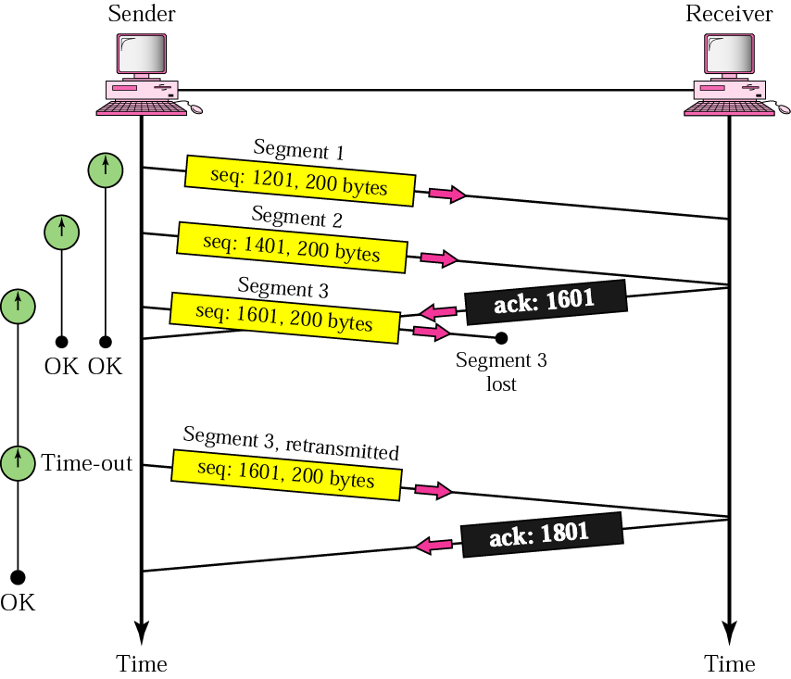
Error control in TCP
-lost or corrupted segment -
Igor Radovanović, i.radovanovic@tue.nl
TU/e Computer Science, System Architecture and Networking

Slide 41
Error control in TCP
-duplicate & out-of-order segment-
Duplicate segment
  the destination TCP simply discards the segment
Out-of-order segment
  not acknowledged until it receives all the segments that precede it
Igor Radovanović, i.radovanovic@tue.nl
TU/e Computer Science, System Architecture and Networking

Slide 42
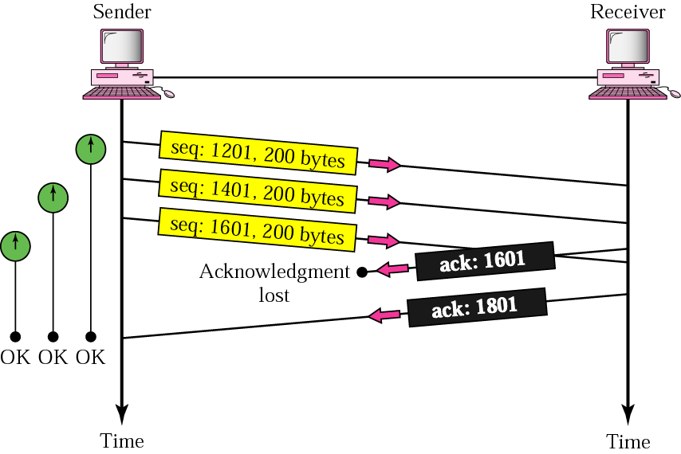
Error control in TCP
-lost ACK-
Igor Radovanović, i.radovanovic@tue.nl
TU/e Computer Science, System Architecture and Networking

Slide 43
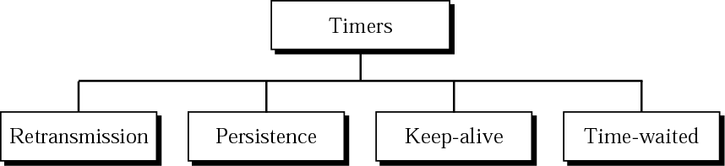
TCP timers
Igor Radovanović, i.radovanovic@tue.nl
TU/e Computer Science, System Architecture and Networking

Slide 44
Retransmission timer
if an ACK is received before the timer goes off – destroy the timer
if the timer goes off before ACK arrives – retransmit the segment & reset the timer
Retransmission time = 2* RTT
  not fixed since paths that IP packets take may differ
  if too short – retransmissions -> waste of bandwidth
  if too large – delay for the application program
RTT = α* previous RTT + (1- α)*current RTT, α usually 90 %
Karn’s algorithm:
  do not consider the RTT of a retransmitted segment in the calculation of the new RTT
Igor Radovanović, i.radovanovic@tue.nl
TU/e Computer Science, System Architecture and Networking

Slide 45
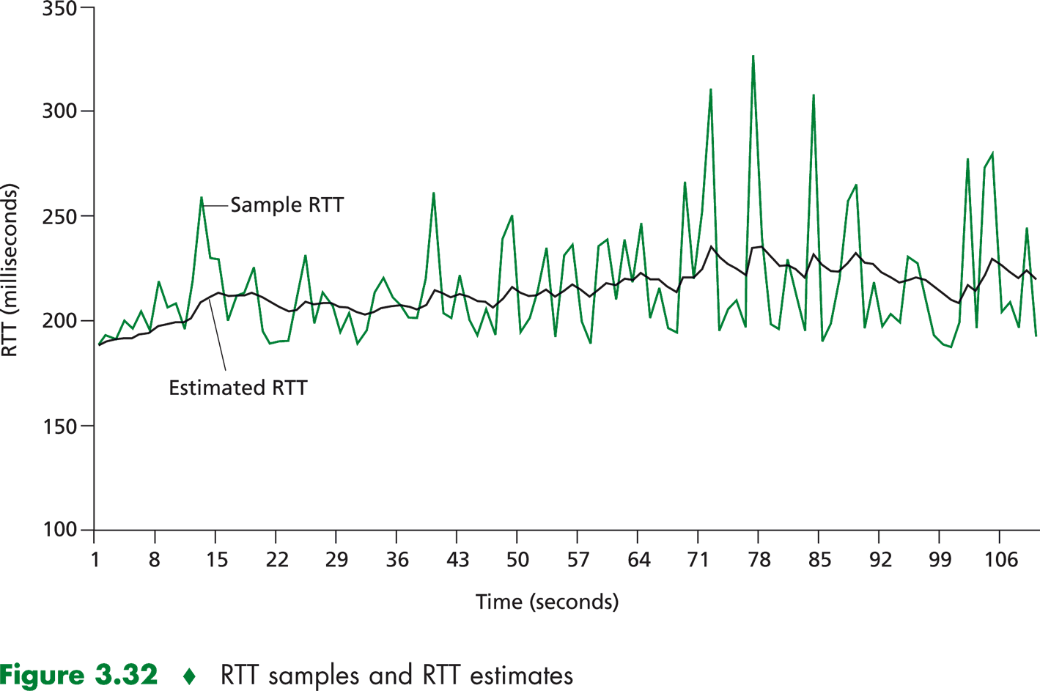
RTT samples and estimates
Copyright © 2005 Pearson Addison-Wesley. All rights reserved.
Igor Radovanović, i.radovanovic@tue.nl
TU/e Computer Science, System Architecture and Networking

Slide 46
Persistence timer
To deal with the zero-size windows
What if the receiver advertises that the window size is ≠ 0 (by sending ACK) and this ACK is lost?
  ACK are not acknowledged in TCP
Start persistence timer
  when this goes off send a probe (1 byte of data)
  it is set to the retransmission time & doubled every time a response is not received (until 60s, then sent every 60s)
Igor Radovanović, i.radovanovic@tue.nl
TU/e Computer Science, System Architecture and Networking

Slide 47
Keep alive timer
to prevent a long idle connection between a client and a server
  either client or server crash
usually set to 2h
Igor Radovanović, i.radovanovic@tue.nl
TU/e Computer Science, System Architecture and Networking

Slide 48
Time-Waited Timer
used during connection termination to allow duplicate FIN segments to be discarded at the destination
usually 2 times the expected lifetime of a segment
Igor Radovanović, i.radovanovic@tue.nl
TU/e Computer Science, System Architecture and Networking

Slide 49
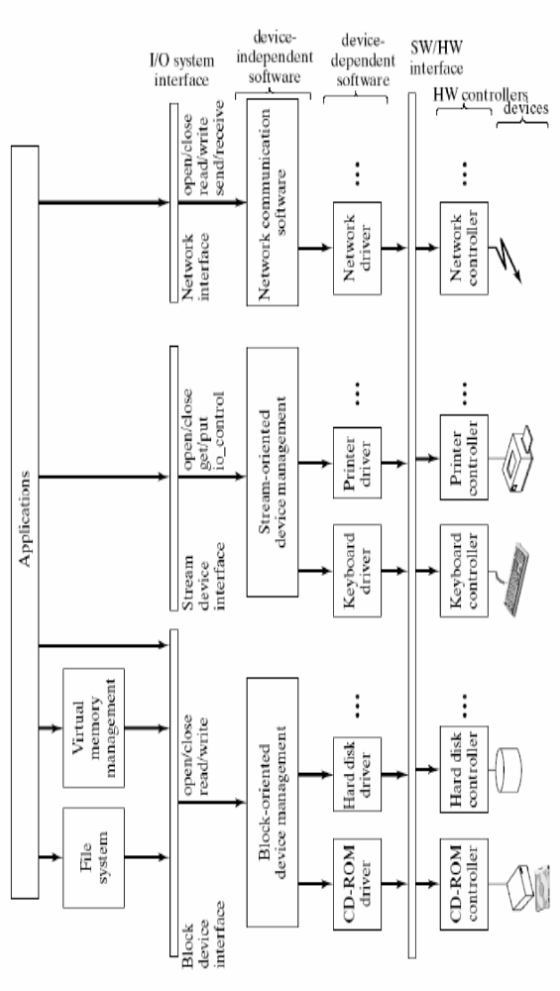
OS - layered view
Igor Radovanović, i.radovanovic@tue.nl
TU/e Computer Science, System Architecture and Networking

