Slide 1
Designing a counter
from
0 to 99 seconds.

Slide 2
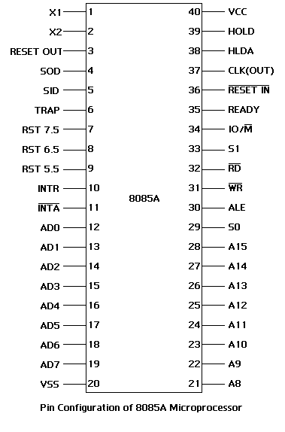
8085 Microprocessor chip
Signals of 8085 can be classified as:-
Address bus-A₁₅-A_{8,},
Data bus-AD₇-AD₀
Control and Status signal-
ALE RD
WR IO/M’
S₁ S₀
Power supply and frequency signal-
V_{SS} V_{CC}
X₁ X₂
CLK RESET IN’
RESET OUT
Externally initiated signal-
INTR INTA’
TRAP RST 7.5
RST 6.5 RST 5.5
HOLD HLDA
READY
Serial I/O ports-
SID SOD

Slide 3
Basic concept of how 8085 works
The three main operations are:-
Opcode Fetch
Memory Read
Memory Write

Slide 4
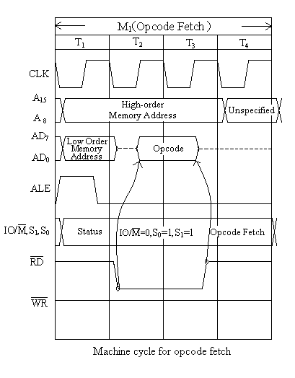
Opcode Fetch

Slide 5
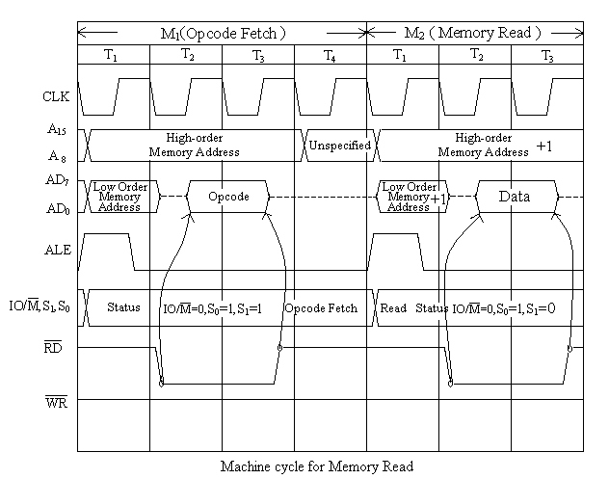
Memory Read

Slide 6
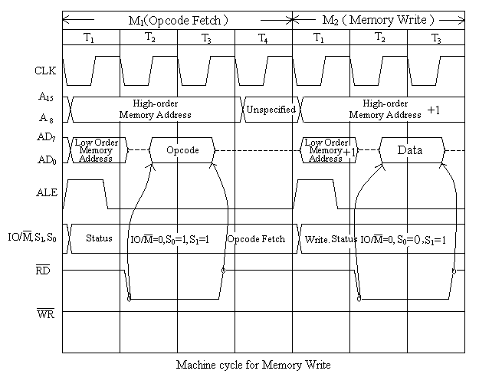
Memory Write

Slide 7
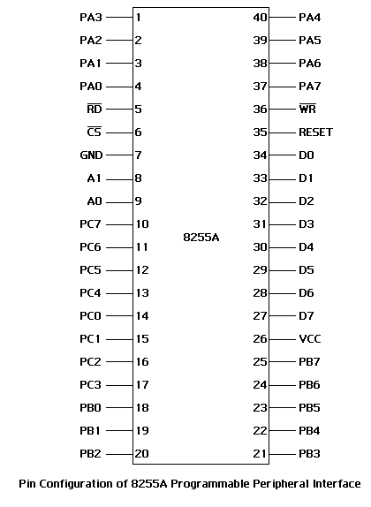
8255 Programmable Peripheral Interfacing Chip
Signals of 8255
Control signals-
RD’ WR’
  CS’ A₀ A₁
RESET
Data lines-
D₇-D₀
I/O Port Lines-
Port A - PA₇-PA₀
Port B - PB₇-PB₀
Port C - PC₇-PC₀
Power supply-
GND V_{cc}

Slide 8
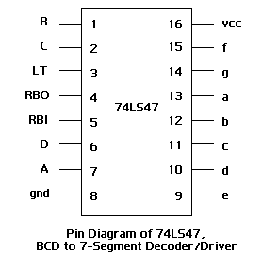
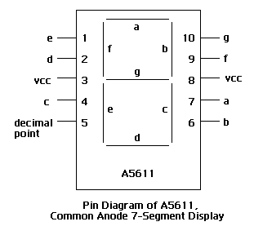
7-Segment Decoder/Driver and 7-Segment Display

Slide 9
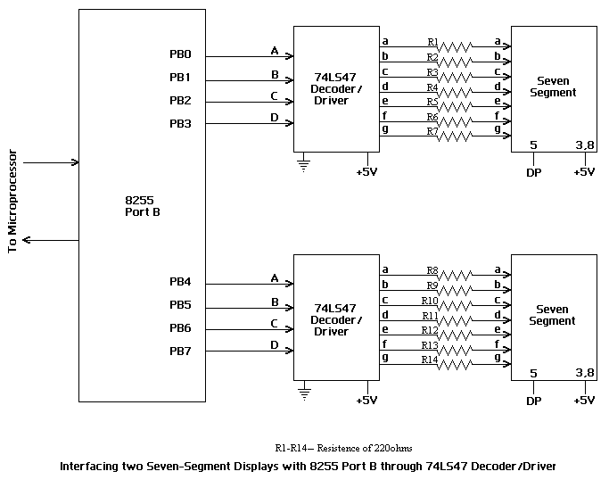
Interfacing the 8255 with the 7-Segment Decoder/Driver and the 7-segment Display

Slide 10










NUMERICAL REPRESENTATION ON THE SEVEN-SEGMENT DISPLAY

Slide 11
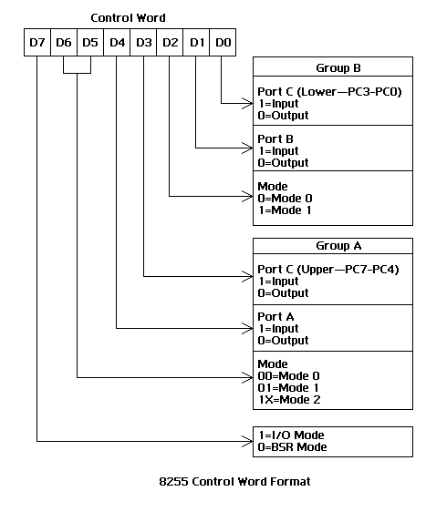
The control word of the 8255
How to design the control word?
Example:-
8255 in I/O Mode
Port A-Input
Port B-Output
Port C(Upper)-Output
Port C(Lower)-Input
Port A-Mode 1
Port B-Mode 0
So the control word is:-
D₇ D₆ D₅ D₄ D₃ D₂ D₁ D₀
1 0 1 1 0 0 0 1 = B1H
To write it in the control register:-
MVI A,B1H
OUT 13H
HLT

Slide 12
FLOWCHAT

Slide 13
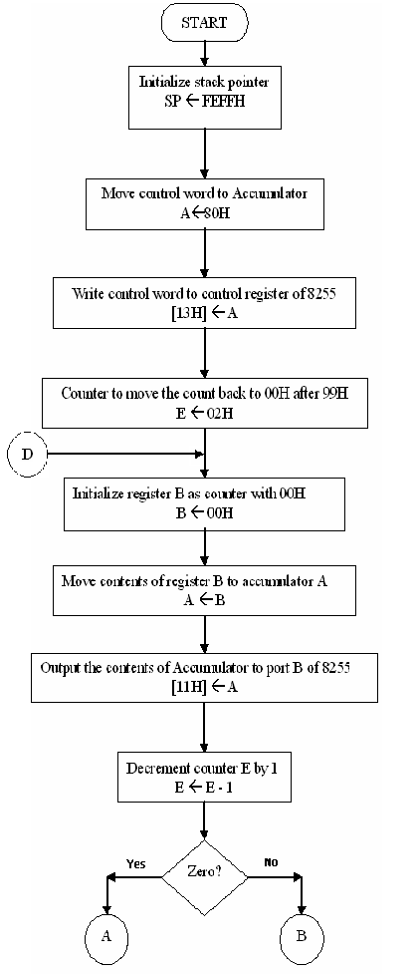

Slide 14
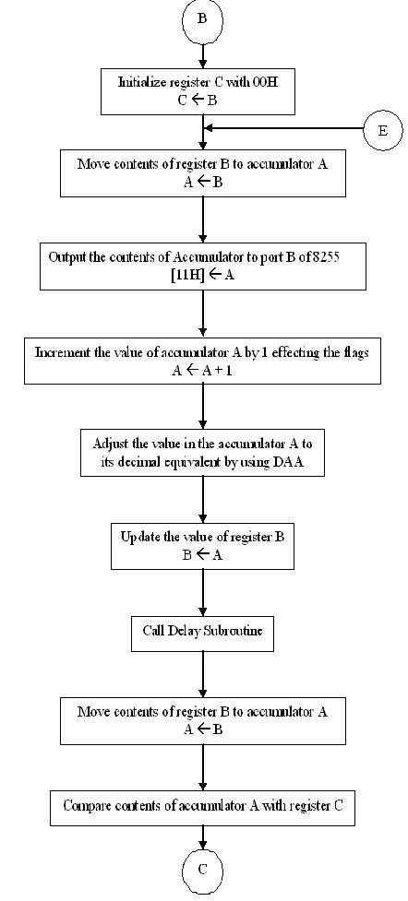

Slide 15
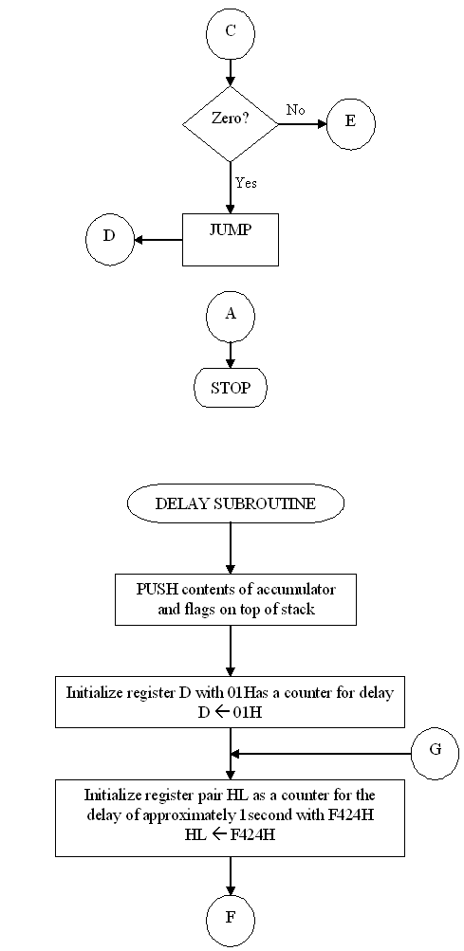

Slide 16
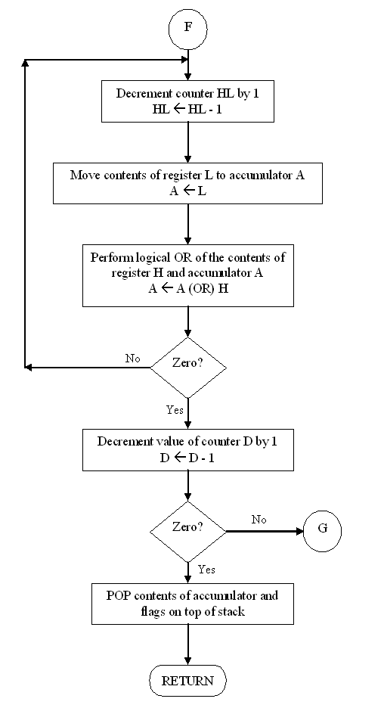

Slide 17
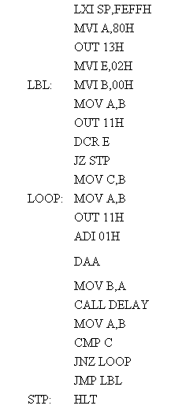
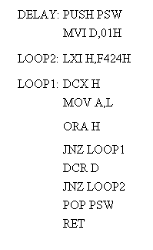
PROGRAM

Slide 18
One of the application of this counter
Controlling the Traffic Signal Lighting

Slide 19
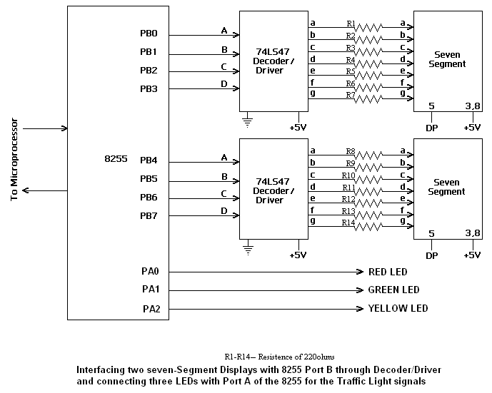
Interfacing the 8255 with the 7-Segment Decoder/Driver and the 7-segment Display along with the lights

Slide 20
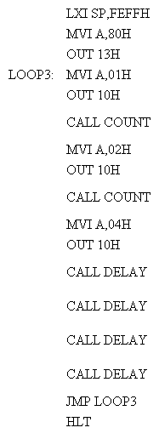
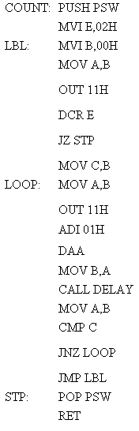
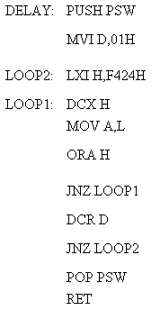
PROGAM FOR CONTROLLING THE TRAFFIC LIGHTS

Slide 21
Acknowledgement:-
Prof. Diptiman Raichoudhuri, Department of Electronic Science, University of Calcutta
Mr.Seera Nawaz, Department of Computer Science, Vidyasagar College
Prof. Paramita Sikdar, Head of the Department of Computer Science, Vidyasagar College
Prof. Raj Kumar Panda, Department of Computer Science, Vidyasagar College
Mr. Sourov Saha, Department of Computer Science, Vidyasagar College
Mrs.Nilima Das

Slide 22

Thank You

