Slide 1
Welcome
to the World of Secret Communication

Slide 2

yhpargotpyrC
es qbsuib qsbujn ebt
lqwhuud vbvwhpv lqgld syw owg

Slide 3
Transposition Cipher
Cryptography
es qbsuib qsbujn ebt
lqwhuud vbvwhpv lqgld syw owg

Slide 4

Transposition Cipher
Cryptography
es qbsuib qsbujn ebt
lqwhuud vbvwhpv lqgld syw owg
Jumbled Image

Slide 5
Transposition Cipher
Cryptography
Substitution Cipher (next letter)
dr partha pratim das
lqwhuud vbvwhpv lqgld syw owg
Jumbled Image

Slide 6
Transposition Cipher
Cryptography
Substitution Cipher (next letter)
dr partha pratim das
interra systems india pvt ltd
Caesar Cipher = 3
Jumbled Image

Slide 7
Cryptography
Dr Partha Pratim Das
Interra Systems India Pvt Ltd
Title Case Restored

Slide 8
Cryptography
Dr. Partha Pratim Das
Interra Systems (India) Pvt. Ltd.
November 15, 2006

Slide 9
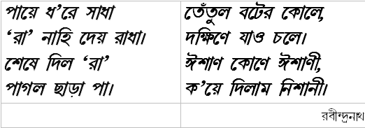
Vernacular Cryptography

Slide 10
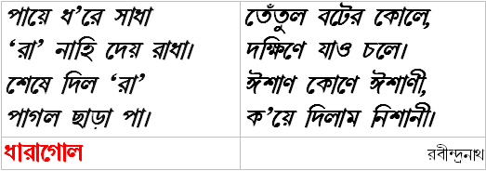
Vernacular Cryptography

Slide 11

The Adventure of the Dancing Men
AM HERE ABE SLANEY

Slide 12
The Adventure of the Dancing Men
A substitution cipher cracked by Holmes using frequency analysis
AM HERE ABE SLANEY

Slide 13
Agenda
Cryptography – What & Why?
Basic Cryptography
An Example Crypto Attack
  Illustrating the use of Frequency Analysis on a Caesar Cipher
History of Cryptography
Modern Cryptography
  Secret-Key (Symmetric) Cryptography
  Public-Key (Asymmetric) Cryptography
  Hash Function (One-way) Cryptography
Popular Crypto Systems

Slide 14
Cryptography – What & Why?
Basic Notion

Slide 15
What is Cryptography?
Cryptography
  The science of writing in secret code
Cryptology
  Study of Secrets
“Cryptography is about communication in the presence of adversaries”
  Ron Rivest

Slide 16
What is Cryptography?
Steganography
(hidden)
Code
(replace words)
Secret
Writing
Substitution
Cryptography
(scrambled)
Cipher
(replace letters)
Transposition
Notes:
NOTE:
Cryptography does not hide the existence of messages.
Steganography hides even the existence of a message.
Herodotus concealed a message - a tattoo on a slave's shaved head – by re-grown hair.

Slide 17
Why Cryptography?
Hiding the meaning of messages
Ensure secrecy in communications between
  Spies & Military leaders,
  Diplomats,
  Religious applications,
  P-Language (used by girls in schools)
  …
Ensure
  Identification,
  Authentication,
  Signature
  …

Slide 18
Basic Cryptography
Notions, Terms, Examples & Techniques

Slide 19
Cryptography – A Few Terms
Plaintext
  The initial unencrypted (unscrambled) data to be communicated.
  Example: “dr partha pratim das”
Ciphertext
  Plaintext is encrypted (scrambled) into something unintelligible – ciphertext for communication
  Example: “es qbsuib qsbujn ebt”
Encryption
  The process of converting ordinary information (plaintext) into ciphertext.
Decryption
  The reverse process of moving from unintelligible ciphertext to plaintext.
Notes:
The term is often used to refer to the field as a whole, as is cryptology ("the study of secrets"). The study of how to circumvent the confidentiality sought by using encryption is called cryptanalysis or, more loosely, "codebreaking." The field is a rich source of jargon, some of it humorous.
Until modern times, cryptography referred almost exclusively to encryption, the process of converting ordinary information (plaintext) into something unintelligible; this is a ciphertext. Decryption is the reverse, moving from unintelligible ciphertext to plaintext. A cipher (or cypher) is a pair of algorithms which perform this encryption and the reversing decryption. The detailed operation of a cipher is controlled both by the algorithm and, in each instance, by a key. This is a secret parameter (known only to the communicants) for the cipher algorithm. Keys are important as ciphers without variable keys are trivially breakable and so rather less than useful. Historically, ciphers were often used directly for encryption or decryption without additional procedures.
In colloquial use, the term "code" is often used to mean any method of encryption or concealment of meaning. However, within cryptography, code has a more specific meaning; it means the replacement of a unit of plaintext (i.e., a meaningful word or phrase) with a code word (for example, apple pie replaces attack at dawn). Codes are no longer used in serious cryptography—except incidentally for such things as unit designations (eg, 'Bronco Flight')—since properly chosen ciphers are both more practical and more secure than even the best codes, and better adapted to computers as well.
Some use the English terms cryptography and cryptology interchangeably, while others use cryptography to refer to the use and practice of cryptographic techniques, and cryptology to refer to the subject as a field of study. In this respect, English usage is more tolerant of overlapping meanings than are several European languages.

Slide 20
Cryptography – A Few Terms
Cipher
  Pair of algorithms performing encryption & decryption.
Key
  A secret parameter for the cipher algorithm.
Key Management
  Management of generation, exchange, storage, safeguarding, use, vetting, and replacement of keys.
  Provisions in
    Cryptosystem design,
    Cryptographic protocols in that design,
    User procedures, and so on.
Crypto Analysis / Code Breaking
  The study of how to circumvent the confidentiality sought by using encryption.
Notes:
The term is often used to refer to the field as a whole, as is cryptology ("the study of secrets"). The study of how to circumvent the confidentiality sought by using encryption is called cryptanalysis or, more loosely, "codebreaking." The field is a rich source of jargon, some of it humorous.
Until modern times, cryptography referred almost exclusively to encryption, the process of converting ordinary information (plaintext) into something unintelligible; this is a ciphertext. Decryption is the reverse, moving from unintelligible ciphertext to plaintext. A cipher (or cypher) is a pair of algorithms which perform this encryption and the reversing decryption. The detailed operation of a cipher is controlled both by the algorithm and, in each instance, by a key. This is a secret parameter (known only to the communicants) for the cipher algorithm. Keys are important as ciphers without variable keys are trivially breakable and so rather less than useful. Historically, ciphers were often used directly for encryption or decryption without additional procedures.
In colloquial use, the term "code" is often used to mean any method of encryption or concealment of meaning. However, within cryptography, code has a more specific meaning; it means the replacement of a unit of plaintext (i.e., a meaningful word or phrase) with a code word (for example, apple pie replaces attack at dawn). Codes are no longer used in serious cryptography—except incidentally for such things as unit designations (eg, 'Bronco Flight')—since properly chosen ciphers are both more practical and more secure than even the best codes, and better adapted to computers as well.
Some use the English terms cryptography and cryptology interchangeably, while others use cryptography to refer to the use and practice of cryptographic techniques, and cryptology to refer to the subject as a field of study. In this respect, English usage is more tolerant of overlapping meanings than are several European languages.

Slide 21
Crypto Communicators
Crypto literature frequently illustrates secret communication scenarios in terms of some fictitious characters:
  Alice and Bob
    The common communicating parties.
  Carol and Dave
    If there is a third or fourth party to the communication
  Mallory
    The malicious party
  Eve
    An eavesdropper
  Trent
    A trusted third party.
Notes:
In many of the descriptions below, two communicating parties will be referred to as Alice and Bob; this is the common nomenclature in the crypto field and literature to make it easier to identify the communicating parties. If there is a third or fourth party to the communication, they will be referred to as Carol and Dave. Mallory is a malicious party, Eve is an eavesdropper, and Trent is a trusted third party.

Slide 22
Simple (Cipher) Cryptography
Transposition Ciphers
  Rearrange the order of letters in a message
  'help me' becomes 'ehpl em'
Substitution Ciphers
  Systematically replace letters or groups of letters with other letters or groups of letters
  'fly at once' becomes 'gmz bu podf' by replacing each letter with the one following it in the alphabet.
Caesar Cipher
  Each letter in the plaintext was replaced by a letter some fixed number of positions further down the alphabet.
  Named after Julius Caesar who is reported to have used it, with a shift of 3, to communicate with his generals during his military campaigns.
Notes:
The earliest forms of secret writing required little more than pen and paper. The main classical cipher types are transposition ciphers, which rearrange the order of letters in a message (e.g. 'help me' becomes 'ehpl em' in a trivially simple rearrangement scheme); and substitution ciphers, which systematically replace letters or groups of letters with other letters or groups of letters (e.g., 'fly at once' becomes 'gmz bu podf' by replacing each letter with the one following it in the alphabet). Simple versions of either offered little confidentiality, and still don't. An early substitution cipher was the Caesar cipher, in which each letter in the plaintext was replaced by a letter some fixed number of positions further down the alphabet. It was named after Julius Caesar who is reported to have used it, with a shift of 3, to communicate with his generals during his military campaigns.

Slide 23
An Example of Crypto Attack
Illustrating the use of Frequency Analysis on a Caesar Cipher

Slide 24
A Simple Crypto Analysis
Ciphertext
  jshwduynts nx ymj ywfsxktwrfynts tk ifyf nsyt f ktwr ymfy nx fx hqtxj yt nrutxxngqj fx utxxngqj yt wjfi bnymtzy ymj fuuwtuwnfyj pstbqjilj nyx uzwutxj nx yt jsxzwj uwnafhd gd pjjunsl nsktwrfynts mniijs kwtr fsdtsj ktw bmtr ny nx sty nsyjsiji jajs ymtxj bmt mfaj fhhjxx yt ymj jshwduyji ifyf ijhwduynts nx ymj wjajwxj tk jshwduynts ny nx ymj ywfsxktwrfynts tk jshwduyji ifyf gfhp nsyt fs nsyjqqnlngqj ktwr

Slide 25
Strategy for Crypto Attack
Assumptions / Prior Knowledge
  It is known that the text is simple English.
  It is believed that the sender uses a Cipher – possibly a simple Caesar Cipher.
  Blanks are preserved in the text.
  Case is ignored in the text.
We decide to try “Frequency Analysis”
  Found by Arabs around 1000 AD.

Slide 26
Crypto Attack by Frequency Analysis
Frequency analysis
  In any given stretch of written language, certain letters and combinations of letters occur with varying frequencies.
  There is a characteristic distribution of letters that is roughly the same for almost all samples of that language.
  For instance,
    E tends to be very common,
    X is very rare.
    ST, NG, TH, and QU are common pairs of letters
    NZ and QJ are rare.
  The phrase "ETAOIN SHRDLU" encodes the 12 most frequent letters in typical English language text.

Slide 27
Relative Frequencies of Letters in General English Plain text
Letter | Frequency | Letter | Frequency
a | 0.0817 | n | 0.0675
b | 0.0149 | o | 0.0751
c | 0.0278 | p | 0.0193
d | 0.0425 | q | 0.0010
e | 0.1270 | r | 0.0599
f | 0.0223 | s | 0.0633
g | 0.0202 | t | 0.0906
h | 0.0609 | u | 0.0276
i | 0.0697 | v | 0.0098
j | 0.0015 | w | 0.0236
k | 0.0077 | x | 0.0015
l | 0.0403 | y | 0.0197
m | 0.0241 | z | 0.0007
e t a o i n s r h l d c u m f p g w y b v k x j q z

Slide 28
A Simple Crypto Analysis
Frequency Analysis
  Check Relative Frequency of Letters (Monogram)
  Check Relative Frequency of Diagram
    th he an in er on re ed nd ha at en es of nt ea ti to io le is ou ar as de rt ve
  Check Relative Frequency of Trigram
    the and tha ent ion tio for nde has nce tis oft men
  Identify Vowels / Common Consonants like ‘t’.
  Guess Blank (one in a six letters in English is a blank)
  Identify Probable Starting Letters
    t a i s o c m f p w
  Identify Probable End Letters
    e s d t n y r o l f
Identify Common Words

Slide 29
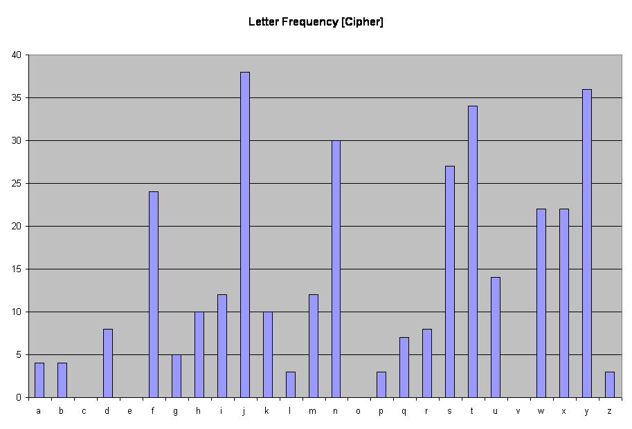
A Simple Crypto Analysis
Notes:
The frequency distribution of the cipher ext. Note the skewed pattern of the distribution that resembles the Natural Language distribution pattern.

Slide 30
A Simple Crypto Analysis
E
Notes:
We guess that the most occurring letter (‘j’ in cipher text) must of ‘e’. Therefore ‘e’ → ‘j’.

Slide 31
A Simple Crypto Analysis
E
T
Notes:
‘t’ → ‘y’. We have the clue that we have a Caesar Cipher for 5 displacement.

Slide 32
A Simple Crypto Analysis
E
O
T
Notes:
This makes a guess of ‘a’ → ‘t’. This breaks the Caesar Cipher. So we try the next option and guess ‘o’ → ‘t’. The rule of 5 reigns.

Slide 33
A Simple Crypto Analysis
E
O
T
A

Slide 34
Replace: j → E; y → T; t → O; f → A;
Partially Recovered Plaintext
  EshwduTnOs nx TmE TwAsxkOwrATnOs Ok iATA nsTO A kOwr TmAT nx Ax hqOxE TO nruOxxngqE Ax uOxxngqE TO wEAi bnTmOzT TmE AuuwOuwnATE psObqEilE nTx uzwuOxE nx TO EsxzwE uwnaAhd gd pEEunsl nskOwrATnOs mniiEs kwOr AsdOsE kOw bmOr nT nx sOT nsTEsiEi EaEs TmOxE bmO mAaE AhhExx TO TmE EshwduTEi iATA iEhwduTnOs nx TmE wEaEwxE Ok EshwduTnOs nT nx TmE TwAsxkOwrATnOs Ok EshwduTEi iATA gAhp nsTO As nsTEqqnlngqE kOwr

Slide 35
Identify: m → H; n → I; x → S;
Partially Recovered Plaintext
  EshwduTnOs nx TmE TwAsxkOwrATnOs Ok iATA nsTO A kOwr TmAT nx Ax hqOxE TO nruOxxngqE Ax uOxxngqE TO wEAi bnTmOzT TmE AuuwOuwnATE psObqEilE nTx uzwuOxE nx TO EsxzwE uwnaAhd gd pEEunsl nskOwrATnOs mniiEs kwOr AsdOsE kOw bmOr nT nx sOT nsTEsiEi EaEs TmOxE bmO mAaE AhhExx TO TmE EshwduTEi iATA iEhwduTnOs nx TmE wEaEwxE Ok EshwduTnOs nT nx TmE TwAsxkOwrATnOs Ok EshwduTEi iATA gAhp nsTO As nsTEqqnlngqE kOwr

Slide 36
Replace: m → H; n → I; x → S;
Partially Recovered Plaintext
  EshwduTIOs IS THE TwAsSkOwrATIOs Ok iATA IsTO A kOwr THAT IS AS hqOSE TO IruOSSIgqE AS uOSSIgqE TO wEAi bITHOzT THE AuuwOuwIATE psObqEilE ITS uzwuOSE IS TO EsSzwE uwIaAhd gd pEEuIsl IskOwrATIOs HIiiEs kwOr AsdOsE kOw bHOr IT IS sOT IsTEsiEi EaEs THOSE bHO HAaE AhhESS TO THE EshwduTEi iATA iEhwduTIOs IS THE wEaEwSE Ok EshwduTIOs IT IS THE TwAsSkOwrATIOs Ok EshwduTEi iATA gAhp IsTO As IsTEqqIlIgqE kOwr

Slide 37
Identify: s → N; i → D; b → W; a → V;
Partially Recovered Plaintext
  EshwduTIOs IS THE TwAsSkOwrATIOs Ok iATA IsTO A kOwr THAT IS AS hqOSE TO IruOSSIgqE AS uOSSIgqE TO wEAi bITHOzT THE AuuwOuwIATE psObqEilE ITS uzwuOSE IS TO EsSzwE uwIaAhd gd pEEuIsl IskOwrATIOs HIiiEs kwOr AsdOsE kOw bHOr IT IS sOT IsTEsiEi EaEs THOSE bHO HAaE AhhESS TO THE EshwduTEi iATA iEhwduTIOs IS THE wEaEwSE Ok EshwduTIOs IT IS THE TwAsSkOwrATIOs Ok EshwduTEi iATA gAhp IsTO As IsTEqqIlIgqE kOwr

Slide 38
Replace: s → N; i → D; b → W; a → V;
Partially Recovered Plaintext
  ENhwduTION IS THE TwANSkOwrATION Ok DATA INTO A kOwr THAT IS AS hqOSE TO IruOSSIgqE AS uOSSIgqE TO wEAD WITHOzT THE AuuwOuwIATE pNOWqEDlE ITS uzwuOSE IS TO ENSzwE uwIVAhd gd pEEuINl INkOwrATION HIDDEN kwOr ANdONE kOw WHOr IT IS NOT INTENDED EVEN THOSE WHO HAVE AhhESS TO THE ENhwduTED DATA DEhwduTION IS THE wEVEwSE Ok ENhwduTION IT IS THE TwANSkOwrATION Ok ENhwduTED DATA gAhp INTO AN INTEqqIlIgqE kOwr

Slide 39
Identify: h → C; q → L; w → R; k → F;
Partially Recovered Plaintext
  ENhwduTION IS THE TwANSkOwrATION Ok DATA INTO A kOwr THAT IS AS hqOSE TO IruOSSIgqE AS uOSSIgqE TO wEAD WITHOzT THE AuuwOuwIATE pNOWqEDlE ITS uzwuOSE IS TO ENSzwE uwIVAhd gd pEEuINl INkOwrATION HIDDEN kwOr ANdONE kOw WHOr IT IS NOT INTENDED EVEN THOSE WHO HAVE AhhESS TO THE ENhwduTED DATA DEhwduTION IS THE wEVEwSE Ok ENhwduTION IT IS THE TwANSkOwrATION Ok ENhwduTED DATA gAhp INTO AN INTEqqIlIgqE kOwr

Slide 40
Replace: h → C; q → L; w → R; k → F;
Partially Recovered Plaintext
  ENCRduTION IS THE TRANSFORrATION OF DATA INTO A FORr THAT IS AS CLOSE TO IruOSSIgLE AS uOSSIgLE TO READ WITHOzT THE AuuROuRIATE pNOWLEDlE ITS uzRuOSE IS TO ENSzRE uRIVACd gd pEEuINl INFORrATION HIDDEN FROr ANdONE FOR WHOr IT IS NOT INTENDED EVEN THOSE WHO HAVE ACCESS TO THE ENCRduTED DATA DECRduTION IS THE REVERSE OF ENCRduTION IT IS THE TRANSFORrATION OF ENCRduTED DATA gACp INTO AN INTELLIlIgLE FORr

Slide 41
Identify: r → M; d → Y; u → P; g → B;
Partially Recovered Plaintext
  ENCRduTION IS THE TRANSFORrATION OF DATA INTO A FORr THAT IS AS CLOSE TO IruOSSIgLE AS uOSSIgLE TO READ WITHOzT THE AuuROuRIATE pNOWLEDlE ITS uzRuOSE IS TO ENSzRE uRIVACd gd pEEuINl INFORrATION HIDDEN FROr ANdONE FOR WHOr IT IS NOT INTENDED EVEN THOSE WHO HAVE ACCESS TO THE ENCRduTED DATA DECRduTION IS THE REVERSE OF ENCRduTION IT IS THE TRANSFORrATION OF ENCRduTED DATA gACp INTO AN INTELLIlIgLE FORr

Slide 42
Replace: r → M; d → Y; u → P; g → B;
Partially Recovered Plaintext
  ENCRYPTION IS THE TRANSFORMATION OF DATA INTO A FORM THAT IS AS CLOSE TO IMPOSSIBLE AS POSSIBLE TO READ WITHOzT THE APPROPRIATE pNOWLEDlE ITS PzRPOSE IS TO ENSzRE PRIVACY BY pEEPINl INFORMATION HIDDEN FROM ANYONE FOR WHOM IT IS NOT INTENDED EVEN THOSE WHO HAVE ACCESS TO THE ENCRYPTED DATA DECRYPTION IS THE REVERSE OF ENCRYPTION IT IS THE TRANSFORMATION OF ENCRYPTED DATA BACp INTO AN INTELLIlIBLE FORM

Slide 43
Identify: p → K; l → G; z → U;
Partially Recovered Plaintext
  ENCRYPTION IS THE TRANSFORMATION OF DATA INTO A FORM THAT IS AS CLOSE TO IMPOSSIBLE AS POSSIBLE TO READ WITHOzT THE APPROPRIATE pNOWLEDlE ITS PzRPOSE IS TO ENSzRE PRIVACY BY pEEPINl INFORMATION HIDDEN FROM ANYONE FOR WHOM IT IS NOT INTENDED EVEN THOSE WHO HAVE ACCESS TO THE ENCRYPTED DATA DECRYPTION IS THE REVERSE OF ENCRYPTION IT IS THE TRANSFORMATION OF ENCRYPTED DATA BACp INTO AN INTELLIlIBLE FORM

Slide 44
Replace: p → K; l → G; z → U;
Fully Recovered Plaintext
  ENCRYPTION IS THE TRANSFORMATION OF DATA INTO A FORM THAT IS AS CLOSE TO IMPOSSIBLE AS POSSIBLE TO READ WITHOUT THE APPROPRIATE KNOWLEDGE ITS PURPOSE IS TO ENSURE PRIVACY BY KEEPING INFORMATION HIDDEN FROM ANYONE FOR WHOM IT IS NOT INTENDED EVEN THOSE WHO HAVE ACCESS TO THE ENCRYPTED DATA DECRYPTION IS THE REVERSE OF ENCRYPTION IT IS THE TRANSFORMATION OF ENCRYPTED DATA BACK INTO AN INTELLIGIBLE FORM

Slide 45
A Simple Crypto Analysis
Coupled with the known facts we get:
  This is encrypted by Caesar Cipher = 5.
Recovered Plaintext
  Encryption is the transformation of data into a form that is as close to impossible as possible to read without the appropriate knowledge. Its purpose is to ensure privacy by keeping information hidden from anyone for whom it is not intended, even those who have access to the encrypted data. Decryption is the reverse of encryption; it is the transformation of encrypted data back into an intelligible form.

Slide 46
History of Cryptography
A Few Interesting Stories

Slide 47
Ancient Cryptography
Transposition Ciphers
Substitution Ciphers
Caesar Cipher
Christian New Testament Book of Revelation:
  666 (Number of the Beast) → Roman Emperor Nero
Hebrew ciphers
Kama Sutra
  Lovers to communicate without inconvenient discovery

Slide 48
Cryptography in Middle Ages
Polyalphabetic cipher
  Leon Battista Alberti (1467).
  Use different ciphers for various parts of a message
  Vulnerable to Frequency Analysis
Vigenère cipher
  Polyalphabetic encryption uses a key word.
  Made vulnerable to Frequency Analysis by Babbge (mid 1800).

Slide 49
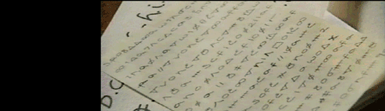
Babington Plot: The Tragedy of Mary Queen of Scott
Mock-up of letters between Mary Queen of Scotts & Anthony Babington in a conspiracy to assassinate Queen Elizabeth I.
The code was broken by frequency analysis in 1587.
Notes:
To prove the importance of secure ciphers, here is the tragic story of Mary Queen of Scots, who was foolish enough to use a weak cipher in the 16th century, long after codebreakers had mastered frequency analysis. To cut a long story short, Mary wanted to assassinate Queen Elizabeth I, and began exchanging messages with her co-conspirators, in particular Anthony Babington. This was dubbed the Babington Plot. Their messages were so treacherous that they were enciphered, so that they could not be read if they fell into the wrong hands.
Above you can see a mock-up of the letters that were sent between Mary Queen of Scots and Anthony Babington.

Slide 50
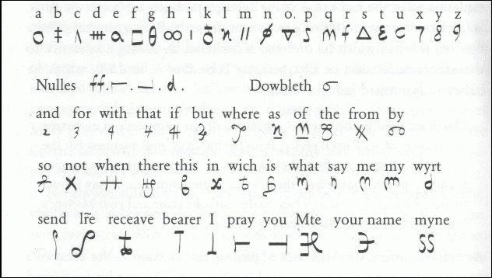
Babington Plot: The Tragedy of Mary Queen of Scott
Mary’s nomenclator – mixture of codes & ciphers.
Notes:
The nomenclator of Mary Queen of Scots, consisting of a cipher alphabet and codewords. Mary's messages were captured by Elizabeth's spies and they were cracked by her chief codebreaker. Mary was immediately arrested, put on trial and the deciphered messages were used as evidence of her treachery. She was found guilty and was executed in 1587 ... all because her cipher was cracked.

Slide 51
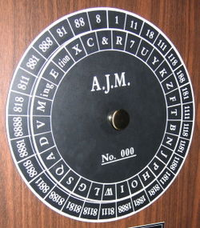
Cryptography Machines
Cipher disk
Developed
  In 15th century
  By Leon Battista Alberti

Slide 52
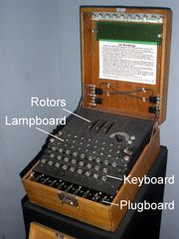
Cryptography Machines
Enigma Machine
Developed
  In 1923, Bern
  Used in World War II
Polyalphabetic Cipher

Slide 53
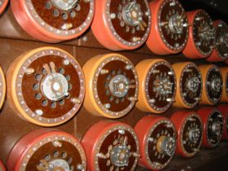
Cryptography Machines
Bombe Machine
Developed
  By Alan Turing and Gordon Welchman
Used by British to break German Codes from Enigma

Slide 54
Kerckhoff’s Principle (1883)
Secrecy of a cipher's Algorithm is not a sensible, nor practical, safeguard against attack
Secrecy of the Key should alone be sufficient for confidentiality when under attack
Stated by
  Auguste Kerckhoffs
Also, Shannon's Maxim
  'the enemy knows the system' – Claude Shannon

Slide 55
Modern Cryptography
Techniques, Standards and Applications

Slide 56
Issues in Modern Cryptography
Privacy/confidentiality:
  Ensuring that no one can read the message except the intended receiver.
Authentication:
  The process of proving one's identity.
Integrity:
  Assuring the receiver that the received message has not been altered in any way from the original.
Non-repudiation:
  A mechanism to prove that the sender really sent this message.

Slide 57
Modern Cryptography
Secure Communications
  Document / Data / Email Encryption
  VPN
Identification and Authentication
Secret Sharing
Electronic Commerce and Payments
  ATMs / Credit Cards
  Net Banking / Web Shopping
Certification
  Digital Signature (NOT Digitized Signature)
Key Recovery
Remote Access
  Secure ID
Notes:
Secret Sharing
Another application of cryptography, called secret sharing, allows the trust of a secret to be distributed among a group of people. For example, in a (k, n)-threshold scheme, information about a secret is distributed in such a way that any k out of the n people (k £ n) have enough information to determine the secret, but any set of k-1 people do not. In any secret sharing scheme, there are designated sets of people whose cumulative information suffices to determine the secret. In some implementations of secret sharing schemes, each participant receives the secret after it has been generated. In other implementations, the actual secret is never made visible to the participants, although the purpose for which they sought the secret (for example, access to a building or permission to execute a process) is allowed. See Question 2.1.9 for more information on secret sharing.

Slide 58

Modern Cryptography
Entertainment
  Cable TV: Set-top Box – Pay-per-view (Encryption)
  Satellite TV: Select Channel (Scrambling)
Mobile Communication
  Voice Encryption
Anti-Spamming
  CAPTCHA™ (from Carnegie Mellon University)
    Completely Automated Public Turing test to tell Computers and Humans Apart
Steganography
  Invisible ink,
  Microdots,
  Digital Watermarking

Slide 59
Modern Cryptography Techniques
Secret-Key (Symmetric) Cryptography
  Uses a single key for both encryption and decryption
Public-Key (Asymmetric) Cryptography
  Uses one key for encryption and another for decryption
Hash Function (One-way) Cryptography
  Uses a mathematical transformation to irreversibly "encrypt" information

Slide 60
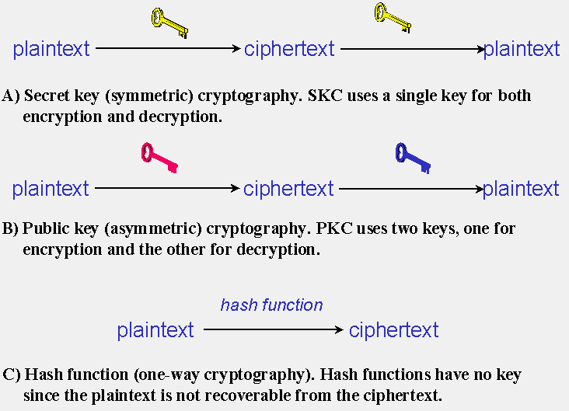
Cryptography in 21st Century

Slide 61
Secret-Key Cryptography
An Overview

Slide 62
Secret-Key Cryptography
Single key used for both encryption & decryption.
  Sender uses the key (or some set of rules) to encrypt the plaintext and sends the ciphertext to the receiver.
  Receiver applies the same key (or ruleset) to decrypt the message and recover the plaintext.
Also called symmetric encryption.
The key must be known to sender & receiver both.
Popular:
  Data Encryption Standard (DES)
Drawback
  Distribution of the key.
Advantage
  Very fast in encryption / decryption

Slide 63
Secret-Key Cryptography
Secret key cryptography schemes
  Stream Ciphers
    Encrypt the bits of the message one at a time
  Block Ciphers
    Take a number of bits and encrypt them as a single unit.
    Blocks of 64 bits have been commonly used;
    Advanced Encryption Standard (AES)
      128-bit blocks.
      Approved by NIST in December 2001.

Slide 64
Public-Key Cryptography
An Overview

Slide 65
Public-Key Cryptography
A crypto system for secure communication over a non-secure communications channel without having to share a secret key.
  Usually, a two-key system
    Public Key
    Private Key
One key (public / private) is used to encrypt while the other (public / private) is used to decrypt.
The most significant new development in cryptography in the last 300-400 years.

Slide 66
Public-Key Cryptography
Applications:
  Encryption
  Digital Signature
  Key Distribution for Symmetric Algorithm
Popular:
  RSA public-key cryptosystem
  Diffie-Hellman public-key cryptosystem
In modern cryptosystem designs, both asymmetric (public key) and symmetric algorithms are used to take advantage of the virtues of both.

Slide 67
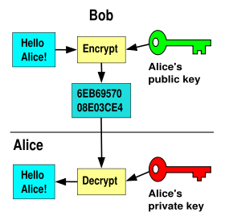
Key Generation: Public-Key
Notes:
A big random number is used to make a public-key pair.

Slide 68
Encryption: Public-Key
Notes:
Anyone can encrypt using the public key, but only the private key can decrypt. Secrecy depends on the security of the private key.

Slide 69
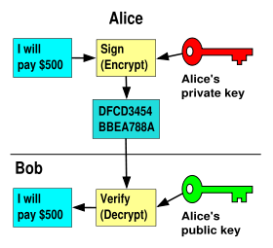
Signature: Public-Key
Notes:
Using a private key to encrypt (thus signing) a message; anyone can check the signature using the public key. Validity depends on private key security.

Slide 70
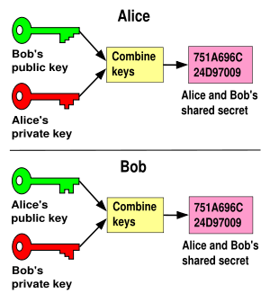
Shared Secret: Public-Key
Notes:
By combining your own private key with the other users public key you can calculate a shared secret that only the two of you know. The shared secret can be used as the key for a symmetric cipher.

Slide 71
Public-Key Cryptography
Based upon one-way trapdoor functions
  Mathematical functions that are easy to compute whereas their inverse function is relatively difficult to compute.
    Multiplication vs. factorization
    Exponentiation vs. logarithms
  Has a trap door in the one-way function so that the inverse calculation becomes easy given knowledge of some item of information.

Slide 72
PKC: Multiplication vs Factorization
It is easy to multiply two primes:
  3 * 5 =
  17 * 23 =
  101 * 223 =
It is difficult to factorize into two primes:
  35 =
  551 =
  24503 =
15
391
22523
5 * 7
19 * 29
107 * 229
Heart of RSA

Slide 73
PKC: Exponentiation vs Logarithm
It is easy to raise a prime to another:
  3 ^ 2 =
  5 ^ 3 =
  11 ^ 7 =
It is difficult to find base-exponent pair:
  8 =
  243 =
  1977326743 =
9
125
19487171
2 ^ 3
3 ^ 5
7 ^ 11
Heart of Diffie-Hellman

Slide 74
Inventors of Public-Key Cryptography
"New Directions in Cryptography"
  Whitfield Diffie & Martin Hellman, Stanford Univ.
  IEEE Trans. on Information Theory, November 1976.
  Logarithm based.
"A Method for Obtaining Digital Signatures and Public-Key Cryptosystems"
  Ronald Rivest, Adi Shamir, & Leonard Adleman, MIT.
  Communications of the ACM (CACM), February 1978.
  Factorization based.

Slide 75
Hash Function Cryptography
An Overview

Slide 76
Message Digest / Hash Function
Should be
  Like a random function in behavior
  Deterministic
  Efficiently computable.
A cryptographic hash function is considered insecure if either of the following is computationally feasible:
  finding a (previously unseen) message that matches a given digest. (IRREVERSIBLE)
  finding "collisions", wherein two different messages have the same message digest. (UNIQUE)

Slide 77
Message Digest / Hash Function
Applications:
  Message Identity
  Identical Files
  Password Authentication
Popular:
  MD5: Message Digest Algorithm
  SH-1: Secure Hash Algorithm

Slide 78
Popular Crypto Systems
Impact of Cryptography on Civilization

Slide 79
Popular Crypto Systems
Public-Key Infrastructure
Secure Sockets Layer (SSL) / Transport Layer Security (TLS)
  HTTPS
PGP
GPG

Slide 80
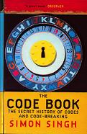
References: Books
“The Code Book: The Secret History of Codes and Code Breaking” by Simon Singh, 1998: http://www.simonsingh.net/The_Code_Book.html

Slide 81
References: Papers / URL
“An Overview of Cryptography” by Gary C. Kessler, May 1998 (Revised 1 August 2006): http://www.garykessler.net/library/crypto.html
“Cryptography” on Wikipedia: http://en.wikipedia.org/wiki/Cryptography
“Crypto FAQ” on RSA Security: http://www.rsasecurity.com/rsalabs/node.asp?id=2152

Slide 82
Credits / Acknowledgements
Prof Paramita Sikdar, Vidyasagar College
  For the kind invitation
Ms Madhubanti Dasgupta, Interra Systems
  For proposing the topic
  For P-Language Lessons
Ms Anindita Sarkar, Interra Systems
  For providing the text of “Dancing Men”

Slide 83
Thank You

