Slide 1

A Brief Study On Cryptography
Dipendu Ghosh
3rd year, Computer Science, Vidyasagar College, Kolkata

Slide 2
Introduction
What is Cryptography?
Why is Cryptography needed?

Slide 3
Some of the Simple Cipher Cryptography techniques
Transposition Ciphers
- Rearrange the order of letters in a message
Substitution Ciphers
- Systematically replace letters or groups of letters with other letters or groups of letters
Caesar Cipher
- Each letter in the plaintext was replaced by a letter some fixed number of positions further down the alphabet.

Slide 4
Some formats used in modern Cryptography
Secure Communications
-Document / Data / Email Encryption/VPN
Identification and Authentication
Electronic Commerce and Payments
-ATMs / Credit Cards/Net Banking / Web Shopping
Certification
-Digital Signature (not Digitized Signature)

Slide 5

Some formats used in modern Cryptography
Remote Access
-Secure ID
Entertainment
-Cable TV: Set-top Box – Pay-per-view (Encryption)
-Satellite TV: Select Channel (Scrambling)
Mobile Communication
-Voice Encryption
Steganography
-Invisible ink/Microdots/Digital Watermarking

Slide 6
The three types of cryptographic schemes
Secret Key Cryptography(Symmetric encryption)
Public-Key Cryptography(Asymmetric encryption)
Hash Functions (One-way encryption)

Slide 7
Some of the commonly used Codes in
Cryptography

Slide 8
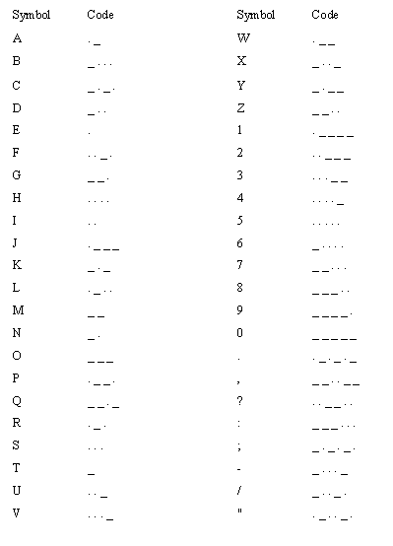
The International Morse Code Symbols

Slide 9
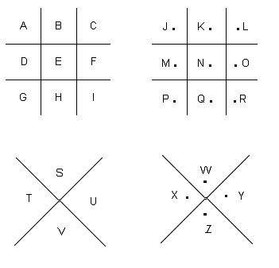

The Pigpen Cipher

Slide 10
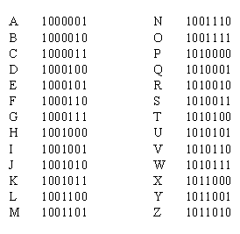

Encryption using the ASCII binary numbers

Slide 11
Cryptanalysing a Cipher-text using C++ Programing
SOURCE CODE:
main()
{
crypto ob1(2),ob2(1);
while(1)
{
cout<<"\t\t\tMENU"<<endl;
cout<<"\t\t1.To Encrypt a entered text"<<endl;
cout<<"\t\t2.To Decrypt a entered text"<<endl;
cout<<"\t\t3.Exit"<<endl;
cout<<"\tEnter choice - ";
cin>>c;
switch(c)
{

Slide 12
Cryptanalysing a Cipher-text using C++ Programing
//Encrypting the Decrypted message
case 1:
ob1.get_encrypt();/*The “get_encrypt()” function takes the original text as input for the object ‘ob1’ of the class ‘crypto’ to be encrypted*/
ob1.encrypt();/*The “encrypt()” function encrypts the original text entered using the “get_encrypt()” function.*/
ob1.display_encrypt();/*Displays the encrypted text of the original text entered using “get_encrypt()” function and encrypting it using “encrypt()” function.*/
break;

Slide 13
Cryptanalysing a Cipher-text using C++ Programing
//Decrypting the Encrypted message
case 2:
ob2.get_decrypt();/*The “get_decrypt()” function takes the encrypted text as input for the object ‘ob2’ of the class ‘crypto’ which is to be decrypted*/
ob2.decrypt();/*The “decrypt()” function decrypts the encrypted text entered using the “get_decrypt()” function.*/
ob2.display_decrypt();/*Displays the decrypted text of the encrypted text entered using “get_decrypt()” function and decrypting it using “decrypt()” function.*/
break;

Slide 14
Cryptanalysing a Cipher-text using C++ Programing
case 3:
exit(0);
default:
cout<<"Wrong Choice"<<endl;
break;
}
//For infinite loop termination
cout<<"Do you want to continue?(Enter Y or y to continue - ";
cin>>d;
if(d!='y' || d!='y')
break;
}
}

Slide 15
Cryptanalysing a Cipher-text using C++ Programing
AFTER EXECUTION:
MENU
1.To Encrypt a given text
2.To Decrypt a given text
3.Exit
Enter choice – 1
Enter Original Text –
Now during this time Shahrazad had borne king Shahriyar three sons. On the thousand and first night, when she had ended the tale of Ma’aruf, she rose and kissed the ground before him, saying: ‘Great King, for a thousand and one nights I have been recounting to you the fables of past ages and the legends of ancient kings. May I make so bold as to crave a favour of your majesty?’

Slide 16
Cryptanalysing a Cipher-text using C++ Programing
The Encrypted Text is -
PCQ VMJYPD LBYK LYSO KBXBJXWXV BXV ZCJPO EYPD KBXBJYUXJ LBJOO KCPK. CP LBO LBCMKXPV XPV IYJKL PYDBL, QBOP KBO BXV OPVOV LBO LXRO CI SX’XJMI, KBO JCKO XPV EYKKOV LBO DJCMPV ZOICJO BYS, KXUYPD: ‘DJOXL EYPD, ICJ X LBCMKXPV XPV CPO PYDBLK Y BXNO ZOOP JOACMPLYPD LC UCM LBO IXZROK CI FXKL XDOK XPV LBO RODOPVK CI XPAYOPL EYPDK. SXU Y SXEO KC ZCRV XK LC AJXNO X IXNCMJ CI UCMJ SXGOKLU?’
Do you want to continue?(Enter Y or y to continue) – y

Slide 17
Cryptanalysing a Cipher-text using C++ Programing
MENU
1.To Encrypt a given text
2.To Decrypt a given text
3.Exit
Enter choice – 2
Enter Ciphered Text -
pcq vmjypd lbyk lyso kbxbjxwxv bxv zcjpo eypd kbxbjyuxj lbjoo kcpk. cp lbo lbcmkxpv xpv iyjkl pydbl, qbop kbo bxv opvov lbo lxro ci sx’xjmi, kbo jcko xpv eykkov lbo djcmpv zoicjo bys, kxuypd: ‘djoxl eypd, icj x lbcmkxpv xpv cpo pydblk y bxno zoop joacmplypd lc ucm lbo ixzrok ci fxkl xdok xpv lbo rodopvk ci xpayopl eypdk. sxu y sxeo kc zcrv xk lc ajxno x ixncmj ci ucmj sxgoklu?’

Slide 18
Cryptanalysing a Cipher-text using C++ Programing
The Deciphered Text is –
NOW DURING THIS TIME SHAHRAZAD HAD BORNE KING SHAHRIYAR THREE SONS. ON THE THOUSAND AND FIRST NIGHT, WHEN SHE HAD ENDED THE TALE OF MA’ARUF, SHE ROSE AND KISSED THE GROUND BEFORE HIM, SAYING: ‘GREAT KING, FOR A THOUSAND AND ONE NIGHTS I HAVE BEEN RECOUNTING TO YOU THE FABLES OF PAST AGES AND THE LEGENDS OF ANCIENT KINGS. MAY I MAKE SO BOLD AS TO CRAVE A FAVOUR OF YOUR MAJESTY?’
Do you want to continue?(Enter Y or y to continue) – y

Slide 19
Cryptanalysing a Cipher-text using C++ Programing
MENU
1.To Encrypt a given text
2.To Decrypt a given text
3.Exit
Enter choice – 3
Exiting Program-

Slide 20
Some of the
Machines used in cryptography

Slide 21
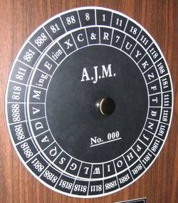
A cipher Disk. Developed in 15th century by Leon Battista Alberti

Slide 22
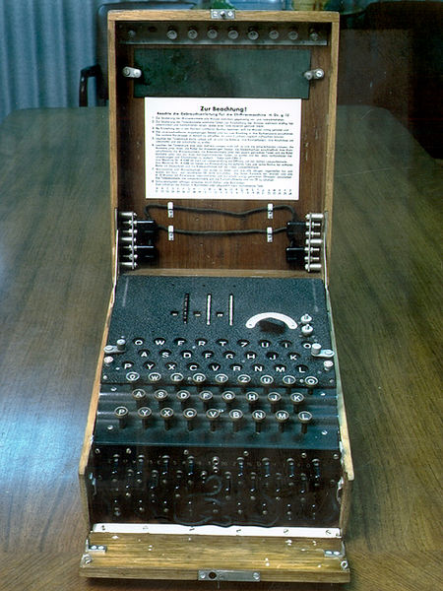
The Enigma machine

Slide 23
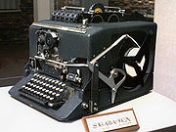
SIGABA

Slide 24
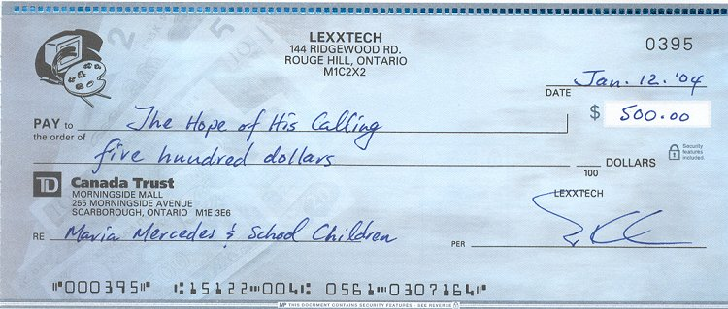
A cheque is not a machine but uses cryptography

Slide 25

Another example of applying cryptography

Slide 26
Reference:-
Simon Singh, The Code Book – The Secret History of Codes and Codebreaking, 1st edition, Fourth Estate Limited, 1999
Henk C. A. Van. Tilborg, Editor in chief, Encyclopedia of Cryptology and Security, New York : Springer Science+Business Media, Inc., 2005
D. E. Newton, Encyclopedia of Cryptology, ABC-CLIO, Inc, 1997
Gary C. Kessler, An Overview of Cryptography, May 1998 (Revised 1 August 2006) http://www.garykessler.net/library/crypto.html
“Cryptography” on Wikipedia: http://en.wikipedia.org/wiki/Cryptography

