Slide 1
Elective II: VLSI Design
Code: CISM 402
Pritha Banerjee
Courtsey for slides: Debasis Mitra, NIT Durgapur

Slide 2
Exam Schedule
Mid-Sem Exam: 30 marks
  Tentative schedule:
    25/04/2011 - 30/04/2011
  Syllabus:
    Topics covered 1 week before the date of exam
Class assignments : 30 marks
  All assignments for a week should be submitted on the last working day of the next week

Slide 3
Resources
Books:
  Naveed A. Sherwani, Algorithms for VLSI Physical Design Automation, Kluwer Academic Publishers
  M. Sarafzadeh and C. K. Wong, An introduction to VLSI Physical Design, The McGraw Hill Companies, Inc.
  S. M. Sait and H. Youssef, VLSI Physical Design Automation: Theory and Practice, World Scientific
  S. K. Lim, Practical Problems in VLSI Physical Design Automation, Springer
  Neil H.E. Weste and Kamran Eshraghian, Principles of CMOS VLSI DESIGN – A Systems Perspective, Second edition, Addison Wesley, Chapter 1.

Slide 4
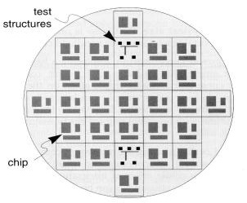
Introduction
Study of theory and methodologies for designing a chip

Slide 5
Introduction
Study of theory and methodologies for designing a chip
Objective: packing more and more logic devices into smaller and smaller areas
VLSI : Very Large Scale Integration of transistors in an IC (Integrated circuit)
VLSI CAD (Computer Aided Design): study of algorithms and tools for aiding VLSI design
ASIC : Application Specific IC

Slide 6
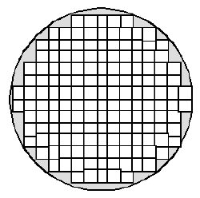
Terminologies
IC : combination of inter connected circuit element within a substrate
Substrate: semiconductor material on which chip is fabricated
Wafer: 10 cm (diameter)
12 to 30 chips
Feature size: minimum gate length of a transistor : 0.18µ
Fabrication process : 0.18µ process, 200mm wafer
chip

Slide 7
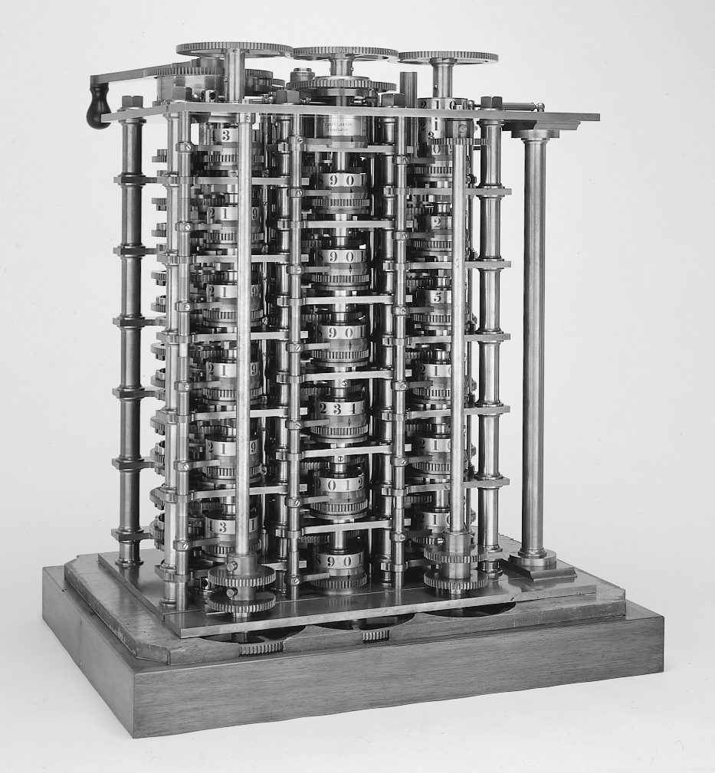
Evolution of Computer
Babbage Difference Engine : First Computer (1832)
25000 parts

Slide 8
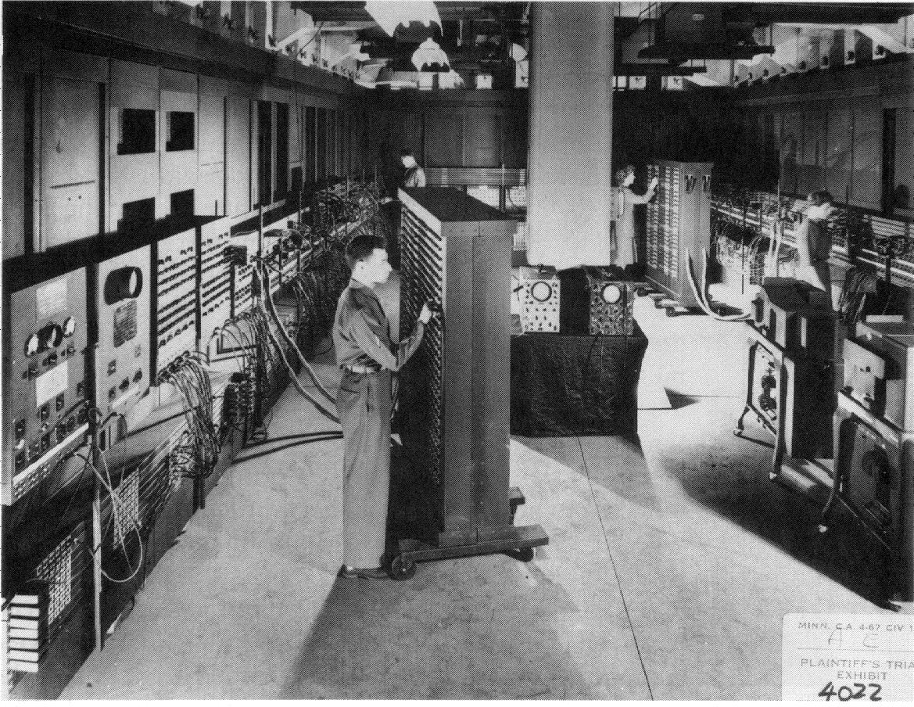
Evolution of Computer
ENIAC : The First Electronic Computer (1943-1946)
Length = 80 ft
Height =8.5 ft
Floor area = 1500 sq ft
Weight = 30 tons
18000 vacuum tubes
70,000 resistors
140 kw of power

Slide 9
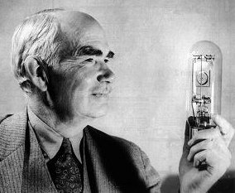
Evolution of Computer
ENIAC : The First Electronic Computer (1943-1946)
Audion (Triode), 1906, Lee De Forest

Slide 10
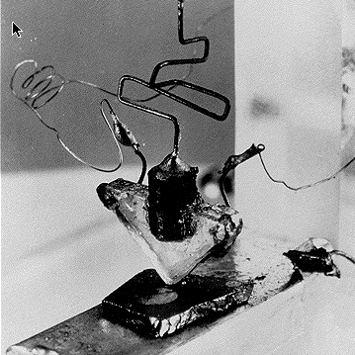
Foundation of IC Industry
First transistor (germanium), 1947
John Bardeen and Walter Brattain, Bell Laboratories

Slide 11
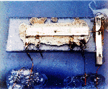
Foundation of IC Industry
First integrated circuit (germanium), 1958
Jack S. Kilby, Texas Instruments

Slide 12

Foundation of IC Industry
First integrated circuit (germanium), 1958
Jack S. Kilby, Texas Instruments
Jack S. Kilby (1923 - 2005)
Better late than never : Awarded Nobel prize in Physics in 2000

Slide 13
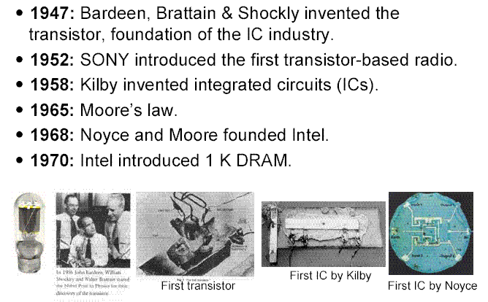
Milestones of IC Industry

Slide 14
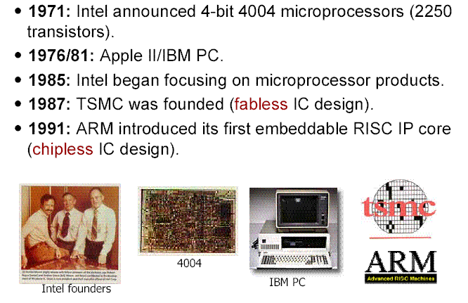
Milestones of IC Industry

Slide 15
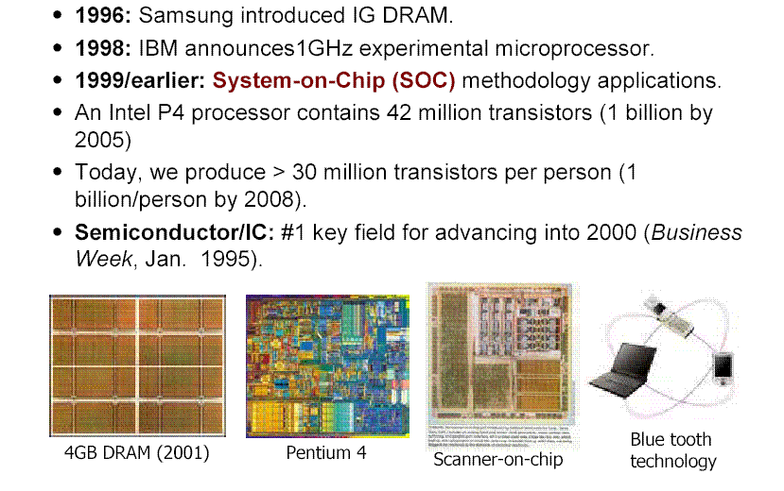
Milestones of IC Industry

Slide 16
Gordon Moore: 1965
Predicted that the number of transistors integrated on a die would grow exponentially (doubling every 12 to 18 months)
Million transistors/chip barrier crossed in the 1980s
  42 Million, 2 GHz clock, 0.18 m m CMOS technology (Intel P4) - 2001
  140 Million transistor (HP PA-8500)

Slide 17
Moore’s law in Microprocessors
1000
100
2X growth in 1.96 years!
Transistors (MT)
10
P6
Pentium® proc
1
486
386
0.1
286
8085
8086
0.01
8080
8008
0.001
4004
1970
1980
1990
2000
2010
Year
Transistors on Lead Microprocessors double every 2 years
Courtesy, Intel

Slide 18
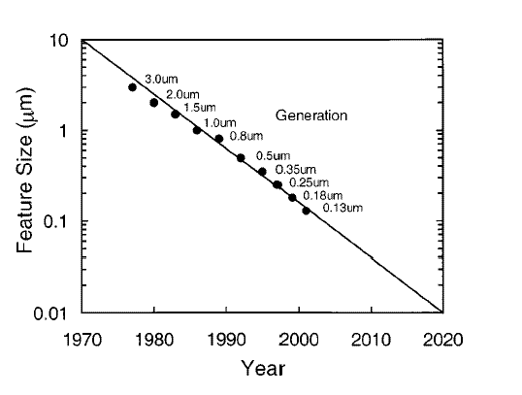
Semiconductor Technology Minimum Feature Size
Courtesy: Intel

Slide 19
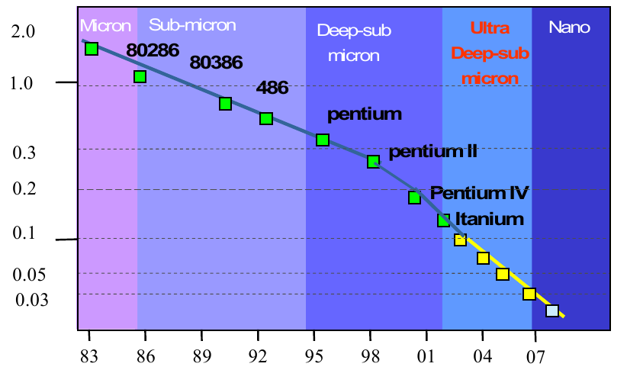
How small are transistors
Courtesy: Intel

Slide 20
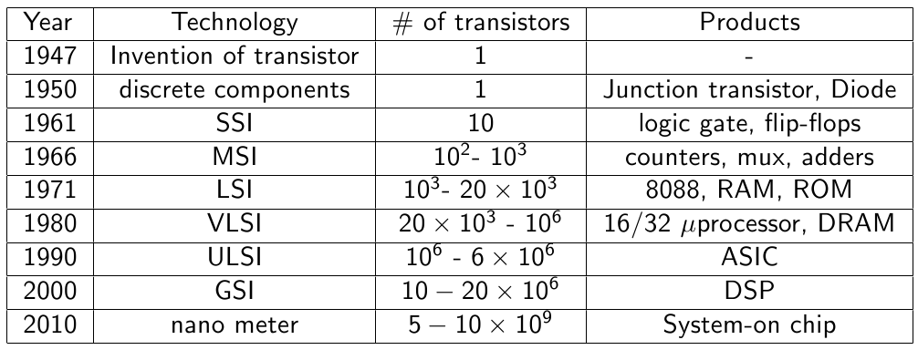
History of IC (Integrated Chip)

Slide 21
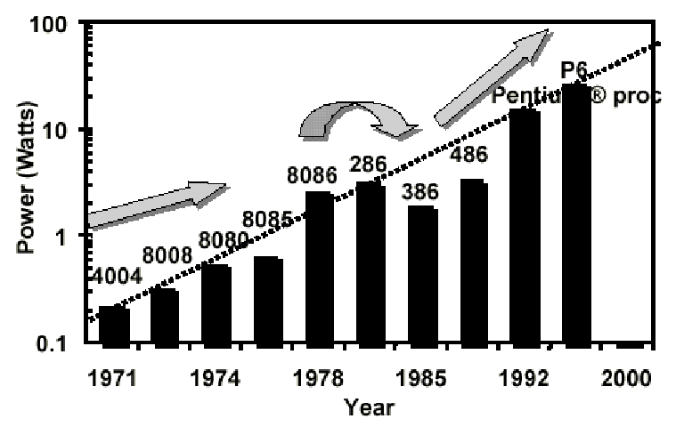
Processor Power trends

Slide 22
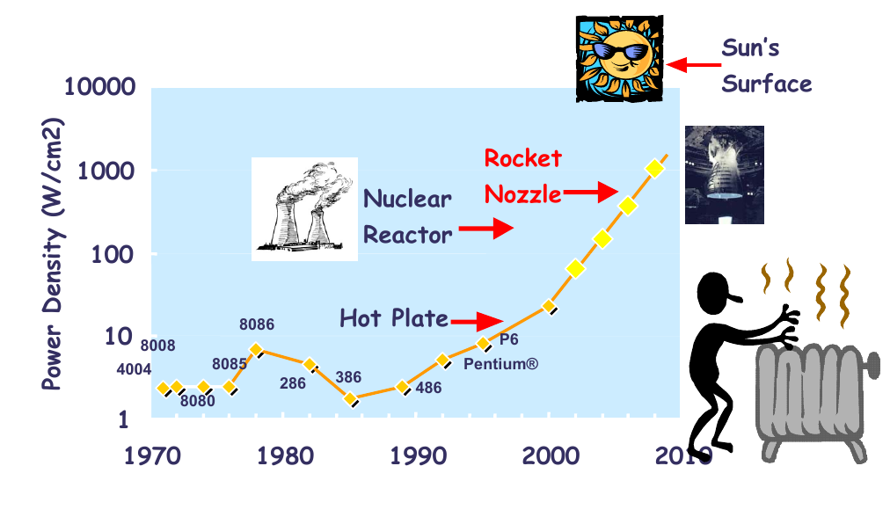
Processor Power density increase

Slide 23
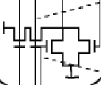
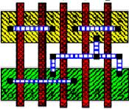
VLSI Design Cycle
System specifications
Functional design (o/p:timing diagram , relationship between blocks/subblocks)
Logic design/RTL(o/p : RTL and boolean expn)
F = (AB + C) *(D+E(X+Y)),
G = XY + AD
Circuit design ( o/p: CMOS transistor, R, C)
Physical design
(deals with geometric structures)
Design Verifivation
(deals with DRC and Circuit Extraction)
DIP (Dual Inline Package)
PGA (Pin Grid Array)
Fabrication ,Packaging, Testing, Debugging
(die/ chip on wafer)
ATPG

Slide 24
VLSI Design Cycle
System specifications
Functional design (High level language)
High level Synthesis
Logic design / RTL (Hardware Description Language VHDL/Verilog)
Logic Synthesis
Circuit design
Physical design ( netlist of components)
Physical Synthesis ( Floorplaning , Place and Route)
Fabrication and Packaging
Testing

Slide 25
Physical Design Flow
Circuit Partitioning
Floorplanning & Placement
Routing
Layout Compaction
Extraction and Verification

Slide 26
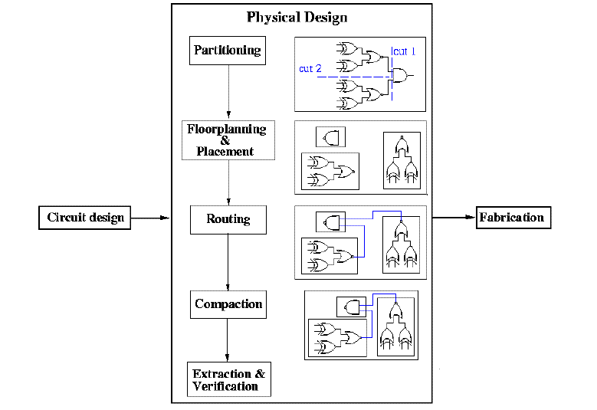
Physical Design Flow

Slide 27
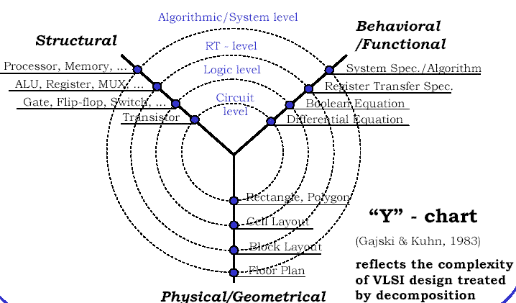
Different Design Views
generation
extraction

Slide 28
Design Styles
Full-Custom Design
Standard Cell
Gate Array
FPGA
System-on-Chip (SOC)

Slide 29
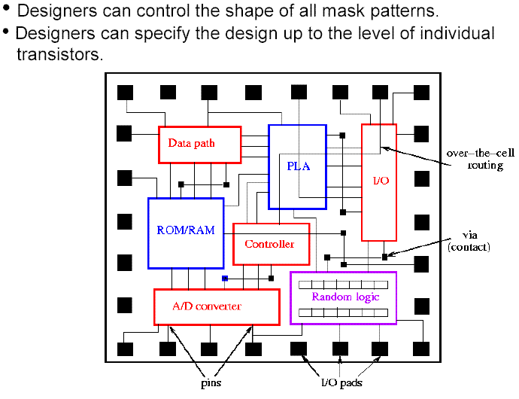
Full Custom Design Style

Slide 30
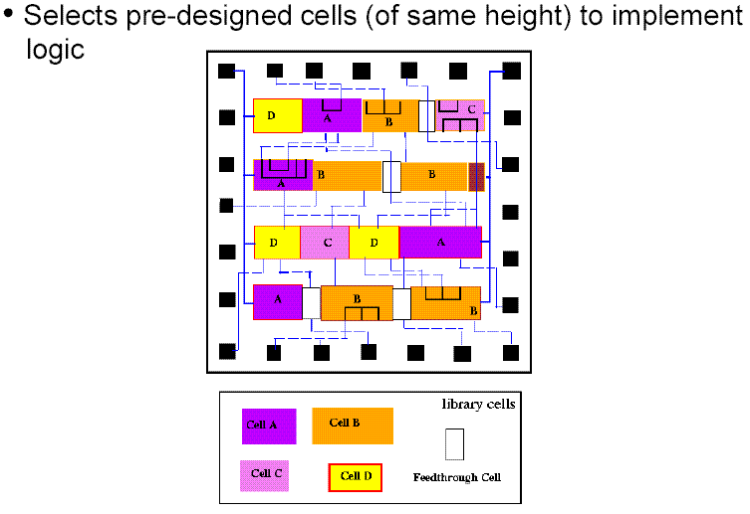
Standard Cell Design Style

Slide 31
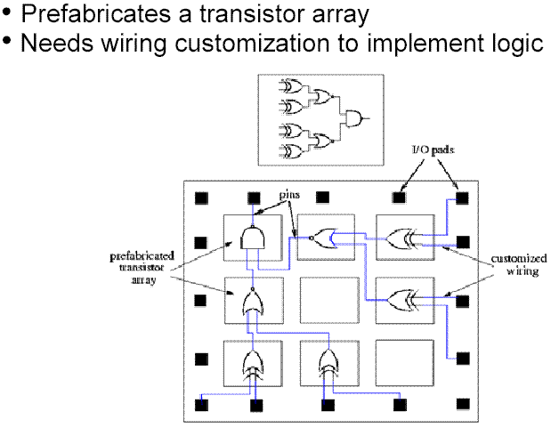
Gate Array Design Style

Slide 32
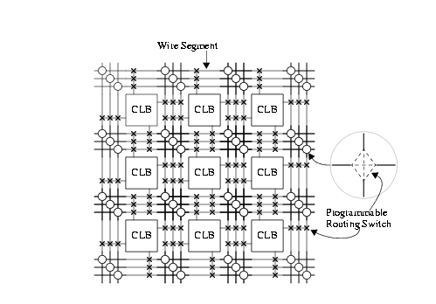
FPGA Design Style
Logic and interconnects both prefabricated

Slide 33
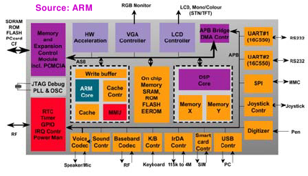
System on chip

Slide 34
Comparison of Design Styles
Full-
Custom
Standard
Cell
Gate
Array
FPGA
fixed
height
fixed
fixed
Cell size
variable
program-
mable
Cell type
variable
variable
fixed
Cell
placement
variable
in row
fixed
fixed
Inter-
connections
program-
mable
variable
variable
variable
Fabrication
layers
routing
layers only
no layer
all layers
all layers
Area
compact
compact to
moderate
moderate
large

Slide 35
Comparison of Design Styles
Full-
Custom
Standard
Cell
Gate
Array
FPGA
high to
moderate
moderate
low
Performance
high
Design
cost
high
medium
medium
low
Time-to-
market
long
medium
medium
short

Slide 36
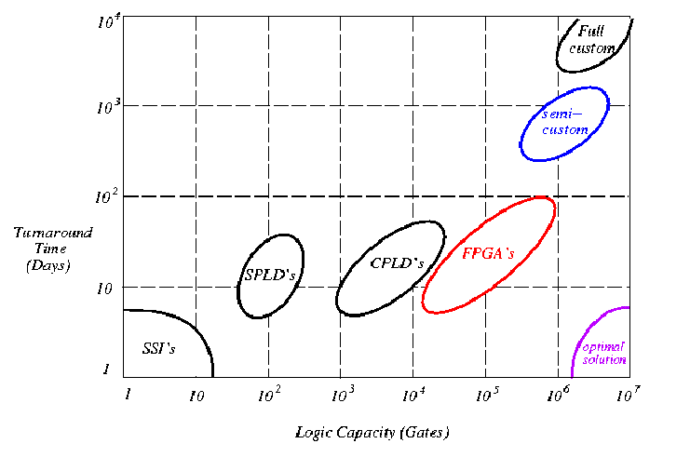
Design Style Trade-offs

Slide 37
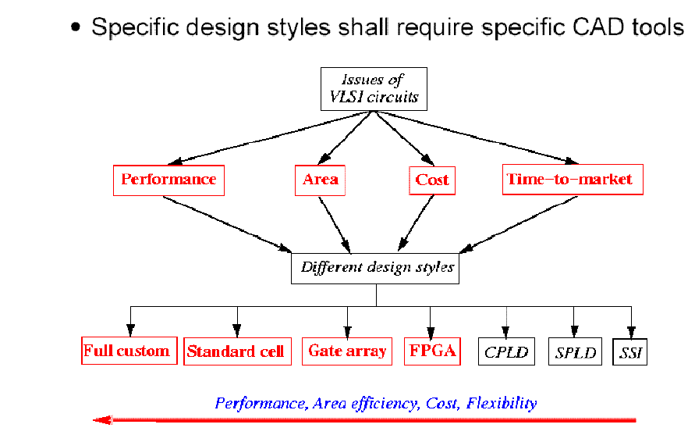
Comparison of Design Styles

Slide 38
VLSI Physical Design Automation
Objective:
study of algorithms and data structures related to physical design process
Optimal arrangement of devices on plane & Efficient interconnection scheme
  Performance of chip
  Size of chip
  Power
Develop time efficient CAD tool

Slide 39
How to solve ?
Type of objects: geometric objects- line, rectangles
Algorithms: graph theoretic, combinatorial optimization,
  Constraints are problem dependent ( electrical requirement)

Slide 40
Design Entry for IC design
Register transfer level (RTL) is a level of abstraction to describe operation of a synchronous digital circuit.
  flow of signals (or transfer of data) between hardware registers,
  logical operations performed on those signals.
Hardware Description Languages (HDLs) : Verilog and VHDL
  create high-level representations of a circuit,
  lower-level representations and ultimately actual wiring can be derived.
Elective II : VLSI Design

Slide 41
VHDL
Very High Speed Integrated Circuit H/W Description Language
entity ff is
Port ( D : in STD_LOGIC;
Q : out STD_LOGIC;
clk : in STD_LOGIC);
end ff;
architecture Behavioral of ff is
Begin
process(clk)
begin
if clk'event and clk ='1' then
Q <= D;
end if;
end process;
end Behavioral;
D
Q
clk
Elective II : VLSI Design

