Slide 1
VHDL

Slide 2
What is VHDL
Very High Speed Integrated Circuit Hardware Description Language
Language used for writing models of a system
Circuit description at different level of abstraction
  Behavioral
  RTL
  Structural
  Gate level

Slide 3
Components of VHDL
Entity – Interface definition of each design object
Architecture – functionality of design entities
Configuration – association of entities to architecture
Package- library of data structure and subprograms
Driver – source on a signal, signal may have drivers
Bus – may have drivers turned off
Attributes – current drive capability of a driver, predefined data about design objects
Generic – required for passing information to an entity through parameters
Process – basic unit of execution in VHDL

Slide 4
Entity
Designs are expressed as entities
Defines the Interface to communicate with other design objects
ENTITY mux IS
PORT (a,b,c,d : IN BIT;
s0, s1 : IN BIT;
x: OUT BIT);
END mux;

Slide 5
Architecture
Describes behavior of entity
An entity can have many architectures: Behavioral or Structural
ARCHITECTURE dataflow OF mux IS
SIGNAL select : INTEGER;
BEGIN
select <= 0 WHEN s0 = '0' AND s1 = '0' ELSE
1 WHEN s0 = '1' AND s1 = '0' ELSE
2 WHEN s0 = '0' AND s1 = '1' ELSE
3;
x <= a AFTER 0.5 NS WHEN select = 0 ELSE
b AFTER 0.5 NS WHEN select = 1 ELSE
c AFTER 0.5 NS WHEN select = 2 ELSE
d AFTER 0.5 NS;
END dataflow

Slide 6
Concurrent Signal Assignment
No specified order of assignment statements
Execution depends on an event occurring on the signal
Event on signal : value of signal changes
select <= 0 WHEN s0 = '0' AND s1 = '0' ELSE
1 WHEN s0 = '1' AND s1 = '0' ELSE
2 WHEN s0 = '0' AND s1 = '1' ELSE
3;
x <= a AFTER 0.5 NS WHEN select = 0 ELSE
b AFTER 0.5 NS WHEN select = 1 ELSE
c AFTER 0.5 NS WHEN select = 2 ELSE
d AFTER 0.5 NS;

Slide 7
Event Scheduling
AFTER clause
Delaying the new value is called scheduling an event
Event on signal : value of signal changes
x <= a AFTER 0.5 NS WHEN select = 0 ELSE
b AFTER 0.5 NS WHEN select = 1 ELSE
c AFTER 0.5 NS WHEN select = 2 ELSE
d AFTER 0.5 NS;

Slide 8
Concurrency of Statements
First assignment statement gets executed when there is a change in s0 and s1
Second : when value of select, a, b, c, d changes
Right hand side of <=
select <= 0 WHEN s0 = '0' AND s1 = '0' ELSE
1 WHEN s0 = '1' AND s1 = '0' ELSE
2 WHEN s0 = '0' AND s1 = '1' ELSE
3;
x <= a AFTER 0.5 NS WHEN select = 0 ELSE
b AFTER 0.5 NS WHEN select = 1 ELSE
c AFTER 0.5 NS WHEN select = 2 ELSE
d AFTER 0.5 NS;

Slide 9
Behavioral Design
Flow of data is expressed in behavioral design
Not the structure of a design in terms of gates.
Used for functionality test, to correctly specify the system requirements etc.
Behavioral designs may not be synthesizable to target technology

Slide 10
MUX
a
b
c
U3
d
a1
inv1
s0
U1
U4
a2
s1
U7
U2
x
x
inv2
U5
a3
U6
a4

Slide 11
Structural Design (Contd.)
BEGIN
U1: inv
port map(s0,inv1);
U2: inv
port map (s1,inv2);
U3: and3
port map (a,inv1,inv2,a1);
U4: and3
port map(b,s0,inv1,a2);
U5: and3
port map(c,inv1,s1,a3);
U6: and3
port map(d,s0,s1,a4);
U7: or
port map(a2 => b, a1 => a, a4 => d, a3 => c, x => x);
END
a
b
c
U3
d
a1
inv1
s0
U1
U4
a2
U7
s1
U2
x
x
inv2
U5
a3
U6
a4

Slide 12
Structural Design
Architecture defined as connections of different basic / compound components
Hierarchical structure
ARCHITECTURE netlist OF mux is
COMPONENT and3
PORT(a,b,c : IN BIT; x: OUT BIT;
END COMPONENT;
COMPONENT inv
PORT(a : IN BIT; d: OUT BIT;
END COMPONENT;
COMPONENT or4
PORT(a,b,c,d : IN BIT; x: OUT BIT;
END COMPONENT;
SIGNAL inv1,inv2,a1,a2,a3,a4 : BIT;

Slide 13
Sequential Behaviour
Use of process statement
ARCHITECTURE seq OF mux IS
PROCESS(a,b,c,d,s0,s1) – sensitivity list
VARIABLE sel : INTEGER;
BEGIN
IF s0 = '0' AND s1 = '0' THEN sel := 0;
ELSIF s0 = '1' AND s1 = '0' THEN sel := 1;
ELSIF s0 = '0' AND s1 = '1' THEN sel := 2;
ELSE sel := 3;

Slide 14
Sequential Behavior (Contd.)
CASE sel IS
WHEN 0 => x <= a;
WHEN 1 => x <= b;
WHEN 2 => x <= c;
WHEN OTHERS => x <= d;
END CASE;
END PROCESS;
END seq;

Slide 15
PROCESS statement
Sensitivity list
Process declarative part
Statement part
Events on process sensitivity list executes the process sequentially
VARIABLES are only used in process statements
Order of statement inside process – important

Slide 16
Architecture Selection
Which architecture to model mux?
Structural : if needs synthesis for final layout
Behavioral : otherwise
Better use concurrent style
RTL VHDL : for synthesis- optimizes gate-level description

Slide 17
Architecture Selection : Configuration
Maps component instantiation to entities
Associate architecture with entity
Only the new configuration is compiled in the library
CONFIGURATION muxconf OF mux IS
FOR netlist – architecture netlist for mux
FOR U1, U2 : inv USE ENTITY WORK.myinv(v1);
END FOR;
FOR U3, U4,U5,U6 : and3 USE ENTITY WORK.myand(v1);
END FOR;
FOR U7 : or4 USE ENTITY WORK.myor(v1);
END FOR;
END FOR;
END muxconf

Slide 18
Behavioral Modeling
Signal assignment a<= b
Signal b is in sensitivity list of statement
If different value, event scheduled for target signal
No change in value – no event but transaction
C <= a and b after 10ns
Change in value ->Transaction-> schedules an event

Slide 19
Concurrent statement
ARCHITECTURE arch OF mux IS
SIGNAL sel : INTEGER;
BEGIN
WITH sel SELECT
x <= a AFTER 0.5 NS WHEN 0 ,
b AFTER 0.5 NS WHEN 1,
c AFTER 0.5 NS WHEN 2 ,
d AFTER 0.5 NS WHEN 3 ;
sel <= 0 WHEN s0 = '0' AND s1 = '0' ELSE
1 WHEN s0 = '1' AND s1 = '0' ELSE
2 WHEN s0 = '0' AND s1 = '1' ELSE
3;
END dataflow

Slide 20
Test Benches
Testing a design by simulation
Use simulator
Inputs are sequence of test values
Inputs are given in the form of waveforms
Outputs are generated as waveforms

Slide 21
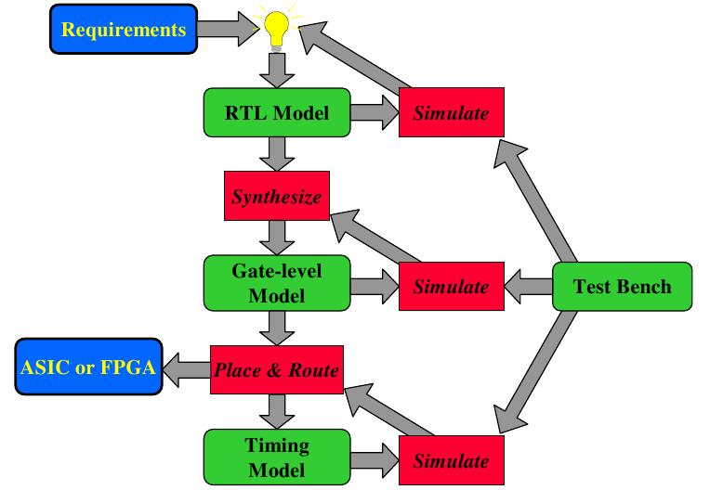
Design flow

