Slide 1
Elective II: VLSI Design
Code: CISM 402
Pritha Banerjee
Courtsey for slides: Debasis Mitra, NIT Durgapur

Slide 2
Submission of Assignment
Assignments I: April 10, 2011
  Seven segment decoder
  4 bit ALU
  3-bit counter
Assignment II: April 30, 2011
  8-bit processor

Slide 3
Resources
Books:
  Chapter 4 of Naveed A. Sherwani, Algorithms for VLSI Physical Design Automation, Kluwer Academic Publishers
  Chapter 2 ( 2.1) of M. Sarafzadeh and C. K. Wong, An introduction to VLSI Physical Design, The McGraw Hill Companies, Inc.

Slide 4
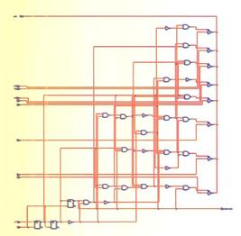
Physical Design Cycle
Physical Design -- Convert the netlist (circuit description) into a geometric representation. The outcome is called a layout.

Slide 5
Physical Design Flow
Circuit Partitioning
Floorplanning & Placement
Routing
Layout Compaction
Extraction and Verification

Slide 6
Net and Netlist
Net: a set of terminals which have to be made electrically equivalent.
Netlist: a collection of nets
net

Slide 7
Circuit Partitioning
Partition a large circuit into sub-circuits (called blocks). Factors like # blocks, block sizes, interconnection between blocks, critical delay … are considered.
IT-830 CAD for VLSI Design and Test Debasis Mitra 2011

Slide 8
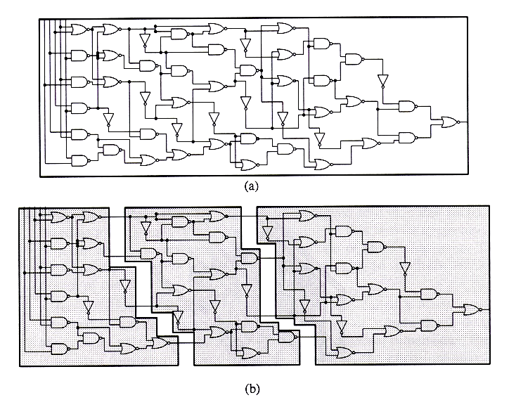
Circuit Partitioning
IT-830 CAD for VLSI Design and Test Debasis Mitra 2011

Slide 9
Partitioning in VLSI
A VLSI system is partitioned at several levels due to its complexity

Slide 10
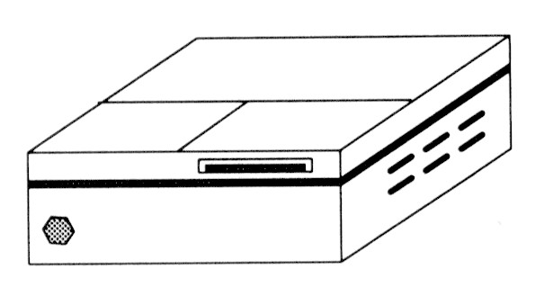
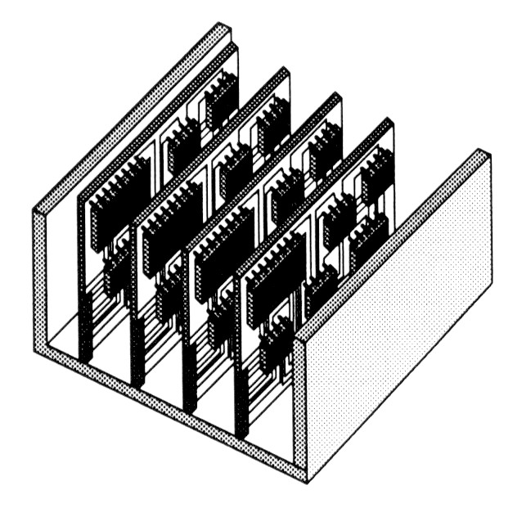
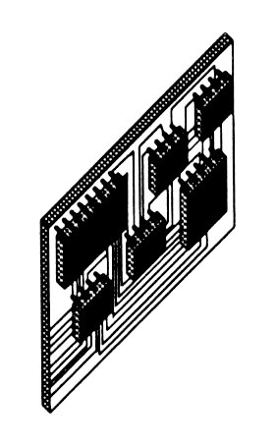
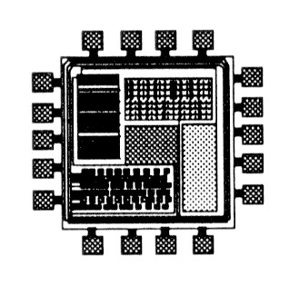
Partitioning in VLSI
System level
Board level
Chip level

Slide 11
Some Terminology
Partitioning: Dividing bigger circuits into a small number of partitions (top down)
k-way Partitioning: Dividing into k partitions.
Bipartitioning: 2-way partitioning.
Bisectioning: Bipartitioning such that the two partitions have the same size.
Clustering: cluster small cells into bigger clusters (bottom up).

Slide 12
Circuit Partitioning
Objectives
minimize interconnection between partitions
minimize delay due to partitioning

Slide 13
Circuit Partitioning
Constraints
  number of terminals in a partition has an upper bound
  area of each partition
  number of partitions within a range

Slide 14
Algorithms for Partitioning
Input -
A set of components and
A netlist
Output -
A set of subcircuits which when connected, function as the original circuit and
Terminals required for each subcircuit to connect it to the others

Slide 15
Algorithms for Partitioning
Terminal
Cutsize = 2

Slide 16
Partitioning Algorithms - Classification
Based on input
Constructive
  typically used for constructing some initial partition which can be improved by using other algorithms (preprocessing)
  input is the circuit components and the netlist
  output is a set of partitions and the new netlist
Iterative
  accept an initial set of partitions and netlist
  generate an improved partitions set and modified netlist
  Iterates until the partitions cannot be improved further

Slide 17
Partitioning Algorithms - Classification
Based on process used
Group Migration
  starts with some partitions (usually generated randomly)
  moves components between partitions to improve the partitioning
Simulation Based
  starts with a random solution and then
  reaches the desired solution through movements from one feasible solution to another
  uses a cost function, which classifies any feasible solution , and a set of moves, which allows movement to other solutions

Slide 18
Hyper Graphs
A hyperedge is an interconnection of a set of distinct
vertices
A hypergraph is a set of hyperedges
A1
B4
A3
B1
A2
B3
B2

Slide 19
Modeling of a circuit by a Hyper Graph
A
X
B
Y
hyper-edge
C
D
A
B
X
C
D
Y

Slide 20
Circuit Representation
Netlist:
  Gates: A, B, C, D
  Nets: {A,B,C}, {B,D}, {C,D}
Hypergraph:
  Vertices: A, B, C, D
  Hyperedges: {A,B,C}, {B,D}, {C,D}
  Vertex label: Gate size/area
  Hyperedge label:
  Importance of net (weight)
B
A
C
D
B
A
C
D

Slide 21
Kernighan - Lin Algorithm
A Bisectioning Algorithm
a circuit can be partitioned into more than two partitions by the iterative application of the algorithm

Slide 22
Restricted Partition Problem
Kernighan - Lin Algorithm
Restrictions:
  For Bisectioning of circuit
  Assume all gates are of the same size
  Works only for 2-terminal nets
    If all nets are 2-terminal,the Hypergraph reduces to a Graph
B
B
A
A
C
D
C
D
Hypergraph Representation
Graph Representation

Slide 23
Problem Formulation
Input: An unweighted graph with
  Set vertices V. (|V| = 2n)
  Set of edges E. (|E| = m)
  Cost c_{AB} for each edge {A, B} in E.
Output: 2 partitions X & Y such that
  Total cost of edges cut is minimized.
  Each partition has n vertices.

Slide 24
A Trivial Approach
Try all possible bisections. Find the best one.
For 4 vertices (A,B,C,D), 3 possibilities.
  1. X={A,B} & Y={C,D}
  2. X={A,C} & Y={B,D}
  3. X={A,D} & Y={B,C}
If there are 2n vertices,
# of possibilities = ^{2n}C_{n} = (2n)! / n!²
For 100 vertices, 5x10²⁸ possibilities.
  Need 1.59x10¹³ years if one can try 100M possibilities per second

Slide 25
Kernighan - Lin Algorithm
A Bisectioning Algorithm
a circuit can be partitioned into more than two partitions by the iterative application of the algorithm

Slide 26
Kernighan - Lin Algorithm
Steps -
The circuit to be partitioned is represented as a graph G(V,E) with modules representing nodes and the connections between nodes representing as edges
1
5
1
5
2
6
2
6
3
7
3
7
4
8
4
8

Slide 27
Kernighan - Lin Algorithm
Steps -
2. The graph G(V,E) is partitioned into two subsets G1, G2 of equal sizes ( balanced bipartition)
Cutsize = 9
1
5
2
6
3
7
4
8

Slide 28
Kernighan - Lin Algorithm
Steps -
3. A vertex pair v1, v2 is chosen from G1, G2 such that it results largest decrease or smallest increase in cutsize, The vertex pair is then exchanged tentatively and increase / decrease of cutsize is recorded in a log
1
5
2
6
3
7
4
8

Slide 29
Kernighan - Lin Algorithm
Steps -
3. A vertex pair v1, v2 is chosen from G1, G2 such that it results largest decrease or smallest increase in cutsize, The vertex pair is then exchanged tentatively and increase / decrease of cutsize is recorded in a log
1
5
Vetex pair | Cutsize | gain
1, 5 | 9 | 0
1, 6 | 8 | 1
1,7 | 7 | 2
3,5 | 6 | 3
… | …. | ….
4, 8 | 9 | 0
2
6
3
7
4
8

Slide 30
Kernighan - Lin Algorithm
Steps -
3. A vertex pair v1, v2 from G1, G2 is exchanged tentatively and increase / decrease of cutsize is recorded in a log
Gain (decrease in cutsize) g(3,5) = 3
1
3
3 and 5 exchanged
2
6
Cutsize = 6
5
7
4
8

Slide 31
Kernighan - Lin Algorithm
Steps -
4. The vertex pair v1, v2 is then locked prohibiting them from taking part in any further tentative exchanges
1
3
2
6
5
7
4
8

Slide 32
Kernighan - Lin Algorithm
Steps -
5. Step 3 and 4 is repeatedly applied to the new partitions until all the vertices are locked
1
3
2
6
5
7
4
8

Slide 33
Kernighan - Lin Algorithm
Steps -
6. A set of vertex pairs are selected for actual exchange whose exchange results largest decrease or smallest increase in cutsize
1
3
2
6
5
7
4
8

Slide 34
Kernighan - Lin Algorithm
Steps -
6. A set of vertex pairs are selected for actual exchange whose exchange results largest decrease or smallest increase in cutsize
Decision is made based on the entries in the log
Tentative Exchange Number (k) | Vertex pair | gain g_{k} | Partial sum of gain Σg_{j} _{j=0 to k} | cutsize
0 | - | - | - | 9
1 | 3,5 | 3 | 3 | 6
2 | 4,6 | 5 | 8 | 1
3 | 1,7 | -6 | 2 | 7
4 | 2,8 | -2 | 0 | 9

Slide 35
Kernighan - Lin Algorithm
Steps -
6. A set of vertex pairs are selected for actual exchange whose exchange results largest decrease or smallest increase in cutsize
Decision is made based on the entries in the log
Tentative Exchange Number (k) | Vertex pair | gain g_{k} | Partial sum of gain Σg_{j} _{j=0 to k} | cutsize
0 | - | - | - | 9
1 | 3,5 | 3 | 3 | 6
2 | 4,6 | 5 | 8 | 1
3 | 1,7 | -6 | 2 | 7
4 | 2,8 | -2 | 0 | 9
The value of k for which maximum partial sum is achieved is determined

Slide 36
Kernighan - Lin Algorithm
Steps -
6. A set of vertex pairs are selected for actual exchange whose exchange results largest decrease or smallest increase in cutsize
Decision is made based on the entries in the log
Tentative Exchange Number (k) | Vertex pair | gain g_{k} | Partial sum of gain Σg_{j} _{j=0 to k} | cutsize
0 | - | - | - | 9
1 | 3,5 | 3 | 3 | 6
2 | 4,6 | 5 | 8 | 1
3 | 1,7 | -6 | 2 | 7
4 | 2,8 | -2 | 0 | 9
The first k pairs of vertices are actually exchanged

Slide 37
Kernighan - Lin Algorithm
Steps -
6. A set of vertex pairs are selected for actual exchange whose exchange results largest decrease or smallest increase in cutsize
1
5
1
3
1
8
2
2
6
6
6
3
2
7
3
7
5
7
5
4
4
8
4
8

Slide 38
Kernighan - Lin Algorithm
Steps -
7. A new iteration of steps 2 to 6 is started. The algorithms stops when no decrease of cutsize is possible during an iteration

Slide 39
Kernighan - Lin Algorithm
KL(G)
  Bipartition G into 2 groups V1, V2
  Repeat
    For i = 1 to n/2 do
      Find a pair of unlocked vertices va in V1 and vb in V2 whose exchange makes largest decrease or smallest increase in cut-cost
      Mark va, vb as locked, store gain gi
    Find k s.t ∑gi = Gain_{k} is maximized
    If Gain_{k} > 0
      move va1, va2, ….vak from V1 to V2
      move vb1, vb2, ….vbk from V2 to V1
  Unitil Gain_{k} <= 0

Slide 40
Kernighan - Lin Algorithm
Computing gain formally:
g(v_{i}, v_{j}) = decrese in cutsize if v_{i} changes over to the other partition D(i)
+
decrese in cutsize if v_{j} changes over to the other partition D(j)
-
2 * no. of edges between v_{i} and v_{j}
D(i) - outedge(i) – inedge(i)
Edge (v_{i} , v_{j} ) do not contribution on the overall gain, as
  vi ,vj remain in different partitions and edges between them will still cross the partition.
  Edge(v_{i} , v_{j} ) has been considered to contribute in both the cases of individual migration of vi and vj, hence subtract 2.

Slide 41
Kernighan - Lin Algorithm
1
5
Computing gain formally:
Example:
D(3) = 3 – 1 = 2
D(5) = 2 – 1 = 1
Hence,
g(3, 5) = 2 + 1 -2*0 = 3
2
6
3
7
4
8

Slide 42
Kernighan - Lin Algorithm
Time Complexity of KL Algorithm: O(n³)
For each pass,
  O(n²) time to find the best pair to exchange.
  n pairs exchanged.
  Total time is O(n³) per pass.
Number of passes is usually small (can be considered as constant)
Extensions: can be extended to r –way partition
  Bipartition rC₂ pair of subsets, each taking (n/r)³
  Time Complexity: (rC₂) (n/r)³ = O(n³/r)

Slide 43
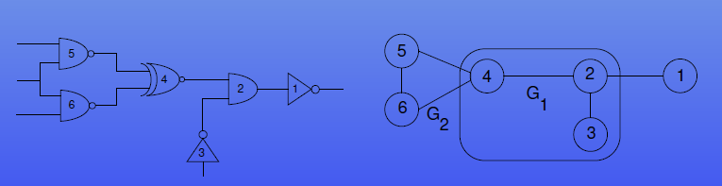
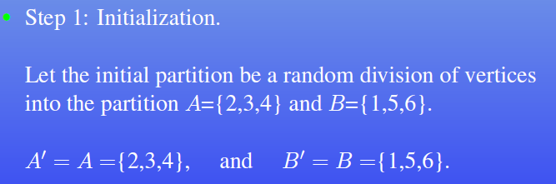
Kernighan - Lin Algorithm
Another example:

Slide 44
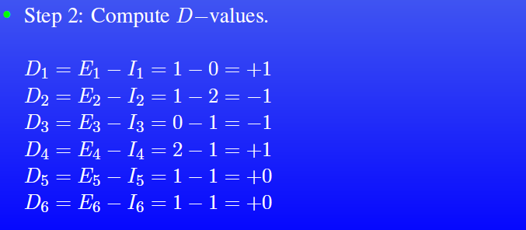
Kernighan - Lin Algorithm
Another example:

Slide 45
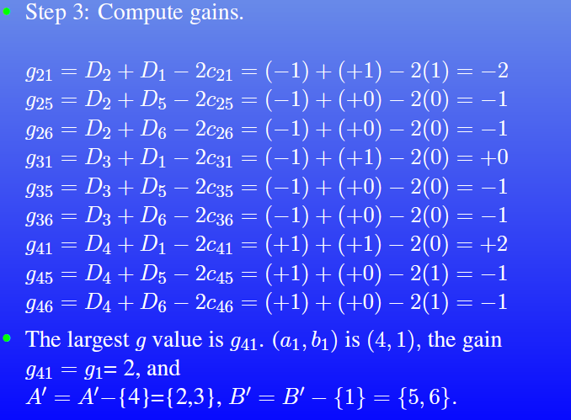
Kernighan - Lin Algorithm
Another example:

Slide 46
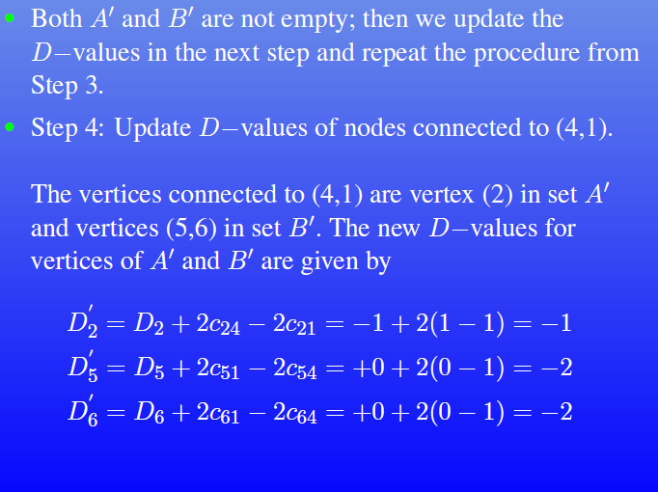
Kernighan - Lin Algorithm
Another example:

Slide 47
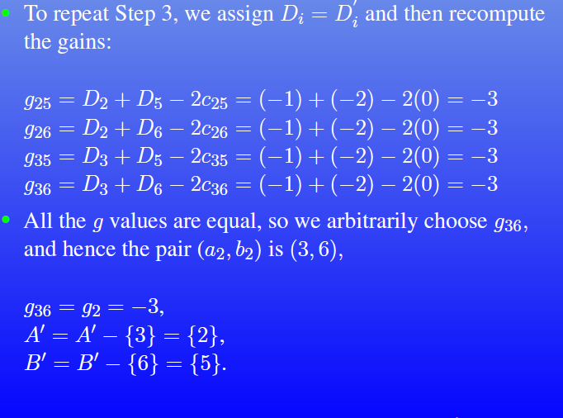
Kernighan - Lin Algorithm
Another example:

Slide 48
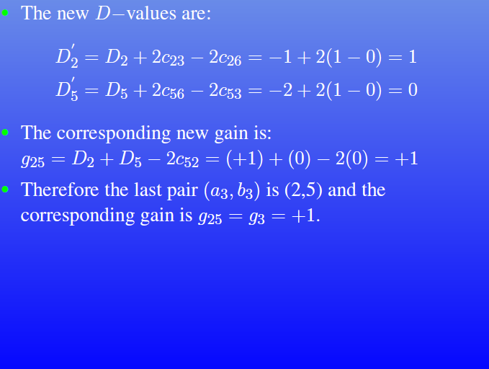
Kernighan - Lin Algorithm
Another example:

Slide 49
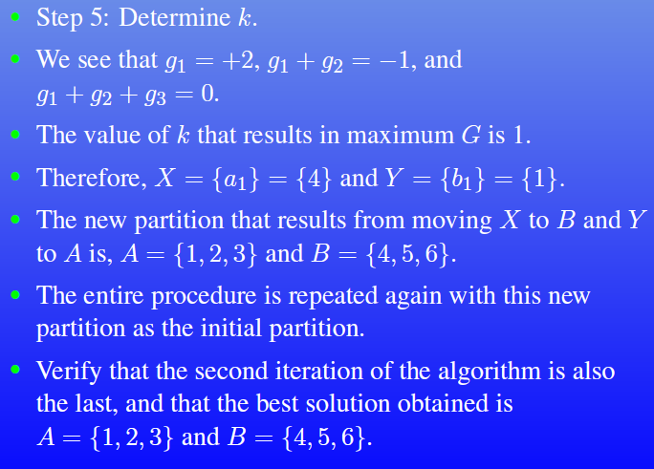
Kernighan - Lin Algorithm
Another example:

Slide 50
Drawbacks of KL Algorithm
Considers unit vertex weights
  Vertex weight: Represent block sizes, which usually differ from block to block
Not applicable to hypergraphs; KL uses edge-cut model (multi terminal nets are represented by complete graph on the set of terminals)
Partition sizes have to be pre-specified
High time complexity
How to handle these drawbacks?

Slide 51
Fiduccia-Mattheyses Heuristic
Terminology
Improvement over KL : time complexity per pass is O(t), t : # of terminals in G
A1
B4
A3
B1
A2
B3
B2
# terminals: 3+ 4+ 2 + 2+2+2 = 15

Slide 52
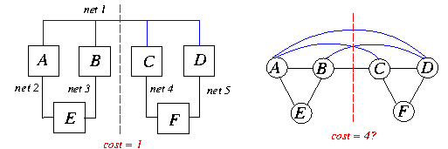
Handling Hypergraphs
For multi-terminal nets, net cut is a more accurate measurement for cut cost (i.e., deal with hyperedges).
{A B E} {C D F} is a good partition
Should not assign same weight to all edges

Slide 53
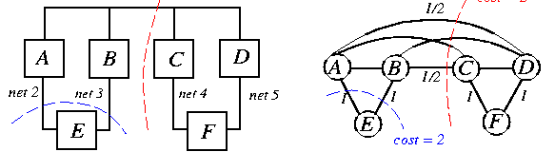
Handling Hypergraphs: net-cut model
n(i) = # of cells associated with Net i.
Edge weight w_{xy} =2 / n(i) for an edge connecting cells x and y.

Slide 54
Fiduccia-Mattheyses Heuristic
Improvement over KL :
  Aims at reducing net-cut costs; the concept of cutsize is extended to hypergraphs.
  time complexity per pass is O(t), t : # of terminals in G (A special data structure used to select a vertex to be moved to the other partition)
  Only a single vertex is moved across the cut in a single move
  Vertices are weighted
  Can handle “unbalanced” partitions; ( can obtain partitions with given balance factor)
Balance Factor:
  w(v_{i}) = weight of vertex v_{i}
  Weight of each partition : α∑w(v_{i}), ½ <= α < 1

Slide 55
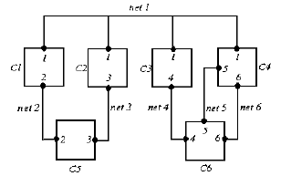
Fiduccia-Mattheyses : Notations
n(i): # of cells in Net i; e.g., n(1) = 4.
s(i): size of Cell i (weight of cell)
t(i): # of pin terminals in Cell i; e.g., t(6)=3.
C: total # of cells; e.g., C=6.
N: total # of nets; e.g., N=6.
t: total # of terminals; t = t(1) + … + t(C) = n(1) + … + n(N).

Slide 56
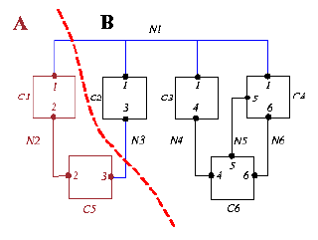
Fiduccia-Mattheyses Heuristic: Problem
Input : A weighted ( vertex and edges) hypergraph, required balance factor b,
Output: balanced bipartition with minimum cut satisfying the balance factor b
W(A) , W(B) <= ∑w(v)/2 + max{w(v)}, [if equal size bipartition], W(A): sum of weights of v in partition A
w(v) : area/size of module represented by v
Cut set = {N1, N3}
W(A) = Size(A) = s(1) + s(2) = |A|
W(B) = Size(B) = s(3)+ s(4)+ s(5)+ s(6) = |B|

Slide 57
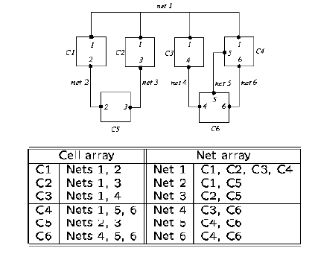
Fiduccia-Mattheyses Heuristic: Input Data structure
#of terminals t : 14
Construction takes O(t) time

Slide 58
Fiduccia-Mattheyses Heuristic
Initial Partition : A,B
  Sort v in decreasing order of size(weight), Put alternate vertices in A and B.
Movement of a single vertex causes a change of atmost :-pmax to +pmax in the cut-cost (gain).
pmax: max degree of vertex
Maintain 2 lists A and B for each partition indexed by the gain
Choose the max gain vertex from either A or B if its movement does not violate the balance condition

Slide 59
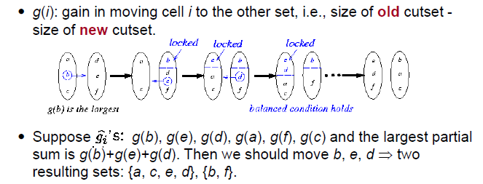
Fiduccia-Mattheyses Heuristic (contd.)
Move the vertex temporarily as in KL, so lock vertex
Update the data structure to reflect the change in gains of vertices which are adjacent to the moved vertices
Continue till all vertices are locked.
Choose the sequence of moves (Partial sum of gains) s.t cut-cost is minimized
Continue with another pass till there is no more improvement in cut cost

Slide 60
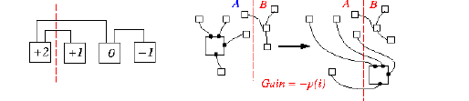
Cell gain
-t(i) ≤ g(i) ≤ t(i)
Gain = -t(i)
Two “bucket list” structures, one for set A and one for set B
(P_{max} = max_{i} t(i)).

Slide 61
Fiduccia-Mattheyses Heuristic :
Data Structure
BUCKET
BUCKET
+p_{max}
List A
List B
MAX
GAIN
MAX
GAIN
Cell #
Cell #
Cell #
Cell #
- p_{max}
- p_{max}
vertex
1
2
C
O(1)-time operations:
find a cell with Max Gain, remove Cell i from the structure, insert Cell i into the structure, update g(i) to g(i)+ Δ,
and update the Max Gain pointer.

Slide 62

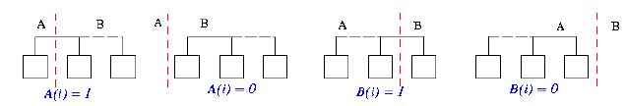
Distribution of nets and critical nets
Distribution of Net i: (A(i), B(i)) = (2, 3).
  (A(i), B(i)) for all i can be computed in O(t) time.
Critical Nets: A net is critical if it has a cell which if moved will change its cut state.
  4 cases: A(i) = 0 or 1, B(i) = 0 or 1.
Gain of a cell depends only on its critical nets.

Slide 63
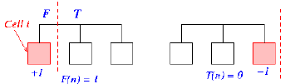
Compute Cell gains
Initialization of all cell gains requires O(t) time:
g(i) = 0;
F = the “from partition” of Cell i;
T = the “to partition” of Cell i;
for each net n on Cell i do
if F(n)=1 then g(i) = g(i)+1;
if T(n)=0 then g(i) = g(i)-1;
Only need O(t) time to maintain all cell gains in one pass.

Slide 64
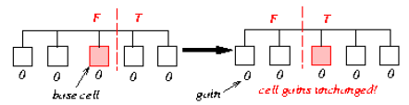
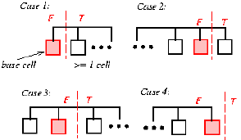
Update Cell gains
To update the gains, look at those nets, connected to the base cell, which are critical before or after the move.
Base cell: The cell selected for movement from one set to the other
Consider only the case where the base cell is in the left partition.
Other case is similar

Slide 65
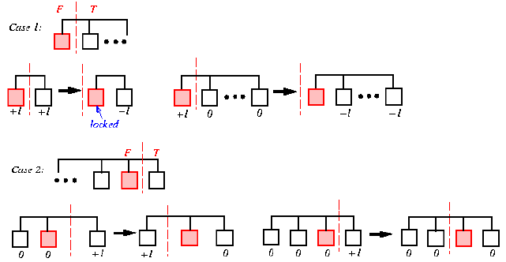
Update Cell gains

Slide 66
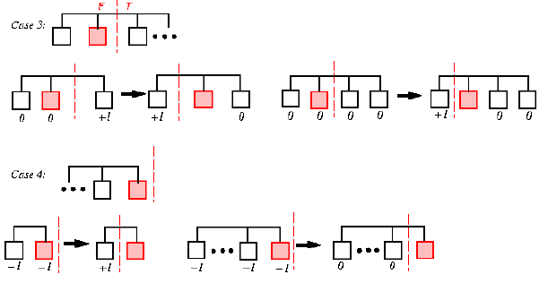
Update Cell gains

Slide 67
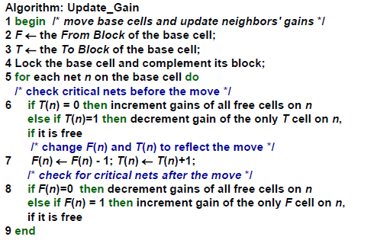
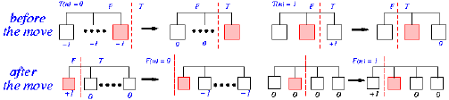
Algorithm : Update Cell gains

Slide 68
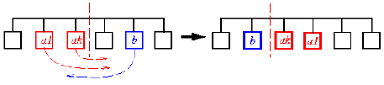
Complexity of updating the cell gains
Once a net has “locked” cells at both sides, the net will remain cut from now on.
Suppose we move a1, a2, …, ak from left to right, and then move b from right to left i.e, At most a1, a2, …, ak and b need updating!
To update the cell gains, it takes O(n(i)) work for Net i., n(i): number of cells in net n
Total time = n(1)+n(2)+…+n(N) = O(t).

Slide 69
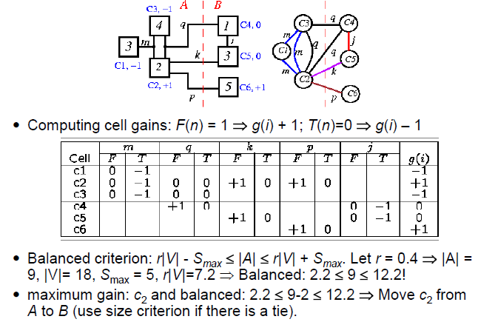
Fiduccia-Mattheyses Heuristic: Example

Slide 70
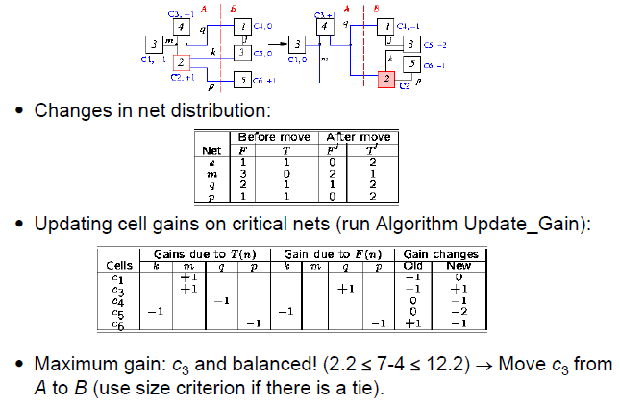
Fiduccia-Mattheyses Heuristic: Example

Slide 71
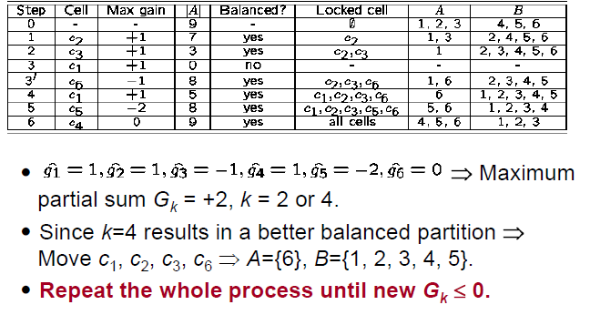
Fiduccia-Mattheyses : Summary

