Slide 1
Elective II: VLSI Design
Code: CISM 402
Pritha Banerjee
Courtsey for slides: Debasis Mitra, NIT Durgapur

Slide 2
Floorplanning
Books:
  Chapter 5 of Naveed A. Sherwani, Algorithms for VLSI Physical Design Automation, Kluwer Academic Publishers
  Chapter 2 ( 2.2) of M. Sarafzadeh and C. K. Wong, An introduction to VLSI Physical Design, The McGraw Hill Companies, Inc.

Slide 3
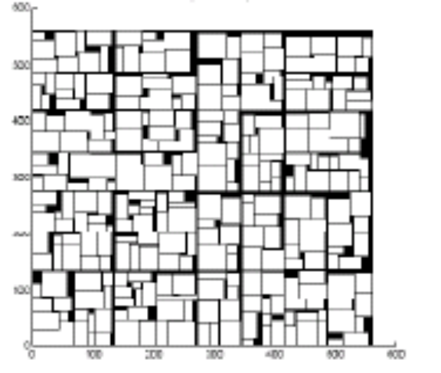
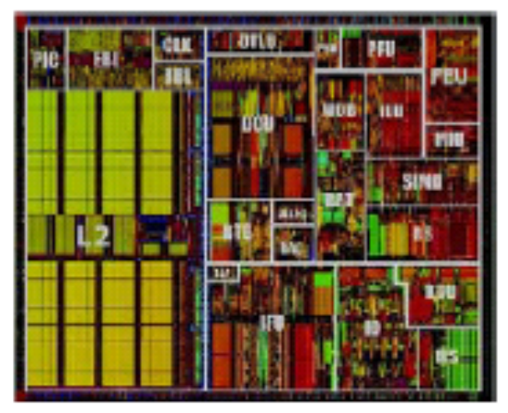
Physical Design Flow
Circuit Partitioning
Floorplanning & Placement
Routing
Layout Compaction
Extraction and Verification

Slide 4
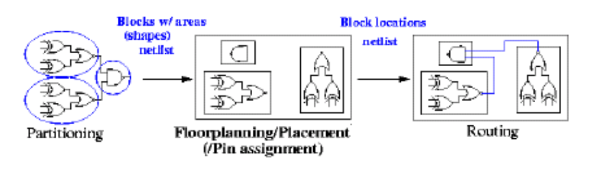
Partitioning is over! What Next?
Partitioning leads to
Blocks with well-defined areas and shapes (rigid/hard blocks).
Blocks with approximated areas and no particular shapes (flexible/soft blocks).
A netlist specifying connections between the blocks.
Objectives
Find locations for all blocks.
Consider shapes of soft block and pin locations of all the blocks.

Slide 5
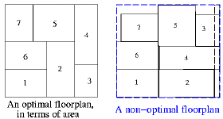
Floorplanning
To plan the positions and shapes of the modules at the beginning of the design cycle to optimize the circuit performance:
    Chip area
    Total wirelength
    Critical path delay
    Routability
    Others (eg, noise, heat dissipation etc.)

Slide 6
Floorplanning Vs Placement
Both determines block positions to optimize the circuit performance
Floorplanning:
  Details like shapes of blocks, I/O pin positions, etc. are not yet fixed
  Blocks with flexible shape are called soft blocks
Placement:
  Details like module shapes and I/O pin positions are fixed
  blocks with no flexibility in shape are called hard blocks

Slide 7
Floorplanning Problem
Input:
  n Blocks with areas A₁, ... , A_{n}
  Bounds r_{i} and s_{i} on the aspect ratio of block B_{i}
Output:
  Coordinates (x_{i}, y_{i}), width w_{i} and height h_{i} for each block such that h_{i} w_{i} = A_{i} and r_{i} ≤ h_{i}/w_{i} ≤ s_{i}
Objective:
  To optimize the circuit performance
  A commonly used objective function: a weighted sum of area and wirelength (cost = αA + βL)
where A is the total area of the packing, L is the total wirelength, and α and β are constants

Slide 8
Floorplanning
Aspect ratio (h_{i}/w _{i})
  If there is no bound on the aspect ratios, can we pack everything tightly?
    Yes
  But we don’t want to layout blocks as long strips, so we require a bound (r_{i} ≤ h_{i}/w_{i} ≤ s_{i})for each i

Slide 9
Floorplanning
Aspect ratio (h_{i}/w _{i})
  Several shapes are allowed keeping AR within the range for soft blocks
  For hard blocks, the orientations can be changed

Slide 10
Floorplanning
Wirelength estimation:
- Exact wirelength of each net is not known until routing is done
- In floorplanning, even pin positions are not known yet.
- Some possible wirelength estimations:
  Center-to-center estimation
  Half-perimeter estimation

Slide 11
Floorplanning
Dead space:
The space that is wasted:
Minimizing area is the same as minimizing dead space
Dead space percentage is computed as
(A - Σ_{i}D_{i}) / A × 100%
Dead space

Slide 12
Floorplanning Algorithms
Floorplanning problem belongs to the class of NP complete problems- thus heuristics
Floorplanning requires:
  Floorplanning topology generation: determine the relative location of modules/ blocks
  Floorplan sizing : determining the exact shape (w, h) of each module
such that area of floorplan is minimal and total wirelength is minimal
Need to devise efficient representation of floorplan

Slide 13
Slicing and Non-Slicing Floorplan
Slicing Floorplan:
One that can be obtained by repetitively subdividing (slicing) rectangles horizontally or vertically
Non-Slicing Floorplan:
One that may not be obtained by repetitively subdividing alone
Otten (LSSS-82) pointed out that slicing floorplans are much easier to handle

Slide 14
Data structure :Slicing Floorplan
Example:
B
H
I
A
C
F
G
D
E

Slide 15
Data structure: Slicing Floorplan
Slicing Tree:
A binary tree in which each leaf represents a partition ( module) and each internal node represents a cut
Slicing tree is of order 2
B
H
I
A
C
F
G
D
E

Slide 16
Slicing and Non-Slicing Floorplan
Slicing Tree:
A binary tree in which each leaf represents a partition and each internal node represents a cut
Example:
1
V
B
H
I
A
C
F
G
D
E

Slide 17
Slicing and Non-Slicing Floorplan
Slicing Tree:
A binary tree in which each leaf represents a partition and each internal node represents a cut
Example:
1
V
B
H
I
A
3
C
H
H
2
F
G
D
E

Slide 18
Slicing and Non-Slicing Floorplan
Slicing Tree:
A binary tree in which each leaf represents a partition and each internal node represents a cut
Example:
1
V
B
H
I
A
3
C
H
H
2
F
G
V
V
V
V
D
E

Slide 19
Slicing and Non-Slicing Floorplan
Slicing Tree:
A binary tree in which each leaf represents a partition and each internal node represents a cut
Example:
1
B
V
H
I
A
3
C
H
H
2
F
G
V
V
V
V
D
E
A
H
D
E
H
I
F
G

Slide 20
Slicing and Non-Slicing Floorplan
Slicing Tree:
A binary tree in which each leaf represents a partition and each internal node represents a cut
Example:
1
B
V
H
I
A
3
C
H
H
2
F
G
V
V
V
V
D
E
A
H
D
E
H
I
F
G
B
C
Polish Expression: postorder trversal: ABC-|DE|-HI|FG|-|

Slide 21
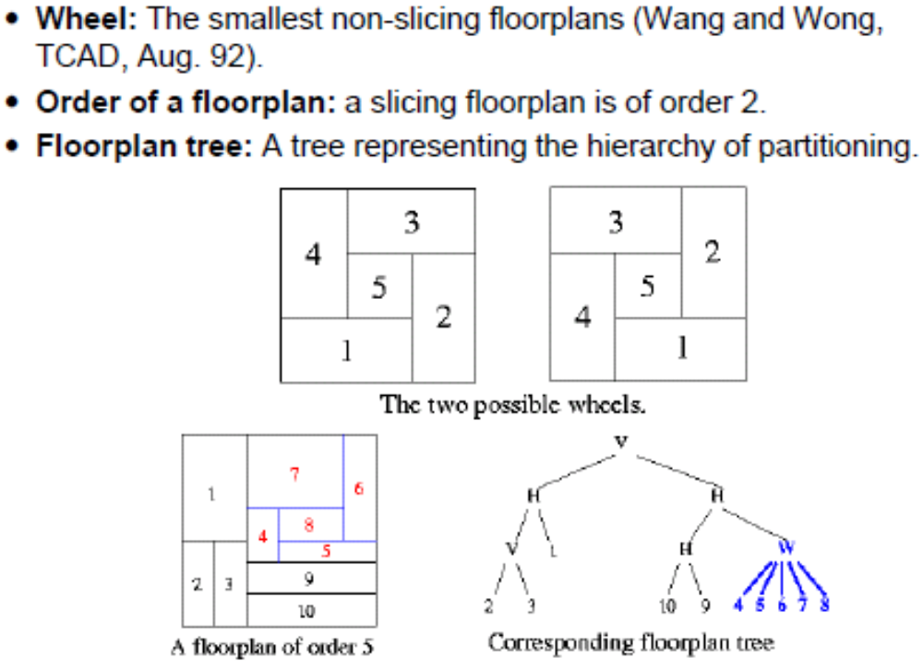
Floorplan order: Non-Slicing

Slide 22
Floorplanning approach
Rectangular dual graph approach to floorplanning
Hierarchical approach to floorplanning
  Bottom-up
  Top-down
Simulated annealing based approach to floorplanning

Slide 23
Rectangular dual graph approach
Block Adjacency Graph:
A floorplan is modeled by an undirected graph:
  Vertex: block
  Edge: (v_{i}, v_{j}) is an edge if the block corresponding to v_{i} is adjacent to the block corresponding to v_{j}

Slide 24
Graph Representation of Floorplan
Block Adjacency Graph:
Example:
b
a
b
a
d
c
c
d
e
e
f
g
g
f

Slide 25
Graph Representation of Floorplan
Block Adjacency Graph:
Example:
b
a
b
a
d
c
c
d
e
e
f
g
g
f
Every T junction represents a triangulated face of adjacency graph
rectangular floorplan with T junction : planar triangulated graph

Slide 26
Graph Representation of Floorplan
Block Adjacency Graph:
Properties:
  The graph is planar and rectangular dualizable
  Every face (closed contour within which there is nothing) is a triangle
  There is no complex triangle ( cycle (a,b,c) of length 3 is not a face)
    No valid floorplan exist for this graph
  All interior vertices have degree ≥ 4
    An interior block must have atleast 4 adjacencies
  There are atmost 4 vertices of degree 2
    Degree 2 vertices represent corner blocks

Slide 27
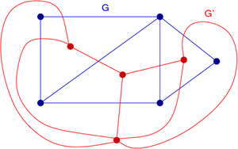
Geometric dual
Geometric dual (or simply dual) of a planar graph G is a graph which has a vertex for each face of G, and an edge for each edge in G joining two neighboring faces, for a certain embedding of G
The term "dual" is used because this property is symmetric
  i.e., if H is a dual of G, then G is a dual of H (if G is connected)

Slide 28
Floorplanning by Rectangular Dualization
Idea:
Generates topology, i.e., determines dissection pattern based on neighborhood constraints
  Sizing has to be taken care of separately
Input: Neighborhood graph obtained from partitioning phase
Steps:
  Make sure that
    The graph is planar
    Every interior faces are triangles
    There is no complex triangle
  Construct the dual
  Redraw it in a rectilinear fashion

Slide 29
Floorplanning by Rectangular Dualization
Example:
A
F
G
E
J
B
H
K
I
C
D

Slide 30
Floorplanning by Rectangular Dualization
Example:
16
A
1
3
2
F
G
12
11
13
4
E
10
B
J
14
H
15
5
K
6
I
9
7
C
D
8

Slide 31
Floorplanning by Rectangular Dualization
Example:
16
A
1
3
2
F
G
12
11
13
4
E
10
B
J
14
H
15
5
K
6
I
9
7
C
D
8

Slide 32
Floorplanning by Rectangular Dualization
Example:
16
A
1
3
2
F
G
12
11
13
4
E
10
B
J
14
H
15
5
K
6
I
9
7
C
D
8

Slide 33
Floorplanning by Rectangular Dualization
Example:
16
A
1
2
3
F
G
12
11
13
4
E
10
B
J
14
H
15
5
K
6
I
9
7
C
D
8

Slide 34
Floorplanning by Rectangular Dualization
Example:
16
A
1
2
3
F
G
12
11
13
4
E
10
B
J
14
H
15
5
K
6
I
9
7
C
D
8

Slide 35
Floorplanning by Rectangular Dualization
Example:
16
A
1
2
3
G
12
13
4
F
J
10
11
15
14
E
B
H
K
I
5
9
8
7
6
C
D

Slide 36
Floorplanning by Rectangular Dualization
Example:
16
A
1
2
3
16
G
12
13
4
F
J
10
11
15
14
E
B
I
H
K
16
16
5
9
8
7
6
D
C
16
Problems: netlist is hypergraph, obtaining planar triangulated graph for the netlist, block areas not considered

Slide 37
Hierarchical approach
Divide and conquer paradigm, a small number of rectangles are considered
Enumerate all possible floorplans for a small number of modules, say 3, w.r.t connectivity
Bottom-up approach :
  cluster modules depending on connectivity, when we have few super blocks, enumerate all possibilities and take the best one
Top-down approach: recursively partition netlist and enumerate at each level of hierarchy
a
c
a
b
c
b
c
b
a
c
b
a

Slide 38
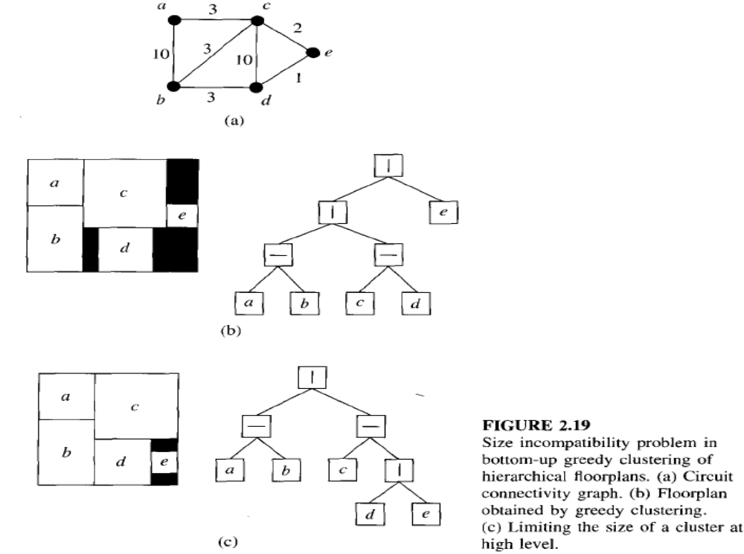
Hierarchical approach: bottom-up

Slide 39
Simulated annealing based approach
Combinatorial optimization problems (like partitioning) can be thought as a State Space Search Problem.
A State is just a configuration of the combinatorial objects involved.
The State Space is the set of all possible states (configurations).
A Neighbourhood Structure is also defined (which states can one go in one step).
There is a cost corresponding to each state.
Search for the min (or max) cost state.

Slide 40
State Space Search Problem
3 2 1 cost = 1 (only one element (2) is in proper place)
3 1 2 cost = 2 (none is in proper place)
1 3 2 cost = 1 (only one element (1) is in proper place)
1 2 3 cost = 0 (all the tree elements are in proper place)
2 1 3 cost = 1 (only one element (3) is in proper place)
2 3 1 cost = 2 (none is in proper place)
Moves : swapping adjacent digits; used to move from one state to the other state
Cost : 3 digits in proper place costs 0, 1 digits in proper place cost 1, none in proper place cost 2
Minimize cost

Slide 41
Greedy Algorithm
A very simple technique for State Space Search Problem.
Start from any state.
Always move to a neighbor with the min cost (assume minimization problem).
Stop when all neighbors have a higher cost than the current state.

Slide 42
Simulated Annealing
Very general search technique.
Try to avoid being trapped in local minimum by making probabilistic moves.
Popularize as a heuristic for optimization by:
  Kirkpatrick, Gelatt and Vecchi, “Optimization by Simulated Annealing”, Science, 220(4598):498-516, May 1983.

Slide 43
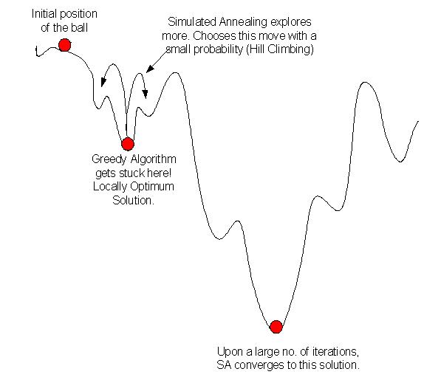
Simulated Annealing
Movement of ball on terrain

Slide 44
Simulated Annealing
Motivation
Annealing in metals
Heat the solid state metal to a high temperature
Cool it down very slowly according to a specific schedule
If the heating temperature is sufficiently high to ensure random state and the cooling process is slow enough to ensure thermal equilibrium, then the atoms will place themselves in a pattern that corresponds to the global energy minimum of a perfect crystal
Attaining a min cost state in simulated annealing is analogous to attaining a good crystal structure in annealing

Slide 45
Simulated Annealing
The procedure:
Let t be the initial temperature.
Repeat
Repeat
  Pick a neighbor of the current state randomly.
  Let c = cost of current state.
  Let c’ = cost of the neighbour picked.
  If c’ < c, then move to the neighbour (downhill move).
  If c’ > c, then move to the neighbour with probablility e^{-(c’-c)/kt} (uphill move).
Until equilibrium is reached.
Reduce t according to cooling schedule.
Until Freezing point is reached.

Slide 46
Simulated Annealing
Things to be decided while using SA:
  The state space
  The neighborhood structure
  The cost function
  The initial state
  The initial temperature
  The cooling schedule (how to change t)
  The freezing point

Slide 47
Simulated Annealing for floorplanning
Given: set of modules and finite number of shapes (w,h)
State Space: a valid slicing floorplan ( feasible solution) having non overlapping modules
Obtaining new solution: rules to generate a new solution from the current solution
Cost function: minimize area and total wire length

Slide 48
Simulated Annealing for floorplanning
Start with any initial floorplan: Initial slicing tree
|
-
|
12-34||
1
1
2
3
4
3
4
|
2
|
4
12-3|4|
Ambigous representation:
Solution space increases
Right child and its parent should have different cut
-
3
1
2

Slide 49
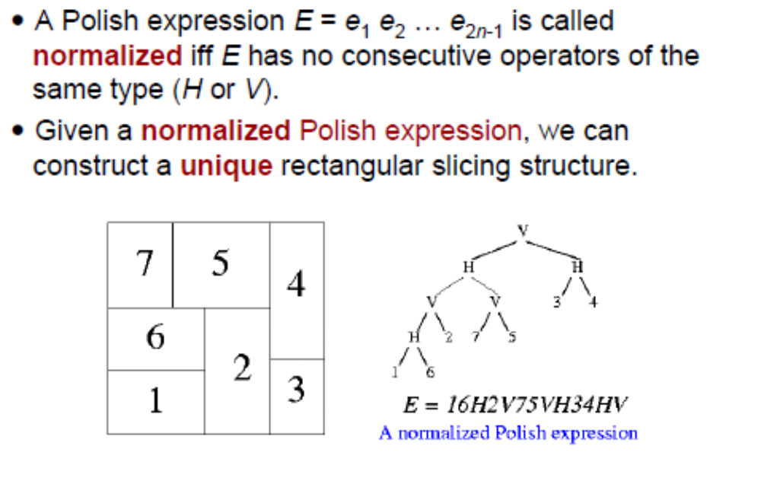
Simulated Annealing for floorplanning

Slide 50
Simulated Annealing for floorplanning
Obtaining new floorplan configuration /solution:
3 types of moves:
O1 (Operand Swap): Swap two adjacent operands
 operands.
O2 (Chain Invert): Complement some chain of operators bwtween two operands (V = H, H = V).
O3 (Operator/Operand Swap): Swap two adjacent operand and operator if results is normalized polish expression
New configuration is also normalized polish expression

Slide 51
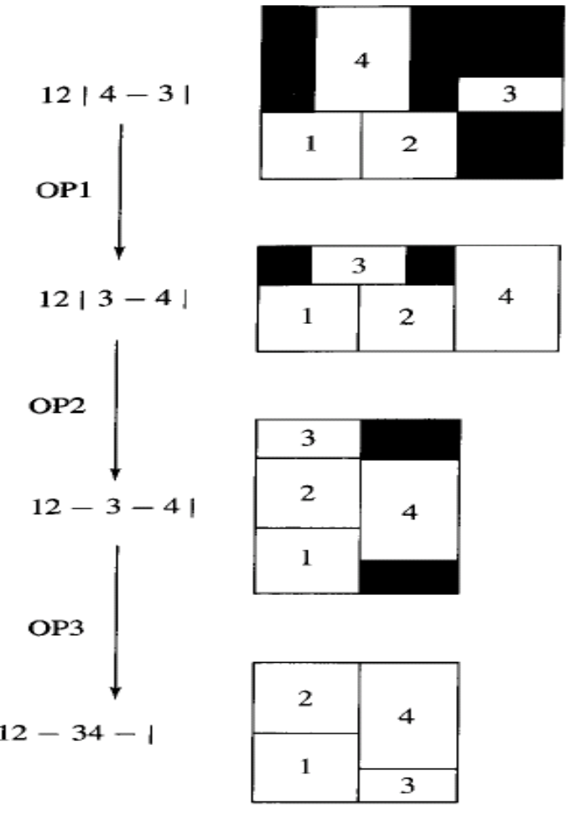
Simulated Annealing : Moves
Op1 : swap 3 and 4
Op2 : Complement – to | after 2
Op3 : - 4 is swaped
It is possible to visit all the floorplans using these moves

Slide 52
Problems yet to consider
Generated Initial Solution
Decided about how to generate new solution from the existing one => topology generation
How to measure the quality of floorplan?
  How to evaluate cost function: C = αA + βL, A : area, L: wirelength
  Area A: How do you compute the floorplan given a shape for each module?
Floorplan Sizing

Slide 53
Floorplan sizing
Circuit modules has many implementations based on different size, speed and power consumption trade-off
Floorplan sizing problem is to determine appropriate module implementation
How to determine the shape of the final floorplan ?

Slide 54
How to determine final shape of floorplan?
Polar Graph representation:
A floorplan is modeled by a pair of directed acyclic graphs:
  Horizontal polar graph ( dependency graph)
  Vertical polar graph (dependency graph)
For horizontal (vertical) polar graph,
  Vertex: Vertical (horizontal) channel
  Edge: if there is a module between 2 channels
  Edge weight: known width (height) of the block for fixed cell

Slide 55
Graph Representation of Floorplan
Polar Graph representation:
Example:

Slide 56
Graph Representation of Floorplan
Polar Graph representation:
a
Example:
b
d
c
Vertical Polar Graph
e
g
f
b
a
c
d
Horizontal Polar Graph
e
f
g

Slide 57
How to determine final shape of floorplan?
Dependency graph : directed acyclic graph (DAG)
Edge weight represents width / height of a module
Find the longest path from left most (top most) channel to right most (bottom most) channel in the dependency graph- Total width/height of the floorplan
Longest path for DAG? [Refer cormen 24.2]
  Topological sorting of vertices : O(V+E) or
  Negate the edge weights, Run shortest path for DAG: O(V+E)
a
c
d
e
f
g
Horizontal Polar Graph

Slide 58
How to determine final shape of floorplan?
Longest path for DAG?
  algorithm dag-longest-path
  input: Directed acyclic graph G
  output: Length of the longest path
  length_to = array with |V(G)| elements of type int with default value 0
  for each vertex v in topOrder(G) do
    for each edge (v, w) in E(G) do
      if length_to[w] <= length_to[v] + weight(G,(v,w)) then length_to[w] = length_to[v] + weight(G, (v,w))
  return max(length_to[v] for v in V(G))
a
c
d
e
f
g

Slide 59
Hierarchical Floorplan sizing
Finds area-optimal implementation of soft (variable-sized) modules on a sliceable floorplan
Sizing algorithm runs in O(dn) time, d: height of slicing tree, n: # of modules
Given: sliceable floorplan F, a set of modules, each having a set of possible implementation (w_{k},h_{k}) sorted as w₁ < w₂ < w₃ < … < w_{s} and h₁ > h₂ > … > h_{s} [non redundant shapes]

Slide 60
Hierarchical Floorplan sizing
  Horizontal node sizing
  Vertical node sizing
y
w = max(a,x), h = b+ y
x
b
a
w = a +x, h = max(b, y)
y
b
a
x

Slide 61
Vertical Node sizing
Given 2 subfloorplans with the topology one with s and the other with t non redundant implementations, parent subfloorplan has atmost s + t – 1 non redundant implementation
Possible to combine each of s with each of t implementation to generate s*t implementation at parent=> at root exponential # of implementation
Not all of them are non redundant.
Which possibilities do we combine ?
(ai,bi)
(xi,yi)

Slide 62
Vertical Node sizing
If bi is dominant ht, (xk,yk) with k > j => (yk< yj) => all combinations of (ai,bi)(xk,yk) are inferior, increases width ( since xk > xj); don’t consider
Similarly if yj is dominant, all cases (al,bl) where l > i not considered
(ai,bi)
(xj,yj)

Slide 63
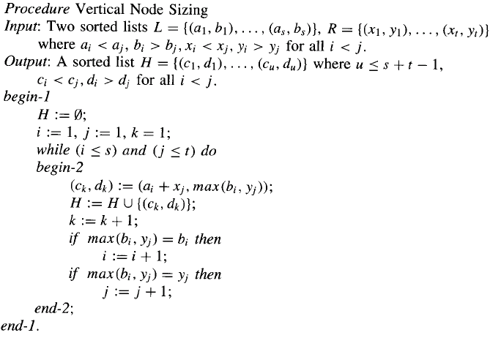
Vertical Node sizing

Slide 64
Vertical Node sizing: complexity
In while loop either i or j or both increases by 1
Worst case: when i and j increases alternatively
  s + t -1 time the loop is executed=> max size of non redundant list at parent
  Tree processed bottom up ( post-order) generating a set of implementations at root, choose the one with minimum area
  Work done at each level : O(n)
  If tree is balanced : height is O(log n) => O(n log n)
  Unbalanced tree: height is O(n) => O(n²)

Slide 65
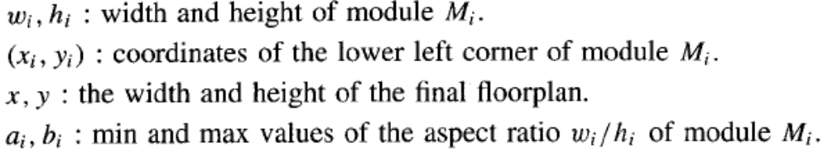
Non hierarchical sizing
No restriction on organization of modules
Integer linear programming approach
Formulation of LP equations
Find x_{i},y_{i}, w_{i}, h_{i} for each module s.t all constraints are satisfied and xy is minimized

Slide 66
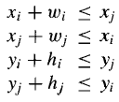
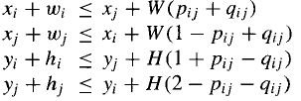
ILP formulation
Constraints:
  Non overlap constraint
  Module size constraint
Non overlap Constraint
  Assuming wi and hi are known
  Atleast one of the constraint must be satisfied
  For each pair of modules mi, mj , two integer variables pij,qij ( 0 or 1 value) introduced
  W, H : upper bounds
  pij = 1, qij = 0, ???

Slide 67

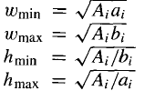
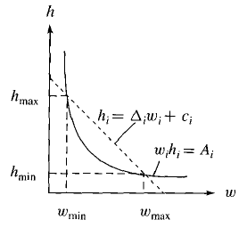

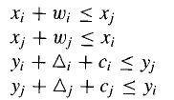
ILP formulation
Module size constraint:
  wi, hi are unknown
  wi in [wmin, wmax]
  hi in [hmin,hmax]
  wi. hi > Ai : non linear
  Transform into linear constraint

Slide 68

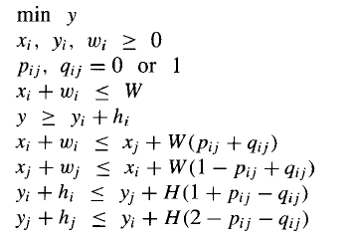
ILP formulation: Cost function
Fix Width and minimize height
Finally:

Slide 69
Graph Representation of Floorplan
Channel digraph representation:
A floorplan is modeled by a directed graph:
  Vertex: channel or cut
  Edge: (v_{i}, v_{j}) is an edge if the cut corresponding to v_{i} is the base and the cut corresponding to v_{j} is the crosspiece of a T-junction
How to identify if a floorplan is slicible or not?
T-junction
Base
crosspiece

Slide 70
Graph Representation of Floorplan
Channel digraph representation:
a
Example:
a
d
b
f
b
f
c
e
e
c
d

Slide 71
Graph Representation of Floorplan
Channel digraph representation:
a
Example:
a
d
b
f
b
f
c
e
e
c
d
a
a
c
c
d
b
d
b

Slide 72
Graph Representation of Floorplan
Channel digraph representation:
a
Example:
a
d
b
f
b
f
c
e
e
c
d
a
a
c
c
d
b
d
b

Slide 73
Graph Representation of Floorplan
Channel digraph representation:
Properties:
  A vertex in channel digraph corresponding to a through cut (a cut whose each end touches the boundary) has outdegree = 0
    A through cut cannot be a base
  A floorplan is slicible iff its channel digraph is acyclic
  4-cycle theorem: A floorplan is non-slicible iff there exist at least one cycle of length 4 in the corresponding channel digraph
    The channel digraph of the simplest non-slicing floorplan is a 4-cycle

