Slide 1
Elective II: VLSI Design
Code: CISM 402
Pritha Banerjee
Courtsey for slides: Yao Wen Chang, National Taiwan University, Taiwan

Slide 2
Placement
Books:
  Chapter 5 of Naveed A. Sherwani, Algorithms for VLSI Physical Design Automation, Kluwer Academic Publishers
  Chapter 2 ( 2.3) of M. Sarafzadeh and C. K. Wong, An introduction to VLSI Physical Design, The McGraw Hill Companies, Inc.

Slide 3
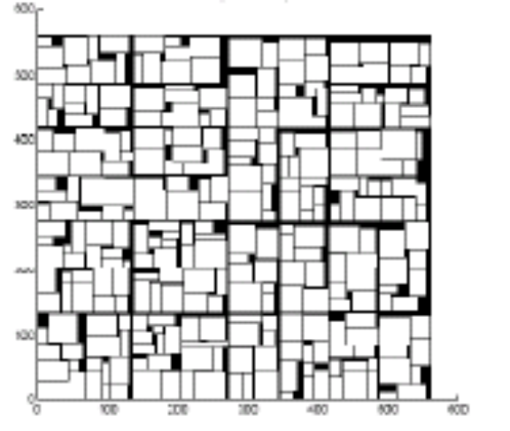
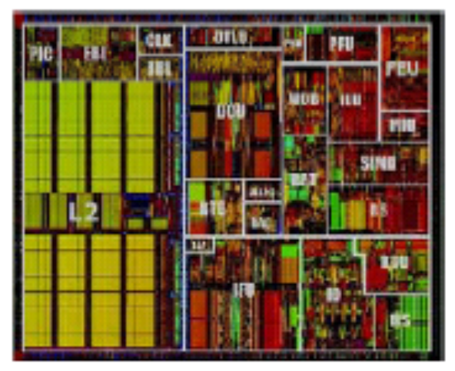
Physical Design Flow
Circuit Partitioning
Floorplanning & Placement
Routing
Layout Compaction
Extraction and Verification

Slide 4
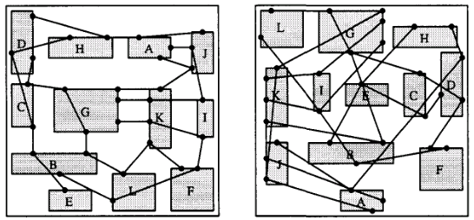
Placement
Problem:
  Given a netlist of fixed blocks with fixed pin locations, construct a layout of blocks ( find positions) s.t
    all nets are routable (congestion driven placement)
    Area is minimized ( area /wirelength driven placement)
    Length of longest path (critical path length) is minimized : performance driven ( timing driven placement)
Placement problem is NP complete

Slide 5
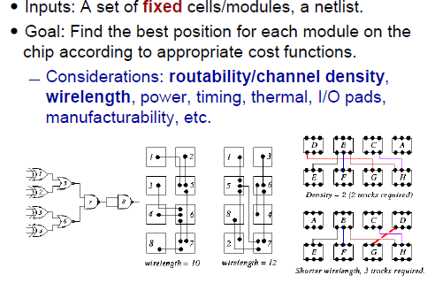
Placement

Slide 6
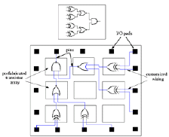
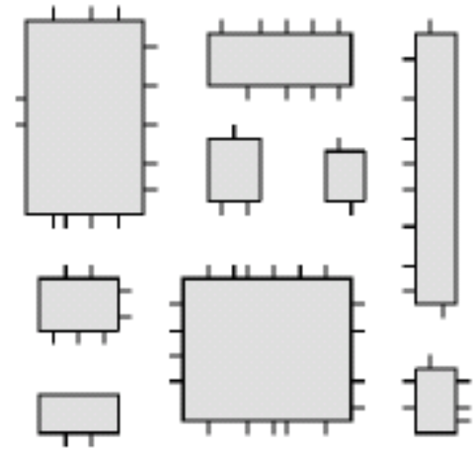
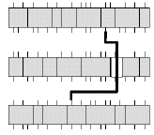
Design style specific placement problems
Full Custom: blocks have different size and shape, minimize area and critical path length
Standard Cells: cells have same height, minimize channel height, width of widest row
Gate arrays: assign gates to slots on the gate array

Slide 7
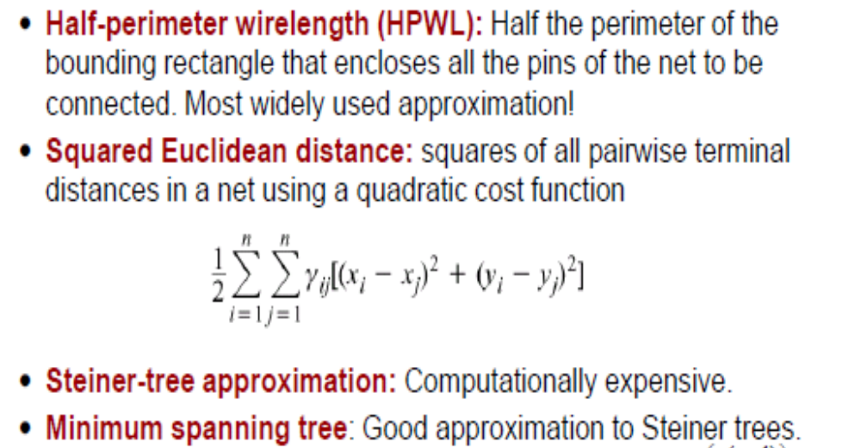
Basic wirelength Models

Slide 8
Minimum spanning Tree
Given an edge weighted undirected graph G(V,E), find the minimum set of edges that spans all the vertices of G
Kruskal’s Algorithm: O(E log E)
  Sort edges in non decreasing order, have |V| sets
  add edge (u,v) in tree if u, v belongs to different set and create new set having u and v, else
  edge is discarded
Prim’s Algorithm: O(E log E)
  Start with random vertex, pick least weighted edge that do not form a cycle

Slide 9
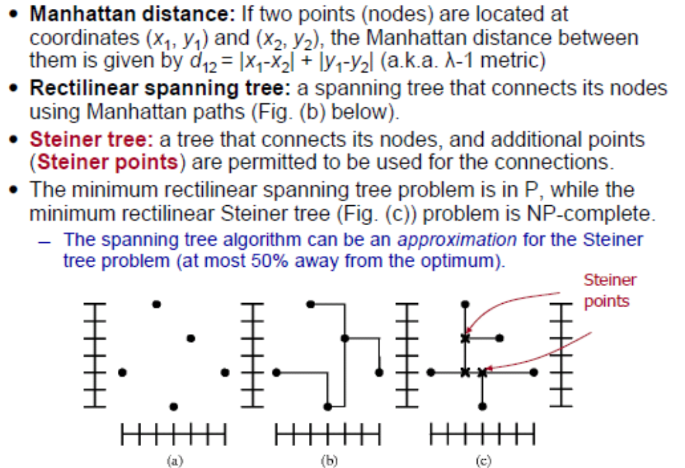
Spanning Tree Vs. Steiner Tree

Slide 10
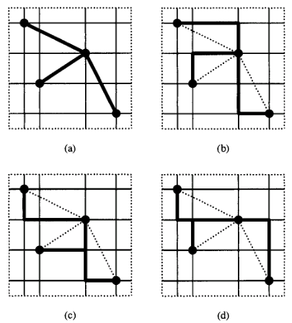
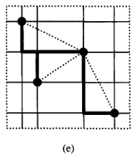
Spanning Tree Vs. Steiner Tree
Find Minimum Spanning tree: cost(MST)
Apply local modification to obtain Rectilinear Steiner tree: cost (RSMT)
Cost(MST)/Cost (RSMT) <= 3/2

Slide 11
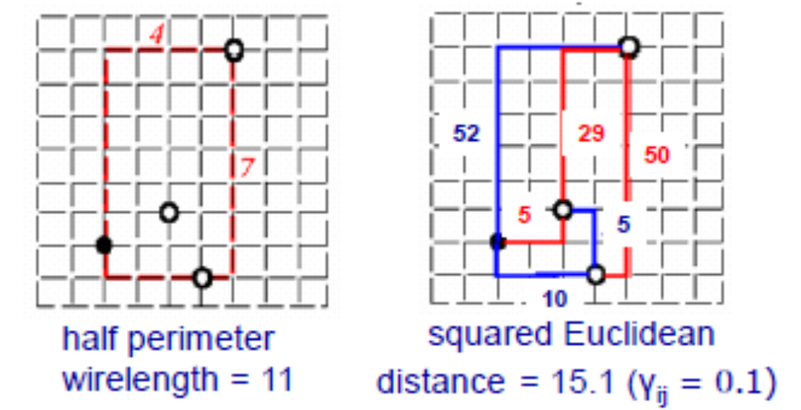
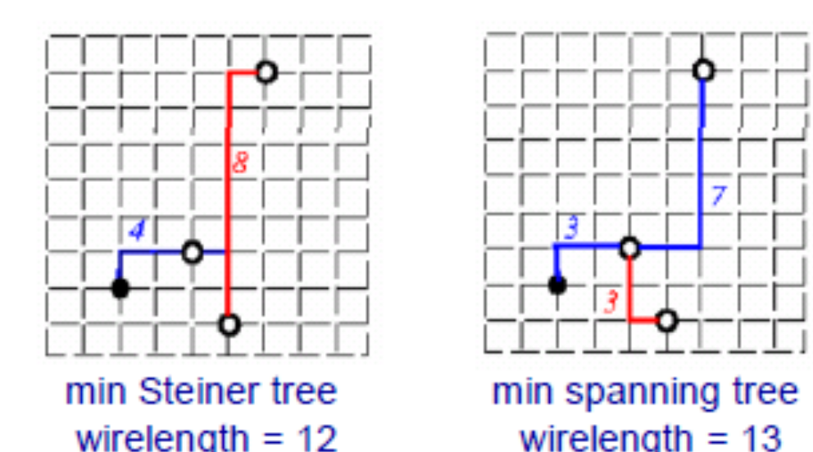
Basic wirelength Models

Slide 12
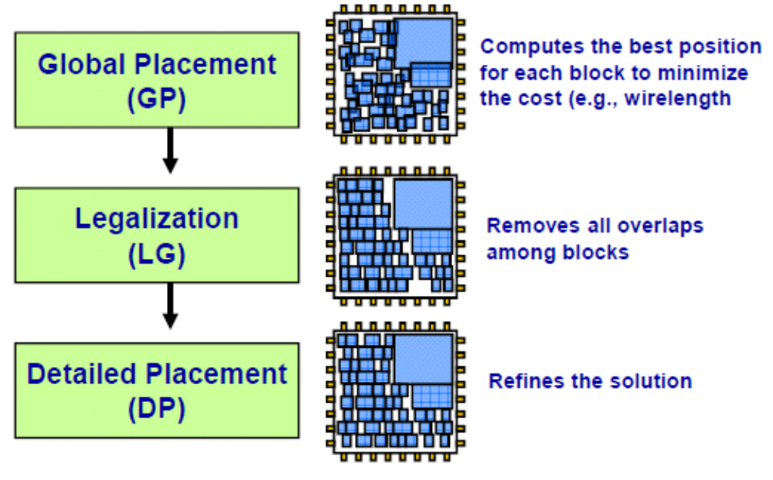
Typical Placement Flow

Slide 13
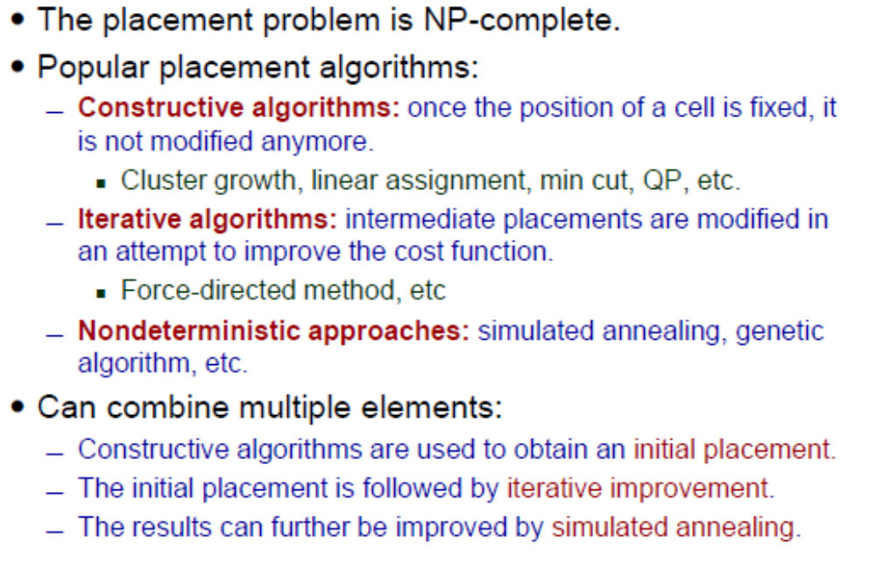
Global Placement Methods

Slide 14
Placement Methods
Simulated annealing based placement for standard cells
Partition based placement for custom design
Analytical placement : force directed
Regular Placement : Assignment problem
Placement by Genetic algorithm

Slide 15
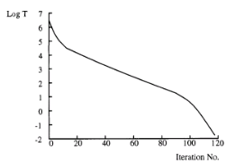
Placement : Simulated annealing based
Timber-Wolf 3.2 for standard cell placement
  Initial temperature : 4000000
  Final temperature : 0.1
  Cooling Schedule (T): α(T). T
    α(T): low when T high: 0.8, temperature decreases rapidly
    α(T): 0.95, when T medium, temperature changes slowly
    α(T): 0.8 when T low, temperature changes faster
  Inner loop criteria: # of trials per temperature
    Depends on # of blocks in circuit

Slide 16
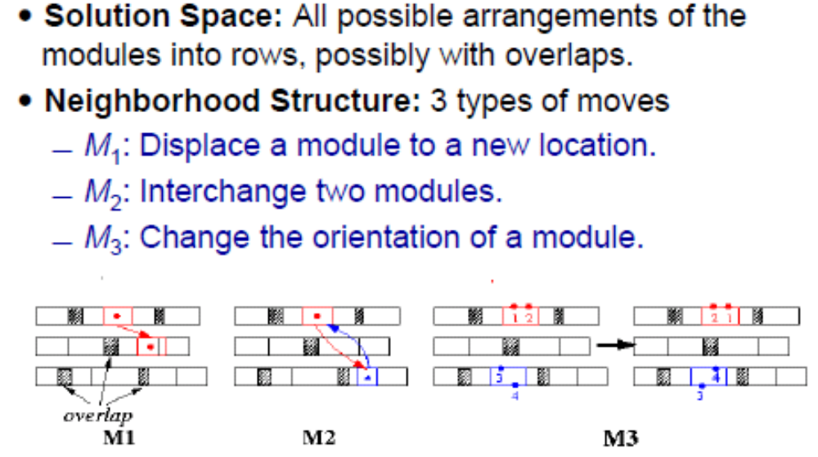
Placement : Simulated annealing based
Timber-Wolf 3.2 for standard cell placement
  Moves to generate new configuration

Slide 17
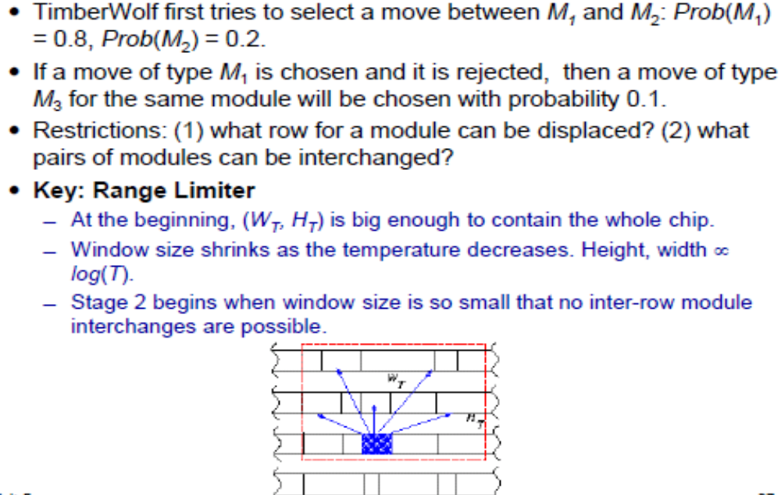
Placement : Simulated annealing based
Timber-Wolf 3.2 for standard cell placement
  Move selection

Slide 18
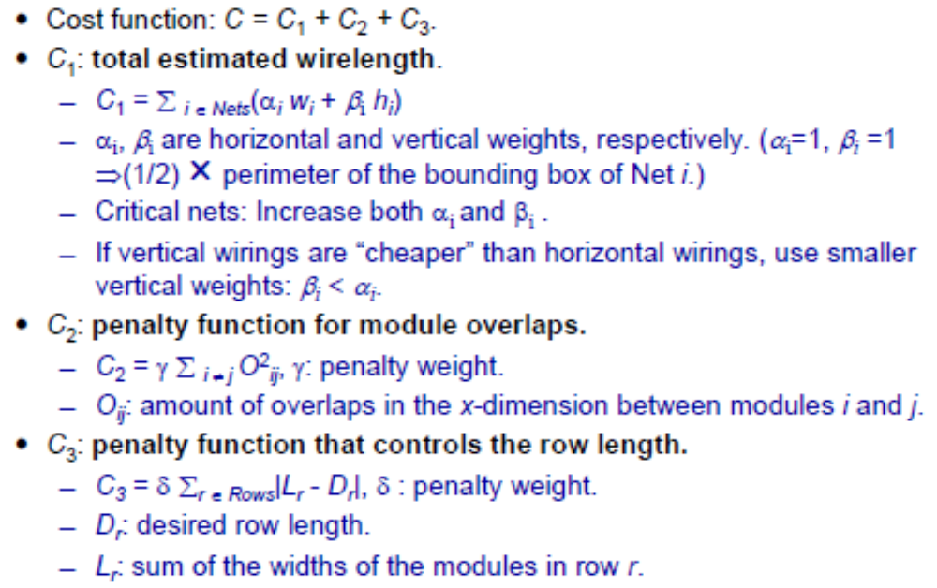
Placement : Simulated annealing based
Timber-Wolf 3.2 for standard cell placement
  Cost function

Slide 19
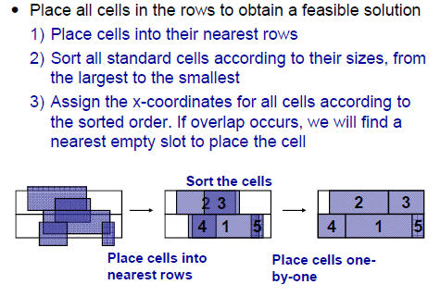
Placement : Simulated annealing based
Remove Overlap (Legalization)

Slide 20
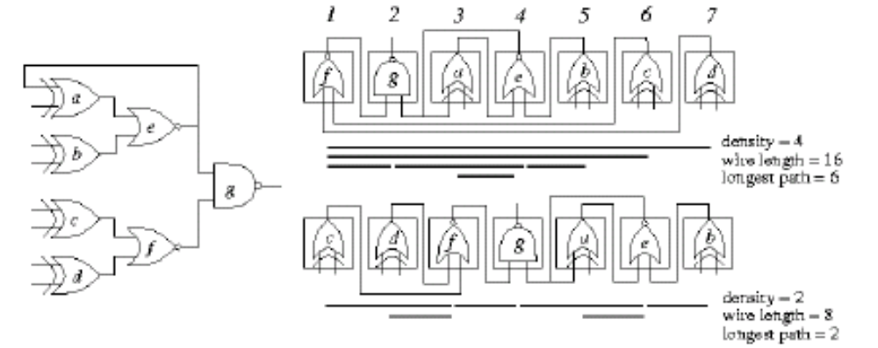
Placement : Partition based Placement
top-down min-cut based
  Reduce number of nets cut across partition on chip
  Objectives
    Total net cut: Sum of all nets cut by vertical and horizontal cut line; minimize semi perimeter wirelength
    Min-max cut value: for std. cell, gate arrays, need to reduce # of nets routed through channel; cut-line is the channel between rows

Slide 21
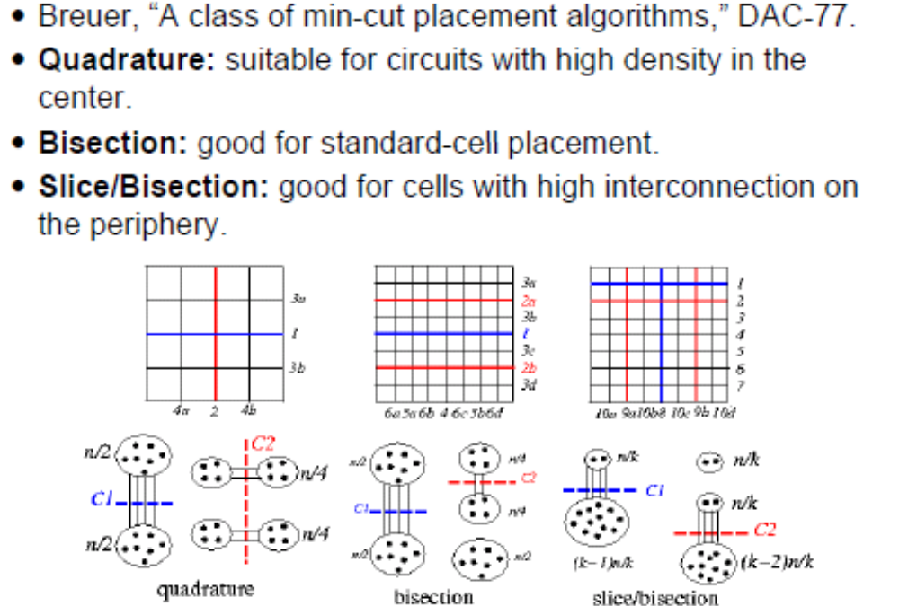
Placement : Partition based
top-down min-cut based

Slide 22
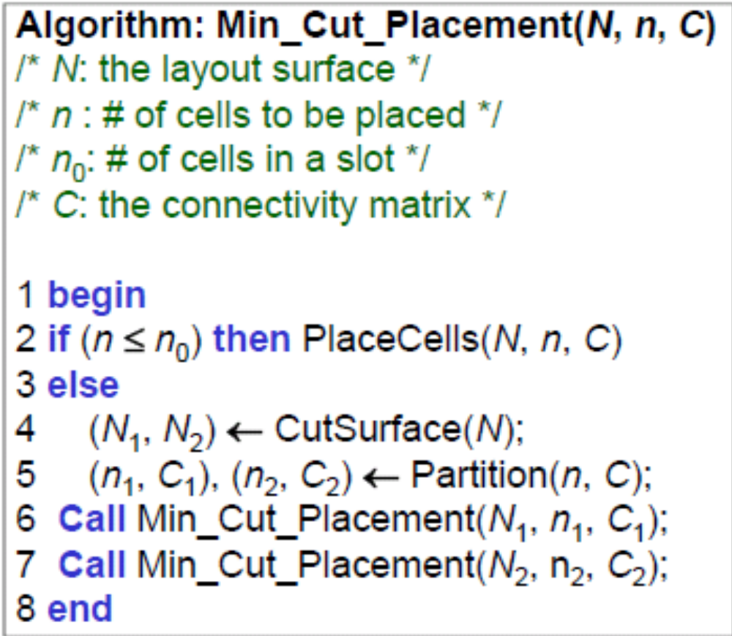
Placement : Partition based
top-down min-cut based

Slide 23
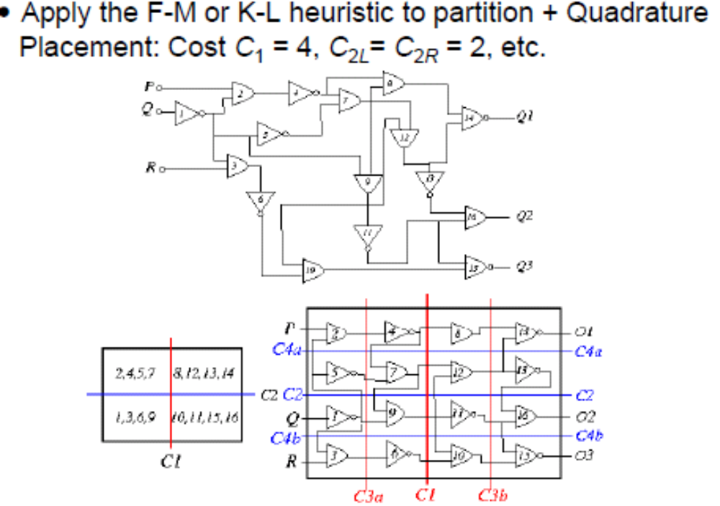
Placement : Partition based
Quadrature placement example

Slide 24
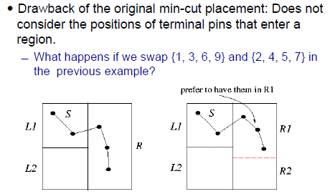
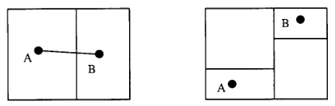
Min cut placement with terminal propagation
Increases wirelength
Increases congestion

Slide 25
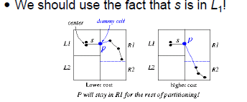
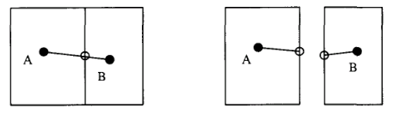
Min cut placement with terminal propagation
Introduce dummy terminal at the nearest boundary, fore partitioner not to put the blocks in the other partition during next level of partition

Slide 26
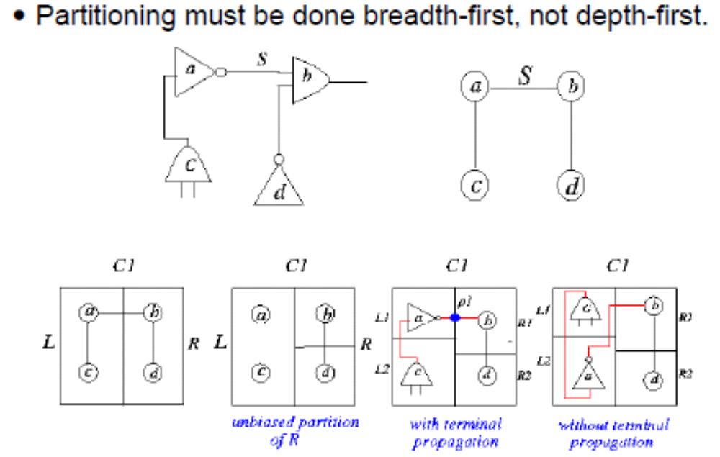
Min cut placement with terminal propagation

Slide 27
Regular Placement: Assignment problem
Possible positions (targets) of modules are known
Assign each module to a target s.t wirelength is minimized
  Relaxed placement ( may have overlaps)
  Overlap removal
Relaxed placement : solve an LPP
Overlap removal: solve minimum weighted perfect matching

Slide 28
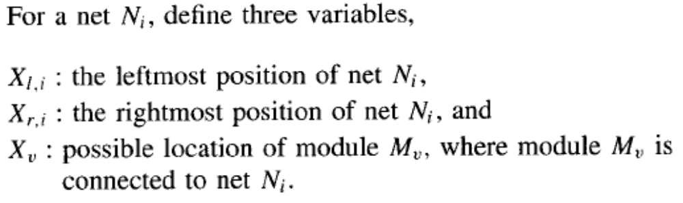
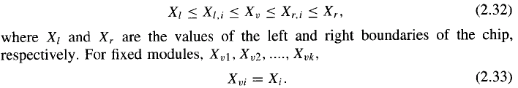

Regular Placement: Relaxed Placement
LPP formulation
Similar equation for Yi

Slide 29
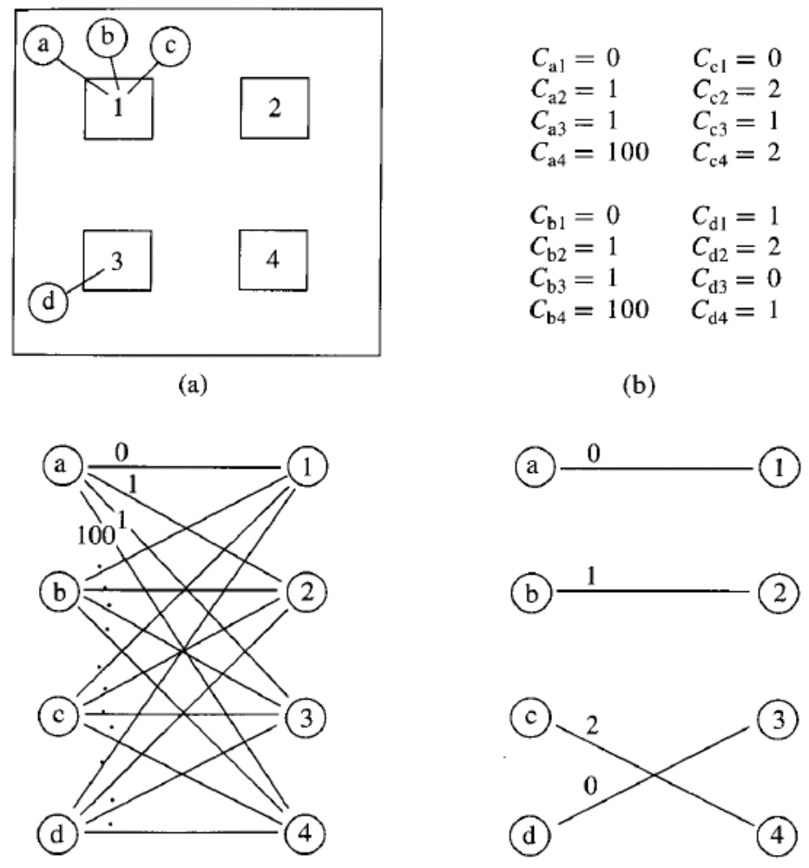
Regular Placement: Relaxed Placement
Overlap removal
Cij = Cost(Mi,Hj)
Cij = distance of current position of Mi to Hj
Define complete bipartite graph
  LHS: modules
  RHS: targets
  Edge weight = cij
Find a minimum weighted perfect matching:O(n³)

Slide 30
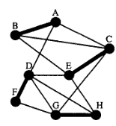
Matching
G=(V,E) be a connected undirected graph
Matching in G is a subset of edges M s.t no two edges in M have a vertex in common
e is matched if it is in M else unmatched or free
v is matched if it is incident to matched edge else unmatched or free
A maximum matching: matching of maximum cardinality. |M| is maximum
A perfect matching: every vertex is
matched
Min wt matching: sum of weights of M is minimum

Slide 31
Matching
Alternating path p w.r.t given M in undirected graph: a simple path (without repeating vertices) consisting of alternating matched and unmatched edges
Augmenting path w.r.t M: if all the matched edges in p are in M & its endpoints are free (odd number of edges)
a
b
c
d
a
b
c
d
e
f
g
h
|M| = 4
|M| = 4 + 1
e
f
g
h
i
j
k
l
i
j
k
l
Y: unmatched, W: mathched
p : abcgfe: aug. path
Reverse edges (matched becomes Unmatched and vice–versa)
M is maximum iff G has no aug. path w.r.t M

Slide 32
Bipartite Matching Algorithm
Input : Bipartite graph G=(X U Y, E)
Output: maximum matching M in G
Initialize M to any matching (empty)
While there exists a free x-vertex and free y vertex
  Let r be a free x-vertex. Use BFS, grow alternating path tree T rooted at r
  If T is Hungarian tree then G = G – T {remove T}
  Else find aug. path p in T and M = M p
End while
Hungarian Tree: if no free y vertex starting from r
M p : augment matching by reversing edge roles

Slide 33
Bipartite Matching algorithm
a
b
c
b
d
Free vertex
a
d
e
e
f
c
g
f
g
h
j
i
j
Alternating path tree
b
c
d
a
f
c
e
i
f
d
e
g
h
Hungarian tree
i
j
Y: unmatched, W: mathched
Construction of alternating path tree: O(|E|) using breadth first search
O(|V|) trees are constructed
Total running time : O(|V||E|) = O(n³), n= |V|

Slide 34
Linear Placement
One dimensional placement problem
  Min-cut or total length based
  Optimal linear arrangement is NP-hard
Use it to obtain initial placement
Clustering / partition tree created
Nodes are placed according to leaf sequence
May be improved by considering all possible d! positions if a node has degree d.
d : max degree of a node, d! time at each internal node, for each permutation O(n) is cost evaluation time; so, O(n.d!) at each internal node
Atmost n inner nodes; So total time complexity: O(n² d!)
If d = n, O(n² n!), good quality but expensive w.r.t time
If d = 2, O(n² ), sacrifice quality, good run time

Slide 35
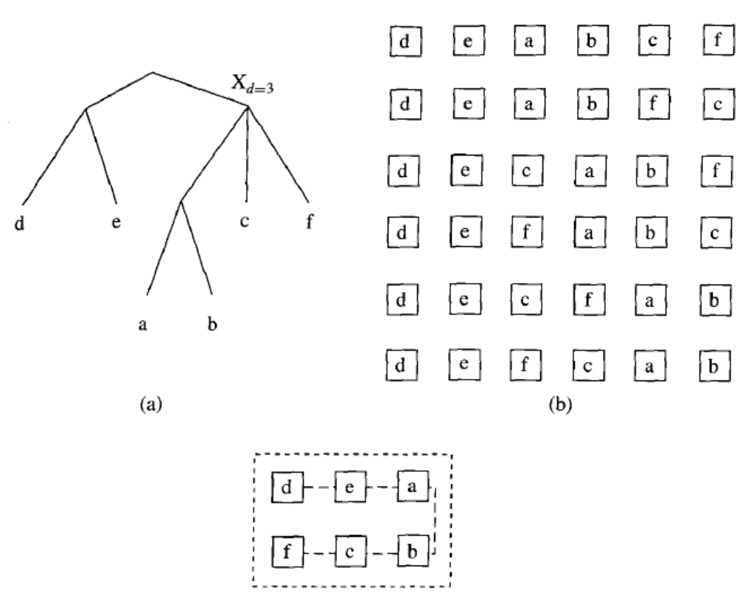
Linear Placement

Slide 36
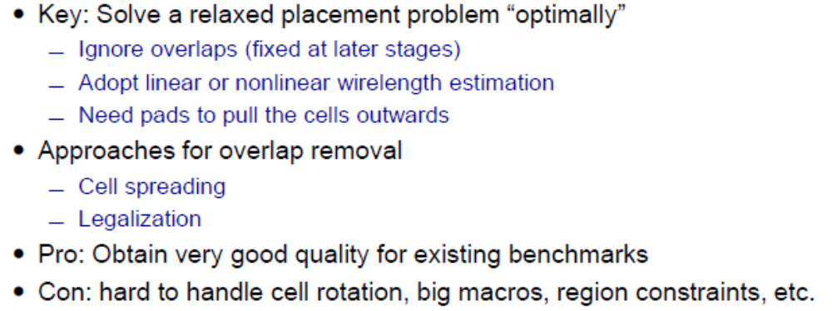
Analytical Placement
Force Directed placement

Slide 37
Analytical Placement
Force Directed placement

Slide 38
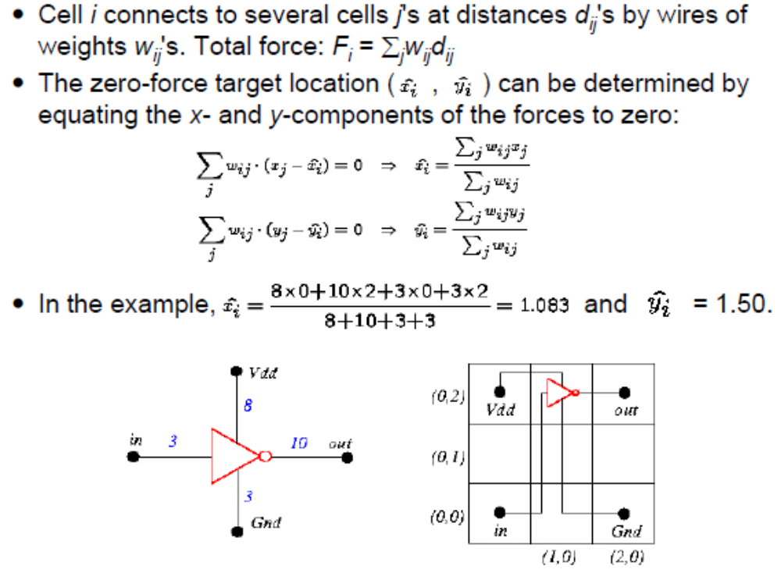
Analytical Placement
Find zero-force target location

Slide 39
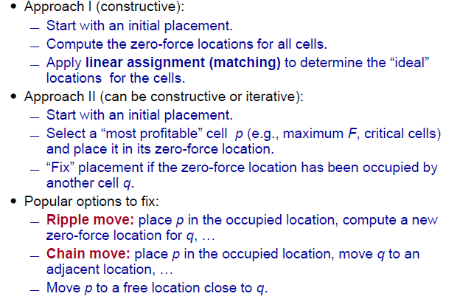
Analytical Placement
Force Directed placement : approaches

Slide 40
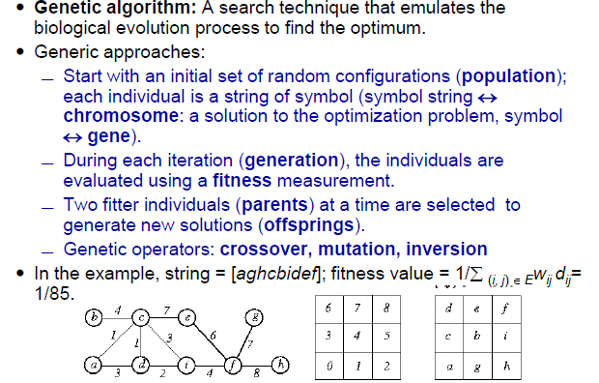
Placement by Genetic Algorithm

Slide 41
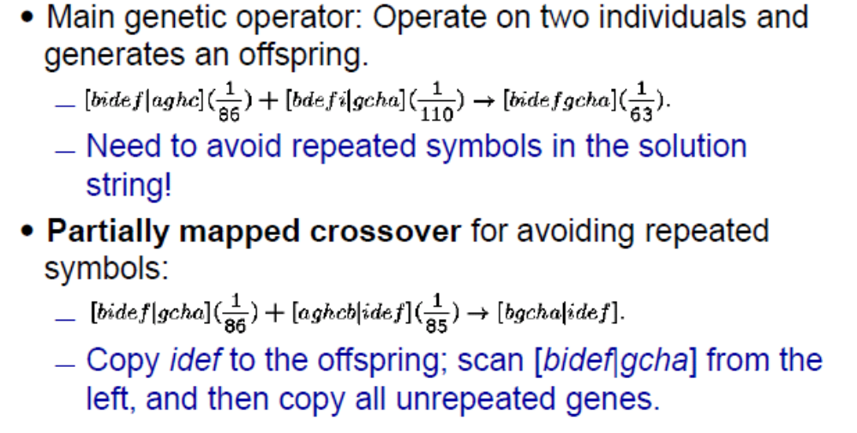
Placement by Genetic Algorithm
Genetic Operator : Crossover

Slide 42
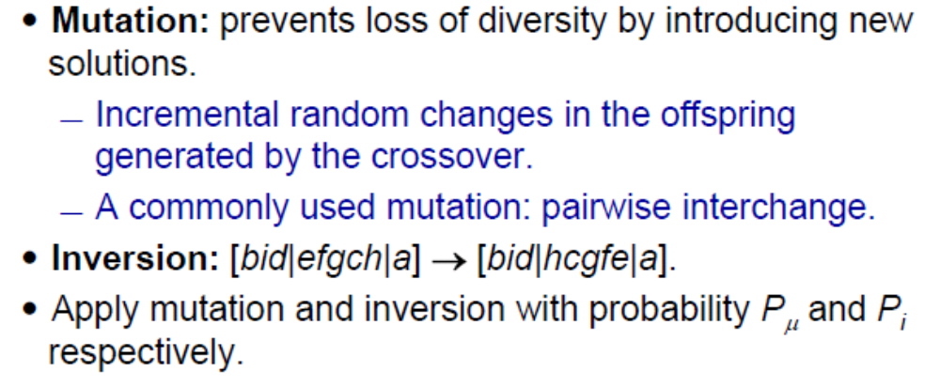
Placement by Genetic Algorithm
Genetic Operator : Mutation and Inversion

Slide 43
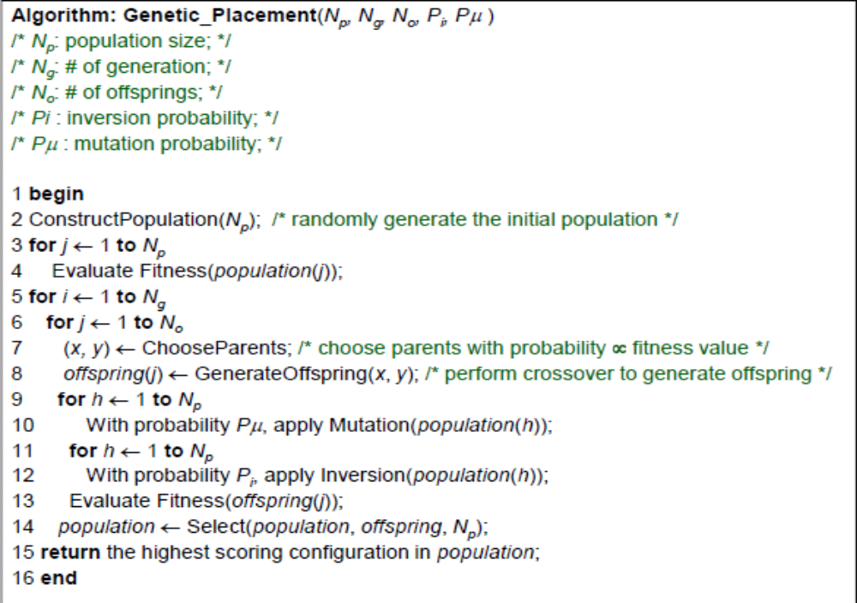
Placement by Genetic Algorithm

Slide 44
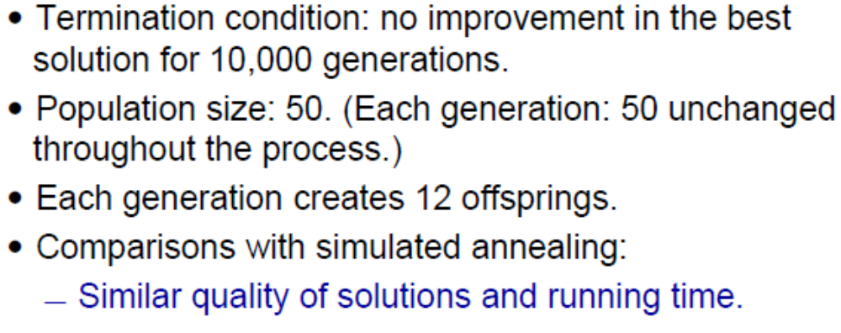
Placement by Genetic Algorithm
Experimental parameters

