Slide 1
Elective II: VLSI Design
Code: CISM 402
Pritha Banerjee
Courtsey for slides: Debasis Mitra, NIT Durgapur

Slide 2
Design and Fabrication of devices
Books:
  Chapter 2,3 of Naveed A. Sherwani, Algorithms for VLSI Physical Design Automation, Kluwer Academic Publishers

Slide 3
The underlying technology
Chip has several layers of different materials on silicon wafer
  Shape, size and location of materials in each layer is given by mask
  Layers are ordered
  Devices formed by overlapping different materials in different layers
  Design rules required to ensure proper fabrication
Transistors : basic building blocks of chip
  nMOS: n-type Metal Oxide Semiconductor Field effect Transistor (nMOSFET)
  pMOS: p-type Metal Oxide Semiconductor
  CMOS: Complementary Metal Oxide Semiconductor

Slide 4
MOS Transistors
Silicon –a semiconductor, forms the starting material
MOS (Metal Oxide Silicon) structure created by superimposing several layers of conducting, insulating, and transistor forming materials
n-type/nMOS: Electrons carry charge
p-type/pMOS: Holes carry charge
    CMOS transistors
  Building logic gates from transistors
  Transistor layout and fabrication

Slide 5
Silicon Lattice
Transistors are built on a silicon substrate
Silicon is a Group IV material
Forms crystal lattice with bonds to four neighbors
Si
Si
Si
Si
Si
Si
Si
Si
Si

Slide 6
Dopants
Silicon is a semiconductor
Pure silicon has no free carriers and conducts poorly
Adding dopants increases the conductivity
Group V: extra electron (n-type);Arsenic;
Group III: missing electron , called hole (p-type); Boron
Si
Si⁻
Si
Si
Si+
Si
Si
As⁺
Si
Si
B-
Si
Si
Si
Si
Si
Si
Si

Slide 7
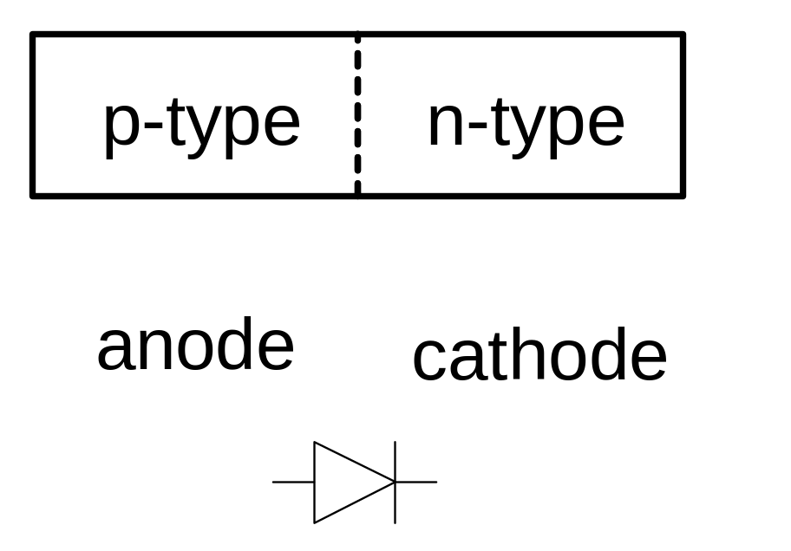
P-n junction
A junction between p-type and n-type semiconductor forms a diode.
Current flows only in one direction
Voltage at p-type > volt. At n-type ; current flows; else very little current flows

Slide 8
P-n junction
A junction between p-type and n-type semiconductor forms a diode.
Current flows only in one direction
Voltage at p-type > volt. At n-type ; current flows; else very little current flows

Slide 9
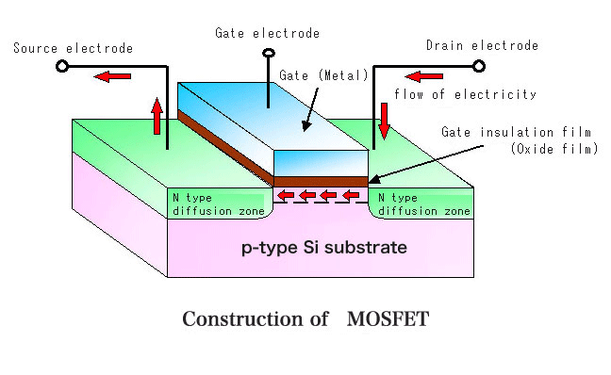
An n-MOS Transistor
Four terminals: gate, source, drain, body
Gate – oxide – body stack looks like a capacitor
  Gate and body are conductors
  SiO₂ (oxide) is a very good insulator
  Gate is polycrystalline silicon
  Body : grounded
  P-n junction: no current
  Flow
  Gate <= 0, drain and
  source disconnected
  Gate <=1, current flow
  from drain to source

Slide 10
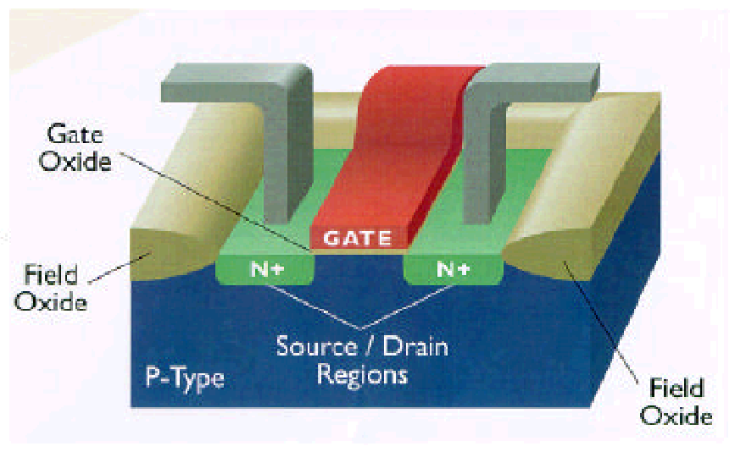
An n-MOS Transistor: 3D Perspective
Polysilicon
Aluminum

Slide 11
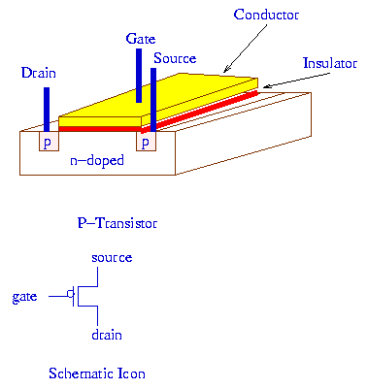
An p-MOS Transistor

Slide 12
An p-MOS Transistor
Similar, but doping and voltages reversed
  Body tied to high voltage (V_{DD})
  Gate low: transistor ON
  Gate high: transistor OFF
  Bubble indicates inverted behavior
Source
Gate
Drain
Polysilicon
SiO
2
p
+
p
+
n
bulk Si

Slide 13
Working of MOS Transistors
N-type: If gate is ‘0’the source is disconnected from the drain and if gate is ‘1’, source is connected to the drain
P-type: If gate is ‘0’the source is connected to the drain and if gate is ‘1’, source is disconnected from the drain

Slide 14
Working of MOS Transistors
N-type: If gate is ‘0’the source is disconnected from the drain and if gate is ‘1’, source is connected to the drain
P-type: If gate is ‘0’the source is connected to the drain and if gate is ‘1’, source is disconnected from the drain

Slide 15
MOS Transistors as Switches
N-SWITCH
P-SWITCH
G = 0
G = 1

Slide 16
More on MOS Switches
N-SWITCH:
perfect if ‘0’ is to be passed but
imperfect when ‘1’ is to be passed
P-SWITCH:
perfect if ‘1’ is to be passed but
imperfect when ‘0’ is to be passed
N and P switches are ON/OFF on complementary values of gate signal, need both types to get perfect 0 and 1

Slide 17
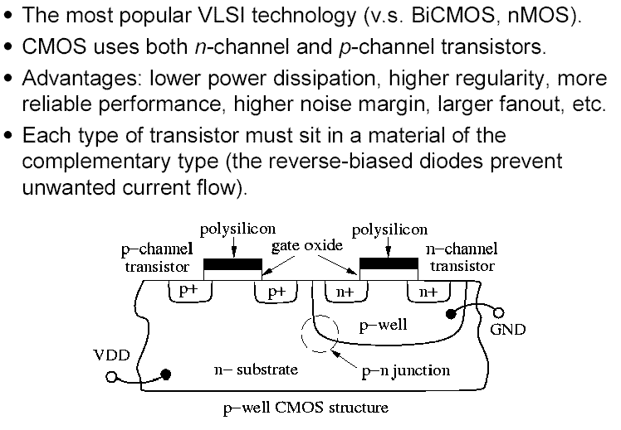
Complementary MOS (CMOS)

Slide 18
Complementary MOS (CMOS)
V_{g}
V_{out}
V_{s}
V_{d}
p⁺
p⁺
n⁺
n⁺
p
n

Slide 19
CMOS Technology
VDD
P-MOS
Pull-up
Y
N-MOS
Pull-down
VSS

Slide 20
Why CMOS Technology
For all input combinations, there is always a path either from ‘VDD’ to the output or from the output to ‘VSS’
There is never a direct path between ‘VDD’ and ‘VSS’–this is the basis for the low static power dissipation for CMOS

Slide 21
CMOS Inverter
V_{DD}
V_{DD}
pMOS
A
B
A
B
nMOS
GND
pMOS
G=0, pMOS on
G =1, nMOS on
GND
nMOS
CMOS Transistor layout

Slide 22
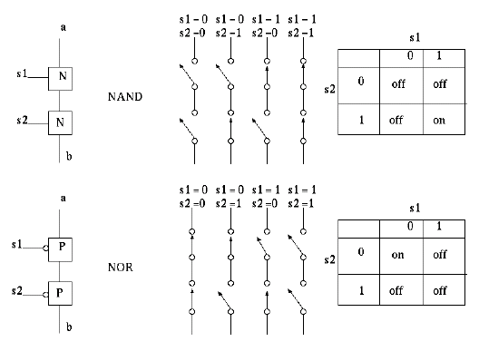
Series and Parallel connections
nMOS: 1 = ON
pMOS: 0 = ON
Series: both must be
ON
Parallel:
either can be ON

Slide 23
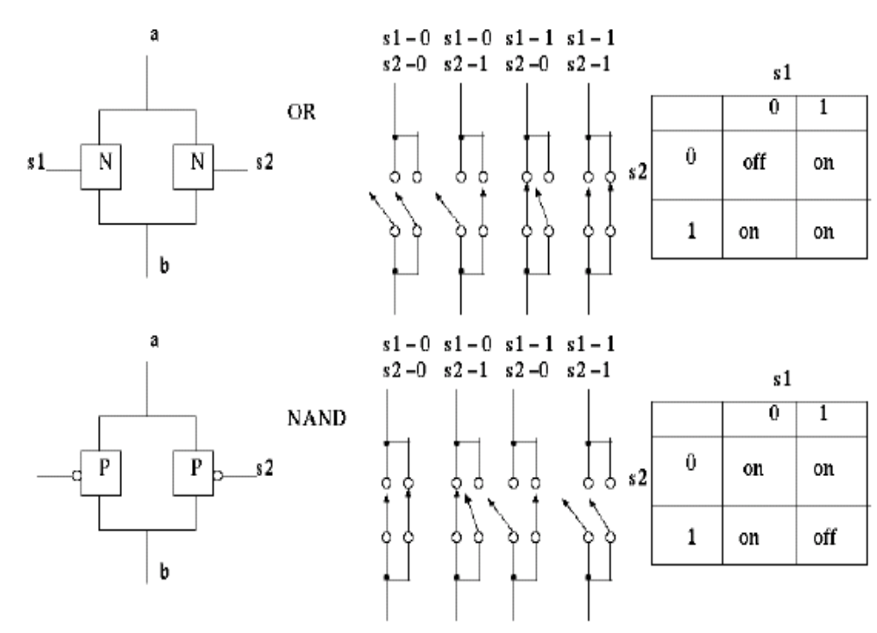
Series and Parallel connections
nMOS: 1 = ON
pMOS: 0 = ON
Series: both must
be ON
Parallel:
either can be ON

Slide 24
Logic Design in CMOS
Fundamentals:
Series: combination is ON when both are ON
Parallel: combination is ON when either is ON
P switches in Parallel : A’ + B’ + C’+ ….. [or (A.B.C…..)’]
P switches in Series : A’.B’.C’…. [or (A+B+C+…)’]
N switches in Parallel : A + B + C + …..
N switches in Series : A.B.C….

Slide 25
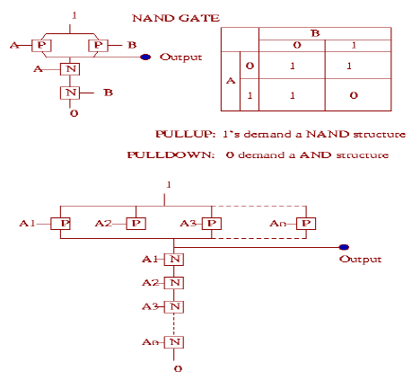
Build NAND using CMOS
NAND gate
Pull-up implements
Original function
2-input NAND gate
Pull-down implements complement of the function
n-input NAND gate

Slide 26
CMOS NAND Gate
VDD
VDD
B
B
A
A
C
C
GND
pMOS
GND
nMOS

Slide 27
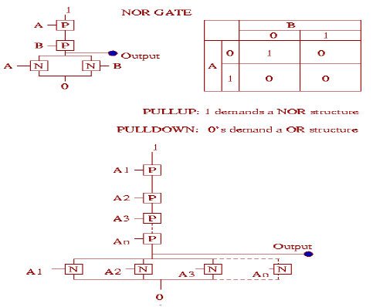
Buid NOR using CMOS
NOR gate
2-input NOR gate
n-input NOR gate

Slide 28
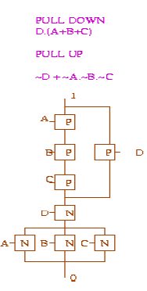
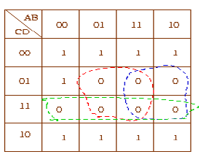
Logic Design in CMOS
General Boolean function: ((A+B+C).D)’
output
NOTE: Karnaugh map can be used to minimize the given function

Slide 29
Logic Design in CMOS
Assignment 1: Design the following Boolean functions in CMOS.
((A.B) + (C.D))’
(((A.B) + C).D)’

Slide 30
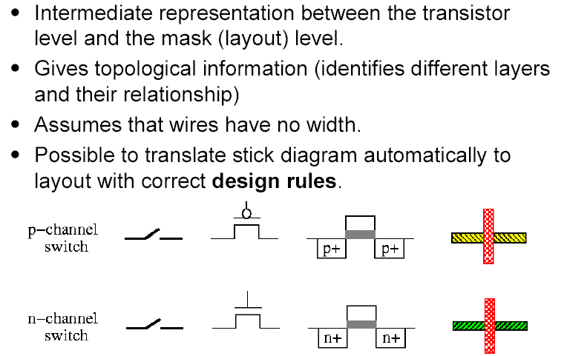
Stick Diagram

Slide 31
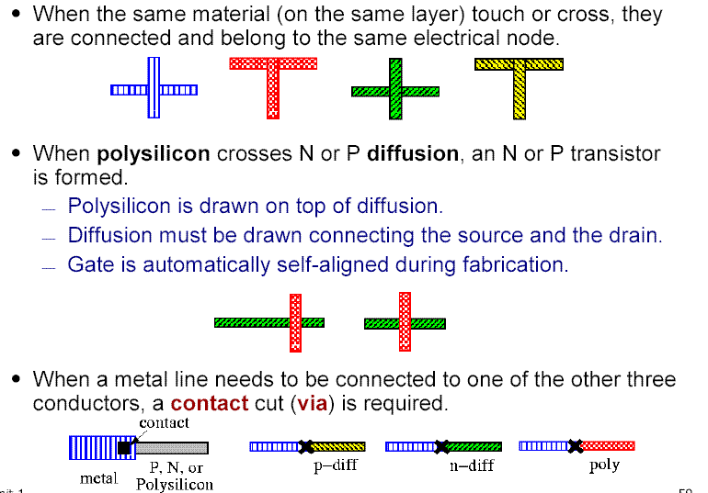
Stick Diagram

Slide 32
CMOS Inverter Stick Diagrams
V_{DD}
pMOS
A
B
nMOS
GND

Slide 33
CMOS Inverter Stick Diagrams
V_{DD}
pMOS
A
B
nMOS
GND

Slide 34
CMOS Inverter Stick Diagrams
V_{DD}
pMOS
A
B
nMOS
GND
pMOS
nMOS

Slide 35
CMOS Inverter Stick Diagrams
V_{DD}
pMOS
A
B
A
nMOS
GND
pMOS
nMOS

Slide 36
CMOS Inverter Stick Diagrams
V_{DD}
V_{DD}
pMOS
A
B
A
B
nMOS
GND
GND
pMOS
nMOS

Slide 37
CMOS Inverter Stick Diagrams
V_{DD}
V_{DD}
pMOS
A
B
A
B
nMOS
GND
GND
pMOS
nMOS

Slide 38
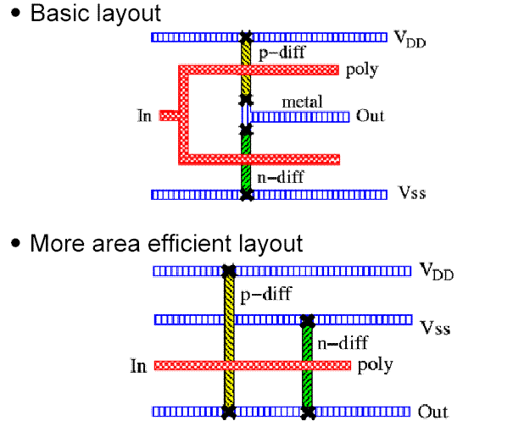
CMOS Inverter Stick Diagrams

Slide 39
CMOS Inverter Stick Diagrams
V_{DD}
pMOS
Y
A
B
A
B
nMOS
GND
V
DD
V
DD
A
A
B
C
metal
1
poly
ndiff
pdiff
Y
Y
contact
GND
GND
INV
NAND
3

Slide 40
Design Rules
Interface between designer and process engineer
Guidelines for constructing process masks
Unit dimension: Minimum line width
  scalable design rules: lambda parameter
  absolute dimensions (micron rules)

Slide 41
Design Rules
The constraints imposed on the geometry of a circuit layout to guarantee that the circuit can be fabricated with an acceptable yield
Diffusion Region Width
Polysilicon Region Width
Diffusion-Diffusion Spacing
Poly-Poly Spacing
Polysilicon Gate Extension
Contact Extension
Metal Width
2λ
2λ
3λ
2λ
2λ
λ
3λ
λ is the maximum
misalignment of a
feature from its
intended position
in the wafer due to
over-etching, over
or underexposure,
distortion, ...

Slide 42
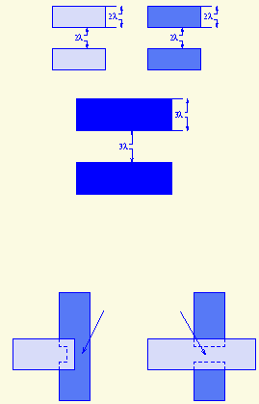
Size and Separation Rules
Diffusion
Poly
Metal
Incorrectly and Correctly Formed Channels
Diffusion
Short
Channel
Poly
Incorrectly formed
Correctly formed

Slide 43
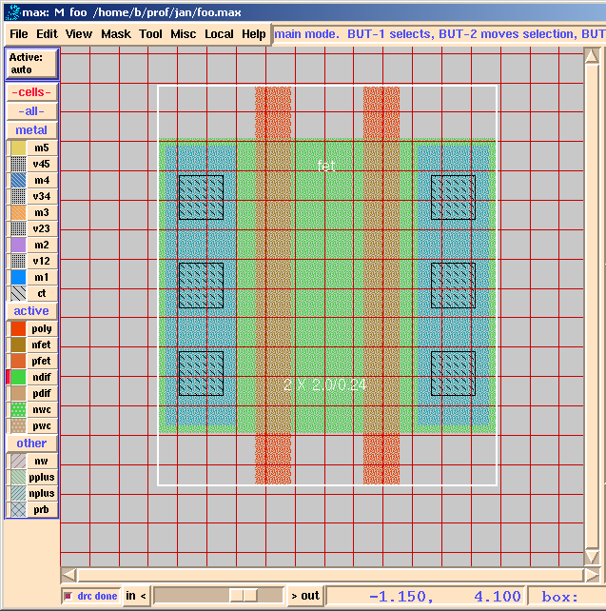
Layout Editor

Slide 44
Magic
http://opencircuitdesign.com/magic/
http://vlsi.cornell.edu/magic/
http://esaki.ee.boun.edu.tr/courses/ee537/magic-tut.pdf

Slide 45
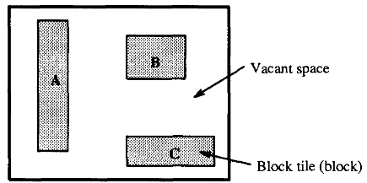
Layout Editor
Allows designer to create and edit VLSI layout – semiautomatic features
What data structure to use?
How to represent a layout ?
- Each feature is a rectangular region
- partition the region into a collection of tiles
- elements of a layout : block tiles/blocks
- p-diff, n-diff, poly, metal ….
- area with no block- vacant space, vacant tiles

Slide 46
Operations on Layout Editor
Basic operations to be performed on layout
Point finding : given coordinate of point p(x,y), find if it lies in a block, if yes, identify block
Neighbour finding: find all blocks touching a given block
Block visibility: find all bocks visible from block B in x and y direction
Area searching: Given a block with fixed area, upper-left corner, width, height, find if it intersects with other block
Directed area enumeration: Given above for a block B, visit each block intersected by B in sorted order

Slide 47
Operations on Layout Editor
Block insertion: Insert a block in the layout without any overlap
Block Deletion: Delete a block from layout
Plowing: Given an area A & direction d, remove all blocks Bi from A by shifting each Bi in direction of d, while preserving order of blocks
Compaction: compress entire layout
Channel generation: determine vacant space in the layout and partition into tiles

Slide 48
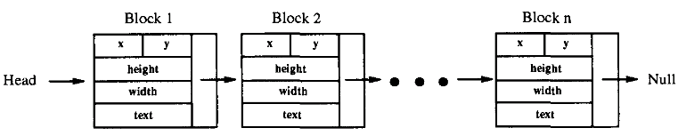
How to store Blocks?
Linked list L
Find neighbour of B in L
  Check each side of B if it shares the side with all the remaining blocks
  O(n) complexity

Slide 49
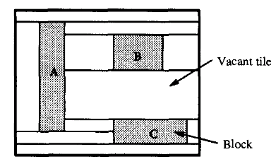
How to store vacant spaces?
Linked list L structure does not store vacant spaces of layout
How to store vacant spaces?
Convert vacant spaces into vacant tiles by extending upper & lower boundaries of each block horizontally
Vacant tiles can also be stored as blocks in the linked list

Slide 50
Data structures for layout
Linked list of blocks
Bin Based method
Neighbour pointers
Corner stiching

Slide 51
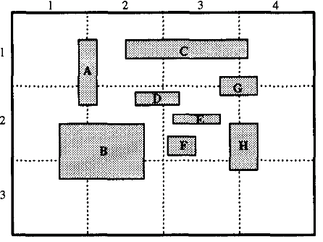
Bin –based Method
Does not store vacant tiles
A grid imposed on layout; creates bins
Each bin maintains a linked list of blocks that intersect with this bin
Space complexity : O(bn), b: # of bins, n: # blocks
Find neighours of block B
For all bins that contain
B, has to be searched for

Slide 52
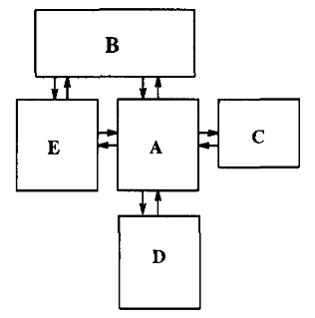
Neighbour-pointers
Represents blocks by left-upper corner, length, width and pointers to all its neighbouring blocks
Space complexity : O(n²)
Difficult to maintain
Block insertion/deletion
take O(n) time
Does not represent
vacant tiles

Slide 53
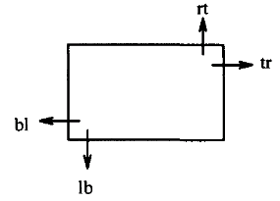
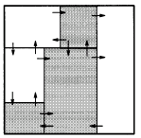
Corner Stitch
Best representation so far
Both block & vacant tiles are stored
Neighbour information is stored but pointer update easier than neighbour pointer data structure
Most of the operations are O(n)
Tiles are linked by set of pointers called corner stitches

Slide 54
Operations using Corner Stitch
Point finding
Neighbour finding
Area Search

Slide 55
Point finding using Corner Stitch
Given a point p2, find the path through the corner stitches from current point p1 to p2, traversing minimum number of tiles.
Move up/down (rt,lb) until we find tile whose vertical range contains the destination point
Move left/right (tr,bl) until we find tile whose horizontal range contains the destination point
Repeat steps 1& 2 whenever search goes out of the horizontal range of tile containing destination point

Slide 56
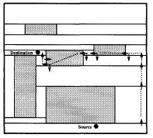
Point finding using Corner Stitch
Point-find(B, x,y)
B: current block
x,y: the desired point
B is stored as :
Coordinate of left-bottom corner
Width, height

Slide 57
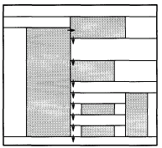
Neighbour finding using Corner Stitch
Find all tiles that touch a given side of a given tile
From tr ptr of current tile, start traversing using lb ptr downward until a tile is found which dose not lie in vertical range of current tile

Slide 58
Area search using Corner Stitch
Given an area, report if there exists any block in the area
Find tile where upper-left cornet of given area is located.(point finding)
If tile is vacant tile then if its right edge is within given area, the adjacent tile must be block
If tile is a block, search is complete. If no block is found, go to next tile touching right edge of given area by traversing lb ptr down and then traversing right using tr ptr
Repeat steps2 and 3 until area has been searched or block has been found

Slide 59
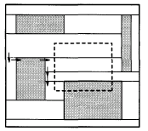
Area search using Corner Stitch

