Slide 1
Physical Design Automation
Placement and Routing
Speaker:
Devjyoti Patra

Slide 2
Problem formulation (Placement)
Input:
  Blocks (standard cells and macros) B₁, ... , B_{n}
  Shapes and Pin Positions for each block B_{i}
  Nets N₁, ... , N_{m}
Output:
  Coordinates (x_{i} , y_{i} ) for block B_{i}.
  No overlaps between blocks
  The total wire length is minimized
  The area of the resulting block is minimized or given a fixed die
Other consideration: timing, routability, clock, buffering and interaction with physical synthesis

Slide 3
Floorplanning v.s. Placement
Both determines block positions to optimize the circuit performance.
Floorplanning:
  Details like shapes of blocks, I/O pin positions, etc. are not yet fixed (blocks with flexible shape are called soft blocks).
Placement:
  Details like module shapes and I/O pin positions are fixed (blocks with no flexibility in shape are called hard blocks).

Slide 4
Importance of Placement
Placement is a key step in physical design
Poor placement consumes large area, leads to difficult/ impossible routing task
Ill placed layout cannot be improved by high quality routing
Quality of placement:
  Layout area
  Routability
  Performance (usually timing, measured by delay of critical/ longest net)

Slide 5
Placement Cost Components
Area
  Would like to pack all the modules very tightly
Wire length (half-perimeter of the hnet bbox)
  Minimize the average wire length
  Would result in tight packing of the modules with high connectivity
Overlap
  Could be prohibited by the moves, or used as penalty
  Keep the cells from overlapping (moves cells apart)
Timing
  Not a 1-1 correspondent with wire length minimization, but consistent on the average
Congestion
  Measure of routability
  Would like to move the cells apart

Slide 6
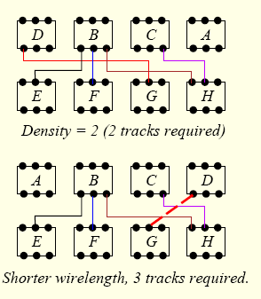
Placement affects chip area

Slide 7
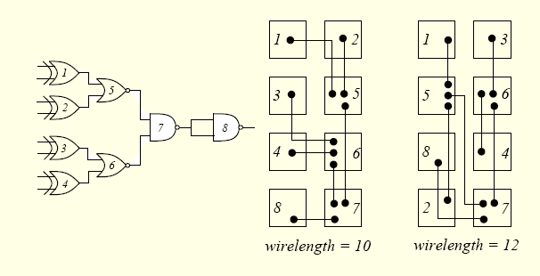
…And also Wire Length

Slide 8
Placement Algorithms
A
Top-Down
  Partitioning-based placement
  Recursive bi-partitioning or quadrisection
    Cut direction?
    Partition vs. physical location
Iterative
  Simulated annealing
  OR: Force directed
  Start with an initial placement, iteratively improve the wire-length and area
Constructive
  Start with a few cells in the center, and place highly connected adjacent modules around them
2
1
B
C
L
H
D
B
A
F
G
Notes:
In the top down placement, should we assign 1 to A or to B? What should be the balance criteria? 50-50? 30-70? How many cuts should we make at each level? Bipartitioning? Quadrisection?

Slide 9
Partitioning-based Placement
Simultaneously perform:
  Circuit partitioning
  Chip area partitioning
  Assign circuit partitions to chip slots
Problem:
  Circuit partitioning unaware of the physical location
  Solution: Terminal propagation (add dummy terminals)
B
A
B
A
A
B
A
B

Slide 10
Partitioning-based Placement
More problems:
  Direction of the cut? [Yildiz, DAC’01]
  How to handle fixed blocks? (area assigned to a partition might not be enough)
  How to correct a bad decision made at a higher level?
Advantages:
  Hierarchical, scalable
  Inherently apt for congestion minimization, easily extendable to timing optimization
1
1
1
2
4
5
2
3
5
1
6
2
3
2
3
7
6
7
4
5
8
3
9
4
(a)
(b)
(c)
(d)

Slide 11
Force Directed Approach
Transform the placement problem to the classical mechanics problem of a system of objects attached to springs
Analogies:
  Module (Block/Cell/Gate) = Object
  Net = Spring
  Net weight = Spring constant
  Optimal placement = Equilibrium configuration

Slide 12
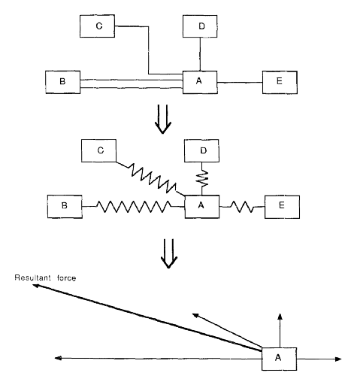
An Example
Resultant
Force

Slide 13
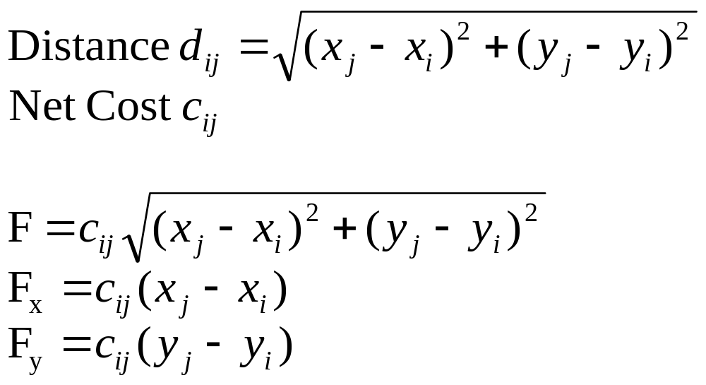
Force Calculation
Hooke’s Law:
  Force = Spring Constant x Distance
Can consider forces in x- and y-direction separately:
(x_{j}, y_{j})
F
F_{x}
(x_{i}, y_{i})
F_{y}

Slide 14
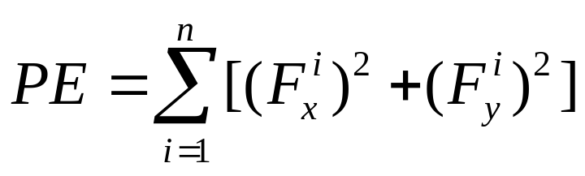
Problem Formulation
Equilibrium: Σ_{j} c_{ij} (x_{j} - x_{i}) = 0 for all module i
However, trivial solution: x_{j} = x_{i} for all i, j. Everything placed on the same position!
Need to have some way to avoid overlapping
A method to avoid overlapping:
  Add some repulsive force which is inversely proportional to distance (or distance squared)
Solution of force equations correspond to the minimum potential energy of system

Slide 15
Comments on
Force-Directed Placement
Use directions of forces to guide the search
Usually much faster than simulated annealing
Focus on connections, not shapes of blocks
Only a heuristic; an equilibrium configuration does not necessarily give a good placement
Successful or not depends on the way to eliminate overlapping

Slide 16
Simulated Annealing Placement
Cost
  Area (usually fixed # of rows, variable row width)
  Wirelength (Euclidian or Manhattan)
  Cell overlap (penalty increases with temperature)
Moves
  Exchange two cells within a radius R
  (R temperature dependent?)
  Displace a cell within a row
  Flip a cell horizontally
Low vs. High temperature
  If used as a post processing, start with low-temp
Post-processing?
  Might be needed if there are still overlaps
Notes:
Overlap can be handled in two ways:
Allowing overlap in the moves, but consider it as part of the cost function (will be eliminated towards the end of the annealing process)
Not allowing overlaps at all (e.g., when moving a cell to a new location, shift all the cells to the right of it if it overlaps with its neighboring cell.)
Depending on the library, a cell might be horizontally/vertically flipped and/or rotated

Slide 17
Routing in design flow
B
A
C
Post Placed
Netlist
INV
AND
Routing
OR
Process of finding geometric layouts of the net
Floorplan/Placement

Slide 18
The Routing Problem
Apply it after Placement
Input:
  Netlist
  Timing budget for, typically, critical nets
  Locations of blocks and locations of pins
Output:
  Geometric layouts of all nets
Objective:
  Minimize the total wire length, the number of vias, or just completing all connections without increasing the chip area.
  Each net meets its timing budget.

Slide 19
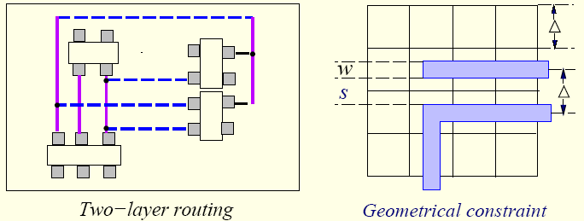
The Routing Constraints
Examples:
  Placement constraint
  Number of routing layers
  Delay constraint
  Meet all geometrical constraints (design rules)
  Physical/Electrical/Manufacturing constraints:
    Crosstalk

Slide 20
Steiner Tree
For a multi-terminal net, we can construct a spanning tree to connect all the terminals together.
But the wire length will be large.
Better use Steiner Tree:
  A tree connecting all terminals and some additional nodes (Steiner nodes).
Rectilinear Steiner Tree:
  Steiner tree in which all the edges run horizontally and vertically.
Steiner
Node

Slide 21
Routing Problem is Very Hard
Minimum Steiner Tree Problem:
  Given a net, find the Steiner tree with the minimum length.
  Input :An edge weighted graph G=(V,E) and a subset D (demand points)
  Output: A subset of vertices V’(such that D is covered) and induces a tree of minimum cost over all such trees
  This problem is NP-Complete!

Slide 22
Heuristic Algorithms
Use MST (minimum spanning tree) algorithms to start with
  Cost_{MST}/Cost_{RMST}≤3/2
  Heuristics can guarantee that the weight of RST is at most 3/2 of the weight of the optimal tree
Apply local modifications to reach a RMST (rectilinear minimum steiner tree)

Slide 23
Kinds of Routing
Global Routing
Detailed Routing
  Channel
  Switchbox
Others:
  Maze routing
  Over the cell routing
  Clock routing

Slide 24
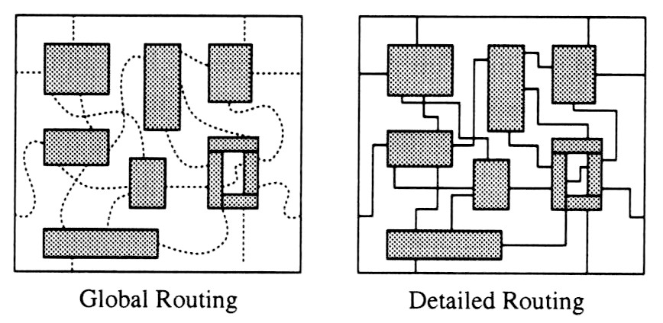
General Routing Paradigm
Two phases:

Slide 25
Extraction and
Timing Analysis
After global routing and detailed routing, information of the nets can be extracted and delays can be analyzed.
If some nets fail to meet their timing budget, detailed routing and/or global routing needs to be repeated.

Slide 26
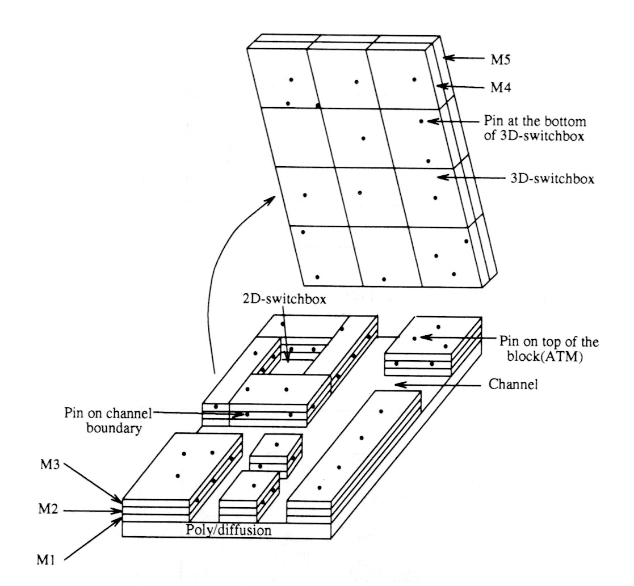
Routing Regions

Slide 27
Global Routing
Global routing is divided into 3 phases:
  1. Region definition
  2. Region assignment
  3. Pin assignment to routing regions

Slide 28
Maze Routing Problem
Given:
  A planar rectangular grid graph.
  Two points S and T on the graph.
  Obstacles modeled as blocked vertices.
Objective:
  Find the shortest path connecting S and T.
This technique can be used in global or detailed routing (switchbox) problems.

Slide 29
Grid Graph
S
S
S
X
X
T
T
X
X
T
Area Routing
Grid Graph
(Maze)
Simplified
Representation
Blocked cells

Slide 30
Maze Routing
S
T

Slide 31
Lee’s Algorithm
“An Algorithm for Path Connection and its Application”, C.Y. Lee, IRE Transactions on Electronic Computers, 1961.

Slide 32
Basic Idea
A Breadth-First Search (BFS) of the grid graph.
Always find the shortest path possible.
Consists of two phases:
  Wave Propagation
  Retrace

Slide 33
An Illustration
S
0
1
2
3
1
2
3
3
4
5
5
4
5
T
6

Slide 34
Wave Propagation
At step k, all vertices at Manhattan-distance k from S are labeled with k.
A Propagation List (FIFO) is used to keep track of the vertices to be considered next.
S
0
S
0
1
2
3
S
0
1
2
3
1
2
3
1
2
3
3
3
4
5
T
T
5
4
5
T
6
After Step 0
After Step 3
After Step 6

Slide 35
Retrace
Trace back the actual route.
Starting from T.
At vertex with k, go to any vertex with label k-1.
S
0
1
2
3
1
2
3
3
4
5
5
4
5
T
6
Final labeling

Slide 36
How many grids visited using Lee’s algorithm?
13
12
11
10
7
6
7
7
9
10
12
11
10
9
6
5
6
7
8
9
10
11
12
11
10
9
8
7
6
5
4
7
8
9
10
11
10
9
8
7
6
5
4
3
6
7
8
9
10
7
6
5
4
3
2
1
2
3
4
5
6
7
8
9
6
5
4
3
2
1
S
1
2
3
4
5
6
7
8
9
8
7
6
3
2
1
2
3
4
5
6
7
8
9
10
9
8
7
3
5
6
7
8
9
10
11
10
9
8
9
10
7
6
7
8
9
10
11
12
11
10
11
12
11
10
9
8
9
10
11
12
13
12
11
12
13
12
11
9
13
10
10
11
12
12
13
13
12
11
10
11
12
13
13
13
12
11
12
13
13
12
T
13
13

Slide 37
Time and Space Complexity
For a grid structure of size w × h:
  Time per net = O(wh)
  Space = O(wh log wh) (O(log wh) bits are needed during exploration phase + one additional bit to indicate blocked or not)
For a 2000 × 2000 grid structure:
  12 bits per label
  Total 6 Mbytes of memory!
For 4000 x 4000, 48 M bytes!

Slide 38
Acker’s coding :
Improvement to Lee’s Algorithm
The vertices in wave-front L are always adjacent to the vertices L-1 and L+1 in the wavefront
Soln: the predecessor of any wavefront is labeled different from its successor
0,0,1,1,0,….
Need to indicate blocked or not
Hence can do away with 2 bits
Time complexity is not improved

Slide 39
Acker’s Technique
S
0
1
0
1
1
0
1
1
0
1
1
0
1
T
0

Slide 40
Detailed routing
Global routing do not define wires
They define routing regions
Detailed router places actual wires within regions, indicated by the global router
We consider the channel routing problem here…

Slide 41
Channel Routing
A channel is the routing region bounded by two parallel rows of terminals
Assume top and bottom boundary
Each terminal is assigned a number to indicate which net it belongs to
0 indicates : does not require an electrical connection

Slide 42
Channel Routing
channel

Slide 43
Channel Routing
Terminals
Via
Upper boundary
Tracks
Dogleg
Lower boundary
Trunks
Branches

Slide 44
Channel Routing
0
1
4
5
1
6
7
0
4
9
10
10
2
3
5
3
5
2
6
8
9
8
7
9
How to connect all the points with the same
label with the smallest no. of tracks
(to minimize the channel height)?

Slide 45
Horizontal Constraint Graph (HCV)
0
1
6
1
2
3
5
1
2
6
3
5
4
0
2
4
6
3
5
4
0
1
6
1
2
3
5
6
1
3
5
4
Clique of size 4
2

Slide 46
Left-Edge Algorithm
1. Sort the horizontal segments of the nets in increasing order of their left end points.
2. Place them one by one greedily on the bottommost available track.

Slide 47
Left-Edge Algorithm
0
1
6
1
2
3
5
6
3
5
4
0
2
4
1. Sort by left end points.
2. Place nets greedily.
0
1
6
1
2
3
5
0
1
6
1
2
3
5
6
1
5
3
3
5
1
2
4
6
4
2
6
3
5
4
0
2
4
6
3
5
4
0
2
4

Slide 48
Vertical Constraint Graph and Doglegs
1
2
1
2
VCG : Cycle
2
1
2 imposes a vertical constraint on 1
1 imposes a vertical constraint on 2, as top terminal belongs to 1 and bottom terminal belongs to 2
1
2
Dogleg
2
1

Slide 49
Placement
Row based ASICS.
Interconnects run in horizontal and vertical directions.
Channel Capacity: Maximum number of horizontal connections.
Row Utilization

Slide 50
Routing
Minimize the interconnect length.
Maximize the probability that the detailed router can completely finish the job.
Minimize the critical path delay.

Slide 51
Main references
Algorithms for VLSI Physical Design Automation (Hardcover) by Naveed A. Sherwani
Application-Specific Integrated Circuits, M. J. Sebastian Smith

