Slide 1
IT Security: Defense against the digital dark arts by Google
17IT036-Joshi Dipenkumar

Slide 2
Introduction of IT Security
IT security is a set of cybersecurity strategies that prevents unauthorized access to organizational assets such as computers, networks, and data. It maintains the integrity and confidentiality of sensitive information, blocking the access of sophisticated hackers.

Slide 3
WEEK 1 : Understanding Security Threats
In the first week of this course, we will cover the basics of security in an IT environment. We will learn how to define and recognize security risks, vulnerabilities and threats. We'll identify the most common security attacks in an organization and understand how security revolves around the "CIA" principle. By the end of this module, you will know the types of malicious software, network attacks, client-side attacks, and the essential security terms you'll see in the workplace.

Slide 4
.
We learn about…
Introduction to IT Security
Malicious Software
Network Attacks
Other Attacks
And final I give Graded Assessments
Key Concepts
Be able to identify the most common security attacks.
Understand how security revolves around the CIA principle
Define and recognize security risks, vulnerabilities and threats.

Slide 5
Week 2 :- Pelcgbybtl (Cryptology)
We'll learn about cruptology.We'll explore different types of encryption practices and how they work. We'll show you the most common algorithms used in cryptography and how they've evolved over time. By the end of this module, you'll understand how symmetric encryption, asymmetric encryption, and hashing work; you'll also know how to choose the most appropriate cryptographic method for a scenario you may see in the workplace.

Slide 6
We learn about…
Symmetric Encryption
Public Key or Asymmetric Encryption
Hashing
Cryptography Applications
Key concepts
Understand the how symmetric encryption, asymmetric encryption, and hashing work.
Describe the most common algorithms of cryptography.
Choose the most appropriate cryptographic method given a scenario.

Slide 7
Week 3:- AAA Security (Not Roadside Assistance)
we'll learn about the "three A's" in cybersecurity. No matter what type of tech role you're in, it's important to understand how authentication, authorization, and accounting work within an organization. By the end of this module, you'll be able to choose the most appropriate method of authentication, authorization, and level of access granted for users in an organization.

Slide 8
We learn about…
Authentication
Authorization
Accounting
Key consepts
Identify and describe the most common authentication services.
Understand and be able to choose the most appropriate method of authentication or authorization.
Be able to grant the appropriate level of access for the users of an organization.

Slide 9
Week 4:- Securing Your Networks
we'll learn about secure network architecture. It's important to know how to implement security measures on a network environment, so we'll show you some of the best practices to protect an organization's network. We'll learn about some of the risks of wireless networks and how to mitigate them. We'll also cover ways to monitor network traffic and read packet captures. By the end of this module, you'll understand how VPNs, proxies and reverse proxies work; why 802.1X is a super important for network protection; understand why WPA/WPA2 is better than WEP; and know how to use tcpdump to capture and analyze packets on a network.

Slide 10
We learn about…
Secure Network Architecture
Wireless Security
Network Monitoring
Key concepts
Implement security measures on a network environment.
Understand how to monitor network traffic and read packet captures.
Understand the risks of wireless networks and how to mitigate them.

Slide 11
Week 5 - Defense in Depth
We'll cover ways to implement methods for system hardening, application hardening, and determine the policies for OS security. By the end of this module, you'll know why it's important to disable unnecessary components of a system, learn about host-based firewalls, setup anti-malware protection, implement disk encryption, and configure software patch management and application policies.

Slide 12
System Hardening
Application Hardening

Slide 13
Week 6 - Creating a Company Culture for Security
we'll explore ways to create a company culture for security. It's important for any tech role to determine appropriate measures to meet the three goals of security. By the end of this module, you will develop a security plan for an organization to demonstrate the skills you've learned in this course. You're almost done, keep up the great work!

Slide 14
Risk in the Workplace
Users
Incident Handling

Slide 15
Project- password detector
The password detector is use to detected your input password using brute force concepts.
In this project we generate a python code and make or made one gui file using pyautogui library
We enter or input our password on it then our core is detect input password I few time.

Slide 16
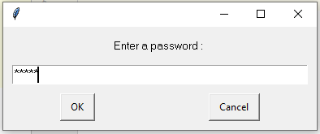
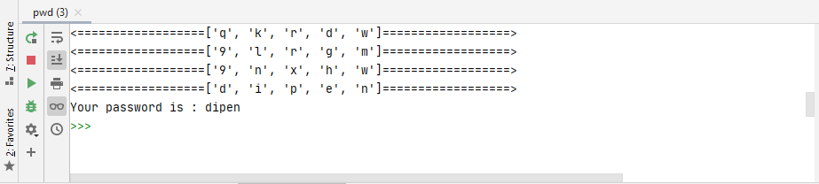
Screenshort

Slide 17
Thank You

