Slide 1

Web Search Engine
Group: 11
Hamza Baig
Talha Mohammed Shamoon Choudhary
Adeel Ahmed
Dipen Kalal

Slide 2

Search Engine
A search engine is a software system that searches the web to find the most relevant information related to the query given.

Slide 3

Working of Search Engine
What really happens when you search for something on Google?

Slide 4
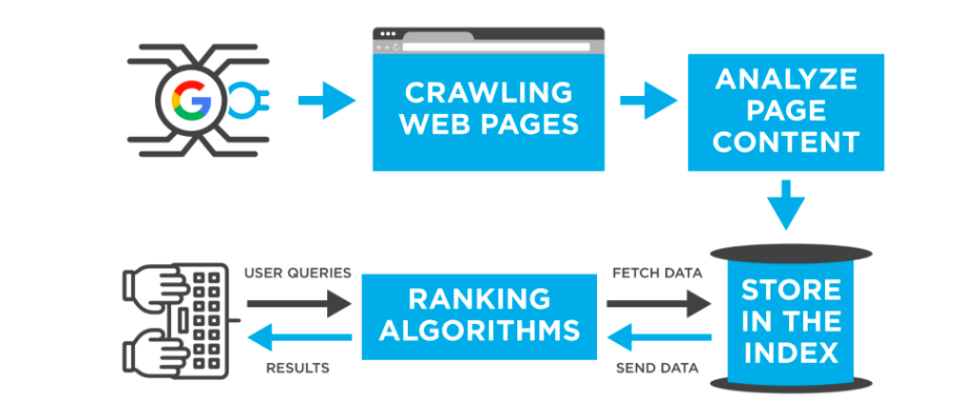
How does google work?
A simple example of a search through the world’s most used search engine.
Notes:
https://jellymarketing.ca/blog/how-do-search-engines-work/

Slide 5
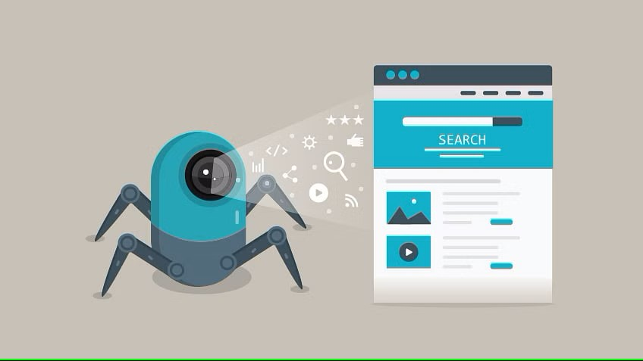
Web Crawling
Web crawlers systematically browse webpages to learn what each page on the website is about, so this information can be indexed, updated and retrieved when a user makes a search query
Notes:
https://www.techtarget.com/whatis/definition/crawler

Slide 6
Web Crawling
Jsoup was used for crawling the webpages. The urls were hit using jsoup and files were downloaded as text files. These files were added to cache as well.
Notes:
https://www.techtarget.com/whatis/definition/crawler

Slide 7
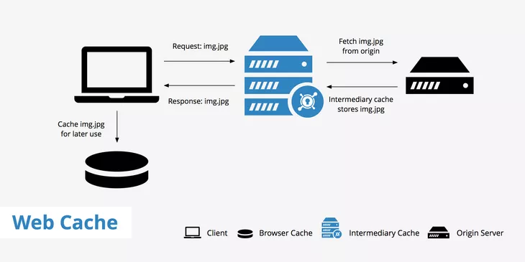
Cache
A web cache is a device or software application used to store temporary copies of information received by the origin server.
Notes:
https://www.keycdn.com/support/web-cache

Slide 8
Cache
A web cache is a device or software application used to store temporary copies of information received by the origin server.
Notes:
https://www.keycdn.com/support/web-cache

Slide 9
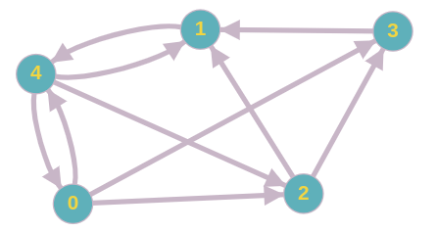
Page Ranking
Page ranking was done based on the most occurrence of a word in the page. And word searches were performed on the pages in cache
Notes:
https://towardsdatascience.com/pagerank-algorithm-fully-explained-dc794184b4af

Slide 10
Auto-correct
Three cases were handled:
Wrong words. autocorrect made correction(s)
Right word. autocorrect validated it.
Word not found in word bank. autocorrect asked to enter the word-to-word bank and once added it accepted the input as a valid word

Slide 11
Auto-fill
Trie was used for creating the mechanism of Auto-fill. The Trie was constructed from history.
As the user keeps on searching, the word bank improves and can give better suggestions.

Slide 12
References
Amine, A. (2021, December 24). PageRank algorithm, fully explained - Towards Data Science. Medium. https://towardsdatascience.com/pagerank-algorithm-fully-explained-dc794184b4af
Gillis, A. S. (2022, September 30). web crawler. WhatIs.com. https://www.techtarget.com/whatis/definition/crawler
Web Cache Guide - KeyCDN Support. (n.d.). KeyCDN. https://www.keycdn.com/support/web-cache
Notes:
https://towardsdatascience.com/pagerank-algorithm-fully-explained-dc794184b4af

Slide 13
Thank You
Action is the foundational key to all success
Notes:
Action is the foundational key to all success
Pablo Picasso

