Slide 1

Neural Networks Fail to Learn Periodic Functions and How to Fix It
The paper uses experimental evidence to show that common activations like ReLU, tanh, sigmoid, and their variations are all incapable of learning how to extrapolate basic periodic functions.
The research went on to suggest a new activation, which is referred as the snake function.
Github Link - https://github.com/dipenpadhiyar/AML-reproducibility

Slide 2
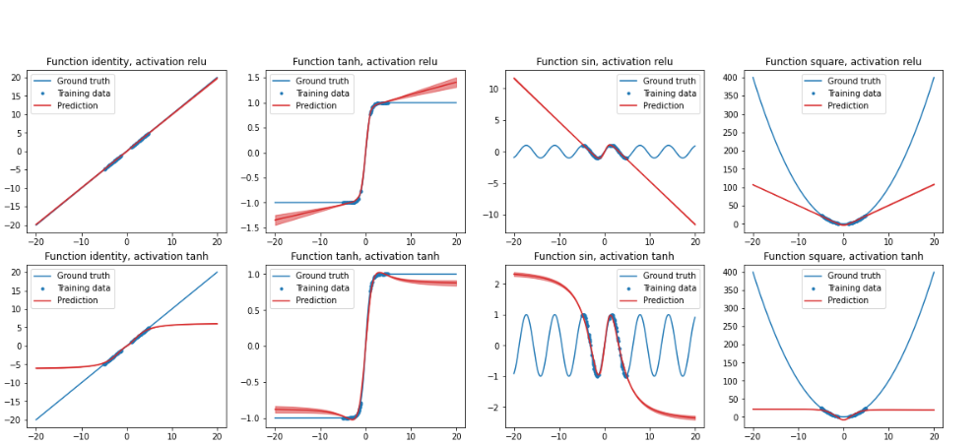
Extrapolation experiments on several functions

Slide 3

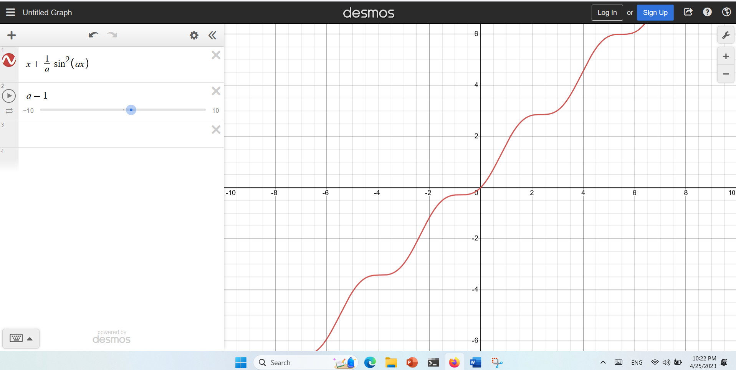
Snake Function

Slide 4
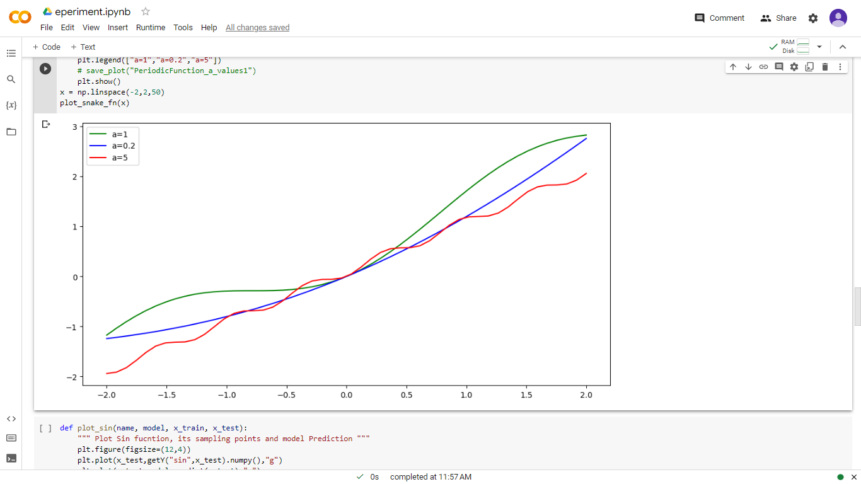
Snake_(hyperparameter-a)

Slide 5
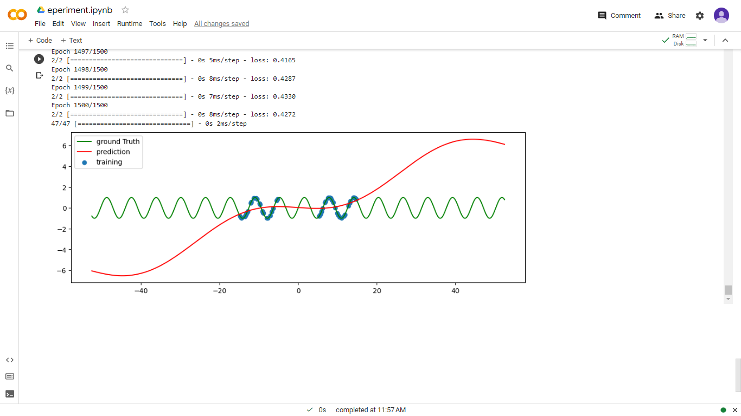
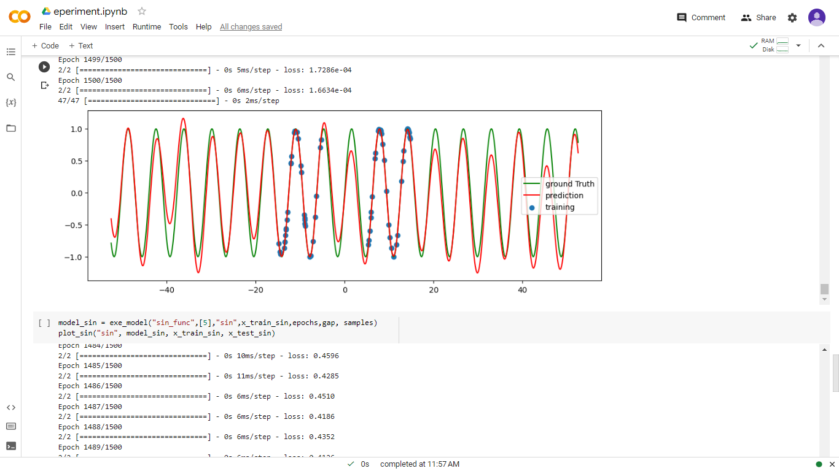
Sin function with Snake as Activation
Sin function with Sin as Activation

Slide 6
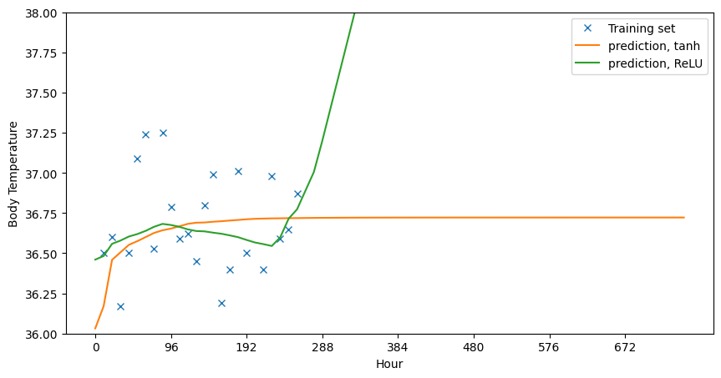
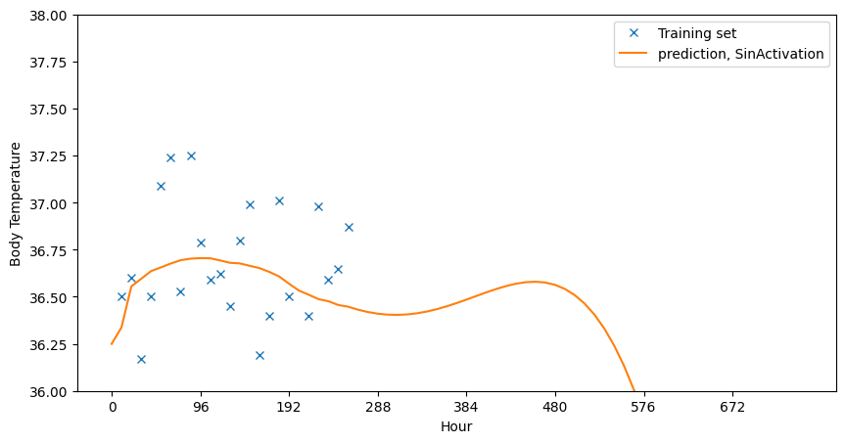
Body_temp_regre_scratch_keras
activations = ["tanh","relu"]
labels = ["tanh","ReLU"]
activations = ["SinActivation"]
labels = [ "SinActivation"]

Slide 7
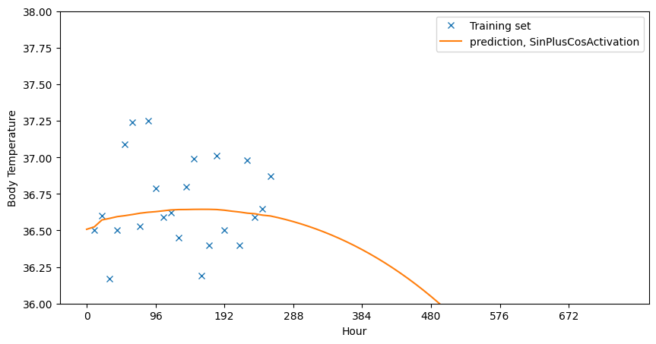
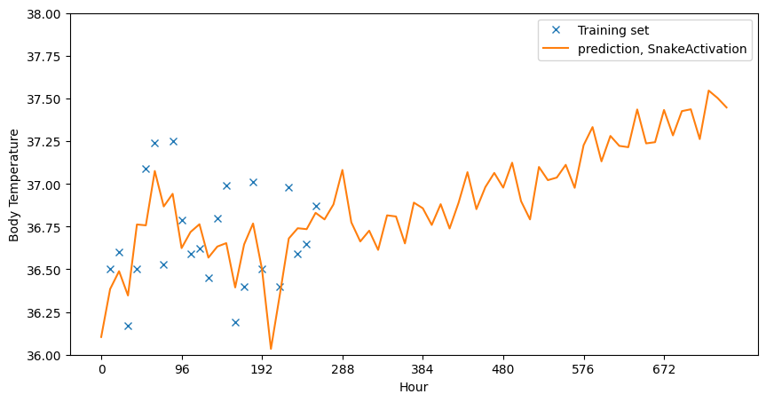
activations = ["SinPlusCosActivation"]
labels = [ "SinPlusCosActivation"]
activations = ["SnakeActivation"]
labels = [ "SnakeActivation"]

Slide 8
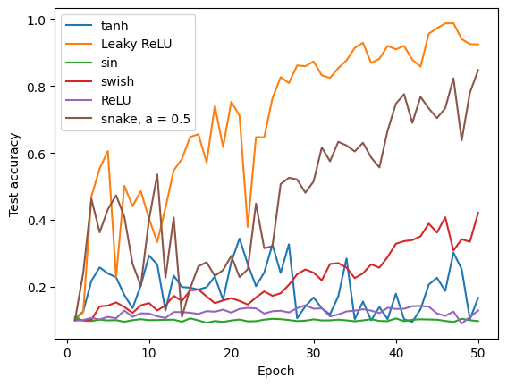
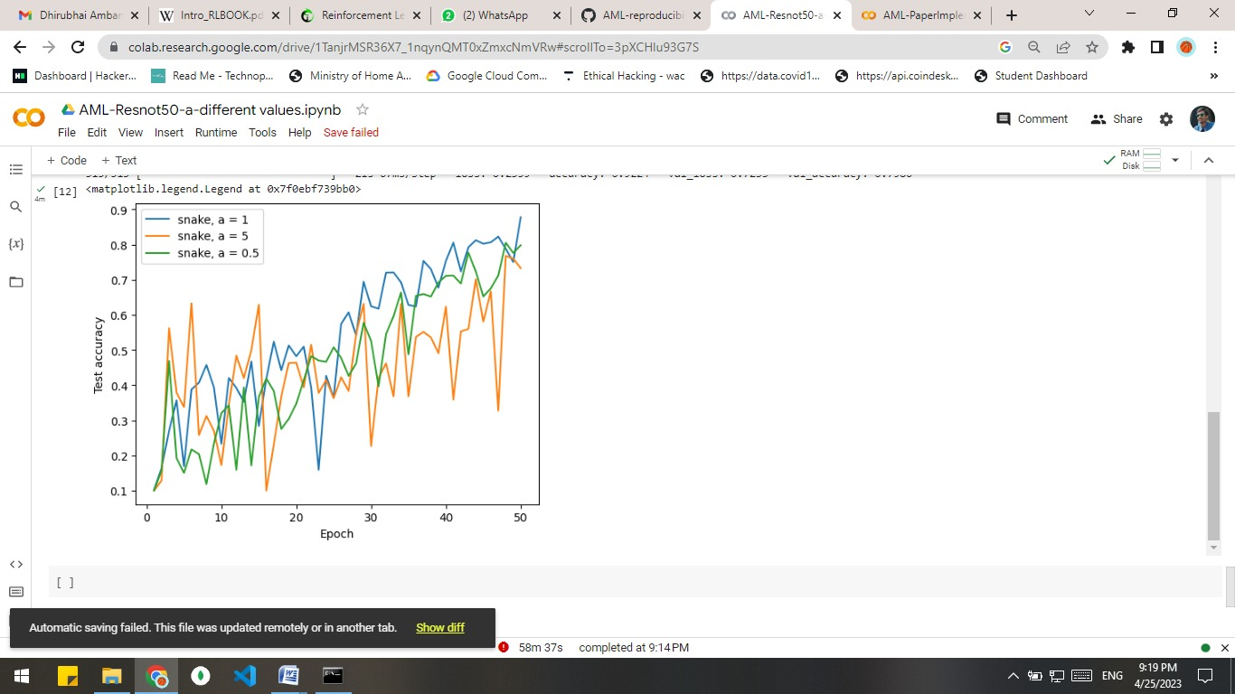
resnet50_cifar10

Slide 9
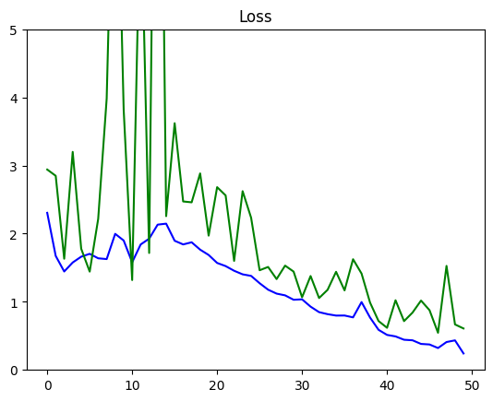
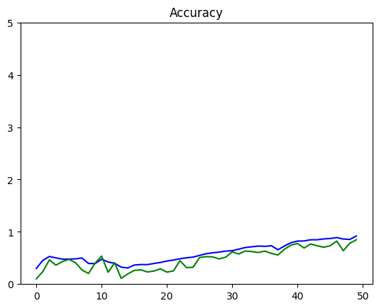
Matric

