Slide 1
COURSE PROJECT
Explainable Predictive
Maintenance Using Machine Learning
Anomaly detection, failure classification, and responsible decision thresholds
Bijay Pandey | Student ID: ADD ID
Add group member(s), if applicable
Responsible and Explainable AI
University of Regina
FINAL PRESENTATION
Notes:
Good morning. My project is Explainable Predictive Maintenance Using Machine Learning. I studied how sensor data can identify unusual machine behavior and predict possible failures. I also investigated how Explainable AI and Responsible AI can make those results understandable and usable with appropriate caution.

Slide 2
Introduction: problem and motivation
PROBLEM
FROM SENSOR DATA TO A SUPPORTED DECISION
Machine failure can cause downtime, cost, and safety concerns.
Machine
sensors
AI
analysis
Prediction +
explanation
Maintenance
decision
Sensor data may identify risky conditions before serious failure.
A prediction is more useful when its reasoning and limits are visible.
The model supports inspection and prioritization. A qualified user remains responsible for the final maintenance action.
MOTIVATION
Build an understandable decision-support prototype, not an autonomous maintenance system.
Responsible and Explainable AI | University of Regina
2
Notes:
Industrial machine failure can lead to downtime, cost, production delay, and safety concerns. Predictive maintenance uses sensor data to identify risky behavior early. However, a prediction alone is not enough. Users should understand which conditions influenced it and what errors are possible. I therefore designed this as decision support rather than an autonomous system.

Slide 3
Project objectives
Six connected questions guided the implementation
1
Explore and prepare industrial sensor data
4
Study relationships between sensor features
2
Detect records with unusual behavior
5
Explain global and individual predictions
3
Classify failure and no-failure records
6
Evaluate errors using Responsible AI principles
Anomaly detection asks what looks unusual. Classification asks what resembles known failures.
Responsible and Explainable AI | University of Regina
3
Notes:
The project followed six objectives. I explored and prepared the data, used anomaly detection to find unusual behavior, and trained classifiers from known failure labels. I then studied feature relationships, used SHAP and LIME to explain model behavior, and examined false alarms, missed failures, and thresholds from a Responsible AI perspective.

Slide 4
Brief literature review
Related work informed the data, methods, and responsible-use framing
Predictive
maintenance
Explainable
AI
Responsible
prototype
Related work | Idea used in this project
Matzka [1] | AI4I dataset and explainable predictive maintenance
Cummins et al. [2] | Need for understandable maintenance outputs
Liu et al. [3] | Isolation Forest for unusual observations
Ribeiro et al. [4] | LIME local explanations
Lundberg and Lee [5] | SHAP additive feature contributions
Course-level contribution: integrate prediction, explanation, error analysis, and threshold consequences.
Responsible and Explainable AI | University of Regina
4
Notes:
Matzka introduced the AI4I dataset in an explainable predictive-maintenance context. Cummins and colleagues emphasized understandable outputs. The Isolation Forest, LIME, and SHAP papers provided the main methods. This project does not claim a new algorithm. Its contribution is an integrated course-level evaluation.

Slide 5
Dataset and methodology
10,000
339
3.39%
80 / 20
6
machine records
failure records
failure rate
train-test split
leakage-safe inputs
EXPERIMENTAL WORKFLOW
Explore
Prepare
Detect
anomalies
Classify
failures
Study
relationships
Explain
results
INPUTS
SAFE DESIGN
Machine type | Air temperature | Process temperature
Rotational speed | Torque | Tool wear
Failure-mode columns excluded to prevent leakage
Stratification preserved the rare failure ratio
Tools: Python | Jupyter | pandas | scikit-learn | Matplotlib | SHAP | LIME
Responsible and Explainable AI | University of Regina
5
Notes:
AI4I contains 10,000 records but only 339 failures, so the data is strongly imbalanced. I used six input features and machine failure as the target. Identifier and failure-mode columns were excluded. I used a stratified 80-20 split, giving 8,000 training and 2,000 test records, including 68 test failures. Preprocessing was learned from training data.

Slide 6
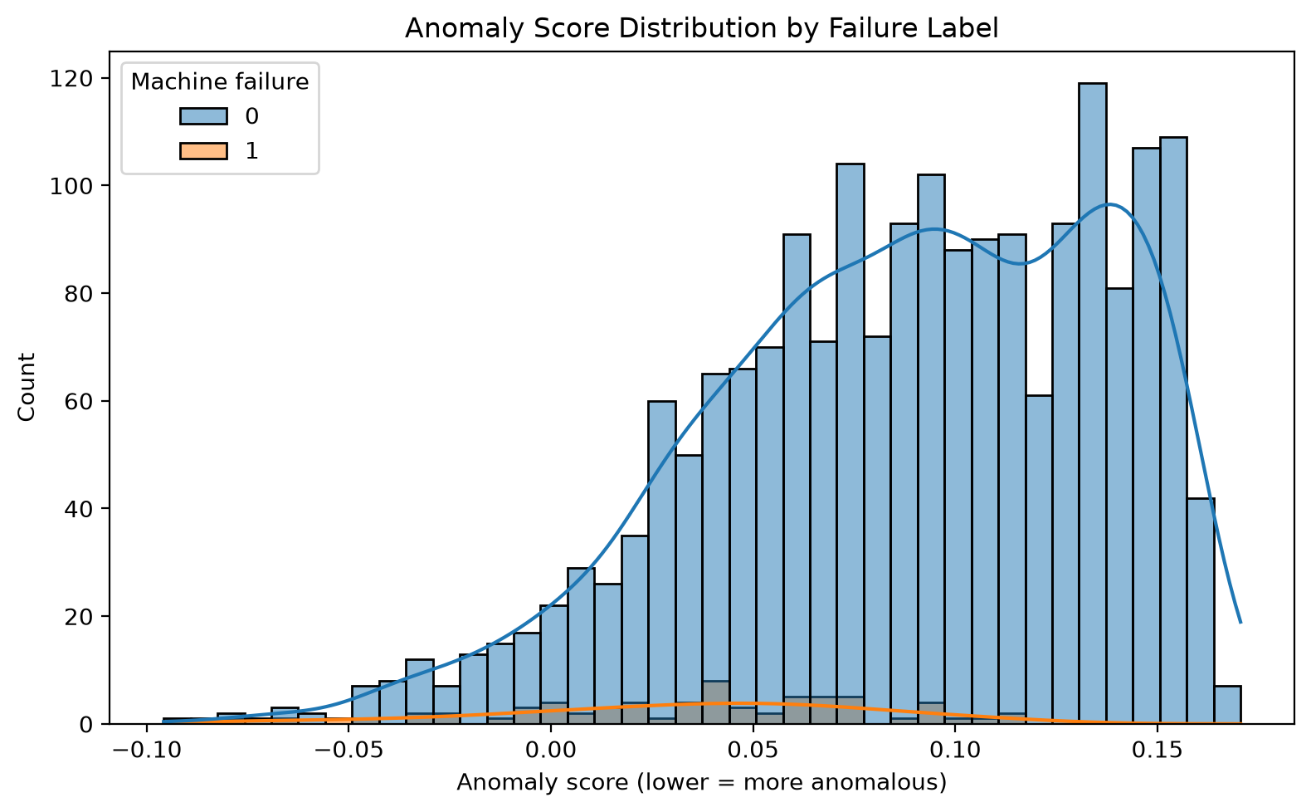
Anomaly detection results
Question: Does this record look unusual?
RESULTS
Test result | Count
Records flagged | 113
Actual failures | 68
Failure overlap | 16
Unusual behavior is not always failure, and failure is not always unusual.
Lower score = more anomalous
Responsible and Explainable AI | University of Regina
6
Notes:
I trained Isolation Forest on normal training records. On the graph, lower scores toward the left are more anomalous. Blue shows no-failure records and orange shows failures. The distributions overlap. The model flagged 113 records, but only 16 of the 68 failures were among them. Anomaly describes unusual data; failure is a labeled outcome.

Slide 7
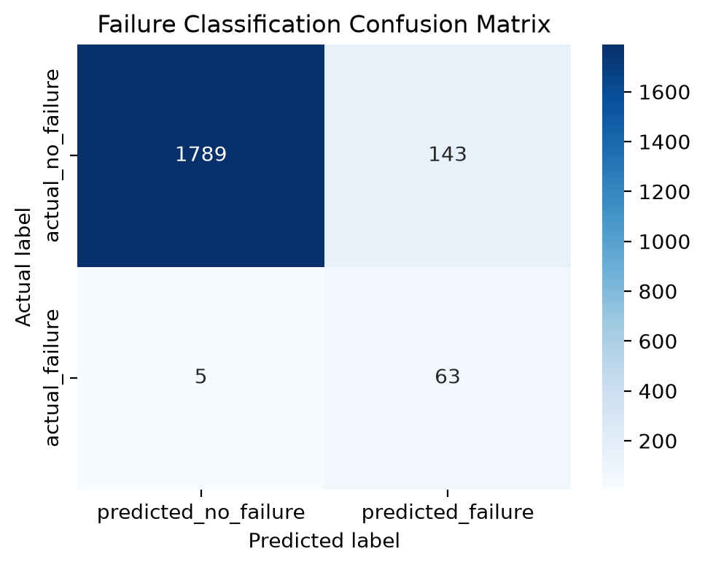
Failure classification results
Question: Does this record match a known failure pattern?
BASE TREE
Metric | Result
Accuracy | 92.60%
Precision | 30.58%
Recall | 92.65%
F1 | 45.99%
63 of 68 failures detected
5 failures missed
143 false alarms
High recall came with low precision.
Responsible and Explainable AI | University of Regina
7
Notes:
The classifier learned directly from failure labels. The bottom row of the confusion matrix shows 63 detected failures and 5 missed failures, giving recall of 92.65%. The top-right cell shows 143 false alarms, so precision was 30.58%. Accuracy alone hides this tradeoff because normal records dominate the dataset.

Slide 8
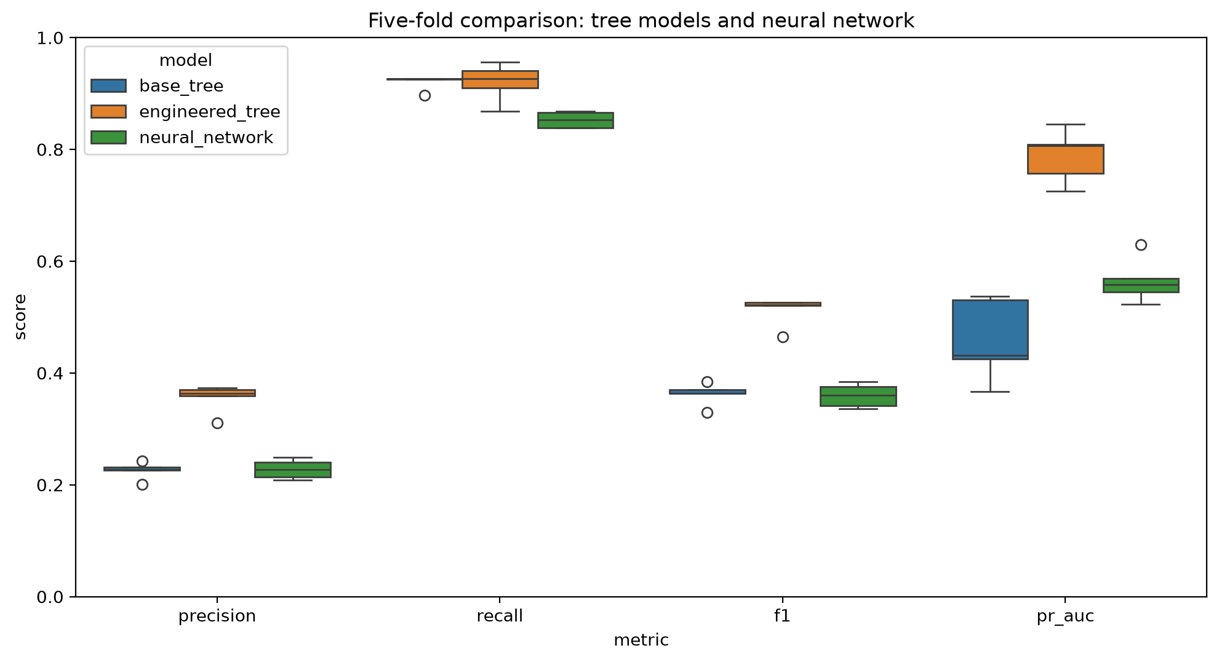
Neural network experiment
A nonlinear benchmark evaluated against the decision-tree models
ARCHITECTURE
8 inputs -> 16 ReLU -> 8 ReLU -> 1 sigmoid
Balanced weights | Adam | regularization | early stopping
Five-fold mean | Precision | Recall | F1
Base decision tree | 0.2256 | 0.9204 | 0.3621
Engineered decision tree | 0.3552 | 0.9203 | 0.5119
Neural network | 0.2279 | 0.8525 | 0.3593
Result: the engineered tree kept the best failure-focused balance.
Responsible and Explainable AI | University of Regina
8
Notes:
I trained a small feedforward neural network with two hidden layers as a nonlinear benchmark. Numeric inputs were standardized, class weights addressed the rare failure class, and early stopping limited overfitting. I compared it with both decision trees using the same stratified five-fold validation. The neural network reached mean precision 0.2279, recall 0.8525, and F1 0.3593. The engineered tree had the strongest precision and F1 while retaining high recall, so it remained the primary model. This result does not mean trees always outperform neural networks; it only describes this dataset and experiment.

Slide 9
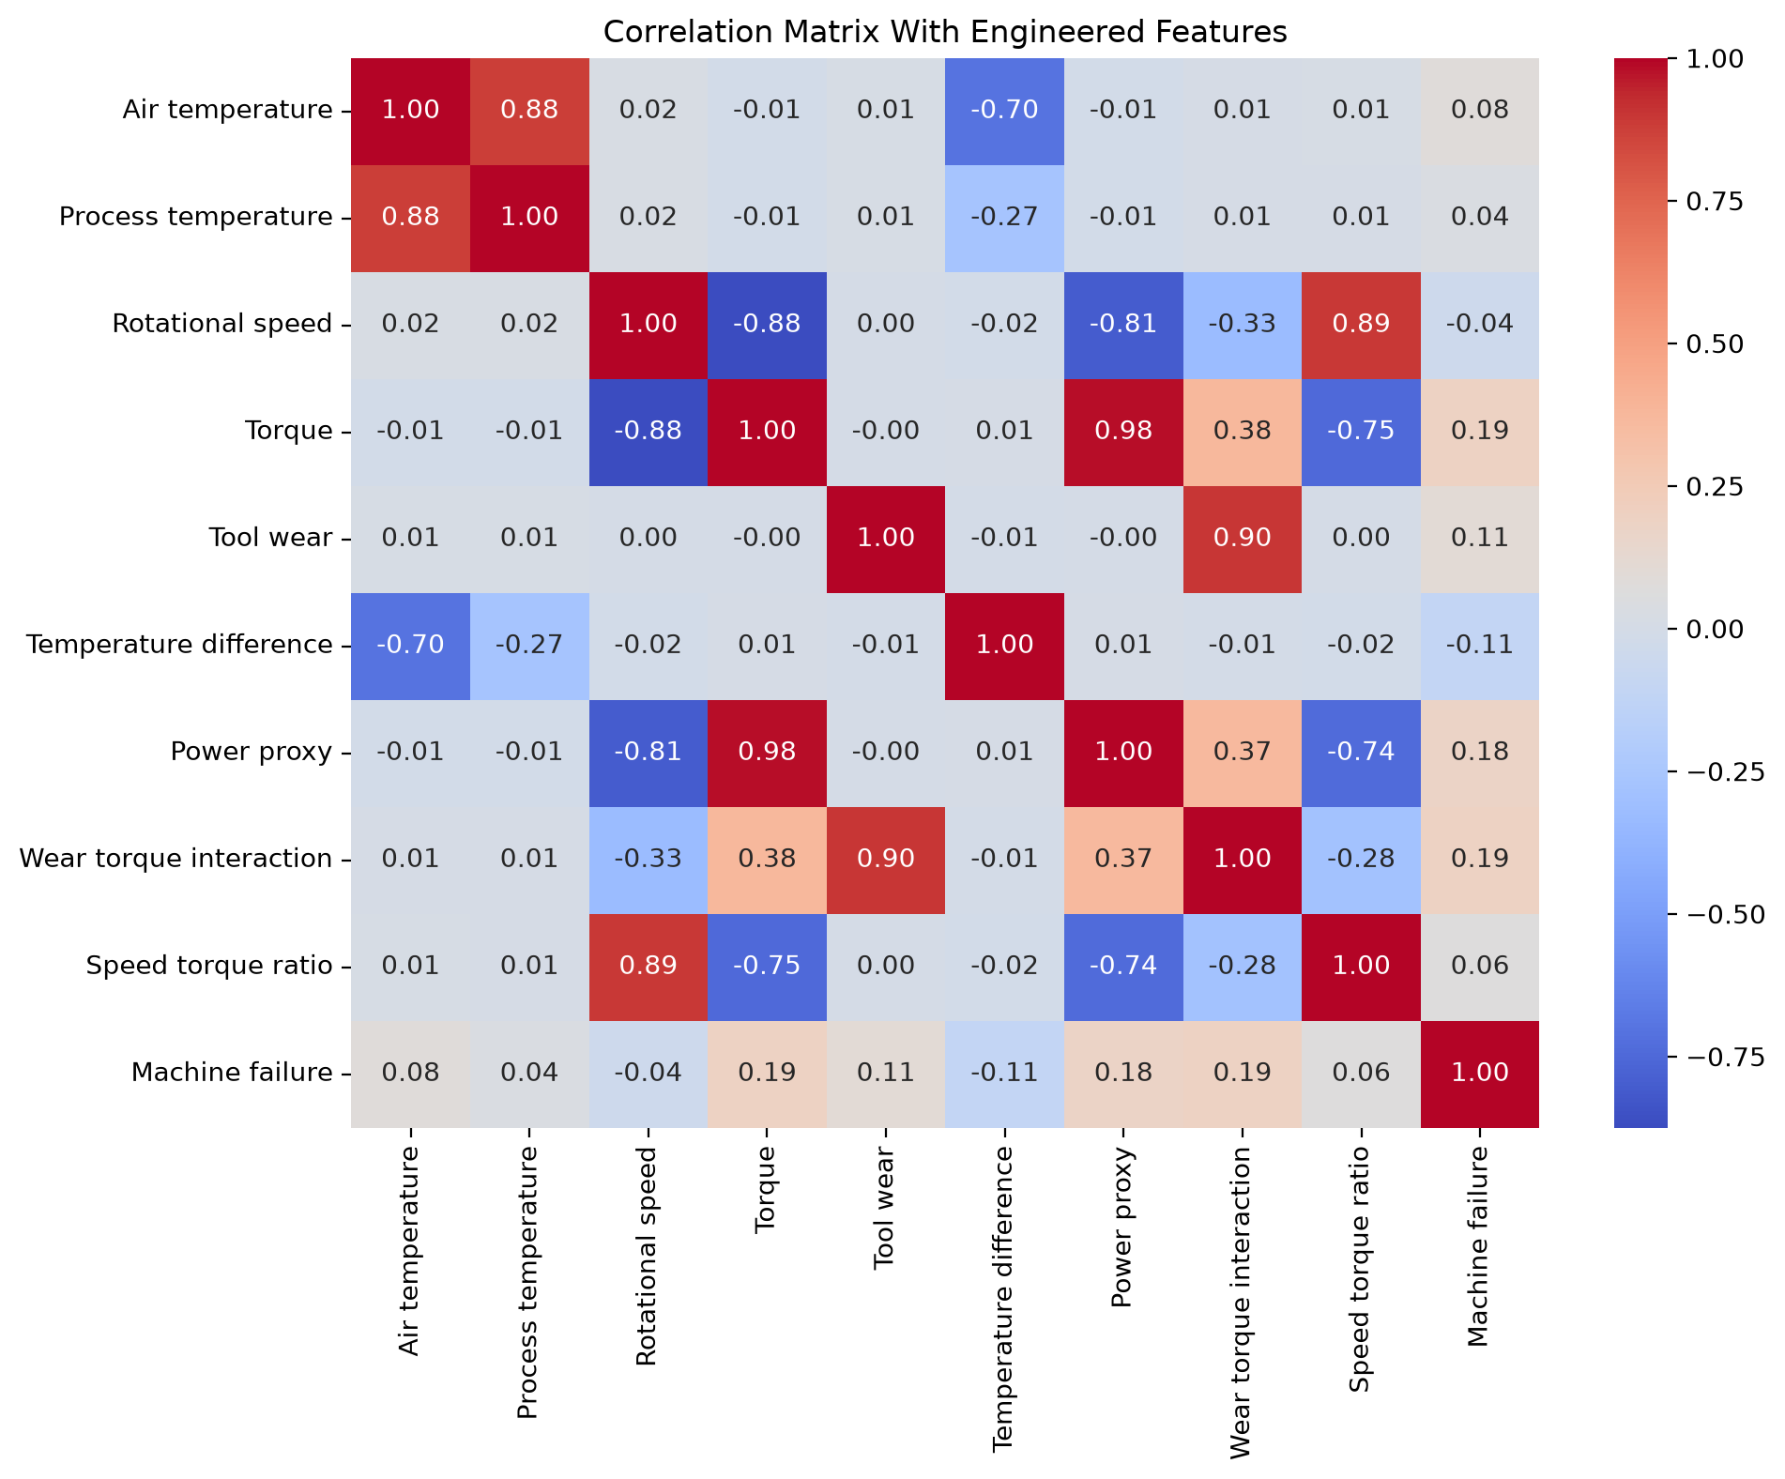
Feature relationships
Correlation describes linear association; models may also use nonlinear thresholds
RELATIONSHIPS
Temperature difference
Torque x rotational speed
Tool wear x torque
Speed / torque
Five-fold F1
0.36 -> 0.51
Low linear correlation does not rule out useful nonlinear decision rules.
Responsible and Explainable AI | University of Regina
9
Notes:
I studied pairwise correlation and created understandable relationships such as temperature difference, speed with torque, and wear with torque. Red indicates positive correlation, blue negative correlation, and values near zero weak linear correlation. The engineered features improved mean F1 from 0.36 to 0.51 across five folds. These are candidate relationships, not proven physical laws or causal equations.

Slide 10
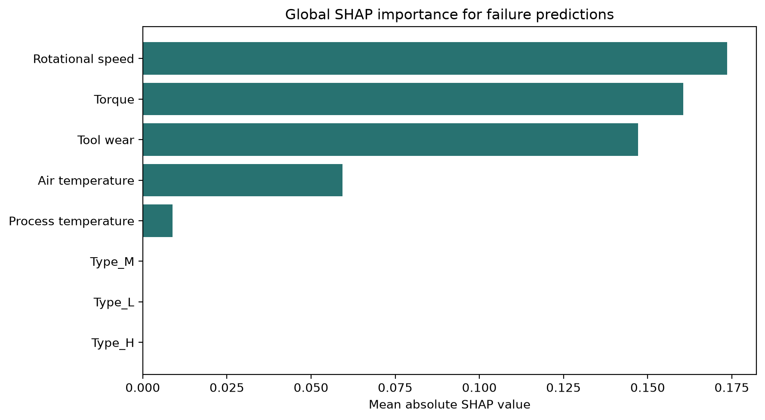
Global explanation with SHAP
Which features influenced the tree across the test records?
SHAP
Mean absolute contributions relative to the model baseline
Main tree influences
1. Rotational speed
2. Torque
3. Tool wear
Longer bars mean greater average influence, not direction.
Explanation is not causality.
Responsible and Explainable AI | University of Regina
10
Notes:
SHAP explains how features move predictions away from a model baseline. This global chart uses mean absolute contributions across test records, so longer bars mean greater average influence but do not show whether a high feature value raises or lowers the score. Rotational speed, torque, and tool wear were most influential. SHAP describes the fitted model's behavior; it does not establish physical causality or guarantee that a prediction is correct.

Slide 11
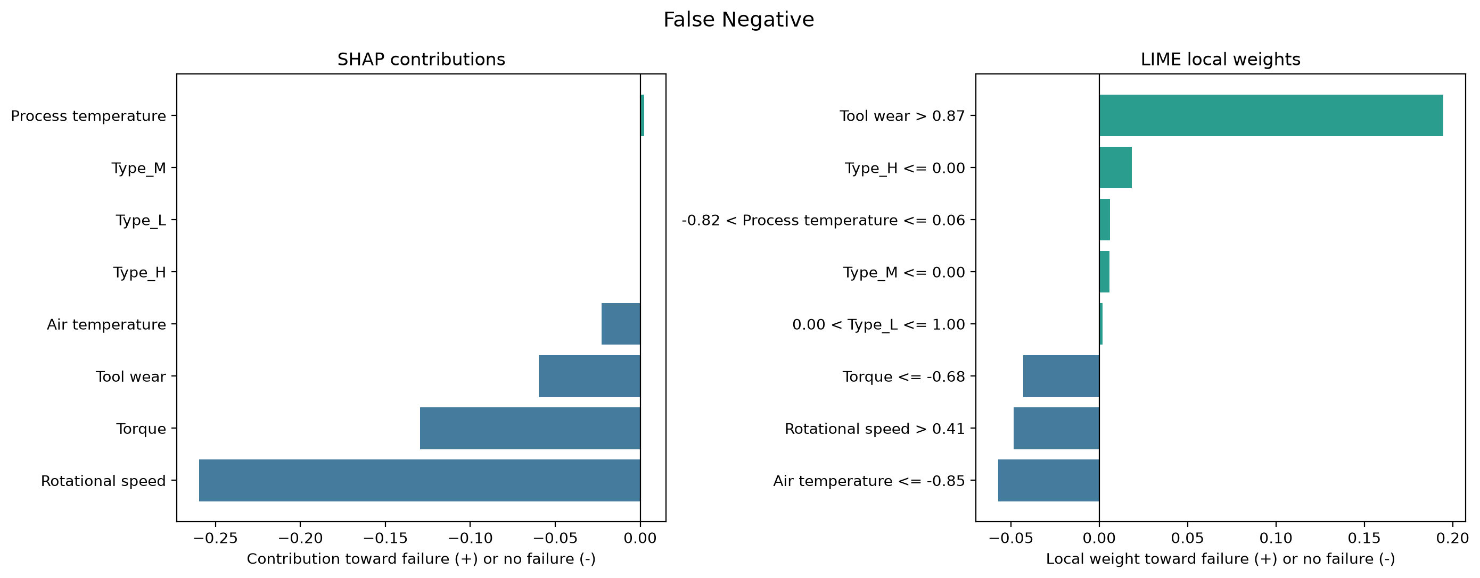
Local explanation with LIME
A missed failure shows why explanation fidelity must also be evaluated
LIME
Perturb one record
Query the classifier
Fit a weighted local surrogate
Report supporting and opposing features
False-negative fidelity
mean R² = 0.097
Readable does not always mean faithful.
Responsible and Explainable AI | University of Regina
11
Notes:
LIME explains one prediction by generating nearby artificial records, querying the classifier, and fitting a simple weighted surrogate around the selected case. This figure shows a false negative: the machine actually failed, but the classifier predicted no failure. The local SHAP and LIME panels let us compare which features supported or opposed the prediction. I also tested LIME stability instead of assuming the explanation was reliable. For false-negative cases, its mean local surrogate R-squared was only 0.097 and the mean top-three feature overlap across repeated runs was 0.70. Therefore LIME was readable, but its local approximation was weak and should be presented as supporting evidence rather than ground truth.

Slide 12
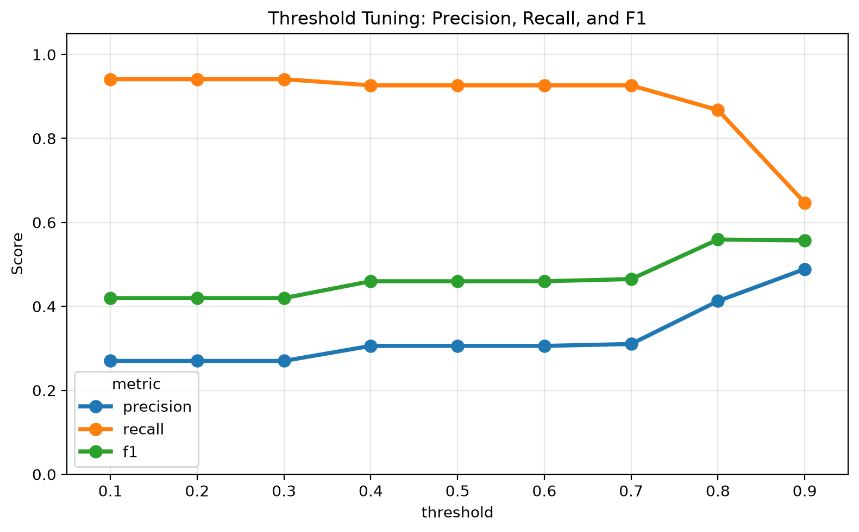
Threshold tuning and Responsible AI
The decision threshold changes who receives a failure alarm
Threshold | Detected | False alarms | Missed
0.5 | 63 / 68 | 143 | 5
0.8 | 59 / 68 | 84 | 9
RESPONSIBLE AI
Report both error types
Choose for the maintenance context
Document assumptions
Keep expert decision authority
No threshold is universally best.
Responsible and Explainable AI | University of Regina
12
Notes:
The threshold converts a model score into a failure alarm. At 0.5, the model detected 63 failures with 143 false alarms. At 0.8, it detected 59 failures with 84 false alarms. Raising the threshold improved precision but reduced recall. Threshold 0.8 is not automatically better. A responsible choice depends on the consequences of missed failures and unnecessary inspections, and should use domain expertise and validation data.

Slide 13
Conclusion, limitations, and future work
CONCLUSIONS
LIMITATIONS
FUTURE WORK
Anomaly and failure are different concepts
Synthetic dataset
Real temporal machine data
Engineered tree gave the best classification balance
No machine time histories
Calibration and monitoring
SHAP exposed influence; LIME required fidelity checks
No expert evaluation
Domain-defined error costs
Thresholds change practical error consequences
Probabilities not calibrated for deployment
Maintenance-expert explanation study
Responsible prediction requires performance, explanation, error analysis, and honest limits.
Questions?
Responsible and Explainable AI | University of Regina
13
Notes:
In conclusion, anomaly detection and failure classification answer different questions. The neural-network experiment showed that greater model complexity did not improve the main failure-focused metrics in this study. The engineered tree provided the strongest balance and remained easier to explain. SHAP supported model inspection, while LIME showed why explanation fidelity must be evaluated. Threshold tuning demonstrated that responsible decisions depend on error consequences. The prototype demonstrates course concepts but is not ready for industrial deployment. Future work should use real temporal data, calibrated probabilities, domain-defined costs, and expert evaluation. Thank you. I am happy to answer questions.

