Slide 1


Slide 2
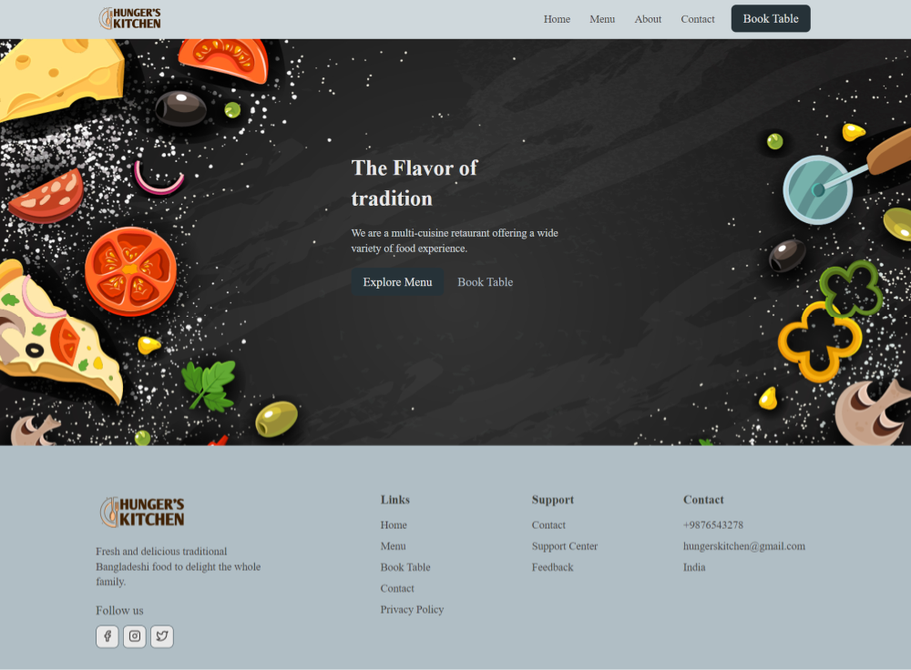
Home Page

Slide 3
Introduction
Our System is made for Restaurant management System.
It will be useful for customer to Book Table from there mobile.
And it will be also useful for restaurants to manage table arrangement time wise as user can book there table with specific time, table type, locations and many more…

Slide 4
System and Tools
Systems we are using:
MacBook Pro i5
Dell Laptop Ryzen 5 5000
Tools :
HTML
CSS
JavaScript (React)

