Slide 1
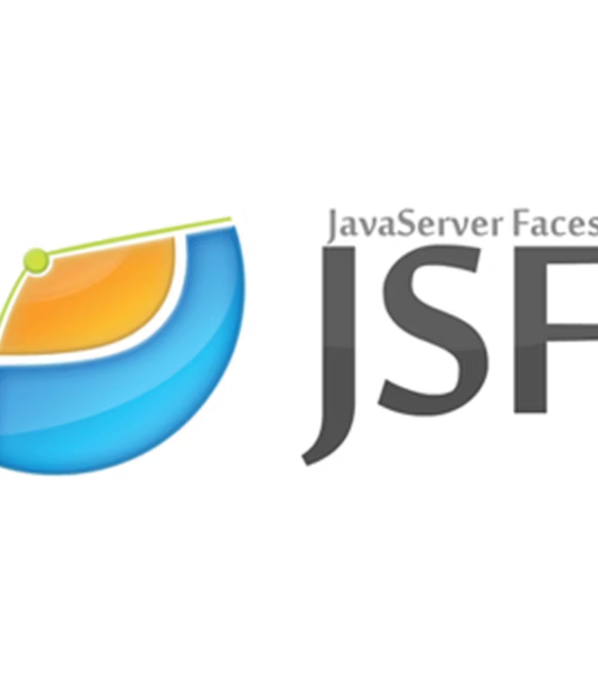
JavaServer Faces (JSF)
Concepts, Features & Best Practices
Prepared by: Dipesh Malla
For: Akshamala Java Internship Program

Slide 2








What is JSF?
JavaServer Faces (JSF) is a Java-based web application framework for building component-based UIs.
Developed under Java EE specifications (now Jakarta EE).
Provides server-side UI rendering using reusable components.
Uses XML-based configuration and Facelets (.xhtml) for UI definition.
Follows MVC architecture for separation of concerns.
Key Idea: Write less HTML/JavaScript manually – let JSF handle UI state and event processing.

Slide 3










Merits of JSF
Component-Based
Rich Tag Libraries
Event-Driven Programming
Reusable UI elements.
<h:>, <f:>, <p:> (PrimeFaces).
Handles UI events like buttons, dropdowns.
Built-in Navigation Handling
Integration Friendly
AJAX Support
Works with EJB, JPA, CDI, Spring.
Built-in with <f:ajax> or PrimeFaces <p:ajax>.
Page flow control with minimal code.

Slide 4





Demerits of JSF
Steeper Learning Curve
Stateful Nature
Less Popular in Modern Startups
More complex than JSP/Servlets.
Can lead to memory overhead in large apps.
Replaced by SPA frameworks (React, Angular).
Verbose Configuration
Slower Initial Load
Unless using annotations.
Due to component rendering.

Slide 5












JSF Life Cycle (6 Phases)
Restore View Phase
Apply Request Values
Build or restore component tree.
Map submitted values to components.
Render Response
Process Validations
Generate HTML response for browser.
Validate input against rules.
Invoke Application
Update Model Values
Execute business logic / navigation.
Update managed bean properties.

Slide 6






Features of JSF
UI Component Model
Validation & Conversion
Internationalization (i18n)
Encapsulated HTML generation.
Built-in and custom validators/converters.
Locale support.
Template Support
Event Handling
Tool Support
Facelets templating for consistent layouts.
Server-side action listeners.
Integrated in IDEs like NetBeans, Eclipse, IntelliJ.

Slide 7
Managed Bean in JSF
Definition: Java class managed by JSF framework, acts as a controller in MVC.
Stores UI state and handles business logic.
Declared via annotations or faces-config.xml.
Example:
@ManagedBean(name = "studentBean")@SessionScopedpublic class StudentBean { private String name; // getters/setters}

Slide 8

Managed Bean Scopes
Request Scope (@RequestScoped)
View Scope (@ViewScoped)
Lives for one HTTP request.
Lives while user interacts with same JSF view.
Lightweight, good for stateless operations.
Good for multi-step forms.
Demerit: Data lost after response.
Demerit: Lost if navigation occurs.
Session Scope (@SessionScoped)
Application Scope (@ApplicationScoped)
Lives for entire HTTP session.
Shared across all users and sessions.
Good for user login data.
Good for constants/configurations.
Demerit: Memory-heavy for many users.
Demerit: Thread-safety needed.

Slide 9
AJAX in JSF
AJAX: Asynchronous JavaScript and XML.
Allows partial page updates without reloading entire page.
Improves user experience and performance.
Benefits:
Faster responses.
Reduced bandwidth.
Better interactivity.
Usage in JSF:
<p:ajax event="change" update="output" listener="#{bean.method}"/>

Slide 10

Conclusion
JSF is a mature, enterprise-ready Java web framework.
Offers powerful component-based development and server-side rendering.
Best suited for enterprise apps needing tight Java EE integration.
Understanding lifecycle, managed beans, scopes, and AJAX is key to mastering JSF.
"JSF simplifies UI development, but mastery lies in knowing when and how to use it."

