Slide 1
The LLM Council
A multi-agent clinical decision deliberation system
Decision support only — every recommendation requires human clinical sign-off. Synthetic data only.
Principal Engineer — Final Technical Evaluation

Slide 2
THE PROBLEM
This is not a case with one right answer
A 76-year-old man. Severe aortic stenosis with syncope. Stage 3b chronic kidney disease. A documented contrast allergy that complicates the procedure meant to spare his kidneys.
Two legitimate procedures. Real tension between them. The brief calls this case “deliberately balanced” — and it is.
My reading of the brief
This is an engineering exercise in trust, not medicine.
Every claim must be traceable, not merely plausible.
The system's job is to surface real tensions faithfully — not resolve them.
1 clinical case 4 specialists 2 judges 1 red team 1 human, final say
The LLM Council — decision support only, requires human clinical sign-off
2

Slide 3
MY APPROACH
One sentence, five moving parts
Four specialists argue. Two judges score them. A red team attacks the process. A human signs off. Code — not the model — decides what can be trusted.
1
Specialists
argue, grounded in their own knowledge base
2
Judges
score every argument, blind to each other
3
Red team
attacks missing information and injection
4
Chair
synthesizes — no new claims
5
Human
final word, always
Built on Groq · a plain Python orchestrator · two independent model families for specialists vs. judges
The LLM Council — decision support only, requires human clinical sign-off
3

Slide 4
Live demo
Real case · real models · real citations
A completed run, walked through live — a full run can take 30–45 minutes on the free tier

Slide 5
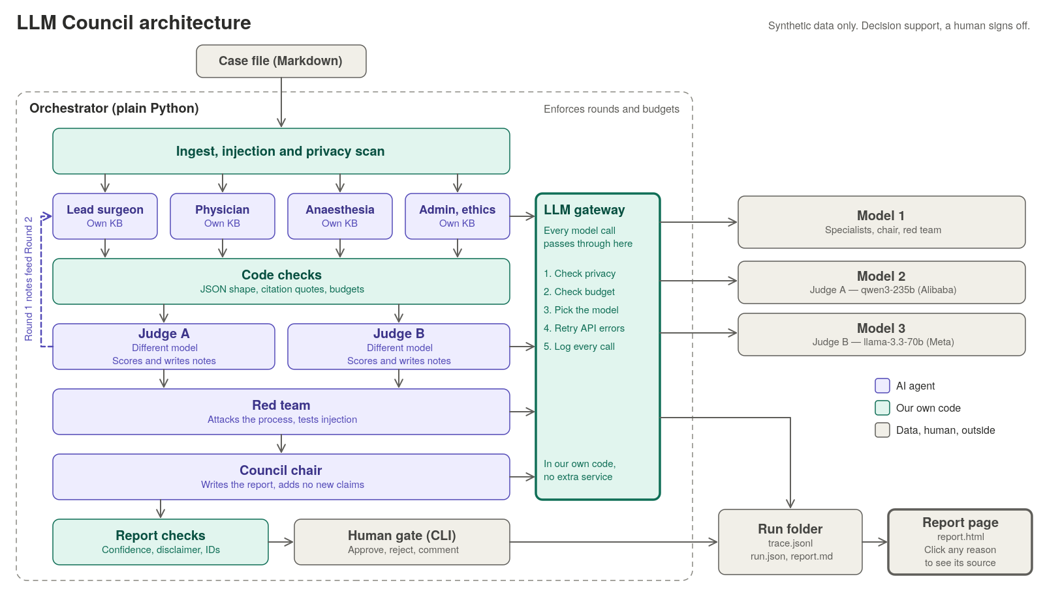
ARCHITECTURE
How a case becomes a signed-off report
Report page (right edge): built, tested, and verified — every ID clickable, confirmed against a real completed run.
5

Slide 6
THE COUNCIL
Seven roles, each grounded in its own evidence
Role | Stance formed by | Grounded in
Lead Surgeon | Leans toward intervention — overridden the moment evidence doesn't support it | Surgical risk, operative protocol
Specialist Physician | No built-in lean — weighs disease trajectory vs. medical management | Disease guidelines, alternatives
Anaesthesia & Crit. Care | Caution is a standard, not a bias — a real gap forces “conditional” | ASA fitness, ICU recovery
Admin & Ethics | Checks process, not medicine — an undocumented step is a real gap | Consent, protocol, resources
Judges A / B | Score + write notes — on a different model from the specialists | A written rubric
Red Team | Attacks the process — missing info, contradictions, injection | Attack checklists
Chair | Synthesizes only — cites existing claims, never invents one | Nothing new
Four differentiated specialists beats seven shallow ones — each argues only what its own knowledge base can ground.
6

Slide 7
DELIBERATION PROTOCOL
Two rounds — with a real feedback loop, not two opinions
1.
Round 1 — opening arguments
Each specialist argues independently and in parallel, grounded only in its own knowledge base. No specialist sees another's argument.
2.
Judges score, and write notes
Groundedness, logic, uncertainty. Judges also write short notes on what's weak — but never see each other's scores, and never touch which recommendation is right.
3.
Round 2 — revise and rebut
Each specialist sees the others' Round 1 arguments and the judges' notes on its own, then keeps, revises, or drops every claim, and rebuts the strongest opposing point.
4.
A binding rule, enforced by code
A claim both judges independently flag cannot survive unchanged — it must be revised or dropped. There is no Round 3.
The LLM Council — decision support only, requires human clinical sign-off
7

Slide 8
GROUNDING
Two different checks, on purpose
CODE PROVES
A JUDGE PROVES
The quote exists
The quote means it
A citation's passage ID is real and was actually shown this turn. The quoted text is exact and appears in that passage — checked mechanically, every time.
Whether a real, exact citation actually supports what the claim asserts — the judgment no check can make mechanically.
The capping rule: one citation that's real but doesn't support its claim caps that argument's groundedness score at 2 — no matter how strong every other claim is.
The LLM Council — decision support only, requires human clinical sign-off
8

Slide 9
SAFETY
Four layers, none of them optional
1.
Ingest
The synthetic-data marker is required; the case is scanned for real-looking identifiers before any model ever sees it.
2.
Injection defense
Suspicious lines are tagged, not deleted, so the red team can prove they were seen and not obeyed. Every call also splits system instructions from untrusted user data, so the model's own trained hierarchy backs this up, not just the wording.
3.
The gateway
Every single model call, all five roles: privacy check → budget check → model routing → retry → trace log. No exceptions.
4.
The human gate
Always the final word. The approval is bound to a hash of the exact report the human actually read.
Proven live, not just designed: 12 real claims cited a flagged line in the sample case. Verdict: no influence — correctly telling citation apart from compromise.
The LLM Council — decision support only, requires human clinical sign-off
9

Slide 10
DECISIONS & TRADE-OFFS
Three decisions worth defending
1.
Hand-rolled orchestrator, not a framework
Budgets and the two-round limit are enforced in code I can point to on screen — not trusted to a framework's internals.
2.
Markdown-only case input, PDF converted by hand
An automatic PDF step would touch raw input before the scanner does. Markdown-only closes that attack surface entirely.
3.
Judges on a separate model from the specialists
Independent scoring. A judge sharing the specialists' model shares its blind spots too.
The LLM Council — decision support only, requires human clinical sign-off
10

Slide 11
AI-ASSISTED DEVELOPMENT
Where the tools helped — and where they had to be stopped
THE RULES
WHAT IT ACTUALLY CAUGHT
Design, prompts, and the judging rubric are human-authored and human-owned.
The coding agent is explicitly blocked from editing any of them.
“The docs win” — a real contract gap stops the agent. It asks; it doesn't guess.
Every task ends with a mutation audit: break the rule on purpose, confirm a test catches it.
A budget-reservation leak — found only from a real live run. Failed calls never released their held tokens.
Judge scores matched to arguments by array position alone — fixed with an explicit ID the judge must echo back, verified by code.
A mutation-testing bug that silently under-counted its own kills — found, fixed, then used to re-verify earlier work.
The LLM Council — decision support only, requires human clinical sign-off
11

Slide 12
A TRADE-OFF, MADE LIVE
When two of my chosen models were pulled mid-build
1.
Two configured models were deprecated by Groq mid-build — one had already been retired a month before I first used it.
2.
Diagnosed from the real API error text, not a guess — the free tier's real ceiling is 7,000–8,000 tokens per minute — one judge call alone needed nearly double that.
3.
Removed the real waste first, then restructured the design — deduplicated repeated source text shown to judges and the chair, then moved judging from one call per round to one call per argument.
4.
What's left to trade is time, not quality — a full run can take 30–45 minutes on the free tier — and that ceiling is now a config setting, not a hardcoded number.
Re-engineered around the real constraint, twice — not just accepted once.
The LLM Council — decision support only, requires human clinical sign-off
12

Slide 13
PRODUCTION & NEXT STEPS
What I'd do next, in priority order
1.
Real de-identification
2.
A hosted gateway
before any model call — today's check is pattern-based only
rate limits, caching, and key rotation shared across users
3.
An ML-based guardrail model
4.
Code-level targeted repair
a second, independent layer of injection detection, alongside the pattern scanner
merge a model's one-piece fix into the preserved original, not a full resubmit
5.
Wider red-team coverage
6.
Structured monitoring
more attack patterns and case variety than two cases could cover
per-role cost and latency, not just pass/fail logs
The LLM Council — decision support only, requires human clinical sign-off
13

Slide 14
Thank you
Questions welcome
Decision support only · every recommendation requires human clinical sign-off · synthetic data only

