Slide 1


The Evaluation of AI and ML in Ethical and Social Issues
Dipesh Singh
12200599
BUS707 Applied Business Research
CRICOS 03171A
1

Slide 2
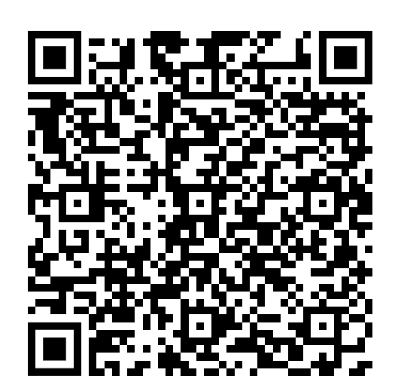
CRICOS 03171A
2

Slide 3
Research Questions and Research Objectives
Research Questions
How do AI and ML technologies raise ethical concerns in decision-making processes?
How can frameworks be established to guide the ethical development and deployment of AI and ML technologies?
What are the broader social implications of AI and ML deployment across different sectors?
Solutions to Research Questions
Analyze and explain the ethical challenges posed by AI and ML algorithms.
Propose guidelines and frameworks for responsible AI and ML integration.
Assess the social impacts, including shifts in employment, labor market disruptions, and privacy concerns.

Slide 4
Methodology Plans
Alternative Methodology 1
Research Type: Descriptive
Research Approach: Quantitative
Type of Data: Primary
Sampling Plan: Convenience Sampling

Slide 5
Alternative Methodology 1 (continued)
Advantages
Larger sample for broader conclusions
Statistically confirmed results
Limitations
Lack of in-depth understanding
Numeric data may miss theoretical touches
Time, cost, and resource-intensive

Slide 6
Alternative Methodology 2
Alternative Methodology 2
Research Type: Causal
Research Approach: Quantitative
Type of Data: Primary
Sampling Plan: Convenience Sampling/ Random Sampling

Slide 7
Alternative Methodology 2 (continued)
Advantages and Limitations
Advantages
Establish cause-and-effect relationships
Correctness and accuracy
Customizable experiments
Limitations
Ethical dilemmas (situations where researchers face conflicting ethical principles or values that make it challenging to make a clear and morally acceptable decision.)
Limited generalizability(a limitation of a study's findings)

Slide 8
Recommendation & Conclusion
Consider a combination of descriptive and causal research.
Descriptive research provides initial insights, while causal research establishes cause-and-effect relationships.
Choose research methodology based on research objectives, resources, and ethical considerations.
Researchers should prioritize ethical considerations in AI and ML research.

Slide 9
Reference List
Barocas, S., Hardt, M., & Narayanan, A. (2019). Fairness and Machine Learning
Brown, J. M. (2020). Impact of AI on the Job Market: Automation vs. Human Creativity
Bryson, J. J., Diamantis, M. E., & Grant, T. D. (2017). Of, for, and by the people: The legal lacuna of synthetic persons. Artificial Intelligence and Law, 25(3), 273-291.
Floridi, L., Cowls, J., Beltrametti, M., Chatila, R., Chazerand, P., Dignum, V., ... & Wachter, S. (2018). AI4People—An Ethical Framework for a Good AI Society: Opportunities, Risks, Principles, and Recommendations. Minds and Machines, 28(4), 689-707.
Batt, R. and Kahn, L., 2021. Data Transparency and Methods in Quantitative and Qualitative Research: Letter from the Editors. ILR Review, 74(5), pp.1079-1082.
Choy, L.T. (2014), ‘The Strengths and Weaknesses of Research Methodology: Comparison and Complimentary between Qualitative and Quantitative Approaches’, IOSR Journal of Humanities and Social Science, pp. 99–104. Available at: https://iosrjournals.org/iosr-jhss/papers/Vol19- issue4/Version-3/N0194399104.pdf [Accessed on 15th May 2022]
Daza, M.T. and Ilozumba, U.J., 2022. A survey of AI ethics in business literature: Maps and trends between 2000 and 2021. Frontiers in Psychology, 13, p.1042661.
Diakopoulos, N., & Friedler, S. A. (2018). How we analyze it: A model for contextualizing analyses of bias in natural language processing. Proceedings of the 2018 AAAI/ACM Conference on AI, Ethics, and Society, 13-18.
Hair, J. F., Black, W. C., Babin, B. J., & Anderson, R. E. (2019). Multivariate Data Analysis.
Hickok, M., 2021. Lessons learned from AI ethics principles for future actions. AI and Ethics, 1(1), pp.41-47.
Kaewkungwal, J. and Adams, P., 2019. Ethical consideration of the research proposal and the informed-consent process: An online survey of researchers and ethics committee members in Thailand. Accountability in Research, 26(3), pp.176-197.
Lenger, A., 2019. The Rejection of Qualitative Research Methods in Economics. Journal of Economic Issues, 53(4), pp.946-965.
Smith, A., Stevenson, A., Alexander, B., Hansen, H., Barros, M. and R. S. T. A. Elias, S., 2021. Bringing Back the Researcher: Dominance and Silences of Interviews in Qualitative Research. Academy of Management Proceedings, 2021(1), p.1.
Williams, M. and Moser, T., 2019. The Art of Coding and Thematic Exploration in Qualitative Research. International Management Review, 15(1), pp.45-55.

Slide 10
Thank You for Your Attention!

