Slide 1


Team Details
Team name: AccessPath AI
Team leader name: Dipesh Jagtap
Problem Statement: People seeking mobility and related support—and their caregivers—struggle to find trustworthy resources, understand next steps, and coordinate referrals. Support organisations often track cases in spreadsheets and chats, with little visibility into whether assistance was actually delivered.

Slide 2
AccessPath AI
From unmet need to delivered support
AI-powered navigation and coordination for multi-category support in India (education, essential needs, disability/health).
Users describe a need → confirm a summary → receive a grounded plan → discover verified programmes → consent to a referral → track outcomes.
Organisations publish programmes and manage cases; admins verify provider identity evidence.
Not a medical diagnosis system, device prescription tool, or guaranteed-benefits service.
Hackathon demo uses clearly labelled fictional seed data (Pune, Maharashtra demo region).

Slide 3
Brief about the idea
Observed problem: support information is fragmented across NGOs, clinics, schemes, and informal channels; caregivers repeatedly re-explain the same situation.
Organisational pain: referrals stall without shared checklists, consent records, or outcome tracking beyond “sent a message.”
Idea: a guided journey that turns a stated need into a structured, actionable plan grounded only in curated database records.
Gemini on Vertex AI explains matched programmes in plain language; matching itself is deterministic against published, verified programmes.
Consent is explicit and field-level before any personal data is shared with a partner organisation.
Success metric focus: completed referrals and recorded outcomes—not clicks or AI prose alone.

Slide 4
Opportunities
How different is it?
How it solves the problem
USP of the solution
DB-grounded matching first; AI explains—never invents providers or eligibility.
Verification status + source + last-verified shown on listings.
Consent-gated referrals with audit trail; outcomes ≠ submission.
One guided path from need → plan → programme → case.
Persistent checklist keeps next actions visible.
Org dashboard: accept, decline, request info, deliver, close.
Trust architecture: grounding + verification + consent + outcomes.
Deterministic fallback when Vertex AI is unavailable.
B2B/B2B2C: orgs pay for coordination; user guidance free in pilot.

Slide 5
List of features offered by the solution
Multi-category intake (education, essential needs, disability/health)
Summary review & confirmation before planning
Gemini (Vertex AI) grounded navigation plan
Deterministic fallback plan (no invented facts)
Verified programme & resource directory
Persistent user checklist with status owners
Explicit field-level referral consent
Case lifecycle to recorded outcomes
Org workspace: programmes + caseboard
Alternative pathway after decline/stall
Admin verification evidence + audit events
RBAC (user / org roles / platform admin)
Cloud Run ready + /api/health

Slide 6
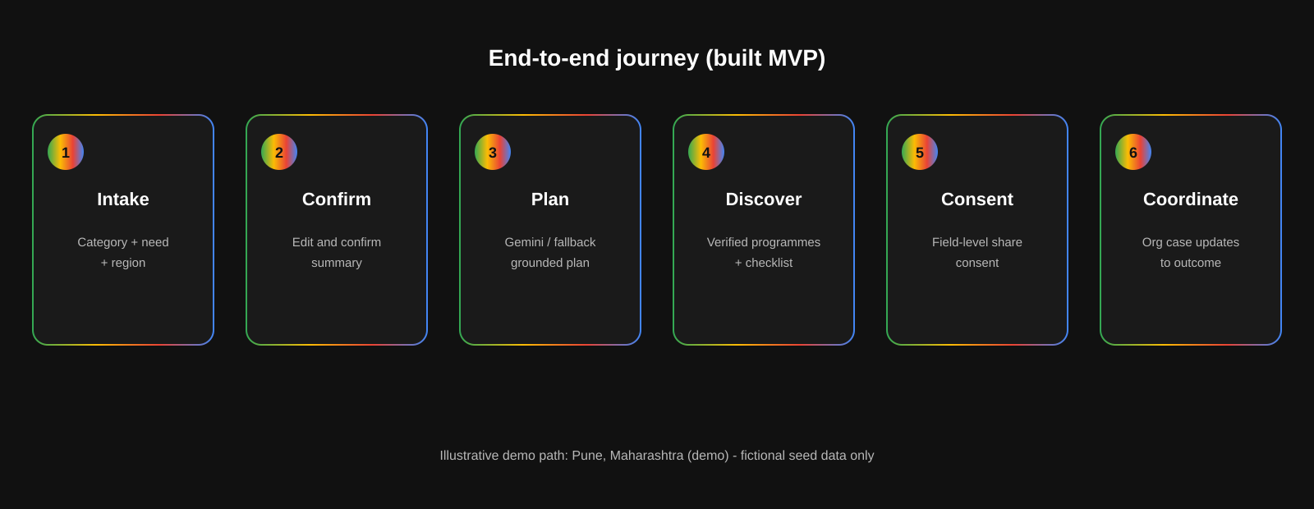
Process flow diagram or Use-case diagram

Slide 7
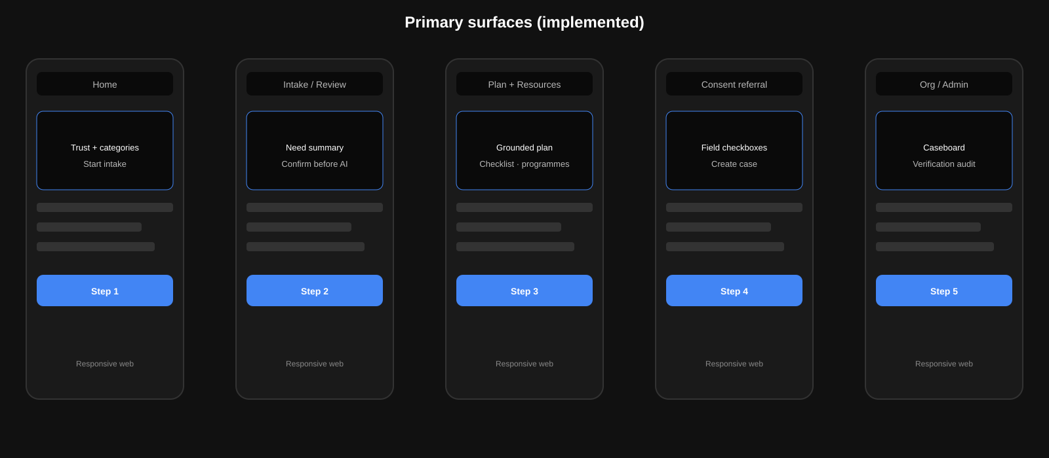
Wireframes/Mock diagrams of the proposed solution (optional)

Slide 8
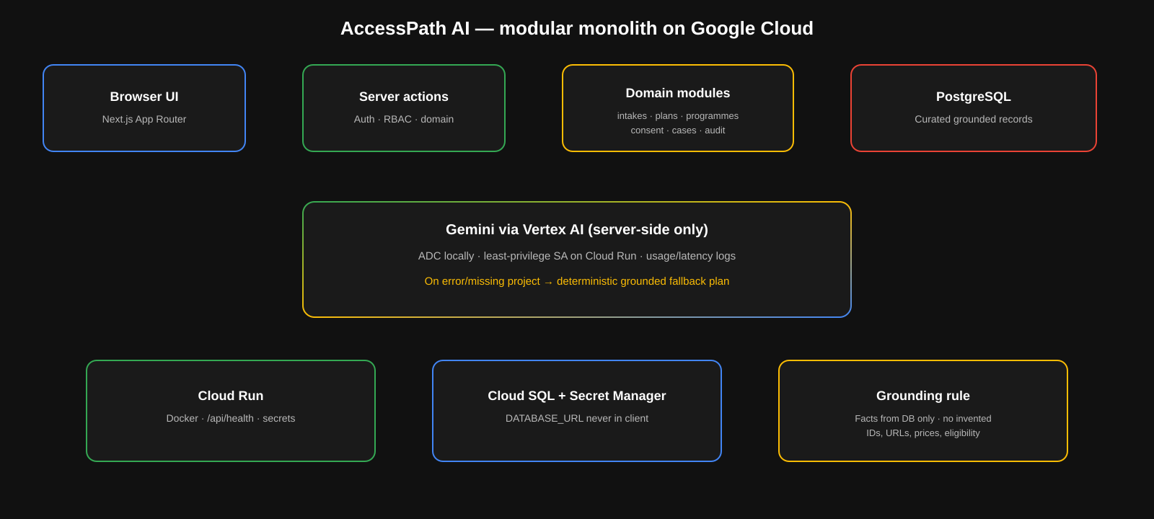
Architecture diagram of the proposed solution

Slide 9
Technologies to be used in the solution
Frontend
Next.js 16 App Router, React 19, TypeScript, Tailwind CSS
Backend
Next.js server actions, modular domain services, Zod validation
Data
PostgreSQL, Drizzle ORM, curated seed + migrations
AI
Gemini via Vertex AI (@google/genai), structured JSON plans
Auth / trust
Session auth, bcrypt, org RBAC, consent events, audit log
Cloud
Cloud Run (Docker), Cloud SQL, Secret Manager, ADC / SA
Quality
Vitest, AI safety script, journey verify, link verify, health API

Slide 10
Estimated implementation cost (optional)
Illustrative monthly GCP cost for a small pilot (not a quote). Assumes low traffic demo + Cloud Run min instances off.
Component | Assumption | Est. / month
Cloud Run | Low RPS web service | USD 5–25
Cloud SQL (Postgres) | db-f1-micro / small | USD 10–40
Vertex AI Gemini | Flash-class, capped prompts | USD 5–30
Secret Manager / Artifact Registry | Minimal | USD 1–5
Egress / misc | Demo traffic | USD 2–10
Pilot total (approx.) | Hackathon → early pilot | USD ~25–110

Slide 11




Snapshots of the prototype
Landing — trust + multi-category entry
People & caregivers journey
Organisation coordination surface
Authenticated workspaces

Slide 12
Prototype Performance report/Benchmarking
Verification harness: npm run verify:all (typecheck, lint, unit tests, AI safety, journey, source links, deploy-env check, build).
AI safety script confirms empty-region → no invented resources; expired listings excluded; schema-validated plan JSON.
Demo journey script walks intake → plan → consent → org decline → alternative → outcome (fictional data).
Health: GET /api/health returns service status, env warnings, DB ping, resource count.
Resilience: if Vertex AI / project / ADC missing, server returns deterministic grounded fallback (source: deterministic_fallback).
No fabricated latency/accuracy benchmarks claimed—pilot metrics to collect: time-to-next-step, referral contact rate, delivered outcomes, staff follow-up time.

Slide 13
Additional Details/Future Development (if any)
Pilot with 2–3 real partner organisations in one region after privacy/consent review (replace fictional seed).
Expand verified catalogue and languages (e.g. Hindi/Marathi) only after verification operations scale.
Notifications for stalled cases (SMS/email) when a provider is configured—not claimed in MVP.
Stronger document checklists and accessibility tooling beyond current smoke criteria.
Measure willingness-to-pay for org coordination & reporting (B2B), keep basic user guidance free early.
Explicit non-goals remain: no diagnosis, no eligibility guarantees, no auto-filing to government systems, no payments/insurance processing.

Slide 14
Provide links to your:
GitHub Public Repository
https://github.com/dipeshjagtap/accesspath
Demo Video Link (3 Minutes)
To be attached / uploaded with submission (script in docs/DEMO_VIDEO.md)
Final Product Link
Deploy via docs/DEPLOYMENT.md to Cloud Run; set NEXT_PUBLIC_APP_URL after first deploy. Local: http://localhost:3000

Slide 15
Target users & illustrative use case
Primary user
Organisational stakeholder
Caregiver or person seeking disability/health or mobility-related support navigation (also education & essential needs).
NGO / rehab caseworkers and org admins who publish programmes and update cases to outcomes; platform admin verifies providers.
Illustrative example (fictional demo data only)
Riya Sharma (demo user) describes a disability/health support need in Pune, Maharashtra (demo). She confirms the summary, receives a plan referencing verified programmes such as the Demo Mobility Navigation Clinic from Sahara Community Support Network (demo). She consents to share selected fields. Caseworker Asha Kulkarni reviews the case; if declined, Riya can consent to an alternative with Nirmal Alternative Care Desk (demo) and track status through to assistance delivered—or another recorded outcome.

Slide 16


