Slide 1


COP 7001 - Cornerstone Project
Accelerated Mobile Video Processing Engine
Group Member:
Kunal Dhyani Dipesh Kant
(2025MCS2112) (2025MCS2110)
Instructor:
Prof. Kolin Paul
Department of Computer Science & Engineering

Slide 2


Terminologies
Video - Rapid sequence of images called frames.
Pixel - Picture Element, smallest individual building block of an image, every frame of a video is a massive grid of these tiny squares, each define by RGBA values.

Slide 3
Terminologies
The Illusion of Motion: FPS dictates how many individual images are flashed on the screen in a single second.
  24 FPS: The standard for movies (gives a "cinematic" look).
  30 FPS: Standard for mobile video and television.
  60 FPS: Used for sports, gaming, and ultra-smooth video.

Slide 4
Math
  The Resolution Factor: Full HD (1080p) video.
    A single 1080p frame is 1920 x 1080 pixels tall.
    1920 x 1080 = 20,73,600 pixels per frame.
  The Real-Time Math (at 30 FPS):
    20,73,600 pixels x 30 frames = 62.2 million pixels/second.
    Since each pixel has 4 channels (Red, Green, Blue, Alpha), the processor is reading, calculating, and writing nearly 250 million individual values per second just to apply a basic filter!

Slide 5
Operation/Transformation
3D LUT COLOR GRADING
  LUT - LookUp Table
  .cube extension
LUT_3D_SIZE 16
0.065805 0.070008 0.074371
0.077419 0.069916 0.073520
0.112865 0.069916 0.073520
0.160339 0.069916 0.073520
  Trilinear Interpolation

Slide 6
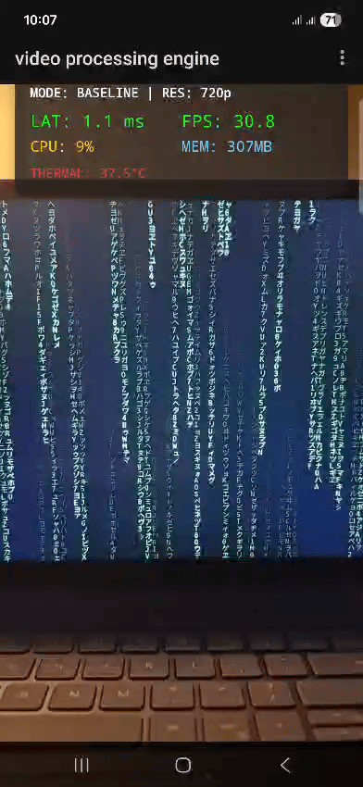
Demo

Slide 7
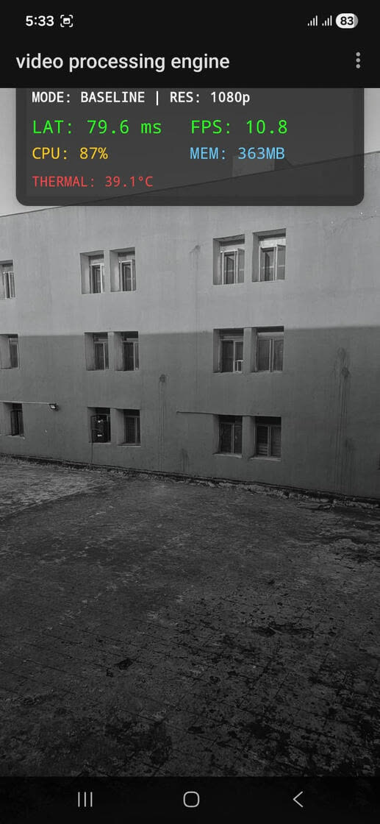
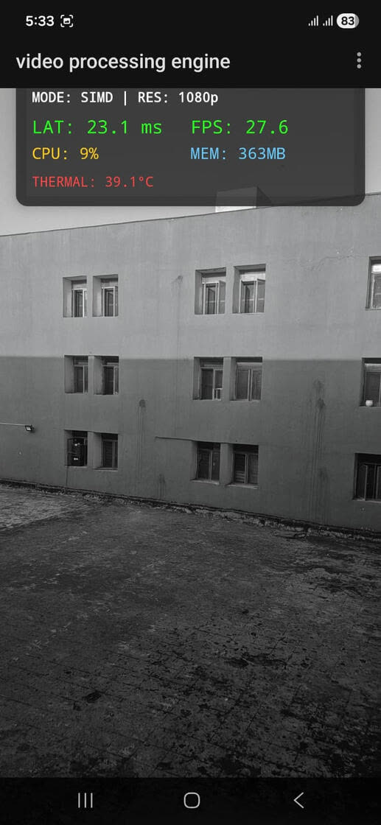
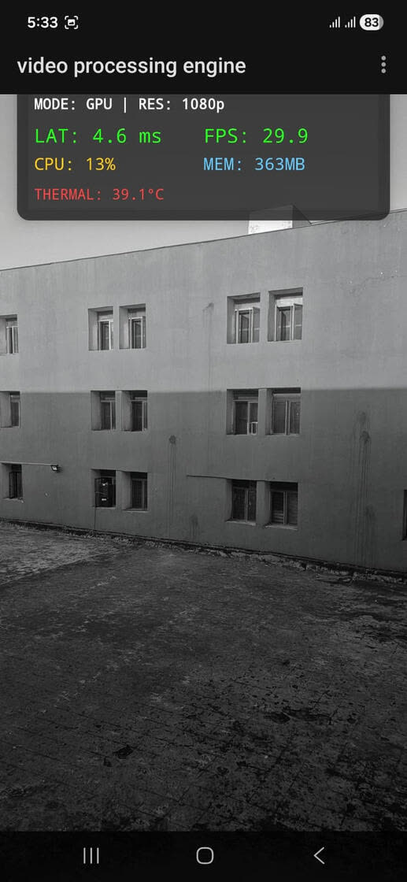
Results

Slide 8
Thank You

