Slide 1
Gym Membership Login System
CS 4398 • Software Engineering Project • Fall 2026
Dipesh Mahato • Andrew Lee • Dalton Lyon
github.com/dipeshmahato111/GymMembershipLoginSystem

Slide 2
INTRODUCTION
Purpose & Scope
A centralized system that replaces manual, paper-based gym operations with a secure, role-based digital workflow — covering membership, attendance, classes, and payments.
IN SCOPE
OUT OF SCOPE
User management & multi-tier authentication (Admin / Trainer / Receptionist / Member)
Membership creation, renewal, and suspension across pricing tiers
Attendance check-in / check-out tracking
Fitness class scheduling and booking
Membership payment processing & receipts
Direct physical hardware control (turnstiles, RFID readers) — the system issues software approval signals only
Full-scale accounting / payroll — transactions are logged, not a QuickBooks replacement
A live third-party payment gateway (simulated for this class project)

Slide 3
SYSTEM DESIGN
Layered Architecture
view
controller
database
MySQL
Swing UI — LoginFrame, role dashboards, feature dialogs
Business logic & validation — one per use case area
DAOs — parameterized SQL over JDBC
gym_management relational database
model
Plain data classes shared across layers
Views never touch the database directly — every screen calls a controller, which returns a Result/AuthResult so validation logic stays testable independent of the GUI (see test/controller).

Slide 4
ROLE-BASED ACCESS
Four User Roles, One Consistent UI
Administrator
Trainer
A
T
Full system control: manage users, configure membership pricing, generate reports.
Schedules fitness classes and views class rosters.
Receptionist
Member
R
M
Registers members, checks members in, and processes payments.
Views membership status, books classes, checks in, tracks attendance history.

Slide 5
DESIGN — UML CLASS DIAGRAM
Class Structure
«abstract» User
id, name, email, passwordHash, role, status
Administrator
Trainer
Receptionist
Member
adminLevel
trainerId, specialization
shift
joinDate, status
teaches
owns
has
creates
FitnessClass
Membership
Payment
Attendance
Booking
className, schedule, capacity
tier, price, dates, status
amount, method, status
checkInTime, checkOutTime
classId, date, status
generates

Slide 6
BEHAVIOR
Statechart — Membership Lifecycle
suspendMembership()
end_date passes
ACTIVE
EXPIRED
SUSPENDED
renewMembership()
isActive() = status == ACTIVE && endDate has not passed. Gates both check-in (AT-3) and class booking (AT-4).

Slide 7
BEHAVIOR
Statecharts — Attendance & Account Lockout
Attendance
Account Lockout
checkIn()
5th failed login
Checked Out
Checked In
Unlocked
Locked
checkOut()
unlocks after 15 min
SRS 4.2 Robustness
A member cannot check in twice without checking out first, and cannot check in while their membership is expired or suspended. A user account is automatically locked for 15 minutes after 5 consecutive failed login attempts, then unlocks itself — no admin intervention required.

Slide 8
FUNCTIONAL REQUIREMENTS — SRS 3.2
Five Core Use Cases
1
Register Member
Receptionist captures profile details, selects a plan, and creates an active membership.
2
Member Login
Username/password auth with lockout protection; routes to the correct role dashboard.
3
Check In
Verifies an active membership before logging a timestamped attendance record.
4
Book Fitness Class
Members reserve open seats in trainer-scheduled classes; capacity enforced live.
5
Process Payment
Receptionist charges a membership plan and extends/reactivates the subscription.

Slide 9
NON-FUNCTIONAL REQUIREMENTS — SRS 4
Security & Reliability Highlights
Password Hashing
Brute-Force Lockout
PBKDF2WithHmacSHA256, 65,536 iterations, random salt per user — never stored in plaintext.
5 failed attempts locks an account for 15 minutes automatically.
Role-Based Access
SQL Injection Defense
Members & trainers cannot reach admin tables or financial logs.
Every query across every DAO uses PreparedStatement — zero string-concatenated SQL.

Slide 10
QUALITY ASSURANCE
Acceptance Testing Approach
Each use case has a documented test in docs/acceptance-test-plan.md covering the happy path plus every alternate flow from the SRS — executed against a live MySQL instance with a screenshot per step.
ID | Use Case | Alternate Flows Verified
AT-1 | Register Member | Duplicate username/email; missing required fields
AT-2 | Member Login | Wrong password x5 → lockout; correct password rejected while locked
AT-3 | Check In | Already checked in; suspended membership
AT-4 | Book Fitness Class | Class full; duplicate booking; expired membership
AT-5 | Process Payment | Declined payment; membership correctly extended on success

Slide 11
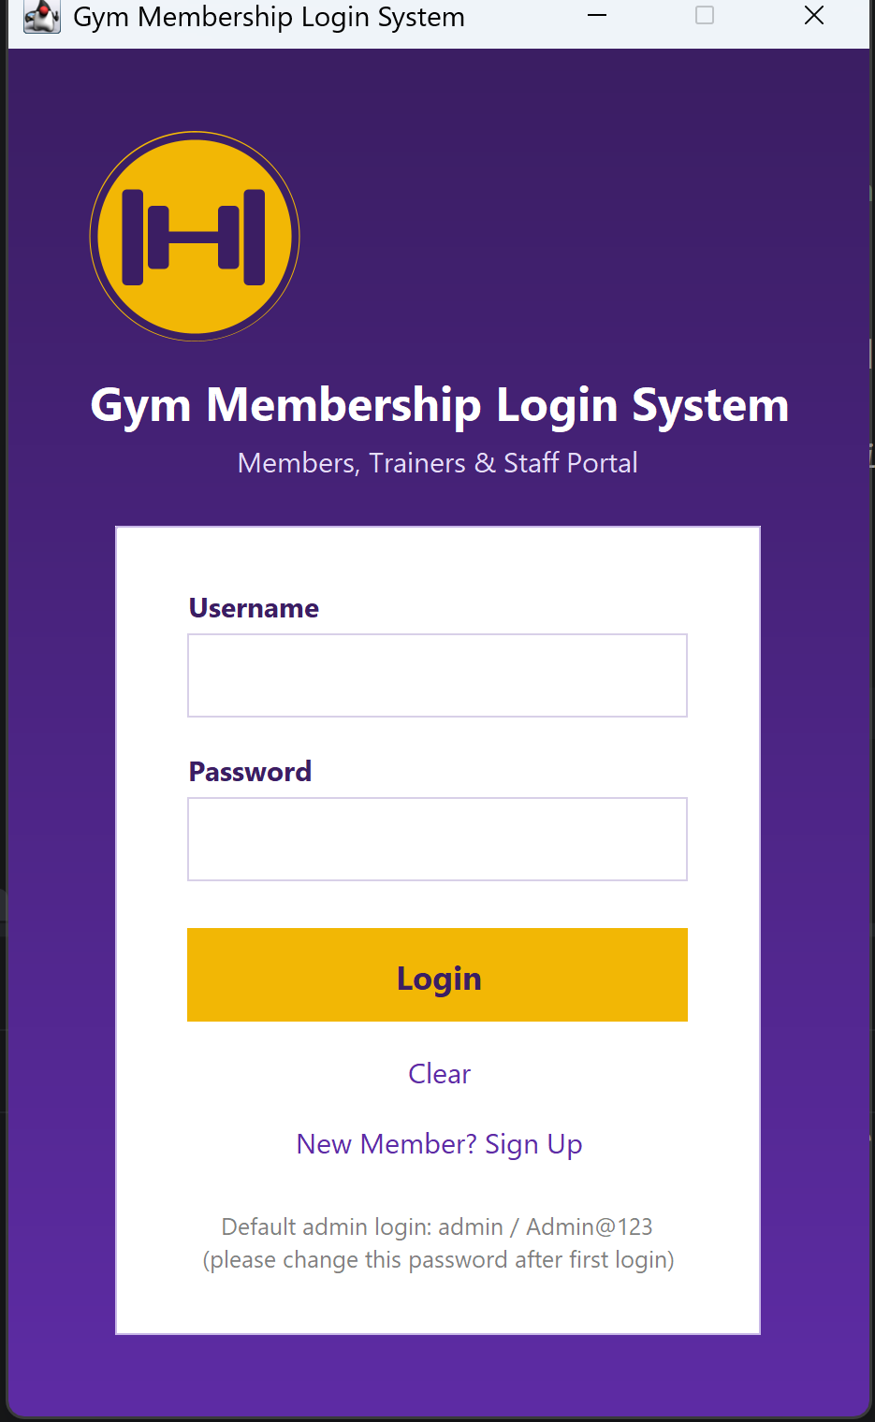
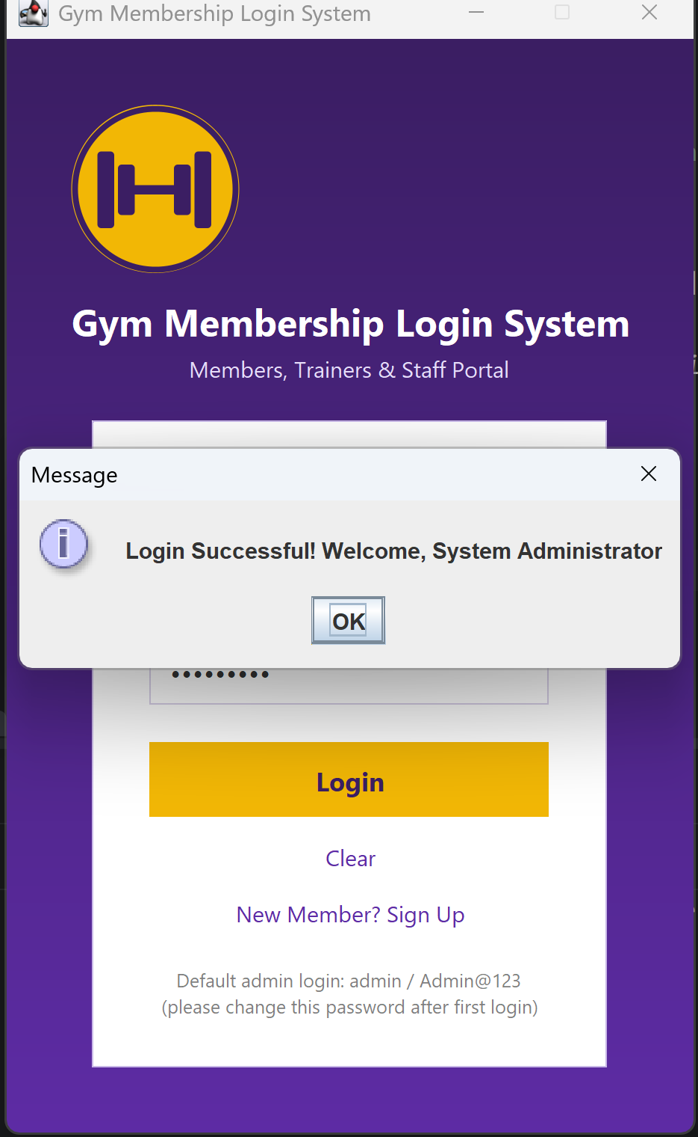
APPLICATION IN ACTION
Branded Login & Authentication
HOW IT WORKS
Purple brand theme with a logo drawn at runtime via Graphics2D — no external image asset to manage (UiTheme, GymLogoPanel)
Credentials verified through AuthenticationController against PBKDF2WithHmacSHA256-hashed passwords (65,536 iterations, random salt) stored in MySQL
A successful login routes the user to the dashboard matching their role — Admin, Trainer, Receptionist, or Member
Five consecutive failed attempts trigger a 15-minute account lockout, per SRS 4.2 Robustness
LOGIN SCREEN
SUCCESSFUL AUTHENTICATION

Slide 12
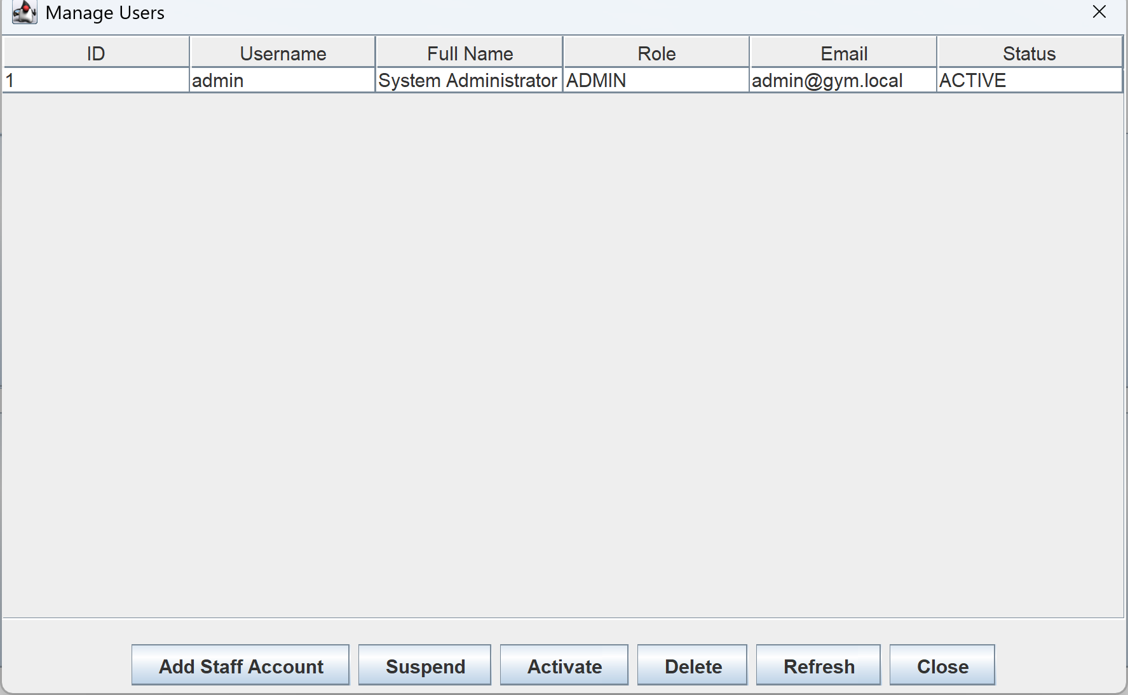
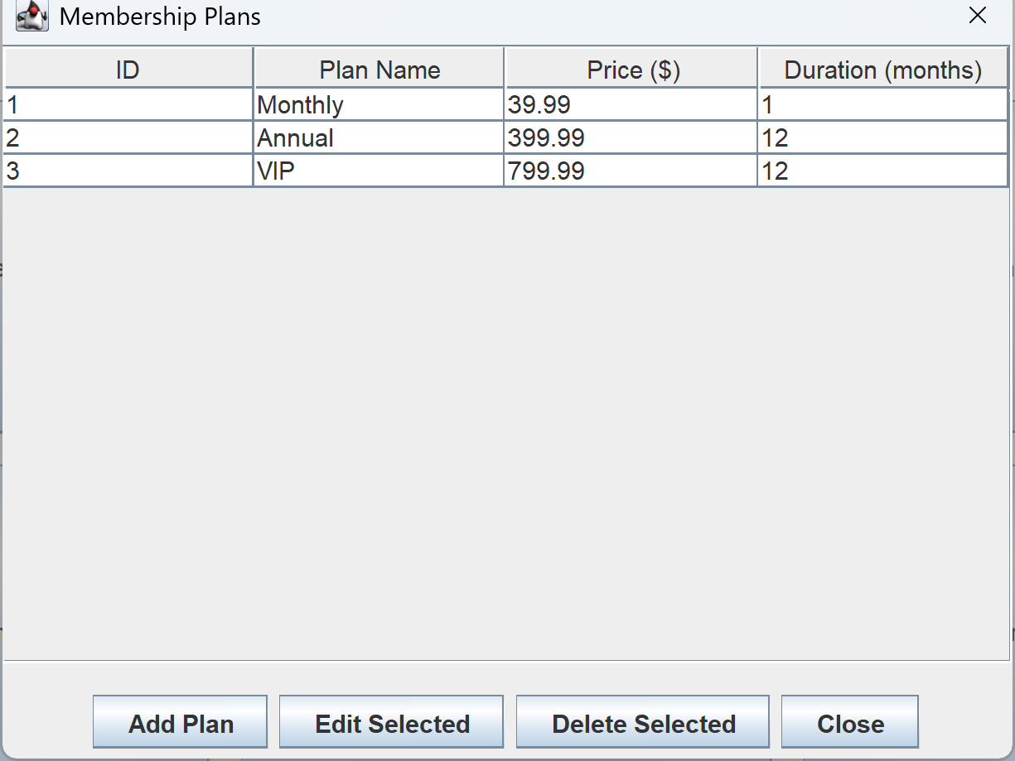
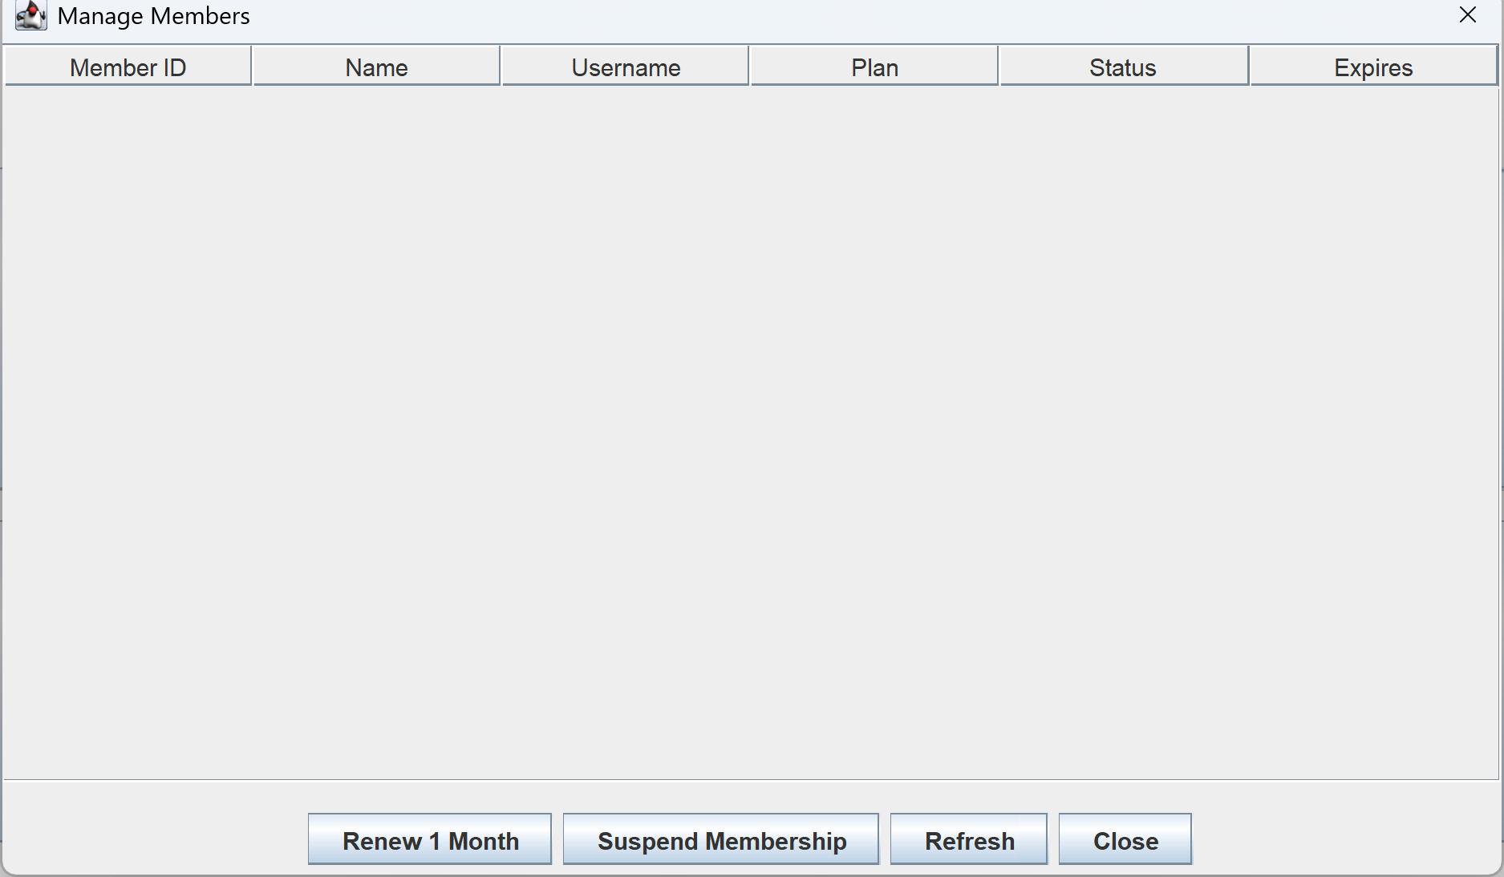
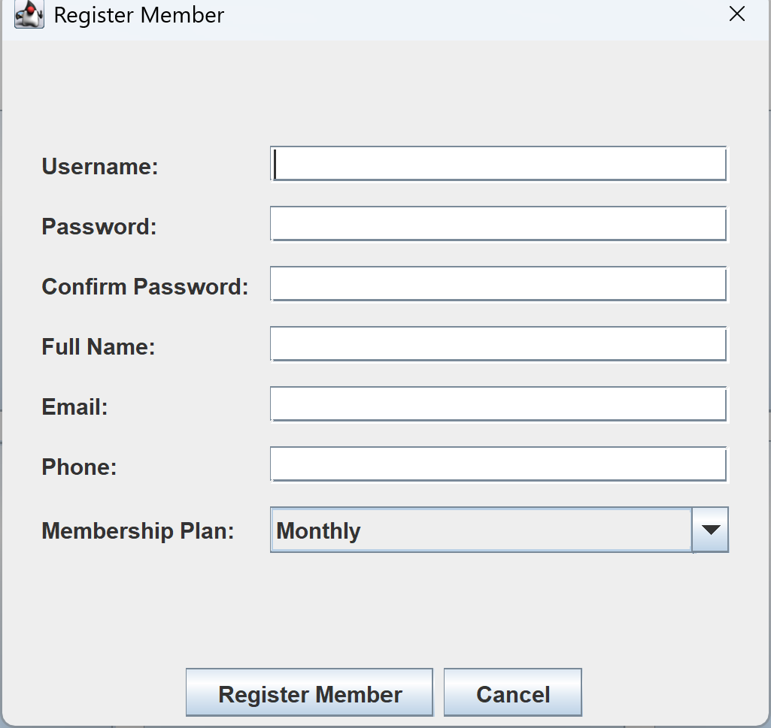
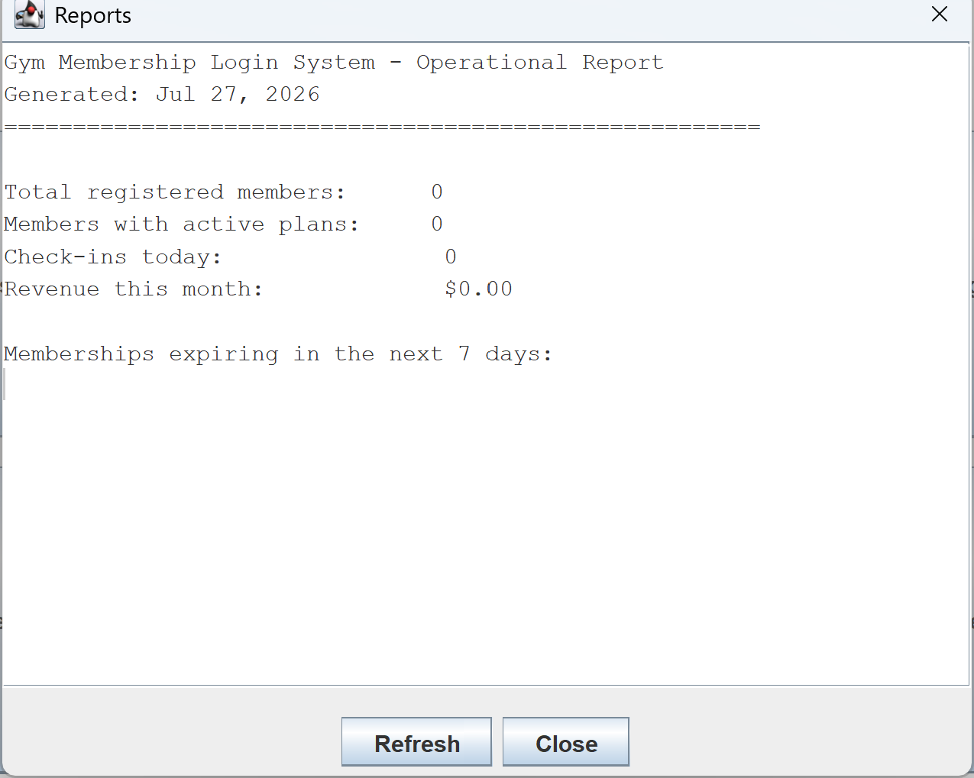
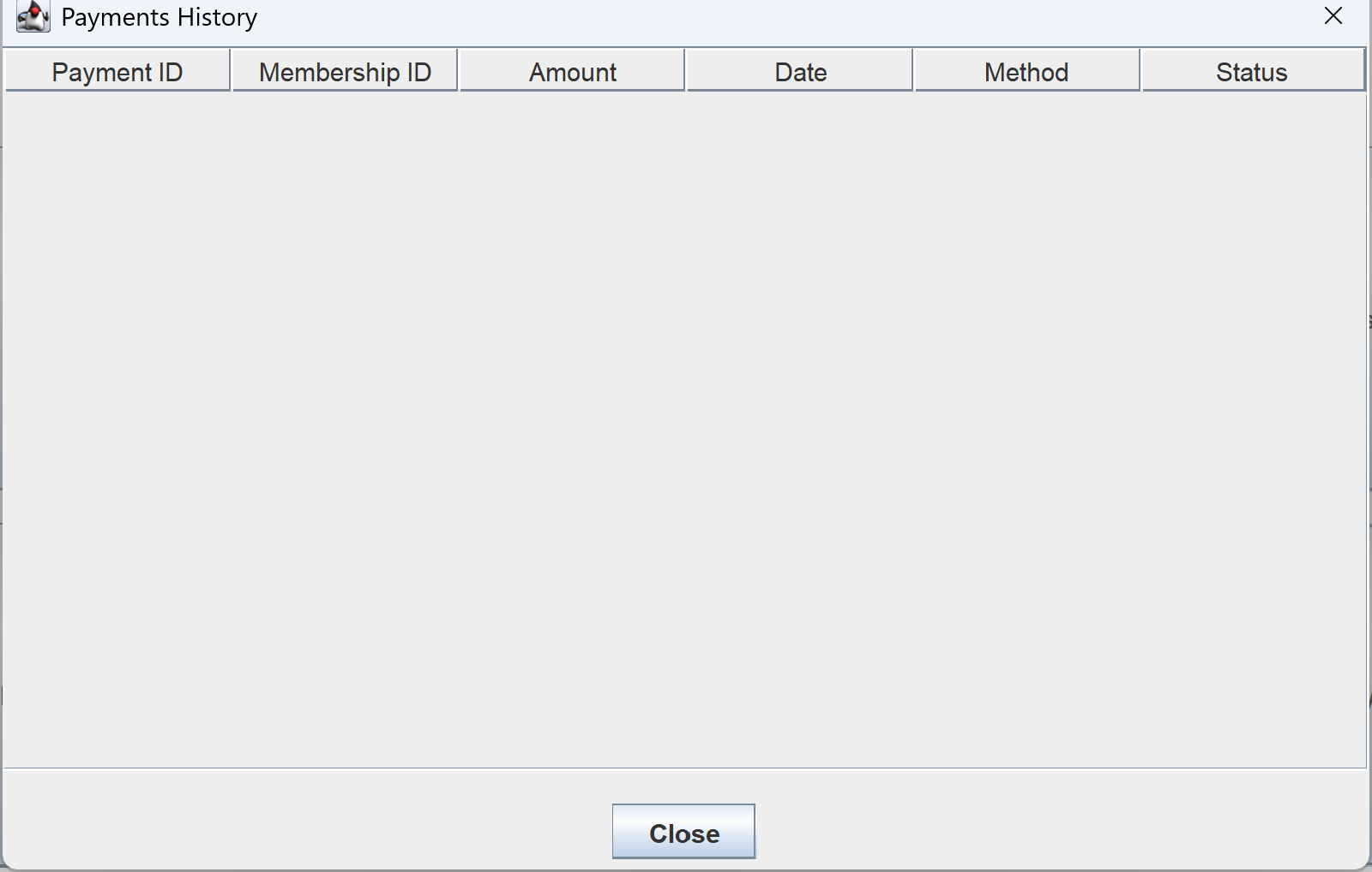
APPLICATION IN ACTION
Core Feature Screens
MANAGE USERS
MEMBERSHIP PLANS
MANAGE MEMBERS
REGISTER MEMBER
OPERATIONAL REPORTS
PAYMENT HISTORY

Slide 13
IMPLEMENTATION
Tech Stack & Tooling
Java 17
Java Swing
MySQL 8
JDBC
JUnit 5
Git
GitHub
IntelliJ IDEA
Maintainability (SRS 4.4)
Modular OOP layering, DB credentials externalized to db.properties (never hard-coded), and membership tier pricing editable from the Admin Dashboard — no rebuild required to change a rate.

Slide 14
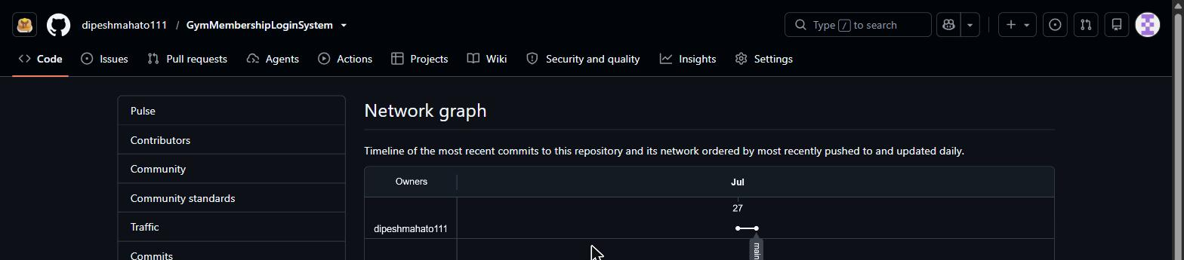
GITHUB REPOSITORY
Version Control
github.com/dipeshmahato111/GymMembershipLoginSystem
Linear history on a single main branch (3 commits) as of this snapshot — captured directly from GitHub Insights → Network.

Slide 15
Thank You
Questions?
Dipesh Mahato • Andrew Lee • Dalton Lyon

