Slide 1
UNIT 3 & 4
UNIT 3: OOP Concepts
UNIT 4: Inheritance and Packaging

Slide 2
OOP Features
allows users create the objects that they want and then create methods to handle those objects. Manipulating these objects to get results is the goal of Object Oriented Programming.
Core OOPS concepts are
Class – group of similar entities. – logical entity. A class can also be defined as a blueprint from which you can create an individual object. - e.g. car
Object – instance of class – physical entity – e.g. santro car, bmw
Abstraction - an act of representing essential features without including background details. E.g. while driving a car, you do not have to be concerned with its internal working.
Encapsulation - technique of wrapping the data and code. the variables of a class are always hidden from other classes. It can only be accessed using the methods of their current class. For example - in school, a student cannot exist without a class.
Polymorphism - refers to the ability of a variable, object or function to take on multiple forms. Two types – overloading and overriding.
Inheritance - one object acquires the properties and behaviors of the parent object. It is used to achieve runtime polymorphism. It’s creating a parent-child relationship between two classes.

Slide 3
package test;
public class Car {
private String color;
private int price;
public String getColor() { return color; }
public void setColor(String color) { this.color = color; }
public int getPrice() { return price; }
public void setPrice(int price) { this.price = price; }
public static void main(String[] args) {
Car car = new Car();
car.color = "Yellow";
//car.setColor("Red");
car.setPrice(500000);
System.out.println("Color = "+car.getColor());
System.out.println("Price = "+car.getPrice());
}
}
Class and Object Examples

Slide 4
How data hiding is possible in java?
In encapsulation, the variables of a class will be hidden from other classes, and can be accessed only through the methods of their current class. Therefore, it is also known as data hiding.
To achieve encapsulation in Java −
Declare the variables of a class as private.
Provide public setter and getter methods to modify and view the variables values.
/* File name : EncapTest.java */
public class EncapTest {
private String name;
private int age;
public int getAge() { return age; }
public String getName() { return name; }
public void setAge( int newAge) { age = newAge; }
public void setName(String newName) { name = newName; }
}
/* File name : RunEncap.java */
public class RunEncap {
public static void main(String args[]) {
EncapTest encap = new EncapTest();
encap.setName("James");
encap.setAge(20);
encap.setIdNum("12343ms");
System.out.print("Name : " + encap.getName() + " Age : " + encap.getAge());
}
}
Output
Name : James Age : 20

Slide 5
Constructors in Java
A constructor in Java is a special method that is used to initialize objects. The constructor is called when an object of a class is created. It can be used to set initial values for object attributes:
public class MyClass {
int x;
public MyClass() { x = 5; }
public static void main(String[] args) {
MyClass myObj = new MyClass();
System.out.println(myObj.x);
}
}
// Outputs 5
Rules for Constructors
Constructor name must be the same as its class name
A Constructor must have no explicit return type
A Java constructor cannot be abstract, static, final, and synchronized

Slide 6
Types of Constructors
It is called constructor because it constructs the values at the time of object creation. It is not necessary to write a constructor for a class. It is because java compiler creates a default constructor if your class doesn't have any.
Two types of Constructors (default and parameterized).
The default constructor is used to provide the default values to the object like 0, null, etc., depending on the type.
class Bike1{
Bike1(){
System.out.println("Bike is created");
}
public static void main(String args[]){
Bike1 b=new Bike1();
}
}
A. Default Constructor
Output: Bike is created

Slide 7
B. Parameterized Constructor
class Student4{
int id;
String name;
Student4(int i,String n){
id = i;
name = n;
}
void display(){System.out.println(id+" "+name);}
public static void main(String args[]){
Student4 s1 = new Student4(111,"Karan");
Student4 s2 = new Student4(222,"Aryan");
s1.display();
s2.display();
}
}
A constructor which has a specific number of parameters is called a parameterized constructor.
The parameterized constructor is used to provide different values to distinct objects. However, you can provide the same values also.
Output:
111 Karan
222 Aryan

Slide 8
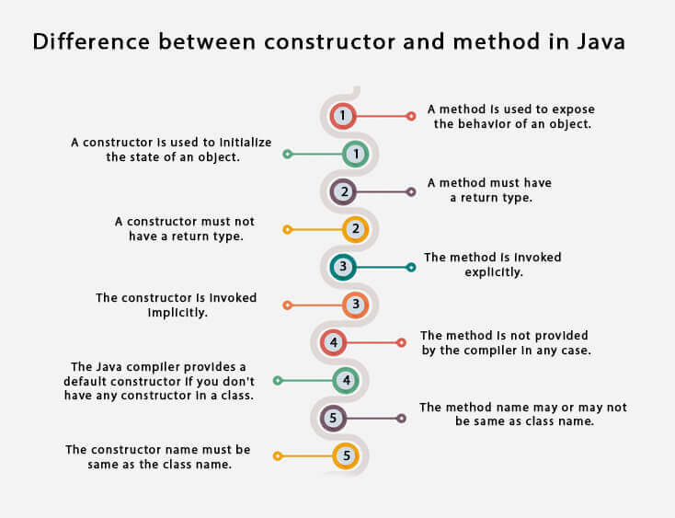

Slide 9
Polymorphism (Overloading & Overriding)
Method Overloading/Static Polymorphism/Compile time Polymorphism/Early Binding
Method Overloading is a feature that allows a class to have more than one method having the same name, if their argument lists are different.
Three ways to overload a method
Number of parameters.
add(int, int)
add(int, int, int)
Data type of parameters.
add(int, int)
add(int, float)
Sequence of Data type of parameters.
add(int, float)
add(float, int)

Slide 10
Method Overloading Example
class DisplayOverloading
{
public void disp(char c)
{
System.out.println(c);
}
public void disp(char c, int num)
{
System.out.println(c + " "+num);
}
}
class Sample
{
public static void main(String args[])
{
DisplayOverloading obj = new DisplayOverloading();
obj.disp('a');
obj.disp('a',10);
}
}
Output:
a
a 10

Slide 11
B. Method Overriding/Dynamic Polymorphism/Run time Polymorphism/Late Binding
Overriding is a feature that allows a subclass or child class to provide a specific implementation of a method that is already provided by one of its super-classes or parent classes.
When a method in a subclass has the same name, same parameters or signature and same return type(or sub-type) as a method in its super-class, then the method in the subclass is said to override the method in the super-class.
Rules for method overriding:
The overriding method must have same return type (or subtype)
The access modifier for an overriding method can allow more, but not less, access than the overridden method. For example, a protected instance method in the super-class can be made public, but not private, in the subclass.
Final methods can not be overridden
Static methods can not be overridden
Private methods can not be overridden
We can not override constructor as parent and child class can never have constructor with same name

Slide 12
class Parent {
void show()
{
System.out.println("Parent's show()");
}
}
class Child extends Parent {
void show()
{
System.out.println("Child's show()");
}
}
class Main {
public static void main(String[] args)
{
Parent obj1 = new Parent();
obj1.show();
Parent obj2 = new Child();
obj2.show();
}
}
Method Overriding Example
Output:
Parent's show()
Child's show()

Slide 13
Inheritance in Java
Inheritance in Java is a mechanism in which one object acquires all the properties and behaviors of a parent object.
The idea behind inheritance in Java is that you can create new classes that are built upon existing classes. When you inherit from an existing class, you can reuse methods and fields of the parent class. Moreover, you can add new methods and fields in your current class also.
Inheritance represents the IS-A relationship which is also known as a parent-child relationship.
Why use inheritance in java
For Method Overriding (so runtime polymorphism can be achieved).
For Code Reusability.
Syntax of inheritance
class Subclass-name extends Superclass-name
{
//methods and fields
}

Slide 14
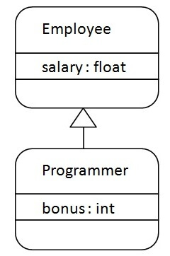
class Employee{
float salary=40000;
}
class Programmer extends Employee{
int bonus=10000;
public static void main(String args[]){
Programmer p=new Programmer();
System.out.println("Programmer salary is:"+p.salary);
System.out.println("Bonus of Programmer is:"+p.bonus);
}
}
Output
Programmer salary is:40000.0
Bonus of programmer is:10000

Slide 15
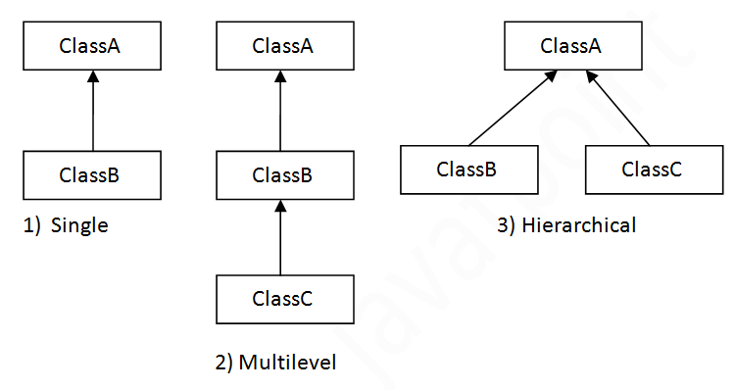
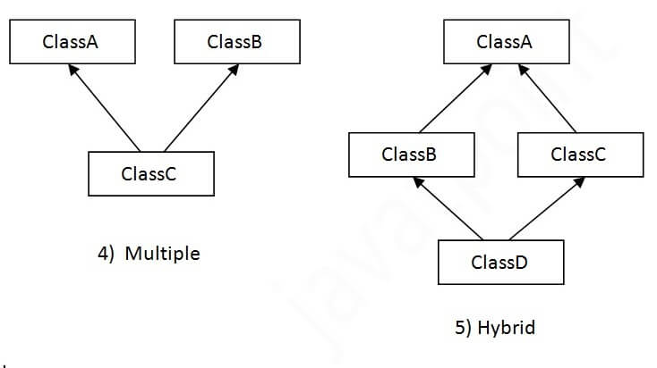
Types of inheritance in java
On the basis of class, there can be three types of inheritance in java: single, multilevel and hierarchical.
In java programming, multiple and hybrid inheritance is supported through interface only.

Slide 16
Java Packages
A package in Java is used to group related classes. Think of it as a folder in a file directory. We use packages to avoid name conflicts, and to write a better maintainable code. Packages are divided into two categories:
Built-in Packages (packages from the Java API)
User-defined Packages (create your own packages)
Examples
import package.name.Class; // Import a single class
import package.name.*; // Import the whole package
Import mypackage; // importing user defined packages

Slide 17
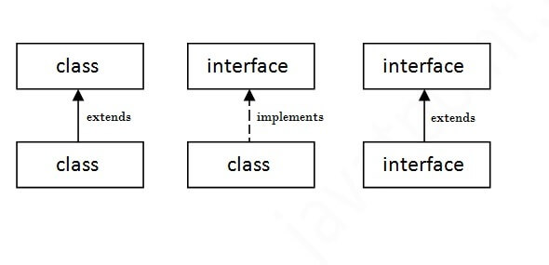
Interface in Java
The interface in Java is a mechanism to achieve abstraction. There can be only abstract methods in the Java interface, not method body. It is used to achieve abstraction and multiple inheritance in Java.
In other words, you can say that interfaces can have abstract methods and variables. It cannot have a method body.
interface <interface_name>{
// declare constant fields
// declare methods that abstract by default.
}

Slide 18
Interface Example
Multiple inheritance in Java
interface printable{
void print();
}
class A6 implements printable{
public void print(){System.out.println("Hello");}
public static void main(String args[]){
A6 obj = new A6();
obj.print();
}
}
interface Printable{
void print();
}
interface Showable{
void show();
}
class A7 implements Printable,Showable{
public void print(){System.out.println("Hello");}
public void show(){System.out.println("Welcome");}
public static void main(String args[]){
A7 obj = new A7();
obj.print();
obj.show();
}
}
Output:Hello
Welcome
Output:
Hello
Multiple inheritance is not supported in the case of class because of ambiguity. However, it is supported in case of an interface because there is no ambiguity. It is because its implementation is provided by the implementation class.

Slide 19
Simply, abstract class achieves partial abstraction
(0 to 100%) whereas interface achieves fully
abstraction (100%).
Abstract class | Interface
1) Abstract class can have abstract and non-abstract methods. | Interface can have only abstract methods. Since Java 8, it can have default and static methods also.
2) Abstract class doesn't support multiple inheritance. | Interface supports multiple inheritance.
3) Abstract class can have final, non-final, static and non-static variables. | Interface has only static and final variables.
4) Abstract class can provide the implementation of interface. | Interface can't provide the implementation of abstract class.
5) The abstract keyword is used to declare abstract class. | The interface keyword is used to declare interface.
6) An abstract class can extend another Java class and implement multiple Java interfaces. | An interface can extend another Java interface only.
7) An abstract class can be extended using keyword "extends". | An interface can be implemented using keyword "implements".
8) A Java abstract class can have class members like private, protected, etc. | Members of a Java interface are public by default.
9)Example: public abstract class Shape{ public abstract void draw(); } | Example: public interface Drawable{ void draw(); }

Slide 20
Assignment 2
Define OOP. Explain features of Object Oriented Programming Language.
Define class and object. Write a program to illustrate relationship between them.
Define Abstract Class. Explain different types of Access controls available in java.
Define method overriding? Write any program to implement concept of multiple inheritance in Java.
Define the use of static keyword. Write any four String methods used in java with example.
Define super, final and this keyword in java.
Explain the concept of MVC in brief.
How overloading is different from overriding? Illustrate with an example of each.
What is constructor? Why we need it? Explain different types of constructors with example.
What is Inheritance? Why we need it? Explain different types of inheritance with example.
What is package? How to define and import package?
What is interface? Explain how multiple inheritance is supported by Interface?

Slide 21
Lab Sheet 2
B. Write a program to illustrate
class and object
parameterized constructor
overloading
overriding
single inheritance
multilevel inheritance
multiple inheritance

