Slide 1
UNIT 10 (3Hrs)
HOLDING COLLECTION OF DATA

Slide 2
Collections in Java
The Collection in Java is a framework that provides an architecture to store and manipulate the group of objects.
Java Collections can achieve all the operations that you perform on a data such as searching, sorting, insertion, manipulation, and deletion.
Java Collection means a single unit of objects. Java Collection framework provides many interfaces (Set, List, Queue, Deque) and classes (ArrayList, Vector, LinkedList, PriorityQueue, HashSet, LinkedHashSet, TreeSet).
The java.util package contains all the classes and interfaces for the Collection framework.

Slide 3
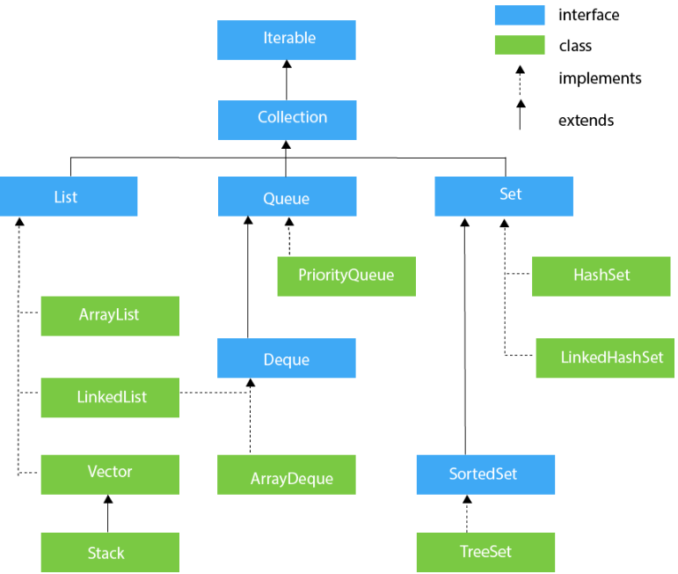

Slide 4
Methods of Collection interface
Method | Description
boolean add(E e) | used to insert an element in this collection.
boolean addAll(Collection<? extends E> c) | used to insert the specified collection elements in the invoking collection.
boolean remove(Object element) | used to delete an element from the collection.
boolean removeAll(Collection<?> c) | used to delete all the elements of the specified collection from the invoking collection.
int size() | returns the total number of elements in the collection.
void clear() | removes the total number of elements from the collection.
boolean contains(Object element) | used to search an element.
boolean containsAll(Collection<?> c) | used to search the specified collection in the collection.
Iterator iterator() | returns an iterator.

Slide 5
Iterator interface
Iterator interface provides the facility of iterating the elements in a forward direction only.
Method | Description
boolean hasNext() | It returns true if the iterator has more elements otherwise it returns false.
Object next() | It returns the element and moves the cursor pointer to the next element.
void remove() | It removes the last elements returned by the iterator. It is less used.

Slide 6
Iterable Interface
It is the root interface for all the collection classes.
The Collection interface extends the Iterable interface and therefore all the subclasses of Collection interface also implement the Iterable interface.
It contains only one abstract method. i.e.,
Iterator<T> iterator() : It returns the iterator over the elements of type T.
Collection Interface
It is implemented by all the classes in the collection framework.
It declares the methods that every collection will have.
It builds the foundation on which the collection framework depends.
Methods of Collection interface are Boolean add(Object obj), Iterator iterator(), void clear(), etc. which are implemented by all the subclasses of Collection interface.

Slide 7
List Interface
List interface is the child interface of Collection interface.
It inhibits a list type data structure in which we can store the ordered collection of objects.
It can have duplicate values.
List interface is implemented by the classes ArrayList, LinkedList, Vector, and Stack.
To instantiate the List interface, we must use :
List <data-type> list1= new ArrayList();
List <data-type> list2 = new LinkedList();
List <data-type> list3 = new Vector();
List <data-type> list4 = new Stack();

Slide 8
Classes that implement List Interface
ArrayList
The ArrayList class implements the List interface. It uses a dynamic array to store the duplicate element of different data types. The ArrayList class maintains the insertion order and is non-synchronized. The elements stored in the ArrayList class can be randomly accessed.
LinkedList
LinkedList implements the Collection interface. It uses a doubly linked list internally to store the elements. It can store the duplicate elements. It maintains the insertion order and is not synchronized. In LinkedList, the manipulation is fast because no shifting is required.
Vector
Vector uses a dynamic array to store the data elements. It is similar to ArrayList. However, It is synchronized and contains many methods that are not the part of Collection framework.
Stack
The stack is the subclass of Vector. It implements the last-in-first-out data structure, i.e., Stack. The stack contains all of the methods of Vector class and also provides its methods like boolean push(), boolean peek(), boolean push(object o), which defines its properties.

Slide 9
ArrayList Implementation
import java.util.*;
class TestJavaCollection1{
public static void main(String args[]){
ArrayList<String> list=new ArrayList<String>();
list.add("Ravi"); list.add("Vijay");
list.add("Ravi"); list.add("Ajay");
Iterator itr=list.iterator();
while(itr.hasNext()){
System.out.println(itr.next());
}
}
}
Output:
Ravi
Vijay
Ravi
Ajay

Slide 10
Sorting Element in Arraylist
import java.util.*;
public class HelloWorld{
public static void main(String []args){
ArrayList<String> al=new ArrayList<String>();
al.add("Viru"); al.add("Saurav");
al.add("Mukesh"); al.add("Tahir");
System.out.println(al);
Collections.sort(al); System.out.println(al);
Collections.sort(al,Collections.reverseOrder());
System.out.println(al);
}
}
$javac HelloWorld.java
$java -Xmx128M -Xms16M HelloWorld
[Viru, Saurav, Mukesh, Tahir]
[Mukesh, Saurav, Tahir, Viru]
[Viru, Tahir, Saurav, Mukesh]

Slide 11
LinkedList Implementation
import java.util.*;
public class TestJavaCollection2{
public static void main(String args[]){
LinkedList<String> al=new LinkedList<String>();
al.add("Ravi"); al.add("Vijay");
al.add("Ravi"); al.add("Ajay");
Iterator<String> itr=al.iterator();
while(itr.hasNext()){
System.out.println(itr.next());
}
}
}
Output:
Ravi
Vijay
Ravi
Ajay

Slide 12
Set Interface
A list can contain duplicate elements whereas Set contains unique elements only.
HashSet Class
HashSet stores the elements by using a mechanism called hashing.
HashSet contains unique elements only.
HashSet allows null value.
HashSet class is non synchronized.
HashSet doesn't maintain the insertion order. Here, elements are inserted on the basis of their hashcode.
HashSet is the best approach for search operations.
TreeSet class
Java TreeSet class contains unique elements only like HashSet.
Java TreeSet class access and retrieval times are quiet fast.
Java TreeSet class doesn't allow null element.
Java TreeSet class is non synchronized.
Java TreeSet class maintains ascending order.

Slide 13
Hashset Implementation
import java.util.*;
class HashSet2{
public static void main(String args[]){
HashSet<String> set=new HashSet<String>();
set.add("Ravi"); set.add("Vijay");
set.add(“ "); set.add(null);
set.add("Ravi"); set.add("Ajay");
Iterator<String> itr=set.iterator();
while(itr.hasNext()){
System.out.println(itr.next());
}
}
}
Null
Ajay
Vijay
Ravi

Slide 14
Treeset Implementation
import java.util.*;
class TreeSet1{
public static void main(String args[]){
TreeSet<String> al=new TreeSet<String>();
al.add("Ravi"); al.add("Vijay");
al.add("Ravi"); al.add("Ajay");
Iterator<String> itr=al.iterator();
while(itr.hasNext()){
System.out.println(itr.next());
}
}
}
Ajay
Ravi
Vijay

Slide 15
Map Interface
A map contains values on the basis of key, i.e. key and value pair. Each key and value pair is known as an entry. A Map contains unique keys.
A Map is useful if you have to search, update or delete elements on the basis of a key.
There are two interfaces for implementing Map in java: Map and SortedMap, and three classes: HashMap, LinkedHashMap, and TreeMap.
A Map doesn't allow duplicate keys, but you can have duplicate values. HashMap and LinkedHashMap allow null keys and values, but TreeMap doesn't allow any null key or value
A Map can't be traversed, so you need to convert it into Set using keySet() or entrySet() method.
Class | Description
HashMap | HashMap is the implementation of Map, but it doesn't maintain any order.
LinkedHashMap | It is the implementation of Map. It inherits HashMap class. It maintains insertion order.
TreeMap | TreeMap is the implementation of Map and SortedMap. It maintains ascending order.

Slide 16
Map.Entry Interface
Entry is the subinterface of Map. So we will be accessed it by Map.Entry name. It returns a collection-view of the map, whose elements are of this class. It provides methods to get key and value.

Slide 17
Map Implementation
import java.util.*;
class MapExample2{
public static void main(String args[]){
Map<Integer,String> map=new HashMap<Integer,String>();
map.put(100,"Amit");
map.put(101,"Vijay");
map.put(102,"Rahul");
//Elements can traverse in any order
for(Map.Entry m:map.entrySet()){
System.out.println(m.getKey()+" "+m.getValue());
}
}
}
102 Rahul
100 Amit
101 Vijay

Slide 18
Questions
How collections is different from Array in Java?
Write Collection interfaces and classes that implement them.
What is List Interface? WAP implementing Arraylist in java.
How sorting is done in Collections? Explain with a program.
How Set is different from List? List classes that implement set interface.
How Hashset is different from Treeset? WAP illustrating the use of both.
What is MAP? How is it different from Set and List Interface? Explain with an suitable program.

