Slide 1
Java Applications
Unit 11 [8 hrs]

Slide 2
Java AWT (Abstract Window Toolkit)
Java AWT is an API to develop GUI (Graphical User Interface) or window-based application in java.
Java AWT components are platform-dependent i.e. components are displayed according to the view of operating system. AWT is heavyweight i.e. its components uses the resources of system.
It offers user interaction via some graphical components
The java.awt package provides classes for AWT api such as TextField, Label, TextArea, RadioButton, CheckBox, Choice, List etc.

Slide 3
Java Swing
Java Swing is a part of Java Foundation Classes (JFC) that is used to create window-based applications. It is built on the top of AWT (Abstract Windowing Toolkit) API and entirely written in java.
It acts as replacement of AWT API as it has almost every control corresponding to AWT controls.
Unlike AWT, Java Swing provides platform-independent and lightweight components.
The javax.swing package provides classes for java swing API such as Jlabel, JButton, JTextField, JTextArea, JRadioButton, JCheckbox etc.
Swing API is set of extensible GUI Components to ease developer's life to create JAVA based Front End/ GUI Applications.
Swing component follows a Model-View-Controller architecture to fulfill the following criteria’s.
A single API is to be sufficient to support multiple look and feel.
API is to model driven so that highest level API is not required to have the data.
API is to use the Java Bean model so that Builder Tools and IDE can provide better services to the developers to use it.

Slide 4
Swing features
Light Weight - Swing component are independent of native Operating System's API as Swing API controls are rendered mostly using pure JAVA code instead of underlying operating system calls.
Rich controls - Swing provides a rich set of advanced controls like Tree, TabbedPane, slider, color picker, table controls.
Highly Customizable - Swing controls can be customized in very easy way as visual appearance is independent of internal representation.
Pluggable look-and-feel- SWING based GUI Application look and feel can be changed at run time based on available values.

Slide 5
Difference between AWT and Swing
Java AWT | Java Swing
AWT components are platform-dependent. AWT components are heavyweight. AWT doesn't support pluggable look and feel. AWT provides less components than Swing. AWT doesn't follows MVC(Model View Controller) where model represents data, view represents presentation and controller acts as an interface between model and view. | Java swing components are platform-independent. Swing components are lightweight. Swing supports pluggable look and feel. Swing provides more powerful components such as tables, lists, scrollpanes, colorchooser, tabbedpane etc. Swing follows MVC.

Slide 6
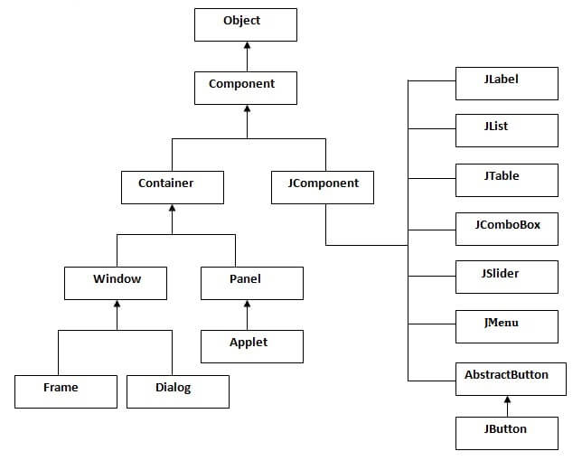
Hierarchy of Java Swing classes

Slide 7
Component
All the elements like the button, text fields, scroll bars, etc. are called components.
There are classes for each component. In order to place every component in a particular position on a screen, we need to add them to a container.
Container
The Container is a component that can contain another components like buttons, textfields, labels etc. The classes that extends Container class are known as container such as JFrame, JDialog and JPanel.
It is basically a screen where the components are placed at their specific locations. Thus it contains and controls the layout of components. There are four types of containers in Java AWT:
JWindow
JPanel
JFrame
JDialog

Slide 8
Commonly used Methods of Component class
The methods of Component class are widely used in java swing that are given below.
Method | Description
void add(Component c) | Add a component into a Container by taking a component as a parameter.
void setSize(int width,int height) | sets size of the component.
void setLayout(LayoutManager m) | sets the layout manager for the component.
void setVisible(boolean b) | sets the visibility of the component. It is by default false.
Void setBounds() | set the position and size of component. To specify the position and size of the components manually, the layout manager of the frame can be null.

Slide 9
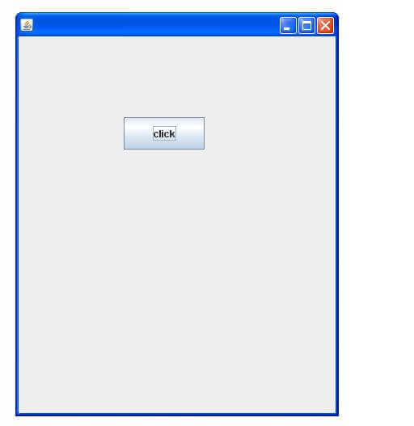
Java Swing Examples
There are two ways to create a frame:
By creating the object of Frame class (association)
By extending Frame class (inheritance)
We can write the code of swing inside the main(), constructor or any other method.

Slide 10
1. Simple example of Swing by Association
import javax.swing.*;
public class Simple {
JFrame f;
Simple(){
f=new JFrame();//creating instance of JFrame
JButton b=new JButton("click");//creating instance of JButton
b.setBounds(130,100,100, 40); //(x,y,width,height)
f.add(b);//adding button in JFrame
f.setSize(400,500);//400 width and 500 height
f.setLayout(null);//using no layout managers
f.setVisible(true);//making the frame visible
}
public static void main(String[] args) {
new Simple();
}
}

Slide 11
2. Simple example of Swing by inheritance
import javax.swing.*;
public class Simple2 extends JFrame{//inheriting JFrame
JFrame f;
Simple2(){
JButton b=new JButton("click");//create button
b.setBounds(130,100,100, 40);
add(b);//adding button on frame
setSize(400,500);
setLayout(null);
setVisible(true);
}
public static void main(String[] args) {
new Simple2();
}}

Slide 12
JFrame
The javax.swing.JFrame class is a type of container which inherits the java.awt.Frame class.
JFrame works like the main window where components like labels, buttons, textfields are added to create a GUI.
Unlike Frame, JFrame has the option to hide or close the window with the help of setDefaultCloseOperation(int) method.
Constructor | Description
JFrame() | It constructs a new frame that is initially invisible.
JFrame(String title) | It creates a new, initially invisible Frame with the specified title.

Slide 13
JLabel
The object of JLabel class is a component for placing text in a container.
It is used to display a single line of read only text.
The text can be changed by an application but a user cannot edit it directly. It inherits JComponent class.
Constructor | Description
JLabel() | Creates a JLabel instance with no image and with an empty string for the title.
JLabel(String s) | Creates a JLabel instance with the specified text.
Methods | Description
String getText() | It returns the text string that a label displays.
void setText(String text) | It defines the single line of text this component will display.

Slide 14
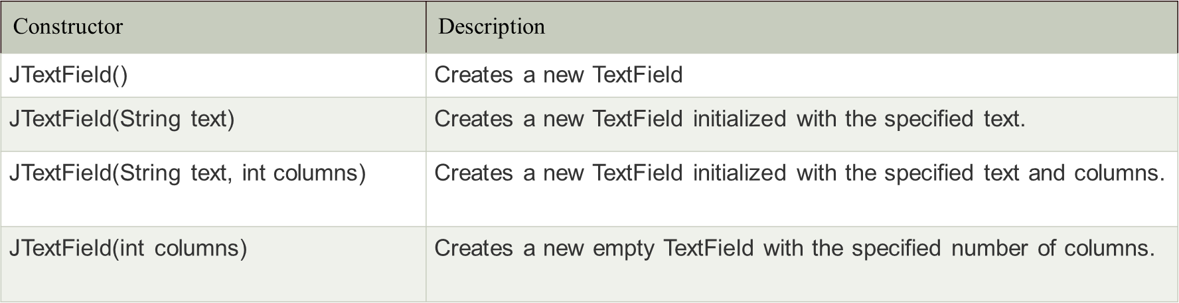
JTextField
The object of a JTextField class is a text component that allows the editing of a single line text. It inherits JTextComponent class..

Slide 15
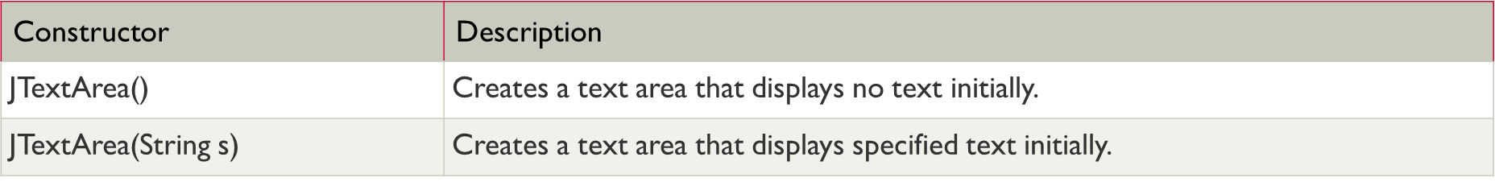
JTextArea
The object of a JTextArea class is a multi line region that displays text. It allows the editing of multiple line text. It inherits JTextComponent class

Slide 16
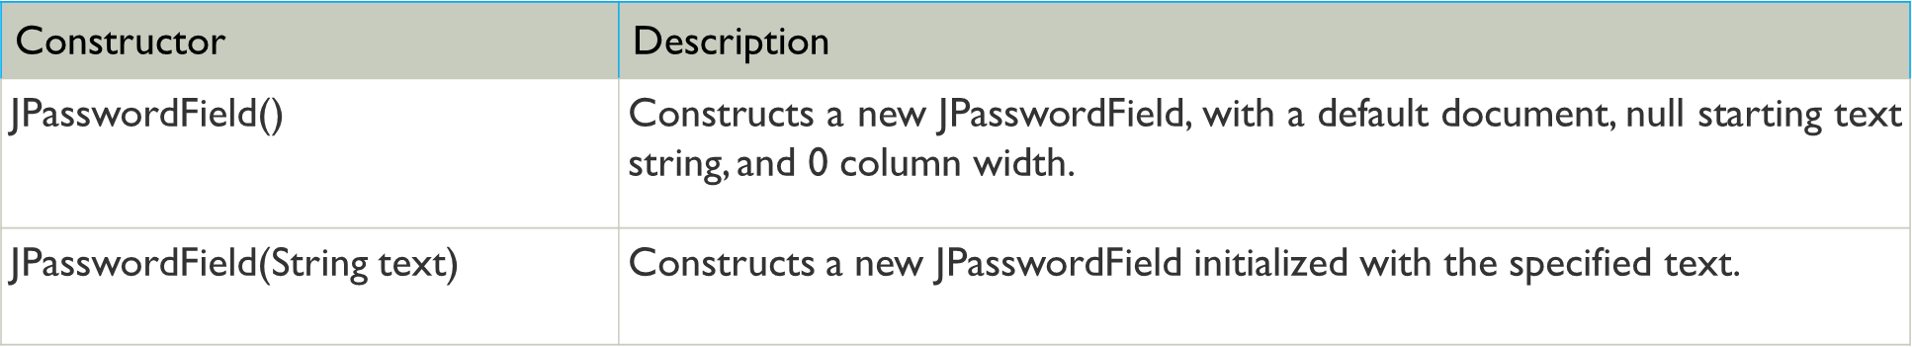
JPasswordField
The object of a JPasswordField class is a text component specialized for password entry. It allows the editing of a single line of text. It inherits JTextField class.

Slide 17
JButton
It is used to create a labeled button that has platform independent implementation.
The application result in some action when the button is pushed.
It inherits AbstractButton class.
Constructor:
JButton(): It creates a button with no text and icon.
JButton(String s): It creates a button with the specified text.
Methods
void setText(String s): It is used to set specified text on button
String getText(): It is used to return the text of the button.
void setEnabled(boolean b):It is used to enable or disable the button.
void addActionListener(ActionListener a): It is used to add the action listener to this object.

Slide 18
JCheckBox
The JCheckBox class is used to create a checkbox. It is used to turn an option on (true) or off (false).
Clicking on a CheckBox changes its state from "on" to "off" or from "off" to "on ".It inherits JToggleButton class
Constructor | Description
JCheckBox() | Creates unselected check box button with no text, no icon.
JChechBox(String s) | Creates an initially unselected check box with text.
JCheckBox(String text, boolean selected) | Creates a check box with text and specifies whether or not it is initially selected.
Method:
void addItemListener(ItemListener l):Adds the specified item listener to receive item events from this check box.

Slide 19
JRadioButton
The JRadioButton class is used to create a radio button. It is used to choose one option from multiple options. It is widely used in exam systems or quiz.
It should be added in ButtonGroup to select one radio button only.
Constructor | Description
JRadioButton() | Creates an unselected radio button with no text.
JRadioButton(String s) | Creates an unselected radio button with specified text.
JRadioButton(String s, boolean selected) | Creates a radio button with the specified text and selected status.
Methods | Description
void setText(String s) and String getText() | It is used to set specified text on button. It is used to return the text of the button.
void setEnabled(boolean b) | It is used to enable or disable the button.
void addActionListener(ActionListener a) | It is used to add the action listener to this object.

Slide 20
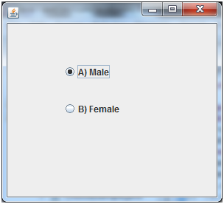
import javax.swing.*;
public class RadioButtonExample {
JFrame f;
RadioButtonExample(){
f=new JFrame();
JRadioButton r1=new JRadioButton("A) Male");
JRadioButton r2=new JRadioButton("B) Female");
r1.setBounds(75,50,100,30);
r2.setBounds(75,100,100,30);
ButtonGroup bg=new ButtonGroup();
bg.add(r1);bg.add(r2);
f.add(r1);f.add(r2);
f.setSize(300,300);
f.setLayout(null);
f.setVisible(true);
}
public static void main(String[] args) {
new RadioButtonExample();
}
}

Slide 21
JComboBox
A component that combines a button or editable field and a drop-down list.
The user can select a value from the drop-down list
JComboBox shows a popup menu that shows a list and the user can select a option from that specified list .
Constructor | Description
JComboBox() | Creates a JComboBox with a default data model.
JComboBox(Object[] items) | Creates a JComboBox that contains the elements in the specified array.
JComboBox(Vector<?> items) | Creates a JComboBox that contains the elements in the specified Vector.

Slide 22
Commonly Used Methods
Methods | Description
void addItem(Object anObject) | It is used to add an item to the item list.
void removeItem(Object anObject) | It is used to delete an item to the item list.
void removeAllItems() | It is used to remove all the items from the list.
void setEditable(boolean b) | It is used to determine whether the JComboBox is editable.
void addActionListener(ActionListener a) | It is used to add the ActionListener.
void addItemListener(ItemListener i) | It is used to add the ItemListener.

Slide 23
JPanel
The JPanel is a simplest container class. It provides space in which an application can attach any other component. It inherits the JComponents class.
It doesn't have title bar.
Constructor | Description
JPanel() | It is used to create a new JPanel with a double buffer and a flow layout.
JPanel(LayoutManager layout) | It is used to create a new JPanel with the specified layout manager.

Slide 24
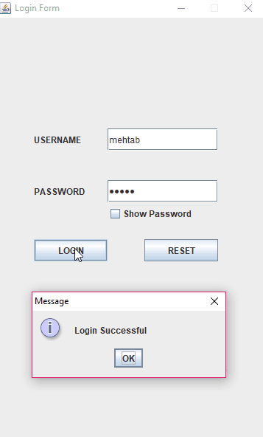
Mini-Project

Slide 25
Event and Listener (Java Event Handling)
Changing the state of an object is known as an event. For example, click on button, dragging mouse etc. The java.awt.event package provides many event classes and Listener interfaces for event handling.
Event Classes | Listener Interfaces
ActionEvent | ActionListener
MouseEvent | MouseListener and MouseMotionListener
MouseWheelEvent | MouseWheelListener
KeyEvent | KeyListener
ItemEvent | ItemListener
TextEvent | TextListener
AdjustmentEvent | AdjustmentListener
WindowEvent | WindowListener
ComponentEvent | ComponentListener
ContainerEvent | ContainerListener
FocusEvent | FocusListener

Slide 26
Registration Methods
Button
public void addActionListener(ActionListener a){}
MenuItem
public void addActionListener(ActionListener a){}
TextField
public void addActionListener(ActionListener a){}
public void addTextListener(TextListener a){}
TextArea
public void addTextListener(TextListener a){}
Checkbox
public void addItemListener(ItemListener a){}
Choice
public void addItemListener(ItemListener a){}
List
public void addActionListener(ActionListener a){}
public void addItemListener(ItemListener a){}

Slide 27
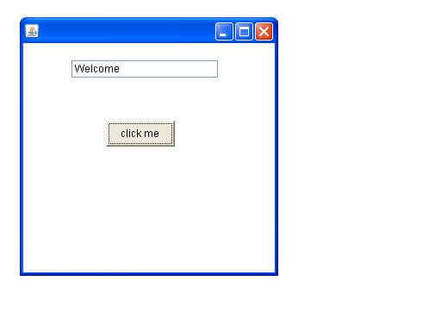
Java event handling by implementing ActionListener
import java.awt.*;
import java.awt.event.*;
class AEvent extends Frame implements ActionListener{
TextField tf;
AEvent(){
//create components
tf=new TextField();
tf.setBounds(60,50,170,20);
Button b=new Button("click me");
b.setBounds(100,120,80,30);
//register listener
b.addActionListener(this);//passing current instance
//add components and set size, layout and visibility
add(b);add(tf);
setSize(300,300);
setLayout(null);
setVisible(true);
}
public void actionPerformed(ActionEvent e){
tf.setText("Welcome");
}
public static void main(String args[]){
new AEvent();
}
}

Slide 28
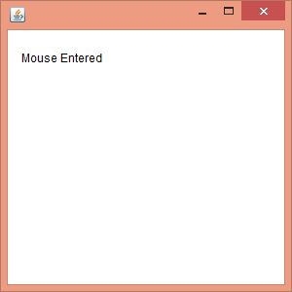
MouseListener Example
import java.awt.*;
import java.awt.event.*;
public class MouseListenerExample extends Frame implements MouseListener{
Label l;
MouseListenerExample(){
addMouseListener(this);
l=new Label();
l.setBounds(20,50,100,20);
add(l);
setSize(300,300);
setLayout(null);
setVisible(true);
}
public void mouseClicked(MouseEvent e) {
l.setText("Mouse Clicked");
}
public void mouseEntered(MouseEvent e) {
l.setText("Mouse Entered");
}
public void mouseExited(MouseEvent e) {
l.setText("Mouse Exited");
}
public void mousePressed(MouseEvent e) {
l.setText("Mouse Pressed");
}
public void mouseReleased(MouseEvent e) {
l.setText("Mouse Released");
}
public static void main(String[] args) {
new MouseListenerExample();
}
}

Slide 29
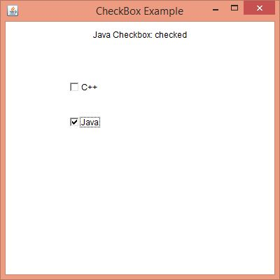
ItemListener Interface
import java.awt.*;
import java.awt.event.*;
public class ItemListenerExample implements ItemListener{
Checkbox checkBox1,checkBox2;
Label label;
ItemListenerExample(){
Frame f= new Frame("CheckBox Example");
label = new Label();
label.setAlignment(Label.CENTER);
label.setSize(400,100);
checkBox1 = new Checkbox("C++");
checkBox1.setBounds(100,100, 50,50);
checkBox2 = new Checkbox("Java");
checkBox2.setBounds(100,150, 50,50);
f.add(checkBox1); f.add(checkBox2); f.add(label);
checkBox1.addItemListener(this);
checkBox2.addItemListener(this);
f.setSize(400,400);
f.setLayout(null);
f.setVisible(true);
}
public void itemStateChanged(ItemEvent e) {
if(e.getSource()==checkBox1)
label.setText("C++ Checkbox: "
+ (e.getStateChange()==1?"checked":"unchecked"));
if(e.getSource()==checkBox2)
label.setText("Java Checkbox: "
+ (e.getStateChange()==1?"checked":"unchecked"));
}
public static void main(String args[])
{
new ItemListenerExample();
}
}

Slide 30
Java Adapter Classes
Java adapter classes provide the default implementation of listener interfaces. If you inherit the adapter class, you will not be forced to provide the implementation of all the methods of listener interfaces. So it saves code.
In an adapter class, there is no need for implementation of all the methods presented in an interface. It is used when only some methods of defined by its interface have to be overridden.
In a listener, all the methods that have been declared in its interface have to be implemented. This is because these methods are
Adapter class | Listener interface
WindowAdapter | WindowListener
KeyAdapter | KeyListener
MouseAdapter | MouseListener
MouseMotionAdapter | MouseMotionListener
FocusAdapter | FocusListener
ComponentAdapter | ComponentListener
ContainerAdapter | ContainerListener

Slide 31
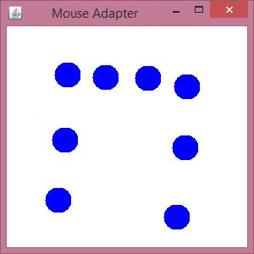
Java MouseAdapter Example
import java.awt.*;
import java.awt.event.*;
public class MouseAdapterExample extends MouseAdapter{
Frame f;
MouseAdapterExample(){
f=new Frame("Mouse Adapter");
f.addMouseListener(this);
f.setSize(300,300);
f.setLayout(null);
f.setVisible(true);
}
public void mouseClicked(MouseEvent e) {
Graphics g=f.getGraphics();
g.setColor(Color.BLUE);
g.fillOval(e.getX(),e.getY(),30,30);
}
public static void main(String[] args) {
new MouseAdapterExample();
}
}

Slide 32
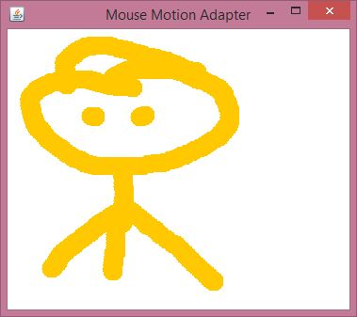
MouseMotionAdapter Example
import java.awt.*;
import java.awt.event.*;
public class MouseMotionAdapterExample extends MouseMotionAdapter{
Frame f;
MouseMotionAdapterExample(){
f=new Frame("Mouse Motion Adapter");
f.addMouseMotionListener(this);
f.setSize(300,300);
f.setLayout(null);
f.setVisible(true);
}
public void mouseDragged(MouseEvent e) {
Graphics g=f.getGraphics();
g.setColor(Color.ORANGE);
g.fillOval(e.getX(),e.getY(),20,20);
}
public static void main(String[] args) {
new MouseMotionAdapterExample();
}
}

Slide 33
Layout Management
The LayoutManagers are used to arrange components in a particular manner. LayoutManager is an interface that is implemented by all the classes of layout managers. There are following classes that represents the layout managers:
java.awt.BorderLayout
java.awt.FlowLayout
java.awt.GridLayout
java.awt.GridBagLayout
java.awt.GroupLayout

Slide 34
BorderLayout
The BorderLayout is used to arrange the components in five regions: north, south, east, west, and center.
Each region (area) may contain one component only. It is the default layout of a frame or window. The BorderLayout provides five constants for each region:
public static final int NORTH
public static final int SOUTH
public static final int EAST
public static final int WEST
public static final int CENTER

Slide 35
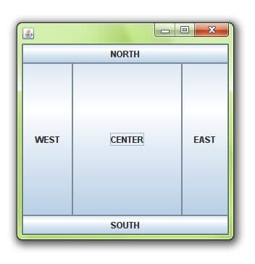
BorderLayout
import java.awt.*;
import javax.swing.*;
public class Border {
JFrame f;
Border(){
f=new JFrame();
JButton b1=new JButton("NORTH");;
JButton b2=new JButton("SOUTH");;
JButton b3=new JButton("EAST");;
JButton b4=new JButton("WEST");;
JButton b5=new JButton("CENTER");;
f.add(b1,BorderLayout.NORTH);
f.add(b2,BorderLayout.SOUTH);
f.add(b3,BorderLayout.EAST);
f.add(b4,BorderLayout.WEST);
f.add(b5,BorderLayout.CENTER);
f.setSize(300,300);
f.setVisible(true);
}
public static void main(String[] args) {
new Border();
}
}

Slide 36
GridLayout
The Java GridLayout class is used to arrange the components in a rectangular grid. One component is displayed in each rectangle.
GridLayout(): creates a grid layout with one column per component in a row.
GridLayout(int rows, int columns): creates a grid layout with the given rows and columns but no gaps between the components.
GridLayout(int rows, int columns, int hgap, int vgap): creates a grid layout with the given rows and columns along with given horizontal and vertical gaps.

Slide 37
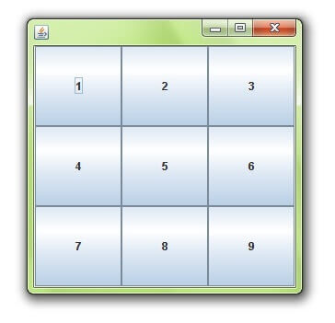
GridLayout
import java.awt.*;
import javax.swing.*;
public class MyGridLayout{
JFrame f;
MyGridLayout(){
f=new JFrame();
JButton b1=new JButton("1");
JButton b2=new JButton("2");
JButton b3=new JButton("3");
JButton b4=new JButton("4");
JButton b5=new JButton("5");
JButton b6=new JButton("6");
JButton b7=new JButton("7");
JButton b8=new JButton("8");
JButton b9=new JButton("9");
f.add(b1);f.add(b2);f.add(b3);f.add(b4);f.add(b5);
f.add(b6);f.add(b7);f.add(b8);f.add(b9);
f.setLayout(new GridLayout(3,3));
//setting grid layout of 3 rows and 3 columns
f.setSize(300,300);
f.setVisible(true);
}
public static void main(String[] args) {
new MyGridLayout();
}
}

Slide 38
FlowLayout
The Java FlowLayout class is used to arrange the components in a line, one after another (in a flow). It is the default layout of the applet or panel. Fields of FlowLayout class
public static final int LEFT, public static final int RIGHT
public static final int CENTER, public static final int LEADING
public static final int TRAILING
Constructors of FlowLayout class
FlowLayout(): creates a flow layout with centered alignment and a default 5 unit horizontal and vertical gap.
FlowLayout(int align): creates a flow layout with the given alignment and a default 5 unit horizontal and vertical gap.
FlowLayout(int align, int hgap, int vgap): creates a flow layout with the given alignment and the given horizontal and vertical gap.

Slide 39
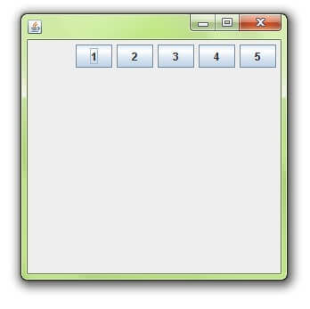
FlowLayout
import java.awt.*;
import javax.swing.*;
public class MyFlowLayout{
JFrame f;
MyFlowLayout(){
f=new JFrame();
JButton b1=new JButton("1");
JButton b2=new JButton("2");
JButton b3=new JButton("3");
JButton b4=new JButton("4");
JButton b5=new JButton("5");
f.add(b1);f.add(b2);f.add(b3);f.add(b4);f.add(b5);
f.setLayout(new FlowLayout(FlowLayout.RIGHT));
//setting flow layout of right alignment
f.setSize(300,300);
f.setVisible(true);
}
public static void main(String[] args) {
new MyFlowLayout();
}
}

Slide 40
GridBagLayout
This is the most flexible layout manager class.
The object of GridBagLayout aligns the component vertically, horizontally, or along their baseline without requiring the components of the same size.
The components may not be of the same size. Each GridBagLayout object maintains a dynamic, rectangular grid of cells.
Each component occupies one or more cells known as its display area. Each component associates an instance of GridBagConstraints.

Slide 41
GroupLayout
GroupLayout groups its components and places them in a Container hierarchically. The grouping is done by instances of the Group class.
Group is an abstract class, and two concrete classes which implement this Group class are SequentialGroup and ParallelGroup.
SequentialGroup positions its child sequentially one after another whereas ParallelGroup aligns its child on top of each other.
The GroupLayout class provides methods such as createParallelGroup() and createSequentialGroup() to create groups.
GroupLayout treats each axis independently. That is, there is a group representing the horizontal axis, and a group representing the vertical axis.
Each component must exist in both a horizontal and vertical group, otherwise an IllegalStateException is thrown during layout or when the minimum, preferred, or maximum size is requested.

Slide 42
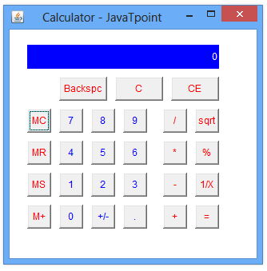
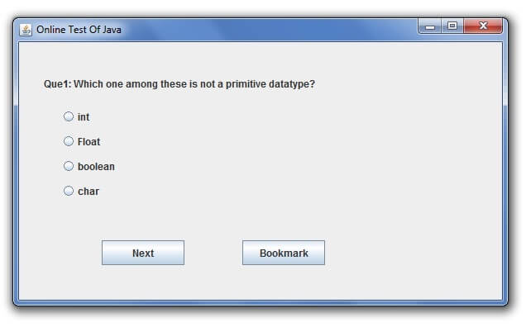
Classworks (Some Applications)

Slide 43
