Slide 1
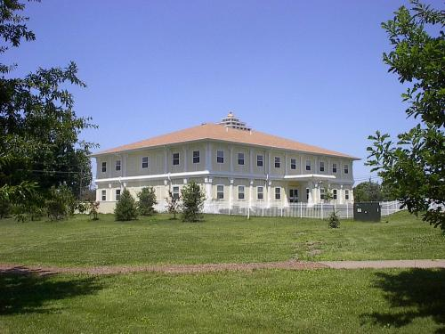
CS401 Modern Programming Practices (MPP) Professor Renuka Mohanraj
MAHARISHI UNIVERSITY of MANAGEMENT
Engaging the Managing Intelligence of Nature
Computer Science Department

Slide 2
© 2015 Maharishi University of Management, Fairfield, Iowa
All rights reserved. No part of this slide presentation may be reproduced or utilized in any form or by any means, electronic or mechanical, including photocopying or recording, or by any information storage and retrieval system, without permission in writing from Maharishi University of Management.

Slide 3
Lecture 4: Interaction Diagrams
Appreciating Dynamism in Silence

Slide 4
Wholeness Statement
In an OO program, objects collaborate with other objects to achieve the objectives of the program.
Sequence diagrams document the sequence of calls among objects for a particular operation.
Object diagrams show relationships among objects and the associations between them; they clarify the role of multiple instances of the same class.
The principle of propagation and delegation clarifies responsibilities of each class and its instances: Requests that arrive at a particular object but cannot properly be handled by the object are propagated to other objects; the task is said to be delegated to others.
Finally, polymorphism makes it possible to add new functionality without modifying existing code (as per the Open-Closed Principle).
In these ways, we use UML diagrams to capture the dynamic features of the system; representing dynamism in the form of a static map illustrates the principle that dynamism has its basis in, and arises within, silence.

Slide 5
Interaction Diagrams
Interaction diagrams describe how groups of objects collaborate in some behavior.
The UML defines several forms of interaction diagram, of which the most common is the sequence diagram and the other one is collaboration diagram.
Typically, a sequence diagram captures the behavior of a single scenario of a use case (like “deposit money”, “open account”, “calculate total price of an order”).
The diagram shows a number of example, objects and the messages that are passed between these objects within the use case.

Slide 6
Interaction Diagrams: Overview
Sequence Diagrams
Object Diagrams
Delegation and Propagation
Polymorphism

Slide 7

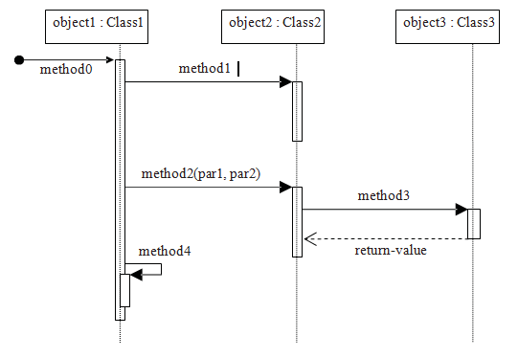
General Syntax
Actors
Notes:
Actors represent anybody or anything that will interact with the system after it’s built; actors drive use cases. Actors generally fall into two broad categories:
• Human users
• Other computer systems

Slide 8
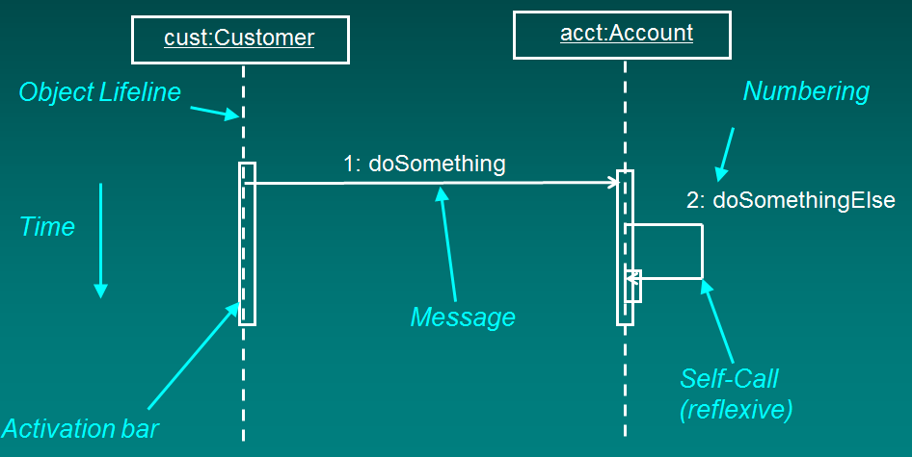
Anatomy of Sequence Diagram
Actor

Slide 9
Sequence Diagrams
A sequence diagram shows interaction between objects
Horizontal arrows indicate calls (sending messages)
Every arrow has a number, name
Activation bars indicate method call duration
Vertical dotted line shows lifetime of object
Is a dynamic view of a scenario through a Use Case
Typically, a sequence diagram begins with an action by an Actor. Subsequent steps occur as one object after another are accessed to accomplish the actor’s request
Notes:
A use case represents a logical thread, or a series of cause-and-effect events, beginning with an actor’s first contact with the system and ending with the achievement of that actor’s goal for using the system in the first place.
Use cases emphasize “what” the system is to do—functional requirements—without concern for “how” such things will be accomplished internally; they aren’t unlike method signatures in this regard.
Some example high-level use cases for the SRS might be
• Register for a Course
• Drop a Course
• Determine a Student’s Course Load
• Choose a Faculty Advisor
• Establish a Plan of Study
• View the Schedule of Classes
• Request a Student Roster for a Given Course
• Request a Transcript for a Given Student

Slide 10
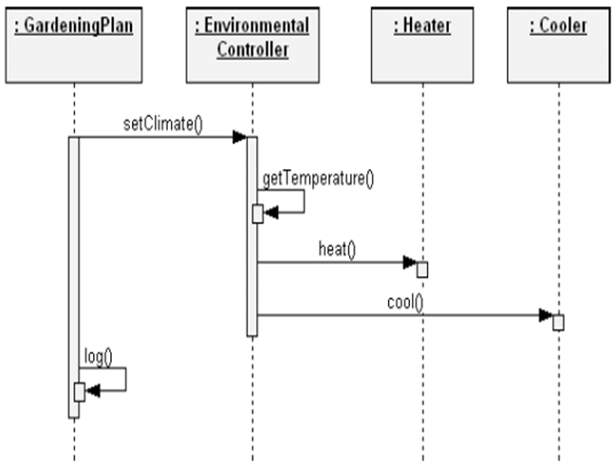
Example -1 – (capture from the problem statement)
Make a Gardening plan to heat or cool the green house.
Set the climate(1) and determine the current temperature using Environment controller(2) then decide to heat(3) or cool(4) the green house. Finally log(5) the temperature in your Gardening plan.

Slide 11
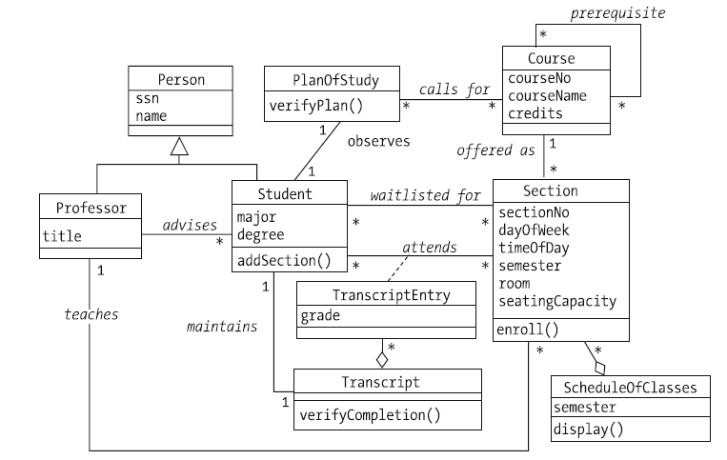
Class diagram of SRS – Lesson -1

Slide 12
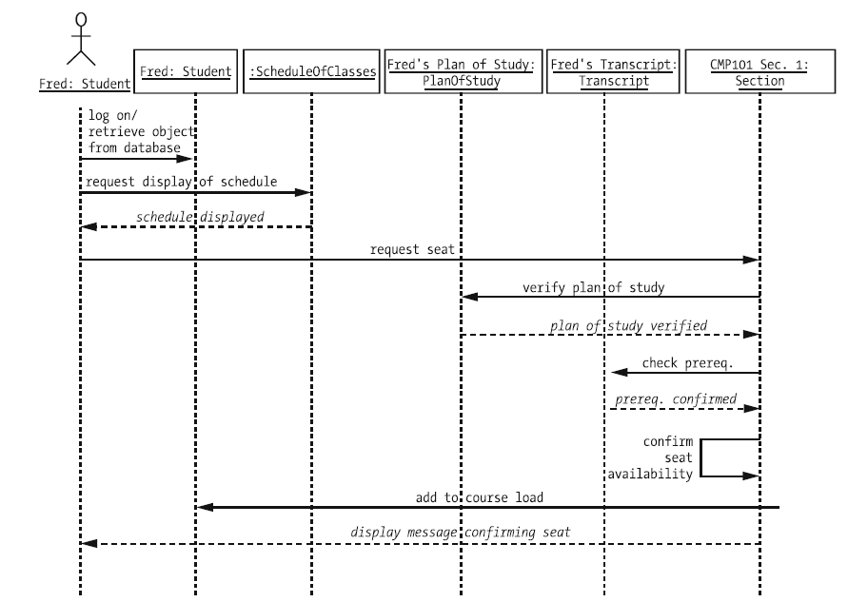
Example 2: Sequence Diagram – Student Course Registration – (capture from class diagrams)
Notes:
Be sure to walk through this interaction diagram, emphasizing the responsibility allocation. Emphasize the application of the guidelines provided earlier.
Another option is to NOT show this slide immediately and to build the interaction diagram interactively with the students on the white board, demonstrating proper allocation of responsibility. When finished, you can compare the results with this slide.
Note: The use of “//” as the first two characters of the message name. This naming convention indicates that the operation is being used to describe the responsibilities of the analysis class and that these “analysis” operations WILL PROBABLY change/evolve in design).
k levi:
go through this quickly
on slide, then work
checkout book with
class--e.g., have them
start, then work out on
board? (make sure
have done on own first)

Slide 13
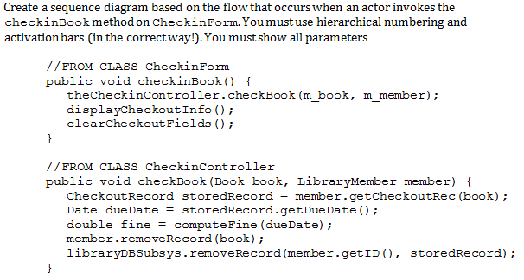
Sequence Diagram Exercise (capture from code)

Slide 14
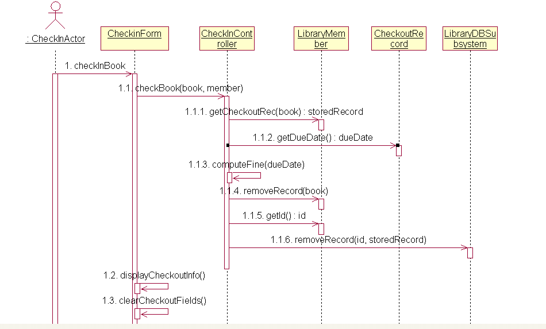
Solution

Slide 15
Real-World Example
We have an order and we are going to invoke a command on it to calculate its price.
To do that, the order needs to look at all the line items on the order and determine their prices, which are based on the pricing rules of the order line's products.
Having done that for all the line items, the order then needs to compute an overall discount, which is based on rules tied to the customer.

Slide 16
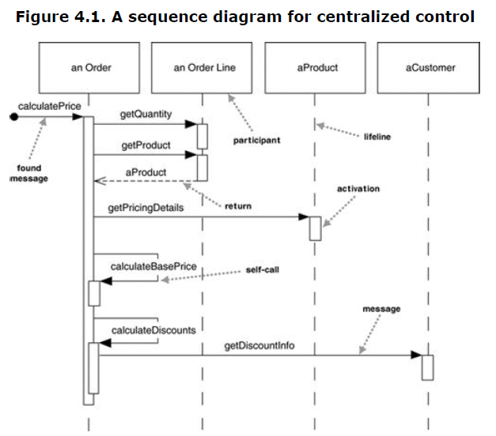
Centralized Control Solution

Slide 17
Centralized Control. Solutions in which there is one primary controlling class are often used for understanding a problem domain (during analysis), but during design, control is distributed so that different objects handle different parts of the scenario according to their responsibilities
Note: The processes of analysis and design are evolutionary processes . A class diagram in analysis may be bare at first and as the problem is studied, more and more information is shown. During analysis, the main concern is with domain classes. As we turn attention to design, additional classes and systems are introduced to facilitate the process of building a system. These are incorporated into our sequence and class diagrams.

Slide 18
About the Diagram
Activation bars. These always mark the beginning and end of a “method call”
Actor not shown. In modeling full systems, actions are always initiated by an actor (could be person or system). However, to model only a portion of a system, a“point” is used as a starting point at the far left, as shown here, indicating some other object is initiating the action.
Indicating Loops: The sequence of messages getQuantity, getProduct, getPricingDetails, and calculateBasePrice needs to be done for each order line on the order, while calculateDiscounts is invoked just once.
How to show looping is occurring. There are several UML ways to do this:
Use Notes. To indicate an operation is repeated, a simple note can be used.
Use an Iteration Marker. Marking an operation with an asterisk (*) indicates that the operation repeats. This is an economical way, but gives no information other than a loop is occurring. [UML2.0 considers this approach to be deprecated – but it is still used sometimes anyway]
Use an Interaction Frame. Introduced in UML2.0. An interaction frame marks off a piece of a sequence diagram to indicate that a loop is occurring there. One objection to this approach is that it makes the diagram harder to read – in this course we do not use interaction frames.

Slide 19
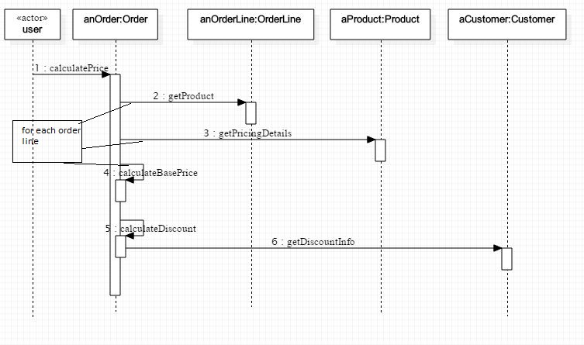
Showing Looping with Notes

Slide 20
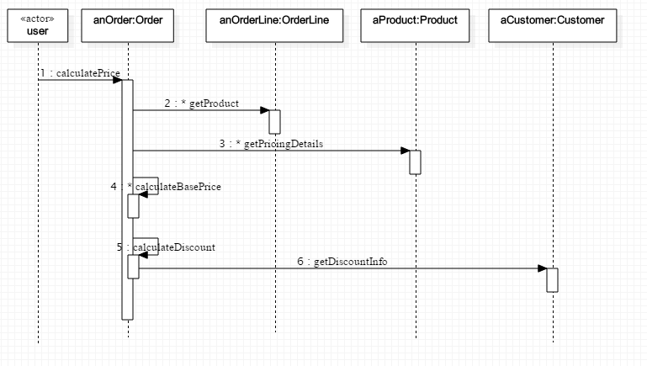
Showing Looping with Iteration Marker(*)

Slide 21
About These Diagrams
The previous diagrams show two ways to indicate looping
They also show proper UML syntax for indicating objects along the top. The syntax is: instanceName:className
Both can be included, or one or the other can be dropped
They also show one of the ways to indicate that an Actor is initiating action, using the actor stereotype.
The StarUML modeling tool does not support the use of Notes – for this course, iteration markers will be sufficient.

Slide 22
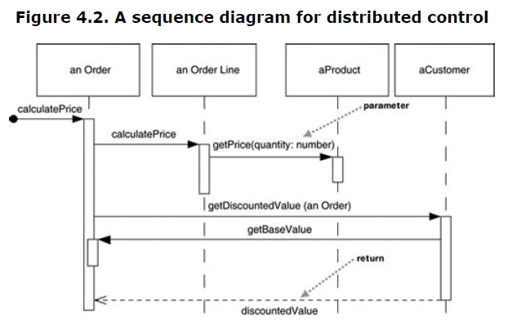
Distributed Control Solution

Slide 23
Exercise
A Company has a name and many Departments, each department has a name, location, and many Positions. Each position has a title and a description, and is filled by a single Employee, which has an employeeId, firstname, middleInitial, lastName, birthDate, SSN, and Salary
The Task: Create a class diagram to provide a model of the above description.

Slide 24
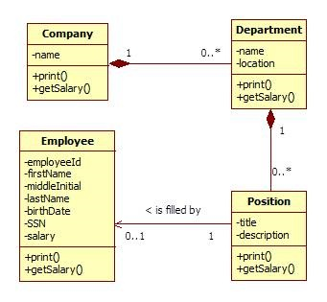
The Class Diagram

Slide 25
The Code – the Classes with Attributes
TASK: Write a program that makes a call to Company to compute the total of all salaries of Employees in the Company. First code the classes with attributes, then create a sequence diagram to model the flow
public class Company {
private String name;
private List<Department> departments;
}
public class Department {
private String name;
private String location;
private List<Position> positions;
}
public class Employee {
private String employeeId;
private String firstName;
private String middleInitial;
private String lastName;
private String SSN;
private Date birthDate;
private double salary;
}
public class Position {
private String title;
private String description;
private Employee emp;
}

Slide 26
A Distributed Control Solution
Note: Here, the responsibility of computing salary is delegated to more and more fine-grained objects that carry out the task according to their own level of responsibility. Ultimately, the computation depends on each Employee salary. It is obvious and natural for control to be distributed in this case.

Slide 27
Turning It into Code
Now we add the code showing the methods we will use to print out the salaries in our four classes.
Here is the simple main class.
public class Application {
public static void main(String[] args) {
...
double totalSalary = company.getSalary();
}
}

Slide 28
(continued)
public class Company {
private String name;
private List<Department> departments;
public double getSalary() {
double result = 0.0;
for (Department dep : departments) {
result += dep.getSalary();
}
return result;
}
}

Slide 29
public class Department {
private String name;
private String location;
private List<Position> positions;
public double getSalary() {
double result = 0.0;
for (Position p : positions) {
result += p.getSalary();
}
return result;
}
}
public class Position {
private String title;
private String description;
private Employee emp;
public double getSalary() {
return emp.getSalary();
}
}
public class Employee {
private String firstname;
private double salary;
public double getSalary() {
return salary;
}
}

Slide 30
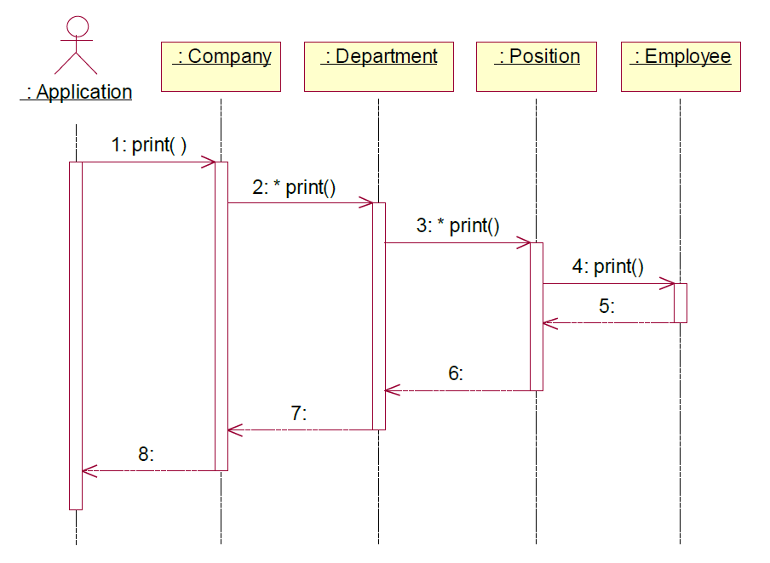
Return Arrows
Return arrows may be shown, optionally
When a return value makes the diagram more understandable, it is good to show it
Showing all return arrows is bad practice because it clutters the diagram
Sometimes a Note is used to indicate an important return value
The example here shows what a waste of space return arrows can be – and they do not add anything valuable
Bad use of returns

Slide 31
Main Point 1
Sequence Diagrams document the sequence of calls different objects (should) make to accomplish a specific task.
Likewise, harmony exists in diversity: Even though each object is specialized to only perform tasks related to itself, objects harmoniously collaborate to create functionality far beyond each object’s individual scope.

Slide 32
Quiz - 1
In sequence diagram which one of the following mark the beginning and end of a “method call”.
Actor
Activation Bar
Horizontal Arrow

Slide 33
Interaction Diagrams: Overview
Sequence Diagrams
Object Diagrams
Delegation and Propagation
Polymorphism

Slide 34
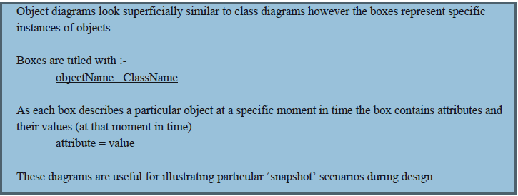
Object Diagrams
An object diagram is a snapshot of the objects in a system at a point in time.
Because it shows instances rather than classes, an object diagram is often called an instance diagram.

Slide 35
Object Diagram Syntax
Underlining indicates it’s an object
Usually shows colon separated name and type
Associations in object diagrams don’t have multiplicities
Associations may or may not display an arrowhead
The state of each object is shown
Frank : Student
Advises
Mary : Student
Advises
Renuka : Faculty
Advises
John : Student

Slide 36
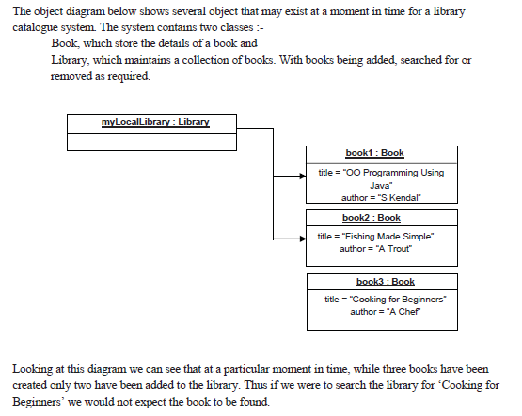
Example

Slide 37
Exercise
Draw a sequence diagram to captures a scenario for the computeSalary problem.
Assume there is one instance
of Company, which has two Departments,
each with two positions, each filled with one employee.
Create an object diagram.

Slide 38
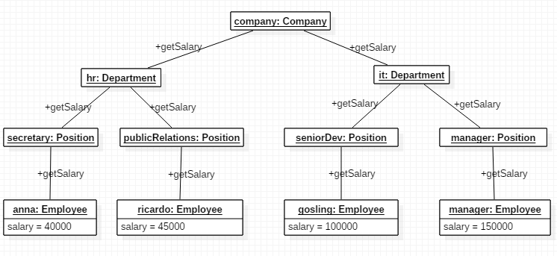
Solution

Slide 39
Main Point 2
Object Diagrams show the relationships between objects, where each object is an instance of a class, and each reference is represented by a single arrow or line.
This phenomenon illustrates the principle that the whole is greater than the sum of the parts: The objects (parts) on their own are not the important focus for an object diagram. What is important is how the objects relate; together, objects and their relationships form a whole that is more than just the sum of individual objects collected together.

Slide 40
Quiz - 2
Object diagrams don’t have multiplicities.
True
False

Slide 41
Interaction Diagrams: Overview
Sequence Diagrams
Object Diagrams
Delegation and Propagation
Polymorphism

Slide 42
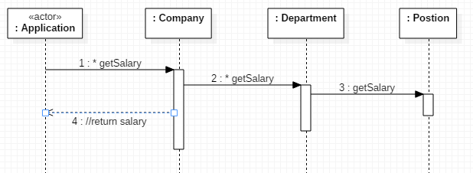
Delegation & Propagation
A class can express functionality in its interface, but it may delegate some or all of the responsibility to an associated class to carry out the action
The responsibility for the action can propagate through a hierarchy.
Notes:
Delegation : If a request is made of an object A and, in fulfilling the request, A in turn requests assistance from another object B, this is known as delegation by A to B. It is a way of making composition as powerful.

Slide 43
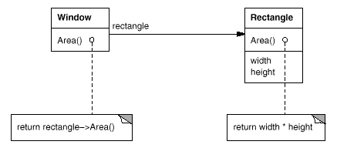
Delegation Example
For example, instead of making class Window a subclass of Rectangle (because windows happen to be rectangular), the Window class might reuse the behavior of Rectangle by keeping a Rectangle instance variable and delegating Rectangle-specific behavior to it.

Slide 44
Main Point 3
OO Systems use delegation and propagation. An individual object only works with its own properties, acts only on what it knows, and then asks related objects to do what they know.
When individual actions are on the basis of self-referral dynamics, individual actions are automatically in harmony with each other because all arise from the dynamics of the a single unified field.

Slide 45
Interaction Diagrams: Overview
Sequence Diagrams
Object Diagrams
Delegation and Propagation
Polymorphism

Slide 46
Polymorphism
Polymorphism = many forms
Objects of a particular type can take different forms
Achieved through dynamic binding (late binding)
Implies that a type has subtypes (extends, implements)
Account act = new CheckingAccount();
act.toString();
CheckingAccount
The method call first checks the class of the actual object to find a toString() method; if not found, it checks successive super classes, rising finally to Object
Account
Object Class

Slide 47
Late Binding
Binding is the connection of a method call to a method implementation.
Late binding, or dynamic binding, occurs at run-time.
the JVM method-call mechanism finds the correct method body and invokes it at run-time.
by traversing the inheritance chain, starting at the runtime type of the object
late binding is the implementation mechanism that makes polymorphism work
Notes:
Private methods have early binding because they are implicitly final, they can never be overwritten, so, no polymorphism!

Slide 48
Early Binding
Static, private, final methods are bound to the correct method body at compile time – this is called early binding.
Static methods. When a call is made to a static method, the method body may not be in the current class – it may be in a super class or some more distant ancestor. The compiler will climb the inheritance chain till it finds the first occurrence of an implemented version of the method and creates the binding – see demo lesson4.lecture.staticinherit.fifth
Private methods. When a private method is called on an object of type A, there is no possibility it was overridden in a subclass, and because of the visibility rules for overriding, it could not have been inherited from a superclass. The binding is uniquely determined in this case
Final methods. When a final method is called, it could not have been overridden in a subclass. The compiler climbs the inheritance chain till it finds the first place where this method has an implementation and performs the binding to that one. See demo lesson4.lecture.finalinherit

Slide 49
Static Typing
Objects of type B or C can be declare as type A
public class Student { ... }
public class Undergraduate extends Student { ... }
public class Graduate extends Student { ... }
Student st1, st2, st3;
Graduate st4;
st1 = new Student();
st2 = new Undergraduate();
st3 = new Graduate();
st4 = new Student();
Where is the Compiler Error?

Slide 50
(continued)
Objects of type B or C can be cast as type A
public class Student { ... }
public class Undergraduate extends Student { ... }
public class Graduate extends Student { ... }
Student st1, st2, st3;
Graduate st4;
st1 = new Student();
st2 = new Undergraduate();
st3 = new Graduate();
st4 = new Student(); //error
NOTE: In the first three cases, the Student class is the static type of the object created. The runtime types
are, respectively, Student, Undergraduate, and Graduate.

Slide 51
Polymorphism Example

Slide 52
public abstract class Account {
private double current_amount;
private String accountnr;
public void deposit(double amount) {
current_amount += amount;
}
public void withdraw(double amount) {
current_amount -= amount;
}
public void setAccountnr(String anr) {
accountnr = anr;
}
public String getAccountnr() {
return accountnr;
}
public double getAmount() {
return current_amount;
}
public abstract void addInterest();
}
public class CheckingAccount extends Account {
private double interest_rate = 0.0255;
@Override
public void addInterest() {
deposit(getAmount() * interest_rate);
}
}
public class SavingsAccount extends Account {
private double interest_rate = 0.0425;
@Override
public void addInterest() {
deposit(getAmount() * interest_rate);
}
}

Slide 53
public class Bank {
private Map<String, Account> accounts =
new HashMap<String, Account>();
public void addInterest_all_accounts() {
for (Account a : accounts.values()) {
a.addInterest();
}
}
public void addAccount(String type, String accountnr) {
Account account;
if (type.equals("checking")) {
account = new CheckingAccount();
} else {
account = new SavingsAccount();
}
account.setAccountnr(accountnr);
accounts.put(accountnr, account);
}
public void delAccount(String accountnr){
accounts.remove(accountnr);
}
}
P2I
Polymorphism

Slide 54
public class BankApp {
public static void main(String[] args) {
Bank mybank = new Bank();
mybank.addAccount("checking", "1");
mybank.addAccount("checking", "2");
mybank.addAccount("savings", "3");
mybank.addInterest_all_accounts();
}
}

Slide 55
Why do we want polymorphism?
It allows us to extend our program with new features without changing existing (already tested)code.

Slide 56
Open-Closed Principle
Software should be designed so that it is open for extension, but closed for modification.
All systems change during their life cycle, but when a single change results in a cascade of changes, the program becomes fragile and unpredictable. When requirements change, you implement these changes by adding new code, not by changing old code that already works.
Demo: lesson4.lecture.openclosed.closedcurve
Software modules can never be 100% closed for modification. Programmer has to decide what aspects should be closed.

Slide 57
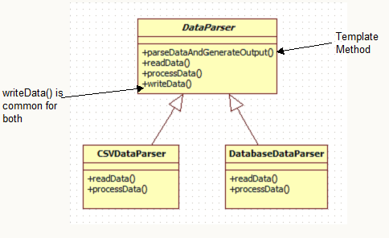

Polymorphism and the Template Method Pattern
Sometimes a class at the top of an inheritance hierarchy needs to carry out a sequence of tasks, some of which need to be implemented by subclasses. This situation is an example of the Template Method Design Pattern – see lesson4.lecture.template
<<abstract>>

Slide 58
Main Point 4
Polymorphism supports use of the Open-Closed Principle: The part of our code that is established and tested is closed to modification (change), but at the same time the system remains open to changes, in the form of extensions.
In a similar way, progress in life is vitally important, and progress requires continual change and adaptation. But change stops being progressive if it undermines the integrity of life. Adaptability must be on the ground of stability.

Slide 59
Quiz - 3
Which one of the following method uses early binding?
A) private
B) static
C) final
D) all the above

Slide 60
Summary
Today we looked at modeling Object Collaboration and the uses of Polymorphism.
Sequence diagrams document the sequence of method calls between objects
Object diagrams show the relationships between objects. It is important to know how a class diagram translates into an Object Diagram
The OO tools of association, delegation, propagation, and polymorphism allow us to build software solutions that reflect accurately the system we are modeling and are efficient, flexible and extensible.

Slide 61
Connecting the Parts of Knowledge With the Wholeness of Knowledge
Sequence Diagrams and Object Diagrams both show how objects relate to each other.
To preserve encapsulation, objects should only act on their own properties, and to accomplish tasks that are the responsibility of other objects, they should send messages (delegation)
Transcendental Consciousness by its very nature, has the fundamental association of self-referral – the Self being aware of the Self
Wholeness moving within itself: In Unity Consciousness one feels intimately associated with all other things in creation as a result of perceiving all things in terms of one’s Self

