Slide 1
Lesson 6, Part I: Building GUIs with JavaFX

Slide 2
Wholeness of the Lesson
JavaFX is a UI library in Java that allows developers to create user interfaces that are rich in content and functionality.
The ultimate provider of tools for the creation of beautiful and functional content in manifest existence is pure intelligence itself; all creativity arises from this field’s self-interacting dynamics.

Slide 3
Overview
Using JavaFX components (learn more from api docs at http://docs.oracle.com/javafx/2/api/ )
Layout basics
Handling GUI events
Using CSS to style your app
Declarative UI building using FXML
Deployment
Notes:
JavaFX is a replacement for Swing. Components have a more modern feel; animations are easier to create and look better; uses CSS for appearance and layout of components; supports more sophisticated UI design patterns, including properties and bindings. JavaFX properties are often used in conjunction with binding, a powerful mechanism for expressing direct relationships between variables. When objects participate in bindings, changes made to one object will automatically be reflected in another object.
JavaFX is a set of graphics and media packages that enables developers to design, create, test, debug, and deploy rich client applications that operate consistently across diverse platforms.

Slide 4
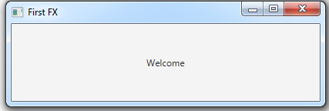
First JavaFX Application
public class FirstApp extends Application {
@Override
public void start(Stage stage) {
Label label = new Label("Welcome");
StackPane root = new StackPane(); // Layout
root.getChildren().add(label); // adding components in the layout
Scene scene = new Scene(root, 400, 100);
stage.setTitle("First FX");
stage.setScene(scene);
stage.show();
}
public static void main(String[] args) {
launch(args);
}
}

Slide 5
About FirstApp.java
Application class
The entry point for a JavaFX application is always a user-defined subclass of the abstract class javafx.application.Application class.
The start() method starts up the application – it is the only abstract method of Application (and so must be implemented).
Stage Class
A JavaFX application defines the user interface container by means of a stage and a scene.
The JavaFX Stage class is the top-level JavaFX container. (Entire Window)
The JavaFX Scene class is the container for all content. (Contents on a stage)
The demo above creates the stage and scene and makes the scene visible in a given pixel size.

Slide 6
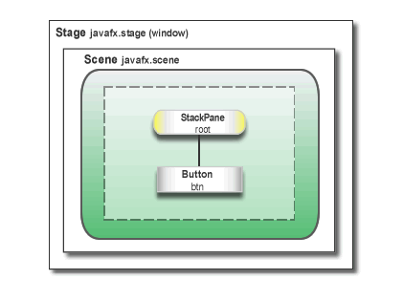
StackPane Class (Kind of Layout)
In JavaFX, the content of the scene is represented as a hierarchical scene graph of nodes.
In this example, the root node is a StackPane object, which is a resizable layout node.
Scene Graph

Slide 7
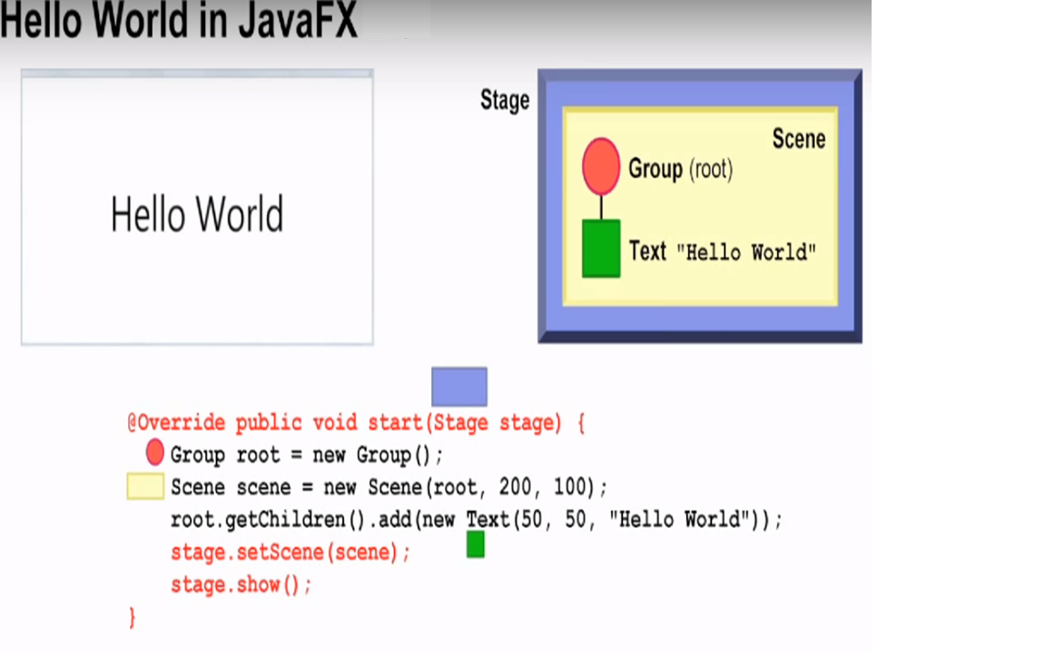

Slide 8
Main Point 1
For creating the look of a JavaFX application, two types of classes are primary: components and containers.
A screen is created by setting the stage with the Stage and Scene container classes. And then the screen is populated with components, like buttons, textboxes, labels, and so on, starting at a root node and extending.
Components and containers are analogous to the manifest and unmanifest fields of life; manifest existence, in the form of individual expressions, lives and moves within the unbounded container of pure existence.

Slide 9
Some General Points about JavaFX Apps
The main() method is not required for JavaFX applications when the JAR file for the application is created with the JavaFX Packager tool.
The JavaFX Packager tool is a commandline tool used to compile, package and deploy a Java FX application (can be found here: <path to Java> \Java\jdk1.8.0_45\bin\javafxpackager.exe)
Using the tool embeds the JavaFX Launcher in the output JAR file, so there is no need to call the Launcher from a main method.
It is useful to include the main() method because
You can run JAR files that were created without the JavaFX Launcher (such as when using an IDE in which the JavaFX tools are not fully integrated, which is the case with Eclipse).
Swing applications that embed JavaFX code require the main() method.
Read about the Packager tool here: http://docs.oracle.com/javafx/2/deployment/packager.htm

Slide 10
The Life-cycle of a JavaFX Application
The entry point for JavaFX applications is the Application class. The JavaFX runtime does the following, in the following order, whenever an application is launched:
Constructs an instance of the specified Application class
Calls the init() method (for initializing; typical use: read commandline args See HelloWorld demo)
Calls the start(javafx.stage.Stage) method
Waits for the application to finish, which happens when either of the following occurs:
the application calls Platform.exit() (this can be done explicitly in code)
the last window has been closed (this is the default behavior, but it can be changed) - See HelloSecondWindow demo
Calls the stop() method (typical use: clean up connections to resources)
The start method is abstract and must be overridden.
The init and stop methods have concrete implementations that do nothing by default

Slide 11
Two Threads
Launcher thread. Application constructor and init method are called on this thread
Application thread. JavaFX creates an application thread for running the application start method, processing input events, and running animation timelines.
Creation of JavaFX Scene and Stage objects as well as modification of scene graph operations to live objects (those objects already attached to a scene) must be done on the JavaFX application thread.

Slide 12
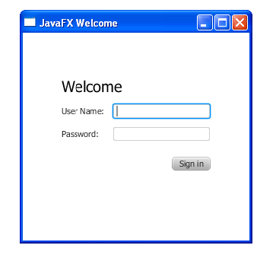
Second Example - Creating a Form in JavaFX
In this example we build a login form – illustrates:
basics of screen layout
how to add controls to a layout pane
how to create input events and handle them.

Slide 13
Create a GridPane Layout
GridPane is a layout node that works like an HTML table. You can place controls in any cell in the grid, and you can make controls span cells as needed.
GridPane grid = new GridPane();
grid.setAlignment(Pos.CENTER);
grid.setHgap(10);
grid.setVgap(10);
grid.setPadding(new Insets(25, 25, 25, 25));
Scene scene = new Scene(grid, 300, 275);
alignment property changes the default position of the grid from the top left of the scene to the center.
gap properties control the spacing between the rows and columns in the grid
padding property controls the space around the edges of the grid pane
insets occur in this order: top, right, bottom, and left. (In this example, there are 25 pixels of padding on each side).
Notes:
NOTES:
When the scene is created, the grid pane is the root node – this is usual approach when using layout containers
As the window is resized, the nodes within the grid pane are resized according to their layout constraints.
The padding properties ensure there is a padding around the grid pane when you make the window smaller.
Code sets the scene width and height to 300 by 275. If you do not set the scene dimensions, the scene defaults to the minimum size needed to display its contents.

Slide 14
Add Text, Labels, and Text Fields
Sample Code:
Label scenetitle = new Label("Welcome");
scenetitle.setFont(Font.font("Tahoma", FontWeight.NORMAL, 20)); //better to set these values in a style sheet
// Parameter are : Node child, int columnIndex, int rowIndex, int colspan, int rowspan
grid.add(scenetitle, 0, 0, 2, 1);
Label userName = new Label("User Name:");
grid.add(userName, 0, 1);
TextField userTextField = new TextField();
grid.add(userTextField, 1, 1);
Label pw = new Label("Password:");
grid.add(pw, 0, 2);
PasswordField pwBox = new PasswordField();
grid.add(pwBox, 1, 2);

Slide 15
TextFields are constructed to have width of 12 pixels by default. The preferred width can be modified using setPrefColumnCount(numCols), or setPrefWidth(pixels), but layout may override preferences.
apply the setPrefColumnCount method of the TextInput class to set the size of the text field
How positions in the grid are specified: (column num, row num):
Text scenetitle = new Text("Welcome");
grid.add(scenetitle, 0, 0, 2, 1);
The last two arguments of the grid.add() method set the column span to 2 and the row span to 1.
(0, 0) | (1, 0) | (2, 0)
(0, 1) | (1, 1) | (2, 1)

Slide 16
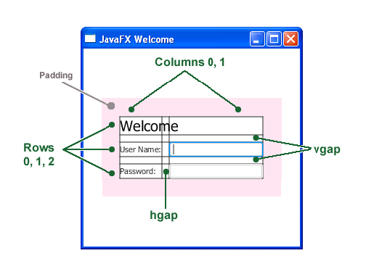
Debugging components on a GridPane
For debugging, GridPane allows you to display the grid lines. Do this here by adding this line of code grid.setGridLinesVisible(true)
When code is run, you see this:

Slide 17
Positioning a Component in GridPane with HBox
Sample code:
Button btn = new Button("Sign in");
HBox hbBtn = new HBox(10);
hbBtn.setAlignment(Pos.BOTTOM_RIGHT);
hbBtn.getChildren().add(btn);
grid.add(hbBtn, 1, 4);
The HBox layout pane is created to allow you to place the button in a special place.
HBox constructor accepts a spacing parameter (spacing between components). In this case, alignment is set to Pos.BOTTOM_RIGHT
If other components are added to an HBox, they are laid out from left to right.

Slide 18
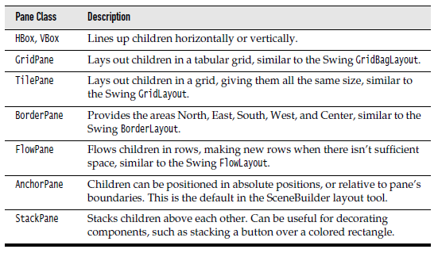
Other Layouts

Slide 19
Main Point 2
In JavaFX, components are arranged in a container through the use of layouts that organize components in different ways. The most convenient layout is GridPane, which allows you to organize components in a table format, and suffices for most layout needs. For special layout requirements, JavaFX provides half a dozen other layout types.
Likewise, all of manifest life is conducted by a vast network of natural laws.

Slide 20
Event Handling
Sample code:
final Text actiontarget = new Text();
grid.add(actiontarget, 1, 6);
// Anonymous implementation
btn.setOnAction(new EventHandler<ActionEvent>() {
@Override
public void handle(ActionEvent e) {
actiontarget.setFill(Color.FIREBRICK);
actiontarget.setText("Sign-in button pressed");
}
});
Add a Text control for displaying the message, as shown below.
The setOnAction() method is used to register an event handler that sets the value of actiontarget to “Sign-in button pressed” when the user presses the button. The color of the actiontarget object is set to firebrick red.

Slide 21
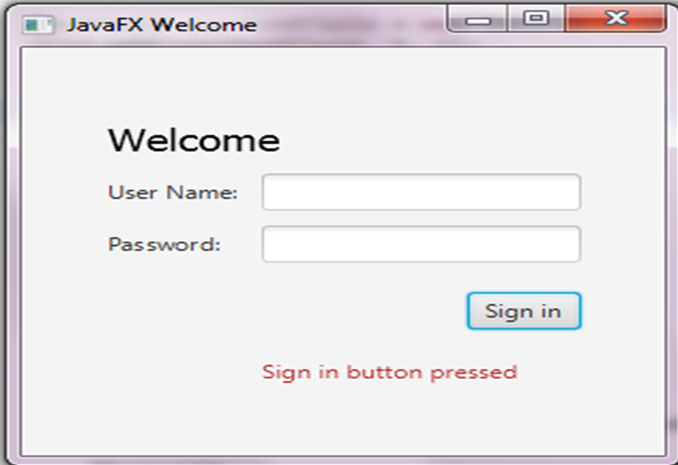
Output

Slide 22
More Examples on Demo
Demo lesson6.lecture.javafx.secondwindow illustrates:
Setting background color of the root
Creating and using a status bar
Setting up a ComboBox and responding to user selections with a ChangeListener
ToggleButton for toggling between states in response to button clicks
Creating multiple Stages and how communication between them is accomplished.
Demo lesson6.lecture.javafx.tables illustrates the use of menus and tables in JavaFX.
The Start class creates a MenuBar, adds two Menus, and adds MenuItems to the first Menu.
The ShoppingCartWindow creates a TableView. TableViews are created one column at a time. In this example, all cells have been made read-only, but with more work, cells can be editable. A TableView requires some Java class to provide the data that it will read and present. In this example, ShoppingCart provides the necessary data. During TableView construction, the field names from ShoppingCart are specified and each will represent one of the TableView columns. After the ShoppingCartWindow has been created, data for the table can be set using the setData method that has been provided. This method accepts a List of ShoppingCarts; each ShoppingCart in the list will be displayed as a row in the table.

Slide 23
Main Point 3
A GUI becomes responsive to user interaction (for example, button clicks and mouse clicks) through the event-handling model of JavaFX, in which event sources are associated with EventHandler classes, whose handle method is called (and is passed an Event object) whenever a relevant action occurs. To make use of this event-handling model, the developer defines a handler class, implements the handle method, and, when defining an event source (like a button), registers the handler class with this event source component.
The “observer” pattern that is used in JavaFX mirrors the fact that in creation, the influence of every action is felt everywhere; existence is a field of infinite correlation; every behavior is “listented to” throughout creation.
Notes:
Observer Pattern : Define a one-to-many dependency between objects so that when one object changes state, all its dependents are notified and updated automatically.

Slide 24
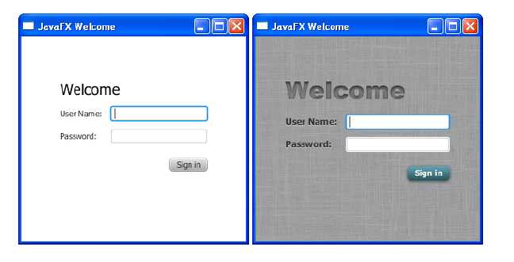
Fancy Forms with JavaFX CSS
For this example, we are going to add a Cascading Style Sheet (CSS) to the JavaFX application as shown below. See lesson6.lecture.javafx.logincss

Slide 25
Add CSS Styling to the Login Class
Create a new CSS file and save it in the same directory as Login.css.
Specify location of the CSS file using the following code:
Scene scene = new Scene(grid, 300, 275);
primaryStage.setScene(scene);
scene.getStylesheets().add(
getClass().getResource("Login.css").toExternalForm());
primaryStage.show();
Reference:
http://docs.oracle.com/javafx/2/css_tutorial/jfxpub-css_tutorial.htm
Detailed reference:
http://docs.oracle.com/cd/E17802_01/javafx/javafx/1.3/docs/api/javafx.scene/doc-files/cssref.html
Other ways to access a CSS file are discussed here:
https://blog.idrsolutions.com/2014/04/use-external-css-files-javafx/

Slide 26
Add a Background Image
.root {
-fx-background-image: url("background.jpg");
}
The background image is applied to the .root style, which means it is applied to the root node of the Scene instance.
The style definition consists of
the name of the property: -fx-background-image, and
the value for the property: url("background.jpg").

Slide 27
Style the Labels
When you specify .label in your stylesheet, the values that are set affect all Labels in the form.
.label {
-fx-font-size: 12px;
-fx-font-weight: bold;
-fx-text-fill: #333333;
-fx-effect: dropshadow(
gaussian , rgba(255,255,255,0.5) , 0,0,0,1 );
}
This example
sets the font size and weight
sets text-fill to gray
applies a drop shadow (the purpose of the drop shadow is to add contrast between the dark gray text and the light gray background).
rgba is RGB + alpha. Alpha (values in range 0..1) specifies opacity
dropshadow parameters can be looked up at http://docs.oracle.com/javafx/2/api/javafx/scene/doc-files/cssref.html

Slide 28
Style Text
Apply css styling to the two Text objects: scenetitle (includes the text Welcome) and actiontarget (“signed in” message at bottom).
Steps:
1. Remove the Java coding of styles (we will replace them with CSS) Remove the following lines of code that define the inline styles currently set for the text objects:
scenetitle.setFont(Font.font(“Tahoma”, FontWeight.NORMAL, 20));
actiontarget.setFill(Color.FIREBRICK);
2. Create an ID for each text node by using the setID() method of the Node class:
scenetitle.setId("welcome-text");
actiontarget.setId("actiontarget");

Slide 29
Style Text
3. In the Login.css file, define the style properties for the welcome-text and actiontarget IDs. For the style name, use the ID preceded by a number sign (#), as shown below –
#welcome-text {
-fx-font-size: 32px;
-fx-font-family: "Arial Black";
-fx-fill: #818181;
-fx-effect: innershadow( three-pass-box , rgba(0,0,0,0.7) , 6, 0.0 , 0 , 2 );
}
#actiontarget {
-fx-fill: FIREBRICK;
-fx-font-weight: bold;
-fx-effect: dropshadow( gaussian , rgba(255,255,255,0.5) , 0,0,0,1 );
}
NOTES: The text fill color for welcome-text is set to a dark gray color (#818181) and an inner shadow effect is applied, creating an embossing effect.

Slide 30
Style the Button
We style the button so that it changes style when the user hovers the mouse over it.
Steps:
Create the style for the initial state of the button by adding the code below. This code uses the .button style class selector, such that if you add a button to the form at a later date, then the new button will also use this style.
.button {
-fx-text-fill: white;
-fx-font-family: "Arial Narrow";
-fx-font-weight: bold;
-fx-background-color: linear-gradient(#61a2b1, #2A5058);
-fx-effect: dropshadow( three-pass-box , rgba(0,0,0,0.6) , 5, 0.0 , 0 , 1 );
}
Create a slightly different look for when the user hovers the mouse over the button. You do this with the hover pseudo-class. A pseudo-class includes the selector for the class and the name for the state separated by a colon (:), as shown below -
.button:hover {
-fx-background-color: linear-gradient(#2A5058, #61a2b1);
}

Slide 31
Using FXML to Create a User Interface
Mark-up Language. FXML is a mark-up language based on XML that is used to design and lay out JavaFX components, and attach event handlers; FXML markup is rendered by the JVM into a fully functioning UI.
Declarative programming. FXML makes it possible to develop UI code in a declarative style, using XML commands to declare what is needed rather than writing the Java code that accomplishes the goal. This flexibility makes it possible to develop FXML code using a designer tool, which supports drag-and-drop layout of components and event-handling. The tool that accomplishes this is called SceneBuilder.

Slide 32
3) Topics for FXML: ( Refer : Lesson-Review of XML.doc)
We give a quick review of XML, including an example of how it is read and used in a Java program
We re-build the small Login app using FXML (without the use of SceneBuilider) showing FXML markup syntax and how it is used by JavaFX code.
In Part II, we show how to work with FXML documents using Scene Builder.

Slide 33
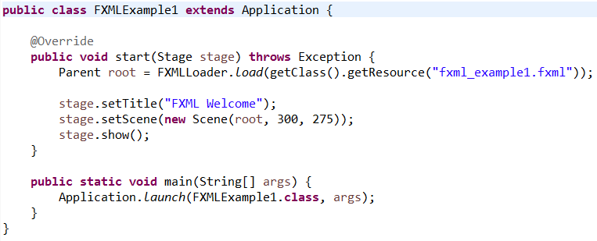
FXML Basics
When building a UI using FXML, there are two types of documents to create: the FXML file(s) and the controlling Java file(s). Here are shells of these for the Login app:

Slide 34
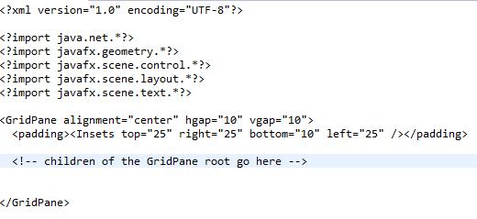
Java Code

Slide 35
FXML Code
XML processing instructions are used to specify Java imports
The root of the FXML document is the root of the Scene that is being built.
Nesting in the FXML document parallels the nesting that is done in building JavaFX components (as we did in building the Login app).
The Java code shows how to access the values specified in the FXML document. After obtaining the root, further JavaFX changes can be made directly in Java.

Slide 36
FXML Example 1: Component Layout
The sample code in lesson6.lecture.javafx.fxmlexample.FXMLExample1
shows how components are laid out using an FXML document

Slide 37
FXML Example 2: Connect Java and FXML Code
The demo
lesson6.lecture.javafx.fxmlexample.FXMLExample2
shows how to link between Java code and the FXML code, using id fields (similar to the approach in JavaScript).
Note:
The id fields are specified as attributes of component elements in the FXML document. <Text id="actiontarget" GridPane.columnIndex="1" GridPane.rowIndex="6" />
You reference components having id tags in the FXML document using Java syntax like the following: Text target = (Text)root.lookup("#actiontarget");
In this approach, event-handling can be done inside the Java code by retrieving (by id) an event-generating component (like a Button) and attaching an event-handler (see the demo).

Slide 38
FXML Example 3: Event Handling
The demo lesson6.lecture.javafx.fxmlexample.FXMLExample3
shows how to handle events in a better way, by injecting event-generating components into a Controller class, responsible for event-handling code.
Notes:
1. You inject components into a controller class using the @FXML annotation. 2. Components that need to be referenced in the controller must have “fx:id” tags instead of simply “id” tags. 3. You reference an event handler within the FXML document with code like this:
<Button text="Sign In" onAction="#handleSubmitButtonAction" /> When the button is clicked, the JVM will look for a method handleSubmitButtonAction in the controller class, and will execute this method. 4. To tell the JVM about the class that you will use as controller, you include an fx:controller attribute in the root, like this:
fx:controller= "lesson6.lecture.javafx.fxmlexample.FXMLExampleController" 5. To tell the JVM about the “fx” namespace, you also include in the root the attribute xmlns:fx, like the following:
xmlns:fx=http://javafx.com/fxml 6. Using a Controller class to be responsible for event-handlers is an application of the Mediator design pattern (discussed in Software Engineering) and supports the principle “separation of concerns” – separating the static UI layout code from the dynamic event-handling code.
Notes:
Definition : Define an object that encapsulates how a set of objects interacts. The mediator pattern promotes loose coupling by keeping objects from referring to each other explicitly, and it lets you vary their interaction independently.
Concept: A mediator is the one who takes the responsibility of communication among a group of objects. The mediator acts as an intermediary who can track the communication between two objects. The other objects in the system are also aware of this mediator and they know that if they need to communicate among themselves, they need to go through the mediator. The advantage of using such a mediator is that we can reduce the direct interconnections among the objects and thus lower the coupling.

Slide 39
FXML Example 4:
Referencing CSS Styles in the FXML Document
The demo
lesson6.lecture.javafx.fxmlexample.FXMLExample4
adds lines to the FXML document to handle CSS styling.

Slide 40
Deploying Your First JavaFX Application
JavaFX applications can be run in several ways:
Launch as a desktop application from a JAR file or self-contained application launcher
Launch from the command line using the Java launcher
Launch by clicking a link in the browser to download an application
View in a web page when opened
For this course, we are going to do it in the first way.
Here are instructions for doing that:
From your Eclipse workspace:
right click your JavaFX application
create a special Run Configuration – example: HelloWorldToJar (Duplicate existing Run Configuration and rename it) , then Close
right click on the application again and select export…select Java folder
Runnable JAR file (Next)
Select launch configuration you just created
choose Export Destination
Now, run the JAR file you just created by double-clicking the file.

Slide 41
Lesson 6, Part II: Building GUIs with SceneBuilder
Make sure you have a version of Eclipse that supports SceneBuilder. We have used efxclipse, which is Luna with several SceneBuilder plugins preloaded http://efxclipse.bestsolution.at/install.html#all-in-one
Download and install SceneBuilder. Instructions are in the setup folder for the course
Go through a demo to build the Login app using SceneBuilder

Slide 42
Steps for creating JavaFX Project using Scene Builder
File → New → Other → JavaFX → JavaFXProject
Add new FXML Document by right click on the project
File → New → Other → JavaFX → New FXML Document
Create a Controller class in the same package to do the necessary functionalities.
Right click on the FXML Document → OpenwithSceneBuilder
Design your screen according to your need
In the screenBuilder, Left side of the screen select controller to choose your controller class.
In Controller class to access the controls from the screen declare the private variables as the type of controls and put @FXML annotation before the variables and for action event methods too.
To bind the declared variables in to Scene Builder, on the ride side of control properties, select code and set the variable names in fx:id.
To perform the action, select the particular control and on the right side select code, then select onAction and choose the specific function.
In your main class remove or comment line the code line //BorderPane root = new BorderPane();
Add the following code
Parent root = FXMLLoader.load(getClass().getResource("/application/Main.fxml"));
Run your Main class
Notes:
The @FXML annotation enables an FXMLLoader to inject values defined in an FXML file into references in the controller class.

