Slide 1

CS401 Modern Programming Practices (MPP) Professor Renuka Mohanraj
MAHARISHI UNIVERSITY of MANAGEMENT
Engaging the Managing Intelligence of Nature
Computer Science Department

Slide 2
© 2015 Maharishi University of Management, Fairfield, Iowa
All rights reserved. No part of this slide presentation may be reproduced or utilized in any form or by any means, electronic or mechanical, including photocopying or recording, or by any information storage and retrieval system, without permission in writing from Maharishi University of Management.

Slide 3
Lecture 7: Interfaces in Java 8 and the Object Superclass

Slide 4
Wholeness Statement
Java supports inheritance between classes in support of the OO concepts of inherited types and polymorphism. Interfaces support encapsulation, play a role similar to abstract classes, and provide a safe alternative to multiple inheritance.
Likewise, relationships of any kind that are grounded on the deeper values at the source of the individuals involved result in fuller creativity of expression with fewer mistakes.

Slide 5
Overview
Java 8 introduces many new features in interfaces and applications of these features to the collections library
The Object class is the superclass of all Java classes. It offers several important methods (usable by any Java class), but to be useful, they must be overridden (in the right way).
Discussion on Inner class

Slide 6
Java 8 Features of Interfaces
Before Java 8, none of the methods in an interface had a method body; all were unimplemented.
In Java 8, two kinds of implemented methods are now allowed: default methods and static methods. Both can be added to legacy interfaces without breaking code.

Slide 7
A default method is a fully implemented method within an interface, whose declaration begins with the keyword default
A static method in an interface is a fully implemented static method having the same characteristics as any static method in a class.
See Demos in package lesson7.lecture.defaultmethods and lesson7.lecture.interfacestatic

Slide 8
New Programming Style
Default Methods in an interface eliminate the need to create special classes that represent a default implementation of the interface.
Examples from pre-Java 8 of default implementations of interfaces: List / Collection. [See JavaLibrary project in workspace]
Now, in developing new code, it is possible in many cases to place these default implementations in the interface directly.
Static Methods in an interface eliminate the need to create special utility classes that naturally belong with the interface.
Examples from pre-Java 8 of how interfaces sometimes have companion utility classes (consisting of static methods): Collection/Collections [See JavaLibrary project] Path/Paths.

Slide 9
Solution to Evolving API Problem
When you need to add new methods to an existing interface, provide them with default implementations using the new Java 8 default feature. Then
legacy code will not be required to implement the new methods, so existing code will not be broken
new functionality will be available for new client projects.

Slide 10
Other Uses
First Set of Examples:
enums can now “inherit” from another type
Second Set of Examples:
forEach – default method in Iterable

Slide 11
First Set of Examples: Review of Enums
An enumerated type is a Java class all of whose possible instances are explicitly enumerated during initialization.
Example:
public enum Size { SMALL, MEDIUM, LARGE};
//usage: if(requestedSize==Size.SMALL)
applyDiscount();
The enum Size (which is a special kind of Java class) has been declared to have just three instances, named SMALL, MEDIUM, LARGE.

Slide 12
Review of Enums
Two important applications for enums:
Provide a list of related “constants” for an application
Weak programming practice: Create a class (or interface) containing constants, stored as public static final values Problem. No compiler control over usage of constants
Better approach when constants are related to each other: Represent constants as instances of an enumerated type.
Optimal, threadsafe implementation of the Singleton Pattern

Slide 13
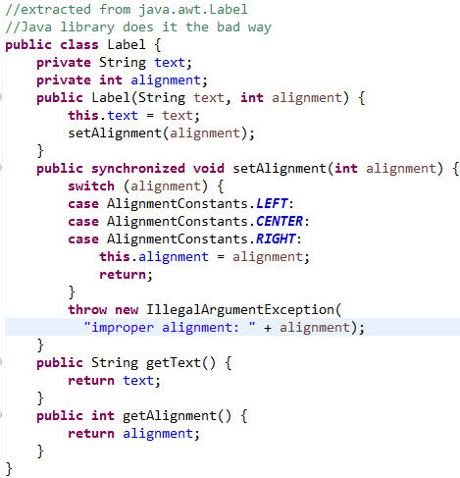
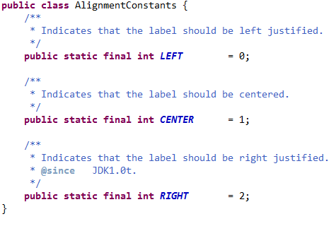
Example: Improve style of managing constants with enums
In the java.awt package there is a class Label, used to represent a label in a UI (built from the old AWT). It makes use of constants to designate alignment properties: left, center, right. This use of constants is flawed, but it is a commonly used style

Slide 14
Problem: No compiler control over use of these constants. Could make the following call: Label label = new Label(“Hello”, 23);
You won’t know till you run the code that “23” is meaningless. The compiler sees that a value of the correct type has been used, but 23 should not be used here. It is better to control the values passed in with the help of the compiler. This is accomplished using an enum to store constants, rather than collecting together a bunch of public static final integers.

Slide 15
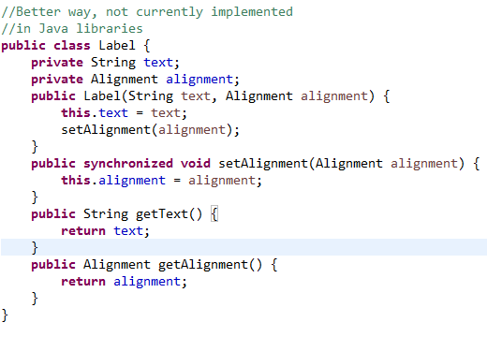
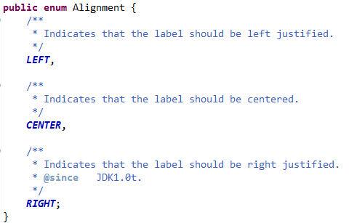
Improved Label Using enums

Slide 16
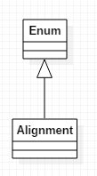
Review of Enums
In the example, each of the instances declared within the Alignment enum has type Alignment, which is a subclass of Enum. All enums implicitly extend java.lang.Enum. Therefore
Alignment is itself a class
Alignment may not inherit from any other class ( since there is no multiple inheritance).

Slide 17
First Set of Examples: Using enums to Create Singletons
A singleton class is a class that can have at most one instance
Easy implementation using an enum:
enum MySingleton {
INSTANCE;
public void behavior() {}
}
//access it like this:
MySingleton.INSTANCE.behavior();
Demo: lesson7.lecture.singletons
Notes:
With lazy initialization you create instance only when its needed and not when the class is loaded.
Eager initialization which always creates an instance when the class is loaded into the JVM.

Slide 18
First Set of Examples: In Java 8, Enums Can implement “Interface”
interface MyInterface {
default usefulThings() {
. . .
}
}
enum MySingleton implements MyInterface {
INSTANCE;
@Override
public void behavior() {
. . .
usefulThings();
}
}
Notes:
Enum is threadsafe, instance are public static final.
Best way to implement the singleton is Enum
Can use Enum in Switch case

Slide 19
Second Set of Examples: forEach
The Iterable interface is part of the Collections API that is implemented by all collection classes, and supports iteration through a collection
The only method in Iterable is iterator(), which returns an Iterator
Iterator has two methods:
hasNext()
next()
When a class (even user-defined) implements the Iterable interface, the “for each” construct can be used (and of course, an instance of Iterator is available).
See Demo: lesson7.lecture.iterator

Slide 20
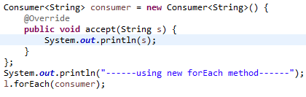

New (Java 8) in the Iterable interface is a default method:
forEach
Sample usage:
Output:
See Demos:
lesson7.lecture.iterator
Review inner classes:
Lesson7.lecture.reviewinner

Slide 21
The forEach method applies the Consumer method accept to each element of the list.
In this example, the accept method just prints the value to the console.
Consumer is a new interface in Java 8, with just one abstract method accept, which accepts a single argument and produces no return value.

Slide 22
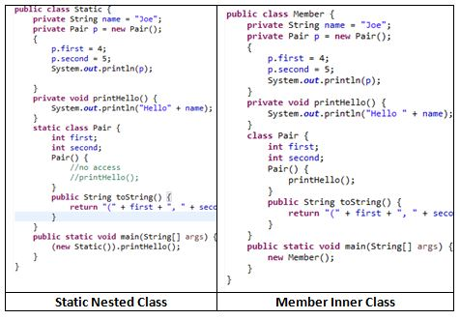
Quick Review of Nested Classes I

Slide 23
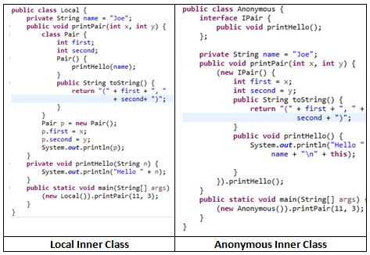
Quick Review of Nested Classes II See Demo : lesson7.lecture.reviewofinner.fourexamples
Notes:
Capture of local variables is restricted to those that are effectively final. Local variables in Java have until now been immune to race conditions and visibility problems because they are accessible only to the thread executing the method in which they are declared. That’s why local variables are effectively final in Java to make it thread safe.
A local class can access local variables and parameters of the enclosing block that are final or effectively final.
A variable or parameter whose value is never changed after it is initialized is effectively final.
It is effectively final in Java 8. No need to make the local variable as final, but in pre-java8 need to declare local variable as final.

Slide 24
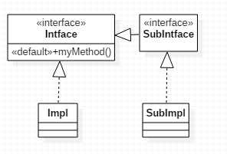
Rules for Default Methods in an Interface
If a class implements an interface with a default method, that class inherits the default method (or can override it).
Potential clash if
two interfaces have the same method, or
one interface and a superclass have the same method

Slide 25
Conflicts
Interface I1{
default void display(){
System.out.println(“Interface I1”);
}
}
class C1{
void display(){
System.out.println(“Class C1”);
}
}
Interface I2{
default void display(){
System.out.println(“Interface I2”);
}
}
// Super class & Interface conflicts
Class Test extends C1 implements I1{
}
// Interface conflicts
Class Test implements I1, I2{
}

Slide 26
Interface vs Interface – clash! When two interfaces each have a method with the same signature:
If one of these is a default method, any implementer of both interfaces must override the method (or declare it as an abstract method) – can’t simply do nothing.
If one of these is a default method, any subinterface of both interfaces must provide a default method (i.e. an implementation) of this method, or declare the method (even if unimplemented). (This rule requires no special effort.)
Note: Even in Java 7, it is not possible to implement two interfaces each of which has a method with the same signature but different return types.

Slide 27
Superclass vs Interface – superclass wins! When a class extends a superclass and also implements an interface, and both super class and interface have a method with the same name, the superclass implementation wins – this is the version that is inherited by the class. The subclass/implementer is not required to override the shared method.
See Demos in lesson7.lecture.defaultmethodrules

Slide 28
Static Methods Do Not Clash
Static methods defined in an interface are not inherited by implementers (this differs from the behavior for subclasses of a class)
Therefore, if two interfaces implement static methods with the same signature, there is no clash to address when a class implements these interfaces.
Static methods can always be accessed in a static way in such cases, but it is not related to inheritance. See demo lesson7.lecture.interfacestatic_clash

Slide 29
Main Point 1
Interfaces are used in Java to specify publicly available services in the form of method declarations. A class that implements such an interface must make each of the methods operational. Interfaces may be used polymorphically, in the same way as a superclass in an inheritance hierarchy. Because many interfaces can be implemented by the same class, interfaces provide a safe alternative to multiple inheritance. Java8 now supports static and default methods in an interface, which make interfaces even more flexible: For instance, enum can now “inherit” from other types and new public operations can be added to legacy interfaces without breaking code (as was done with the forEach method in the Iterable interface). The concept of an interface is analogous to the creation itself – the creation may be viewed as an “interface” to the undifferentiated field of pure consciousness; each object and avenue of activity in the creation serves as a reminder and embodiment of the ultimate reality.

Slide 30
Quiz - 1
1. Enum can implement Interface
a. True b. False
2. What is the output of the following code?
interface i1 {
default int show() {
return 100;
}
}
abstract class A {
public int show() {
return 50;
}
}
public class TestClass extends A implements i1 {
public static void main(String args[]) {
TestClass t = new TestClass();
System.out.println(t.show());
}
}
a. 100 b. 50 c. Run time Error d. Compile time error

Slide 31
Overriding Methods in the Object Class
The Object class is the superclass of all Java classes, and contains several useful methods -
in most cases, they are useful only if they are overridden.
toString()
Equals()
hashCode()

Slide 32
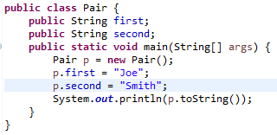
The toString() Method
Every class automatically is equipped with a toString method (by inheritance), but the default implementation simply prints out the class name followed by a code for a memory location. Example:
(Useless) output: tostring.Pair@19e0bfd

Slide 33
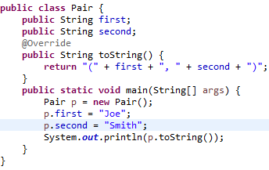
When toString() is overridden, it is possible to capture the state of the current instance of the class and send it to a log file or to the console. This can help in solving a problem after the code has been released, and in debugging during development. Note the @Override annotation.
Output: (Joe, Smith)

Slide 34

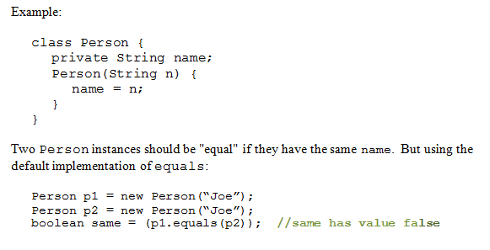
Overriding equals()
Default implementation in Java is same as ==

Slide 35
Properties of equals() method
The equals method implements an equivalence relation on non-null object references:
It is reflexive: for any non-null reference value x, x.equals(x) should return true.
It is symmetric: for any non-null reference values x and y, x.equals(y) should return true if and only if y.equals(x) returns true.
It is transitive: for any non-null reference values x, y, and z, if x.equals(y) returns true and y.equals(z) returns true, then x.equals(z) should return true.
It is consistent: It should be consistent. If x.equals(y) returns true, it should keep returning true until the state of x or y is modified. If x.equals(y) returns false, it should keep returning false until the state of x or y is modified.
Comparison with null reference: For any non-null reference value x, x.equals(null) should return false.
The equals method for class Object implements the most discriminating possible equivalence relation on objects; that is, for any non-null reference values x and y, this method returns true if and only if x and y refer to the same object (x == y has the value true).

Slide 36
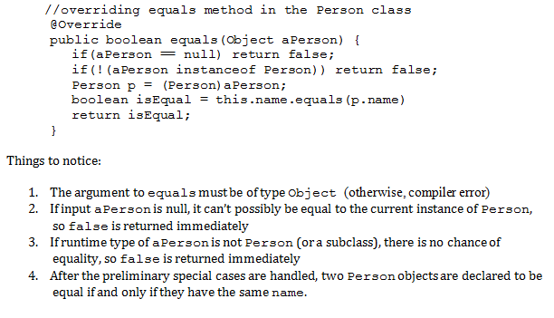
Correct Way to Do It

Slide 37
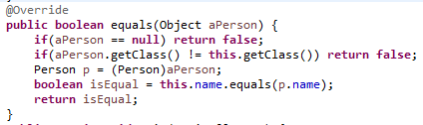
Alternative Approach
To check that the aPerson object is of the right type we used instanceof operator. This is called the instance-of strategy for overriding equals.
An alternative is to call getClass on aPerson to see if it matches the value of getClass for the current object, called the same-classes-strategy for overriding equals

Slide 38
Potential problem with same-classes-strategy: If a subclass of Person is introduced, subclass inherits the equals method but it always returns false when comparing a superclass instance with a subclass instance. For this reason, whenever same-classes strategy is used, you should either:
1. declare the superclass final (to prevent subclassing) or
2. override equals separately in the subclass
See Demos lesson7.lecture.overrideequals.equalclassesstrategyXX

Slide 39
Potential problem with instance-of-strategy: If a subclass of Person is introduced, subclass inherits the equals method. If subclass overrides equals, then an asymmetric equals is created. For this reason, whenever instance-of strategy is used, you should either:
1. declare the superclass final (to prevent subclassing) or
2. require that every subclass relies on the superclass version of equals() (and does not override equals() separately)
See Demos lesson7.lecture.overrideequals.instanceofstrategyXX

Slide 40
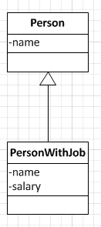
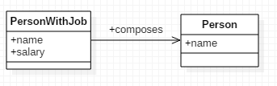
A third alternative: Composition instead of Inheritance
Using separate equals methods for superclass and subclass using either approach (equal-classes or instanceof strategy) is error-prone.
Safe alternative: Replace inheritance with composition:
CHANGE
TO

Slide 41
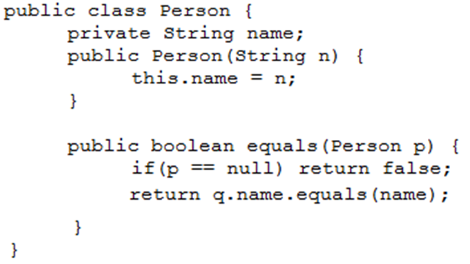
Exercise
Explain with an example how this way of “overriding” equals leads to logic errors in your code:

Slide 42
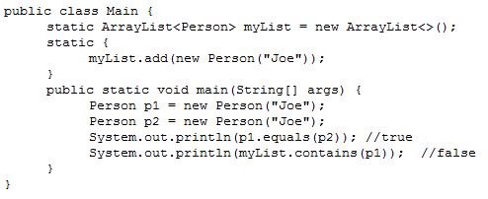
Solution
This version of equals correctly compares two Person objects. The difficulty arises when the Object version of equals needs to be called, and there is no overriding version of equals. This happens (for example) when you want to test whether an object is contained in a List.

Slide 43
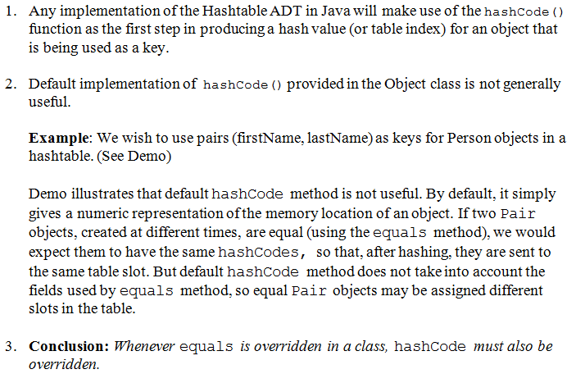
Overriding hashCode()
DEMO: lesson7.lecture.hashcode.xxx

Slide 44
hashCode() Rules
To use an object as a key in hashtable,
you must override equals() and hashCode()
the class on which object is based should be immutable (slide 45) – see demo lesson7.lecture.hashcode.bad3
If k₁,k₂ are keys and k₁.equals(k₂) then it must be true that [k₁.hashCode() == k₂.hashCode()] This means that you must include the same information in your hashCode definition as you include in your implementation of equals.

Slide 45
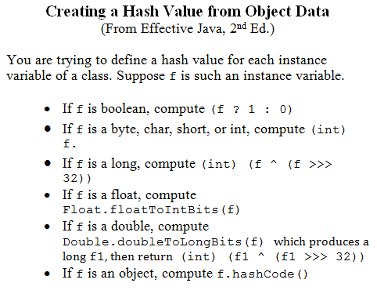

Slide 46
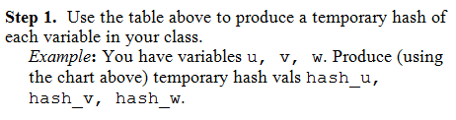
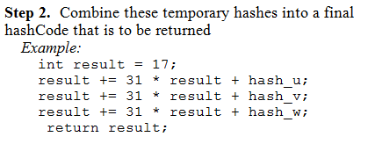
Formula:

Slide 47
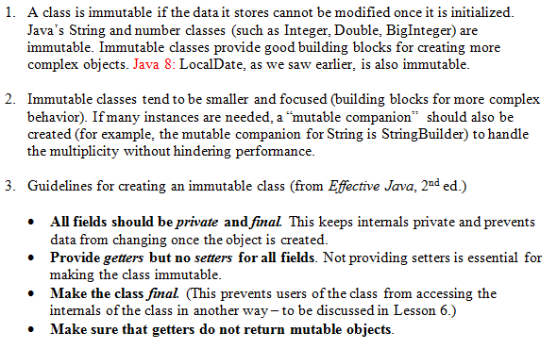
Review: Making Your Classes Immutable

Slide 48
Immutable Classes
Immutable
Mutable
public class IntHolder {
private int value;
public IntHolder(int value) {
this.value = value;
}
public int getValue() {
return value;
}
public String SetValue(int value) {
this.value = value;
}
}
// main method
IntHolder holder = new IntHolder(10);
int v = holder.getValue(); // return 10
Holder.SetValue(20);
v = holder.getValue(); // return 20
final public class IntHolder{
private final int value;
public IntHolder(int value) {
this.value = value;
}
public int getValue() {
return value;
}
}
// main method
IntHolder holder = new IntHolder(10);
int v = holder.getValue(); // return 10

Slide 49
Main Point 2
All classes in Java belong to the inheritance hierarchy headed by the Object class.
Likewise, all individual consciousness inherit from the single unified field.

Slide 50
Quiz 2
1. What is the return type of hashCode() method?
a. boolean b. int c. String

Slide 51
Connecting the Parts of Knowledge With the Wholeness of Knowledge
Inheritance in Java makes it possible for a subclass to enjoy (and re-use) the features of a superclass.
All classes in Java – even user defined classes – automatically inherit from the class Object
Transcendental Consciousness is the field of pure awareness, beyond the active thinking level, that is the birthright and essential nature of everyone. Everyone “inherits” from pure consciousness
Wholeness moving within itself: In Unity Consciousness, there is an even deeper realization: The only data and behavior that exist in the universe is that which is “inherited from” pure consciousness – everything in that state is seen as the play of one’s own consciousness.

