Slide 1
Wilcox-McCandlish
Law of Internet Discourse
Notes:
We are here to discuss the Wilcox- McCandlish Law of Internet Discourse.
http://en.wikipedia.org/wiki/User:SMcCandlish
Bio
Stanton McCandlish is a freelance Web developer and online PR/communications consultant, a buyer and seller of collectibles, and a pool instructor. His specialties include advocacy, media relations, information management and architecture, usability and accessibility, technology policy analysis, and technical writing. He is also an anthropologist by training.
He volunteers as the Communications Director for the CryptoRights Foundation (presently on hiatus). As such, he has acted as the organization's press manager, public relations lead, publications manager, and Webmaster, and has also participated in mission-critical technical projects, such as leading Project HighFire's documentation.
Stanton was among the world's first professional online activists, and came to CryptoRights after working on issue campaigns, policy and online communications at the Electronic Frontier Foundation (EFF) from 1993 to 2002, where he also ran one of the most-linked-to Web sites on the entire 'Net, and edited the organization's newsletter, EFFector, one of the largest-subscription online bulletins of the era. He has written a variety of articles and tutorials, been quoted by most major US news publications on Internet policy issues, and is co-author of the seminal privacy and e-activism handbook Protecting Yourself Online: The Definitive Resource on Safety, Freedom, and Privacy in Cyberspace (with Robert B. Gelman). He also managed production of the updated online editions of Everybody's Guide to the Internet (by Adam Gaffin), including revision, management of multi-language translation, and online distribution.
After studying computer science, technical writing and anthropology/linguistics at the College of Santa Fe, Eastern New Mexico University, and the University of New Mexico, Stanton did technical consulting at UNM, as well as maintaining an early independent electronic bulletin board system (BBS) and operating a small press publishing operation in Albuquerque. Some of his current areas of interest include electronic privacy, unsolicited bulk e-mail (spam) issues, free expression online, preservation of fair use of intellectual property, and protection of the public's interest in the development of technical standards. McCandlish holds a B.A. in cultural anthropology and communication from UNM.
He likes cats, post-punk, and bad girl art, and lives in Albuquerque again for the time being.

Slide 2
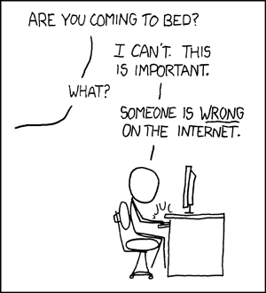
Are you familiar with this scenario?
Notes:
http://imgs.xkcd.com/comics/duty_calls.png

Slide 4
The Wilcox-McCandlish law of online discourse evolution, developed by Bryce Wilcox and Stanton McCandlish on USENET. In 1996 they described patterns they had observed in internet communication in the Wilcox-McCandlish law.
Notes:
http://en.wikipedia.org/wiki/User:SMcCandlish
This particular law was originally founded by bryce wilcox and stanton mccandlish during the newsgroup/usenet days when it was still wildly popular. They basically saw some patterns going around forums and discussion boards and decided to codify these observations into a “law”.

Slide 5
The Evolution of Internet Discourse
In 1979 Usenet was created by two undergraduates from Duke University.
The original intent for Usenet was simply to replace an obsolete announcement system .
It was developed primarily to discuss technical information but quickly became a communication medium for free speech
Notes:
http://www.giganews.com/usenet-history/index.html
Usenet developed in to a large community that evolved over time into groups ranging from news sharing to file sharing. The large community base developed its own social structures. They also evolved outside newsgroups into chat rooms called IRC (Internet Relay Chat).

Slide 6
Today’s standard of internet communication originated with Usenet.
Commonplace things such as:
Emoticons
Flame Wars
Signatures
Slang Acronyms such as (BRB, LOL, U, R, 4)
These ideas spread rapidly through the online community.
Notes:
Large internet forums such as somethingawful.com and reddit.com are staples of internet discussion that have been around for years.

Slide 7
The Law:
“The chance of success of any attempt to change the topic or direction of a thread of discussion in a networked forum is directly proportional to the quality of the current content.”
Notes:
Translation: The crappier the thread the less chance there is of changing the topic.
Take for example a Gizmodo article, where the author makes a genuine attempt to review a piece of hardware and put forth a lot of effort in the quality of the original article. The comments however take a turn in a completely different direction that are irrelevant to the hardware or the article itself.

Slide 8
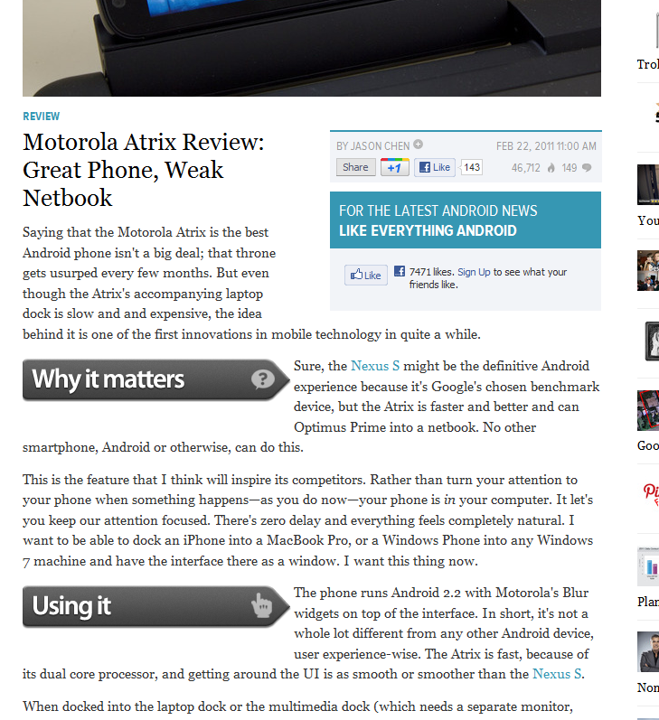

Slide 9
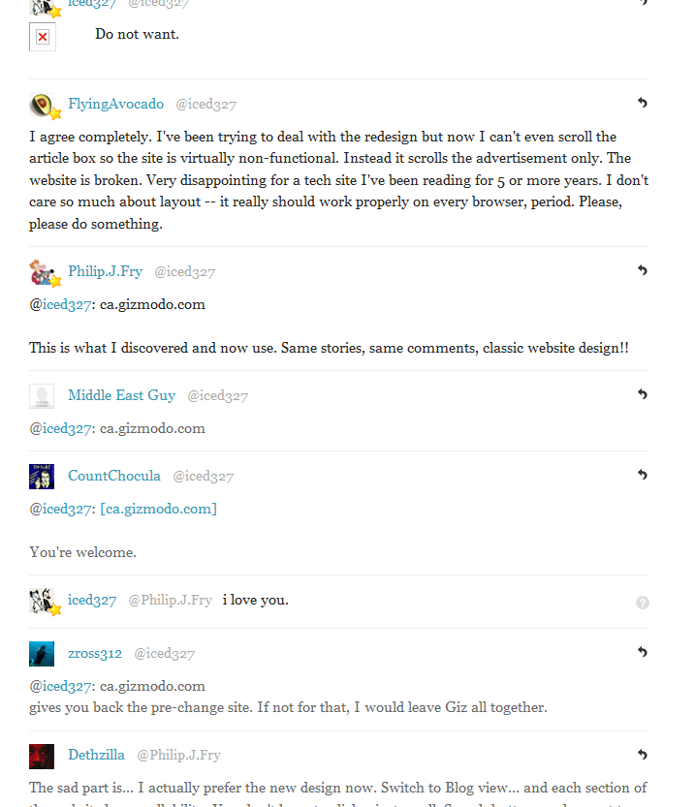

Slide 10
McCandlish's first corollary to the Wilcox-McCandlish law:
“The chance of any change to the topic or direction of a thread being a change for the better is inversely proportional to the quality of the content before the change.”
Notes:
If the topic is crummy the chances are that any change in the topic will be for the better.
If the topic is good, the chances are that any change in topic will be for the worse.

Slide 11
The exception to McCandlish's first corollary:
“When a thread reaches the flame-war stage, all changes in thread topic or direction will be changes for the worse.”
Notes:
http://www.giganews.com/usenet-history/index.html
A great example of this would be the Iphone and Android wars that are all over the internet.

Slide 12
These links contain some offensive language. Watch at your own risk. NSFW. http://goo.gl/MAVPV http://goo.gl/6wkmI

Slide 13
Wilcox's corollary to the Wilcox-McCandlish law:
“The more involved one is in a flame war, the less likely one is to recognize it as such.”
Notes:
Immunity factor
This is similar to road rage in the sense that if someone cuts you off, you view their driving as terrible and the driver is a “jerk” whereas if you were the one driving and cutting people off, you’re merely in a hurry and there is nothing wrong with your driving.

Slide 14
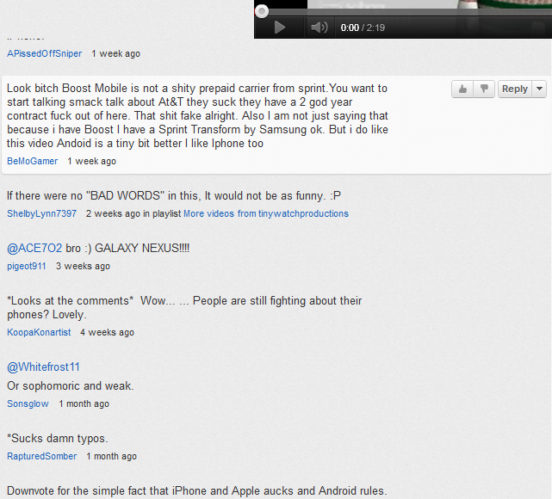
Examining the comments to the previous videos…
Notes:
This further proves that the users are not aware that they’re engaged in a flame war. They are simply participating in the comments and defending their side. There are nearly 35000 comments between the videos, and a combined 20 million views!

Slide 15
“Thread bandwidth consumption increases in inverse proportion to thread content quality.”
McCandlish's second corollary to the Wilcox-McCandlish law:
Notes:
Flame wars may be caused by the deindividuation in our culture, where people are less aware of others feelings.
As more and more users use the internet, the chances are high that the topics discussed in threads will decrease in quality.

Slide 16
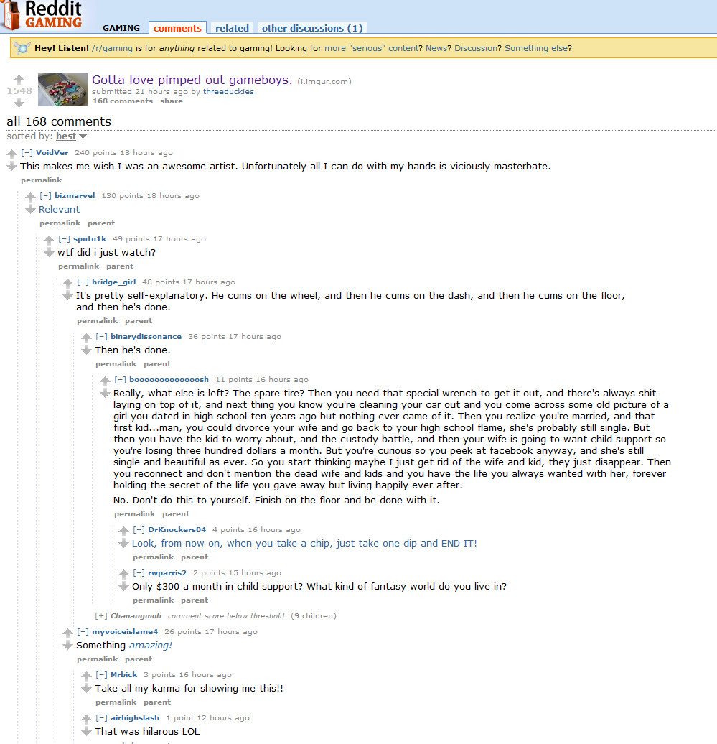
As an example:
Notes:
The original image is of a “ pimped out gameboy”. While the quality is not very high in the original post, this was one of the most popular threads of the week.

Slide 17
McCandlish's third corollary to the Wilcox-McCandlish law:
“Any attempt at recourse to formal logic or identification of classic fallacies will simply increase the irrationality of the discussion.”
Notes:
We should film a scene here and essentially act us this corollary.

Slide 18
The Wilcox-McCandlish paradox:
“Thread degeneration can (theoretically) be forestalled or even reversed by citation to the Wilcox-McCandlish Law.”

Slide 19
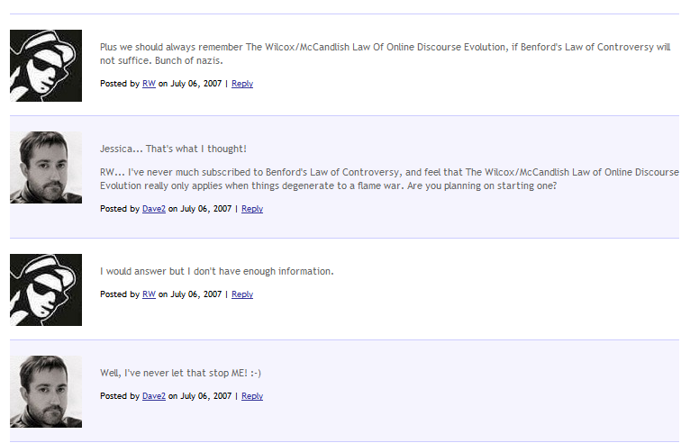

Slide 20
Godwin's Law (also Godwin's Rule of Nazi Analogies) is an adage in Internet culture that was originated by Mike Godwin in 1990. The law states that:
As an online discussion grows longer, the probability of a comparison involving Nazis or Hitler approaches one.

