Slide 1
Networking and Security
Lab 1 Report
Debbie Hoffpauir
Jared Brewton

Slide 2
Case:
At the beginning of the scenario physicians were complaining about delays with response time during certain parts of the day.
The initial connection between the two switches was 100 Mbps.
The two connections with heaviest traffic were identified, and an upgrade to 1 Gbps connection was simulated.
Simulation conducted for the purpose of deciding whether an upgrade would help the situation.

Slide 3
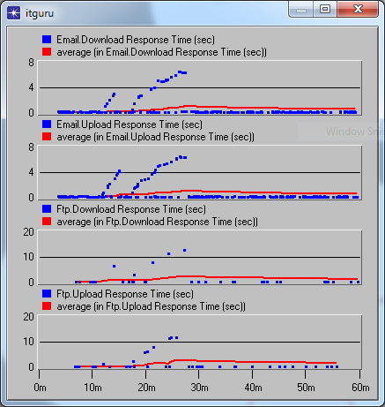
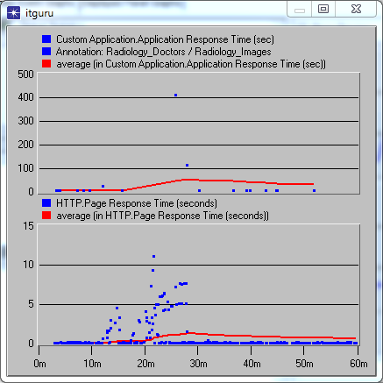
Spikes in response times were identified during a 1 hour simulation.

Slide 4
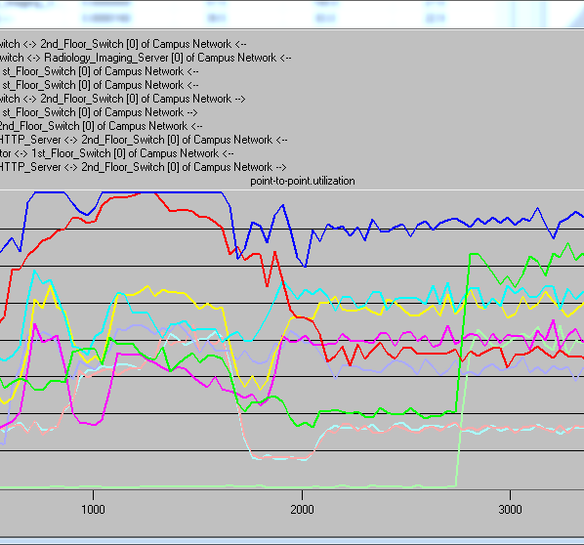
Point to Point utilization at 100 Mbps
Here the link between the two switches is at maximum capacity for out what appears to be over 700 seconds .
During the time that the link between the switches is peaking, the link from the Radiology Imaging Server and the Second Floor Switch is also at 100% capacity.

Slide 5
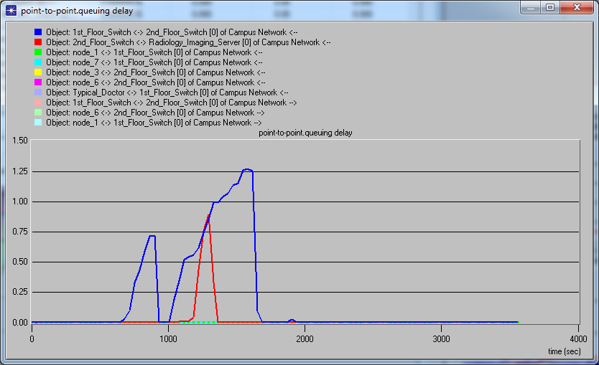
Queuing Delay at 100 Mbps
This graph displays queuing delays between the switches and also between the 2nd Floor Switch and the Radiology Imaging Server.

Slide 6
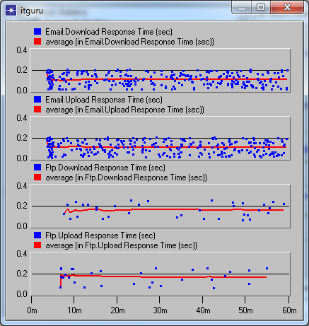
Simulation of network traffic shows that the upgrade greatly reduces delays for email and ftp. Average response times are now all under .2 seconds, when previously delays had been as high as 7 seconds for email download and over 10 seconds for ftp.
100 Mbps
1 Gbps

Slide 7
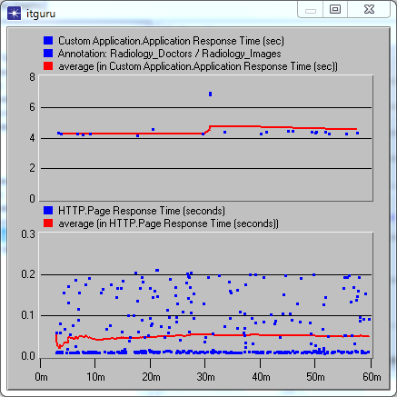
The radiology custom application average response time is reduced from a maximum of over 400 seconds to under 7 seconds. Http page response times are now similar to those for ftp and email with the upgrade, usually below .2 seconds without the past delays of over 10 seconds.
100 Mbps
1 Gbps

Slide 8
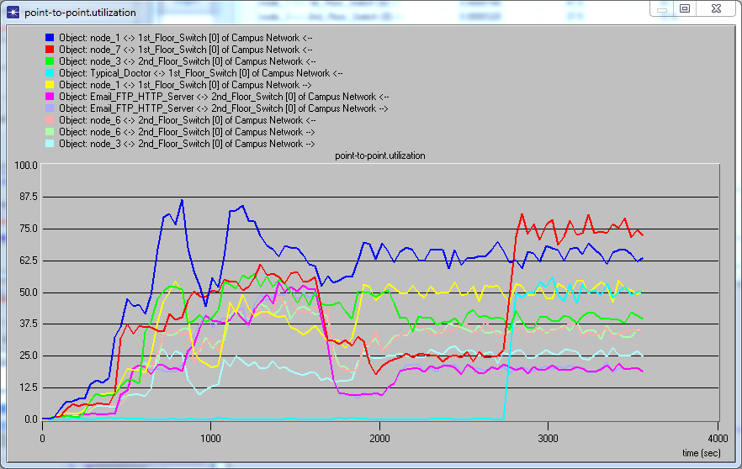
Point to Point utilization at 1 Gbps
With the upgrade neither the connection between the switches nor the connection between the Radiology Server and the 2nd Floor Switch would be pushed to capacity.

Slide 9
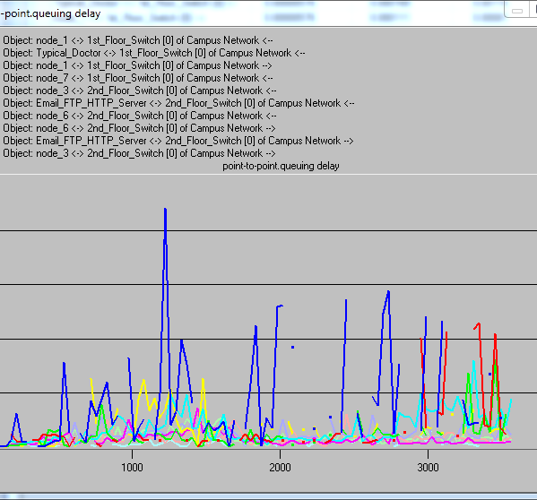
Queuing Delay at 1 Gbps
Queuing delays would now rarely be over .0015 seconds as opposed to previous delays as high as 1.25 second.

Slide 10
Part 5
WAN Results
HTTP page response time
Max .099 sec
Min .031 sec
Avg .060 sec
MAC delay for WAN scenario
Max .0060 sec
Min .00135
Avg .00301
MAC delay for bldg 1
Max .00918
Min 0
Avg .00412
Exported to excel and used descriptive statistics

