Slide 1
Networking and Security Lab Report 3
WAN
Debbie Hoffpauir
Jared Brewton

Slide 2
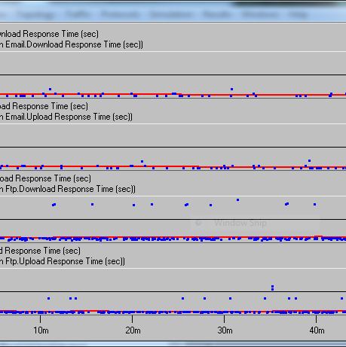
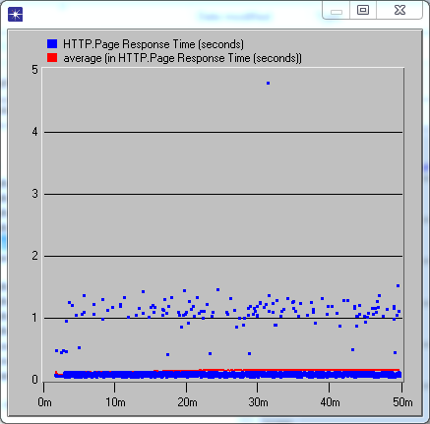
Baseline
Mail and FTP
HTTP

Slide 3
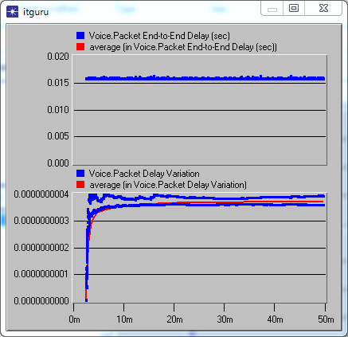
Baseline
Voice
Voice conclusion:
Voice packets are recommended to have no more than a 50 msec delay for high quality. Our speeds are around 16 msec, so the speed is good

Slide 4
Point to Point Utilization
Top Objects Report: point-to-point.utilization
Rank | Object Name | Minimum | Average | Maximum | Std Dev
---- | --------------------------------------------------- | -------------- | -------------- | -------------- | --------------
1 | Southern_California <-> Georgia [0] <-- | 59.5 | 70.1 | 76.2 | 2.54
2 | Southern_California <-> New_York [0] <-- | 57 | 70.1 | 75.8 | 2.44
3 | Southern_California <-> New_York [0] --> | 52 | 69.3 | 74.1 | 2.89
4 | Southern_California <-> Georgia [0] --> | 55.7 | 69.1 | 76.7 | 3.03
5 | New_York <-> Massachusetts [0] --> | 59.7 | 66.5 | 71.7 | 2.34
6 | New_York <-> Massachusetts [0] <-- | 58.6 | 66.1 | 71.3 | 2.33
7 | Southern_California <-> Illinois [0] <-- | 44.9 | 65.1 | 71.1 | 3.29
8 | Southern_California <-> Illinois [0] --> | 46.9 | 64.9 | 71 | 2.8
9 | Northern_California <-> Southern_California [0] <-- | 53 | 60.8 | 65.2 | 1.67
10 | Northern_California <-> Southern_California [0] --> | 55 | 60.7 | 68.7 | 2.78

Slide 5
Queuing Delay
Top Objects Report: point-to-point.queuing delay
Rank | Object Name | Minimum | Average | Maximum | Std Dev
---- | ---------------------------------------------------- | -------------- | -------------- | -------------- | --------------
1 | Washington.HTTP_User <-> Seattle [0] <-- | 0.0055 | 0.217 | 0.51 | 0.08
2 | Northern_California.User_1 <-> San_Francisco [0] <-- | 0.0482 | 0.206 | 0.3 | 0.052
3 | Washington.Seattle <-> FTP_User [0] --> | 0.0051 | 0.184 | 0.92 | 0.316
4 | Northern_California.User_2 <-> San_Francisco [0] <-- | 0.0086 | 0.174 | 0.96 | 0.182
5 | Texas.Houston <-> PPP_Dialup_User [0] <-- | 0.005 | 0.145 | 0.73 | 0.27
6 | Washington.Seattle <-> FTP_User [0] <-- | 0.0053 | 0.122 | 1.26 | 0.295
7 | Texas.Houston <-> PPP_Dialup_User [0] --> | 0.0053 | 0.1 | 0.85 | 0.231
8 | Northern_California.User_2 <-> San_Francisco [0] --> | 0.005 | 0.093 | 0.78 | 0.183
9 | Florida.Miami <-> User_2 [0] --> | 0.0537 | 0.084 | 0.11 | 0.03
10 | Florida.Miami <-> User_1 [0] --> | 0.0537 | 0.084 | 0.11 | 0.03

Slide 6
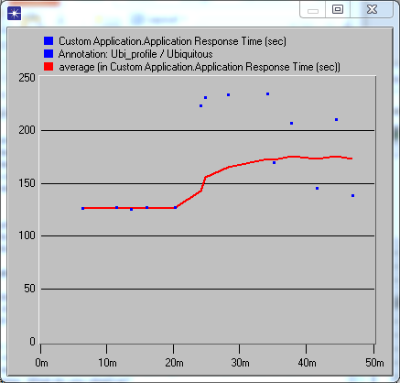
Ubiquitous Deployment
Application Response

Slide 7
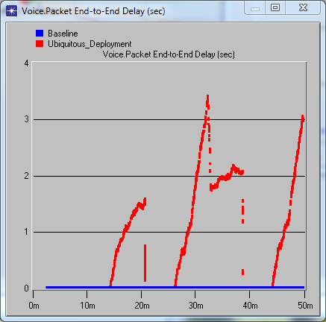
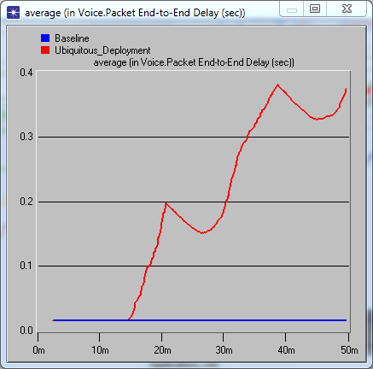
Ubiquitous Comparison
Individual Stats
Average
Notes:
Voice quality has degraded as shown by the spike in delay.

Slide 8
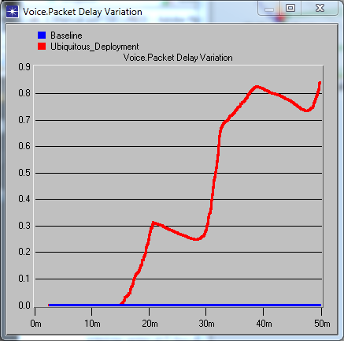
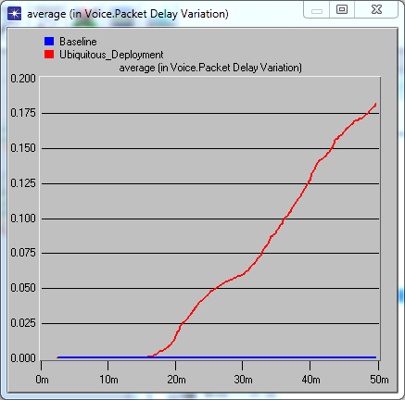
Voice Packet Delay Comparison

Slide 9
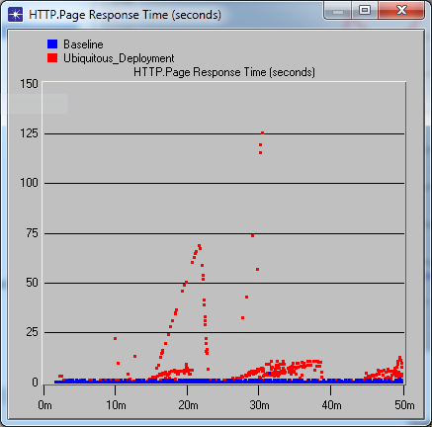
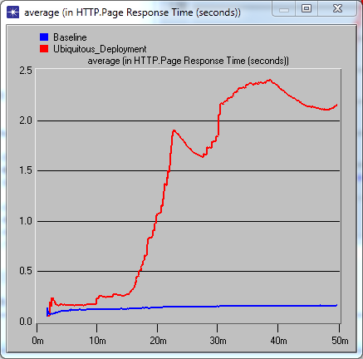
HTTP Response Comparison

Slide 10
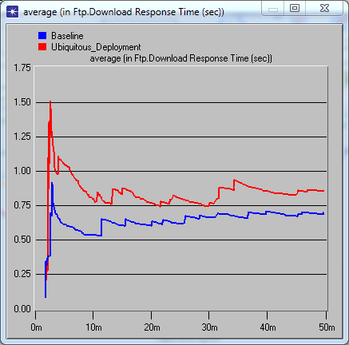
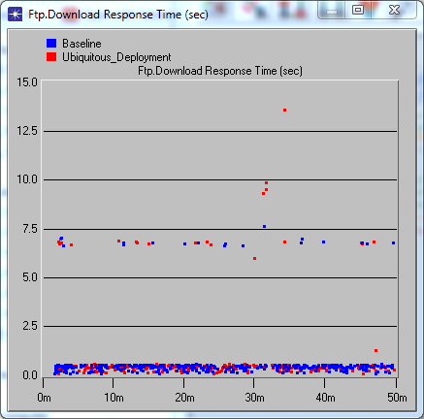
FTP Comparison

Slide 11
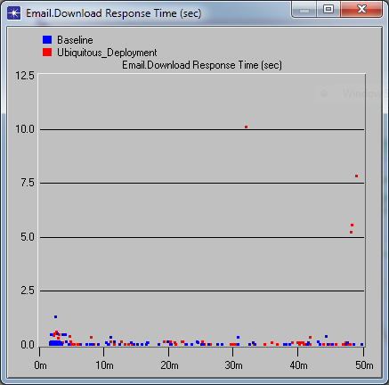
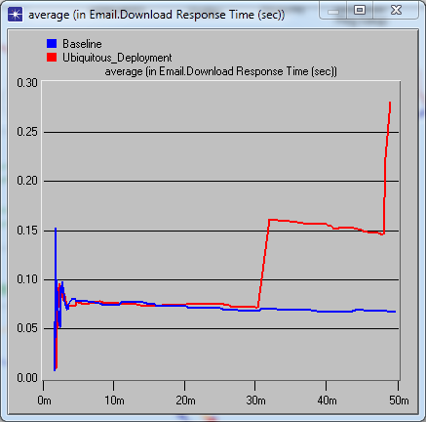
Email Download Comparison

Slide 12
Links reaching 100% utilization
Top Objects Report: point-to-point.utilization
Rank | Object Name | Minimum | Average | Maximum | Std Dev
---- | -------------------------------------------------- | -------------- | -------------- | -------------- | --------------
1 | Texas <-> Georgia [0] <-- | 37.8 | 85 | 100 | 21.5
2 | Southern_California <-> New_York [0] <-- | 58.8 | 83.2 | 100 | 9.5
3 | Southern_California.Los_Angeles <-> Irvine [0] --> | 0 | 75.7 | 100 | 32.4

Slide 13
Queuing Delays
Top Objects Report: point-to-point.queuing delay
Rank | Object Name | Minimum | Average | Maximum | Std Dev
---- | ---------------------------------------------------- | -------------- | -------------- | -------------- | --------------
1 | Texas <-> Georgia [0] <-- | 0 | 48.9 | 148 | 55.2
2 | Washington.HTTP_User <-> Seattle [0] <-- | 0.0025 | 2.6 | 16 | 4.6
3 | Massachusetts.User_1 <-> Boston [0] <-- | 0.0025 | 1.2 | 6 | 2
4 | Southern_California.Los_Angeles <-> Irvine [0] --> | 0 | 0.6 | 2 | 0.7
5 | Massachusetts.User_2 <-> Boston [0] <-- | 0.0025 | 0.5 | 3 | 0.9
6 | Florida.Miami <-> User_1 [0] --> | 0.0025 | 0.4 | 4 | 1
7 | Northern_California.User_1 <-> San_Francisco [0] <-- | 0.055 | 0.2 | 0 | 0.1
8 | Northern_California.User_2 <-> San_Francisco [0] <-- | 0.005 | 0.2 | 1 | 0.1
9 | Washington.Seattle <-> FTP_User [0] <-- | 0.005 | 0.2 | 1 | 0.3
10 | Texas.Houston <-> PPP_Dialup_User [0] --> | 0.0058 | 0.2 | 1 | 0.3

Slide 14
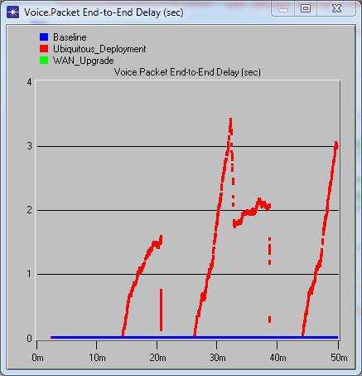
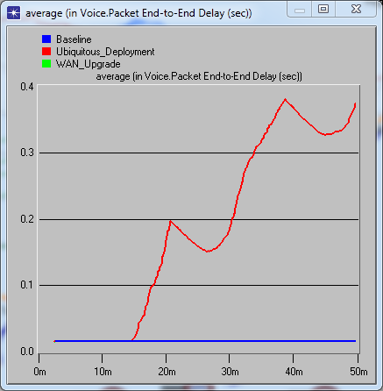
Voice upgrade comparison

Slide 15
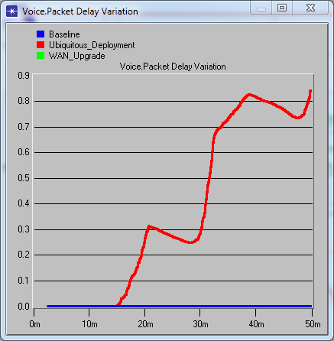
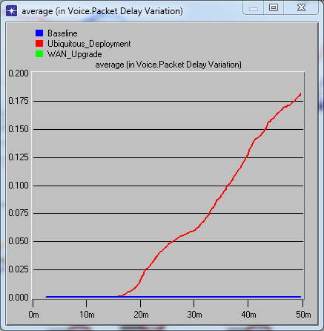
Jitter Comparison
Individual statistics
Average

Slide 16
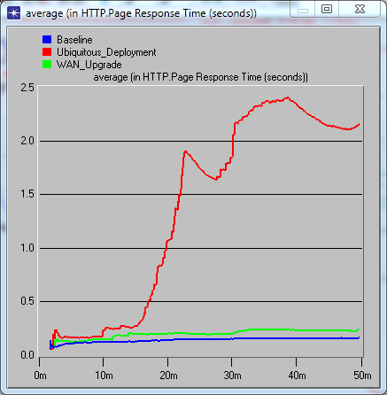
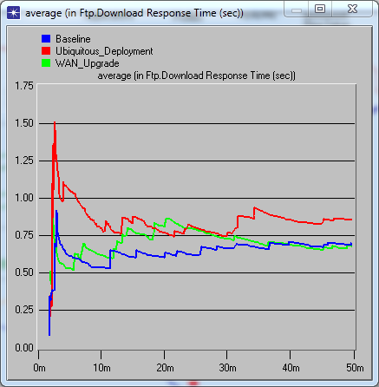
Upgrade comparison
HTTP page response time
FTP download response time

Slide 17
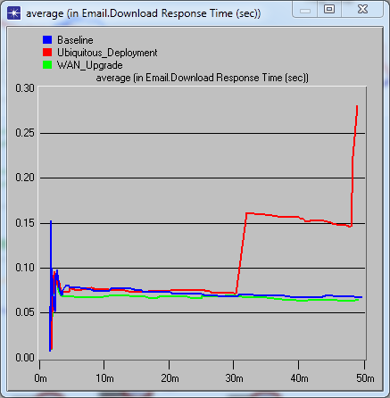
Upgrade WAN Email Comparison
Email download
Average email download

