Slide 1
Test Flight Setup
for OVSC iOS mobile application testing

Slide 2
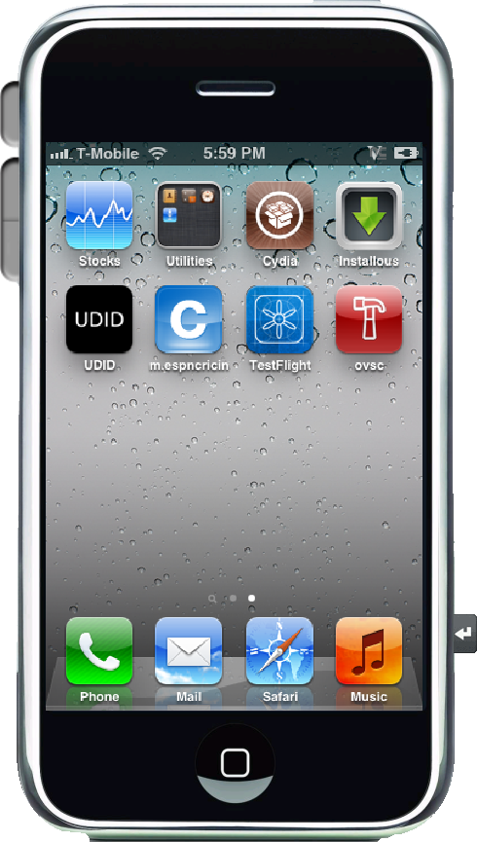
Setup for Testing
In order to install the application on an iOS device, each device’s unique id (UDID) needs to be listed in a provisioning file by the development team.
This allows the application to be distributed outside the Apple App Store for testing purposes.
You will send the UDID to:
____________________________

Slide 3

Acquiring the UDID-2 Options
Using iTunes
UDID Sender
Connect your device to a computer that has iTunes installed.
Click on this device under Devices in iTunes
Click on serial number and the UDID will display
Place the curser on UDID and click ctrl-C.
Ctrl-V to paste the UDID into a document for the development team.
In the App Store search for UDID Sender and install the free application
This will pull the UDID from the phone to send to the development team.
There are many of these applications.
UDID Sender was used in testing.

Slide 4
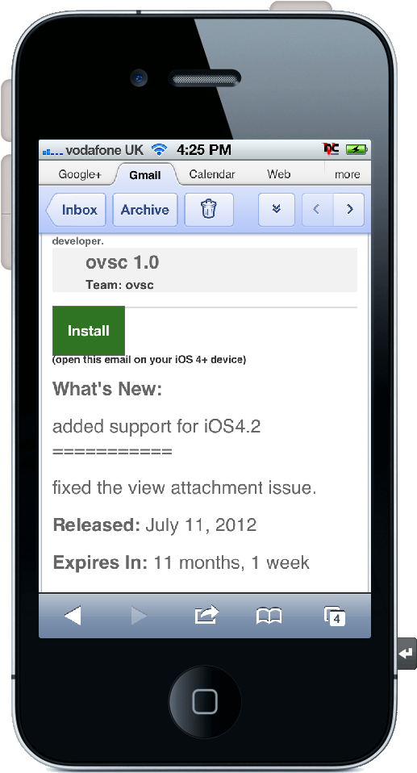
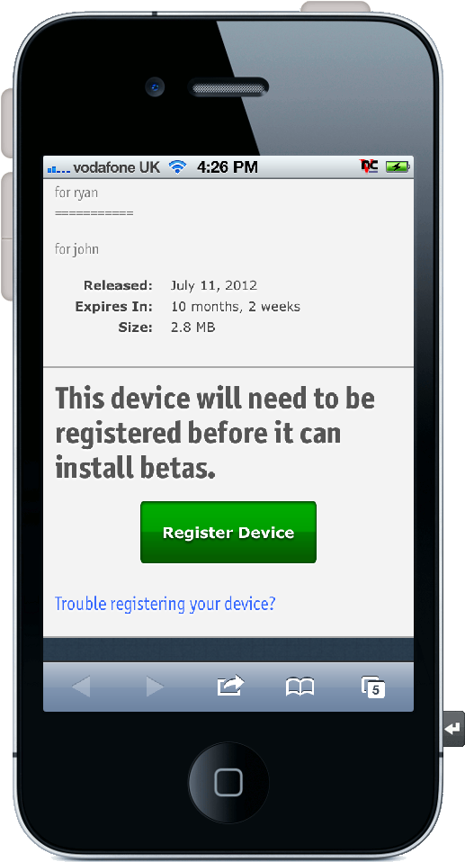
If you are testing OVSC mobile, you will receive an email with an Install button for Test Flight.
After clicking Install, you will be asked to Register Device. This sends your device information to Test Flight for OVSC distribution.

Slide 5
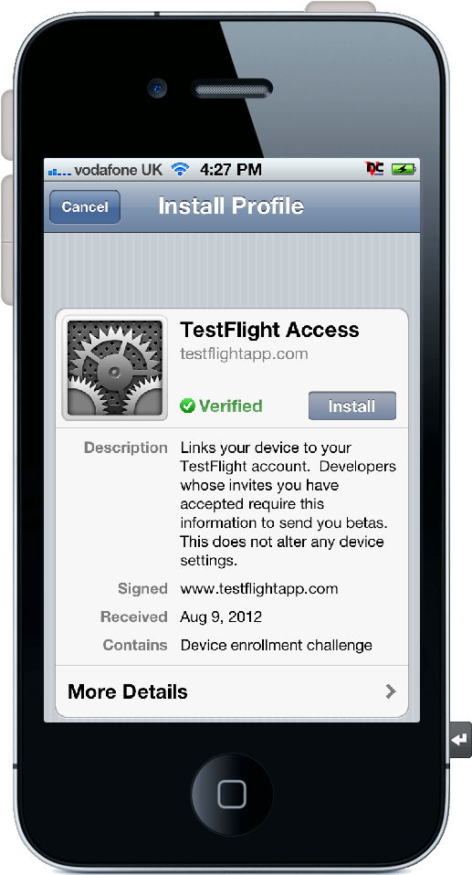
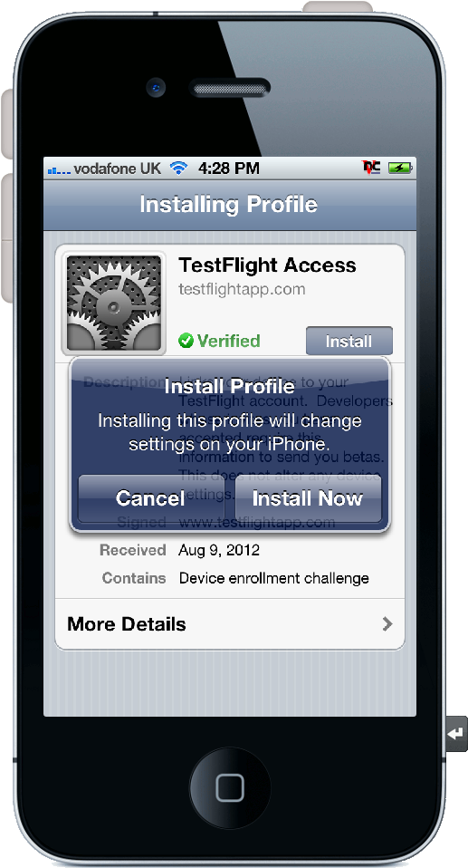
You will be asked to install Test Flight Access. This is the distribution method for OVSC. Click Install.
It requires a few clicks…

Slide 6
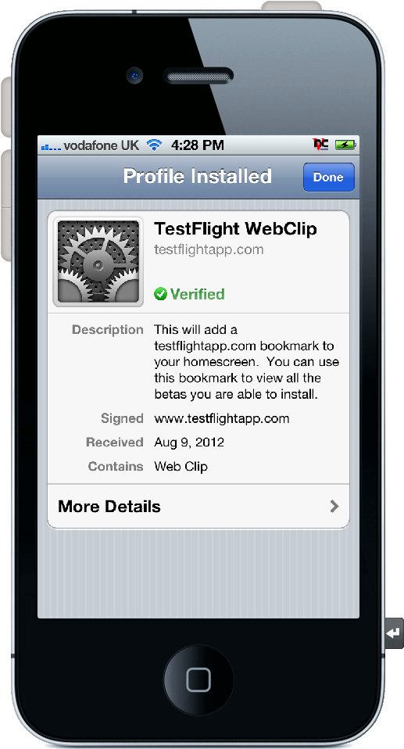
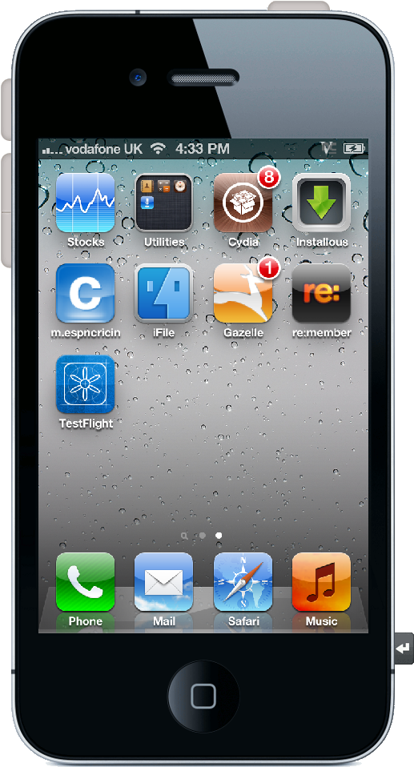
The Test Flight profile will be installed on your mobile device. Click Done to exit.
The Test Flight icon will be placed on your home screen. Here you will have access to new builds of the application as they are released. Click here to get OVSC mobile.

Slide 7
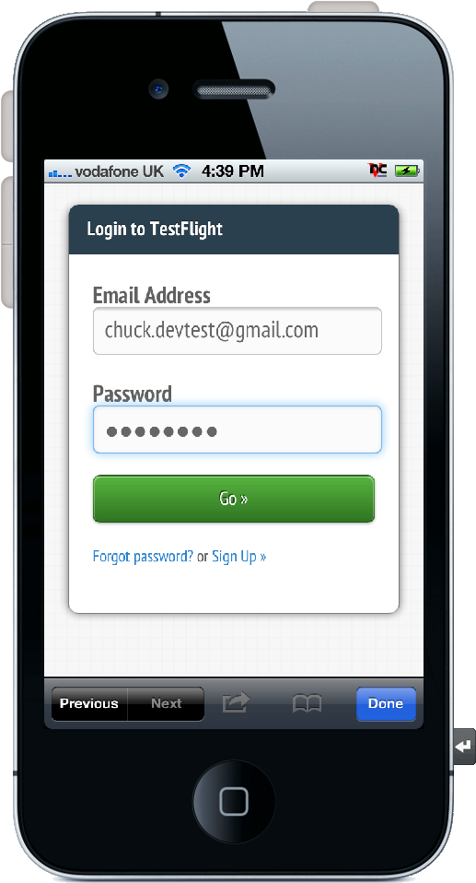
To receive updates and register with Test Flight, click Sign Up to create a username and password. You should only need to enter this once per device.
If you add a different device later, sign in with your username and password.
Press Go to log in.

Slide 8
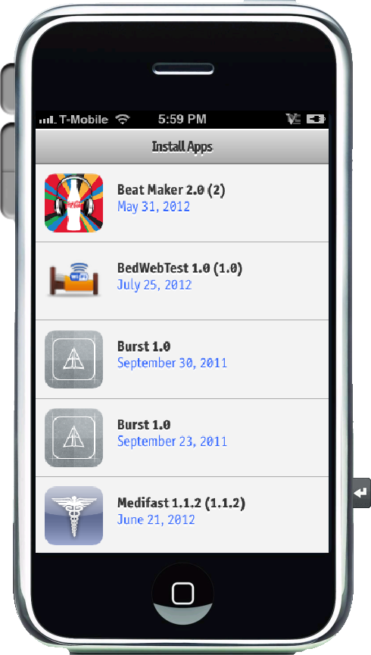
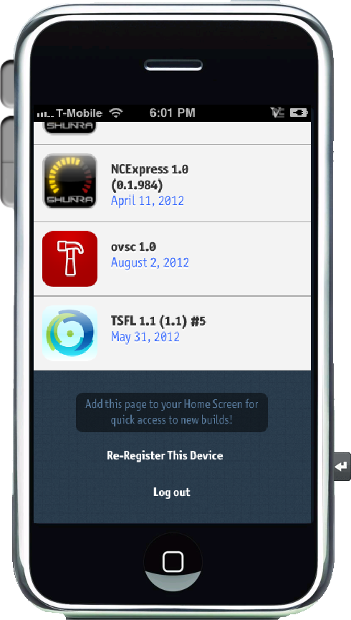
You will see a list of applications available for testing. Scroll down until you see the OVSC icon, and select it.

Slide 9
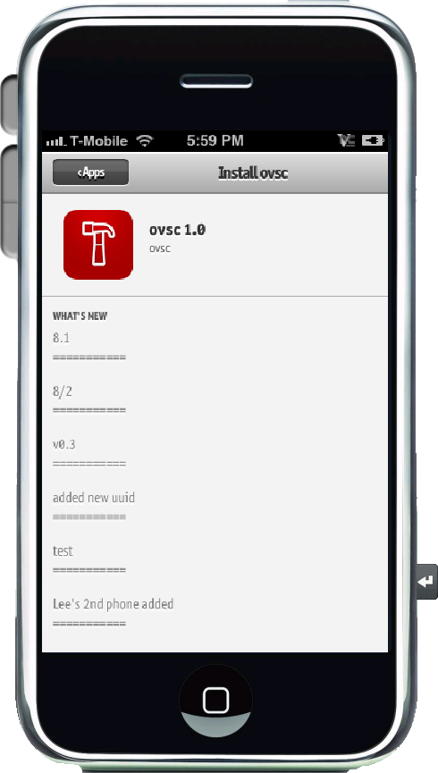
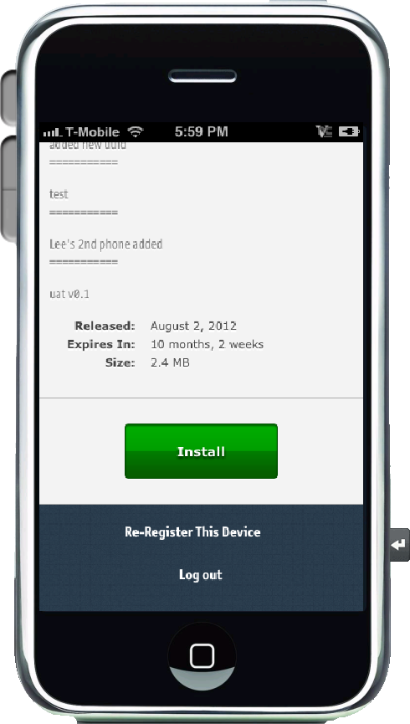
The installation page will display. Scroll to the bottom and press the Install button.

Slide 10
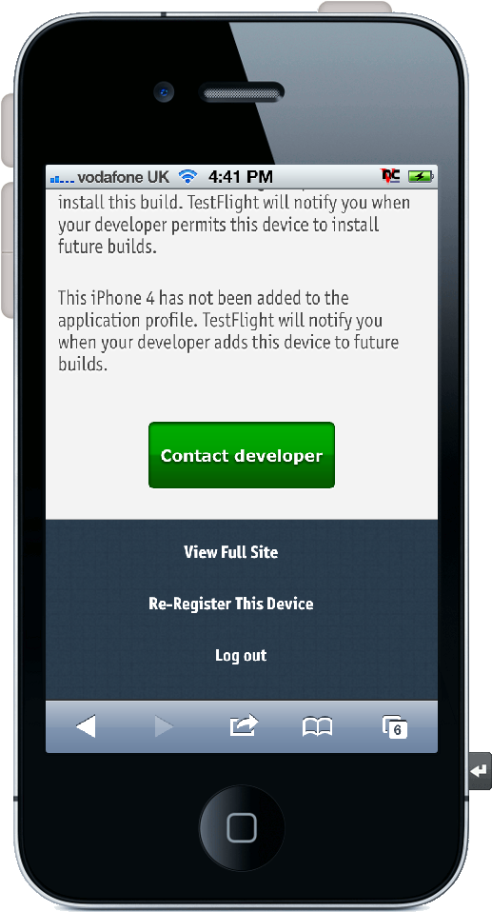
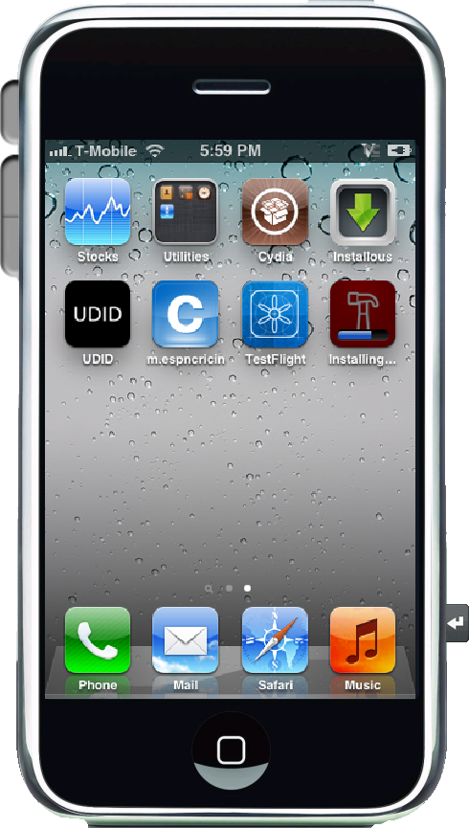
Until your phone’s unique information is added to the provisioning list by the development team, you may see this message.
After your phone has been provisioned, the green Install button downloads the latest version of OVSC mobile.

Slide 11
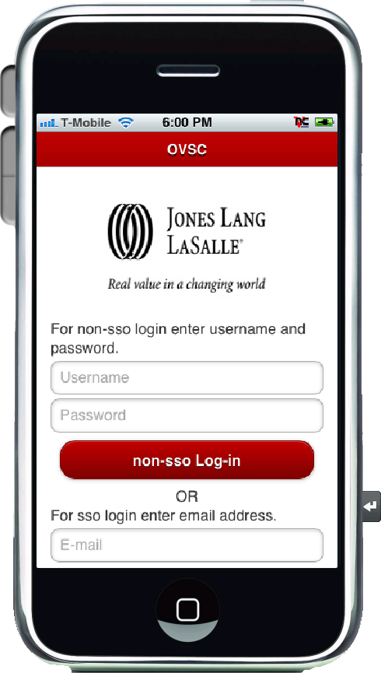
The OVSC app icon will display on the home screen. You may want to keep both icons for easy access to the latest OVSC release through Test Flight.
Tapping the OVSC icon opens the app for your first use.
Welcome to OVSC mobile beta testing!

