Slide 1
Chapter 5. Network and Transport Layers
Business Data Communications and Networking Fitzgerald and Dennis

Slide 2
Chapter 5. Learning Objectives
Be aware of four transport/network layer protocols
Be familiar with packetizing and linking to the application layer
Be familiar with addressing
Be familiar with routing
Understand how TCP/IP works

Slide 3
Chapter 5. Outline
Introduction
Transport and Network Layer Protocols
  TCP/IP, IPX/SPX, X.25, Systems Network Architecture
Transport Layer Functions
  Linking to the Application Layer, Packetizing
  Addressing
    Assigning Addresses, Address Resolution
  Routing
    Types of Routing, Routing Protocols, Multicasting
TCP/IP Example
  Known Addresses + Same Subnet, Known Addresses + Different Subnet, Unknown Addresses, TCP Connections

Slide 4
Introduction

Slide 5
Introduction: The Network and Transport Layers
The transport layer is responsible for end-to-end delivery of messages. Therefore, it ensures complete data transfer.
The transport layer sets up virtual circuits (when needed) and is also responsible for segmentation/packetization (breaking the message into several smaller pieces) at the sending end and reassembly (reconstructing the original message into a single whole) at the receiving end.
The network layer is responsible for addressing and routing of the message.
The network and transport layers also perform encapsulation of message segments from the application layer, passing them down to the data link layer on the sending end and passing them up to the application layer on the receiving end (see Figure 5-1).
Notes:
Transport layer sets up a virtual circuit and verifies that a channel is open
Network layer

Slide 6
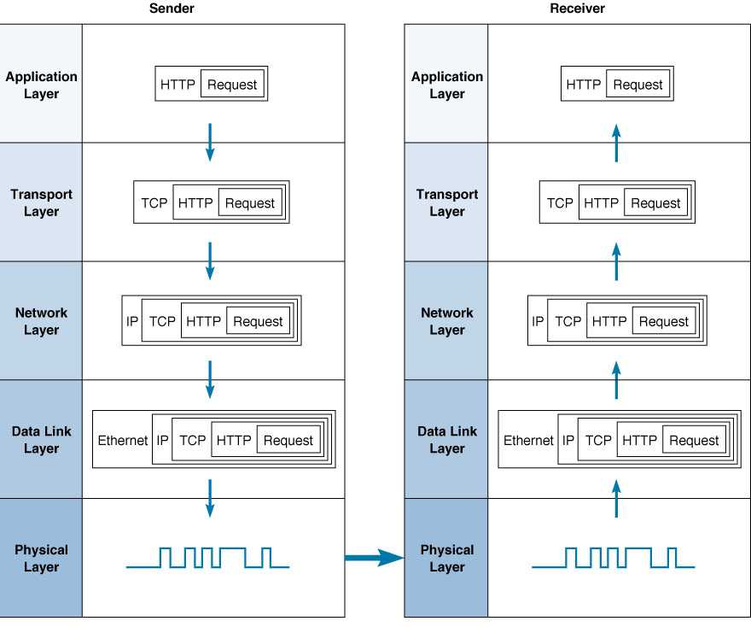
Figure 5-1 TCP/IP’s 5-Layer Network Model

Slide 7
Transport and Network Layer Protocols

Slide 8
Transport and Network Layer Protocols
The following are commonly used protocol suites:
  TCP/IP
  IPX/SPX
  X.25
  SNA

Slide 9
Transmission Control Protocol/Internet Protocol (TCP/IP)
Developed in 1974 by Vint Cerf and Bob Kahn, as part of Arpanet, for the U.S. Department of Defense .
TCP/IP is the protocol used by the Internet.
Almost 70% of all backbone, metropolitan, and wide area networks use TCP/IP.
In 1998, TCP/IP surpassed IPX/SPX to become the most common protocol on local area networks.

Slide 10
Transmission Control Protocol (Figure 5-2)
Need to be active only at the sender and the receiver
TCP performs segmentation, that is creating smaller portions of data called TCP segments, numbering these segments and reassembling them at the destination end of the transmission.
TCP segments are encapsulated into IP packets
TCP also ensures that the segments are reliably delivered.
TCP segments have a 192 bit (24 byte) of control information.
Header fields include: source and destination port identifiers and a packet sequence number used in message reassembly.

Slide 11
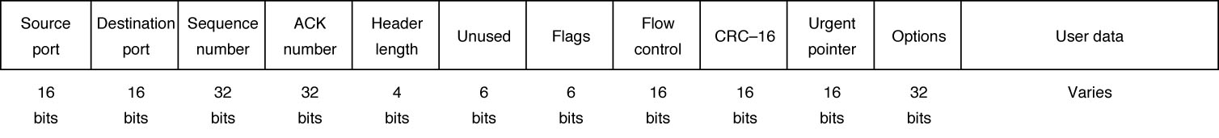
Figure 5-2 TCP Segment
Let’s see how it works: TCP 3-way handshake http://www.youtube.com/watch?v=FdwNzb1CQPg&feature=related

Slide 12
Internet Protocol (Figures 5-3 and 5-4)
Is the network layer protocol
IP software is used at each intervening computer through which the message passes
TCP segments are encapsulated into IP packets
IP is responsible for addressing and routing of data packets.
Two versions in current in use: IPv4 & IPv6.
IPv4: a 192 bit (24 byte) header, uses 32 bit addresses.
IPv6: 320 bit (40 byte) header. Mainly developed to increase IP address space due to the huge growth in Internet usage during the 1990s.
IPv6 uses 128 bit addresses.
Header fields include: source and destination addresses, packet length and packet number.

Slide 13
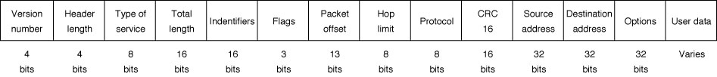
Figure 5-3 IP Packet (version 4)

Slide 14
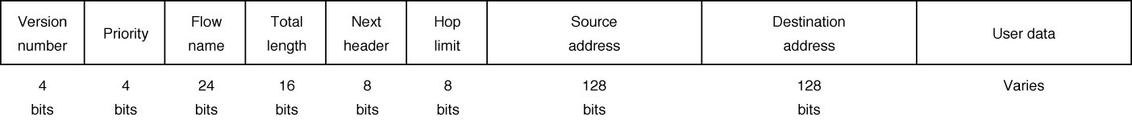
Figure 5-4 IP Packet (version 6)
1. Let’s see how it works with finding the location of a host go to dos prompt and tracert “url” then get IP address and find its location at www.ip-adress.com/ipaddresstolocation
2. Check out what your IP address is at www.cmyip.com
3. Check out how to hide/change your IP address at www.torproject.org

Slide 15
Internetwork Packet Exchange/Sequenced Packet Exchange (IPX/SPX)
Developed by Xerox during the 1970s, IPX/SPX today is mainly used by Novell networks (Novell has since replaced it with TCP/IP).
Similar to TCP/IP:
  SPX performs transport layer functions: packetization, packet numbering, ensuring reliable delivery and packet reassembly.
  IPX performs network layer functions: addressing and routing.
Notes:
Analogy between ipx spx and on test.

Slide 16
X.25
Developed by ITU-T for use in wide area networks.
Seldom used in North America, but has been widely used in other parts of the world, especially in Europe.
X.25 transport layer protocol, called X.3, performs packetization.
Packet Layer Protocol (PLP) is the network layer protocol. It performs routing and addressing.
*LAP-B is usually used as the data link layer protocol. (* is a linked access procedure balance- is a bit-oriented protocol derived from HDLC)
ITU recommends packet size of 128 bytes but X.25 can support packet sizes up to 1024 bytes.
Notes:
Europe tcp/ip.

Slide 17
Systems Network Architecture (SNA)
Developed by IBM in 1974 and used on IBM and IBM-compatible mainframes (such as Amdahl mainframes).
Based on non-standard proprietary protocols, so it is difficult to integrate with non-SNA networks.
Routing message between SNA and non-SNA networks requires special equipment (gateways).
IBM now offers TCP/IP on its networks, so SNA will likely disappear over time.

Slide 18
Transport Layer Functions

Slide 19
Linking to the Application Layer
An important transport layer job is knowing which application layer program to send a message to. This is done using source and destination port numbers, located in the first two TCP header fields.
Applications sending outgoing messages give TCP both port numbers. Incoming messages also provide port numbers.
Port addresses are 2-bytes long. Usually, standard port numbers are used:
  Web servers use port number 80
  FTP servers use port number 21
  Telnet, port number 23
  SMTP uses port 25
Nonstandard port numbers are also possible, but TCP must be specially configured to use them.

Slide 20
Packetization and Reassembly
The application layer sees message as a single block (or stream) of data.
Another transport layer job is breaking large messages into smaller pieces that are encapsulated as IP packets (packetization) and putting them back together at the destination (reassembly).
The transport layer also decides whether to deliver the incoming packets as they arrive (as with the Web pages) or to wait until the entire message arrives (as with e-mail).

Slide 21
Connection-Oriented Routing
TCP also handles end-to-end routing, such as setting up a virtual circuit (called connection-oriented routing).
Sending data on a virtual circuit means all packets in a message follow the same route from source to destination.
The first step in creating a virtual circuit is for the sender to send a special SYN packet, which requests the virtual circuit and negotiates with the receiver over what packet size to use.
Following this, the packets are sent one by one in order from source to destination using the continuous ARQ technique.
Finally, a special FIN packet is sent by TCP to close the virtual circuit.
HTTP, SMTP, FTP and Telnet all use TCP-based connection-oriented routing.
Notes:
Co routing tcp
Coless routing udp

Slide 22
Connectionless Routing using UDP
Sending packets individually without using a virtual circuit is called connectionless routing.
Each packet is sent independently of one another, routed separately and can follow different routes and arrive at different times.
With the TCP/IP, the protocol used for connectionless routing is called User Datagram Protocol (UDP).
UDP uses only a small packet header (only 8 bytes) that contains only four fields (source port, destination port, message length and header checksum).
UDP is commonly used for control messages that are usually small, such as DNS, DHCP, RIP and SNMP (see text for details on these).

Slide 23
Quality of Service
Some applications, especially real time applications (e.g., voice and video frames), require packets be delivered within a certain period of time in order to produce a smooth, continuous output (e-mail doesn’t require this).
The timely delivery of packets is called quality of service (QoS). QoS routing defines classes of service, each with a different priority:
  Real-time applications get the highest priority
  a graphical file for a Web page gets a lower priority
  E-mail gets the lowest priority (since it can wait a relatively long time before being delivered).

Slide 24
Quality of Service Protocols
Asynchronous Transfer Mode (ATM) is a high-speed data link layer protocol that includes QoS.
The TCP/IP protocol suite also includes protocols that use QoS routing capability permitting applications to request connections with minimum data transfer rates including:
  Resource Reservation Protocol (RSVP), a general purpose real-time application layer protocol
  Real-Time Streaming Protocol (RTSP) for audio-video applications
In both cases, the application first establishes a virtual connection and then uses the Real-Time Transport Protocol (RTP), which adds a sequence number and a timestamp before sending the packets.
Because of its small header, RTP uses UDP as its transport layer protocol to send real-time packets.

Slide 25
Addressing

Slide 26
Assigning Addresses (Figure 5-6)
The Internet uses three kinds of addresses:
  Application layer addresses are assigned by network managers and placed in configuration files. Some servers have more than one application layer address.
  Network layer addresses (IP addresses) are also assigned by network managers, or by programs such as DHCP, and placed in configuration files. Every network on the Internet is assigned a range of possible IP addresses for use on its network.
  Data link layer addresses are hardware addresses placed on network interface cards by their manufacturers
Servers have permanent addresses, clients usually do not.
For a message to travel from sender to receiver, these addresses must be translated from one type to another. This process is called address resolution.

Slide 27
Figure 5-6 Types of network addresses
Address Type
Example Software
Example Address
Application Layer
Web Browser
www.kelley.indiana.edu
Network Layer
IP
129.79.127.4
Data Link Layer
Ethernet
00-0C-00-F5-03-5A

Slide 28
Internet Addresses
ICANN (Internet Corporation for Assigned Names and Numbers) manages the assignment of both IP and application layer name space, both directly and through authorized registrars around the world.
ICANN manages some domains directly (e.g., .com, .org, .net) and authorizes private companies to become domain name registrars in other countries (e.g., .ca, .uk, .hk)
Application layer and network layer addresses are assigned at the same time and in groups.
For example, Indiana University uses application layer addresses that end in .indiana.edu and iu.edu and uses IP addresses in the 129.79.x.x range (where x is any number between 0 and 255).

Slide 29
IPv4 Addresses
IPv4, uses 4 byte (32 bit) addresses which are really strings of 32 binary bits.
To make IP addresses easier to understand for human readers, dotted decimal notation is used.
Dotted decimal notation breaks the address into four bytes and writes the digital equivalent for each byte.
An example of an IP address in dotted decimal notation would be: 128.192.56.1

Slide 30
The Need for IPv6 Addressing
IP addresses are often assigned in groups. IPv4’s 4 byte addresses correspond to a total of one billion possible addresses.
Because IP addresses have been allocated in very large groups, giving out many numbers at a time, IPv4 address space has been used up quickly.
For example, Indiana University was allocated a Class A IP address space which includes 65,000 addresses, many more than the university needed.
IPv6 uses 16 byte addresses, so there are 3.2 x 10³⁸ addresses, a very large number. There is little chance the huge IPv6 address space will ever be used up.

Slide 31
Subnets
Computers on the same LAN are usually given IP numbers with the same prefix, called a subnet. For example:
  Computers in a University’s Business school might be given addresses in the range: 128.192.56.x (where x is between 0 & 255)
  While the Computer Science IP addresses could be: 128.192.55.x
The above subnets are 128.192.56.x and 128.192.55.x, respectively. Subnets can also be assigned addresses that are more or less than eight bits in length.
If 7 bits were used for a subnet, one subnet could have a range of 128.184.55.1-128 and the other 128.184.55.129-255.
Subnet masks are used to make it easier to separate the subnet part of the address from the host part. In the above example, the subnet mask would be: 255.255.255.128 or, in binary:
11111111.11111111.11111111.10000000

Slide 32
Dynamic Addressing
In order to efficiently use their IP address space, networks no longer give fixed addresses to clients.
Instead, they use dynamic addressing, giving addresses to clients only when they are logged in to a network.
A small ISP, for example, might only need to assign 500 IP addresses to clients at any one time, even though it has several thousands subscribers.
Two programs are currently in use for this: bootp and Dynamic Host Control Protocol (DHCP).
Instead of having the IP address typed into a configuration file, a client instead broadcasts a message requesting an IP address when it is turned on or connected.
IP addresses can also be assigned with a time limit in which case the clients must send a new request for an IP address when the time limit expires.

Slide 33
Server Name Resolution
The first step in sending a message from a client is to translate the destination host’s domain name to its corresponding IP address (say, www.yahoo.com into 204.71.200.74)
If the desired IP address is not in the client’s address table, it uses the Domain Name Service (DNS) to resolve the address.
DNS works through a group of name servers that maintain databases which contain directories of domain names and their corresponding IP addresses.
Large organizations maintain their own name servers, but smaller ones use name servers provided by their ISPs.

Slide 34
Domain Name Service (Figure 5-7)
When a computer needs to translate a domain name, it sends a UDP packet to its local DNS server.
That computer either responds by sending a UDP packet back to the client or, if it still doesn’t know the IP address, it sends another UDP packet to the next highest name server in the DNS hierarchy.
The higher level is usually the DNS server at the top level domain (such as the DNS server for all .edu domains).
If the name server also doesn’t know the IP address, it sends another UDP packet ahead to another name server, often at the next lower level of the DNS hierarchy.
This is called recursive DNS resolution. Figure 5-7 shows a case of recursive server name resolution for a server at Indiana University from a client on the University of Toronto network.

Slide 35
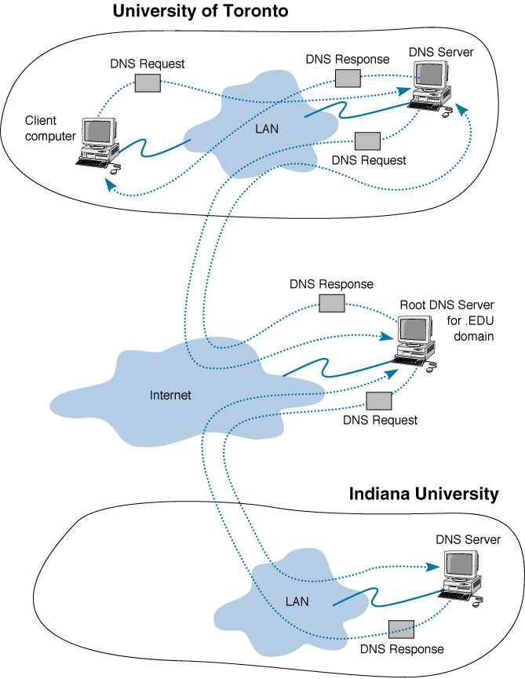
Figure 5-7 How DNS Works

Slide 36
Data Link Layer Address Resolution
As a message moves across the Internet, it travels from one network segment to another. On each of these segments, it uses data link layer addresses to travel from source to destination.
When a data link layer destination address is not known, the Address Resolution Protocol (ARP) is used to find it.
ARP works by broadcasting a message to all computers on a local area network asking which computer has a certain IP address. The host with that address then responds to the ARP broadcast message, sending back its data link layer address.
The sender then stores this data link layer address in its address table and sends its message to the destination host.

Slide 37
Routing

Slide 38
Routing
Routing is the process of deciding what path to have a packet take through a network from sender to receiver (Figure 5-8).
More than one route may be possible, so computers and devices that perform routing must keep tables to make decisions about which path to send packets on to reach a given destination (Figure 5-9).
Routing decisions on the Internet are usually handled by special purpose devices, called routers, that maintain their own routing tables.

Slide 39
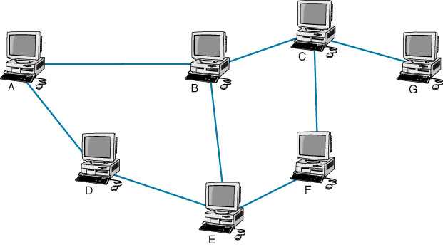
Figure 5-8 Routing Example

Slide 40
Figure 5-9 Example of a Routing Table
Destination Host Next Hop
A A
C C
D A
E E
F E
G C
Notes:
Table is computer B on the previous page!

Slide 41
How to Analyze an actual Routing table output
http://www.youtube.com/watch?v=Qoe8jvpOQhY&feature=related

Slide 42
Types of Routing
With centralized routing, routing decisions are made by one central computer. Centralized routing can be found on small, mainframe-based networks.
The Internet uses decentralized routing in which computers making routing decisions operate independently of one another (although they do need to exchange information).
Decentralized routing has two types:
  Static routing, which tends to be used on relatively simple networks, uses fixed routing tables which are developed by network managers.
  Dynamic routing, in which routing decisions are made dynamically, is based on routing condition information exchanged between routing devices.
Notes:
On exam!

Slide 43
Dynamic Routing Algorithms
To date, there have been two important routing algorithms:
  Distance Vector which uses the least number of hops to decide how to route a packet
  Link State which uses a variety of information types and takes into account such factors as congestion and response time to decide how to route a packet.
Because of its more sophisticated approach, link state routing algorithms have become more popular than distance vector algorithms.

Slide 44
Routing Protocols (Figure 5-11)
Routing algorithms are implemented using routing protocols that can be either interior or exterior.
Exterior routing protocols are those operating outside of or between networks. Because there are many more possible routes, exterior routing is far more complex than interior routing. Thus, exterior routing protocols can’t maintain tables of every single route and have to concentrate instead on the main routes only.
Border Gateway Protocol (BGP): exterior routing protocol used on the Internet.
Routing protocols that operate within a network (called an autonomous system) are called interior routing protocols.
Notes:
On test

Slide 45
Interior Routing Protocols
Routing Information Protocol (RIP): is a dynamic distance vector interior routing protocol commonly used on the Internet.
  Computers using RIP broadcast routing tables every minute or so.
  Now used on simpler networks.
Open Shortest Path First (OSPF): another dynamic interior routing protocol commonly used on the Internet using the link state algorithm.
  OSPF has overtaken RIP as the most popular interior routing protocol on the Internet because of OSPF’s ability to incorporate traffic and error rate measures in its routing decisions.
  OSPF is also less burdensome to the network since it sends updates, not entire routing tables, and only to other routers, rather than broadcasting them.
Enhanced Interior Gateway Routing Protocol (EIGRP): is another dynamic link state interior routing protocol developed by Cisco.
  EIGRP records a route’s transmission capacity, delay time, reliability and load.
  The protocol keeps the routing tables for its neighbors and uses this information in its routing decisions as well.

Slide 46
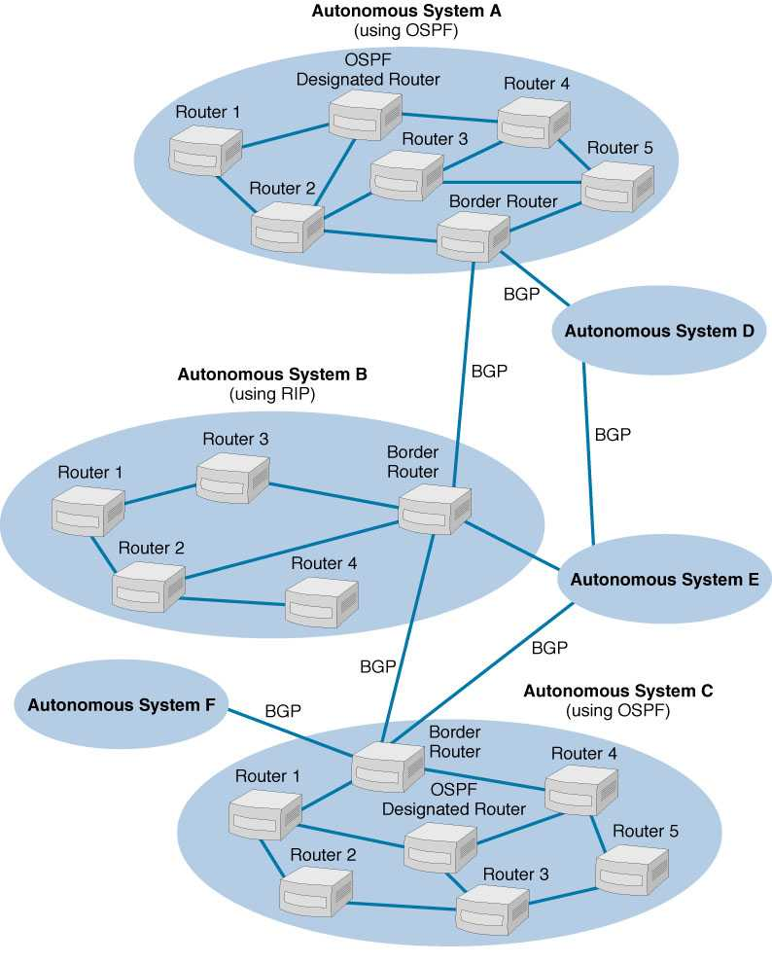
Figure 5-11 Internet Routing using BGP, OSPF and RIP

Slide 47
TCP/IP Example

Slide 48
Sending Messages using TCP/IP
Every computer using TCP/IP must have four kinds of network layer addressing information before it can operate:
  1. The computer’s own IP address
  2. Its subnet mask, so it can determine what addresses are part of its subnet.
  3. The local DNS server’s IP address, so it can translate application layer addresses into IP addresses
  4. The IP address of the router on its subnet, so it knows where to route messages going outside of its subnet
This information is obtained by the computer from a configuration file or given to it by a DHCP server.
Servers also need to know their own application layer addresses (domain names).

Slide 49
TCP/IP Example (Figure 5-12)
Figure 5-12 shows a simple, four LAN network connected together with a backbone network:
  Building A’s subnet address is 128.192.98.x
  Building B’s subnet address is 128.192.95.x
  The backbone’s subnet address is 128.192.254.x
  The backbone has the DNS server
  The backbone also has the gateway router connecting the network to the Internet.
Three possible cases of HTTP requests are:
  1. A Known Address, Same Subnet
  2. A Known Address, Different Subnet
  3. An Unknown Address

Slide 50
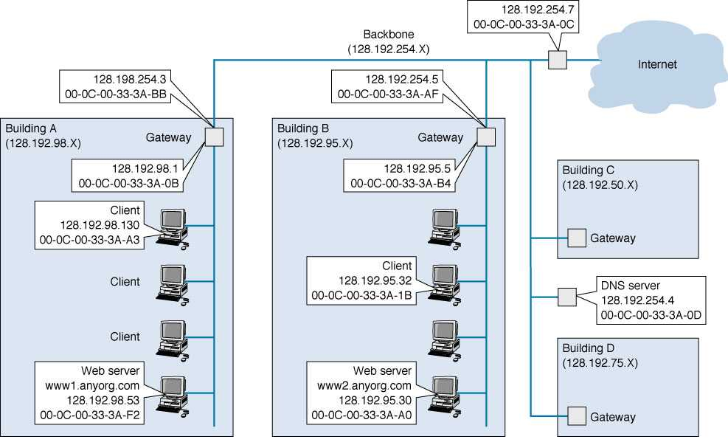
Figure 5-12 TCP/IP Network Example

Slide 51
Case 1a: An HTTP request to a known address on the same subnet
A client (128.192.98.130) requests a Web page from the Web server (www1.anyorg.com) on its subnet, and the client knows the server’s network and data link addresses.
The client’s application layer program (Web browser) first passes the HTTP packet to the transport layer (TCP).
TCP then places the HTTP packet into a TCP packet and sends it on to the network layer (IP).
IP then places the TCP packet into an IP packet, adding the destination IP address, 128.192.98.53.
IP also uses its subnet mask to compare the destination address with its own and sees that the destination is on the same subnet as itself.
IP passes the IP packet to the data link layer, which adds the server’s Ethernet address into its destination address field, and sends the Ethernet frame to the Web server.

Slide 52
Case 1b: An HTTP response to a client on the same subnet
The Web server receives the Ethernet frame, performs error checking and sends back an ACK.
The incoming frame is then successively processed by the data link, network, transport and application layers until the HTTP request emerges and is processed by the Web server.
The Web server sends back an HTTP response which includes the requested Web page.
The outgoing HTTP response is then processed, with each layer adding it’s header until an Ethernet frame is created and sent back to the client.
The incoming message is then processed by each successive layer of the client’s protocol stack until the incoming HTTP request emerges and is processed by the Web browser.

Slide 53
Case 2: Known Address, Different Subnet
The first part of sending an HTTP request to a destination on a different subnet is the same as Case 1.
The first difference occurs when the network layer program compares the destination address with its subnet mask and sees it is on a different subnet.
Outgoing frames are sent to the local subnet’s gateway router which connects the subnet to the backbone.
When the gateway receives the outgoing frame, it removes the Ethernet header. It then examines the destination IP address against its routing table, makes a new Ethernet frame and sends it to the destination subnet’s gateway.
The destination subnet’s gateway receives the frame, looks at its destination IP address, places the IP packet in a new Ethernet frame and sends it to its final destination.

Slide 54
Case 3: Unknown Address
Sending a packet to an unknown address means first determining the destination IP address. DNS does this.
The sending host first sends a UDP packet to the local DNS server.
If the local DNS server knows the destination host’s IP address, it sends a DNS response back to the sending host.
If it doesn’t, it sends a second UDP packet to the next highest DNS host, and so on, until the destination host’s IP address is determined (see DNS discussion & Figure 5-7).
Once the destination IP address has been determined, the process of sending the packet to its destination becomes the same as in the Known Address, Different Subnet case.

Slide 55
End of Chapter 5

