Slide 1
Hospital Management System
Presented By:-
Dipesh Thokar
Ojaswi Shiwakoti
Sushil Gautam

Slide 2
1. Introduction
A hospital management system is a computer system
management of health-care information and the work completion of health-care providers
oversee data from all areas of healthcare, doctor and patience ID, so on.

Slide 3
3. Objective
To reduce paper work
Automate hospital day to day work
ensuring data integrity and reducing inconsistencies.
Proper data management

Slide 4
4. Project Modules
• Administration
• Reception
• Registration

Slide 5
4.1 Administration
This module handles all the master entry details
Add, Delete patient, doctor and receptionist
Make appointment

Slide 6
4.2 Reception
The reception module handles various enquiries about the patient's admission and discharge
Doctor Appointment Scheduling
Enquiry of Patient
Find History of Patient Enquired.

Slide 7
4.3 Registration
This module helps in registering information about patients and handling both IPD and OPD patient’s query
A unique ID is generated for each patient after registration
This helps in implementing customer relationship management and maintains medical history of the patient

Slide 8
5. System Specifications
Hardware Requirements
Software Requirements

Slide 9
5.1. Hardware Requirements
Pentium-IV(Processor).
• 256 MB Ram
• 512 KB Cache Memory
• Hard disk 10 GB
• Microsoft Compatible 101 or more Keyboard

Slide 10
5.2. Software Requirements
Operating System: Windows
• Programming language: Java
• Web-Technology: JSP, Servlet, Html, CSS
• Front-End: HTML, JSP
• Back-End: Java, servlet, JDBC
• Web Server: Apache tomcat

Slide 11
6. Analysis
Existing System
Proposed System
Objective of the System

Slide 12
6.1. Existing System
Hospitals currently use a manual system for the management and maintenance of critical information

Slide 13
6.2. Proposed System
The Hospital Management System (HMS) is designed for Any Hospital to replace their existing manual, paper-based system
The new system is to control the following information: patient information, room availability, staff and operating room schedules, and patient invoices

Slide 14
6.3. Objective of the System
To reduce paper work
Automate hospital day to day work
ensuring data integrity and reducing inconsistencies.
Proper data management

Slide 15
7. System Design
Use Case Diagram
Class Diagram
ER diagram
System architecture

Slide 16
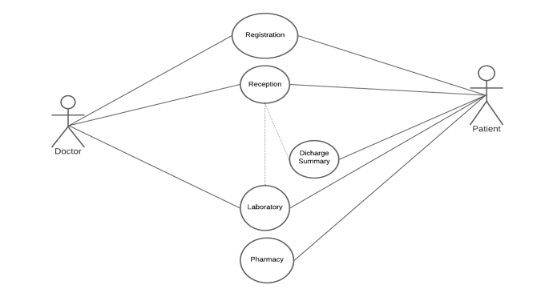
7.1. Use Case Diagram

Slide 17
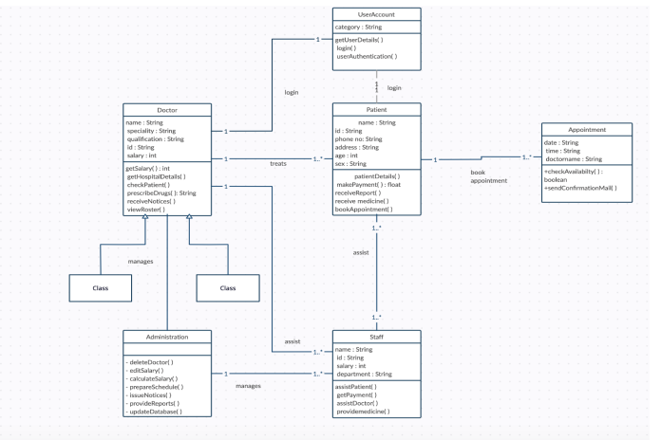
7.2. Class Diagram

Slide 18
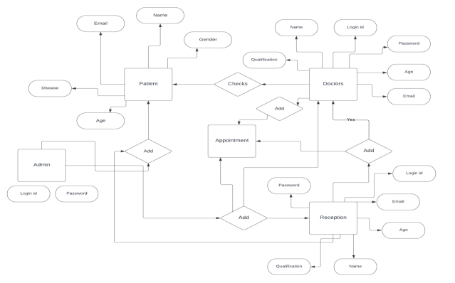
7.3. ER diagram

Slide 19
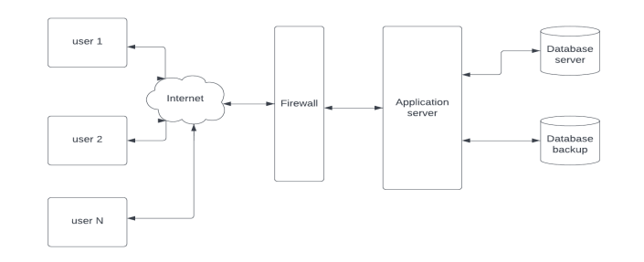
7.4. System architecture

Slide 20
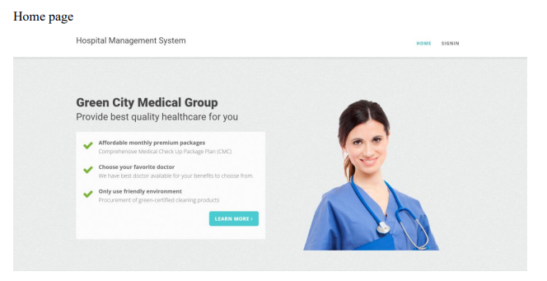
8. User Manua

Slide 21
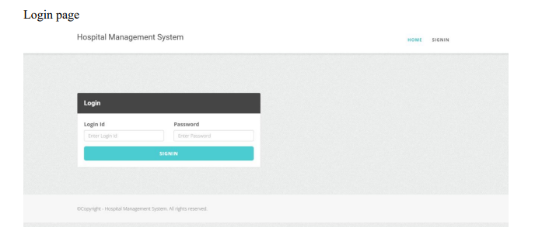
Continued…….

Slide 22
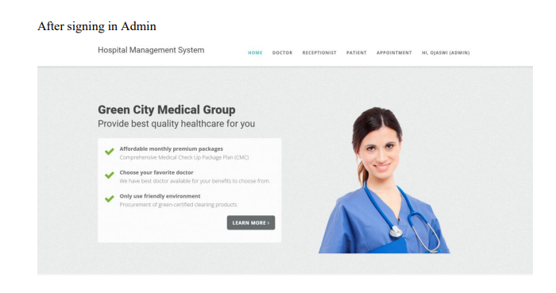
Continued…….

Slide 23
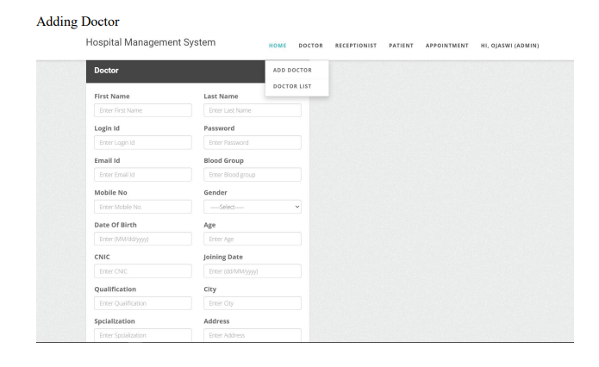
Continued…….

Slide 24
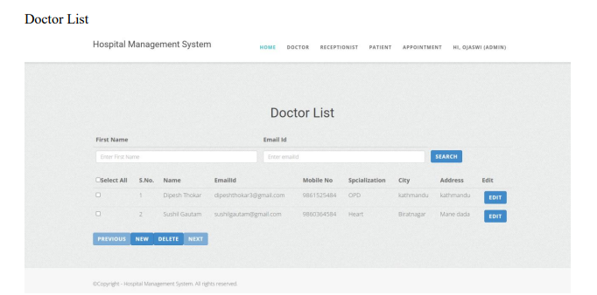
Continued…….

Slide 25
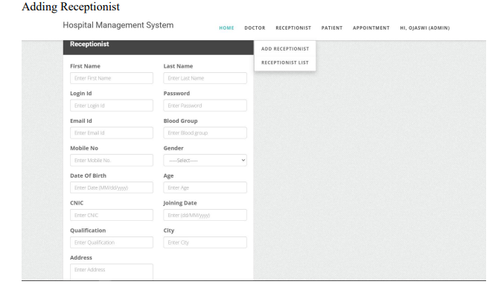
Continued…….

Slide 26
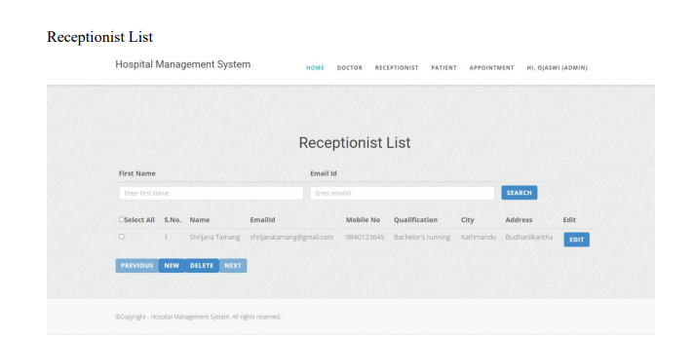
Continued…….

Slide 27
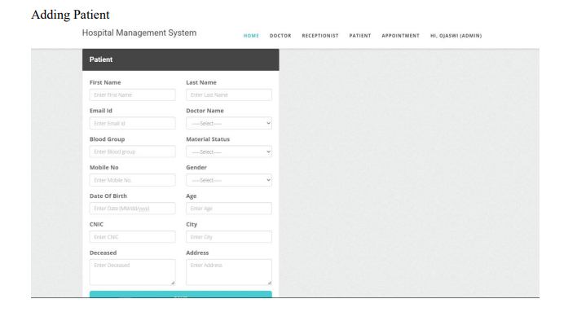
Continued…….

Slide 28
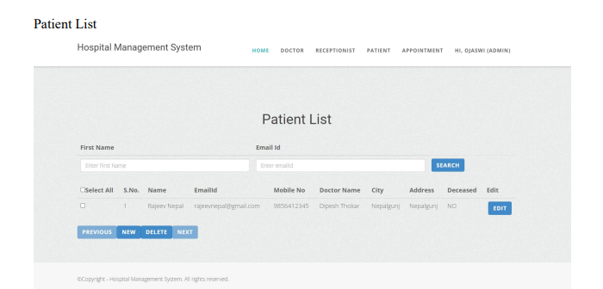
Continued…….

Slide 29
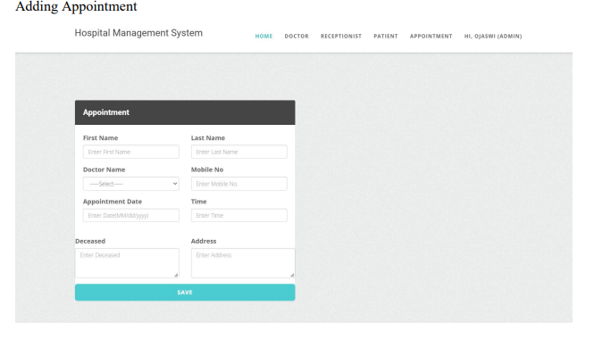
Continued…….

Slide 30
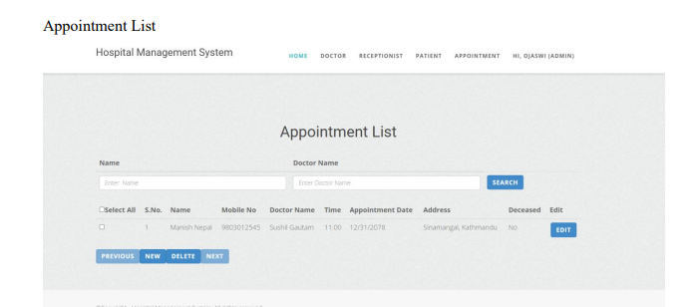
Continued…….

Slide 31
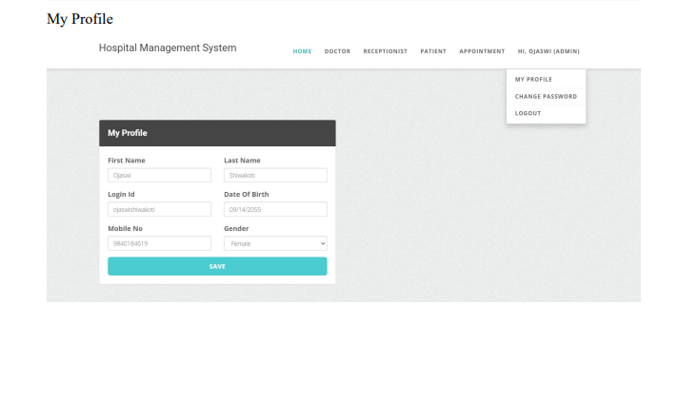
Continued…….

Slide 32
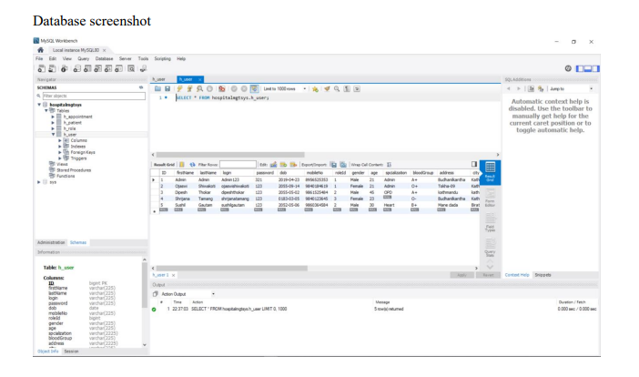
9. Database

Slide 33
10. Testing
Carried out in 3 phases
The first includes unit testing
The second step includes Integration testing
The final step involves validation and testing

Slide 34
18. Conclusion
The package was designed in such a way that future modifications can be done easily
Automation of the entire system improves the efficiency
provides a friendly graphical user interface
It gives appropriate access to the authorized users depending on their permissions
System security, data security and reliability are the striking features

