Slide 1
A Scalable Content-Addressable Network
——Haocheng Xu
Tianpeng Xia
Notes:
Good morning everyone, today we want to share the things that we learned in this paper: A Scalable Content-Addressable Networkd. I am tianpeng, and this is my partner haochen.

Slide 2

Outline
1. Background
2. What is CAN
3. Vanilla Design
4. Improvements
5. Design Review
6. Related Work
7.Discussion
Notes:
I am going to introduce the first 4 topics. Then Haochen will talk about the remaining content.

Slide 3
1. Background
What we had *then*?
Napster
Gnutella
…
Notes:
First I would like to talk about the background where CAN was invented.
There were already some other p2p systems out there, among witch Napster and Gnutella were popular.

Slide 4
1. Background
Napster
P2P on file transfer
C-S on file locating
Gnutella
P2P on file transfer
Flooding on file locating
Notes:
They were both P2P file transfer systems.
Both of them used P2P on file transfer.
But napster used Client-Server based file locating, which is obviously not scalable.
On the other hand Gnutella used Flooding.
An important thing to note here is that I am just discussing the *then* features of these two systems. There might be improvements later.

Slide 5
1. Background
Scalable?
--wikipedia
Notes:
Let’s look at flooding. Clearly flooding is not applicable on large scale p2p systems, because it will consume a lot of bandwidth.

Slide 6
2. What is CAN
Hashtable
Distributed
Internet-scale
Fault-tolerant
Notes:
Because of the above limitations of other systems. CAN was invented.
It’s a Hashtable,
And it’s distributed, internet-scale and fault-tolerant.
I will discuss those properties in the following content.

Slide 7

2. What is CAN
*Indexing Scheme*
“Central to any P2P system is the Indexing Scheme.”
Notes:
Why is CAN just a hashtable? Because The inventor of CAN consider the Indexing Scheme the center to any P2P system and the indexing is key to the overall performance.

Slide 8
3. Vanilla Design
Keys are distributed across a torus coordiante space
The space is divided to zones
Each key resides in a specific zone
Each zone is taken care of by one node
Routing: greedy forwarding
Notes:
In this topic I want to talk about the vanilla design and in the next topic I will show some of the improvements.
First the keys are distributed across a coordinate space.
Second, the space is divided to zones.
Third, each key resides in a specific zone.
Fourth, each zone is taken care of by one node.
Last but not the least, it uses greedy fowarding for the routing.

Slide 9
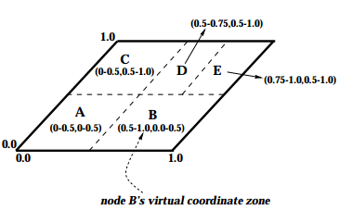
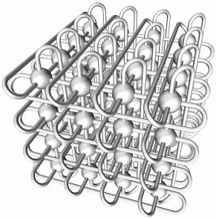
3. Vanilla Design
A 2-d space
A 3-d torus space
NO. of neighbors = 2*d
Notes:
Look at the picture one. We can see that In a 2-d space, a node has two neighbors. In picture two, in a 3-d space, a node has 6 neighbors.
Actually the number of neighbors is 2 times the number of dimensions.
Take the first picture as an example, we can see that there are 5 zones.
Keys are scattered among the zones.
And if the node in charge of zone D gets the query for some data in zone A, it will forward the request from B to A, instead of from E to B and then to A. It always chooses the shortest path.

Slide 10
3. Vanilla Design
Bootstrap
Bootstrap nodes
New nodes join in
Pick a random point
Get a zone
Maintenance
Departure
Recovery
Update the routing
Talk to a bootstrap node
Notes:
To understand the vanilla design, there are 3 important parts: bootstrap, the joining of new nodes and maintenance

Slide 11
3.1 Bootstrap
There are some preset nodes
Zones are already there
Borrowed from YOID project
Notes:
The bootstrap is pretty straight forward.
First, There are some present nodes.
Second, Zones are already there.
This concept is borrowed from YOID project which i am not gonna discuss in detail here.

Slide 12
3.2 New nodes join in
Talk to a bootstrap node
Get a zone
Update the routing
Pick a random node
Notes:
If a new node wants to join, it has to go through four steps.
First it talks to a bootstrap node.
Then it pick a random node, and then it get a zone.
Finally, update the routing.

Slide 13
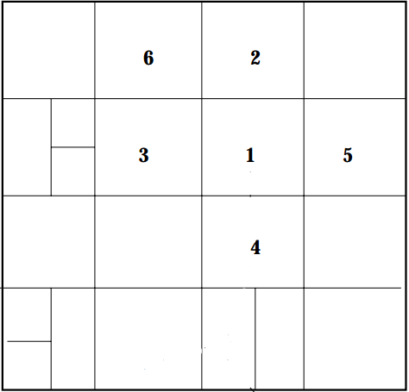
3.2 New nodes join in
Talk to a bootstrap node
I want to join
Notes:
First, it has to talk to a bootstrap node.
Then the bootstrap node will give it a list of the nodes already in the system.

Slide 14
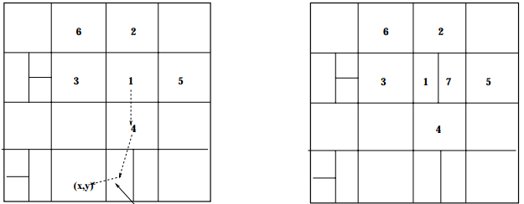
3.2 New nodes join in
Pick a random node( here it chooses 1 )
Notes:
Then the new node will randomly choose one of them.
Here it chooses the node in charge of zone 1.

Slide 15
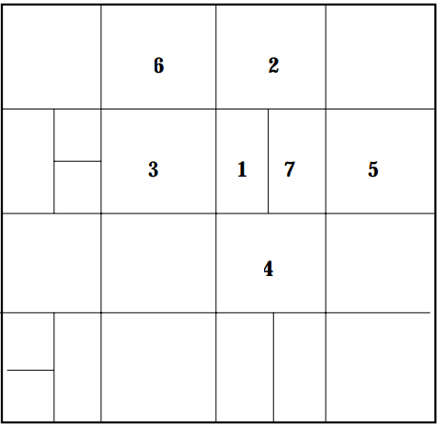
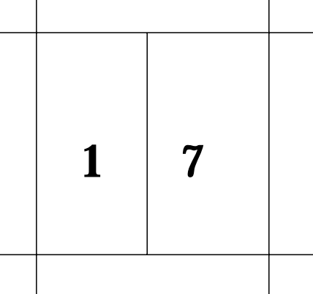
3.2 New nodes join in
Get a zone, or allocated a zone
Notes:
The node in charge of zone 1 gives half of its zone to the new node in charge of zone 7.

Slide 16
3.2 New nodes join in
Update the routing
Before the joining:
From 2 to (x,y)
(x,y)
Notes:
After the splitting, the routing may need to be updated.
Before new node joins, the route is like this.

Slide 17
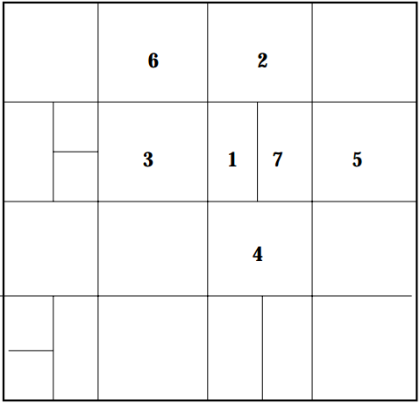
3.2 New nodes join in
Update the routing
After the joining:
From 2 to (x,y)
(x,y)
Notes:
After the new node joins, the node in charge of zone 2 has to take it into account while forwarding requests.

Slide 18
3.3 Maintenance
We need maintenance when:
Nodes depart
Nodes are lost
Notes:
When nodes depart or are lost, we need maintenance.

Slide 19
3.3 Maintanence
Node departure/lost
Before
Node 7 quits/lost:
Notes:
If the node in charge of zone 7 quits or is lost.

Slide 20
3.3 Maintanence
Node departure/lost
After
Node 7 quits/lost:
Notes:
Then its zone should be reclaimed by one of its neighbors.
It’s zone 1 here.

Slide 21
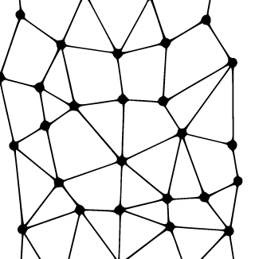
3.3 Maintenance
Recovery
What if an area of nodes are down?
A: We perform an expanding ring search.
Notes:
If more than one node are down, an expanding ring search for stable nodes is performed, as shown in the picture.

Slide 22
3.3 Maintenance
Recovery
And then let stable nodes to take over died zones
Consequences
Data temporarily inaccessible
Notes:
When stable nodes are found, they will take over the dead zones.
However, the key-pairs are temporarily lost until the dead nodes come alive.

Slide 23
4. Improvements
Path length
Per-hop latency
Load balance
Data
Ava.
Notes:
There are actually some improvements that can be applied to the vanilla version.
We have categorized the improvements in 4 aspects: path length, data availability, per-hop latency and load balance.

Slide 24
 | Path length | Per-hop latency | Load balance | Data Availability
Path length | More dimensions | Zone overloading |  | More coordinate spaces
Per-hop latency |  | Take RTT into account Location nearness |  | Zone overloading
Load balance |  |  | Uniform partition | Caching
Data Availability
Notes:
There improvements are put in the table accordingly.
For the sake of time limit, I will pick just one for each aspect to discuss.

Slide 25
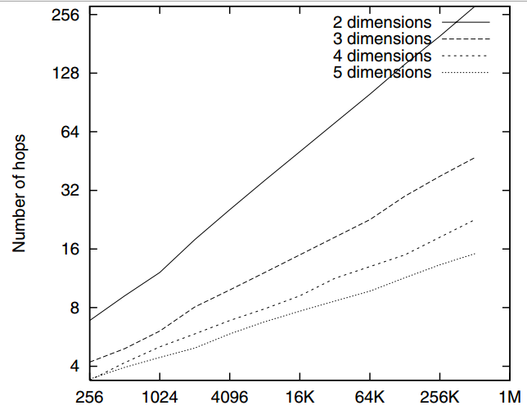
4.1 Path length
More dimensions:
Notes:
To shorten path length, we can add dimensions.
More dimensions mean more neighbors, which means better connectivity.

Slide 26
4.2 Per-hop Latency
A
10ms
1000ms
Take RTT into account:
C
5ms
B
3ms
D
Notes:
For Ideal networks, the latencies between every two hops are the same.
But obviously this can not be the case in reality.
In fact, a network is actually a weighted graph, with RTT as the weight of each edge.
For example, there are two paths from A to B. Although we can go directly from A to B, the latency is 1000ms, while the latency is 18ms if we travel through c, d and then to B.

Slide 27
4.3 Load balance
A
B
Uniform partition
Notes:
Often some nodes are overloaded as popular data are in their zones. So it’s helpful to balance the load.
For area A, all the queries have to be processed by a single node.
For area B, there are 8 zones which means there 8 nodes. So the node in charge of A is vulnerable to overloading.
When uniform partition is applied, if a new node wants to take a share of B, one node in the B would first check its neighbors, the largest one has to split, eg: here A has to give half of its area to the new node and the future requests are balanced among two nodes instead of A alone.

Slide 28
4.4 Data Availability
hashtable
A801 | N12
D872 | N2
… | …
Caching
cache
A801 | N12
0C91 | N9
… | …
query
Notes:
Sometimes data can be unavailable, for example if a node is overloaded with some popular data, it may be unable to respond.
Usually when a query comes in, it’s forwarded to the node whose hashtable has the corresponding entry.
But if certain files are very popular. It’s neighbouring nodes can use a cache to store those entries.
So the popular entries have multiple copies, thus improving the data availability.

Slide 29
5. Design Review
We used the following metrics to evaluate system performance:
☞ Path length: the number of (application-level) hops required to route between two points in the coordinate space.
☞ Neighbor-state: the number of CAN nodes for which an individual node must retain state.
☞ Latency: we consider both the end-to-end latency of the total routing path between two points in the coordinate space and the per-hop latency.
☞ Volume: the volume of the zone to which a node is assigned, that is indicative of the request and storage load a node must handle.
☞ Routing fault tolerance: the availability of multiple paths between two points in the CAN.
☞ Hash table availability: adequate replication of a (key,value)entry to withstand the loss of one or more replicas.

Slide 30
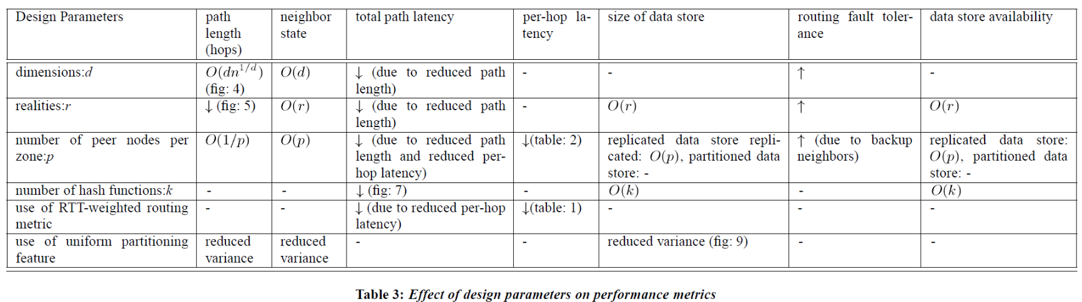
5. Design Review
Notes:
Summarizes the relationship between the different parameters and metrics.
- No significant effect on that metric. While up and down indicate an increase and decrease respectively in that measure caused by increase the corresponding parameter.

Slide 31
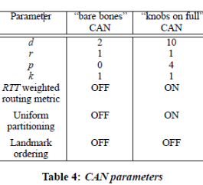
5. Design Review
The key design parameters affecting system performance are:
☞ dimensionality of the virtual coordinate space: d
☞ number of realities: r
☞ number of peer nodes per zone: p
☞ number of hash functions (i.e. number of points per reality at which a (key,value) pair is stored): k
☞ use of the RTT-weighted routing metric
☞ use of the uniform partitioning feature described in Section 3.7

Slide 32
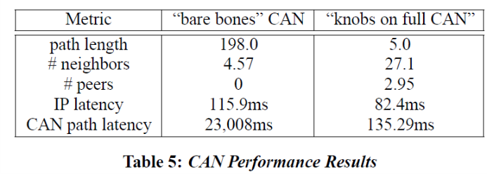

5. Design Review
To measure the cumulative effect of all the above features, we selected a system size of n=$2^{18}$ nodes and compared two algorithms(The topology used for this test is a Transit-Stub topology with a delay of 100ms on intra-transit links, 10ms on stub-transit links and 1ms on intra-stub links):
1. a “bare bones” CAN that does not utilize most of our additional design features
2. a “knobs-on-full” CAN making full use of our added features
Notes:
number of neighbors that a node must maintain to achieve this is approximately 30. a little high but still not unreasonable.
The biggest gain comes from increasing the number of dimensions is that lower the path length from 198 to approximately 5 hops.
Use RTT-weighted routing optimization of next-hop forwarding and reduce the path latency

Slide 33
6.1 Related Work
Related Algorithms
The Distance Vector (DV) and Link State (LS) algorithms:
☞Unlike CAN routing algorithm, DV and LS thus require the widespread dissemination of local topology information.
Plaxton algorithm:
☞Perhaps closest in spirit to the CAN routing scheme.
☞Plaxton algorithm was originally proposed for web caching environments which are typically administratively configured. While CAN is a self-configuring system

Slide 34
6.2 Related System
Domain Name System
OceanStore
Publius
Peer-to-peer file sharing systems

Slide 35
7. Discussion
Two key problems in the design of Content-Addressable Networks: scalable routing and indexing.
Future works:
☞ design a secure CAN that is resistant to denial of service attacks.
☞ extend CAN algorithms to handle mutable content.
☞ design a search techniques such as keyword
searching built around CAN indexing mechanism.

Slide 36
QUESTIONS?
PPT模板下载：www.1ppt.com/moban/ 行业PPT模板：www.1ppt.com/hangye/
节日PPT模板：www.1ppt.com/jieri/ PPT素材下载：www.1ppt.com/sucai/
PPT背景图片：www.1ppt.com/beijing/ PPT图表下载：www.1ppt.com/tubiao/
优秀PPT下载：www.1ppt.com/xiazai/ PPT教程： www.1ppt.com/powerpoint/
Word教程： www.1ppt.com/word/ Excel教程：www.1ppt.com/excel/
资料下载：www.1ppt.com/ziliao/ PPT课件下载：www.1ppt.com/kejian/
范文下载：www.1ppt.com/fanwen/ 试卷下载：www.1ppt.com/shiti/
教案下载：www.1ppt.com/jiaoan/ PPT论坛：www.1ppt.cn

