Slide 1
A Scalable Content-Addressable Network
——Hoachen Xu,
Tianpeng Xia
Notes:
Good morning everyone, today we want to share the things that we learned in this paper: A Scalable Content-Addressable Networkd. I am tianpeng, and this is my partner haochen.

Slide 2

Outline
1. Background
2. What is CAN
3. Vanilla Design
4. Improvements
Notes:
I am going to introduce the first 4 topics. Then Haochen will talk about the remaining content.

Slide 3
1. Background
What we had *then*?
Napster
Gnutella
…
Notes:
First I would like to talk about the background where CAN was invented.
There were already other p2p systems out there, among witch Napster and Gnutella were popular.

Slide 4
1. Background
Napster
P2P on file transfer
C-S on file locating
Gnutella
P2P on file transfer
Flooding on file locating
Notes:
They were both P2P file transfer systems.
But napster used Client-Server based file locating, which is obviously not scalable.
On the other hand Gnutella used Flooding.
An important thing to note here is that I am just discussing the *then* features of these two systems. There might be improvements later.

Slide 5
1. Background
Scalable?
--wikipedia
Notes:
Let’s look at flooding. Clearly flooding is not applicable on large scale p2p systems, because it will consume a lot of bandwidth.

Slide 6
2. What is CAN
Hashtable
Distributed
Internet-scale
Fault-tolerant
Notes:
Because of the above limitations of other systems. CAN was invented to improve the indexing performance.
It’s a Hashtable,
And it’s distributed, internet-scale and fault-tolerant.

Slide 7

2. What is CAN
*Indexing Scheme*
“Central to any P2P system is the Indexing Scheme.”
Notes:
The inventor of CAN consider the Indexing Scheme central to any P2P system and the indexing is key to the overall performance.

Slide 8
3. Vanilla Design
Keys are distributed across a torus coordiante space
The space is divided to zones
Each key resides in a specific zone
Each zone is taken care of by one node
Routing: greedy forwarding
Notes:
In this topic I want to talk about the vanilla design and in the next topic I will show some of the improvements.
First the keys are distributed across a coordinate space.
Second, the space is divided to zones.
Third, each key resides in a specific zone.
Fourth, each zone is taken care of by one node.
Last but not the least, it uses greedy fowarding for the routing.

Slide 9
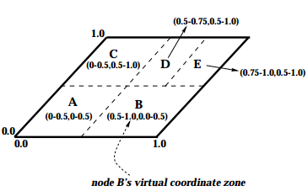
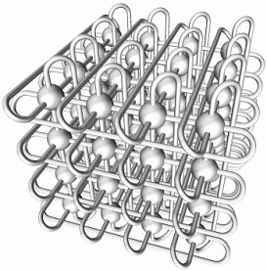
3. Vanilla Design
A 2-d space
A 3-d torus space
NO. of neighbors = 2*d
Notes:
Look at the picture one. We can see that In a 2-d space, a node has four neighbors. In picture two, in a 3-d space, a node has 6 neighbors.
Actually the number of neighbors is 2 times the number of dimensions.
Take the first picture as an example
Keys are scattered among 5 zones.
And if the node in charge of zone D gets a query for some data in zone A, it will forward the request from B to A, instead of from E to B and then to A. It always chooses the shortest path.

Slide 10
3. Vanilla Design
Bootstrap
Bootstrap nodes
New nodes join in
Pick a random point
Get a zone
Maintenance
Departure
Recovery
Update the routing
Talk to a bootstrap node
Notes:
To understand the vanilla design, there are 3 important parts: bootstrap, the joining of new nodes and maintenance

Slide 11
3.1 Bootstrap
There are some preset nodes
Zones are already there
Borrowed from YOID project
Notes:
The bootstrap is pretty straight forward.
First, There are some present nodes.
Second, Zones are already there.
This concept is borrowed from YOID project which i am not gonna discuss in detail here.

Slide 12
3.2 New nodes join in
Talk to a bootstrap node
Get a zone
Update the routing
Pick a random node
Notes:
If a new node wants to join, it has to go through four steps.
First it talks to a bootstrap node.
Then it pick a random node, and then it get a zone.
Finally, update the routing.

Slide 13
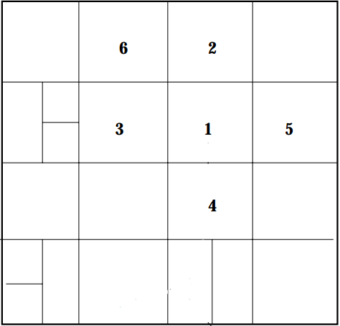
3.2 New nodes join in
Talk to a bootstrap node
I want to join
Notes:
First, it has to talk to a bootstrap node.
Then the bootstrap node will give it a list of the nodes already in the system.

Slide 14
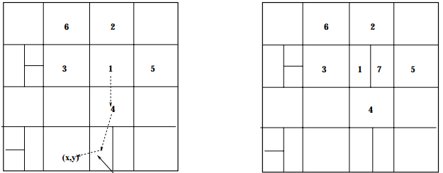
3.2 New nodes join in
Pick a random node( here it chooses 1 )
Notes:
Then the new node will randomly choose one of them.
Here it chooses the node in charge of zone 1.

Slide 15
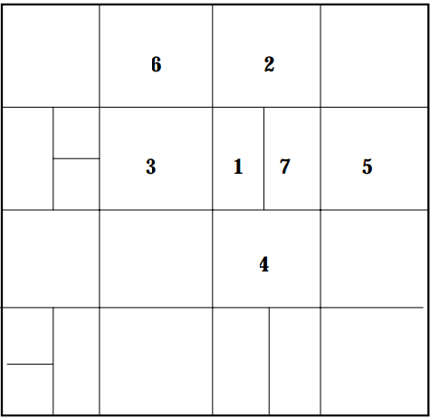
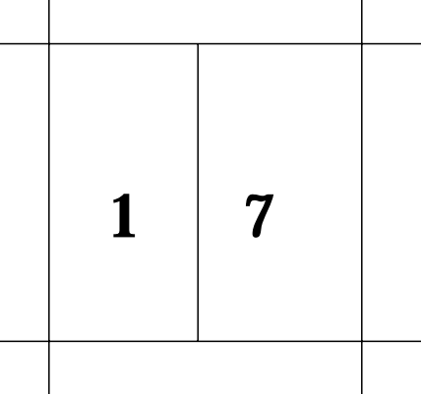
3.2 New nodes join in
Get a zone, or allocated a zone
Notes:
The node in charge of zone 1 gives half of its zone to the new node in charge of zone 7.

Slide 16
3.2 New nodes join in
Update the routing
Before the joining:
From 2 to (x,y)
(x,y)
Notes:
After the splitting, the routing may need to be updated.
Before new node joins, the route is like this.

Slide 17
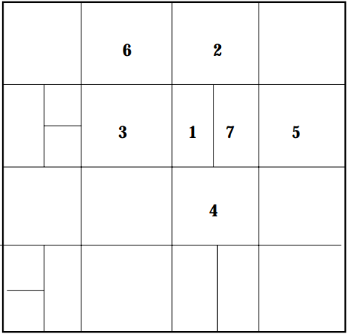
3.2 New nodes join in
Update the routing
After the joining:
From 2 to (x,y)
(x,y)
Notes:
After the new node joins, the node in charge of zone 2 has to take it into account while forwarding requests.

Slide 18
3.3 Maintenance
We need maintenance when:
Nodes depart
Nodes are lost
Notes:
When nodes depart or are lost, we need maintenance.

Slide 19
3.3 Maintanence
Node departure/lost
Before
Node 7 quits/lost:
Notes:
If the node in charge of zone 7 quits or is lost.

Slide 20
3.3 Maintanence
Node departure/lost
After
Node 7 quits/lost:
Notes:
Then its zone should be reclaimed by one of its neighbors.
It’s zone 1 here.

Slide 21
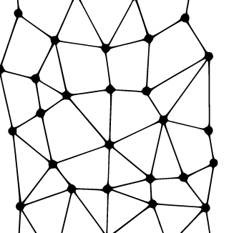
3.3 Maintenance
Recovery
What if an area of nodes are down?
A: We perform an expanding ring search.
Notes:
If more than one node are down, an expanding ring search for stable nodes is performed, as shown in the picture.

Slide 22
3.3 Maintenance
Recovery
And then let stable nodes to take over died zones
Consequences
Data temporarily inaccessible
Notes:
When stable nodes are found, they will take over the dead zones.
However, the key-pairs are temporarily lost until the dead nodes come alive.

Slide 23
4. Improvements
Path length
Per-hop latency
Load balance
Data
Ava.
Notes:
There are actually some improvements that can be applied to the vanilla version.
We have categorized the them in 4 aspects: path length, data availability, per-hop latency and load balance.

Slide 24
 | Path length | Per-hop latency | Load balance | Data Availability
Path length | More dimensions | Zone overloading |  | More coordinate spaces
Per-hop latency |  | Take RTT into account Location nearness |  | Zone overloading
Load balance |  |  | Uniform partition | Caching
Data Availability
Notes:
There improvements are put in the table accordingly.
For the sake of time limit, I will pick just one for each aspect to discuss.

Slide 25
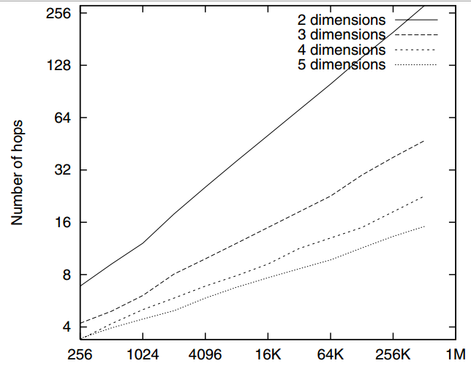
4.1 Path length
More dimensions:
Notes:
To shorten path length, we can add dimensions.
More dimensions mean more neighbors, which means better connectivity.

Slide 26
4.2 Per-hop Latency
A
10ms
1000ms
Take RTT into account:
C
5ms
B
3ms
D
Notes:
The latencies between nodes are different.
For example, If go directly from A to B, the latency is 1000ms, while the latency is 18ms if we travel through c, d and then to B.

Slide 27
4.3 Load balance
A
B
Uniform partition
Notes:
Some nodes may have larger zones.
For area A, all the queries have to be processed by a single node.
For area B, there are 8 zones which means there 8 nodes. So the node in charge of A is vulnerable to overloading.
We can perform a uniform partition in the situation. If a new node wants to take a share of B, one node in the B would first check its neighbors, the largest zone has to split, eg: here A has to give half of its area to the new node and the future requests are balanced among two nodes instead of A alone.

Slide 28
4.4 Data Availability
hashtable
A801 | N12
D872 | N2
… | …
Caching
cache
A801 | N12
0C91 | N9
… | …
query
Notes:
Sometimes data can be unavailable, for example if a node is overloaded with some popular data, it may be unable to respond for a period of time.
But if its neighbors can use a cache to store its popular data, the popular data have multiple copies, they can improve the data availability even if the origin is damaged.

Slide 29

点击输入标题
点击输入标题
点击输入标题
点击输入标题
C
目录

Slide 30
点击输入标题
C
过渡

Slide 31


点击输入标题
LOGO
单击添加标题
1
您的内容打在这里，或者通过复制您的文本后，在此框中选择粘贴，并选择只保留文字。您的内容打在这里。
您的内容打在这里，或者通过复制您的文本后，在此框中选择粘贴，并选择只保留文字。您的内容打在这里。
2
单击添加标题

Slide 32
点击输入标题
LOGO
添加标题
添加标题
添加标题
添加标题
您的内容打在这里，或者通过您的内容打在这里
您的内容打在这里，或者通过您的内容打在这里
您的内容打在这里，或者通过您的内容打在这里
您的内容打在这里，或者通过您的内容打在这里
6月
7月
8月
9月
10月
11月
12月
添加标题
添加标题
添加标题
您的内容打在这里，或者通过您的内容打在这里
您的内容打在这里，或者通过您的内容打在这里
您的内容打在这里，或者通过您的内容打在这里

Slide 33
点击输入标题
LOGO
添加标题
在此录入上述图表的综合描述说明，在此录入上述图表的综合描述说明。
添加标题
在此录入上述图表的综合描述说明，在此录入上述图表的综合描述说明。
添加标题
在此录入上述图表的综合描述说明，在此录入上述图表的综合描述说明。

Slide 34
点击输入标题
LOGO
单击此处添加文本
单击此处添加文本
单击此处添加文本
单击此处添加文本
添加标题
添加标题
添加标题
添加标题
单击此处添加文本
单击此处添加文本
单击此处添加文本
单击此处添加文本
单击此处添加文本
单击此处添加文本
单击此处添加文本
单击此处添加文本

Slide 35
点击输入标题
C
过渡

Slide 36
点击输入标题
LOGO
3
点击输入文本点击输入文本点击输入文本点击输入文本
2
点击输入文本点击输入文本点击输入文本点击输入文本点击输入文本
1
点击输入文本点击输入文本点击输入文本点击输入文本

Slide 37
点击输入标题
LOGO
标签文本
标签文本
添加你的标题
输入你的文字输入你的文字 输入你的文字 输入你的文字 输入你的文字 输入你的文字 输入你的文字 输入你的文字 输入你的文字

Slide 38

点击输入标题
LOGO
在此录入上述图表的综合描述说明，在此录入上述图表的综合描述说明，在此录入上述图表的综合描述说明。
阶段一
阶段二
阶段三
在此录入上述图表的综合描述说明，在此录入上述图表的综合描述说明，在此录入上述图表的综合描述说明。
在此录入上述图表的综合描述说明，在此录入上述图表的综合描述说明，在此录入上述图表的综合描述说明。
阶段四
在此录入上述图表的综合描述说明，在此录入上述图表的综合描述说明，在此录入上述图表的综合描述说明。
阶段五
在此录入上述图表的综合描述说明，在此录入上述图表的综合描述说明，在此录入上述图表的综合描述说明。
在此录入上述图表的综合描述说明，在此录入上述图表的综合描述说明，在此录入上述图表的综合描述说明。
阶段六

Slide 39
点击输入标题
LOGO
添加标题
请在这里输入段落文本内容请在这里输入段落文本内容
添加标题
请在这里输入段落文本内容请在这里输入段落文本内容
添加标题
请在这里输入段落文本内容请在这里输入段落文本内容
添加标题
请在这里输入段落文本内容请在这里输入段落文本内容

Slide 40
点击输入标题
C
过渡

Slide 41
点击输入标题
LOGO
这里添加标题
这里添加标题
输入你的文字输入你的文字 输入你的文字 输入你的文字 输入你的文字 输入你的文字
输入你的文字输入你的文字 输入你的文字 输入你的文字 输入你的文字 输入你的文字 输入你的文字
插入
标签
这里添加标题
这里添加标题
输入你的文字输入你的文字 输入你的文字 输入你的文字 输入你的文字 输入你的文字 输入你的文字
输入你的文字输入你的文字 输入你的文字 输入你的文字 输入你的文字 输入你的文字 输入你的文字

Slide 42
点击输入标题
LOGO
70%
68%
47%
55%
点击输入标题
点击输入标题
点击输入标题
点击输入标题
点击输入文本点击输入文本点击输入文本点击输入文本点击输入文本
点击输入文本点击输入文本点击输入文本点击输入文本点击输入文本
点击输入文本点击输入文本点击输入文本点击输入文本点击输入文本
点击输入文本点击输入文本点击输入文本点击输入文本点击输入文本

Slide 43
点击输入标题
LOGO
标题文字
这里可以添加主要内容这里可以添加主要内容这里可以添加主要内容
54%
标题文字
这里可以添加主要内容这里可以添加主要内容这里可以添加主要内容
75%
标题文字
29%
标题文字
这里可以添加主要内容这里可以添加主要内容这里可以添加主要内容
这里可以添加主要内容这里可以添加主要内容这里可以添加主要内容
40%

Slide 44
点击输入标题
LOGO
点击输入标题
点击输入标题
点击输入文本点击输入文本点击输入文本点击输入文本点击输入文本
点击输入文本点击输入文本点击输入文本点击输入文本点击输入文本
01
03
02
04
点击输入标题
点击输入标题
点击输入文本点击输入文本点击输入文本点击输入文本点击输入文本
点击输入文本点击输入文本点击输入文本点击输入文本点击输入文本

Slide 45
点击输入标题
C
过渡

Slide 46

点击输入标题
LOGO
左侧图片更换方法是对图片点右键->设置对象格式->填充->填充效果->图片，选择事先准备好的图片即可。后文遇图片均可按此操作
1
2
更换图片后动画效果会保留下来，适用于对一个问题进行多项说明时使用。
如果图片变形，是由于图片不是正方形所致，最好的办法是先将图片拖到PPT里，用图片裁切的办法裁成方形。
3
然后另存为一个新图片，在填充选图片时选择你裁好的图，就不会出现变形了，后文遇到长方形，六边形等图片时，操作方法类似。
4
添加
标题
5
更换图片后动画效果会保留下来，适用于对一个问题进行多项说明时使用。

Slide 47
点击输入标题
LOGO
请在此处输入您的文本
添加标题
此处添加详细文本描述，建议与标题相关并符合整体语言风格，语言描述尽量。
添加标题
请在此处输入您的文本
请在此处输入您的文本
此处添加详细文本描述，建议与标题相关并符合整体语言风格，语言描述尽量。
标题
添加标题
此处添加详细文本描述，建议与标题相关并符合整体语言风格，语言描述尽量。
请在此处输入您的文本

Slide 48
点击输入标题
LOGO
1
2
这里添加标题
这里添加标题
输入你的文字输入你的文字 输入你的文字 输入你的文字 输入你的文字
输入你的文字输入你的文字 输入你的文字 输入你的文字 输入你的文字
3
这里添加标题
输入你的文字输入你的文字 输入你的文字 输入你的文字 输入你的文字输入你的文字输入你的文字 输入你的文字 输入

Slide 49


点击输入标题
LOGO
此处添加详细文本描述，建议与标题相关并符合整体语言风格。
此处添加详细文本描述，建议与标题相关并符合整体语言风格。
此处添加详细文本描述，建议与标题相关并符合整体语言风格。
五大
重点工作
此处添加详细文本描述，建议与标题相关并符合整体语言风格。
此处添加详细文本描述，建议与标题相关并符合整体语言风格。

Slide 50
201X
谢谢观看
点击添加公司名称
PPT模板下载：www.1ppt.com/moban/ 行业PPT模板：www.1ppt.com/hangye/
节日PPT模板：www.1ppt.com/jieri/ PPT素材下载：www.1ppt.com/sucai/
PPT背景图片：www.1ppt.com/beijing/ PPT图表下载：www.1ppt.com/tubiao/
优秀PPT下载：www.1ppt.com/xiazai/ PPT教程： www.1ppt.com/powerpoint/
Word教程： www.1ppt.com/word/ Excel教程：www.1ppt.com/excel/
资料下载：www.1ppt.com/ziliao/ PPT课件下载：www.1ppt.com/kejian/
范文下载：www.1ppt.com/fanwen/ 试卷下载：www.1ppt.com/shiti/
教案下载：www.1ppt.com/jiaoan/ PPT论坛：www.1ppt.cn

