Slide 1
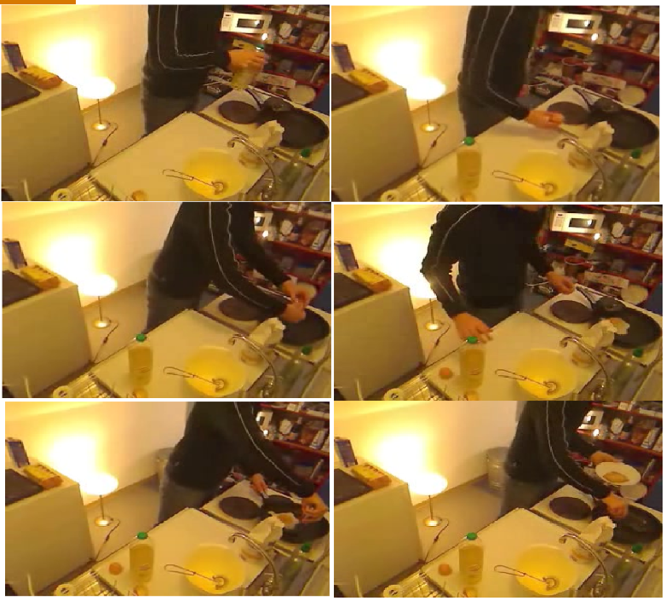
Iterative Contrast-Classify For Semi-supervised Temporal Action Segmentation
Dipika Singhania
Rahul Rahaman
Angela Yao

Slide 2
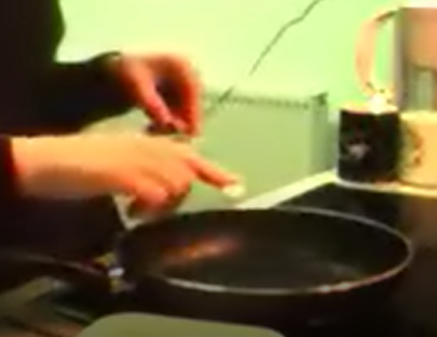
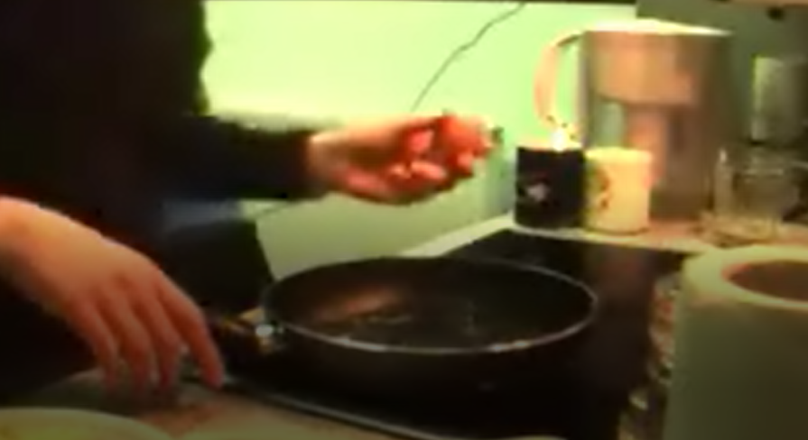
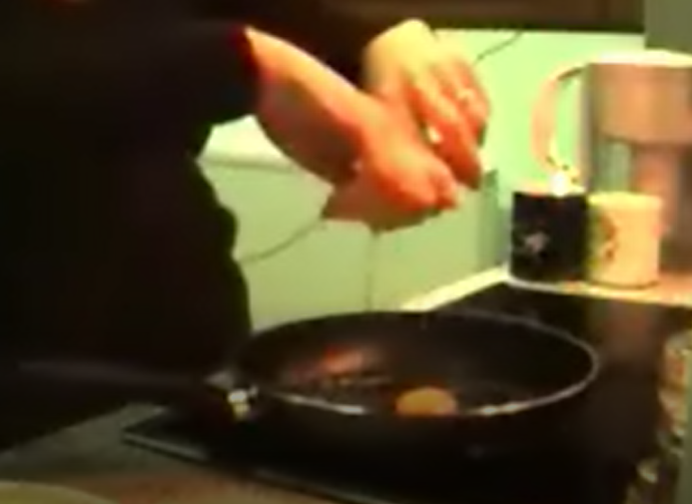
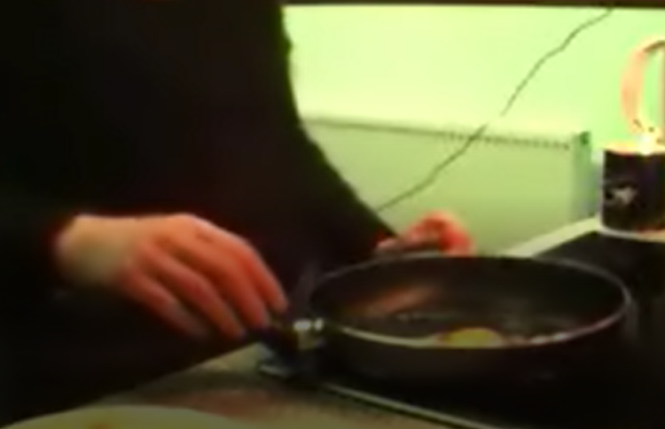
Temporal Action Segmentation
Temporal action segmentation classifies the action of each frame in (long) video sequences.
Making Egg
Butter pan
Take Egg
Crack Egg
Fry Egg
(pictures taken from Breakfast Actions Dataset, CVPR 2014)
Notes:
In complex activity video dataset “Making Egg” serves as one complex activity. This complex activity can be further divided into sub-activity labels, namely “Butter Pan, Take Egg, Crack Egg, Fry Egg”.

Slide 3





Semi-Supervised Temporal Action Segmentation
Annotating framewise action labels has huge cost so we propose the first semi-supervised method for temporal action segmentation.
Semi-Supervised: Having labels only for a fraction of the videos in the training set.
All labels for few training videos
$$V_{1}$$
$$V_{2}$$
$$V_{3}$$
E
C
$$V_{4}$$
A
B
D
$$V_{5}$$

Slide 4
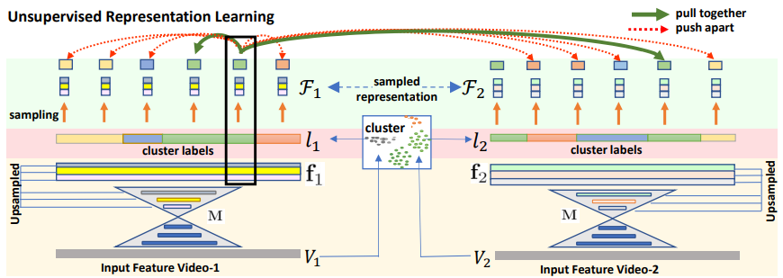
Unsupervised Representation Learning
We propose a novel way to learn frame-wise representations from temporal convolutional networks (TCNs) by clustering input features with added time-proximity condition and multiresolution similarity.

Slide 5
Semi-Supervised Iterative Contrast Classify(ICC)
Unsupervised
Representation
Learning
M
without labels
By merging representation learning with conventional supervised learning, we develop an “Iterative Contrast-Classify (ICC)” semi-supervised learning scheme.
M
Classify Step
(training)
gt labels
M:G
M:G
Classify Step
(predict)
M
pseudo labels
Contrast Step
(training)
M
gt labels

Slide 6
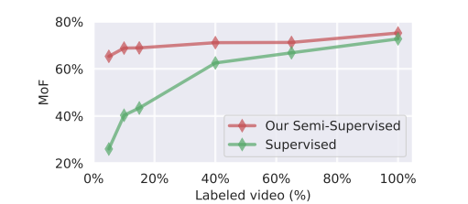
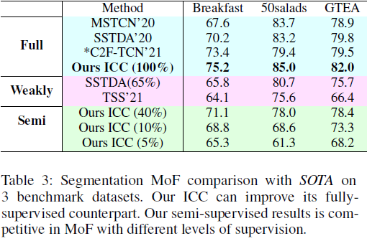
Our Semi-Supervised ICC Performance
With more labelled data, our semi-supervised ICC progressively improves in performance; ICC with 40% labelled videos, performs like fully-supervised counterparts. It improves fully-supervised performance.
Frame accuracy on Breakfast dataset: Our ICC has impressive performance with just 5% labelled videos; at 40%, we almost match the Mean over Frames (MoF) of a 100% fully-supervised setup.

Slide 7

Thank You

