Slide 1
Machine Learning Model Selection Algorithm
Dipika Singhania: A0195129X
Zhang Jinhui: A0191811J

Slide 2
Introduction: Image Classification Model Selection

Slide 3
Meta-Model Selection Algorithm
Pool of models for Image Classification
Pool of datasets for Image Classification
Train all datasets in pool with all models in pool
Given a new dataset, predict which model among the would give best accuracy
RESNET18
Datasets
MOBILENET
RESNET18
VGG16
Train
SHUFFLE-NE
INPUTS
MNAST
OUTPUT
MODEL SELECTION

Slide 4
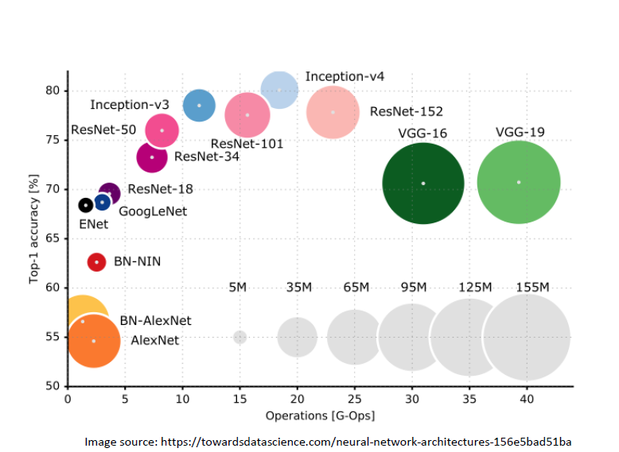
Heuristics Model Selection Algorithm

Slide 5
IMPLEMENTATION DETAILS

Slide 6
Image Classification
Assembling Dataset Pools
Assembling Model Pools

Slide 7
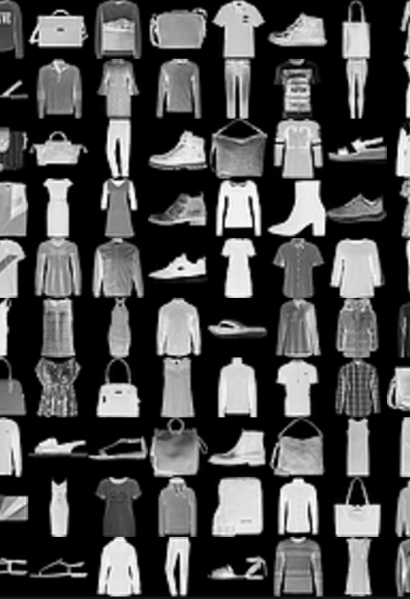
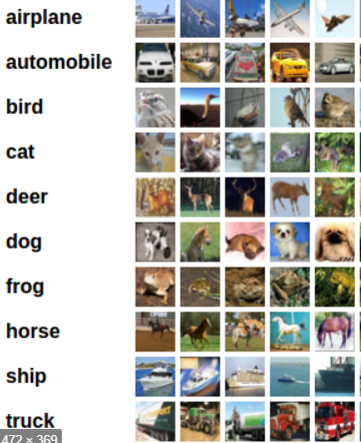
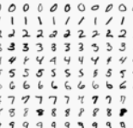
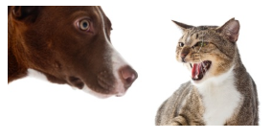
Datasets Pool
CIFAR-10 (10 Labels) (60K/10Kimages)
CIFAR-100 (100 Labels) (60K/10K images)
MNIST (10 Labels) (60K/10K images)
KMNIST (10 Labels) (60K/10K images)
FASHION MNIST (10 Labels)(60K/10K)
STANFORD CARS (186 Labels)(6k)
Dogs Cats Dataset (2 Labels)(25K)
German Traffic Signal(43 Labels) (39K)
Flower (5 Labels) (3.5K)
Notes:
Some were grey scale,
Some were colored
Need to bring them to same scale
Normalized, Rescaled

Slide 8
Converting different formats to Pytorch Datasets
Cifar-10, Cifar-100, Mnist, Kmnist, FashionMnist from Pytorch Datasets download
Stanford cars in .tar format, converted to Dataset similars to Pytorch Datasets
Dog vs Cats in zipped format
All dataset are rescaled(224, 224), normalized
Gray scale images converted to RGB by replicating
API Format: load(dataset=“Cars”, batch_size=128, download_folder=”data/”)
Downloads and returns Train, Validation Datasets, DataLoaders iterators
Notes:
Auto-Download from urls and auto untar,unzip functionalities included in datasets creations

Slide 9
Models Pool (Pytorch Pretrained Imagenet Models)
Model Name | Parameters(In Millions)
mnasnet0_5 | 0.952634
shufflenet_v2_x0_5 | 1.366792
*mobilenet_v2 | 2.236682
mnasnet1_0 | 3.115122
resnet18 | 11.18164
resnet34 | 21.2898
alexnet | 57.04481
**vgg16 | 134.3015
DISCARDED MODELS
Different format Input | Too Large
Inception_V3 | Densenet
SqueezeNet | Resnet50/100
 | GoogleNet
Notes:
*mobilenet_v2 though show so low parameters, but goes out of cuda memory
**vgg16, all layers freezed, only last layer trained

Slide 10
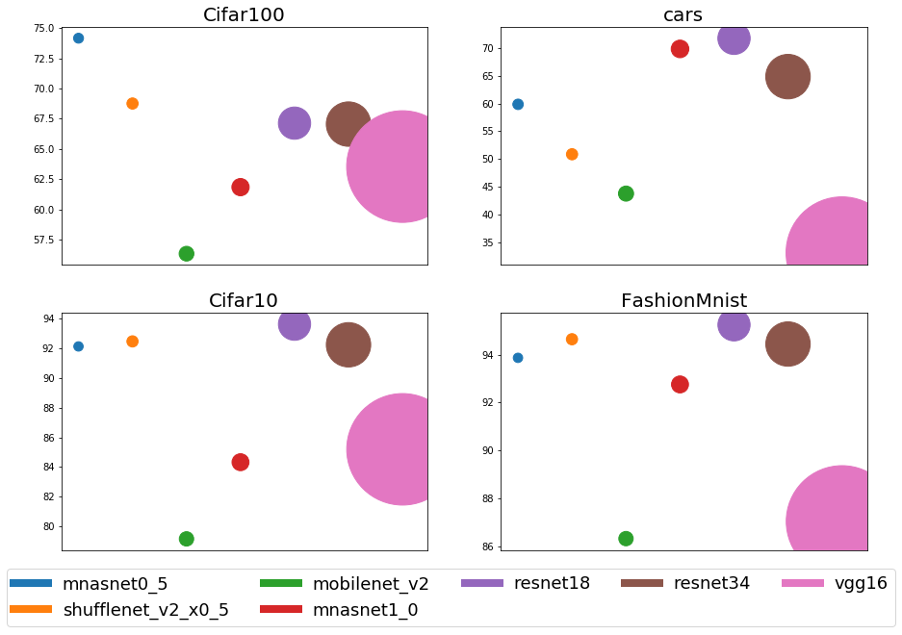
Different Models Accuracy On Different Datasets
Notes:
Completely trained models on GeForce RTX 10 GB Cuda memory

Slide 11
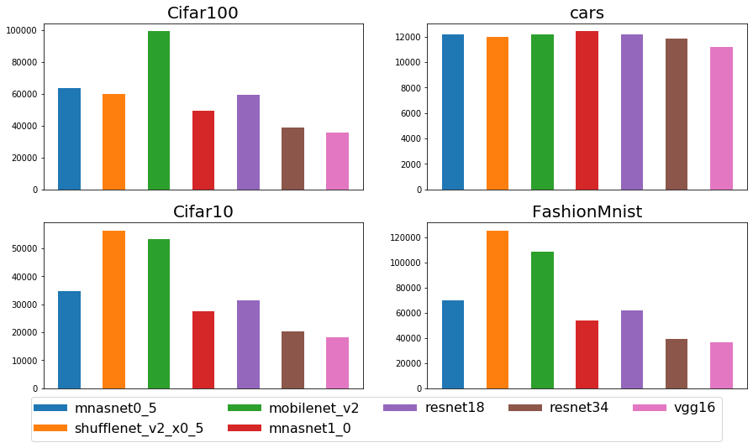
Train Images per Sec On Different Datasets
Notes:
Images per sec = number of training images * number of epochs trained / total time taken

Slide 12
Creating Dataset for Meta-model

Slide 13
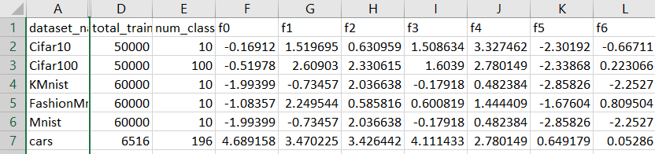
Dataset Features
Image Size
Size of Dataset
Number Of Unique Labels Of datasets
Glove Embedding get 300 size vectors for all labels, Apply PCA to 5 size
Add Max, Min and Avg Pooling of labels as features
API: get_features(name=”Mnist”, img_height=28, img_width=28, total_train_size=60000, num_of_classes=10, labels=[..])

Slide 14
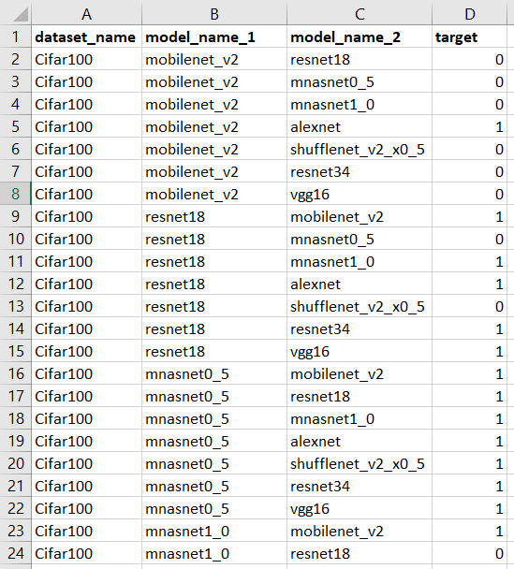
Model Features
Target Creations
Model Parameter size
Depth of Network

Slide 15
Meta-learning Target
Finding a suitable target for the meta-learning task is one of the most important aspect of this meta-model training
For all pairs of model we make a 0-1 target denoting whether model-1 was better in terms of performance on the dataset
Meaning each row of the meta-learning target looks like
In this case ‘renset18’ performs better than ‘vgg16’ on ‘CIFAR10’, which is why the target is 1
All pairs of models are present in this dataset
For each dataset we have 8 * 7 rows in the meta-model

Slide 16
Meta-Model Training

Slide 17
Models/Validation Accuracy
An ensemble of KNN and Decision Tree:
Why these models?
The meta dataset of features and models are not considerable in size. Need algorithms that can manage to work with low volume of dataset
The inner relationship between datasets and models is NOT supposed to have any sort of linearity. That is why DTree (Non-linear) and KNN (Only locally linear) has been chosen
KNN takes into account similarity/distance between features, which is desired when we need to compare dataset attributes.
The ensemble performs with good accuracy
Around 82% accuracy is observed in terms of predicting one-vs-one winning model

Slide 18
Meta-Model Inference

Slide 19
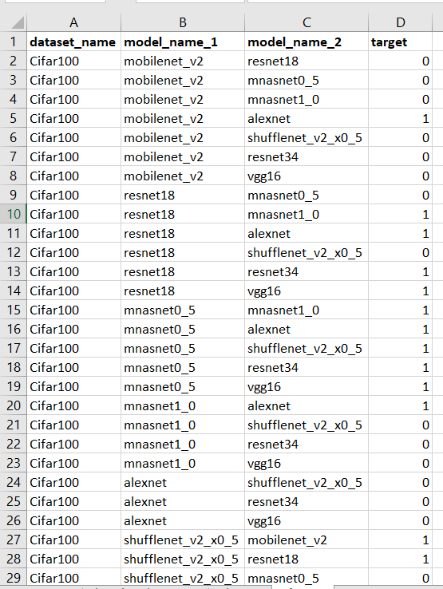
Knockout Inference Policy
For a new dataset, we add all possible combinations of models, and predict target for each row.
Compare A vs B, if A wins compare A and C, else compare B and C
Fallacy: Even if one prediction is wrong, we get a wrong final winner model

Slide 20
Ranking based Inference Policy (Combinations)
For a new dataset, we add all possible combinations of models, and predict target for each row.
If for A vs B, prediction is 1 then we add 1 to score(A) else to score(B)
If one prediction is wrong then it will make a + 2 difference between score of A and B

Slide 21
Ranking based Inference Policy (Permutation)
For a new dataset, we add all possible 2-combination (A-B & B-A) of models, and predict target for each of them.
If for A vs B, prediction is 1 then we add 1 to score(A) else to score(B)
If one prediction is wrong then it will make no difference between final score of A and B
Neutralizes the wrong predictions ie.
A B 1
B A 1
Both gets 1 added to the ranking scores

Slide 22
Meta-Learning Vs Heuristics

Slide 23
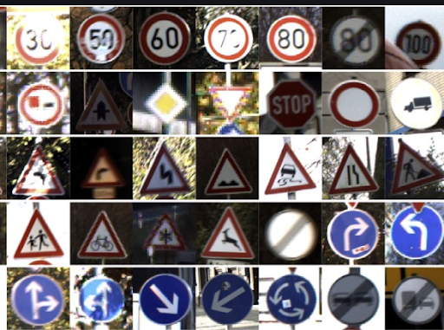
Meta-learning prediction (Traffic)
Heuristic Ground truth(acc%) Meta Learning
Traffic Dataset -
Image size: (30x30)
Data size: 39208
Classes: 43 (Traffic signs)
‘Resnet34’
‘ResNet18’
‘mnasnet’
‘Resnet34’
‘ResNet18’
‘MobileNet’
‘ShuffleNet’
‘Resnet18’
‘ResNet34’
‘ShuffleNet’
‘mnasnet’

Slide 24
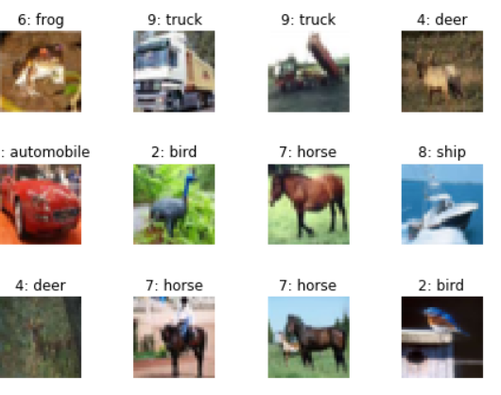
Meta-learning outcome (CIFAR10)
Heuristic Ground truth(acc%) Meta Learning
Traffic Dataset -
Image size: (32x32)
Data size: 60000
Classes: 10 (Horse, Bird, Airplane e.t.c)
‘Resnet34’
‘ResNet18’
‘mnasnet’
‘Resnet18’
‘ShuffleNet’
‘ResNet34’
‘Resnet18’ (tie)
‘ShuffleNet’ (tie)
‘ResNet34’

Slide 25
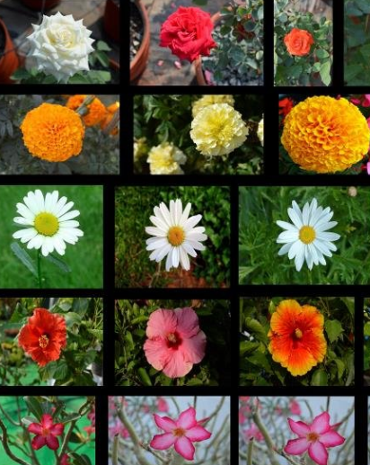
Meta-learning prediction (Flowers)
Heuristic Ground truth(acc%) Meta Learning
Traffic Dataset -
Image size: (213x320)
Data size: 3459
Classes: 6 (Tulip, Daisy e.t.c)
‘Mnasnet’
‘ResNet18’
‘ResNet34’
‘MobileNet’
‘ShuffleNet’
‘ResNet18’
‘Mnasnet’
‘ShuffleNet’
‘ResNet18’
Here it can be seen that for smaller dataset our meta-model prefers smaller networks

Slide 26
Conclusion

Slide 27
Conclusion
Meta-model has potentials of replacing heuristic benchmarking different models of various datasets without even training any models
Heuristic method can not be generalized to arbitrary image size and inter-relation of model features and dataset similarity
Could be integrated with Rafiki or some Database system, where querying with different parameters is easy
Moreover the meta-model is armed with self learning, i.e the more it is used, better performance can be gained on machine-learning/deep-learning platform.

