Slide 1
CPSC-483 Group Project
Team Kaizen
Dipika Mahashabde
Dhaval Shah
Pritesh pimple -Guided by: Prof Kenytt Avery

Slide 2
Competition Chosen from Kaggle
Shelter Animal Outcomes – Play Ground
https://www.kaggle.com/c/shelter-animal-outcomes
We are predicting that if animal will get shelter or not

Slide 3
Data Set
AnimalID:
This is unique for all the entries.
Name:
Name defines the name of Animal. (eg. Hambone, Emily, Pearce)
DateTime:
It represents the date and time based on OutcomeType. (ie. If animal is returnedTo then at what date and time)
OutcomeType:
It shows where animal will be. (eg. ReturnTo, Transfer, etc).
OutcomeSubtype:
It is the condition in which a particular animal is. (eg. Suffering, Medical, Aggressive)

Slide 4
Data Set (Contd.)
AnimalType:
It defines weather the animal is a Dog or a Cat.
SexuponOutcome:
It represent the gender of a particular animal.(eg. Neutered Male, Spayed Female)
AgeUponOutcome:
It States the Age for a particular animal.(eg. 1 year, 9 years, 3 weeks)
Breed:
It indicates the breed of a particular animal.(eg. Pitbull mix, Angora mix)
Color:
It states the color of a particular animal.(eg. Brown/White, silver)

Slide 5
Data Processing
When we are working with the model, we get to know that we have to vectorize/standardize data
Age: We have converted age in Weeks
Age: If age is missing then we consider it as -1
We have done a name frequency if the name is not present then we have given a value of 99999
We are converting all data into numeric values
Date and time is divided into YY, MM , DD, HH , mm

Slide 6
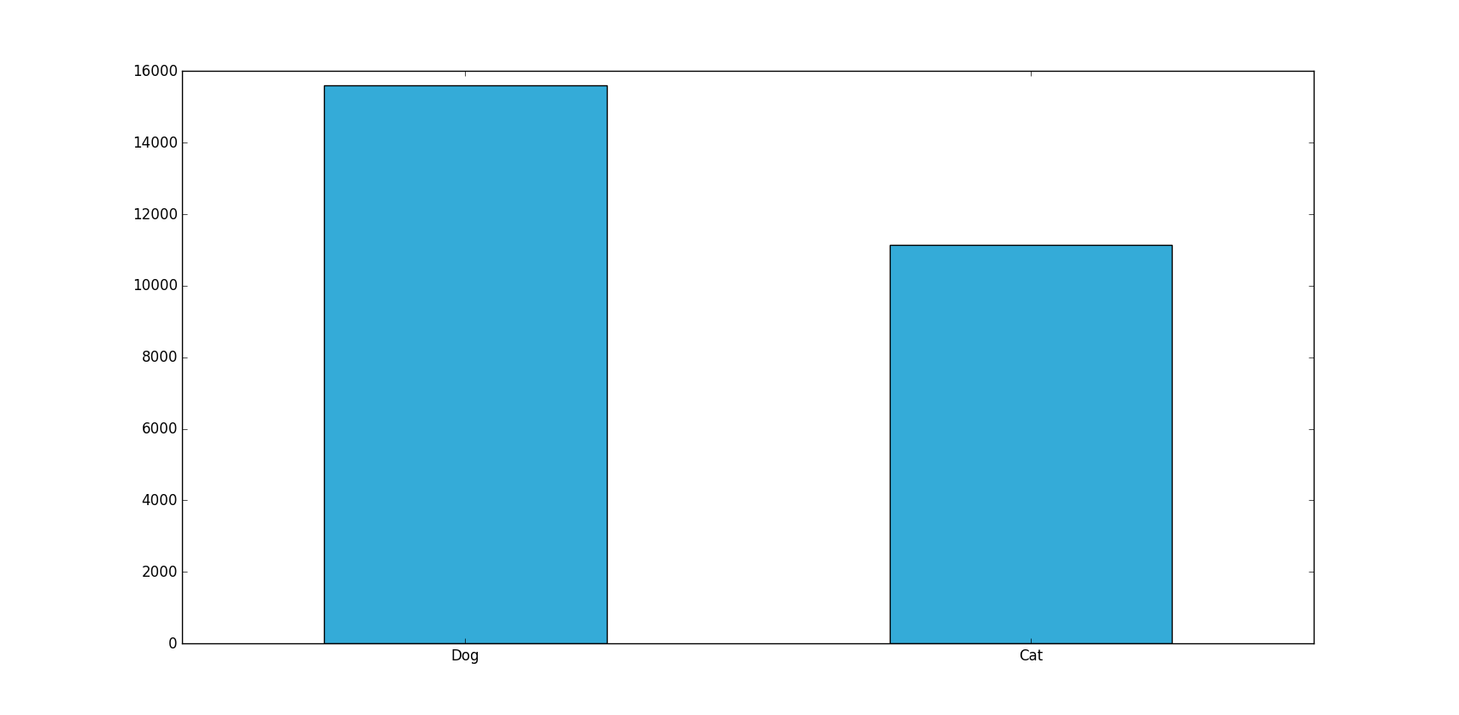
Graphs (Total number of Dogs and Cats)

Slide 7
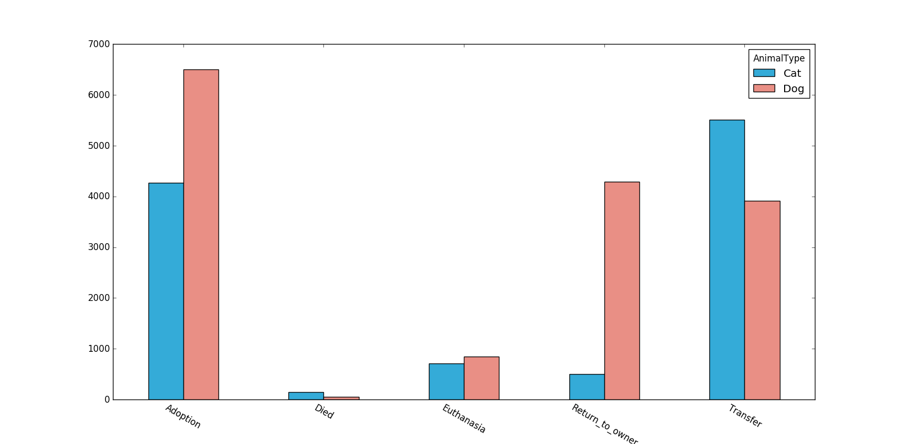
Graphs (Animal Type VS Outcome Type)

Slide 8
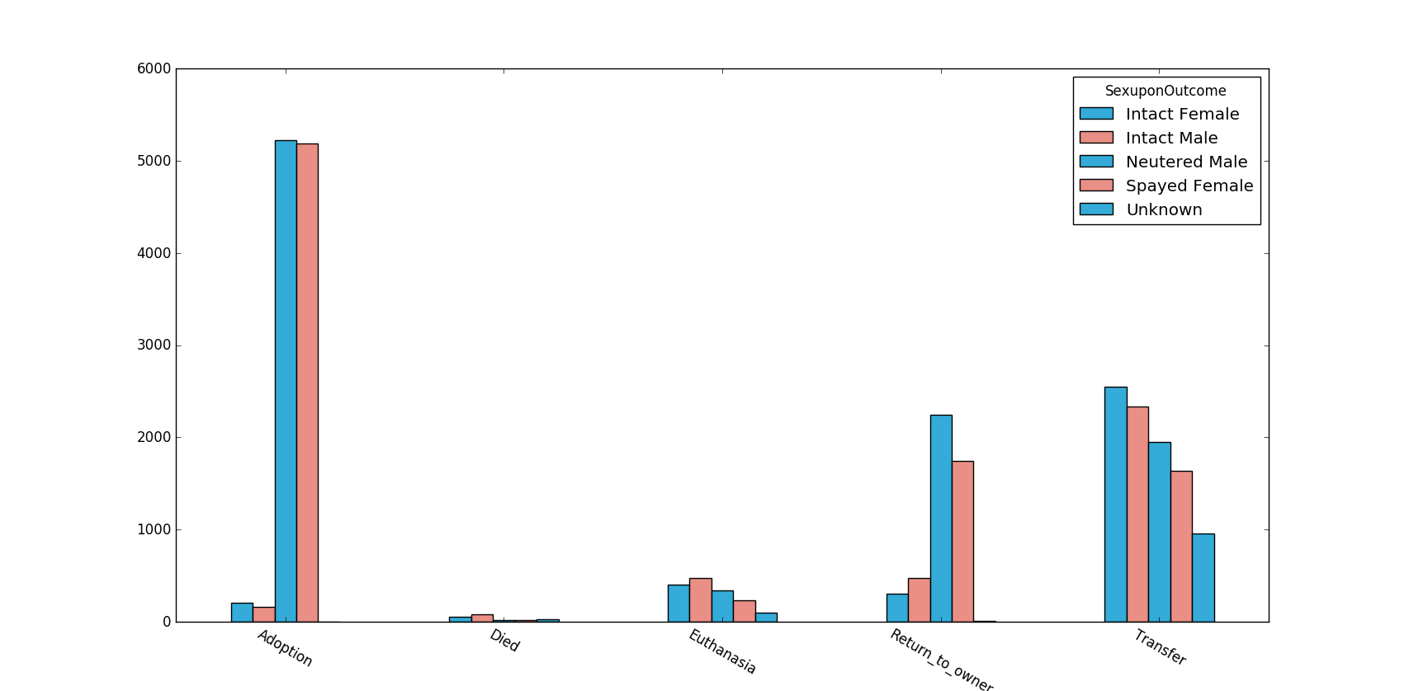
Graphs (Sex Outcome VS Outcome Type)

Slide 9
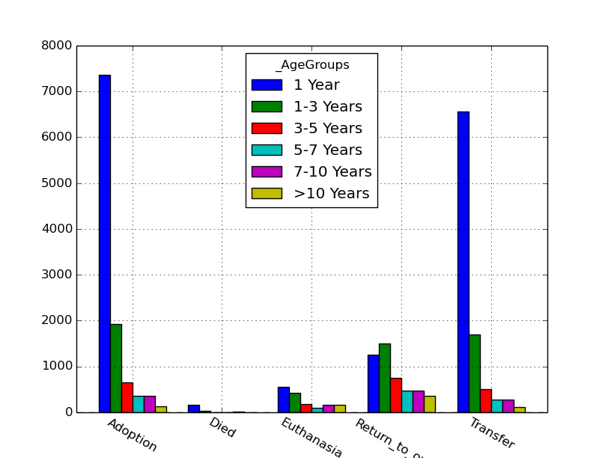
Graphs (Age Group VS Outcome Type)

Slide 10
Feature selection
We have removed outcome subtype.
We have calculated the name frequency and mapped it to the name
Other features consider:
Name
Animal Type
Sex Upon Outcome
Breed
Color
Date Converted into Year, Month, Day, Hour and minute

Slide 11
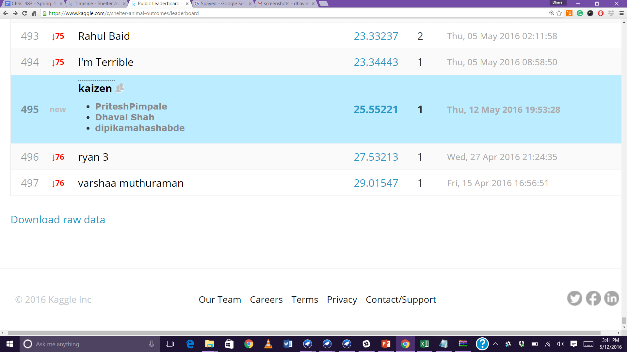
Your initial data mining approach and initial Kaggle results and ranking
Initial Result 25.55221 and ranking is 495

Slide 12
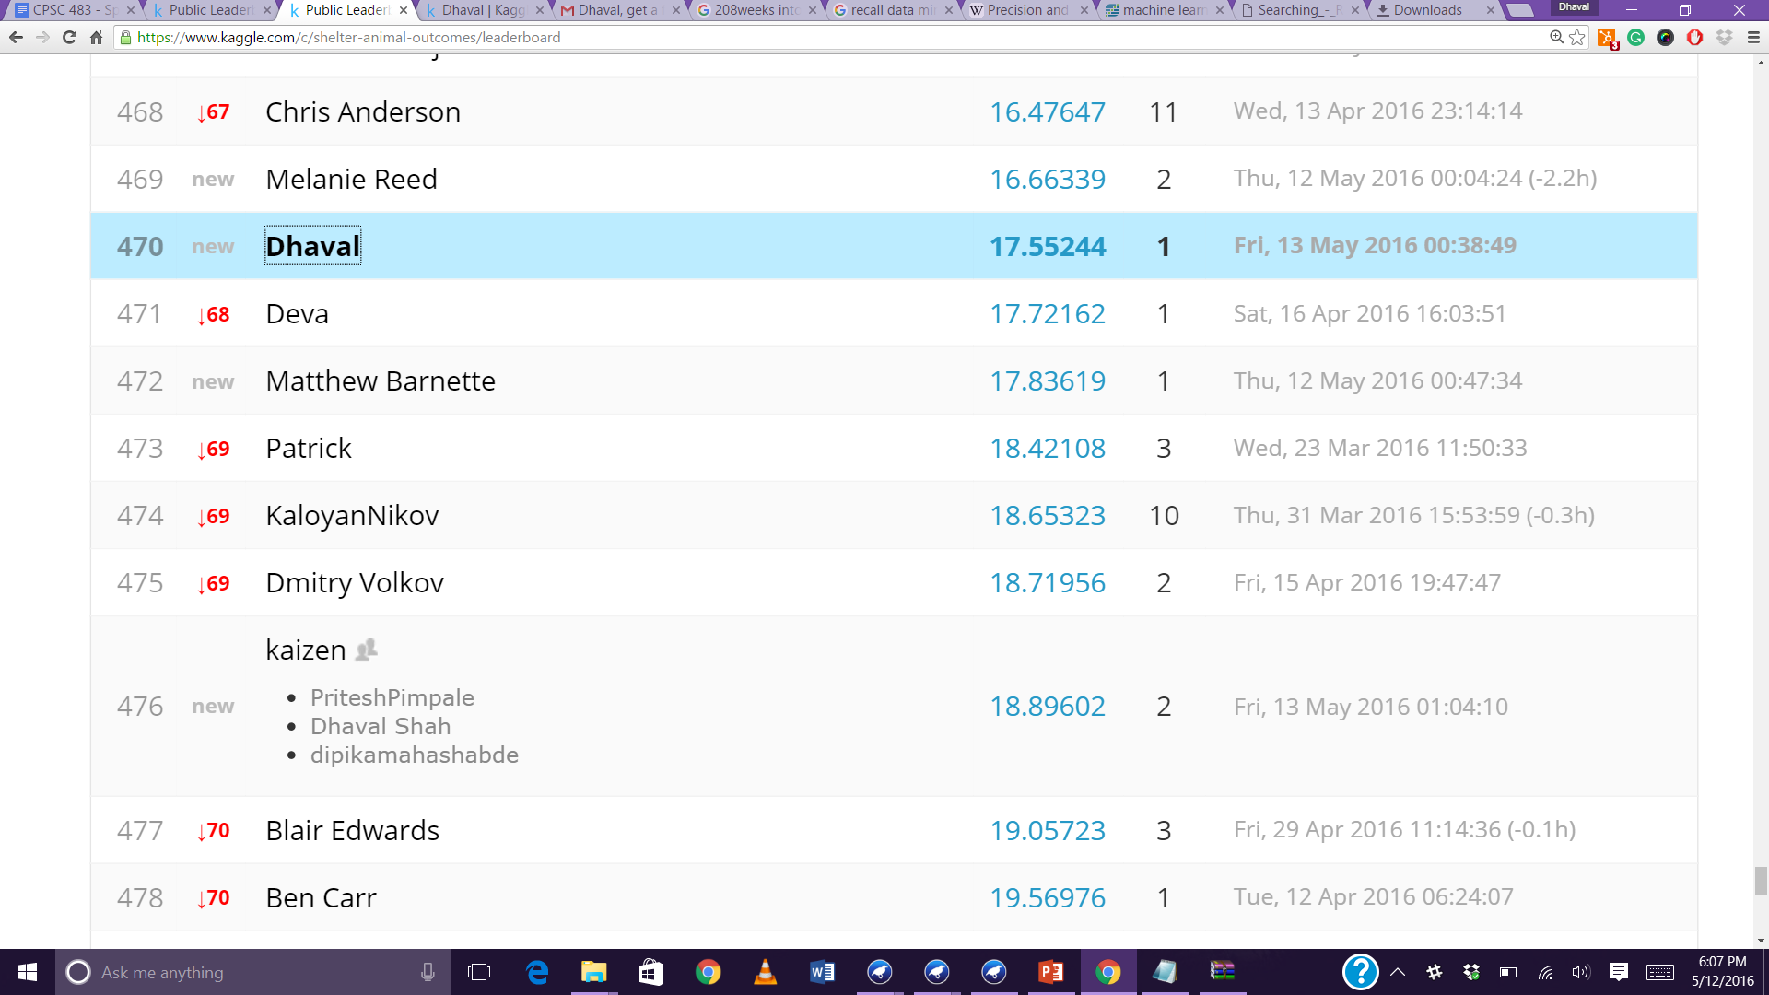
Your final outcome and Kaggle ranking
Initial Result 17.552 and ranking is 470

Slide 13
Thank You!

