Slide 1
CAREER COUNSELLING
Submitted by:
DIPIKA MAHASHABDE ( CWID : 803004274)
Piyusha Zanjad ( CWID : 893578021)
VIDHI PATEL( cwid : 893375105)
CPSC 583
Spring, 2016
Professor: Prof. Anand Panagadan
Department of Computer Science
California State University, Fullerton

Slide 2
Project introduction
High volume data generated from medical machines, patient's health records, financial records, biometric data, data on web, research data etc.
Career counselling helps to students to choose a particular field of study for their career.
Answering different set of questions will show the students aptitude.
Designed in CLIPS.
The information extracted from data can be used to shape better healthcare system.
Data can be in form of text (say doctor’s prescription or notes), images (like sonography report), numbers (hemoglobin count of a patient), or medical videos etc.
The data must be accurate to extract correct information.
Data is generated at high speed, may be in real time. E.g.: Patient's pulse rate

Slide 3
Design Methodology
The basic idea of the project is :
The system will ask the user to take a test which will contain different sets of questions.
Questions will be asked from a wide range of areas of studies.
The user will be asked to enter the answers from the given options.
Based on the answer, the system will evaluate the user by showing the aptitude of the user in every field. (For example Engineering =60 %, Arts =30 % etc.)
Depending upon the percentage displayed, the user can decide the field in which he is proficient.

Slide 4
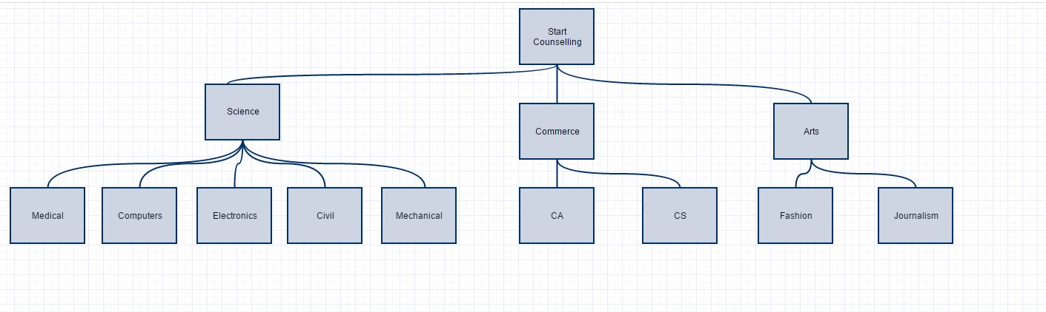
Design methodology – TREE
(Physics, Chemistry ,Maths and Biology)

Slide 5
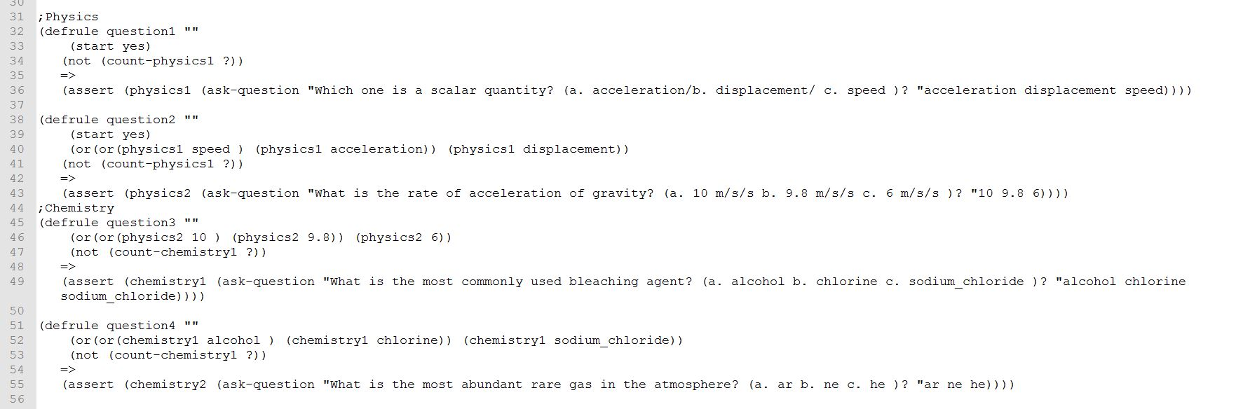
Design Methodology

Slide 6
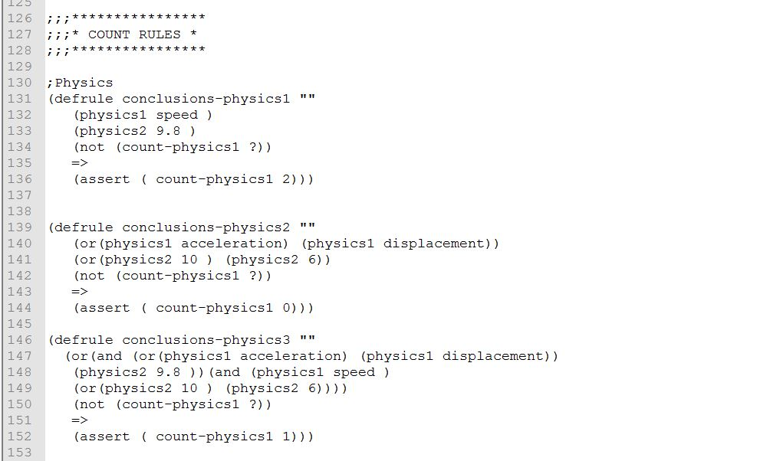
Design Methodology

Slide 7
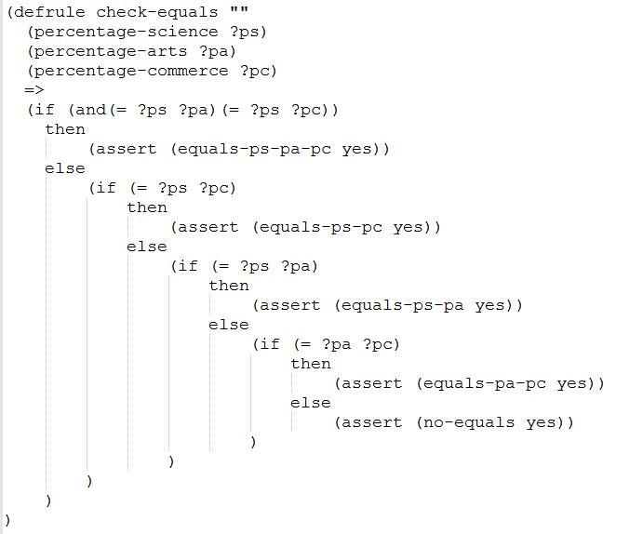
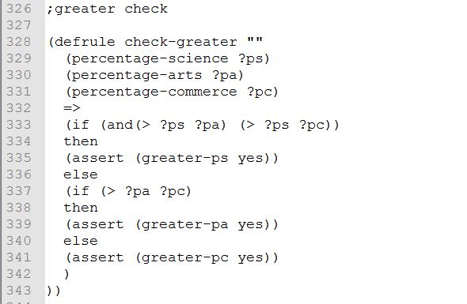
Design Methodology

Slide 8
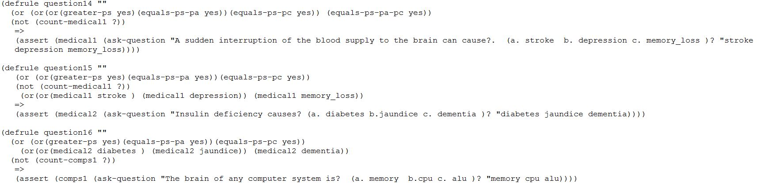
Design Methodology

Slide 9

DEmo

Slide 10
CAREER COUNSELLING
Thank you!!
Questions??

