Slide 1
ANALYSIS OF IMPORTS AND EXPORTS IN NEW ZEALAND

Slide 2
Objective:
The group finding involves any relationship in temperature, immigration and food price index with the export and import in new Zealand.
Notes:
https://adage.com/article/adage-encyclopedia/telemarketing-overview/98900
https://www.grandviewresearch.com/press-release/global-business-process-outsourcing-bpo-market
https://www.transparencymarketresearch.com/outbound-telemarketing-market.html

Slide 3
Solution Overview
Collection of datasets
Scraping of other related datasets
Investigation of the data taken
Cleaning untidy datasets
Finding appropriate packages for
Creation of dataframes
Relational dataframes
Plotting
Use of Git Version Control for the coordination among team members
Notes:
https://www.hfsresearch.com/market-analyses/apac-it-services-and-bpo-market-size-and-forecast-2016-2020
https://twitter.com/HFSResearch/status/770618173632737280
https://www.transparencymarketresearch.com/outbound-telemarketing-market.html

Slide 4
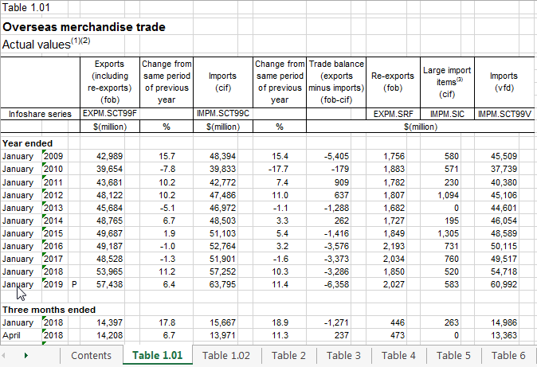
Collection of datasets:
Overseas
Merchandise
Trade

Slide 5
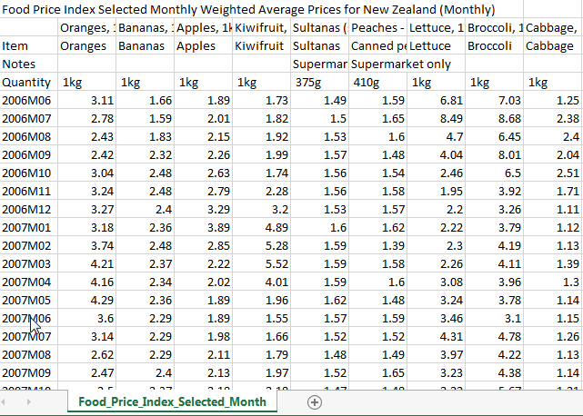
Collection of datasets:
Food
Price
Index

Slide 6
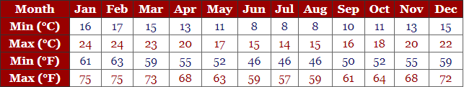
Scraping of related datasets:
Temperature in New Zealand:

Slide 7
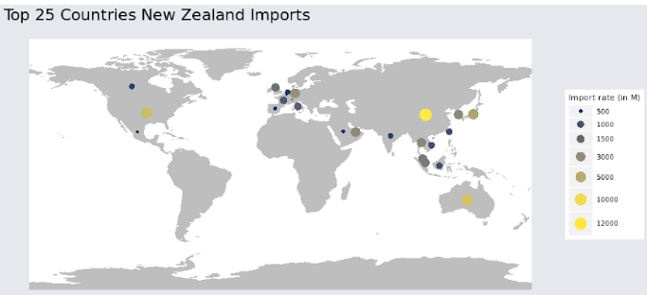
Exploration of the data:

Slide 8
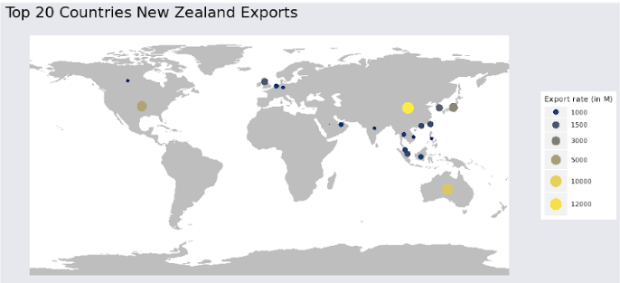
Exploration of the data:

Slide 9
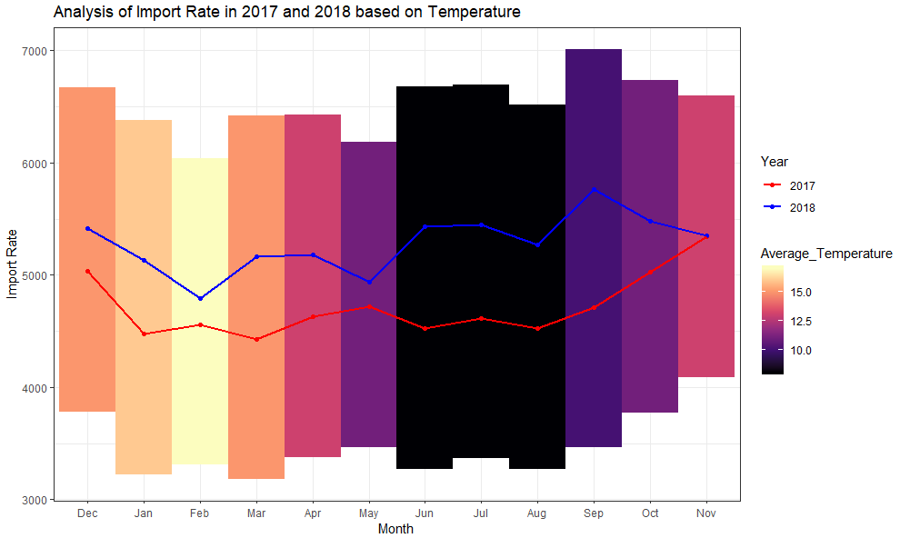
Exploration of the data:

Slide 10
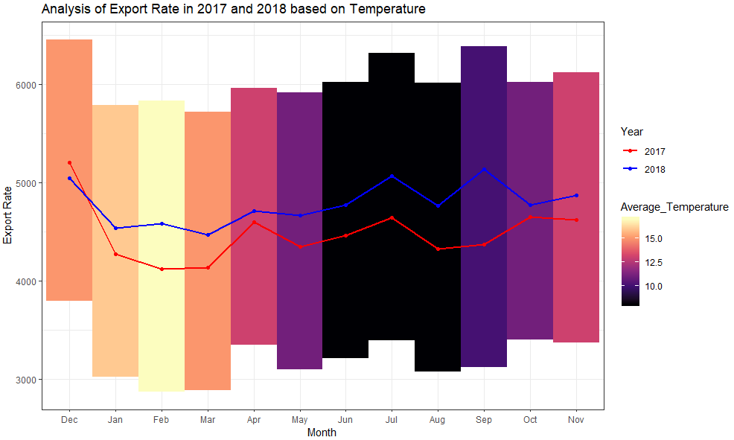
Exploration of the data:

Slide 11
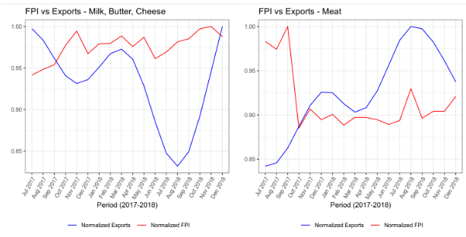
Exploration of the data:

Slide 12
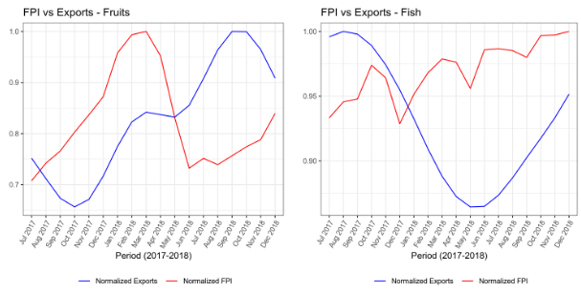
Exploration of the data:

Slide 13
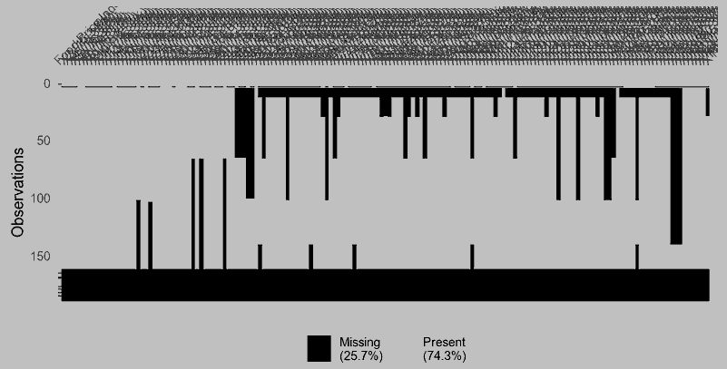
Exploration of the data:
Graph for NAs of the Food Price Index dataset

Slide 14
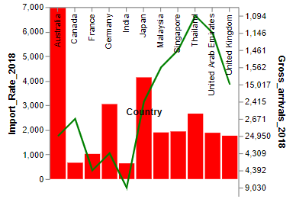
Exploration of the data:
Immigration and Import Rates based on Countries

Slide 15
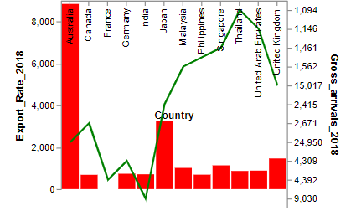
Exploration of the data:
Immigration and Export Rates based on Countries

Slide 16
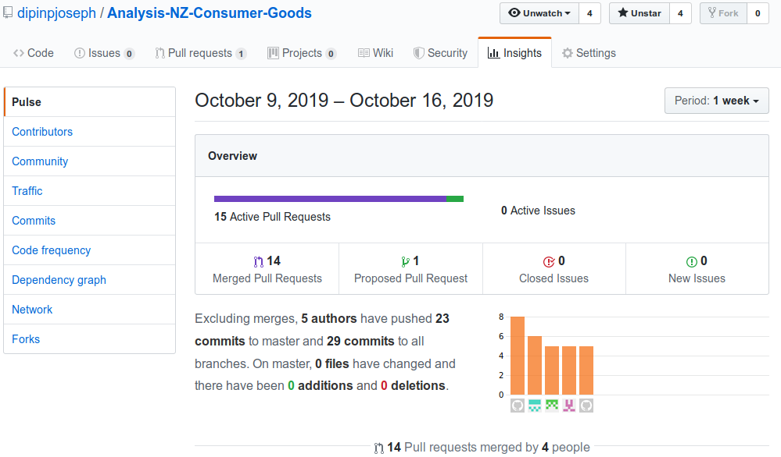
Git Version Control of “Team 5”

