Slide 1
Fine ART FRenzy
Team Name: Hackathon e Hack Kore na
Members:
Ahnaf Tahmid
Dipit Saha
Abrar Jahin

Slide 2
Topic: Supply chain application for authentic artworks and premium collectibles

Slide 3
Phase-1 Implementation of 3 stakeholders to interact with the web application
Push the users’ addresses into separate arrays depending on their response
Supplier, Verifier
Buyers are kept anonymous, and not kept track for

Slide 4
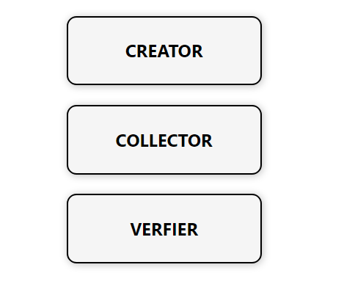

Slide 6
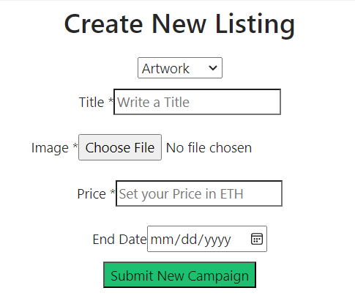

Slide 7
Used:
React.jsx for frontend works
CSS for styling
Solidity for smart contracts
Hardhat for deploying
Ether.js for linking frontend and backend

Slide 8
THANK YOU

