Slide 1
♪
AURALIN
MUSIC PLAYER
A Modern JavaFX Desktop Music Application
Dip Karmokar | OOP Project | 2026
JavaFX 25 · mp3agic · MVC Architecture · Windows Installer · Bundled JRE

Slide 2
Agenda
What we'll cover today
01 Introduction & Motivation
02 System Architecture
03 Key Features
04 Implementation & Patterns
05 Data Persistence
06 UI/UX Design
07 Challenges & Solutions
08 Conclusion & Future Work
Auralin Music Player | Dip Karmokar
2

Slide 3
Introduction
What is Auralin Music Player?
What is Auralin?
Goals & Scope
Modern desktop music player
Built with JavaFX 25 + Java
Inspired by Spotify dark UI
Motivation
Existing players lack modern UI
Deep dive into JavaFX MVC
Tech Stack
JavaFX 25, mp3agic, Inno Setup
launch4j, jlink bundled JRE
Fast startup — no MediaPlayer on load
Persistent library across sessions
Open With — default MP3 player
Custom frameless Win11 window
Deliverables
Runnable .exe installer
Bundled JRE — no Java needed
Full MVC architecture
Auralin Music Player | Dip Karmokar
3

Slide 4
System Architecture
MVC + Observer + Facade + Strategy
MODEL
VIEW
CONTROLLER
Song.java
HomeView
PlayerController
title, artist
LibraryView
ViewManager
filePath
SearchView
DatabaseService
<->
<->
liked, plays
LikedView
FileImportService
lastPlayed
SongTable
PlayerBar.Listener
getDurationStr()
PlayerBar
MusicCard.Listener
Sidebar
Auralin Music Player | Dip Karmokar
NowPlayingView
4

Slide 5
Key Features
Everything Auralin can do
Library Management
Real-time Search
Liked Songs
Home View
Add files & folders, ID3 tags
Filter songs instantly
Heart toggle + persistent
Recent + Recommended grids
Now Playing
Auto-Save
Open With
Custom Window
Full-screen artwork overlay
Library persists on restart
Register as default MP3 player
Frameless + Win11 controls
Auralin Music Player | Dip Karmokar
5

Slide 6
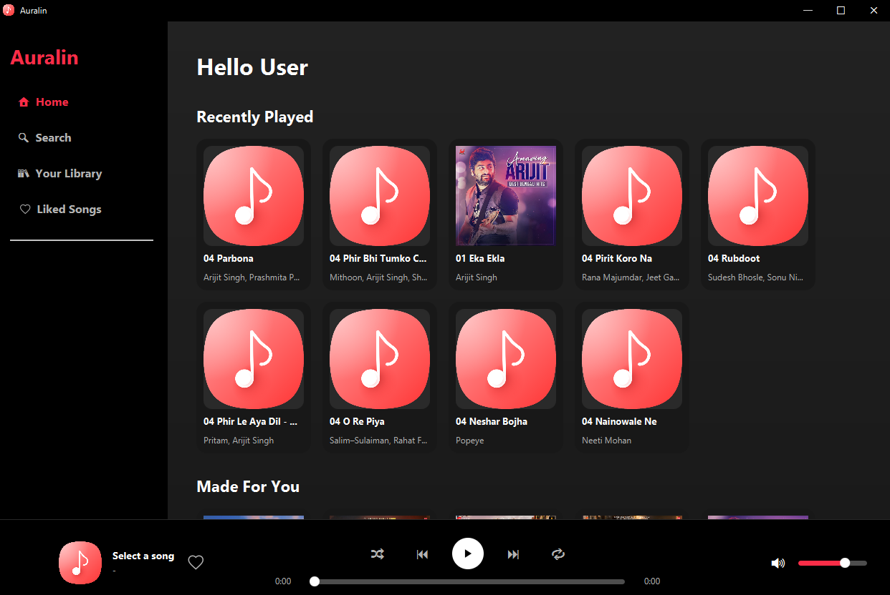
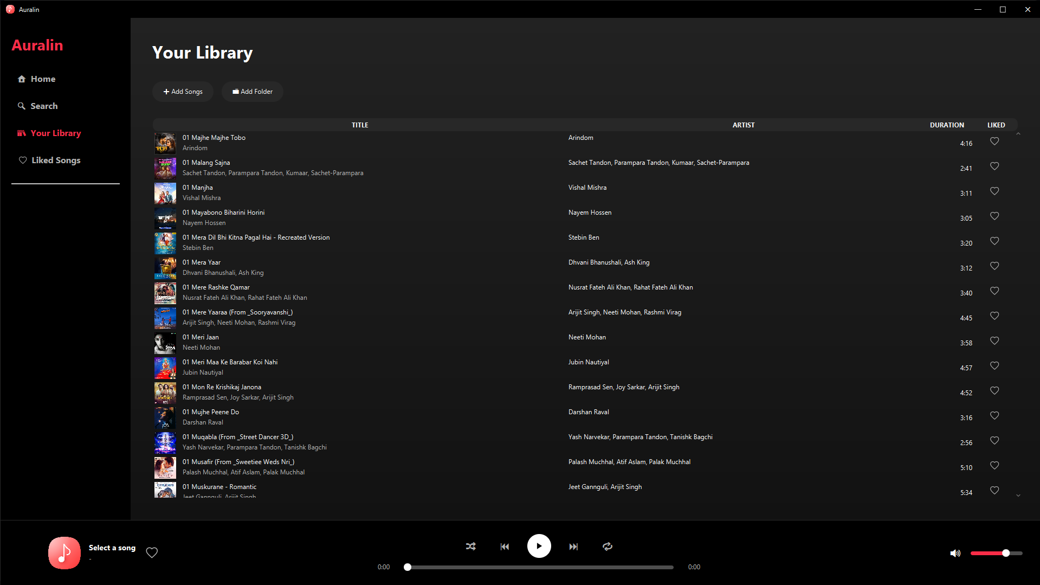
Home View & Library
Screenshots from Auralin Music Player
Home View — Recently Played & Recommendations
Library View — Song Table with Artwork
Auralin Music Player | Dip Karmokar
6

Slide 7
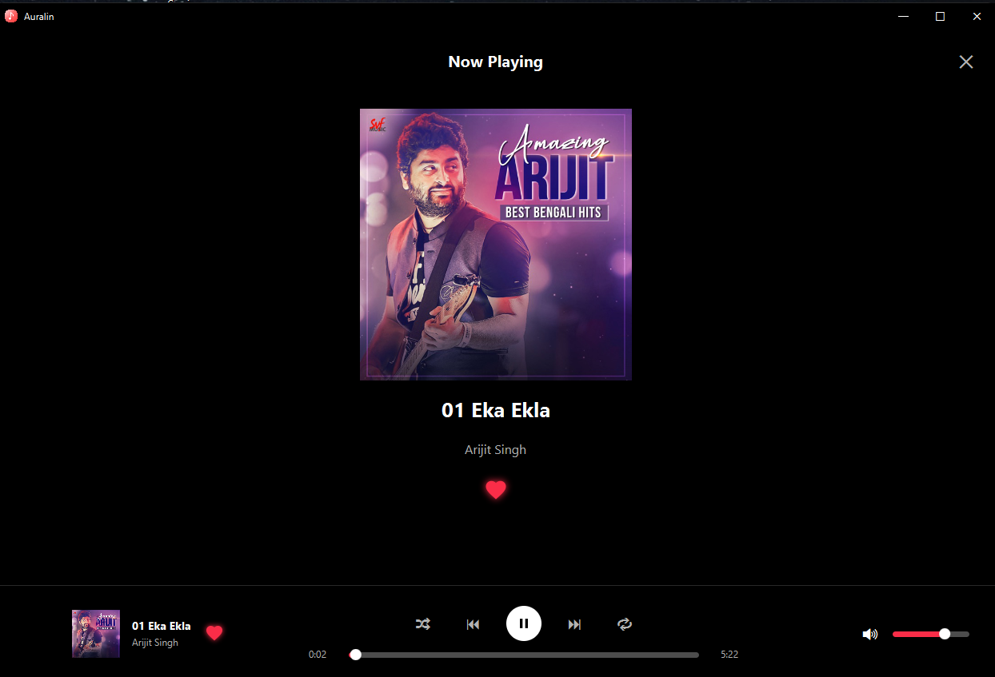
Now Playing & Liked Songs
Full-screen overlay and liked songs view
Now Playing — Full-screen artwork overlay
Liked Songs — Filtered heart-toggled songs
Auralin Music Player | Dip Karmokar
7

Slide 8
Music Playback & Controls
PlayerController + PlayerBar
PlayerController
PlayerBar Component
JavaFX MediaPlayer for audio
Play / Pause / Next / Previous
Shuffle — random song selection
Repeat — loop current song
Seek bar — jump to position
Volume control slider
Callbacks
onSongChange, onLikeChange
onPlayStateChange
Always visible at bottom
Shows artwork thumbnail
Song title + artist name
Progress bar with time
Heart button for like/unlike
Volume slider
Design
Listener interface pattern
Decoupled from controller
Auralin Music Player | Dip Karmokar
8

Slide 9
Design Patterns Used
Clean architecture through proven patterns
MVC
Observer
Model-View-Controller separates data, UI, and logic cleanly
Callbacks: onSongChange, onLikeChange, onPlayStateChange
Strategy
Facade
Shuffle vs Sequential playback — swappable at runtime
DatabaseService hides mp3agic + MediaPlayer complexity
Factory
Singleton
SongTableListener / MusicCardListener interface factories
DatabaseService — single source of truth for all song data
Auralin Music Player | Dip Karmokar
9

Slide 10
Data Persistence & Storage
Library survives app restarts
Save File: %APPDATA%\AuralinPlayer\library.dat
filePath | liked | plays | lastPlayed | artist | durationMs
Save Triggers
Load on Startup
On song play — recordPlay()
On like toggle — saveToDisk()
On app close — stop()
Background thread — non-blocking
Why Fast?
mp3agic reads tags directly
No MediaPlayer on startup
Thread pool (3 threads)
Read pipe-separated lines
Skip missing files automatically
Restore: liked, plays, lastPlayed
Restore: artist, durationMs
Artwork Loading
Background thread per song
Platform.runLater for UI update
Table refreshes incrementally
Auralin Music Player | Dip Karmokar
10

Slide 11
UI/UX Design Highlights
Premium dark aesthetic inspired by Spotify
Background
Card
Auralin Red
Purple
Cyan
Gray
#090909
#1A1A28
#FA2D48
#8B5CF6
#06B6D4
#94A3B8
Custom Window
Components
StageStyle.TRANSPARENT
Custom title bar (32px)
Win11-style min/max/close
8-edge resize handles
Rounded corners (radius 10)
Screen-aware sizing on start
MusicCard — 160px hover card
SongTable — custom TableView
PlayerBar — bottom fixed bar
Sidebar — navigation panel
NowPlayingView — overlay
ScrollPane hidden scrollbars
Auralin Music Player | Dip Karmokar
11

Slide 12
Challenges & Solutions
Real problems solved during development
Slow startup
Cause: MediaPlayer for each song on load
Fix: mp3agic reads tags; no MediaPlayer needed
Scrollbar appearing
Cause: TableView internal ScrollPane
Fix: skinProperty listener hides bars post-skin
Missing DLLs in EXE
Cause: jlink skips JavaFX native DLLs
Fix: Copy javafx/bin/*.dll into runtime/bin/
Data not persisting
Cause: No save mechanism existed
Fix: Pipe-separated file with all metadata cached
Open With missing
Cause: App not registered in Windows
Fix: Inno Setup registry + FriendlyAppName key
Auralin Music Player | Dip Karmokar
12

Slide 13
Installer & Deployment
Zero-dependency Windows installer
1
2
3
4
5
Compile Java
Fat JAR
jlink JRE
launch4j
Inno Setup
->
->
->
->
javac -> .class
jar + mp3agic
80MB bundled JRE
JAR -> .exe
Full installer
What the installer does
Installs AuralinPlayer.exe + bundled runtime to Program Files
Registers .mp3 Open With association in Windows registry
Creates Desktop + Start Menu shortcuts with custom icon
Includes EULA acceptance screen | Full uninstall support
Auralin Music Player | Dip Karmokar
13

Slide 14
Conclusion & Future Work
What was achieved and what comes next
Achievements
Future Work
Full-featured music player
Modern Spotify-inspired dark UI
MVC architecture with patterns
Persistent library — fast startup
Bundled JRE installer
Open With MP3 registration
Custom frameless Win11 window
Background metadata loading
Equalizer & audio effects
Online streaming integration
Playlist & queue management
Cross-platform Linux/macOS
Album & artist grouping
Lyrics display integration
Mini player mode
Cloud sync for library
Auralin Music Player | Dip Karmokar
14

Slide 15
♪
Thank You!
Auralin Music Player
Dip Karmokar | OOP Project | 2026
Questions? Let's discuss!

