Slide 1

Notes:
Opening banner of IEEE CSDE 2026 and IEEE i-COSTE 2026, Cox’s Bazar. Greet the session chair and audience.

Slide 2




11th IEEE Asia-Pacific Conference on Computer Science and Data Engineering (IEEE CSDE 2026)
Paper ID: 5567
Crop Yield Prediction Using Explainable Machine Learning on Multi-State Agricultural Data
Dip Khastagir
Department of Computer Science, American International University-Bangladesh (AIUB), Dhaka, Bangladesh
23-50346-1@student.aiub.edu
1–3 November 2026
Best Western Heritage, Cox’s Bazar, Bangladesh
Notes:
Introduce yourself: Dip Khastagir, Department of Computer Science, AIUB. Paper ID 5567. One-line pitch: high crop-yield accuracy on public panels can be an artefact of evaluation design; this work audits leakage and reports an honest, uncertainty-aware forecast.

Slide 3
Presentation Outline
01
02
03
04
Introduction
Objectives and Contributions
Related Works
Dataset and Workflow
05
06
07
08
Leakage Audit and Evaluation Protocol
Results and Discussion
Conclusion and Future Work
References
Notes:
Walk through the eight parts of the talk.

Slide 4



Introduction
Background
72.3%
Crop-yield forecasts guide seed selection, irrigation, fertilizer allocation and food-security policy. Machine learning can learn yield patterns from public agronomic records.
Problem Statement
of test targets re-enter training as lag features under a row-level random split
Models built on public yield panels often report near-perfect accuracy that can hide target leakage, interpolation between neighbouring years and pooled-crop scale effects.
Motivation and Contribution
A leakage-audited framework that reports an honest one-year-ahead forecast, calibrated uncertainty, explanations and transfer to unseen states and crops.
Source: leakage audit (Table II)
Notes:
Crop yield prediction is a decision-support necessity. ML offers a scalable route, but published accuracies on public panels can be misleading. The key number: under a row-level random split, 72.3% of test targets re-enter training as lag features.

Slide 5



Why Near-Perfect Accuracy Can Mislead
Target leakage
Cross-row interpolation
Pooled-crop scale
Yield is production divided by area, so a model given both columns can recover the label by arithmetic.
A random split puts neighbouring years of the same (state, crop, season) series in both train and test.
Coconut is counted in nuts per hectare, so a few crops dominate raw error and pooled R².
R² = 0.990
72.3%
≈111,621×
production ÷ area vs reported yield
test targets reused as training lags
spread of median yield across crops
Reported accuracy can reflect evaluation design rather than forecasting skill, so this work audits the pipeline before trusting any score.
Notes:
Three traps inflate reported accuracy: (1) target leakage through production, (2) interpolation between neighbouring years of the same series under random splits, and (3) pooled-crop scale effects where coconut dominates raw error.

Slide 6
Research Objectives
01
02
03
Audit the pipeline
Forecast honestly
Quantify trust
Detect missingness, duplicates, target leakage and cross-row reuse before any model is fitted.
Benchmark 12 algorithms, tuning and stacking under a temporal hold-out, always against persistence.
Deliver calibrated conformal intervals, SHAP explanations and transfer tests to unseen states and crops.
RESEARCH QUESTION
Once leakage and cross-row reuse are removed, how much real skill do ML models add over repeating last year’s yield, and how far does that skill transfer?
Notes:
Three objectives: audit, forecast honestly, and quantify trust. The research question asks how much real skill ML adds over simply repeating last year's yield once leakage is removed.

Slide 7
Six Key Contributions
1
2
3
Data-quality audit
Leakage detection
Variance decomposition
Missingness, duplicates, invalid targets and temporal coverage documented before modelling.
Production and its proxies excluded; the feature set of [3] flagged as a leakage risk.
Fertilizer and pesticide shown to encode state-year intensity rates, not crop dosages.
4
5
6
Multi-split testing
Conformal uncertainty
Explainability and transfer
Random, series-grouped, temporal, spatial and cold-start regimes on one log scale.
Split-conformal intervals reach 94.9% coverage at a 95% target under temporal shift.
TreeSHAP attributions plus leave-one-crop-out transfer with a growth-rate target.
Notes:
Six innovations relative to prior work: audit, leakage correction, variance decomposition of fertilizer/pesticide, multi-split testing, conformal uncertainty, and explainability with transfer.

Slide 8
Related Works at a Glance
Ref | Year | Dataset | Method | Key result | Limitation
[1] | 2022 | Remote-sensing studies, 2012–2022 | Review of CNN and LSTM | Vegetation indices most influential | No unified benchmark
[2] | 2023 | DSSAT-simulated sunflower, wheat; Spain | RF, ANN, linear regression | Time-based split lowers accuracy | Simulated, not real, data
[3] | 2023 | Indian panel incl. area and production | DT, RF, XGBoost, CNN, LSTM | RF 98.96% accuracy, RMSE 2.45 | Coarse aggregation
[4] | 2023 | Soybean, 173 counties, China, 34 years | Stacking: KNN + RF + SVR | MAPE below 5% | China only; weather only
[5] | 2024 | Cotton, Faisalabad, Pakistan | RF + XGBoost hybrid (RFXG) | Beats single ML baselines | Single-region case study
[6] | 2024 | Maize hybrid ZhengDan 958, China | XGBoost, GBR, MLP | XGBoost best with weather | Single maize hybrid
[7] | 2025 | Wheat breeding-centre data | SVR, RF, XGBoost + selection | XGBoost R² 0.916 | Complex selection pipeline
[8] | 2024 | 47+ studies, multiple sources | Review of ML and DL | Fusing sources improves accuracy | High heterogeneity
[9] | 2023 | MARS (EU JRC), wheat and maize | LSTM, 1D-CNN vs GBDT | LSTM matches or beats GBDT | Approximate attributions
[10] | 2025 | Landsat + KBS LTER, Michigan | Deep learning regression | 89.44% accuracy (band-based) | Single site, three crops
Notes:
Ensemble and boosting methods dominate on tabular data; deep sequence models appear with remote sensing; interpretability is growing. Most studies cover a single crop, region or short period, and few examine whether evaluation design inflates accuracy or report uncertainty.

Slide 9

Research Gaps and How This Work Responds
GAP IN PRIOR WORK
HOW THIS WORK RESPONDS
Single crop, region or short period [4]–[6], [10]
55 crops, 30 states and 24 years of observed data
Simulated data or leakage-prone inputs [2], [3]
Production excluded, 13 pipeline assertions and a permutation test
Random splits overstate real-world accuracy [2]
Seven split regimes, with persistence skill reported throughout
Single-run metrics and no prediction intervals [3]–[5]
15 paired rolling-origin tests and crop-wise conformal intervals
Approximate or global-only attributions [9]
Exact local and group-wise TreeSHAP, plus transfer to unseen states and crops
Notes:
Map each gap in prior work to the corresponding design decision in this framework.

Slide 10
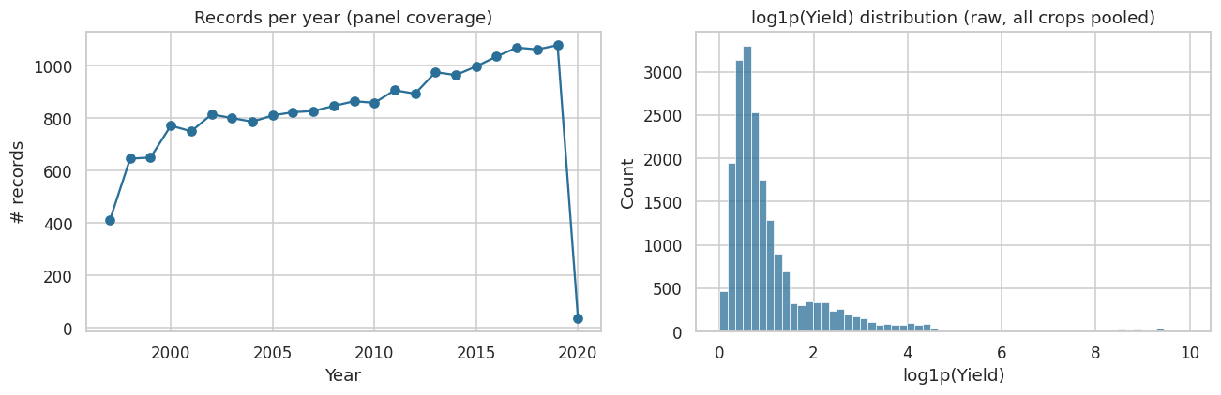
Dataset: A Multi-State Indian Crop Panel
19,689
55
30
24
records
crops
states and union territories
years (1997 to 2020)
Ten attributes per record
Crop
Crop year
Season
State
Area
Production (excluded)
Annual rainfall
Fertilizer
Pesticide
Yield (target)
Records per year (left) and distribution of log1p(yield) across all crops (right)
Source: Kaggle panel [11], compiled from the APY system of India’s Ministry of Agriculture [12]
Notes:
State-level Indian panel from Kaggle, compiled from the Ministry of Agriculture APY system. 19,689 records, 55 crops, 30 states and UTs, 1997 to 2020. Production is present in the data but excluded from all models.

Slide 11

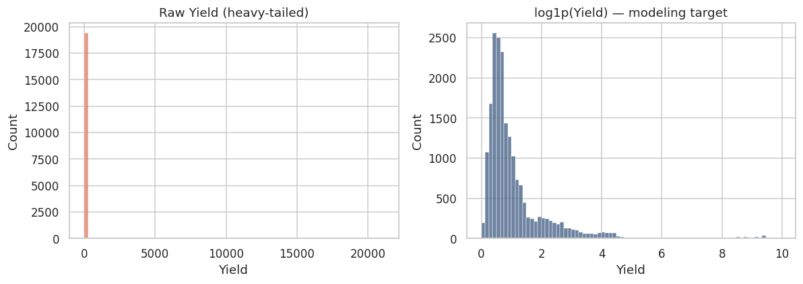
Data Integrity and Scale Heterogeneity
No missing cells
≈111,621×
All ten columns are complete in every record
spread of median yield across crops (coconut is counted in nuts per hectare)
No duplicate records
No exact duplicates or repeated (crop, year, season, state) keys
112 zero-yield rows removed
19,577 valid rows remain for modelling
Log-scale target
log1p(yield) puts all crops on one comparable scale
Raw yield is heavily tailed (left); log1p(yield) is the modelling target (right)
Notes:
The audit found no missing cells, duplicates or repeated keys and removed 112 zero-yield rows, leaving 19,577. Median yield spans a factor of about 111,621 across crops, so all modelling is on log1p(yield).

Slide 12

Proposed Leakage-Audited Workflow
1. Data
2. Audits
3. Features
4. Models
5. Evaluation
19,689 rows
55 crops
30 states
1997 to 2020
Data quality
Leakage (13 checks)
No production
Permutation test
log1p target
Per-hectare rates
Lag and rolling mean
Past information only
12 algorithms
Optuna TPE
Out-of-fold stacking
Train up to 2015
Split regimes
Significance tests
Conformal intervals
SHAP and transfer
Leakage-safe pipeline: every stage uses training years only. Audits run before any model is fitted, and the test years are used once.
Notes:
Fig. 1 of the paper. Records pass integrity and leakage audits before any fitting; features use only pre-harvest information; models are tuned and stacked on training years; the final stage evaluates generalization, significance, uncertainty, explanations and transfer.

Slide 13


Target-Leakage Audit
Check | Result
Production/Area formula vs. reported yield (R²) | 0.990
RF, inputs of [3] incl. production (R²; MAE, RMSE) | 0.978 (6.54, 120.37)
RF, same inputs without production (R²) | 0.965
State-year cells with constant fertilizer rate | 100%
Pipeline assertions passed | 13 / 13
Permuted-target R²_{log}, best of 5 runs | −0.012
Test targets reused as training lags: random split | 72.3%
… temporal, spatial and series-grouped splits | 0%
Production removed
Production is unknown at forecast time and defines yield, so it is excluded from every model.
A risk, not a verdict
Rebuilding [3] gives R² 0.978 vs 0.965; their MAE and RMSE are not reproduced.
No hidden skill
A permuted-target refit scores R²_{log} = −0.012, and all 13 assertions pass.
Notes:
Table II. Production/Area reproduces reported yield with R² = 0.990. Rebuilding the inputs of Sharma et al. gives 0.978 with production vs 0.965 without. Their reported MAE and RMSE are not reproduced, so this is treated as a risk, not a confirmed cause. A permuted-target refit gives no skill.

Slide 14
Cross-Row Reuse and Pipeline Assertions
How the leak happens
In a row-level split, last year’s row of a series sits in training while this year’s row is tested, so the test target is already a training lag feature.
13 / 13 pipeline assertions passed
Fixed feature set
Lags re-derived independently
Shuffle-invariant preprocessing
No feature selection
Training-only baselines
Tuning on training years
Out-of-fold stacking
Disjoint calibration sets
Notes:
In a row-level random split, last year's row of a series sits in training while this year's row is tested, so the test target already appears as a training lag feature. Temporal, spatial and series-grouped splits close this channel completely. Thirteen code assertions guard the pipeline.

Slide 15




Feature Engineering
Target
log1p(yield): one comparable scale for all 55 crops
17,920
rows after dropping each series’ first year
Categorical
Crop, season and state, one-hot encoded
94.3%
follow the previous record by exactly one year
Agronomic
Log area, rainfall, fertilizer and pesticide per hectare, rainfall × fertilizer, crop year
Rates, not raw totals
Raw fertilizer and pesticide track area (ρ = 0.997, 0.993); per-hectare rates do not (ρ = −0.10).
History
Previous yield and the mean of up to three earlier yields, from strictly earlier rows of each (state, crop, season) series
Notes:
Target is log1p(yield). Crop, season and state are one-hot encoded. Numeric inputs use per-hectare rates rather than raw totals. Two history features come from strictly earlier rows of each series. Raw fertilizer and pesticide are area times a regional rate, so only rates are used.

Slide 16
Evaluation Protocol: Seven Split Regimes
Tuning fit: 1997–2012
Val. 2013–15
Test: 2016–2020
Final models train on all years up to 2015 (13,761 rows) and are scored once on 2016–2020 (4,159 rows)
Regime | Deployment scenario | Test n
Random row-level 80/20 | Reference only (gap filling) | 3,584
Series-grouped 5-fold | New (state, crop, season) series | 17,920
Temporal hold-out | One-year-ahead forecast | 4,159
Temporal strict | Forecast with no data after 2015 (lags frozen) | 3,991
Spatial, six states | New states: Haryana, Himachal Pradesh, Maharashtra, Meghalaya, Sikkim, Uttar Pradesh | 3,407
Spatial LOSO (30 folds) | Every state held out in turn | 17,920
LOSO cold start | New state without yield history | 17,920
Metrics on log1p(yield): R²_{log}, RMSE_{log} and MdAPE. Skill = 1 − RMSE_{log} / RMSE_{log} of persistence (repeat last year’s yield).
Notes:
Each regime is tied to a deployment scenario. The temporal hold-out trains on years up to 2015 (13,761 rows) and tests on 2016 to 2020 (4,159 rows). Six spatial test states were selected at random with seed 42. All metrics are on log1p(yield) so they compare across regimes.

Slide 17

Models, Tuning and Stacking
12 algorithms across seven families
Linear
Kernel
Instance
Tree
Bagging
Boosting
Neural
Ridge, Lasso
SVR
KNN
Decision Tree
Random Forest, Extra Trees
GBR, XGBoost, LightGBM, CatBoost
MLP
Optuna TPE tunes five families: fit on years before 2013, score RMSE_{log} on 2013–2015. The lowest validation error selects Extra Trees (0.2002).
Out-of-fold stacking architecture
LightGBM
Training data (≤ 2015, 11 inputs)
GroupKFold (5 folds by series)
Out-of-fold predictions
RidgeCV meta-learner
Yield forecast
XGBoost
Random Forest
Notes:
Twelve algorithms from seven families with fixed settings. Five families tuned with Optuna TPE, fitted on years before 2013 and scored on 2013–2015. Lowest validation error selects Extra Trees. The stack combines tuned LightGBM, XGBoost and RF with out-of-fold predictions grouped by series and a RidgeCV meta-learner.

Slide 18



Testing, Uncertainty, Explanation and Transfer
Significance testing
Conformal intervals
15 rolling origins (2006–2020), each refitted on all earlier years. Friedman test over 8 models, then exact Wilcoxon on 28 pairs, Holm-corrected.
Split-conformal on (A) raw residuals, (B) log residuals and (C) log residuals per crop, checked under random, temporal and spatial shift.
Explanation
Transferability
Exact TreeSHAP on the tuned LightGBM, which matches Extra Trees (RMSE_{log} 0.195) at far lower cost; one-hot columns summed to parents.
Leave-one-crop-out and KMeans crop-family hold-outs, comparing the level target with a growth-rate target log(1+yₜ) − log(1+yₜ₋₁).
Notes:
Significance uses 15 rolling origins with Friedman and Holm-corrected Wilcoxon tests. Conformal intervals: A raw residuals, B log residuals, C log residuals per crop (Mondrian). TreeSHAP on LightGBM, which reaches the same test error as Extra Trees. Transfer via leave-one-crop-out with level vs growth-rate targets.

Slide 19
Generalization Across Split Regimes
0.974
Random split is the most optimistic: 72.3% of its test targets leak in as lags.
0.969 / 0.961
Temporal hold-out and strict variant: skill holds, 0.967 → 0.962 from one to four years ahead.
0.861
Cold start in a new state without history falls below persistence (skill −1.014).
Notes:
Table IV. The random split is most optimistic because 72.3% of its test targets appear as training lags. Temporal hold-out 0.969, strict variant 0.961, declining only from 0.967 to 0.962 over one to four years ahead. LOSO 0.968 (per-state mean 0.918). Cold start falls to 0.861, well below persistence.

Slide 20
Temporal Hold-Out Benchmark (2016–2020)
SELECTED ON VALIDATION YEARS
Tuned Extra Trees
0.970
0.195
R²_{log}
RMSE_{log}
10.2%
0.982
MdAPE
raw R²
Kernel, linear and instance-based models lose to persistence: negative skill means losing to last year’s yield, not to the mean.
Beats persistence
Baseline
Loses to persistence
Notes:
Table V, fixed settings. Boosting and bagging lead; kernel, linear and instance-based models fall below persistence. Negative skill means losing to last year's yield, not to the mean. The validation-selected tuned Extra Trees reaches R²log 0.970, RMSElog 0.195, MdAPE 10.2% and raw R² 0.982 (0.721 without coconut).

Slide 21
Tuning and Stacking Results
Model | Trials | Selected values | Val. RMSE_{log}
Extra Trees | 20 | 153 trees, depth 19, leaf 8, features 0.95 | 0.2002
Random Forest | 20 | 299 trees, depth 12, leaf 1, features 0.25 | 0.2004
XGBoost | 40 | 197 trees, lr 0.027, depth 5, λ 0.11 | 0.2015
LightGBM | 40 | 115 trees, lr 0.069, 17 leaves, depth 9 | 0.2065
Ridge | 30 | α = 3.1 × 10⁻⁴ | 0.3771
RidgeCV meta-learner weights
The stack only matches a simple average, so it is a tested design choice rather than the main contribution. XGBoost scored slightly higher on test but was not selected.
LightGBM 0.70
Random Forest 0.32
XGBoost ≈ 0
Notes:
Table III and the tuned block of Table V. Extra Trees had the lowest validation error and was selected; XGBoost scored marginally higher on the test years but was not selected, to keep the test set untouched. The stack weights LightGBM 0.70, RF 0.32 and XGBoost near zero, and only matches a simple average.

Slide 22
Where the Predictive Skill Comes From
Pooled R² mostly reflects stable yield within each series. The real gain over persistence is about 6%, and agronomic inputs move RMSE_{log} by only −0.7%.
Notes:
Ablation on the temporal hold-out: history features alone reach R²log 0.970, matching the full model at 0.969; static inputs alone drop to 0.917 with skill −0.550. Global SHAP agrees: history holds 85.6% of mean absolute attribution, crop identity 9.1%, and each agronomic input below 1%.

Slide 23
Statistical Significance (15 Rolling Origins)
Model | Mean RMSE_{log} | Mean rank | Wins vs pers. | p_{Holm}
OOF stacking | 0.1997 | 2.60 | 13/15 | 0.024
Random Forest | 0.1990 | 2.73 | 12/15 | 0.050
Extra Trees | 0.2003 | 3.27 | 11/15 | 0.332
XGBoost | 0.2012 | 3.67 | 12/15 | 0.031
LightGBM | 0.2027 | 4.47 | 12/15 | 0.060
Persistence | 0.2139 | 5.60 | n/a | n/a
Three-year mean | 0.2160 | 5.67 | 9/15 | 1.000
Ridge | 0.3732 | 8.00 | 0/15 | 0.002
FRIEDMAN TEST
χ² = 59.42
p = 1.97 × 10⁻¹⁰: equal performance rejected across 15 origins
Significant gains
Stacking (p = 0.024) and XGBoost (p = 0.031) beat persistence after Holm correction.
Not robust
Extra Trees (p = 0.33): its single hold-out edge does not carry across origins.
Notes:
Table VI. Friedman rejects equal performance (chi-square 59.42, p = 1.97e-10). After Holm correction over 28 pairs, stacking (0.024) and XGBoost (0.031) beat persistence; RF (0.050) and LightGBM (0.060) fall just short; Extra Trees does not (0.33). Tree models do not differ from each other except stacking vs LightGBM (0.038). Ridge is significant but in the wrong direction (0 of 15 wins).

Slide 24
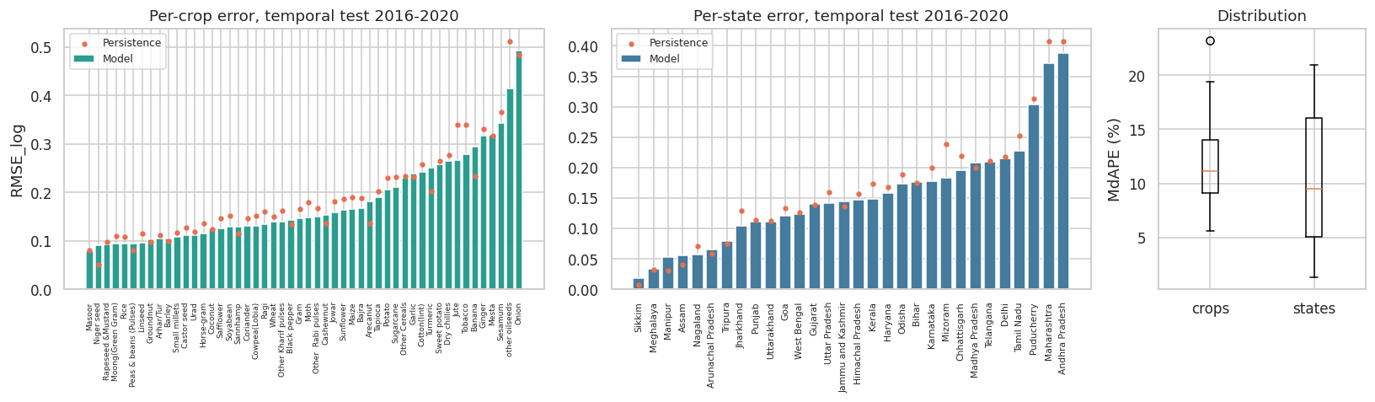
Per-Crop and Per-State Performance
RMSE on log1p(yield) per crop (left) and per state (middle) against persistence (red dots), and MdAPE distributions (right)
72%
0.148
67%
0.969
of crops beat persistence (rice best, MdAPE 5.6%)
median crop RMSE, IQR 0.113 to 0.236
of states beat persistence; 2018 the only losing year
R²_{log} after removing 3.9% carried-forward rows
Notes:
Fig. 3. Across 50 crops, median RMSElog 0.148 (IQR 0.113 to 0.236), median MdAPE 11.2%; the model beats persistence for 72% of crops, from rice (MdAPE 5.6%) to onion. Across 30 states, median RMSElog 0.146 with persistence beaten in 67%; Andhra Pradesh and Maharashtra are hardest; 2018 is the only test year persistence wins. No test feature vector occurs in training.

Slide 25
Crop and State Transferability
0.968
R²_{log} with every state held out in turn: transfer to unseen states stays strong.
78%
of sugarcane lags lie outside training support (a 4.5-IQR level gap), which explains its failure.
0.449 → 0.674
A growth-rate target lifts sugarcane; its crop family rises from 0.192 to 0.484.
Notes:
Table VII. Transfer to unseen states stays strong (LOSO R²log 0.968). For unseen crops, error tracks each crop's own volatility (rho 0.90), and excess error over persistence follows the yield-level gap (rho 0.54) rather than rainfall, area or fertilizer shift (|rho| ≤ 0.13). The growth-rate target lifts sugarcane to 0.674, its family from 0.192 to 0.484, and coconut from −201 to −10.

Slide 26
Uncertainty Quantification: Conformal Intervals
Setting | Method | Coverage | Med. width | Rel. width | Worst crop | Worst quint.
Temporal | A | 0.952 | 5.82 | 4.91 | 0.000 | 0.766
 | B | 0.948 | 1.54 | 1.30 | 0.777 | 0.880
 | C | 0.949 | 1.44 | 1.21 | 0.854 | 0.929
Spatial | A | 0.955 | 7.98 | 7.71 | 0.158 | 0.796
 | B | 0.952 | 1.64 | 1.55 | 0.675 | 0.875
 | C | 0.937 | 1.40 | 1.23 | 0.639 | 0.911
METHOD C · TEMPORAL SHIFT
94.9%
coverage at a 95% target
85.4%
worst-crop coverage
> 92.9%
every yield quintile
Method A (raw residuals)
Spatial shift
≈ 1.2×
Meets the marginal target but never covers coconut; its weakest quintile reaches only 76.6%.
Exchangeability fails: coverage dips to 93.7% and the worst crop to 63.9%.
median band vs prediction
Notes:
Table VIII, 95% target. On the random reference split all methods reach 94.4% to 95.0%. Under temporal shift, method C lifts the worst crop to 85.4% and every quintile above 92.9% at 94.9% overall coverage, with a median band about 1.2 times the prediction; at 90%, C covers 89.8%. Under spatial shift exchangeability fails: 93.7% coverage, worst crop 63.9%.

Slide 27
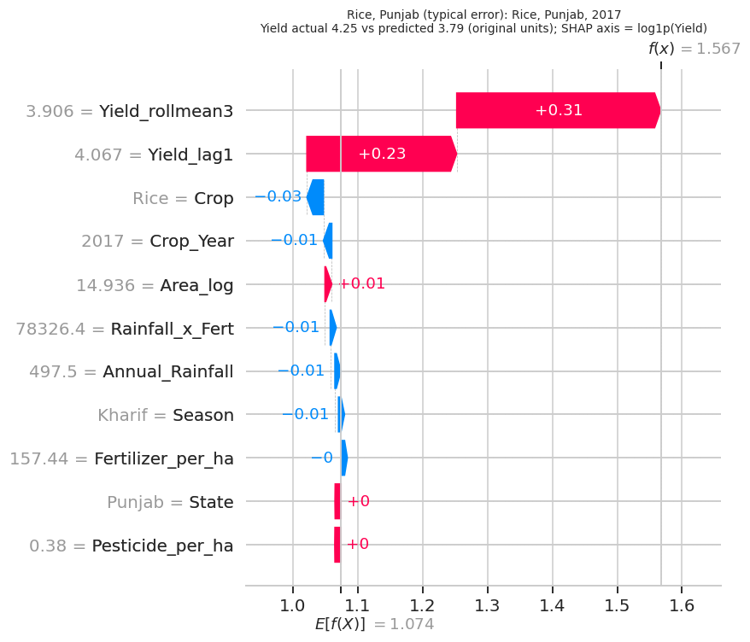
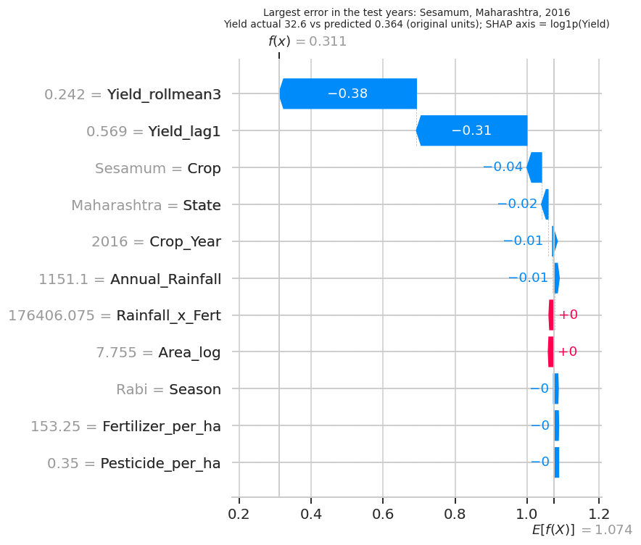
Local and Group-Wise Explanations
Rank agreement of SHAP importance (Kendall’s W)
0.900
across 12 frequent crops
0.804
across 24 well-sampled states
0.901
Rice, Punjab, 2017 (typical error)
Sesamum, Maharashtra, 2016 (largest error)
across four time periods
History features lift the forecast from the panel mean; each agronomic input moves it by about 0.01.
A sharp series break that no input signals drives the largest test error.
History ranks first and second everywhere; crop identity usually third.
Notes:
Fig. 4. For rice in Punjab 2017, the history features lift the forecast from the panel mean while each agronomic input moves it by about 0.01. The largest test error, sesamum in Maharashtra 2016, stems from a sharp series break that no input signals. Disaggregated SHAP keeps the global ranking across 12 crops, 24 states and four periods.

Slide 28

Conclusion and Future Work
Conclusion
Future Work
Near-perfect accuracy on public panels comes largely from evaluation design and stable yield history.
Honest one-year-ahead result: R² = 0.970 on log yield with a 10.2% median error, a real but modest gain over persistence.
Significant for stacking and XGBoost; transfers to unseen states with crop-wise intervals that hold coverage.
Add remote-sensing and seasonal weather covariates to raise skill beyond persistence.
Test shift-aware conformal methods for new regions.
Extend the panel beyond 2020.
Examine transfer across national boundaries.
Limitations: no field-level management or weather detail; fertilizer reflects only state-year rates; weaker interval coverage across states.
Notes:
Summarise: near-perfect accuracy comes largely from evaluation design and stable yield history. Honest one-year-ahead R²log 0.970, median error 10.2%, a real but modest gain over persistence, significant for stacking and XGBoost. Mention limitations, then future work.

Slide 29
References
[1] P. Muruganantham et al., “A systematic literature review on crop yield prediction with deep learning and remote sensing,” Remote Sensing, vol. 14, no. 9, p. 1990, 2022.
[2] A. Morales and F. J. Villalobos, “Using machine learning for crop yield prediction in the past or the future,” Front. Plant Sci., vol. 14, p. 1128388, 2023.
[3] P. Sharma, P. Dadheech, N. Aneja, and S. Aneja, “Predicting agriculture yields based on machine learning using regression and deep learning,” IEEE Access, vol. 11, pp. 111255–111264, 2023.
[4] J. Zhuang et al., “Ensemble learning prediction of soybean yields in China based on meteorological data,” J. Integr. Agric., vol. 22, no. 6, pp. 1909–1927, 2023.
[5] S. T. Haider et al., “An ensemble machine learning framework for cotton crop yield prediction using weather parameters,” IEEE Access, vol. 12, pp. 124045–124061, 2024.
[6] O. Ennaji, S. Baha, L. Vergutz, and A. El Allali, “Gradient boosting for yield prediction of elite maize hybrid ZhengDan 958,” PLOS ONE, vol. 19, no. 12, 2024.
[7] J. C. Moreno Sánchez et al., “Improving wheat yield prediction through variable selection using SVR, RF and XGBoost,” Smart Agric. Technol., vol. 10, p. 100791, 2025.
[8] M. A. Jabed and M. A. A. Murad, “Crop yield prediction in agriculture: A comprehensive review of machine learning and deep learning approaches,” Heliyon, vol. 10, no. 24, 2024.
[9] D. Paudel et al., “Interpretability of deep learning models for crop yield forecasting,” Comput. Electron. Agric., vol. 206, p. 107663, 2023.
[10] A. S. Menon et al., “Deep learning based farm-level crop yield prediction using multi-temporal satellite data,” Smart Agric. Technol., vol. 12, p. 101562, 2025.
[11] akshatgupta7, “Agricultural Crop Yield in Indian States Dataset,” Kaggle, 2023.
[12] Ministry of Agriculture and Farmers Welfare, Govt. of India, “Crop Production Statistics Information System (APY).”
[13] D. Khastagir, “YieldAuditML,” GitHub repository, 2026. github.com/dipkhastagir/YieldAuditML
Notes:
Key references cited in the talk; full list in the paper.

Slide 30

Thank You
Questions & Discussion
Dip Khastagir | American International University-Bangladesh
23-50346-1@student.aiub.edu | Paper ID: 5567
Code and notebooks: github.com/dipkhastagir/YieldAuditML
1–3 November 2026
Best Western Heritage, Cox’s Bazar, Bangladesh
Notes:
Thank the audience and session chair. Invite questions. Point to the public code repository.

